Slide 1
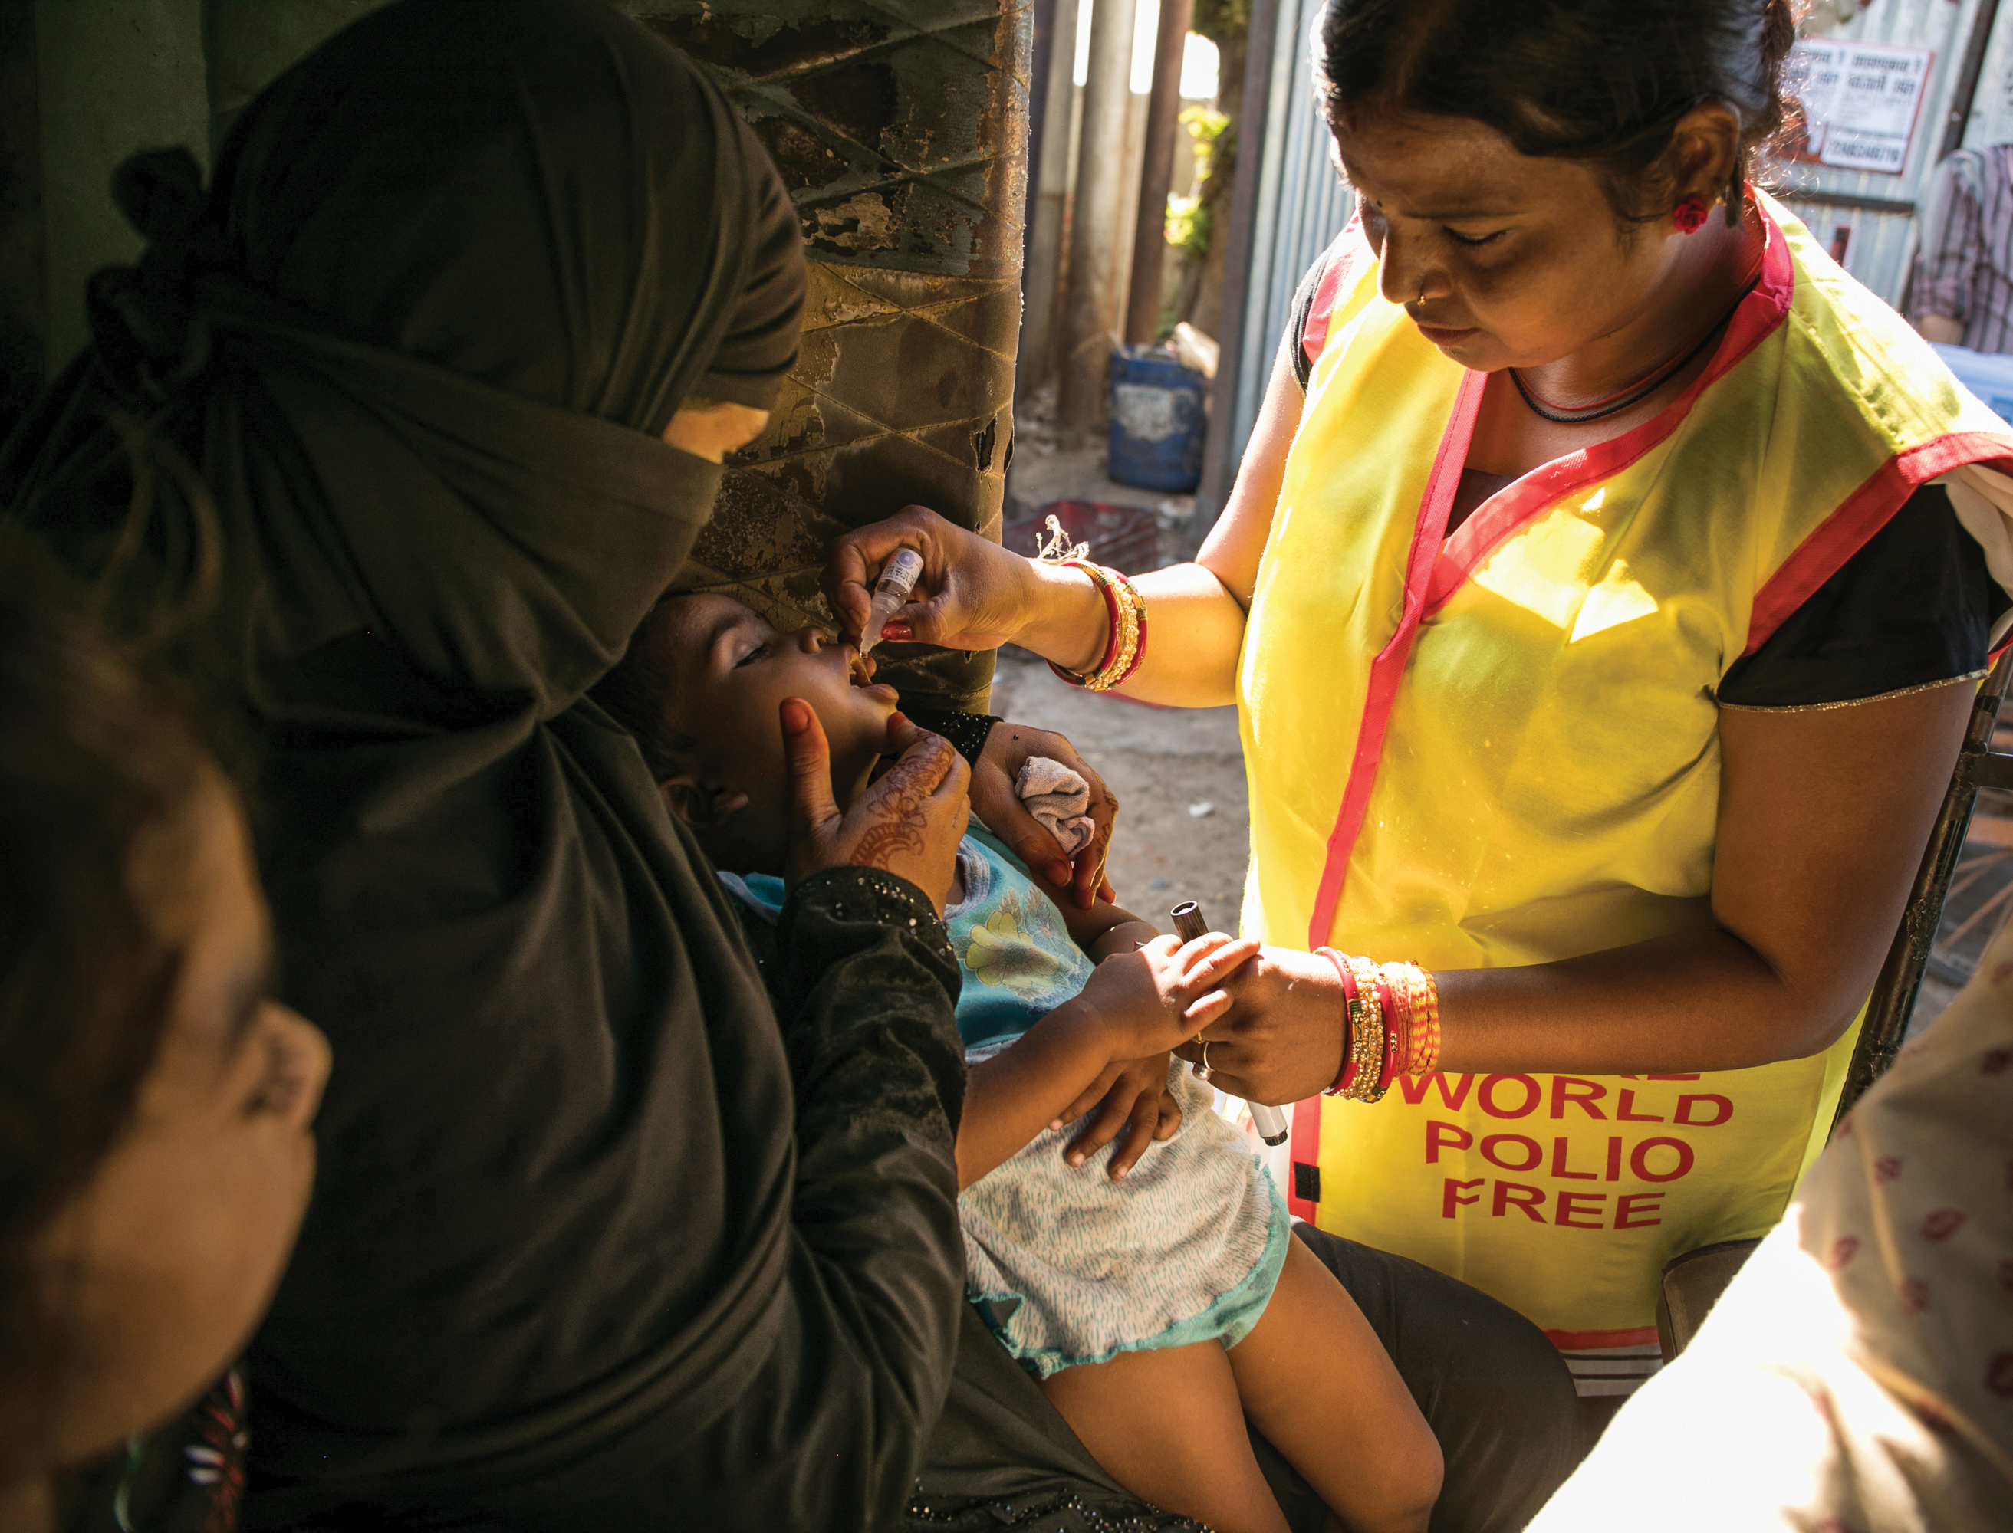
TOGETHER,
WE END
POLIO

Slide 2
Rotary’s mission to eliminate polio
Overview:
What is polio?
History
Rotary’s efforts
Current status
What’s next

Slide 3
WHAT IS POLIO?
Poliomyelitis (a.k.a. poliovirus) – a highly infectious disease that most commonly affects children under 5 years old.
Spread person to person, typically through contaminated water.
Most people who contract polio may be asymptomatic or show mild flu-like symptoms.
Can cause paralysis or death in some people.
There is no cure.
…but it is preventable with a safe and effective vaccine.

Slide 4
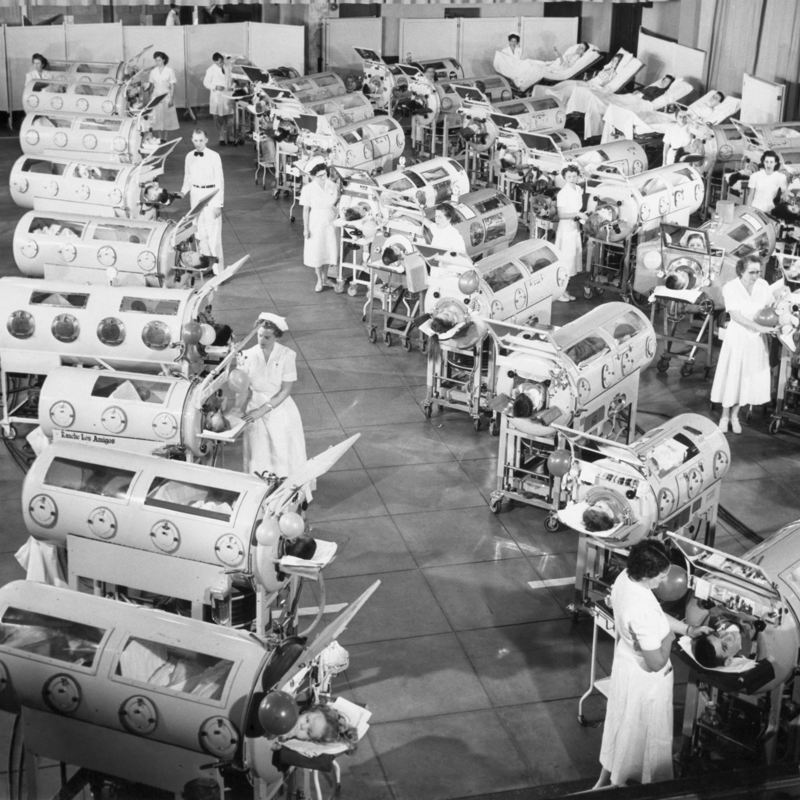
History
First major documented polio outbreak in the U.S. occurred in 1894, with outbreaks throughout the 1900s paralyzing and killing thousands of people.
In 1955, a vaccine developed by Dr. Jonas Salk is declared safe and effective.
Widespread use of polio vaccine starting in 1955 greatly reduced poliovirus infections over the next decade, with only 62 cases reported in 1965.
The last case of naturally-occurring polio in the U.S. was reported in 1979.
Polio was declared eliminated in the U.S. in 1994.
Polio cases are still rarely reported in the U.S., usually as a result of international travel.
Polio could come back in the U.S. if vaccination rates drop too low.
Source: https://my.clevelandclinic.org/health/diseases/15655-polio; Photo: Credit: Science History Images / Alamy Stock Photo

Slide 5
PolioPlus
What’s up with the “plus”?...
Launched in 1985, PolioPlus was the first and largest internationally coordinated private-sector support of a public health initiative, with an initial fundraising target of $120 million.
At that time, polio paralyzed 1,000+ children every single day in 125 polio-endemic countries.
Founding partner of the Global Polio Eradication Initiative; has reduced polio cases by 99.9% since first project (1979).

Slide 6
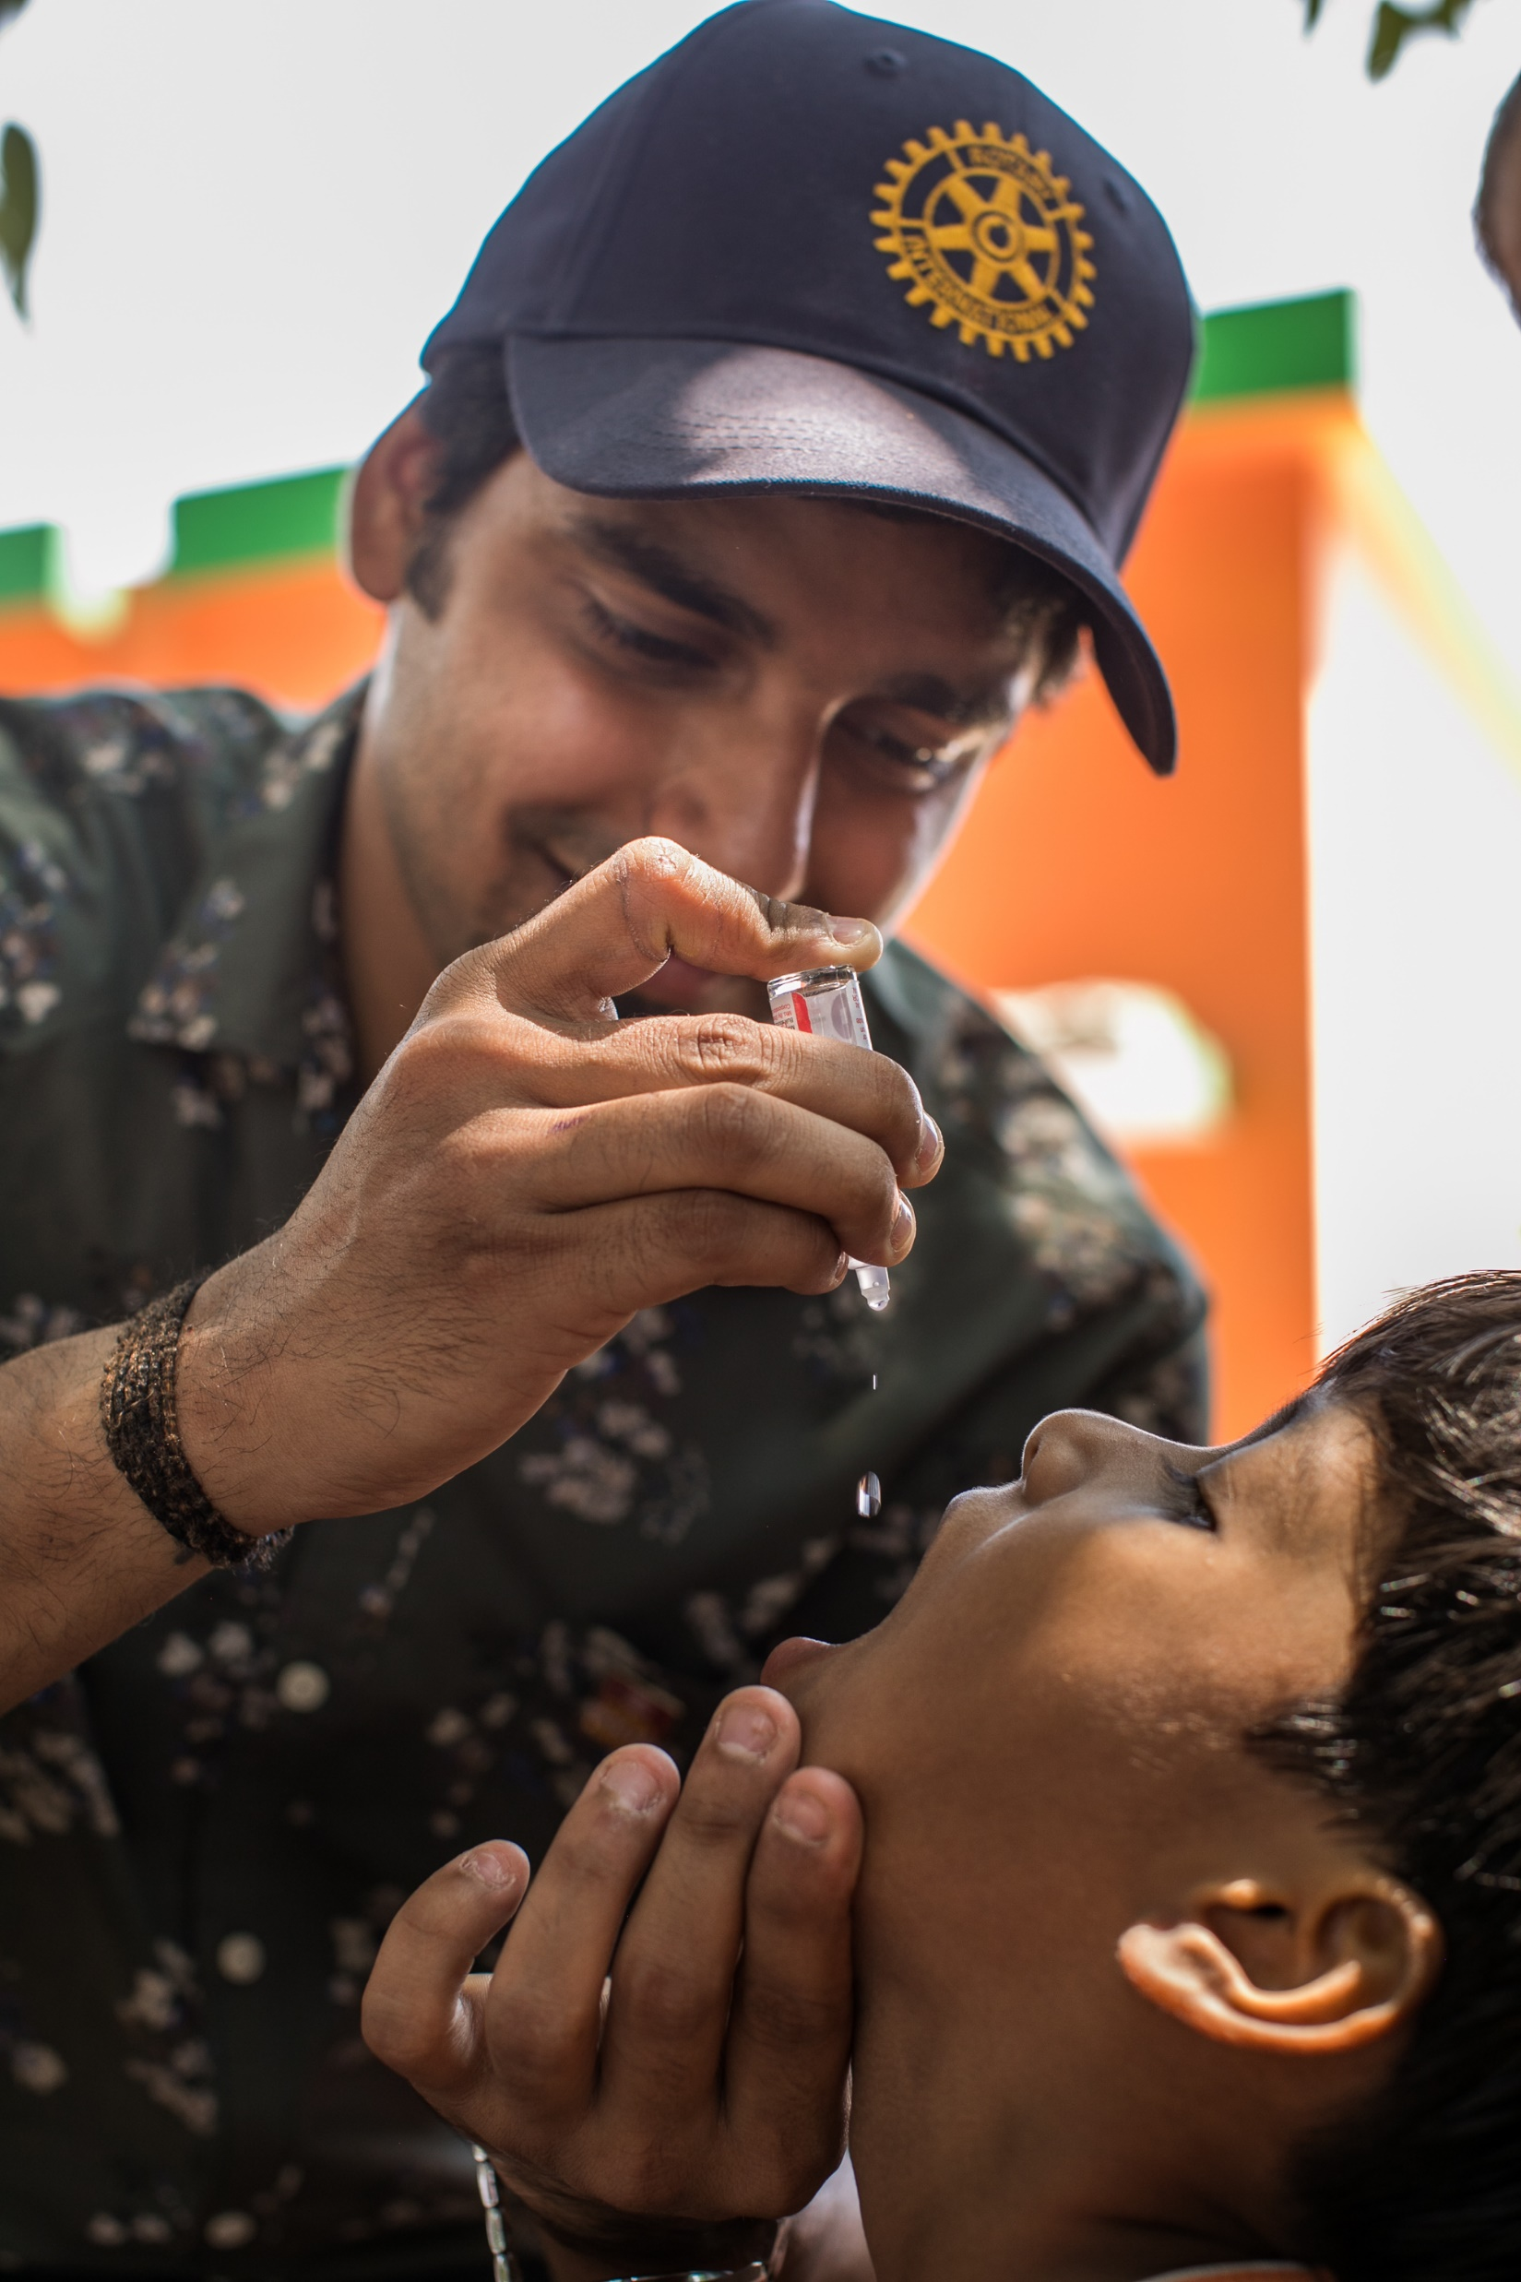
ROTARY’S EFFORTS:
Working to eradicate polio for > 35 years.
Rotary members have contributed > $2.1 billion + countless volunteer hours to protect nearly 3 billion children in 122 countries.
2023: endemic countries wild virus -- 4 cases in Afghanistan, 1 in Pakistan.
2023: in under immunized countries children are susceptible to vaccine derived viruses. Solution is to vaccinate all children < 5.
Over past 10 years, 10 B doses given, fewer than 800 cases of VDPV. Without vaccinations, more than 6.5 M children would have been paralyzed by wild poliovirus.

Slide 7
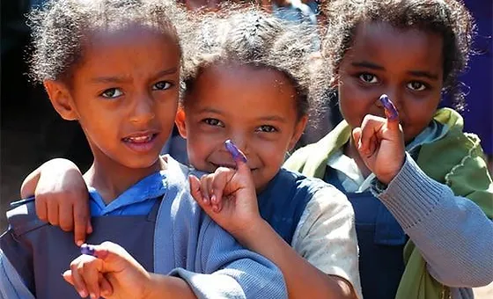
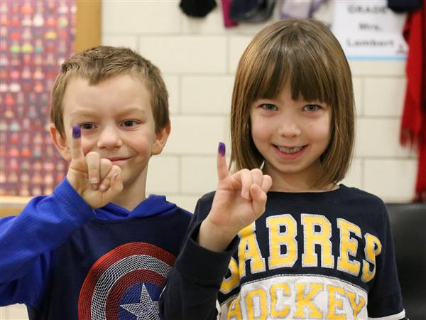
PURPLE PINKIES:
In countries where polio is a threat, kids’ pinkies are marked with purple ink after they’re immunized, helping health workers know which kids are protected.

Slide 8
WORLD
IMMUNIZATION
WEEK
Because #VaccinesWork, Rotary & partners have reduced polio cases by 99.9% worldwide since 1988.
But we won't stop until we end the disease for good. Donate to support #EndPolio:
endpolio.org/donate

Slide 9
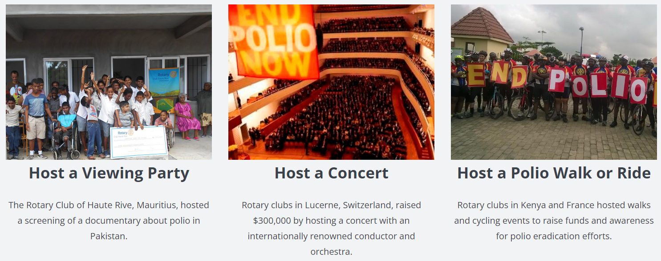
WORLD POLIO DAY
Tuesday October 24, 2023 is World Polio Day
Ideas for Rotary Clubs to raise awareness and donations

Slide 10
CURRENT STATUS:
Polio is only endemic in two countries (Pakistan & Afghanistan).
If all eradication efforts stopped today, within 10 years polio could paralyze as many as 200,000 children each year.

Slide 11
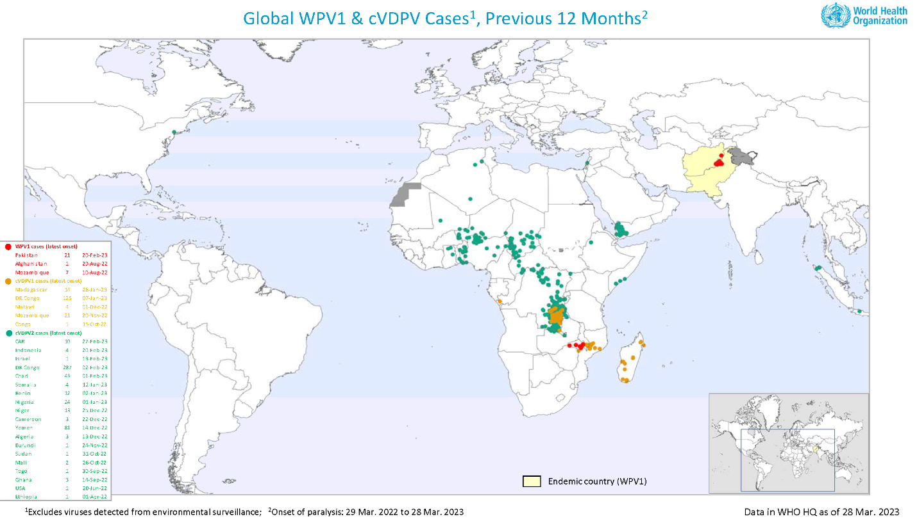

Slide 12
What can you do?
Donate:
Every donation helps us obtain the vaccines, transport, and materials needed in the fight against polio.
Your donation is worth triple: Donations are matched 2:1 by the Gates Foundation.
$3: The average cost to fully protect a child against polio.
Join the PolioPlus Society – commit to donate $100 per year
Learn: Get informed and help make polio a subject of conversation in your community. Visit EndPolio.org to learn more.
Share: Most people don’t know that polio still affects children around the world. Help spread the word!

Slide 13
area of focus:
Disease prevention and treatment

