Slide 1

+
District 6400

Slide 2
What is Rotary Youth Leadership Awards
RYLA is an intensive training program that brings together our youth, to further develop character, leadership skills and to learn about Rotary.
RYLA has team activities that promote:
Leadership
Ethics
Problem Solving
Communication
Citizenship
RYLA is hands on training for our future leaders

Slide 3

We energize!

Slide 4
RYLA IS FUN!
But what else?

Slide 5
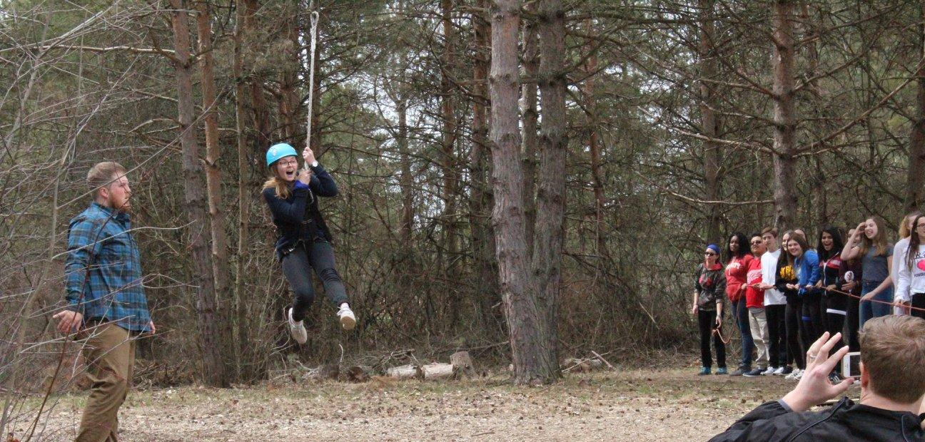
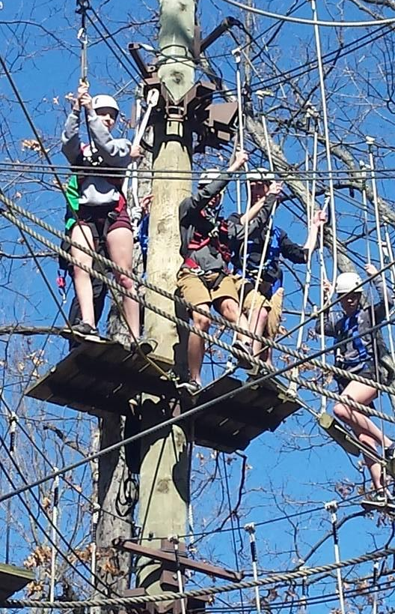
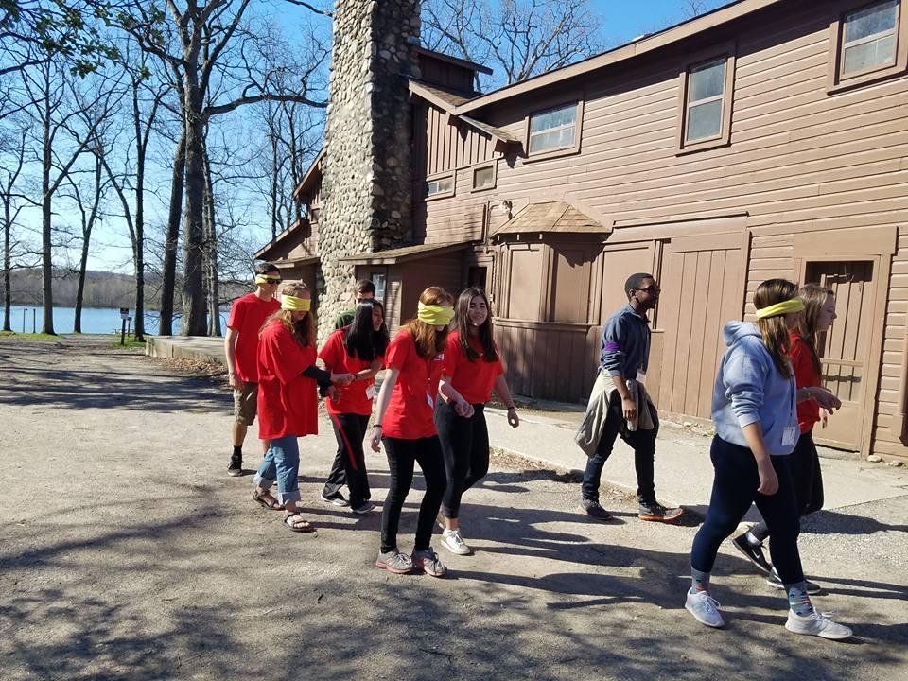
We dare
to believe, trust,
and we
dare
to fly!

Slide 6
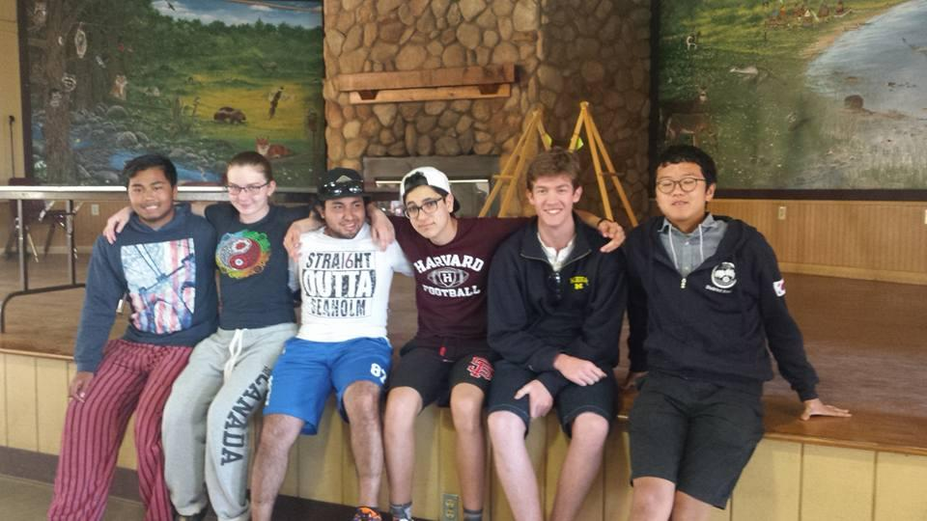
We make
life long friendships

Slide 7
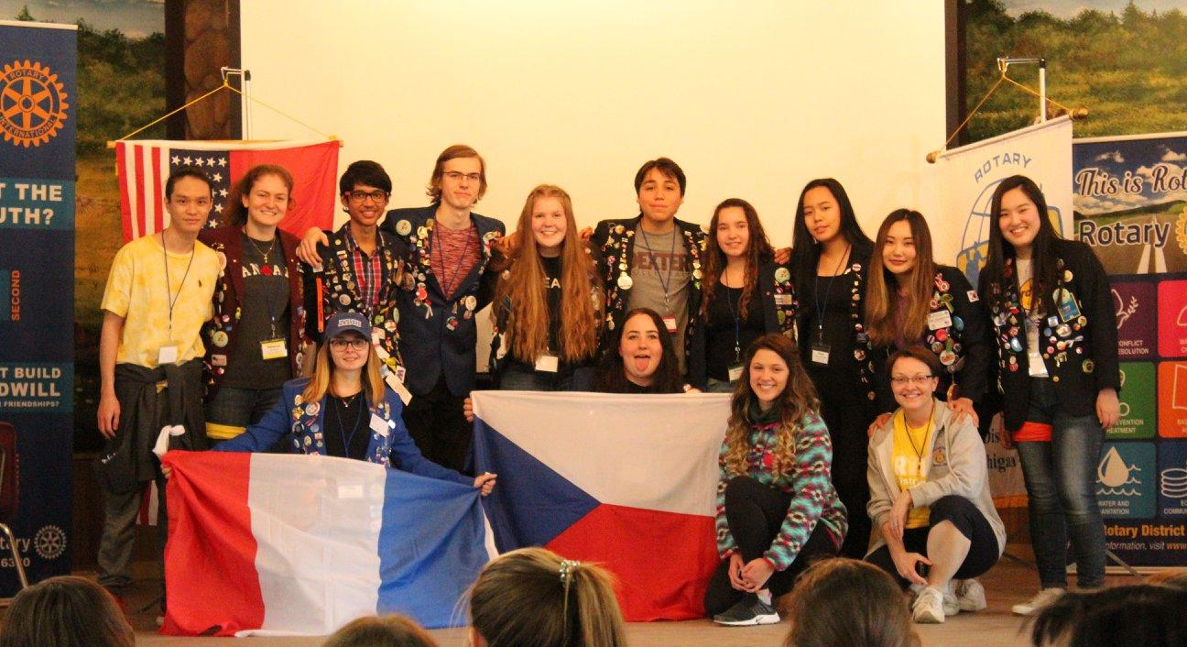
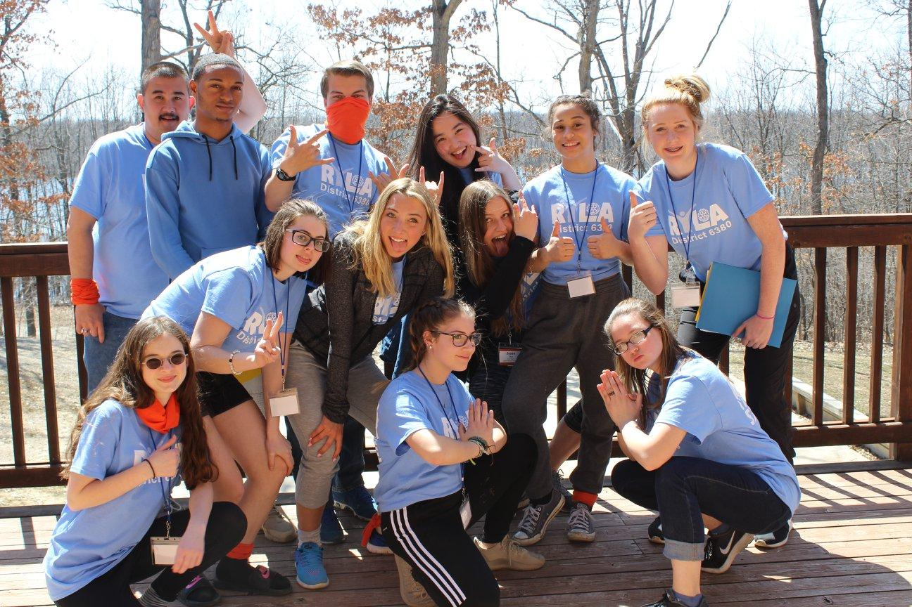
We
have
character,
and we make the world a little smaller through
Rotary &
Youth Exchange

Slide 8
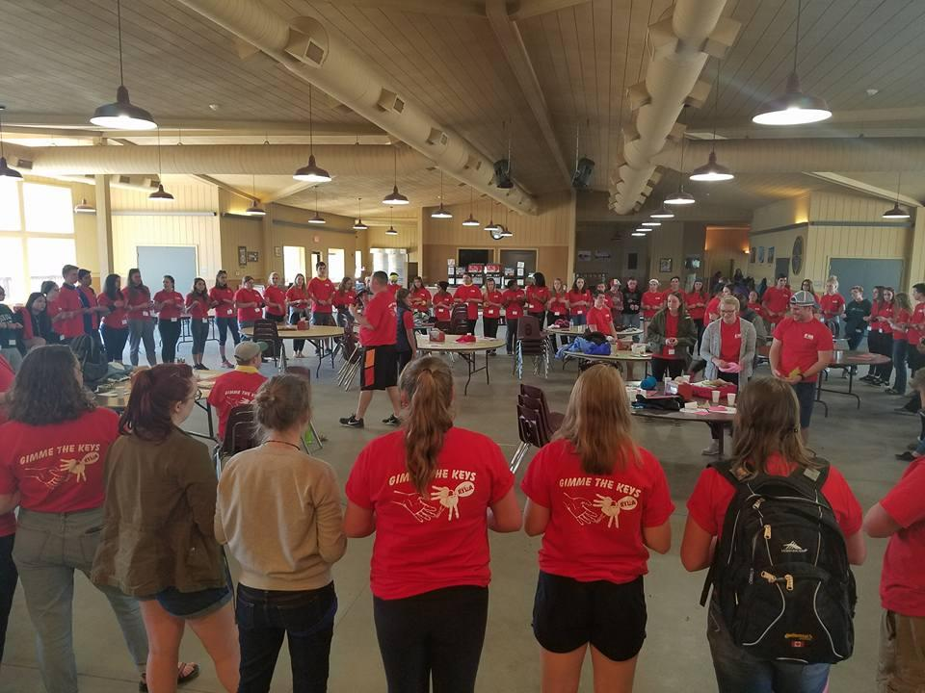
We
get
connected

Slide 9
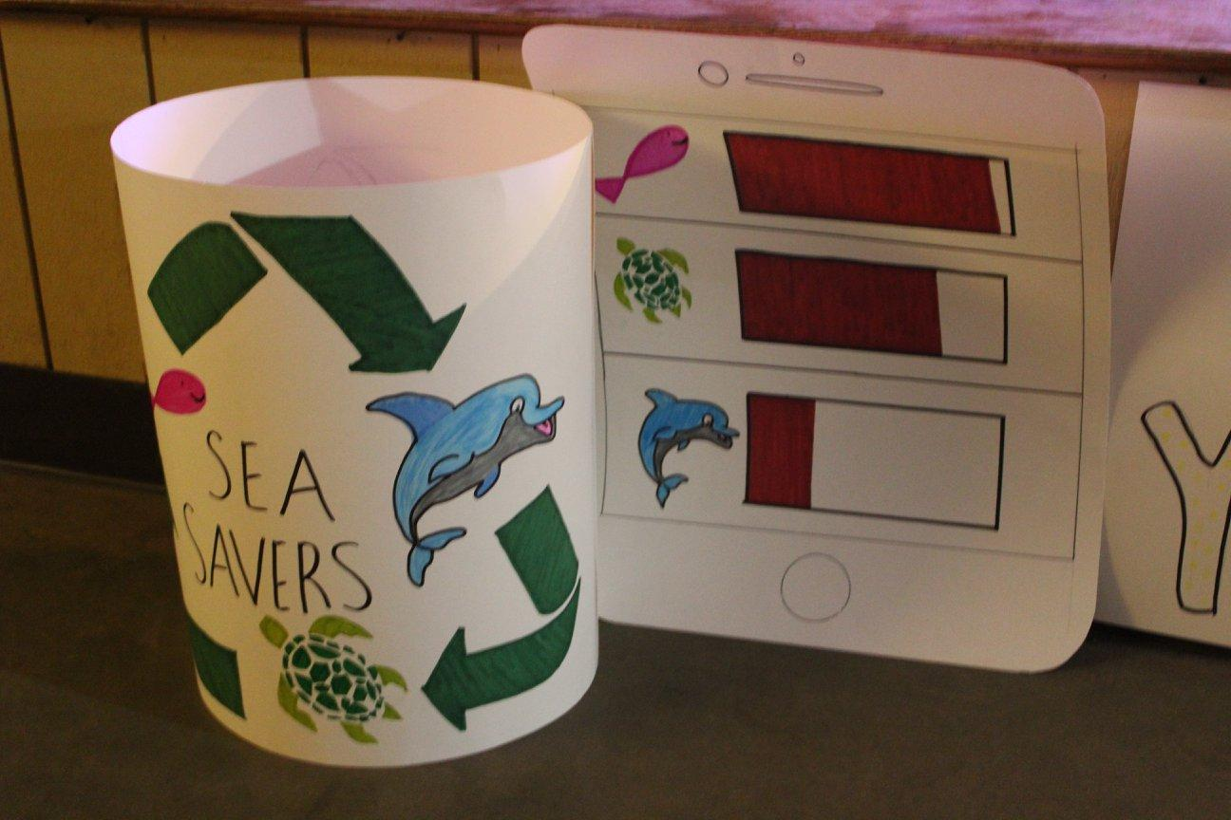
We create change…
RYLA student teams will create service projects related to our 7 areas of focus to bring back to their communities.
You, as Rotarians, can partner with them during these projects!

Slide 10
…
and
we
reflect

Slide 11
Where: Camp Copnecontic - Fenton, MI
Save the date!!!
RYLA
April 19-21, 2024
2 districts
3 days
200+ students
$250/per student
This program is designed to be experienced up to 3 years in a row as a student, plus continuation through leadership roles and transition into Rotaract & Rotary (this is our pipeline of future Rotarians)

Slide 12
Timeline
Step 1
  Confirm students to attend RYLA
Step 2
  Have the students register for RYLA. Link: https://rotary6380.org/page/showhomepage/
Step 3
  Application/waivers will be sent to students/guardians to sign
Step 4
  Attend RYLA April 19-21, 2024
Step 5
  Service projects come back to the communities

Slide 13
TEAMS
RYLArians = High School Students
Attend as RYLArians to build a foundation as future leaders, develop tools to find their own leadership ability, gain confidence to go out and make positive change. AND come back to their communities to perform service projects!
TEAM LEADS = College Age / Younger Adults
Attend as Team Leaders to provide a safe and inclusive learning environment. Grow as leaders through guiding high school students in their leadership development and gain mentorship from our passionate Rotarians focusing on the future of Rotary.
TEAM MENTORS = Young At Heart Rotarians
Attend as Team Mentors to provide life experience of leadership, personal development, and service to both RYLArians and Team Leaders. Help grow the passion with the next generation to become Rotarians through hands on learning opportunities.

Slide 14
Contacts:
District 6380
Kristina Schofer
ryladistrict6380@gmail.com
District 6400
Bruce Diven
RYLA6400@gmail.com

