Slide 1
The Kporkuve Borehole Water Project
Kofi K. Gyan
May 26, 2021

Slide 2
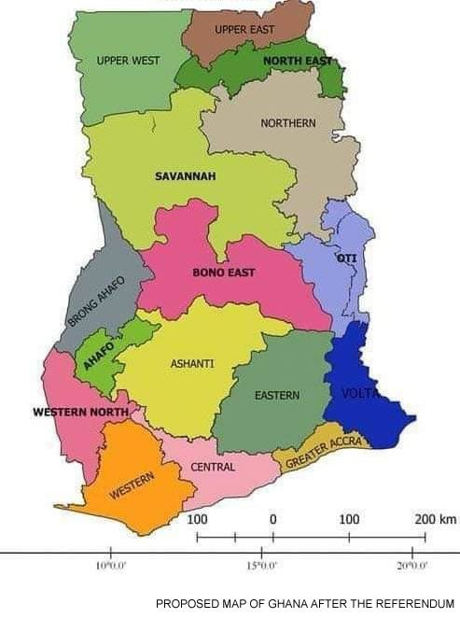
The Map of Ghana – The Blue Color is Volta Region, where the Project will be Located

Slide 3
The Genesis of the Kporkuve Borehole
Water Project
February 2019 initial discussion with Ms. Gifty Ahugah
Meeting with Mr. Maxwell Ahugah
Kporkuve United Community Welfare Union
Kporkuve citizens in the Diaspora (Accra, Ghana)
March 2019 official letter from Kporkuve Unity Community to Rotary Club of Ann Arbor - IHPC

Slide 4
Time in the Memory Lane
July 4, 2019 submission of IHPC Funding Request Summary to RC of AA IHPC.
Funds requested from IHPC was $5,000
September 4, 2019 meeting, IHPC unanimous approved the Kporkuve Borehole Water Project by committing the requested funds of $5,000
Total project was estimated to be $30,000
Mrs. Mary Avrakotos suggested we make this proposal a Global Grant application

Slide 5
Time in the Memory Lane (cont.)
Getting our hands dirty
As the saying goes “a picture worth a thousand words”………
The following pictures tells part of the story

Slide 6
Project Funding Sources

Slide 7
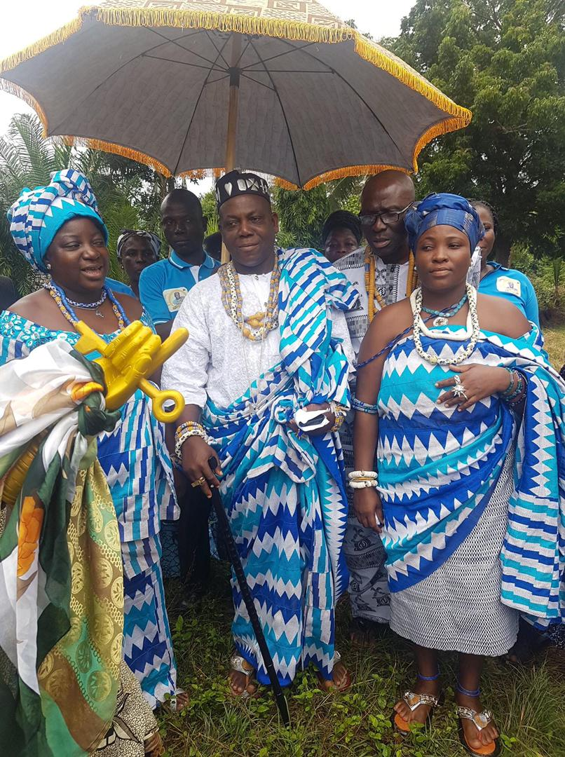
The King and Queen of Kporkuve Community

Slide 8
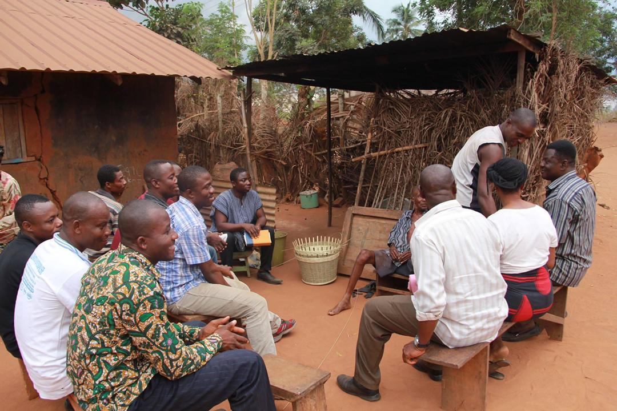
Team of Kporkuve Welfare Union Members
Visit the Community

Slide 9
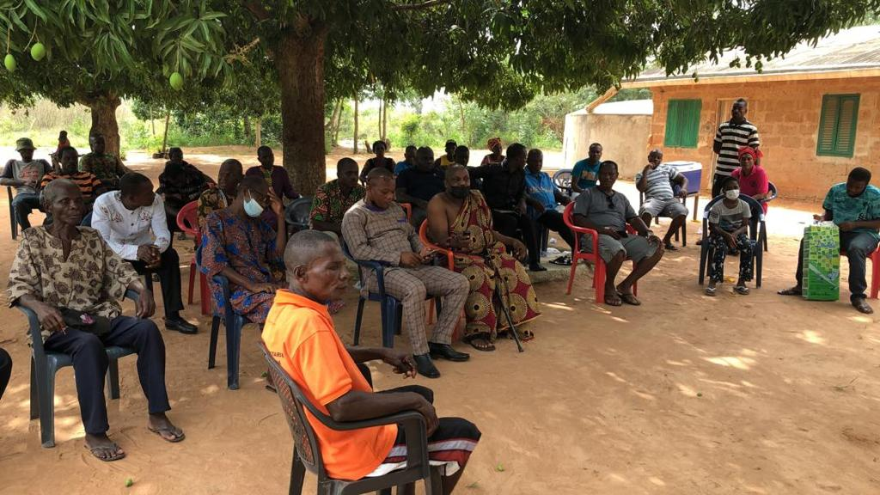
Community Sensitization

Slide 10
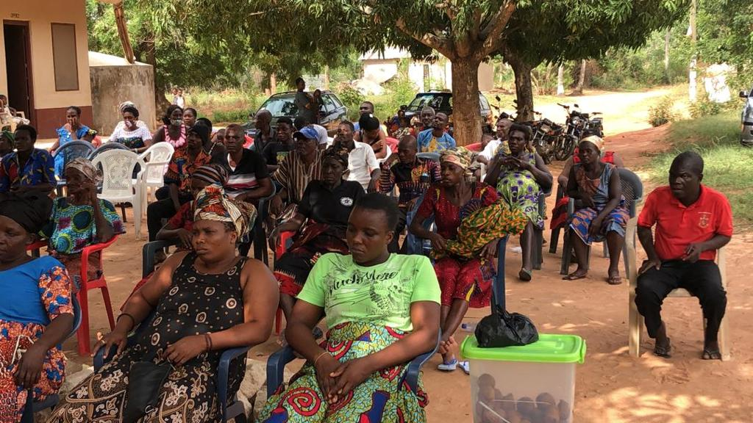
Community Sensitization (Cont.)

Slide 11
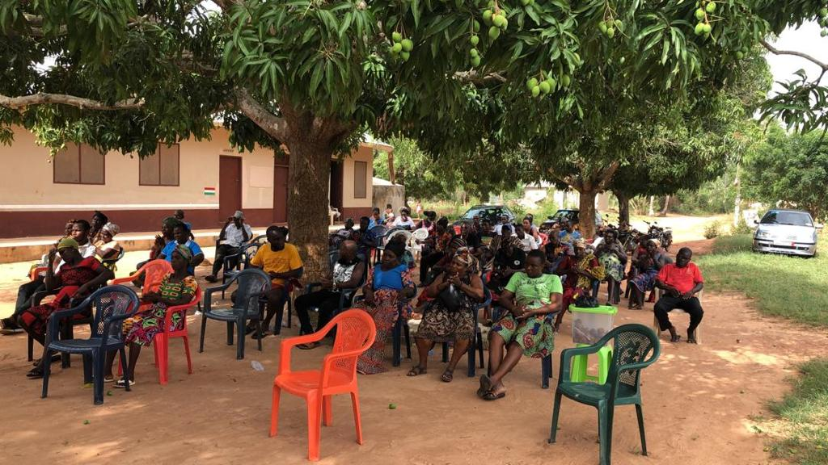
Community Sensitization (Cont.)

Slide 12
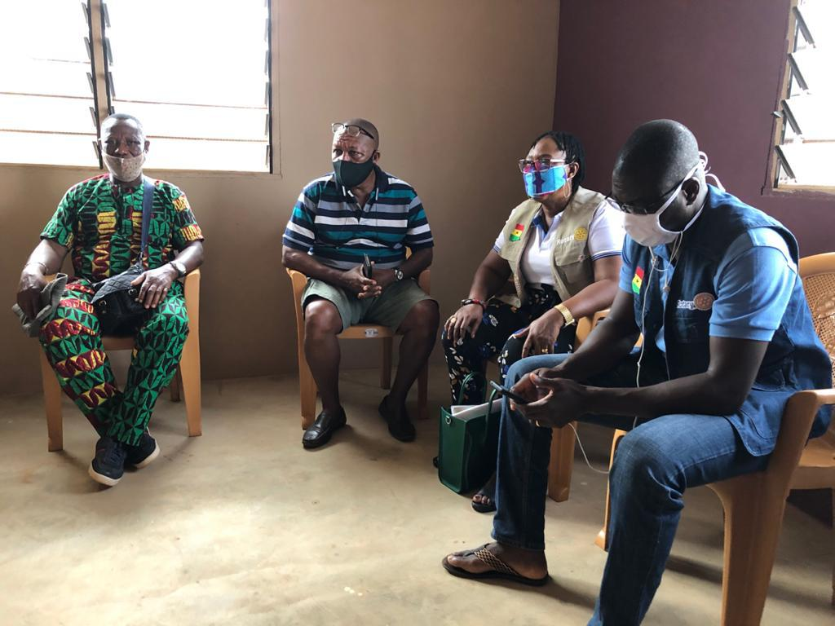
RC of Ho Members Visits Kporkuve
United Community

Slide 13
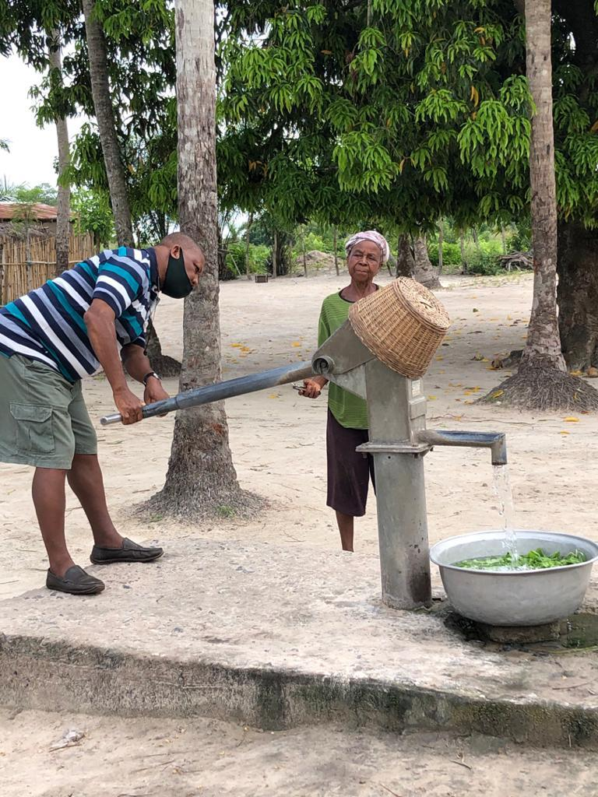
Old Borehole Mechanization System

Slide 14
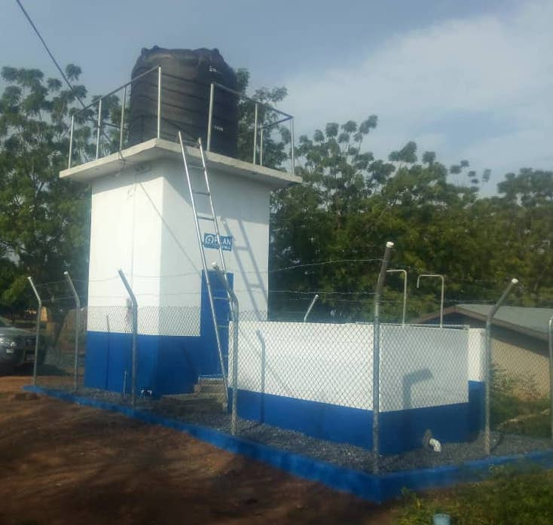
Proposed Borehole Mechanization
System for the Kporkuve Community

Slide 15
What the Water Borehole Project
Will Address
Provision of Clean and Portable Water for Kporkuve United Community.
Will serve nine adjoining villages with a population of 12,000 people.
Three mechanized borehole will directly impact 4,000 members of the community.
Three water tank of 10,000 liters (2,500 gallons) each.

Slide 16
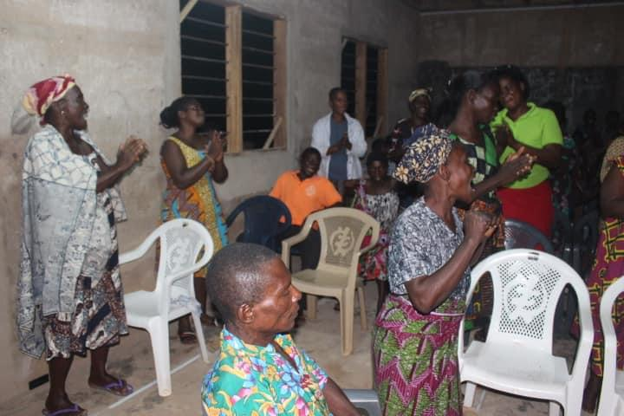
Jubilation on Hearing the Good News

Slide 17
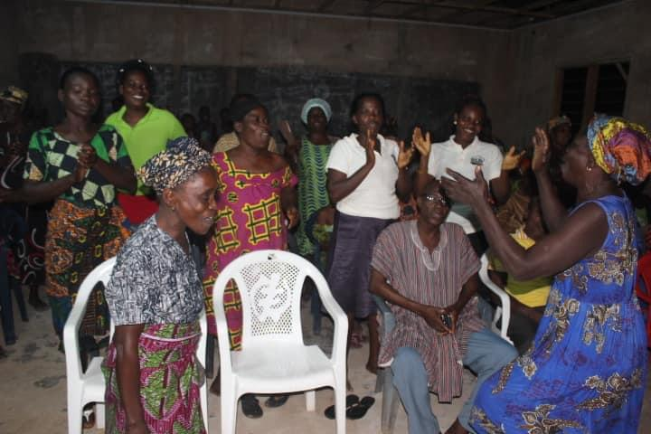
Jubilation on Hearing the Good News

Slide 18
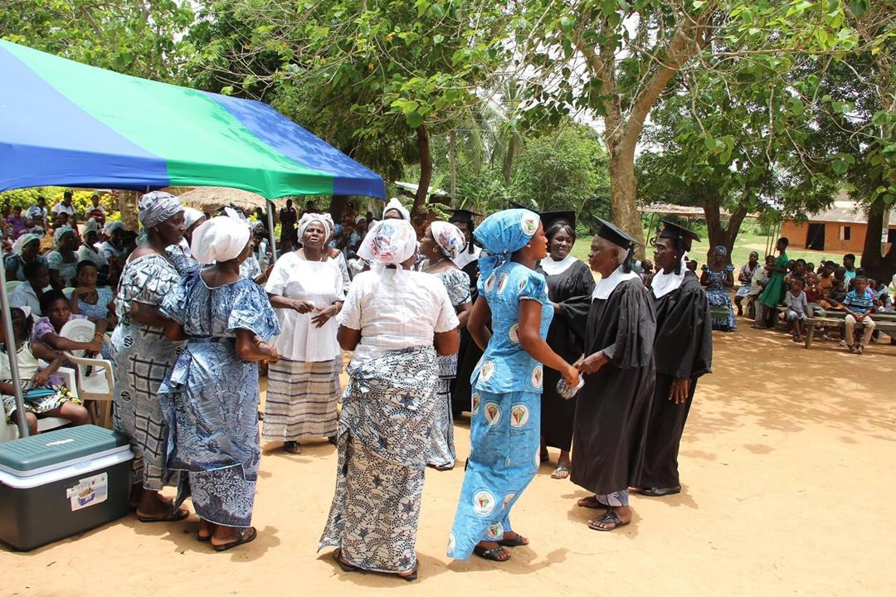
Kporkuve Community Thanksgiving Service

Slide 19
Acknowledgement
RC of Ann Arbor / RC of AA IHPC members
District 6380
District 9102
Rotary Foundation – Mr. Nyenemo Sanguma
RC of Mount Clemons
RC of Ho in Ghana
RC of Kumasi in Ghana
RC of Kumasi East in Ghana
Kporkuve United Community Welfare Union

Slide 20
Thank you!!

