Slide 1
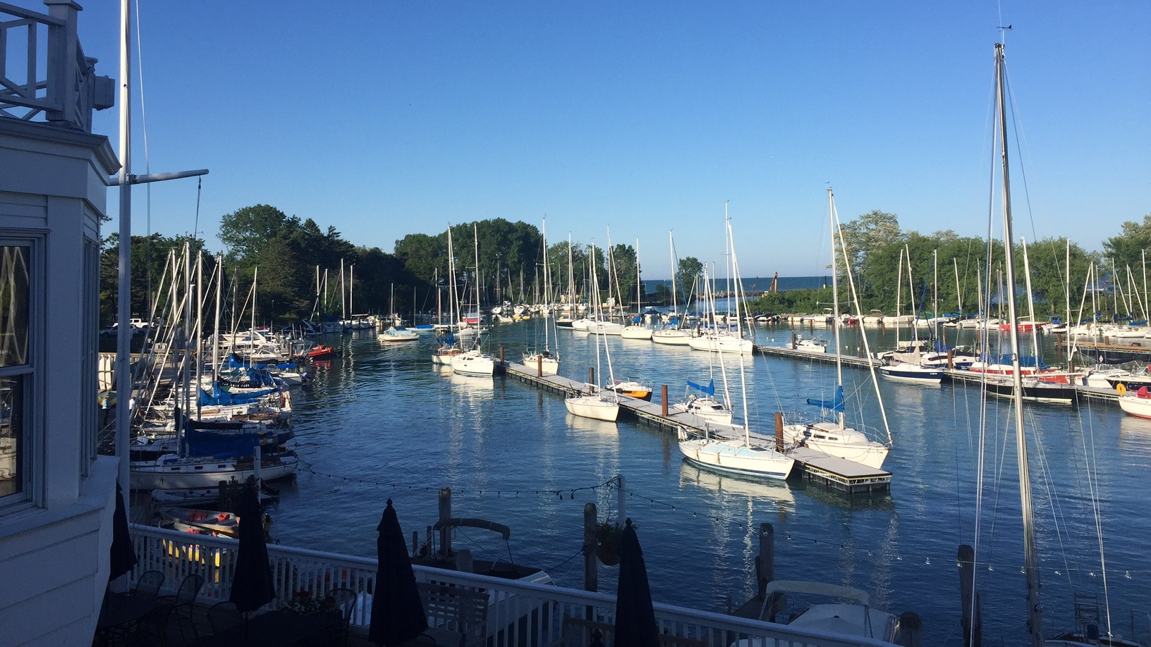
ROTARY CLUB OF WILMETTE
Our commitment to the environment

Slide 2
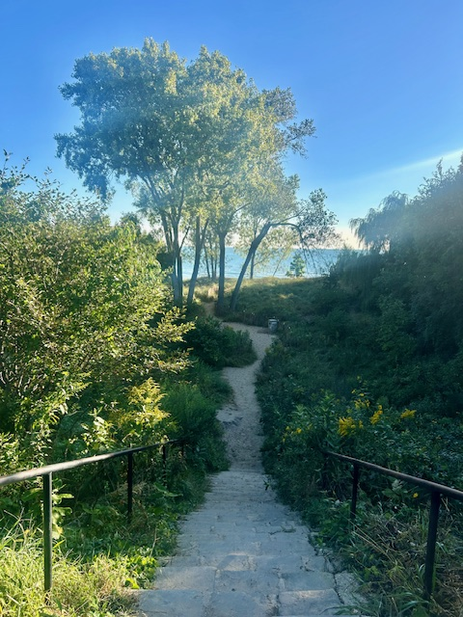
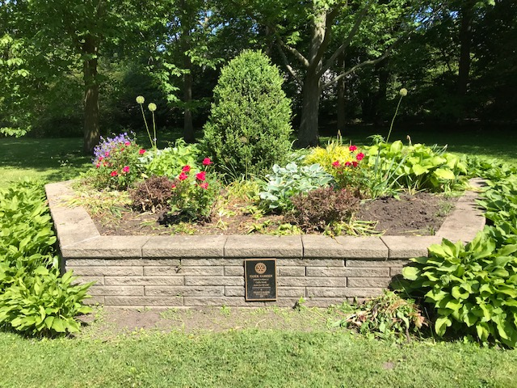
Past Projects
Edens Pollinator Garden
Elmwood Beach Restoration
Pasek Garden – Gillson Park
Funded with support from Rotary District 6440 grants

Slide 3
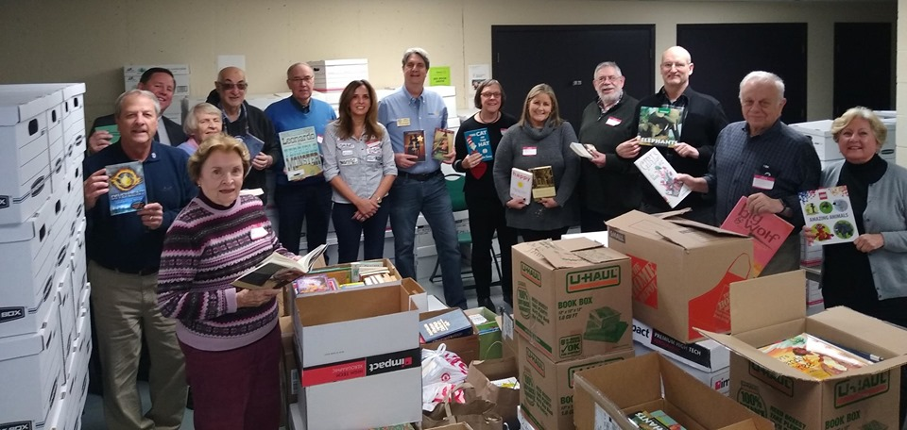
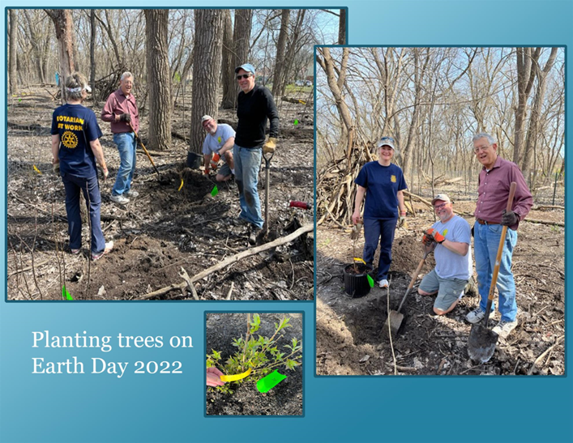
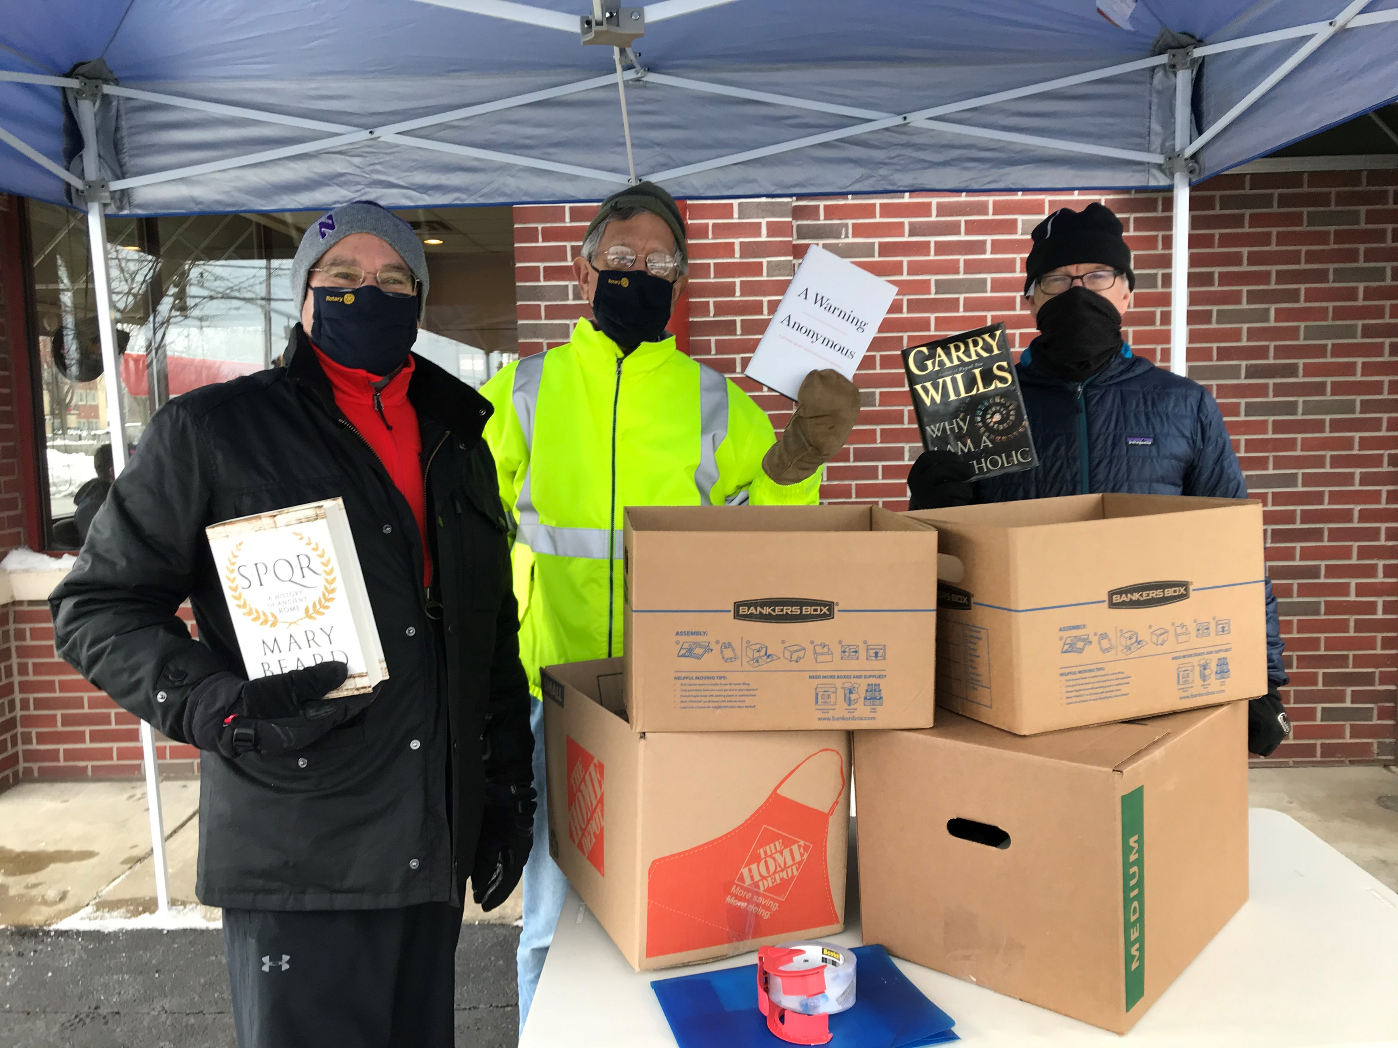
Annual Events
Earth Day Volunteer Day
Annual Youth Beach Sweep
Book Drives

Slide 4
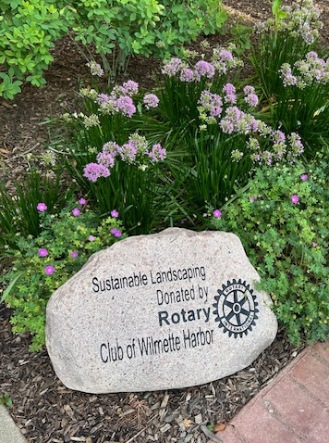
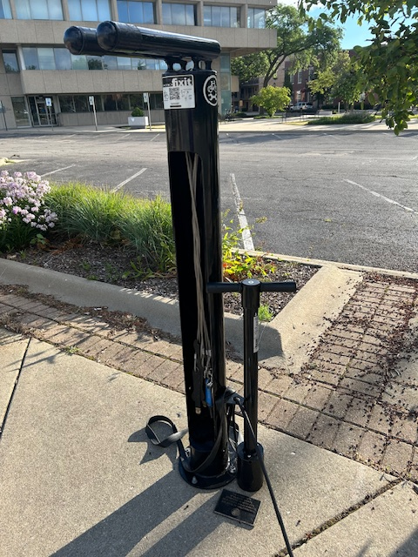
Financial Support for Local Projects
Bike Racks throughout Village
Bike Repair Station
Village Hall Sustainable Landscaping
Village Green Hydration Station
Funded with support from Rotary District 6440 grants

Slide 5
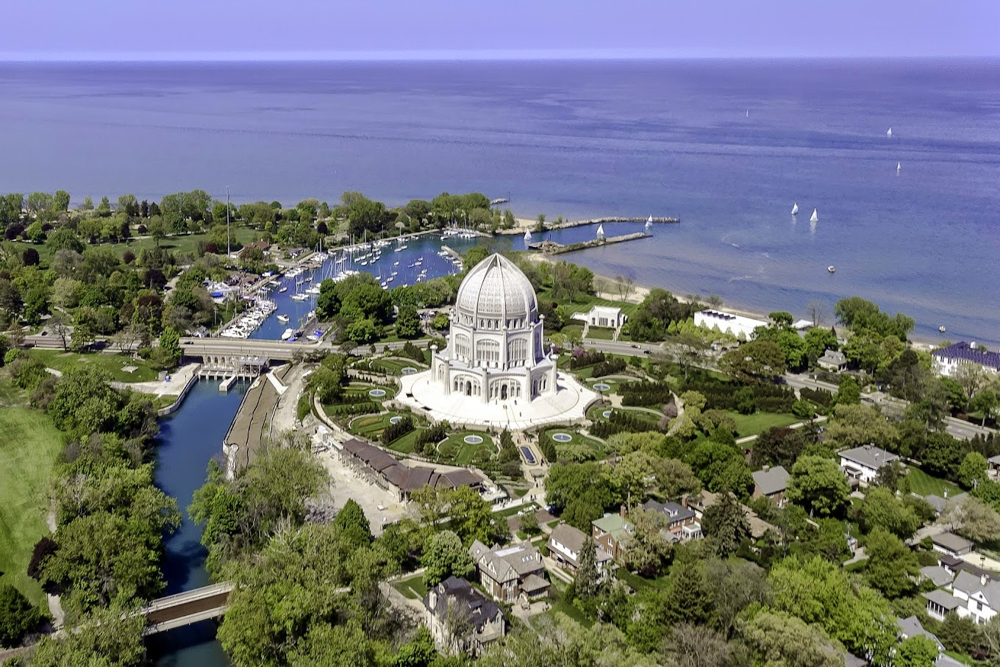
Partnerships

Slide 6
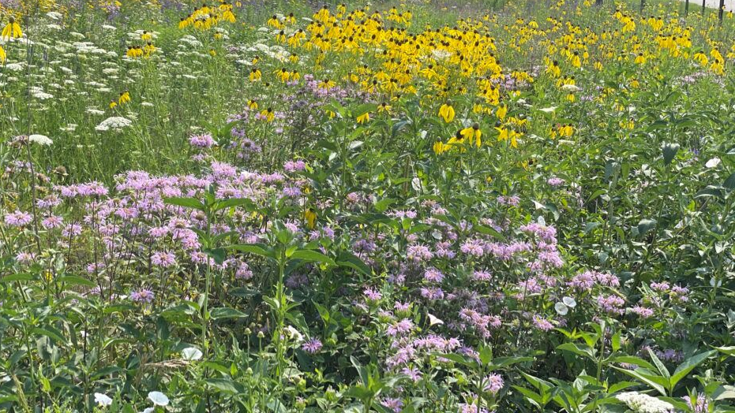
Rotary Club of Wilmette shares an interest in protecting our common legacy: the environment. We believe it is our responsibility “to leave it better than we found it”.

