Slide 1
DISTRICT
Public Image Seminar
DISTRICT 6440

Slide 2
Richard Brill
District 6440 Public Image Chair
richard.brill.rotary@gmail.com

Slide 3
PUBLIC IMAGE SESSION OUTLINE
Introduction and Agenda
Public Image Grant Program
Public Image Recommendations for Clubs
Myself
Public Image Committee Members
Attending Club Public Image Chairs
Questions and Answers

Slide 4
WHAT IS ROTARY PUBLIC IMAGE ?
What Neighbors Know and Think about Rotary
Rough Awareness
But Little Knowledge of Club Existence, Community and Global Impact, Rotary Demographics Today
Effective Public Image Can Help Turn This Around
and Some Clubs are Doing It Well

Slide 5
PUBLIC IMAGE GRANT PROGRAM -- General
Increase Rotary Visibility
Subsidize Marketing Materials
Reach General Public
Up to $250 Per Club
Must Use Correct Logos

Slide 6
PUBLIC IMAGE GRANT PROGRAM -- Logos
Rotary Logos
or

Slide 7
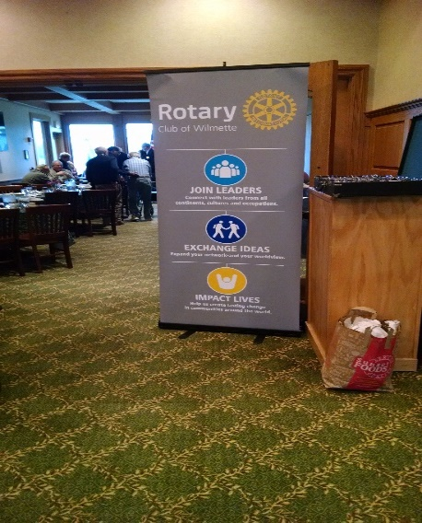
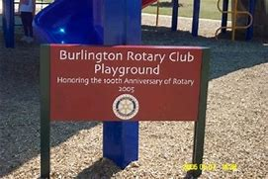
PUBLIC IMAGE GRANT PROGRAM -- Ideas

Slide 8
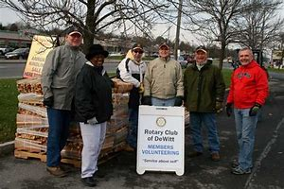
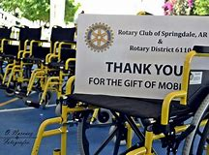
PUBLIC IMAGE GRANT PROGRAM -- Ideas

Slide 9
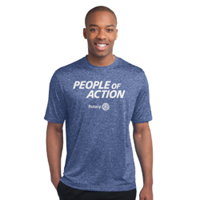
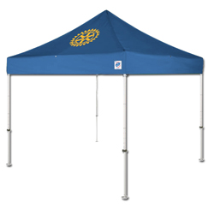
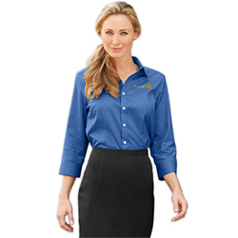
PUBLIC IMAGE GRANT PROGRAM -- Ideas

Slide 10
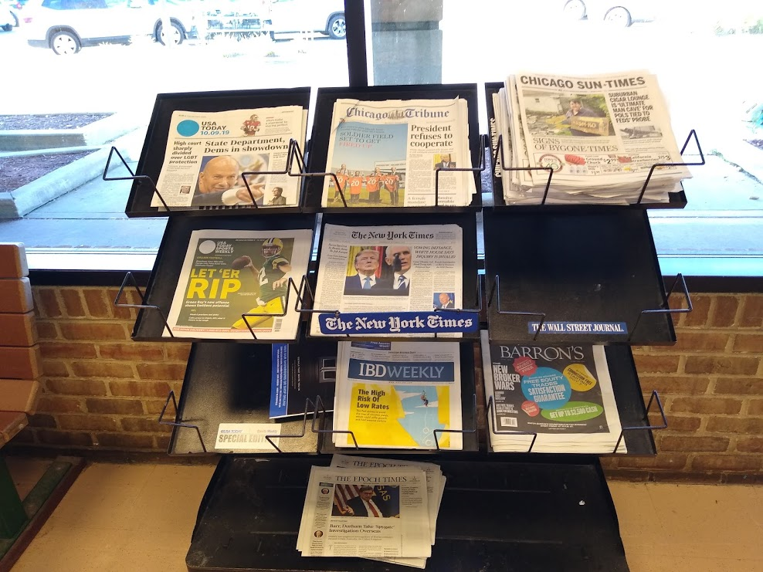
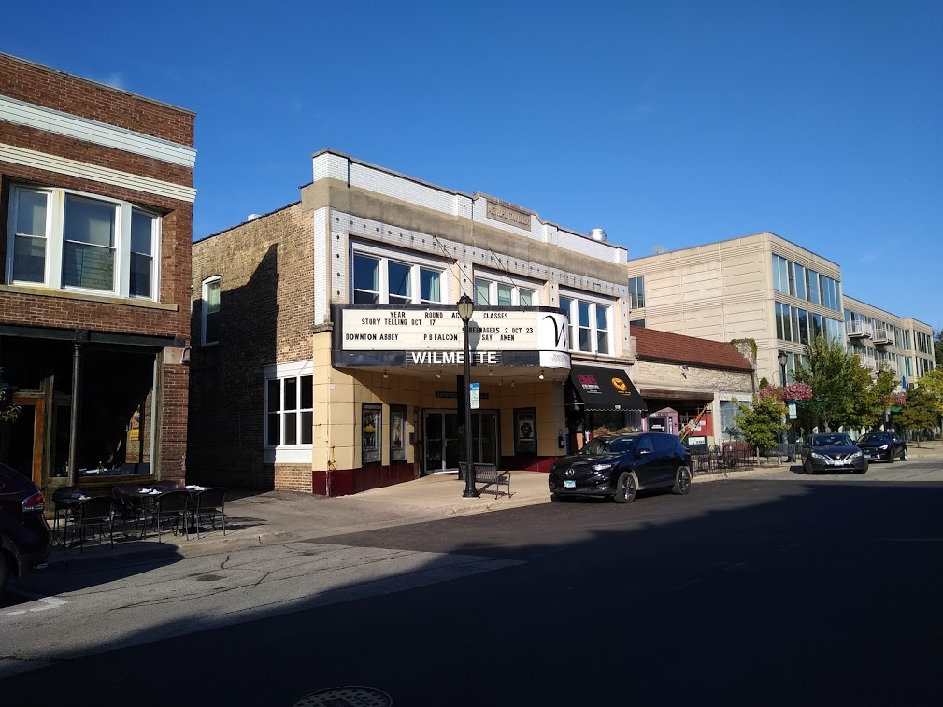
PUBLIC IMAGE GRANT PROGRAM -- Ideas

Slide 11
PUBLIC IMAGE GRANT PROGRAM – How To
Information and Application Form

Slide 12
PUBLIC IMAGE RECOMMENDATIONS
Club Public Image Chair
#1 Person
Skill Sets
Must Have One
Enter Name in ClubRunner Executives & Directors
Form Public Image Committee

Slide 13
PUBLIC IMAGE RECOMMENDATIONS
Social Media
Vital Today
Facebook
Twitter, Instagram, Linked-In

Slide 14
PUBLIC IMAGE RECOMMENDATIONS
Social Media
Reach Hundreds to Thousands
Tell Club Story
Show Action, Excitement, Value
Energize Members
Attract New Members, Especially “Younger”

Slide 15
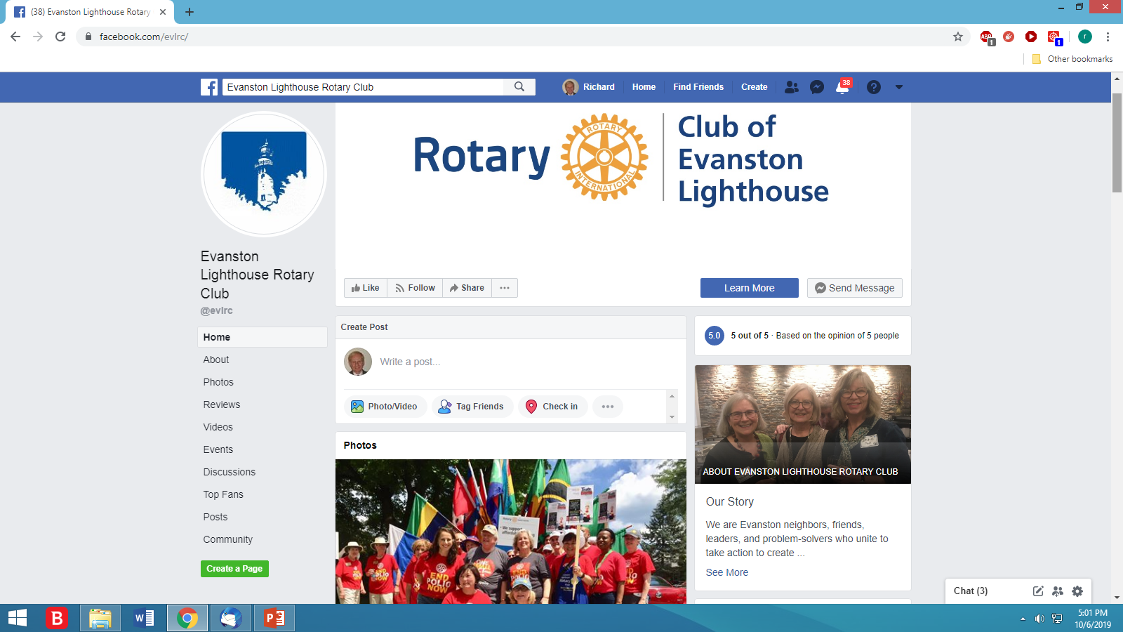
PUBLIC IMAGE RECOMMENDATIONS
Social Media

Slide 16
PUBLIC IMAGE RECOMMENDATIONS
Social Media
Post colorful, lively photos and videos
Include women, younger members, youngsters
Convey information, excitement, People of Action
Motivate viewer interest, ideas, potential membership

Slide 17
PUBLIC IMAGE RECOMMENDATIONS
Social Media
Use correct Rotary logos
Comment, share, engage posts
Events, donate
More soon from Public Image Committee Colleagues

Slide 18
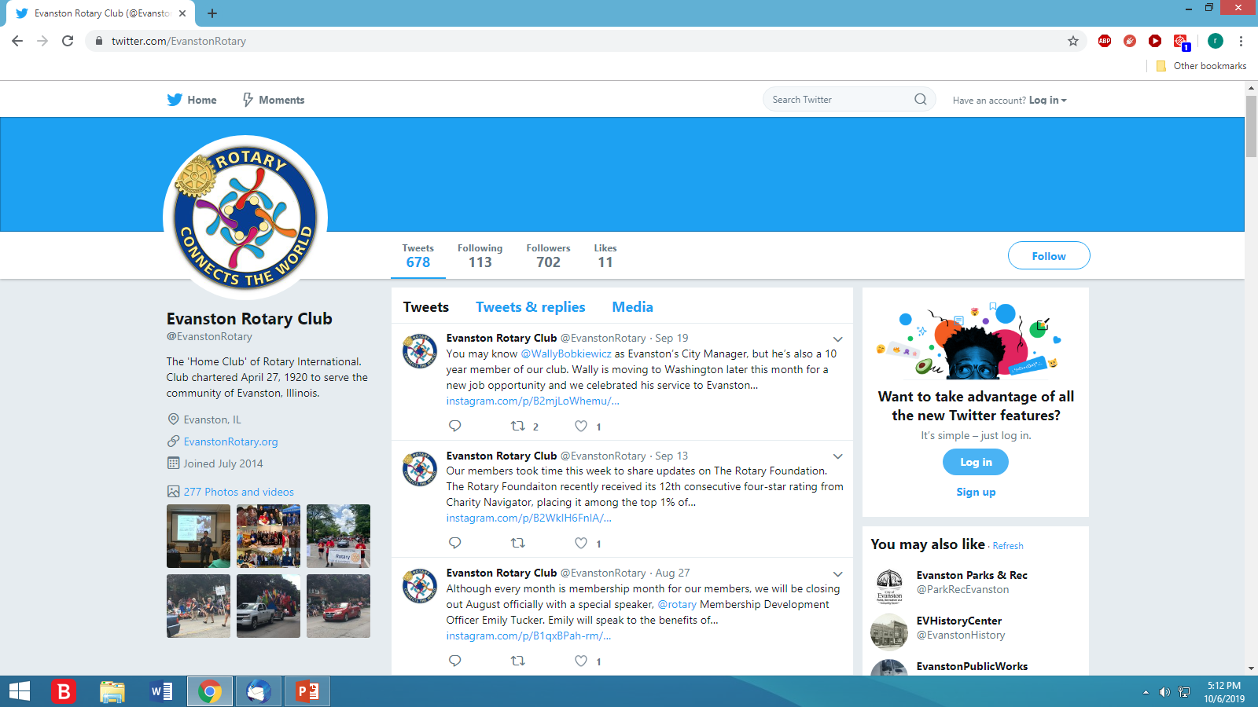
PUBLIC IMAGE RECOMMENDATIONS
Social Media

Slide 19
PUBLIC IMAGE RECOMMENDATIONS
Club Websites
Many Old and Tired
Should Look Modern
ClubRunner New Version

Slide 20
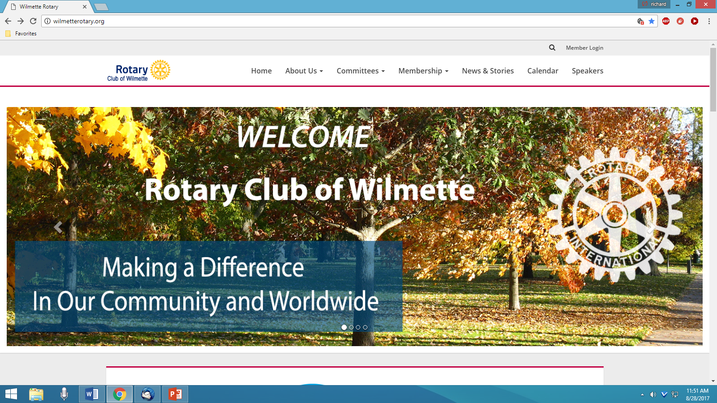
PUBLIC IMAGE RECOMMENDATIONS
Club Websites

Slide 21
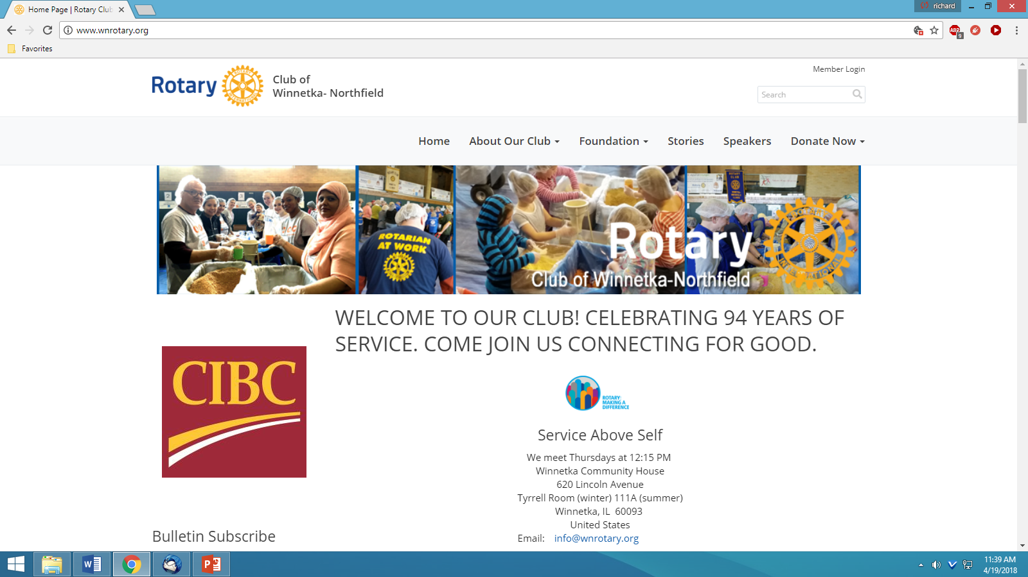
PUBLIC IMAGE RECOMMENDATIONS
Club Websites

Slide 22
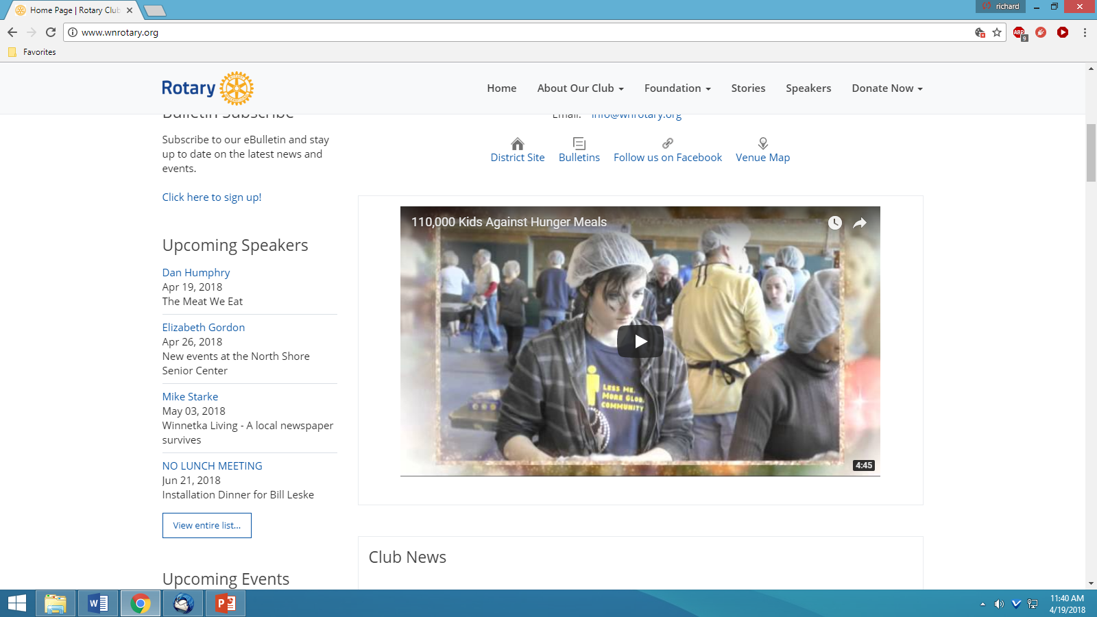
PUBLIC IMAGE RECOMMENDATIONS
Club Websites

Slide 23
PUBLIC IMAGE RECOMMENDATIONS
Club Newsletters / Bulletins
Lively, Colorful, Information Packed
Should Look Like 2020 – Not 1820

Slide 24
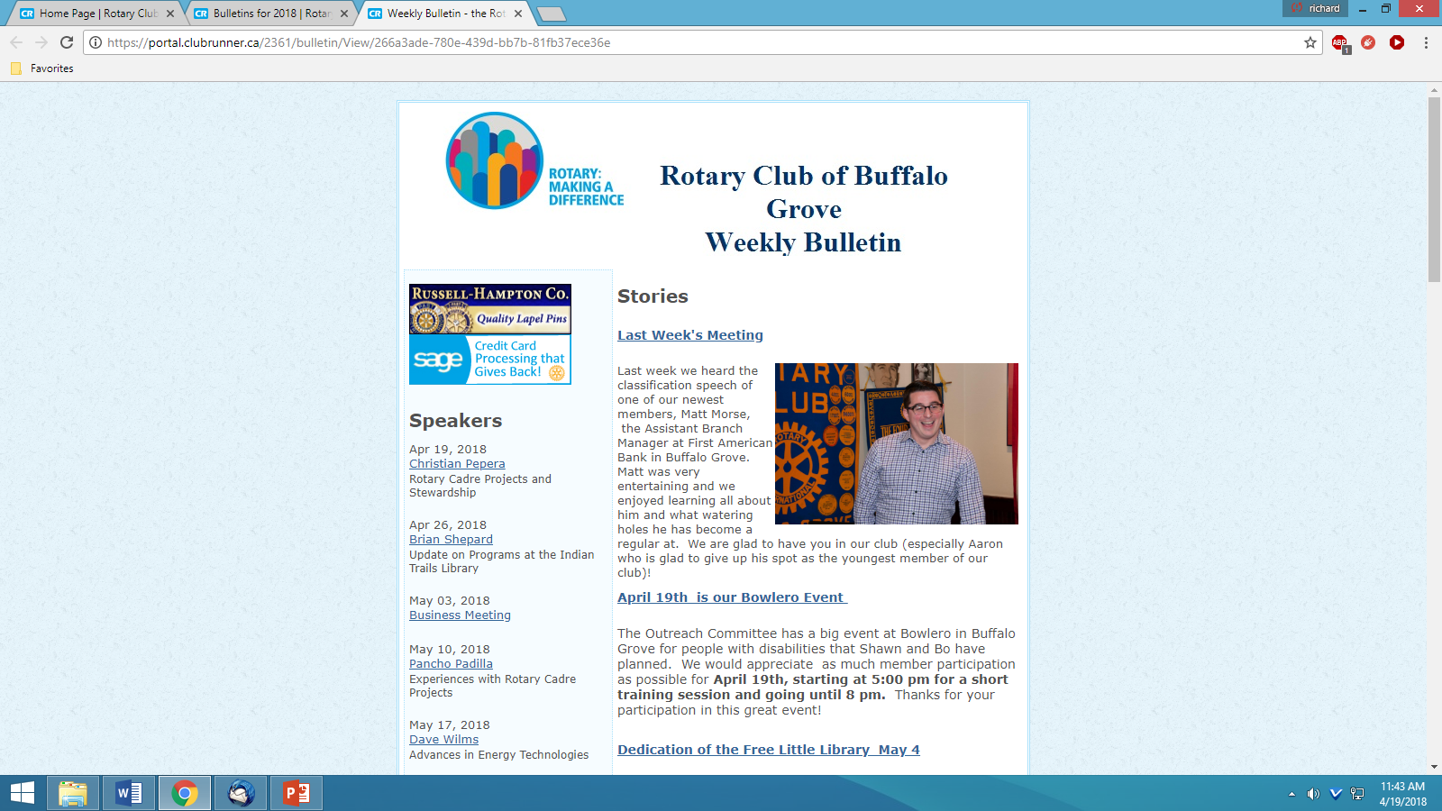
PUBLIC IMAGE RECOMMENDATIONS
Club Newsletters / Bulletins

Slide 25
PUBLIC IMAGE RECOMMENDATIONS
Club Newsletters / Bulletins

Slide 26
PUBLIC IMAGE RECOMMENDATIONS
News Releases and Photos
To Print Newspapers, Online News Sites
To Club Website, Newsletter, Facebook Page
To Other Social Media Platforms
To Many Event Calendars
Show Activities, Events, Awards, People
Invite Editor/Reporter/Photographer

Slide 27
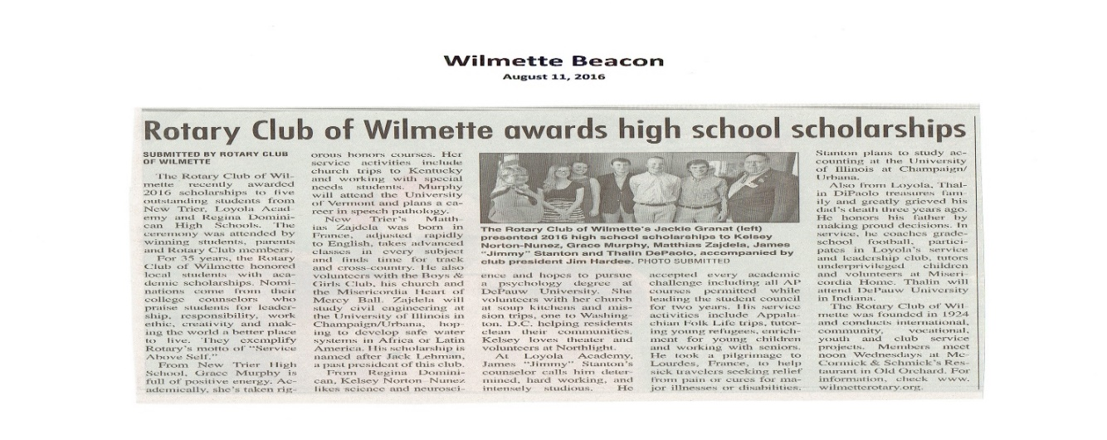
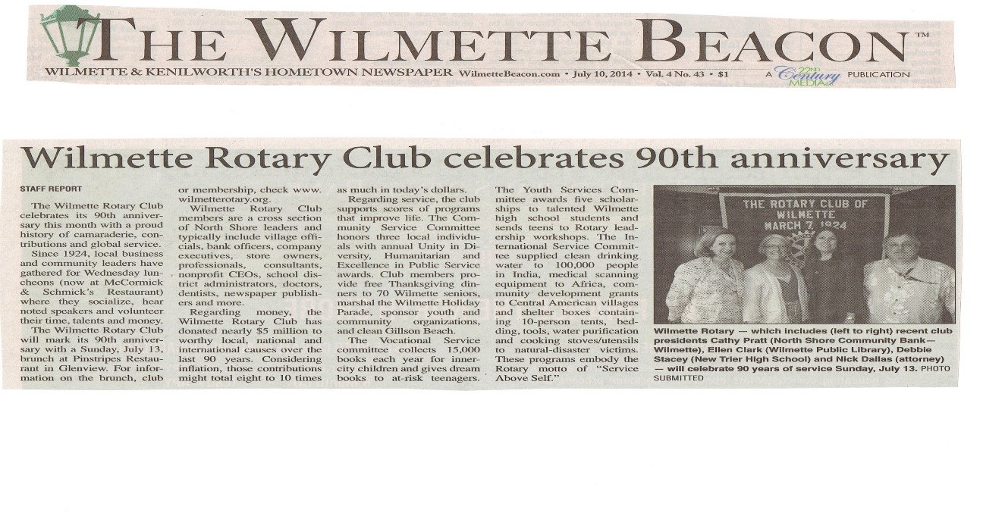
PUBLIC IMAGE RECOMMENDATIONS
News Releases and Photos

Slide 28
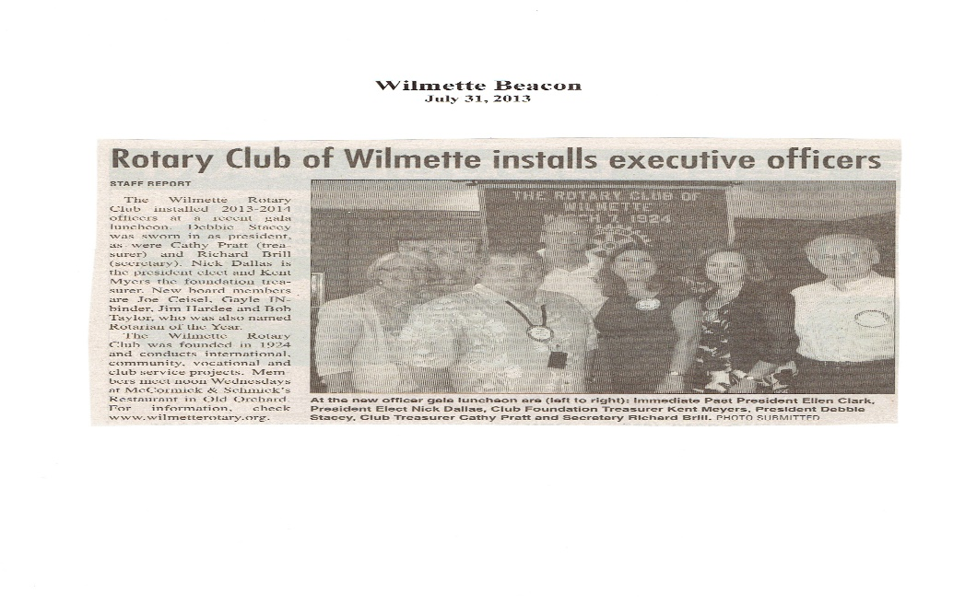
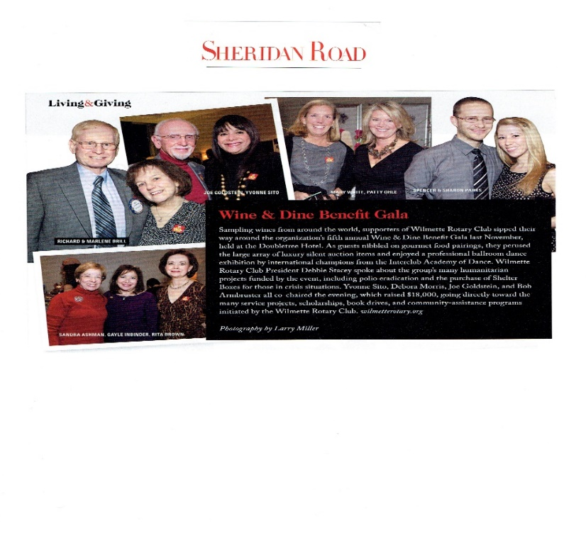
PUBLIC IMAGE RECOMMENDATIONS
News Releases and Photos

Slide 29
PUBLIC IMAGE RECOMMENDATIONS
Community Visibility
Public Service Projects
Wear Logo Gear
Post Signs or Banners
Showcase Rotary

Slide 30
PUBLIC IMAGE RECOMMENDATIONS
Rotary Signs and Materials
Install Signs
Think Big
Be Creative
Many, Many Thousands of Exposures

Slide 31
PUBLIC IMAGE RECOMMENDATIONS
District Community Service Programs
Localize to your Club and Community
Materials
Template News Releases
Distribute Everywhere

Slide 32
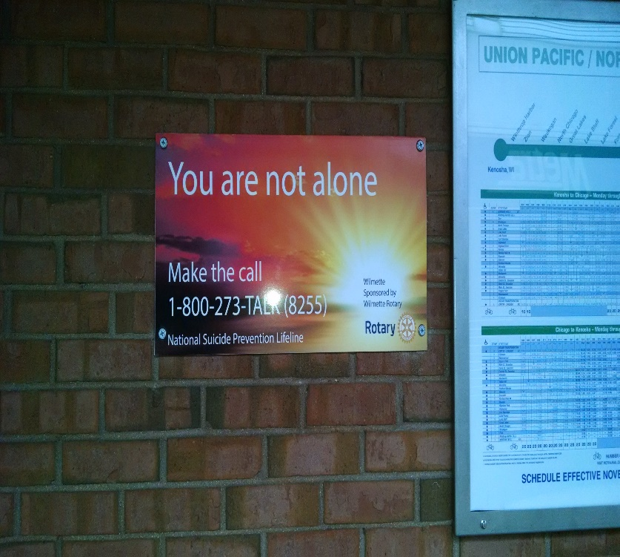
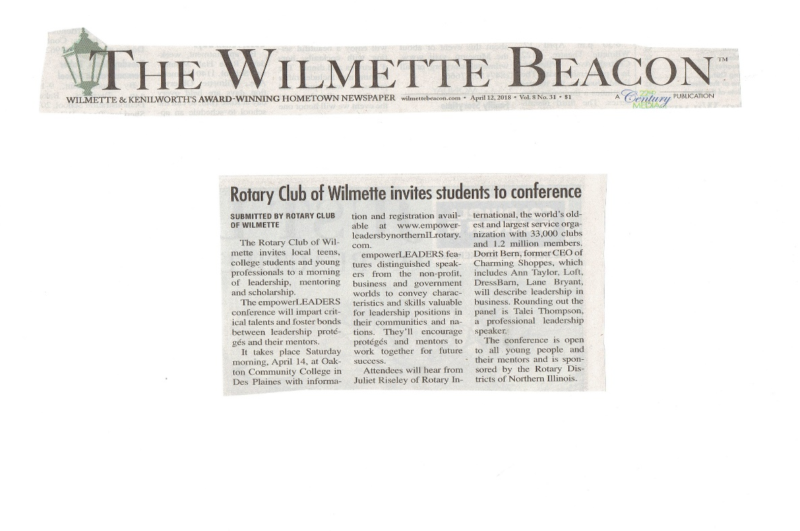
PUBLIC IMAGE RECOMMENDATIONS
District Community Service Programs

Slide 33
PUBLIC IMAGE RECOMMENDATIONS
Color Photos and Videos
A Picture is Really Worth 1,000 Words
Show Great Things
Women, Younger People, Action
Photos to Some Media and Platforms
Videos to Social Media

Slide 34
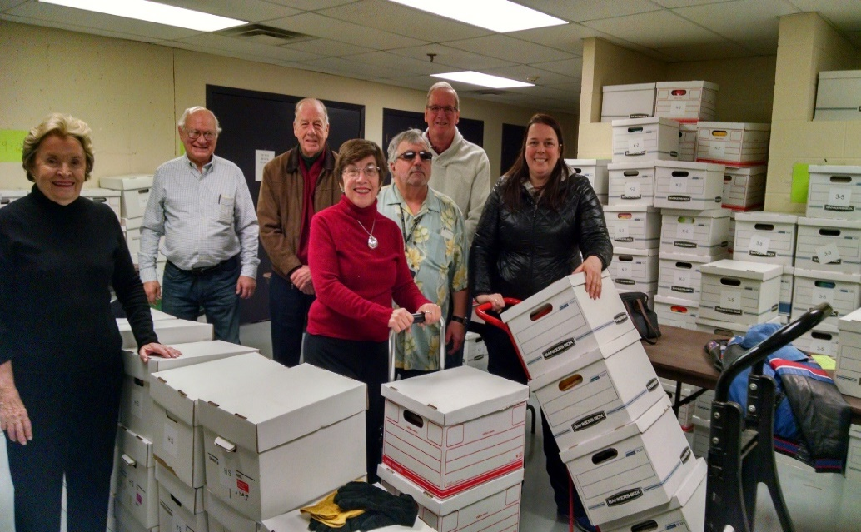
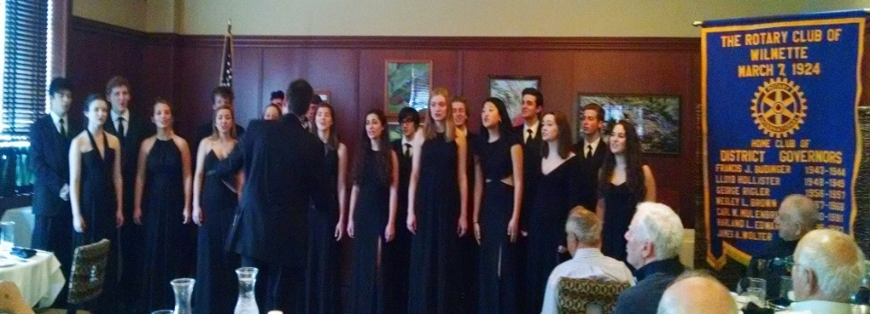
PUBLIC IMAGE RECOMMENDATIONS
Color Photos and Videos

Slide 35
PUBLIC IMAGE RECOMMENDATIONS
Color Photos and Videos
Trademark Issues !

Slide 36
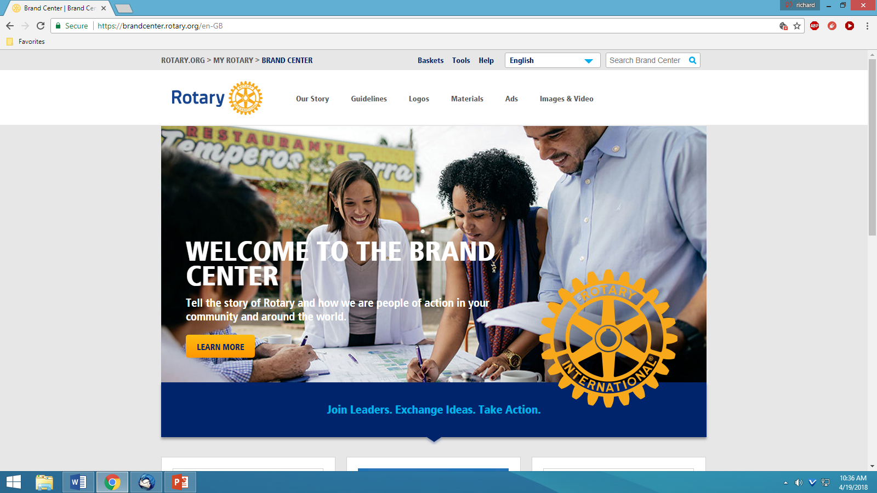
PUBLIC IMAGE RECOMMENDATIONS
Rotary International Brand Center

Slide 37
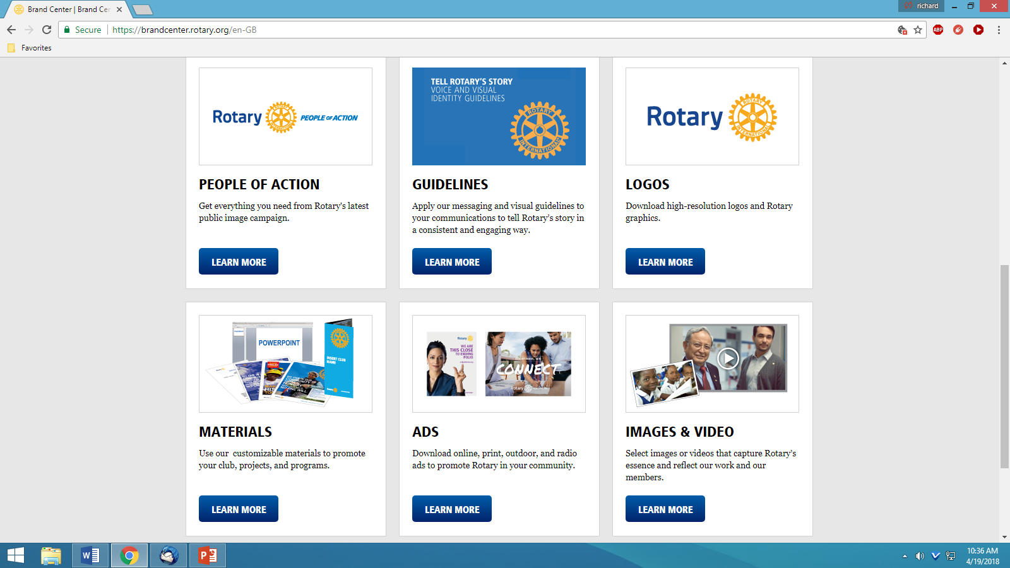
PUBLIC IMAGE RECOMMENDATIONS
Rotary International Brand Center

Slide 38
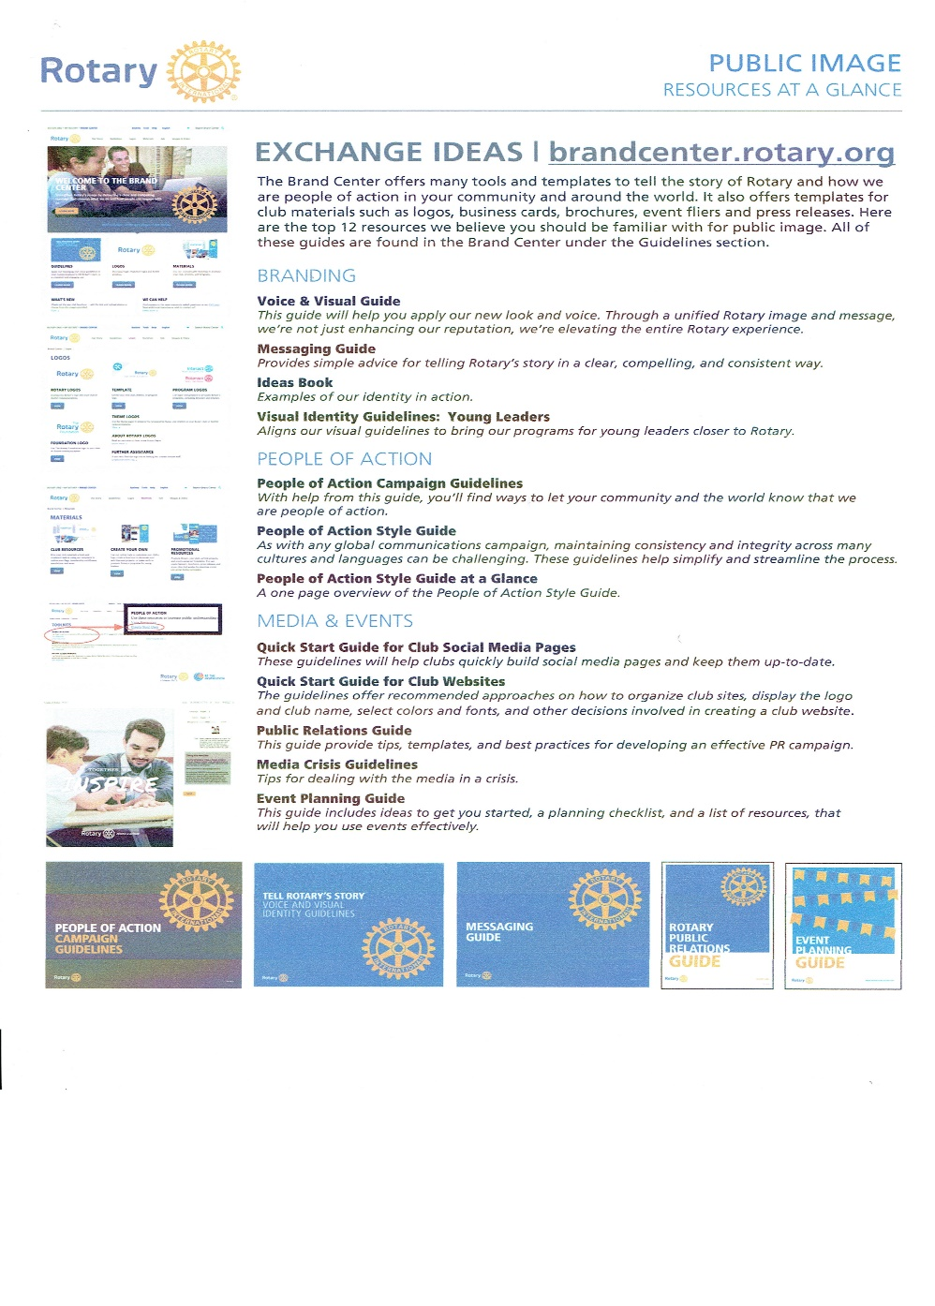
PUBLIC IMAGE RECOMMENDATIONS
Rotary International Brand Center

Slide 39
PUBLIC IMAGE RECOMMENDATIONS
The Pin
A Conversation Starter

Slide 40
PUBLIC IMAGE RECOMMENDATIONS
The Rotarian Magazine
Find a New Home After Reading

Slide 41
PUBLIC IMAGE RECOMMENDATIONS
Printed Materials
Brochures
Business Cards
Poster/Flyer
Billboards

Slide 42
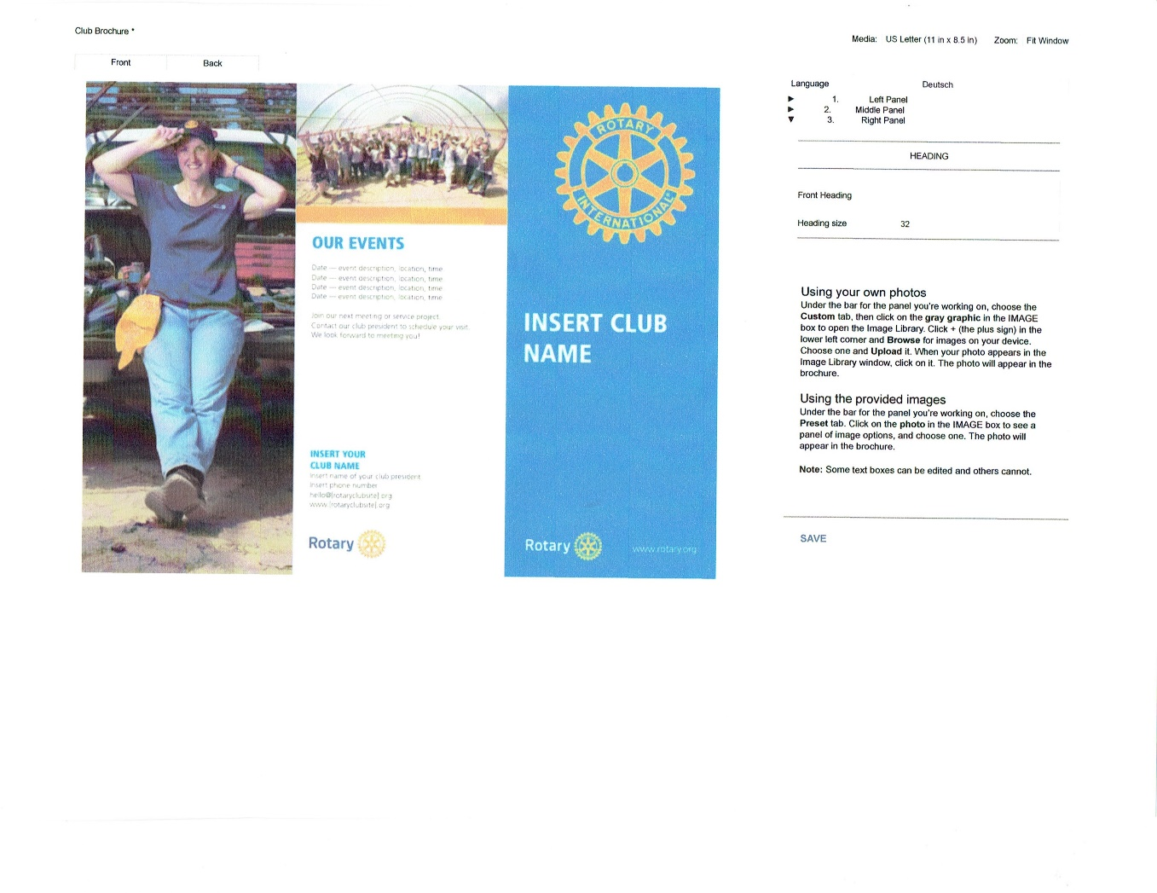
PUBLIC IMAGE RECOMMENDATIONS
Printed Materials

Slide 43
PUBLIC IMAGE RECOMMENDATIONS
Printed Materials

Slide 44
PUBLIC IMAGE RECOMMENDATIONS
Paid Advertising -- Sometimes Valuable

Slide 45
PUBLIC IMAGE RECOMMENDATIONS
Public Image Committee Members:
Dave Pedersen – Batavia
Sonia Penaranda-Taggart – Lake Forest/Lake Bluff
Melanie Santostefano – Buffalo Grove
Marianna Zeidler -- Lincolnshire

Slide 46
PUBLIC IMAGE RECOMMENDATIONS
Public Image – How Will Your Club Benefit ?
Greater Public Awareness
Attract More Members
Attract More Young and Female Members
Increase Member Participation
Raise More Money

Slide 47
PUBLIC IMAGE
Any Questions?
-------
Richard Brill
District 6440 Public Image Chair
richard.brill.rotary@gmail.com

