Slide 1
FUNDRAISING 101
DISTRICT 6440

Slide 2
AGENDA
Philanthropy in the United States
Sources of donation revenue
The stewardship model
Donor-centricity
Basic fundraising activates
Keys to Success and a Few Resources

Slide 3
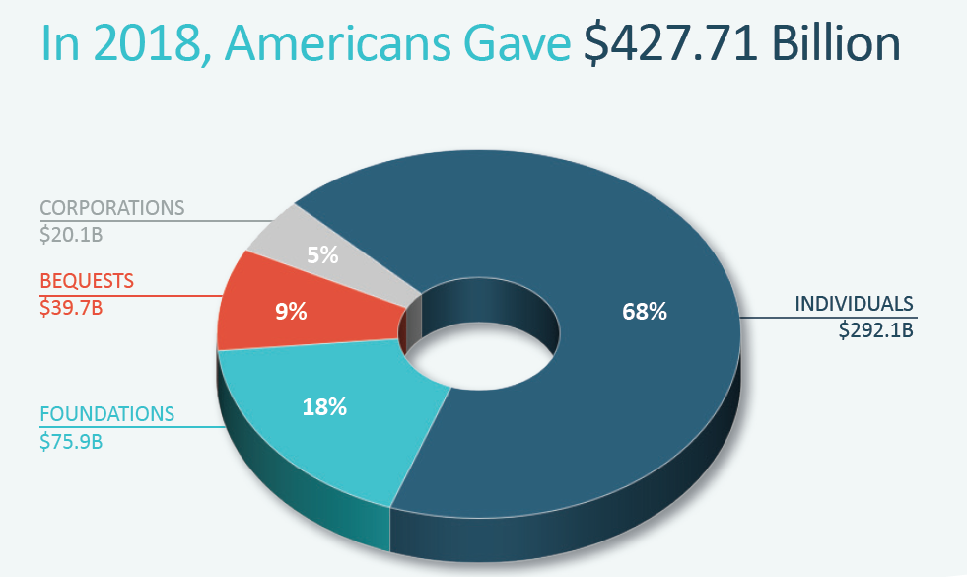
Philanthropy in the United States
Source: CCS Fundraising Guide to Philanthropy in the USA 2019

Slide 4
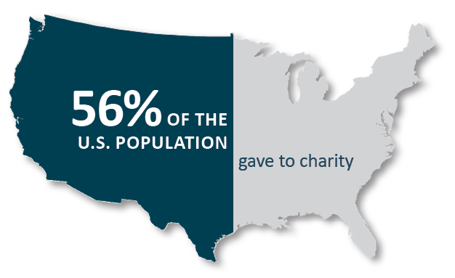
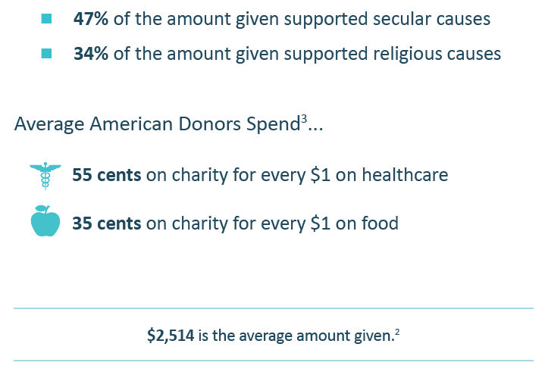
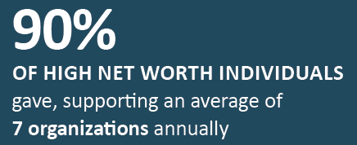
Philanthropy in the United States
Source: CCS Fundraising Guide to Philanthropy in the USA 2019

Slide 5
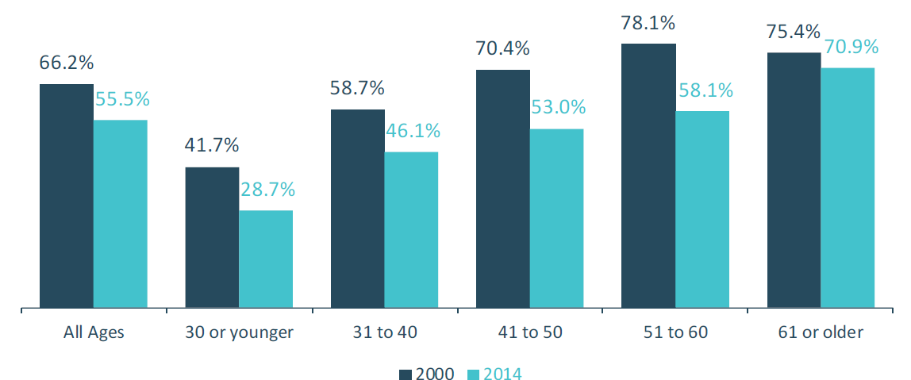
Philanthropy in the United States
Source: CCS Fundraising Guide to Philanthropy in the USA 2019

Slide 6
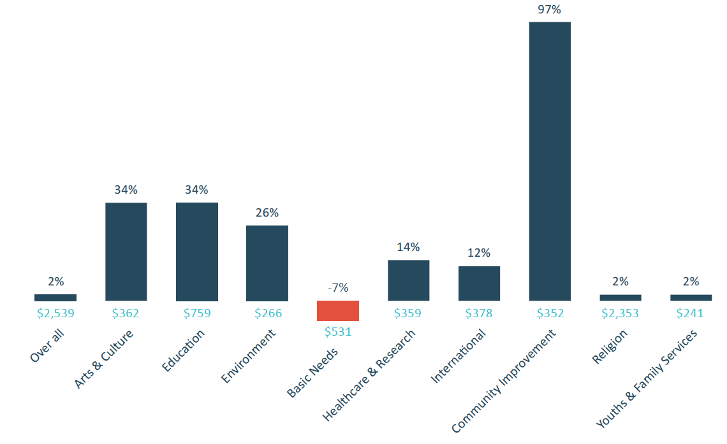
Philanthropy in the United States
Source: CCS Fundraising Guide to Philanthropy in the USA 2019

Slide 7
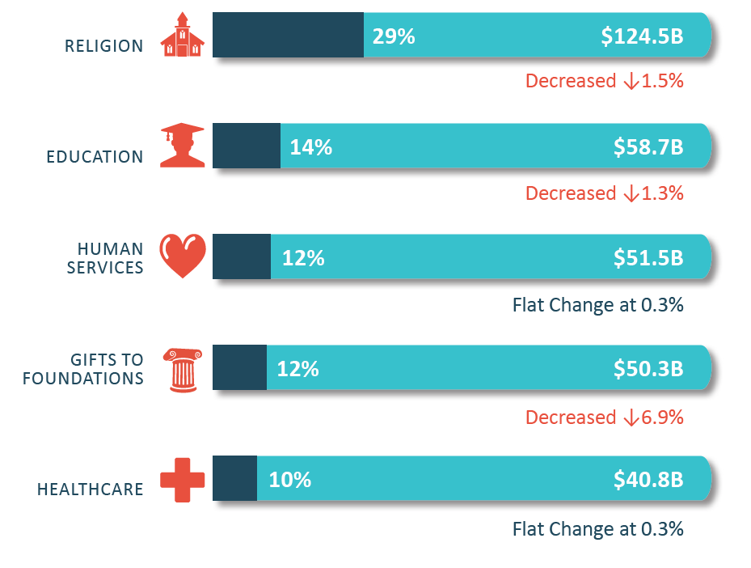
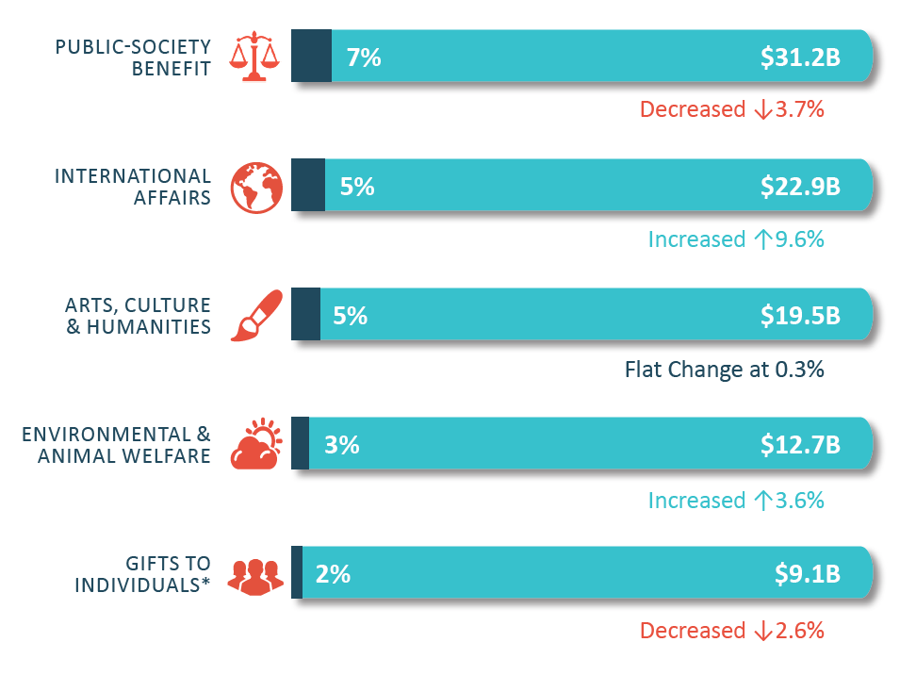
Philanthropy in the United States
Source: CCS Fundraising Guide to Philanthropy in the USA 2019

Slide 8
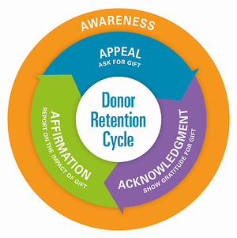
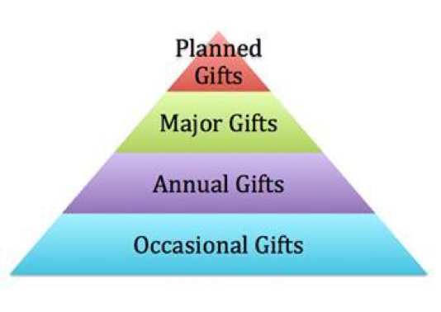
DONOR STEWARDSHIP MODEL
Source: CCS Fundraising Guide to Philanthropy in the USA 2019

Slide 9
DONOR STEWARDSHIP ACTIVITIES
Club brochure
Project brochures, web pages
Social media pages/posts
Thank you letters, emails, phone calls
Public shout outs- meeting, website, annual report
Impact reports
Annual Reports
Source: CCS Fundraising Guide to Philanthropy in the USA 2019

Slide 10
DONORCENTRIC COMMUNICATION
Donor is hero! Not your club.
“Your gift gave _________ to ________.”
Not
“Your gift allowed us to give _______ to ______.”

Slide 11
DONORCENTRIC COMMUNICATION
Focus on Outcomes
Your gift provided the polio vaccine to children so they can live healthy, vibrant lives.
Your gift provided new coats to children so they can attend school with confidence and the hope that comes from know someone- you- care about them.
Your gift allows (student’s name) to pursue their dream to become a (profession), so they can give ________ to the world and provide for their family.

Slide 12
DONORCENTRIC COMMUNICATION
Stories about one person helped are more motivating than stories about many; much more motivating than statistics.
Positive outcomes more motivating than alleviating a negative

Slide 13
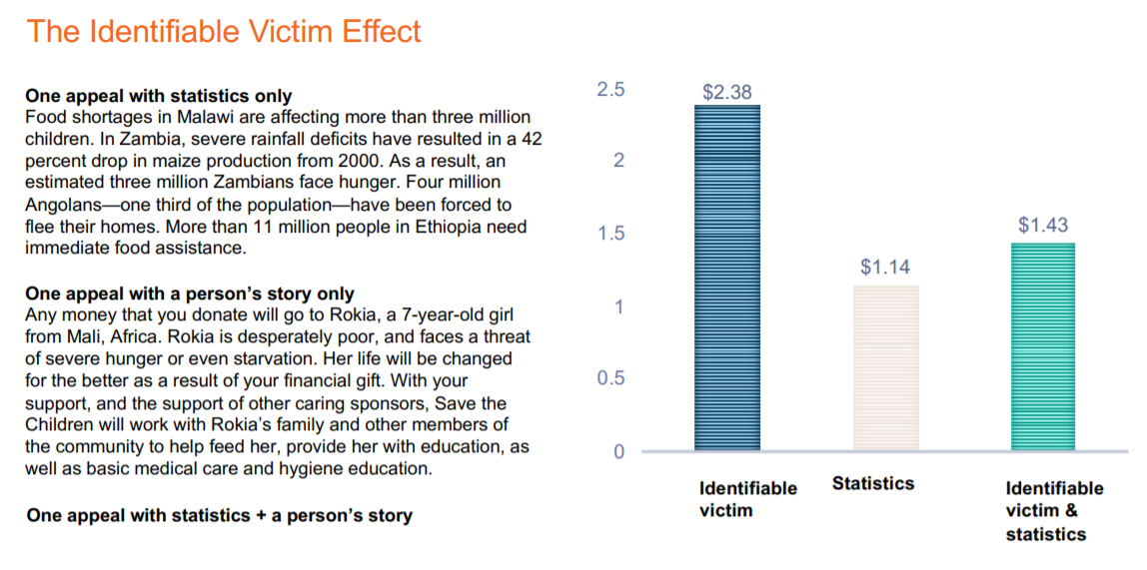

Slide 16
DONORCENTRIC COMMUNICATION
Keep writing simple
5th or 6th grade reading level (Hemingway app)
Short paragraphs
Thank and compliment (You make the world a better place)
More “you”, less “us”
Long letters. Short emails.

Slide 17
DONORCENTRIC COMMUNICATION
Number 1 mistake most fundraisers make-
They don’t ask enough
Number 2 mistake-
Don’t thank or don’t thank enough
Number 3 mistake-
Don’t report on impact

Slide 18
DONORCENTRIC COMMUNICATION
Most common mistake:
Make it all about the organization, not all about the donor.

Slide 19
DONORCENTRIC COMMUNICATION
Biggest Impediment to Success
Afraid to ask.
When you get a donor to give, you are doing them a favor.
Your enthusiasm and passion are contagious.

Slide 20
DONORCENTRIC COMMUNICATION
Other Impediments to Success
Can’t accept a gift when/how the donor wants to give.
More focus on “Rotary”, less on the program and it’s impact.
Only ask your club members.
Too few fundraising programs.
No or limited stewardship plan.

Slide 21
FUNDRAISING ACTIVITIES
Appeals
Individual asks
“Canning”
Direct Mail solicitations
Email solicitations
Online campaigns
Events
Dinners/Breakfasts
Music festivals/concerts
Runs/walks
Novelty events (e.g. duck race, cow pie drops)
Sell Stuff
Raffle
Auctions
Coupon Books
Food & Plants
Source: CCS Fundraising Guide to Philanthropy in the USA 2019

Slide 22
FUNDRAISING ACTIVITIES
Grants
Rotary Grants
Community Foundations
Family Foundations
Donor Advised Funds
Corporate Foundations Foundations(e.g. Walmart, Allstate)
Major Gifts
Bequests
Challenge or Matching Grants/Gifts
IRA RMDs
Sponsorships
Events
Website
Ad sales
Source: CCS Fundraising Guide to Philanthropy in the USA 2019

Slide 23
Keys to Success
“All of the Above” Approach
Have a calendar- year round
Focus on programs and their impact/outcomes
Year End Appeal
Matching Gifts
Stewardship
Ask often, with passion, and position the donor as the hero!
Go beyond your members

Slide 24
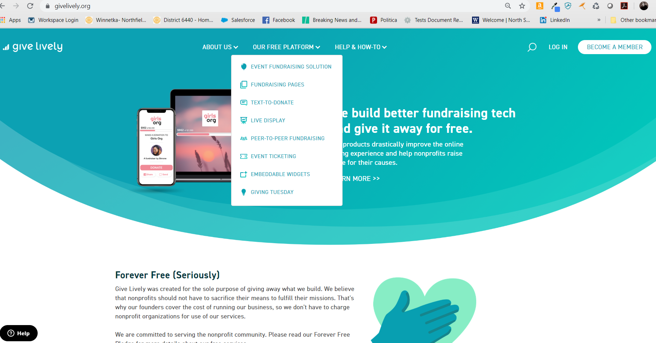
Keys to Success
Online Fundraising
Facebook
Give Lively

Slide 25
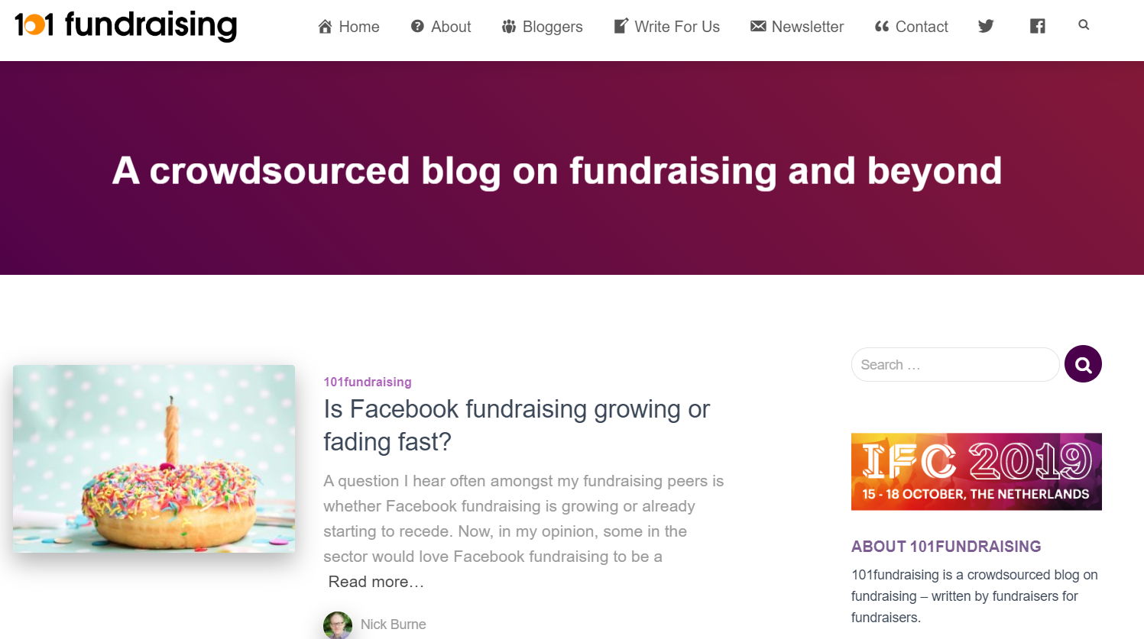
OTHER RESOURCES
Pam Grow
Future Fundraising Now
The Agitator
Fired Up Fundraising- Gail Perry
101 Fundraising

Slide 26
Questions & Comments

