Slide 1


GRANT MANAGEMENT SEMINAR
DISTRICT GRANTS
1
February 3, 2024

Slide 2
Grant Management Seminar
2
Agenda
Grant Roles
Club Qualifications
Grant Characteristics
Funding
Examples of Projects
Finding the Application
Collaborative Grants
Open for Questions

Slide 3
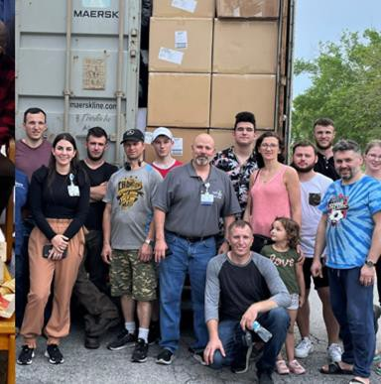
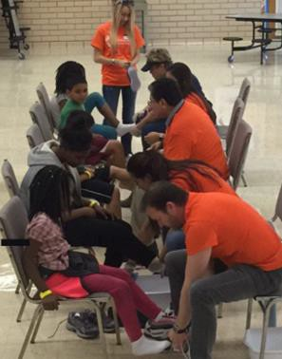
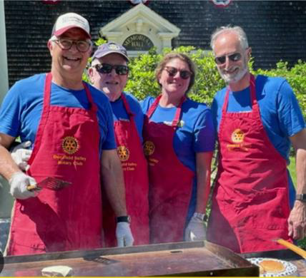
Roles in District Grants
3
District Grants Committee
Sets policies
Reviews applications
Directs disbursement of District Designated Funds (DDF)
Approves Final Reports
Rotary Club
Identifies projects Applies for grants Plans & Implements
projects
Files Final Reports
Shares achievements

Slide 4

How do Clubs Qualify for Grants?
4
Must have available DDF. There is no longer a $500 minimum
Participate in the 2024 Grant Management Seminar
Submit 2024-2025 Club’s Memorandum of Understanding by
May 31st
Enter Club 2024-2025 Goals in My Rotary - Membership, Annual Fund Share, and End Polio Now by May 31st
Complete 2023-24 Final Reports within 30 days after project completion or NLT June 15th

Slide 5
Using District Designated Funds [DDF]
5
Each Club decides how to use its available DDF
DDF can be used for both District and Global Grants
Maximum of 50% of available DDF can be requested for District Grants. Whatever is not used for District Grants will be applied to Global Grants.
Example: If each Club has total of $1,000 DDF:
  Club 1 – Uses $500 for District and $500 for Global Grants
  Club 2 – Uses $1,000 participation in Global Grant
  Club 3 -- Uses $300 for District and $700 for Global Grants
{ Note – each Club having $1,000+ for District Grants can apply for 2 grants }

Slide 6
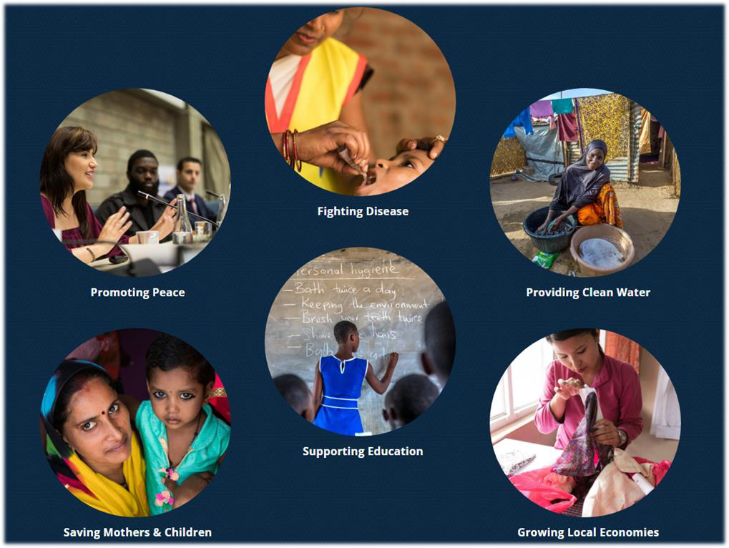

About District Grants
6
Projects must support Rotary Mission and Areas of Focus
Club cash match DDF 100+%
Projects should be “hands-on”
Club with $1,000+ may have one or two grants - may be domestic or international
Projects must be completed within the Rotary year

Slide 7









Project Participation 2023 – 2024
7
$50k of DDF $114k in Projects
Humanitarian
Food Pantries - $34,000
Arlington Heights
Batavia
Buffalo Grove & Wheeling
Carol Stream
Fox Valley Sunset Huntley
Lake Zurich Northbrook
$8300
$7500
$1,200
$1,000
$1,000
$1400
$10,000
$1800

Slide 8







Project Participation – 2023 -2024
8
Humanitarian through NGOs
Various Projects - $18,100
Evanston Lighthouse: Bundled Blessings
Diaper Bank
Evanston Nouveau: Family Mothers
Long Grove/Kildeer/Hawthorn Woods: GiveNKind
McHenry: ShelterBox
Northeast Chicago Passport: ShelterBox
Skokie Valley: Just Harvest Community Kitchen
Winnetka-Northfield: Good News Partner
$3500
$5200
$3900
$1100
$1100
$2,300
$1,000

Slide 9






Project Participation 2023 - 2024
9
Community Involvement - $18,000
Seniors/Veterans:
Crystal Lake Dawnbreakers
= $5,000
Pollution Reduction:
Wheeling = $1,100
Affordable Recovery Housing:
Wilmette = $10,500 Wilmette Harbor = $1,600
Warm Clothing:
$2600
$1000
$9300
Lake Forest- Lake Bluff
Lincolnshire Morning Star
Schaumburg AM

Slide 10

Project Participation 2023 – 2024
10
Education - $40,800
Local Schools: Barrington = $3,700 Cary Grove = $2,200
Dundee Township = $4,800 Wheaton = $7,400
RYLA:
Evanston Lighthouse = $5,200
Colleges & Universities:
Batavia = $1,000
Fox Valley Sunset = $1,400 Libertyville Sunrise = $7,000 Northbrook = $5,000 Wheaton AM = $3,000

Slide 11
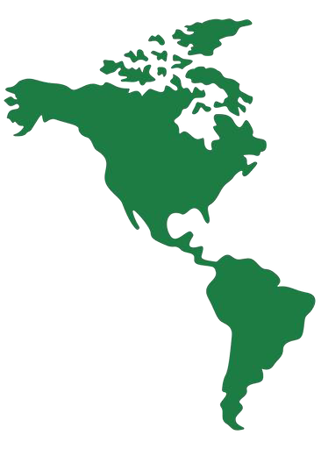
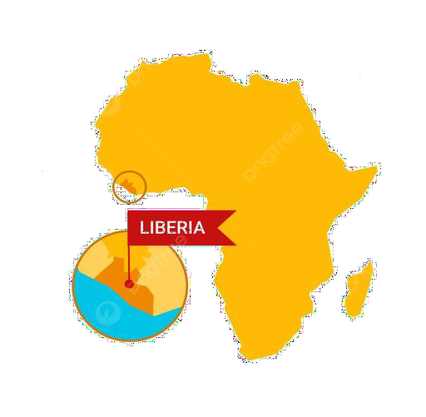

Project Participation 2023 - 2024
11
International - $21,000
Deerfield: $2,900 => Mexico Glen Ellyn: $14,100 => Liberia Highland Park: $1,000 =>
Dominican Republic
Long Grove/Kildeer/Hawthorn Woods: $1,000 => Baja California
Northeast Chicago Passport:
$1,700 => Guatemala

Slide 12
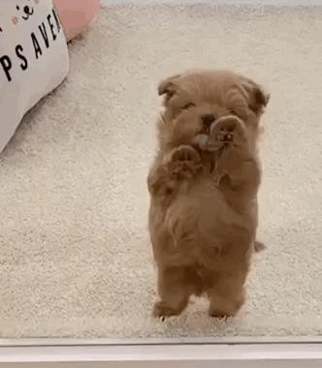

Application Deadline for District Grants
12
June 15, 2024
JUNE 15th

Slide 13
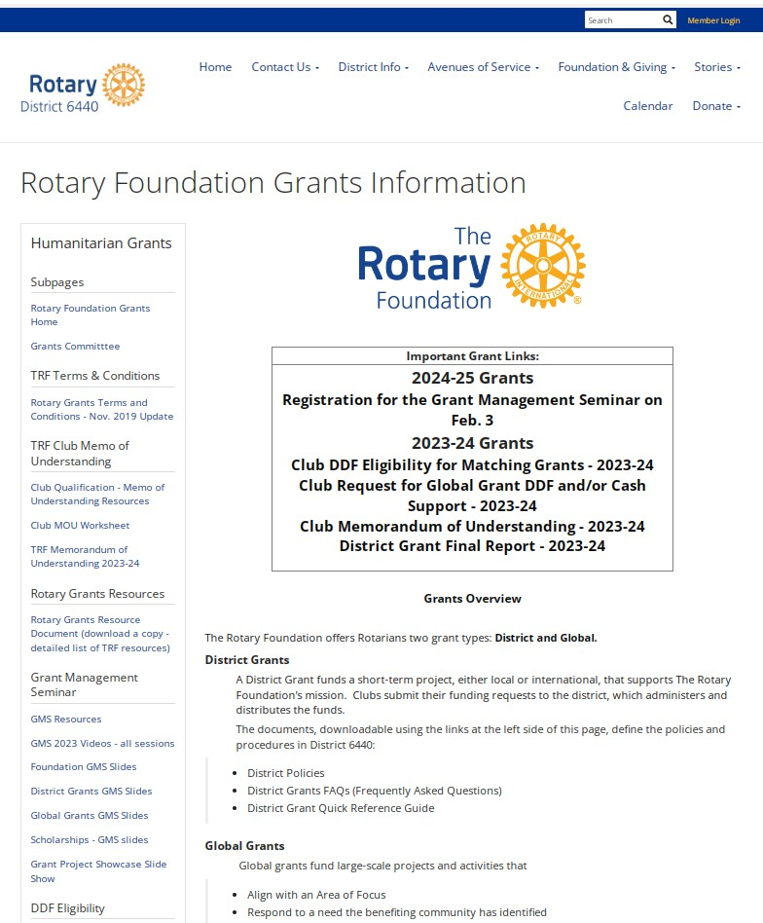
Finding what's needed
13
Navigation: Rotary6440.org
Foundation and Giving > District and Global Grants
HOW-TO RESOUCES:
  DOCUMENTS - VIDEOS - SLIDES
  2024 GRANT MANAGEMENT SEMINAR
  2024-2025 CLUB DDF ELIGIBILITY
  2024-2025 MEMO OF UNDERSTANDING
  2024-2025 GRANT APPLICATIONS
2023-2024 FINAL PROJECT REPORT

Slide 14
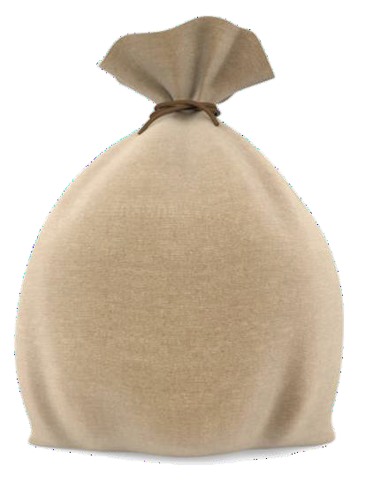

14
2024-2025 Grant Opportunities
Fantastic Project Openings!
$81,000+ available across clubs
$81,000
available
Identify your projects now!
Get your applications in!

Slide 15

Collaborative Grants
15
Offered annually based on available funding
Focus selected by the District Governor and Grants Committee
Minimum of three clubs collaborate contributing
$500-$1,000 cash each - matched by District
Clubs work together as a group
Lead club submits application, manages all financials and submits Final Report no later than June 15th
NO club DDF involved!

Slide 16

Your Partner
16
Mike Quirk
mquirk925@gmail.com 630-277-3586

Slide 17
Open for Questions
17

