Slide 1


Slide 2


D6440 Kickoff
Wednesday,
April 22, 2026

Slide 3

Goals for the Walk
Increase awareness of Rotary’s efforts to eradicate Polio and share consistent talking points on Polio eradication efforts and current efforts being made
Raise money to support efforts to end Polio

Slide 4
Event Logistics
Clubs agree to:
Start the walk at 10:00AM CST
Use the designated “World’s Largest Polio Walk” logo for their events on all print and related materials
  Follow Rotary’s branding guidelines
Have a designated “World’s Largest Polio Walk” Champion, who will participate on ZOOM calls to share ideas, discuss progress, and resolve needs.
Have their Champion report their results – participation, publicity, fundraising
  Use Raise for Rotary to encourage and track giving

Slide 5
You Have Questions!
What could a Walk look like? Can you share ideas?
Who is already signed up to participate? Can we collaborate?
We’re already doing another event for Polio at another time/date. Can’t that count?
  Amplify your existing event, or complement it
How much do you want us to raise?
  Set a goal to rally around; incremental giving
Can we get help with publicity and promotion?
What’s in it for our club?

Slide 6
Ideas!
Signature event at One Rotary Center in Evanston with RILEE
Mall walks: Omaha; Twin Cities at Mall of America
Tie to an existing community or club event
Gathering afterwards – food trucks, music
Partner with groups in your community: Politicians, Healthcare, Schools, Businesses, Community Groups, Seniors
    High profile Honorary Walk Marshall
Various lengths of walks
    Have people join the walk along the way.
T-shirts to identify walkers and raise funds

Slide 7
Participating Clubs So Far
Barrington Afterhours
Batavia
Buffalo Grove
Elgin Breakfast
Evanston Lighthouse
Glen Ellyn
Highland Park-Highwood
Huntley
Lake Forest - Lake Bluff
Lake Zurich
Long Grove / Kildeer / Hawthorn Wds
Northbrook
Park Ridge
Schaumburg - Hoffman Estates
Schaumburg AM
Wilmette
Who are we missing?

Slide 8
Kathi Quinn,
Public Image
District 6440

Slide 9


We are creating a
WLPW customizable checklist & press packet
for you to use
to build momentum in your communities!
“Let’s come together
and make history!”

Slide 10


Media Outreach Targets
Social Media:
Facebook: Photo’s, families
Instagram- teens, young
YouTube – sharable, all ages
LinkedIn – Business, professionals
Traditional Media:
Print – news, events
Online - responses
Radio - alerts
Community – all of the above

Slide 11
Using media COMMUNITY outreach:
Proclamation
How to use the Proclamation:
This is a great photo opp
We will provide a template for you to complete
Generally – onetime use

Slide 12
Using media COMMUNITY outreach:
Club, chamber, school news
How to use a Press Release:
Most orgs will have news they share with students, families, members online or in print
We will provide a press release template for you to complete and share
Try to include photos when you can

Slide 13
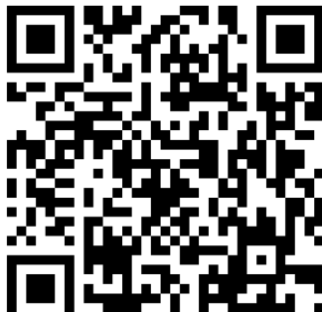
Be Creative!
Promote attendees and groups to join you in the walk:
  Send invites (postcards?) to Politicians, Healthcare Organizations, Schools, Businesses, Scouts, Families, Clubs, Seniors Groups
  Use on Facebook and LinkedIn as Invites
Consider a billboard in a high traffic area
Promote at local restaurants, flier handouts at a drive thru, Chamber of Commerce event, inside a mall
Flyers around your town
Make t-shirts and wear at summer events (concerts, Farmers Markets, Parades)
Each club will have its own QR

Slide 14
You Have Questions!
What could a Walk look like? Can you share ideas?
Who is already signed up to participate? Can we collaborate?
We’re already doing another event for Polio at another time/date. Can’t that count?
  Amplify your existing event, or complement it
How much do you want us to raise?
  Set a goal to rally around; incremental giving
Can we get help with publicity and promotion?
What’s in it for our club?

Slide 15

Event Recognition and Follow Up
All clubs that complete the event will receive a “World’s Largest Polio Walk” participant certificate and thank you letter
An award will be given to the D6440 Club that raises the most money per capita for the event
An award will be given to the D6440 Club that engages the most people in the event
Participants should receive a follow up thank you, encouraging them to attend future Rotary events

Slide 16
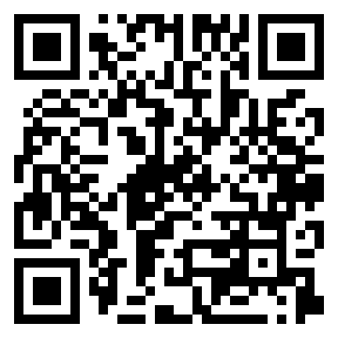
What’s Next?
Sign Up Now!
https://bit.ly/4vPAYH6
When you submit,
- We'll add your club to the list of those participating.
- You will be sent WLPW graphics, videos you can share with your members and partners, and Top 10 Facts about Polio. And you'll be signed up to receive more information as it becomes available.
- You'll receive an invitation to the monthly update Zoom.

Slide 17
What’s Next?
Sign Up Now!
Create a club working group to make it happen
Look for collaborators
Start recruiting partners
Find a location - safe, visible, good traffic
Set a targets for number of participants and fundraising
Make a plan – then PROMOTE it!
  Connect with your local media – plant the seed now and get on their radar
Decide how to follow up and connect with your attendees

Slide 18
What’s Next?
Attend the monthly 6440 WLPW Zoom: 4th Monday of the month at 6PM (next: April 27)
  Hear about promotional tools and strategies
  Peer-to-peer fundraising and Raise for Rotary
  Share ideas, look for collaborators, coordinate activities
  Ask questions
https://us06web.zoom.us/j/83547306982?pwd=QMNOcPACWiKjPIZRwmKEar25bdQz03.1
Meeting ID: 835 4730 6982 Passcode: 516635

Slide 19
Want a presentation to your club?
We’re happy to present in person or via Zoom, or share videos for your club and partners

Slide 20
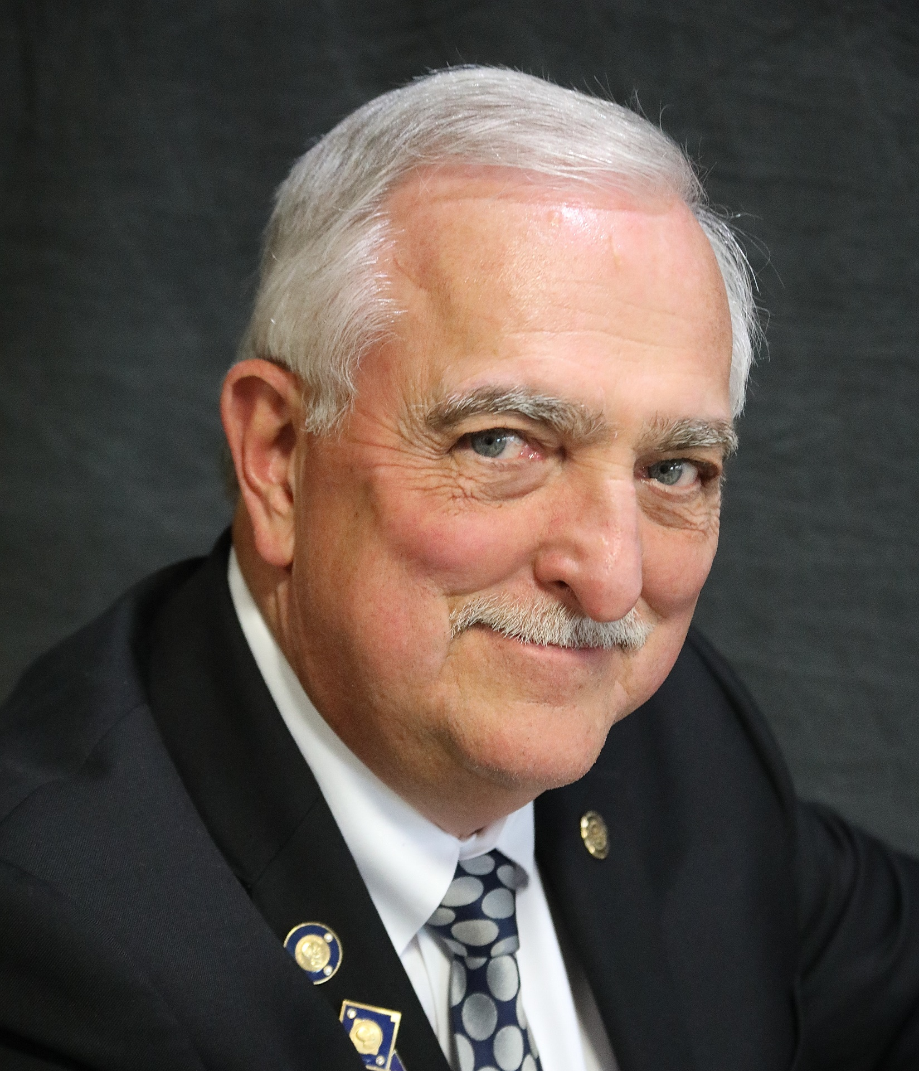
THANK YOU!
Lyle Staab
District 6440 Governor 2020-2021
gov.lyle@rotary6440.org
845-671-1223

