Slide 1


Slide 2



D6440 Update
Monday
June 1, 2026

Slide 3
Quick intro to the WLPW
What is the WLPW, and what started the ball rolling?
Keystone event at One Rotary Center
Who’s planning to participate?
Resources on rotary6440.org
Peer-to-peer fundraising: Raise for Rotary
Roundtable discussion

Slide 4


Slide 5

Notes:
73% of the districts in 25b and 29 have plans to participate.
2 Countries: USA & Canada
11 States
1,145 Clubs
Target: 43,000 Rotarians & Rotaractors

Slide 6
Event Logistics
Clubs agree to:
Start the walk at 10:00AM CST
Use the designated “World’s Largest Polio Walk” logo for their events on all print and related materials
  Follow Rotary’s branding guidelines
Have a designated “World’s Largest Polio Walk” Champion, who will participate on ZOOM calls to share ideas, discuss progress, and resolve needs.
Have their Champion report their results – participation, publicity, fundraising
  Use Raise for Rotary to encourage and track giving

Slide 7
Goals for the Walk
Increase awareness of Rotary’s efforts to eradicate Polio and share consistent talking points on Polio eradication efforts and current efforts being made
Raise money to support efforts to end Polio

Slide 8
Keystone Event
One Rotary Center
Governor Elect Rick and our district’s public image chair, Kathi Quinn, want a cornerstone kickoff for the event at One Rotary Center.
Rick’s vision is that there are a limited number of speakers, including some RI / TRF dignitaries, and Honorary Walk Marshalls from the Blane Family Foundation. Kathi knows this will be attractive to the media, especially if we have a good number of people starting the walk from ORC at 10AM.
What happens after the starting gun is up to the Evanston Area clubs!
Evanston Lighthouse, Evanston, Evanston Nouveau, Wilmette, Winnetka – Northfield are expected to collaborate.

Slide 9
Likely D6440 Events / Partners
Northbrook, Highland Park – Highwood, Glenview Sunrise, Deerfield – Walk to or from Ravinia to ORC.
Walkers to join enroute.
Interact to engage onlookers, real-time interviews on social media.
Activity at each border.
Arlington Heights, Buffalo Grove– Walk around Lake Arlington. Finish with a community celebration with food trucks, music, bouncy castles.
Glen Ellyn – Conflict with Halloween parade; now looking to partner with other clubs. Plan had been for a two mile walk. Rotary and Interact members at different points with booths, signs, stickers, info.

Slide 10
Likely D6440 Events / Partners
Libertyville Sunrise – Walk at a health club, indoors or outdoors depending on the weather.
Carol Stream, Wheaton,
Elgin Breakfast, Elgin, Huntley
Antioch, Illinois Beach Sunrise, Gurnee, Richmond – Spring Grove
Batavia, Bartlett ?
Barrington Afterhours, Barrington ?
Schaumburg – Hoffman Estates, Schaumburg AM ?

Slide 11
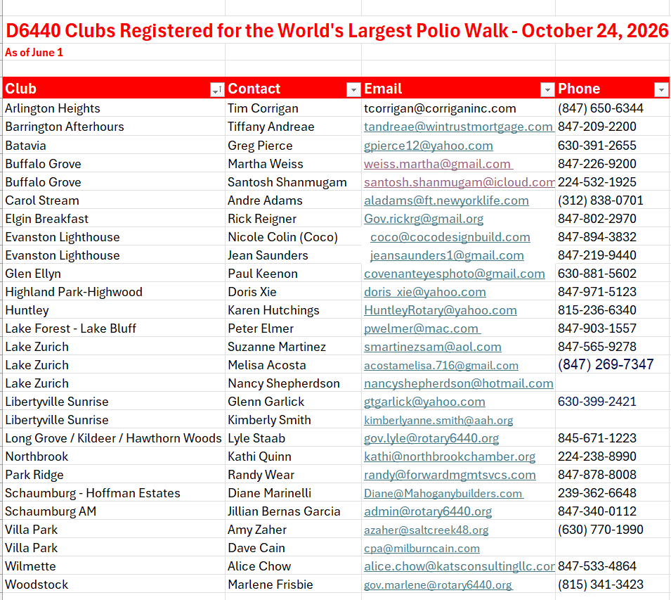

Slide 12
FAQ
What could a Walk look like? Can you share ideas?
Who is already signed up to participate? Can we collaborate?
We’re already doing another event for Polio at another time/date. Can’t that count?
  Amplify your existing event, or complement it
How much do you want us to raise?
  Set a goal to rally around; incremental giving
Can we get help with publicity and promotion?
What’s in it for our club?

Slide 13

Event Recognition and Follow Up
All clubs that complete the event will receive a “World’s Largest Polio Walk” participant certificate and thank you letter
An award will be given to the D6440 Club that raises the most money per member for the event
An award will be given to the D6440 Clubs that engage the most people in the event
Participants should receive a follow up thank you, encouraging them to attend future Rotary events

Slide 14
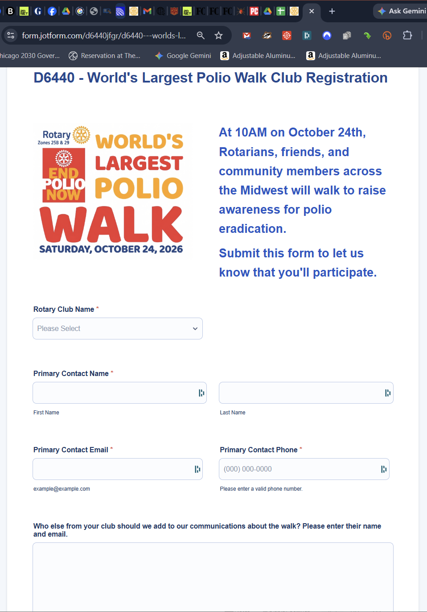
REGISTER YOUR CLUB NOW
https://bit.ly/4vPAYH6

Slide 15
Coming your way….
Updated WLPW graphics
- Club specific logos
Publicity templates
Press Releases
Proclamations
Suggestions on engaging the press
Sample timelines
Links and instructions for Raise for Rotary peer-to-peer fundraising

Slide 16

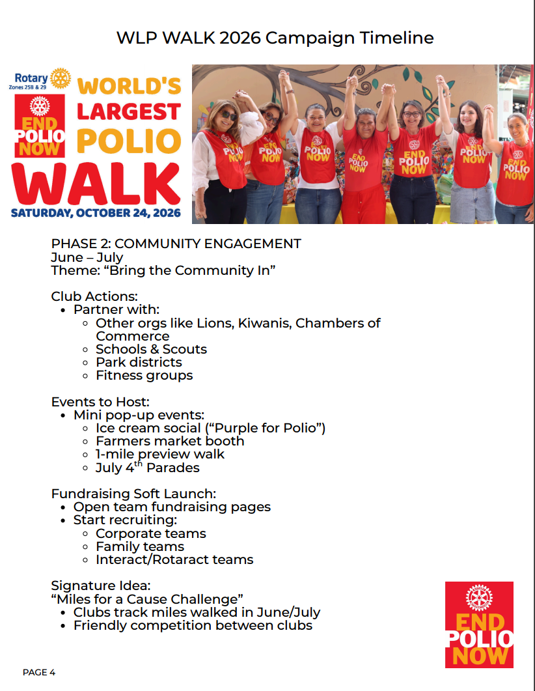

Slide 17

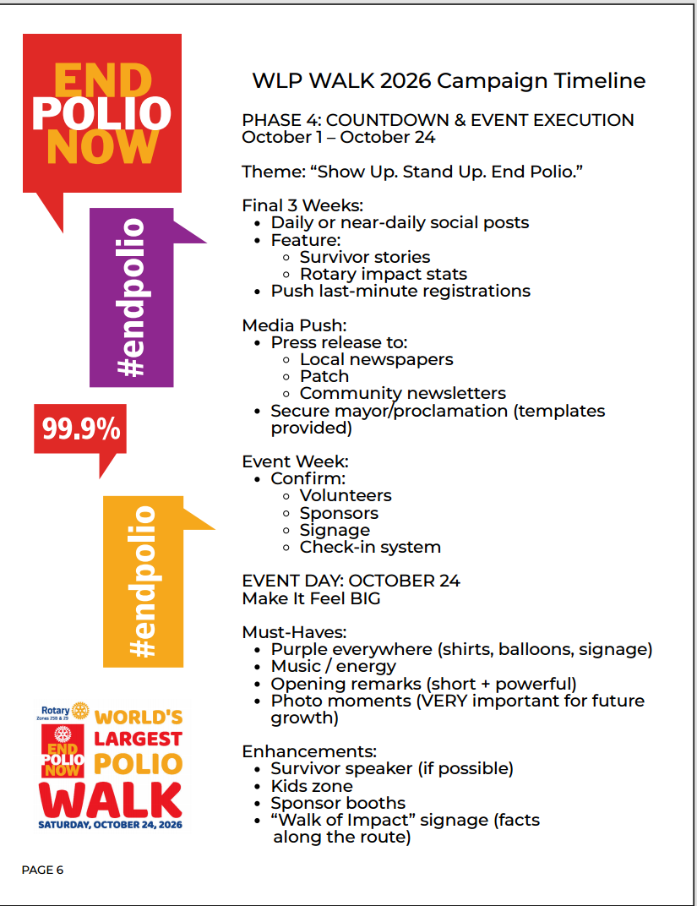

Slide 18
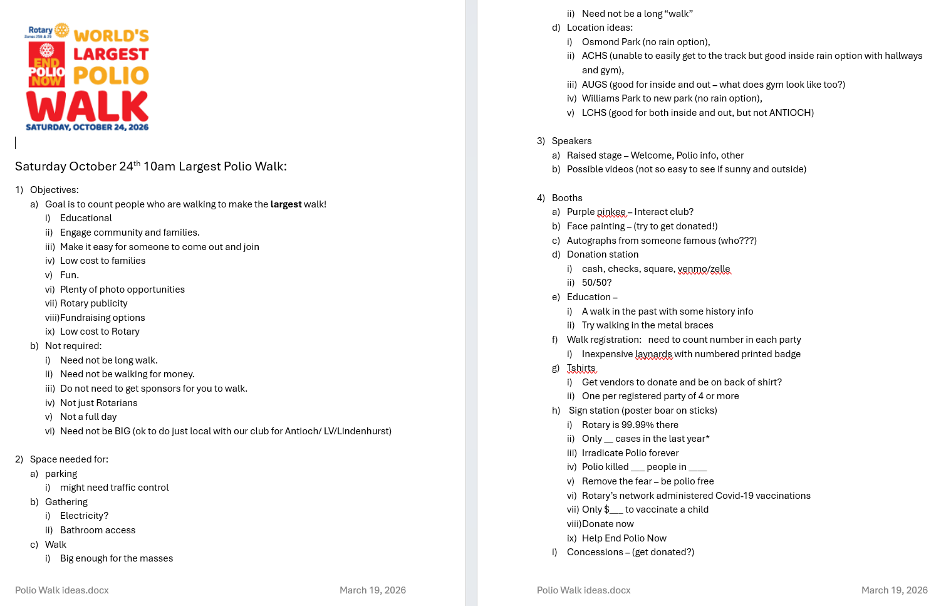

Slide 19
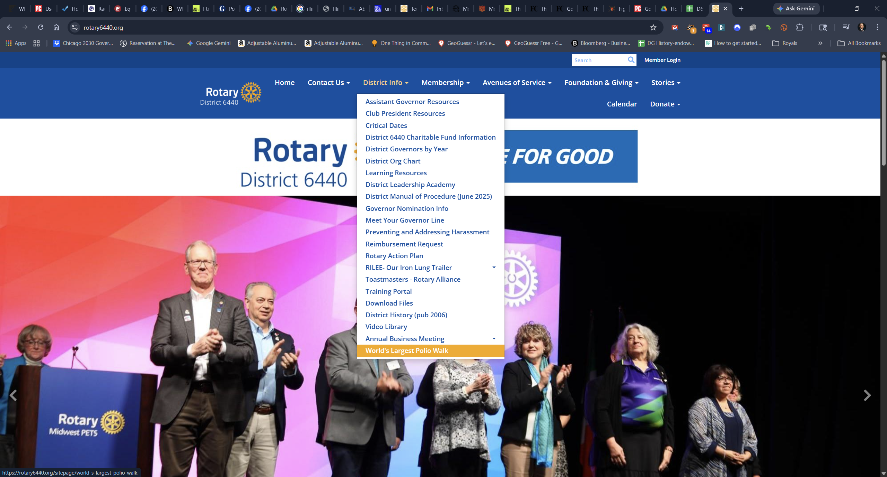

Slide 20
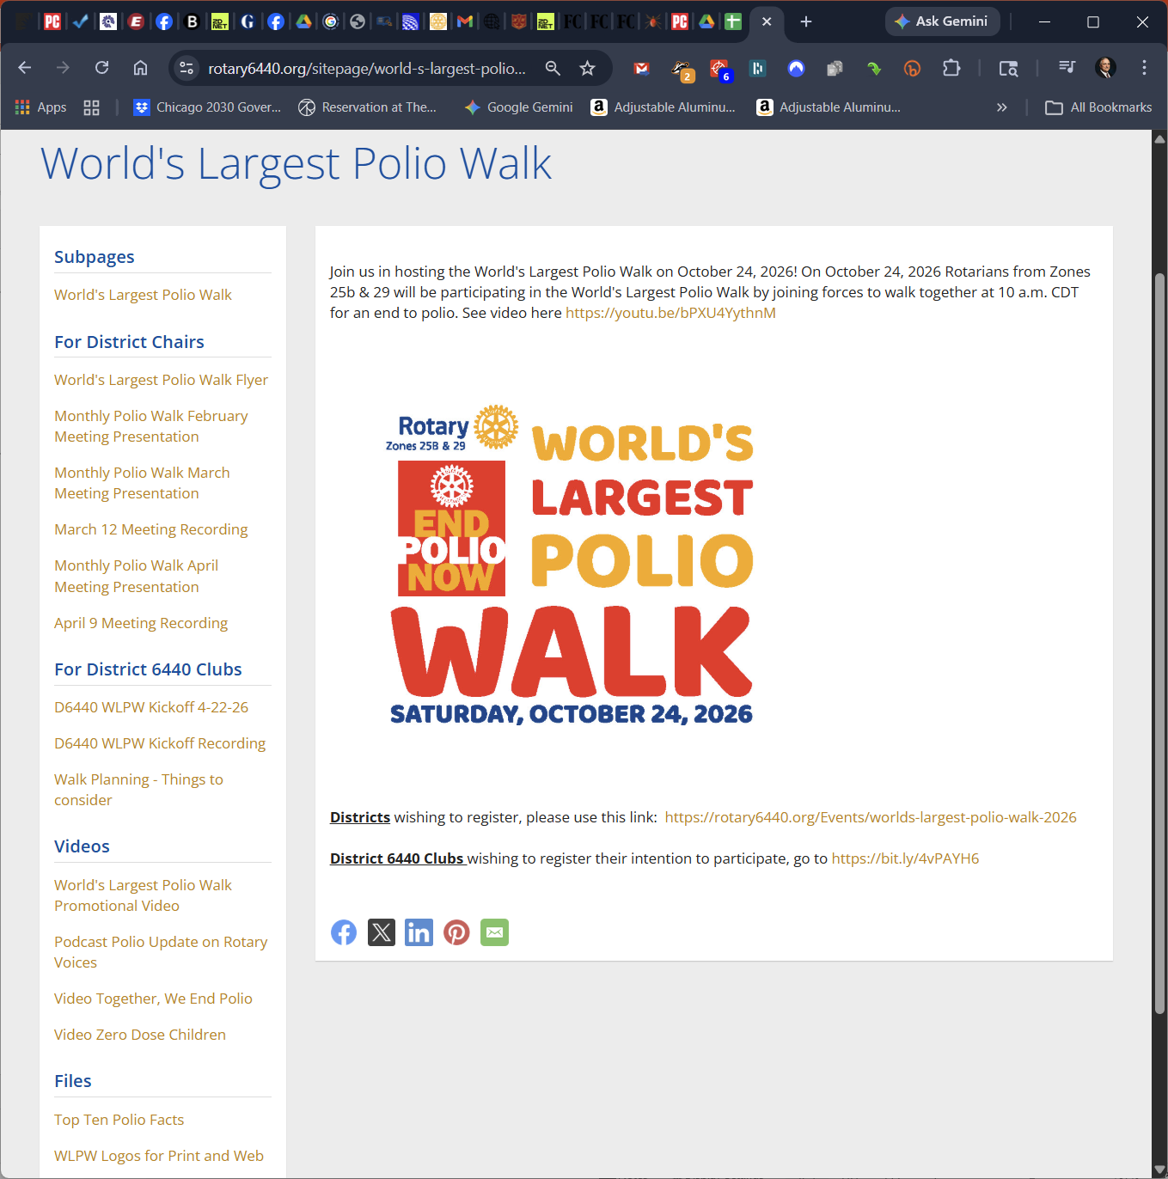

Slide 21

Media/Outreach Targets
Social Media:
Facebook: Photo’s, families
Instagram- teens, young
YouTube – sharable, all ages
LinkedIn – Business, professionals
Traditional Media:
Print – news, events
Online - responses
Radio - alerts
Community – all of the above

Slide 22



Slide 23



Slide 24
Be Creative!
Official Proclamations
Press Releases
Signs / t-shirts / logoed items at summer events (concerts, Farmers Markets, Parades) with a QR Code - Zazzle
Promote attendees and groups to join you:
  Send invites to Politicians, Healthcare orgs, Schools, Business, Scouts, Families, Senior Citizens Centers
  Use on Facebook and LinkedIn to Invite
  Flyers around your town

Slide 25
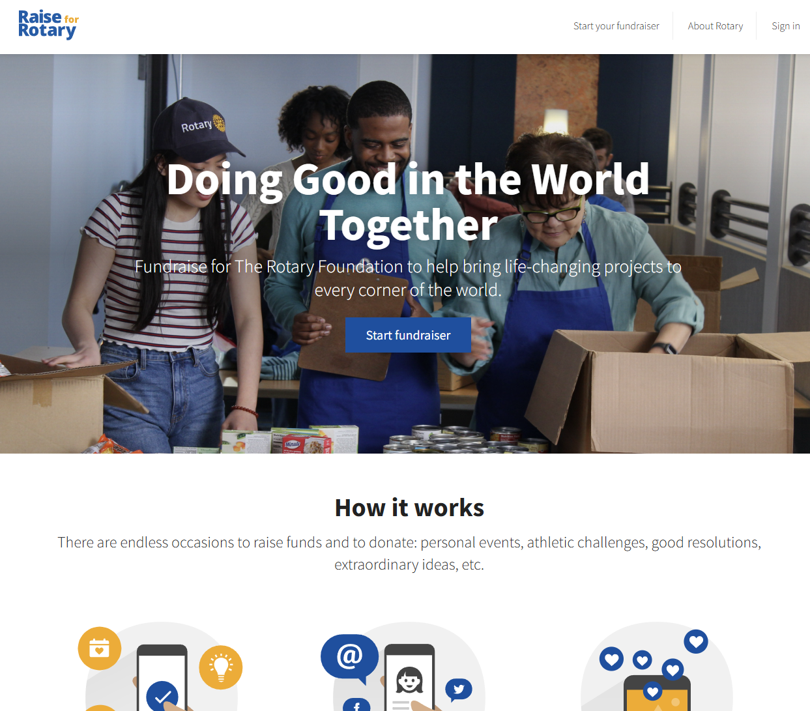

Slide 26

Using for the WLPW
Raise for Rotary (https://raise.rotary.org/) is a limited online peer-to-peer tool that helps individuals and clubs raise money for TRF
Pros
  Donations can be credited to Rotary members and/or their clubs
  Clubs and members can easily solicit funds towards the WLPW
Cons
  It only goes two layers deep
  Rotary members will get individual credit for their donations only if they use the exact same email Rotary has on record on rotary.org
  Offline donations require special handling

Slide 27
How D6440 will use
Lyle will set up a RfR fundraiser for the District. (first level)
Each club will be invited via email to set up a fundraising page that will roll up into the District. (second level)
  The second level MUST be associated with a club ID during setup. RfR will credit all donations by non-members, or those with an email it cannot cross reference back to its rotary.org database, to the club number entered when that level was created.
  The club will receive an email (at the address provided at setup) every time there is an online donation.
When you set up your RfR page, you’ll be emailed templates and tips.
  D6440 will also develop and share some templates, but they should be customized to your club’s plans
With RfR, D6440 will create club-specific forms to solicit and submit offline donations

Slide 28
How will ONLINE donations work?
If when donating online, a Rotary member uses the same email address that is on record for their account on rotary.org, they will automatically receive credit on their TRF giving record.
  Donations qualify for Paul Harris Fellow and Major Donor status
RfR will credit all online donations by non-members, or those with an email it cannot cross reference back to its rotary.org database, to the club number entered when the RfR page was created.
The club and district will receive credit for all online donations made thru a club’s RfR page

Slide 29

How will OFFLINE donations work?
Remit them to TRF through either:
  The RfR offline form for your fundraiser. If you intend to distribute this to potential donors, you’ll want to customize the form, which comes from RfR (Example on right)
  The standard TRF donation forms (The Rotary Foundation Contribution Form or The Rotary Foundation Multiple Donor Form)
Enter the amounts manually into RfR
  Using the RfR offline form does NOT automatically update RfR!
  You’ll enter them on the Edit Fundraiser page
The club and district will receive credit for all donations submitted offline

Slide 30
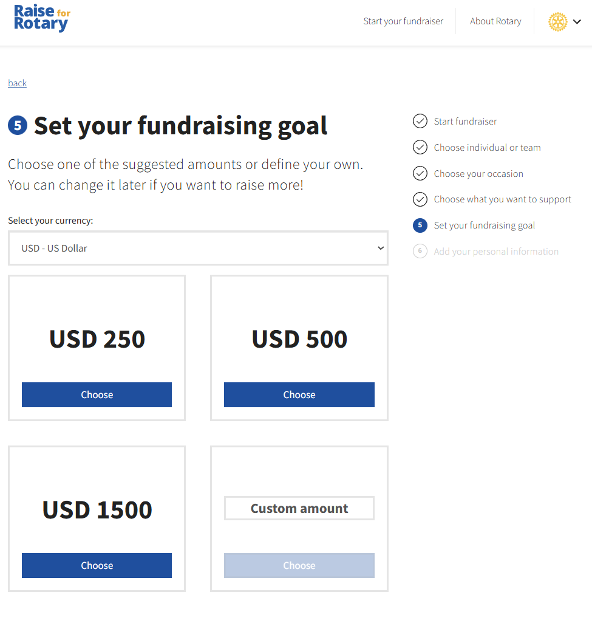
Club – when you click the link you receive by email, the first thing you’ll be see is a page to set your fundraising goal

Slide 31
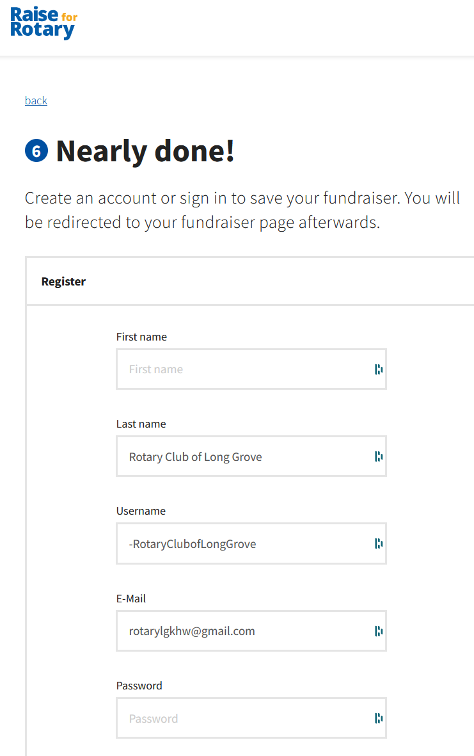
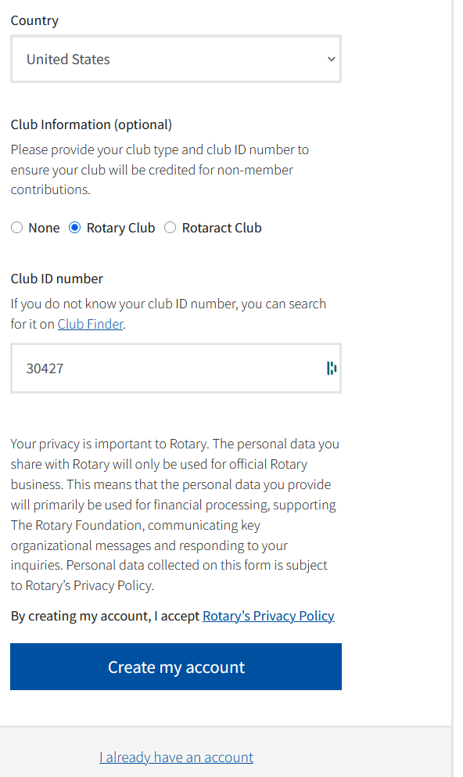
Club:
- Use the name of the Club, not an individual, in the First Name field. Note: 20 character max
- Use the club’s email
- Don’t forget your Club ID number!
Long Grove
Note: 20 character max

Slide 32
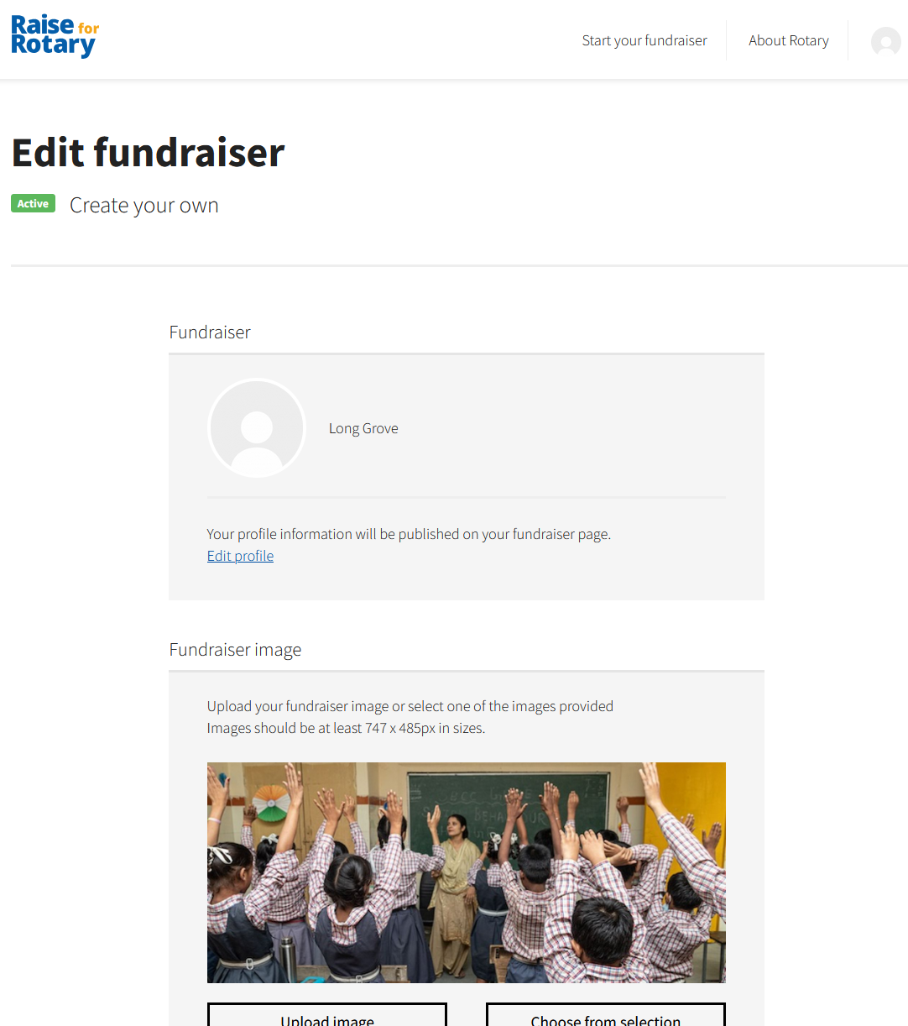
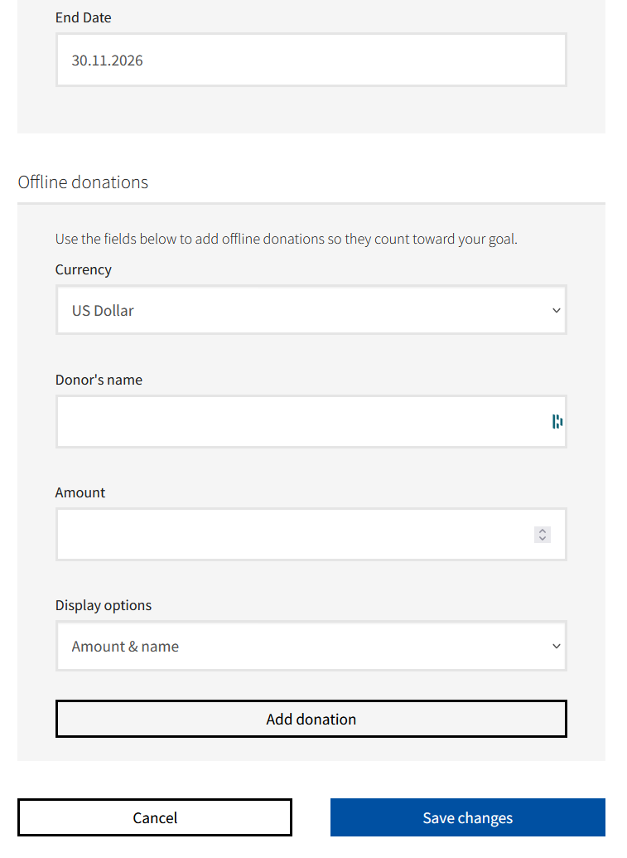
Clubs will report offline donations here, to add them to their totals.

Slide 33
If the Club would prefer that Lyle set up your Raise for Rotary page, you must provide:
Club Fundraising Goal
Club Email Address
Club ID Number

Slide 34

Let’s get started!
Register at rotary6440.org (scan QR code)
Educate your club members and get them excited
Plan and share it
Start recruiting partners
Connect with your local media – plant the seed now and get on their radar
Join our D6440 monthly (or so) calls – Monday, June 29th 6pm https://us06web.zoom.us/j/83547306982?pwd=QMNOcPACWiKjPIZRwmKEar25bdQz03.1
  Meeting ID: 835 4730 6982 Passcode: 516635

