Slide 1


Zone Monthly Check-In Call
Thursday, April 9, 2026
7:30AM

Slide 2

April Agenda
Welcome & Call to Order
Public Image Overview – Kathi Quinn, D6440 Public Image Chair
District Progress Updates
Next Steps – Build up district club participation
Questions
Adjournment

Slide 3

Kathi Quinn,
Public Image
District 6440

Slide 4


Goals for the Walk
We now have 73% of the districts joining us!
Increase awareness of Rotary’s efforts to eradicate Polio
Share consistent talking points on current efforts being made
Raise money to help fund Polio eradication efforts
Illustrate the Power of One

Slide 5
How will we do this?

Slide 6
Use a variety of media outreach to support our goals

Slide 7

Media Outreach
Social Media:
Facebook
Instagram
YouTube
LinkedIn
Traditional Media:
Print
Online
Radio
Community

Slide 8
Media Outreach Targets
Social Media:
Facebook: Photo’s, families
Instagram- teens, young
YouTube – sharable, all ages
LinkedIn – Business, professionals
Traditional Media:
Print – news, events
Online - responses
Radio - alerts
Community – all of the above

Slide 9
Using media COMMUNITY outreach:
Proclamation
How to use the Proclamation:
This is a great photo opp
We will provide a template for you to complete
Generally – onetime use

Slide 10
Using media COMMUNITY outreach:
Press Releases
A press release is simple. It must contain the following info:
WHO
WHAT
WHERE
HOW
WHY

Slide 11
Using media COMMUNITY outreach:
Club, chamber, school news
How to use a Press Release:
Most orgs will have news they share with students, families, members online or in print
We will provide a press release template for you to complete and share
Try to include photos when you can

Slide 12
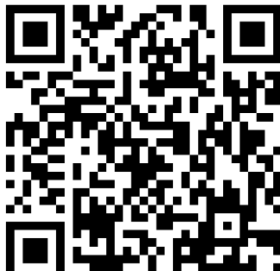
Join Us!
Be creative!
Promote attendees and groups to join you in the walk:
  Send invites (like this postcard!) to Politicians, Healthcare orgs, Schools, Business, Scouts, Families, Clubs by name
  Use on Facebook and LinkedIn as Invites
  Flyers around your town
  Make t-shirts and wear at summer events (concerts, Farmers Markets, Parades)
  with a QR Code!

Slide 13

Steps to keep in motion
Register at rotary6440.org (scan QR code)
Educate your club members and get them excited
Plan and share it
Start recruiting partners
Connect with your local media – plant the seed now and get on their radar
Join our monthly calls the 2nd Thursday of each month at 7:30AM

Slide 14

We are creating a
WLPW customizable checklist & press packet
for you to use
to build momentum in your communities!
“Let’s come together
and make history!”
Thank you!

Slide 15
How to contact me:
Cell 224-238-8990
Work 847-513-6004
Kathi@NorthbrookChamber.org
“Let’s come together
and make history!”
Thank you!

Slide 16


District Progress Reports

Slide 17
Next Steps
Work on recruiting district clubs to get involved – get the word out!
Hold your own monthly district meetings
Establish participant and fundraising “goals”
Identify and recruit community partners
Begin making media and community outreach efforts

Slide 18

Questions

Slide 19

Next Meeting May 14th
7:30AM

