Slide 1
Rotary Foundation District 6540 District Grants 2021-22
Presenter
Mike Crabill
Elkhart Rotary Club – Morning Division
District 6540 Grants Chair

Slide 2
The slides of this Presentation
are available
at
www.rotary6540.org
in the Downloads Section
A recording of this presentation will
Be uploaded to YouTube
Under Rotary District 6540

Slide 3
There are no substantial changes to the District Grant Program for the upcoming Rotary Year 2021-22

Slide 4
Rotary Foundation Grants
Rotary Foundation Makes Two Types of Grants
Global Grants for Large International Projects that involve the cooperation of Two or More Clubs and Districts from around the World (Minimum Budget is $30,000) – RI staff supervise grant
District Grants are intended to support the Projects and efforts of local Rotary clubs in smaller sized projects (Max Grant in D6540 is $3,000) – District 6540 Rotarians supervise projects

Slide 5
What Are District Grants
Rotary Foundation (NOT District) Funds. These $$$ are not from dues.
Each District sets its own rules for participation
Projects are smaller and completed in shorter timeframe (3-6 months)
Projects (hopefully) involve the active participation of the local Rotary Club
Can be done in conjunction with another organization or club

Slide 6
What Do District Grants Support
In addition to Club Projects, Grant Funds Support:
Interact, Rotaract, Earlyact
Rotary Youth Exchange
Summer Scholars – Scholarship Program

Slide 7
Where Do the $$ Come From?
It is a partial return of Contributions to the Rotary Foundation Annual Programs Fund from 3 Years Ago
50% comes back to District 6540
50% of what comes back is eligible to fund District Grants
The other 50% is available to support Global Grant projects of our clubs and Polio Plus
In an Average Year we will have about $75,000 available for District Grant supported activities

Slide 8
District Grant Cycle
Application Window - January1 thru March 31
Application Review – As they are submitted, no decisions on funding until April
Preliminary Approval – May
Final Approval from RI – June
Project Execution – July through May
Final Report – When completed, no later than June 30
Payment to Club – Approval of Final Report

Slide 9
Application Process
Project must fall under one of the Foundation’s 7 Areas of Focus
Water, Health, Literacy, Peace, Disease Prevention, Community Development, Environment
Some activities are NOT permitted – more later
Read Grant Terms and Conditions, RI has Final Decision
Grants Committee reviews and asks questions or requests revisions or gives preliminary OK
Will have more requests than $ available – we will reduce request to match what we have
Clubs that Give More Generously to Foundation have Better Chance of Full Funding – Some Clubs Ineligible to apply due to level of giving

Slide 10
Ineligible Clubs
Clubs not current with RI or District dues are ineligible
Because these funds come directly from the Rotary Foundation, Foundation giving Plays a Role in decision-making
Any Club with three year average giving of less than $50 per capita will not be eligible to receive district grants – club presidents receive a copy of average giving each year
Any club formed in the last five years will be exempt from the average giving requirement and be eligible to apply for a district grant

Slide 11
Prohibited Activities
Purchase of Land or buildings
Fundraising activities
Expenses related to Rotary activities-conferences, anniversary celebrations, etc.
Unrestricted cash donations to an agency
Activities for an expense already paid
Cost of Putting Rotary Signage is over $500.00
Construction where money can be made
Rotary cannot own any equipment purchased

Slide 12
Permitted Activities
Conducting educational seminars
Repair of existing buildings
New construction in parks or public areas
Purchase of equipment for organizations
Food backpack programs
Scholarships (no payments to individuals)
Town Welcome Signs
International projects

Slide 13
Guidelines
Some Do’s and Don’ts

Slide 14
Terms and Conditions

Slide 15
Coordinate with Other Clubs
Project too big for your club? Ask for Help
Multiple clubs can submit grants for the same project
Takes extra planning
Financing gets more complicated
Successful Projects
O’Brien Park - 2 clubs
Book Project Noble County – 3 clubs
Zambia Water Truck – 4 clubs

Slide 16
Plan Your Project
Get two club members committed to project
Plan the scope of activities
Find a way to get Rotarians involved
Get cost and time estimates
Coordinate with any municipal or other entities
Coordinate with other Rotary clubs
Make a plan for Publicity
Have Contingency Plans if we can’t fund your entire request

Slide 17
A Simple Application

Slide 18
A
P
P
L
I
C
A
T
I
O
N
Briefly Describe Project
What Community Needs Addressed and
Which Area of Focus Being Met
How will Rotarians be Involved? Any Partners?

Slide 19
A
P
P
L
I
C
A
T
I
O
N

Slide 20
A
P
P
L
I
C
A
T
I
O
N

Slide 21
A
P
P
L
I
C
A
T
I
O
N
Club President Signs
Complete and Email

Slide 22
Conduct Your Project
Don’t Start before getting final approval
Don’t start before July 1
Don’t spend any money before July 1
Save your receipts!!! Invoices are not receipts
Try to run as many expenses through the club rather than individual members
Do Fundraising if grant is less than expected
If project goes over budget, can we get more Grant money? NO!

Slide 23
What if Things Change
We want all projects completed by June 30
Municipal Timeframes get Changed
Key individual on project leaves
COVID-19 Issues
Fundraising Falls Short
CONTACT US EARLY IN A PROBLEM
We will work to try and accommodate changes
May need to substitute another project
May have to cancel grant

Slide 24
Prepare Your Final Report
Describe what was done
Show what was spent
Attach copies of your receipts
When Treasurer writes a check use memo area
Make sure your numbers match
Sign the report
Scan and email the report

Slide 25
F
I
N
A
L
R
E
P
O
R
T
Example:
We raised $1,000 for
Project but only spent
$800.00.
Answer: Tell us you
Raised $800.00
Must be the same

Slide 26
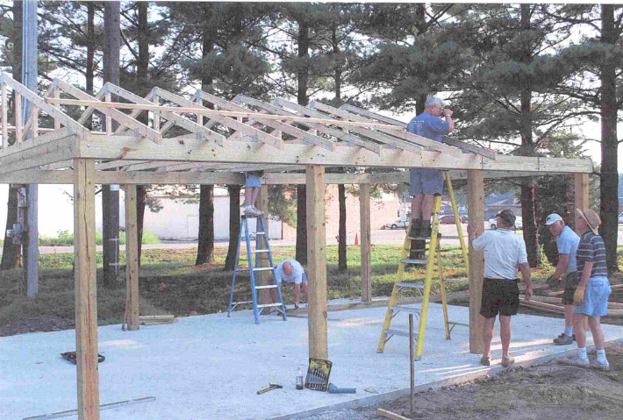
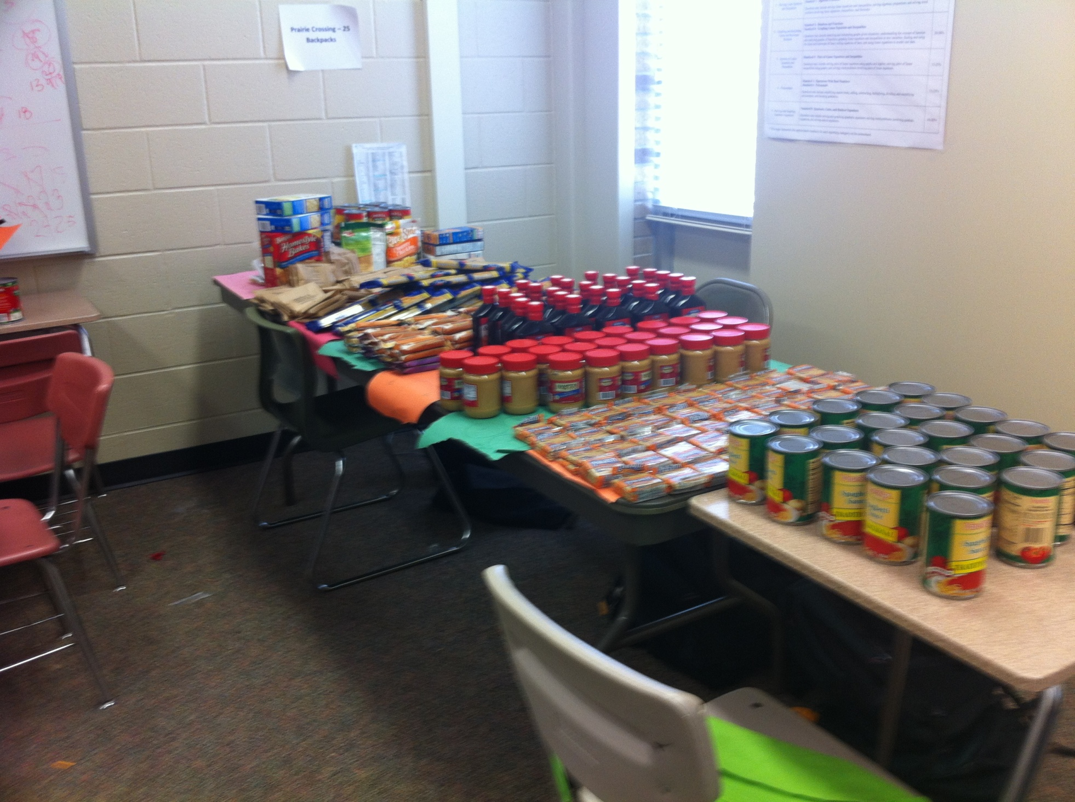
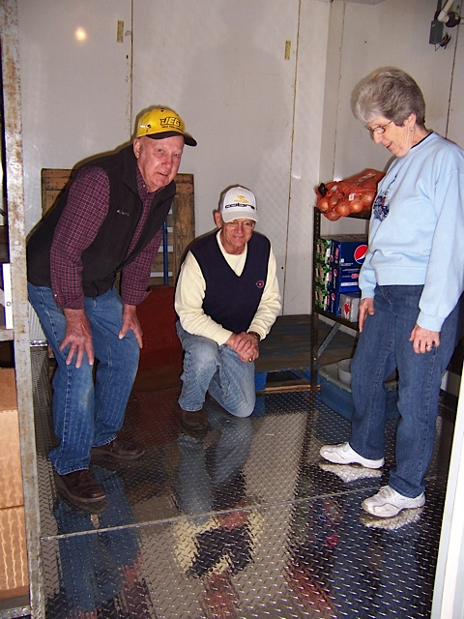
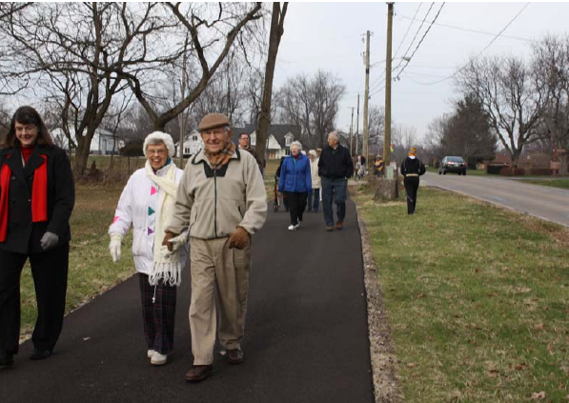
Include Pictures with Report

Slide 27
Getting Your Grant Funds
We operate District Grants as a reimbursement
If we provide funds up front you have to keep them separate from club finances
Be timely in preparing your final report
Check goes to President, Treasurer or Secretary
Rotary allows only one District Grant year to be open at a time – meaning we can’t get funds for the current grant year if last years projects are still open. Your problems become our problems.

Slide 28
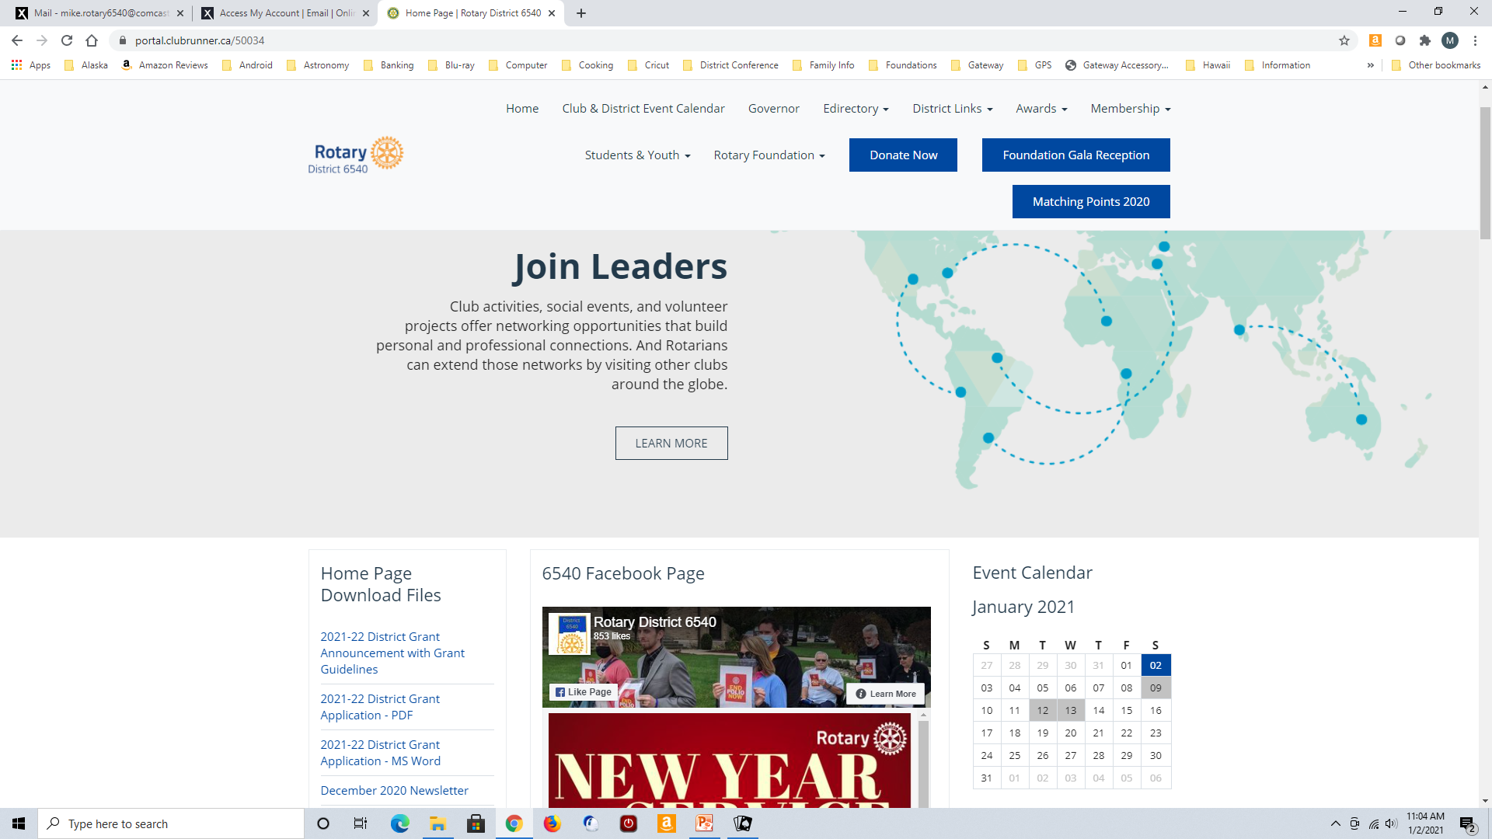
Getting Forms and Info
www.rotary6540.org

Slide 29
Common Mistakes
Income and Expenses don’t match
Buying Equipment, but no Rotary participation
Incomplete set of receipts
Total Grant funds can only supply 75% of Project Cost
Starting too early – Wait until after July 1
Providing way too much detail about project, both in the application and final report
Make Grant Request for Round Amounts, i.e. $950.00 not $947.65. Final Reports should be exact.
No handwritten applications or reports please

Slide 30
QUESTIONS ???
mike.rotary6540@comcast.net
574-229-0910

Slide 31
The slides of this Presentation will be
available tomorrow
at
www.rotary6540.org
in the Downloads Section
A recording of this presentation will
Be uploaded to YouTube
Under Rotary District 6540

