Slide 1
Rotary Foundation District 6540 District Grants 2024-25
Questions?
Contact Holli Seabury, DGE
Rotarianholli@gmail.com
260-760-4831

Slide 2
What Are District Grants
Rotary Foundation Funds.
These $$$ are not from dues, but from donations to the Annual Fund-Share
Each District sets its own rules for participation
Projects are smaller and completed in a shorter timeframe (3-8 months)
Projects (hopefully) will involve the active participation of the local Rotary Club
Can be done in conjunction with another organization or club (see Multiple Clubs Guidelines)

Slide 3
Annual Fund-Share (3 years ago invested by RIF)
47.5% District Designated Funds (DDF)
47.5% RIF World Grants
& Polio Plus
2.5% Administrative
50 % District Grant 50% District
Club Projects Global Grants
Rotaract, Interact & Polio Plus
Youth Programs
Summer Scholars
Rotary Youth Exchange

Slide 4
District Grant Cycle
Application Window – January 1 thru March 31
Application Review – As they are submitted, no decisions on funding until April
Preliminary Approval – May
Final Approval from RIF – June
Project Execution – July through May
Final Report – When completed, no later than June 24
Payment to Club – Upon Approval of Final Report

Slide 5
Application Process
Project must fall under one of the Foundation’s 7 Areas of Focus (Pick ONE)
Economic Development
Education
Environment
Health
Peace and Conflict Resolution,
Water
Community Development

Slide 6
Application Review
The Grants Committee reviews, asks questions, or requests revisions & gives preliminary OK
We often have more requests than $ available – we will reduce request to match what we have
Clubs that Give More Generously to the Foundation have Better Chance of Full Funding

Slide 7
Examples: Eligible Activities
Conducting educational seminars
Repair of existing buildings
New construction in parks or public areas
Purchase of equipment for organizations
Food backpack programs
Scholarships (no payments to individuals)
Town Welcome Signs
International projects

Slide 8
Examples: Ineligible Activities
Purchase of Land or buildings
Fundraising activities
Expenses related to Rotary activities-conferences, anniversary celebrations, etc.
Unrestricted cash donations to an agency
Activities for an expense already paid
Cost of Rotary Signage over $500
Construction where money can be made (i.e., a business like a concession stand)
Rotary cannot own any equipment purchased

Slide 9
ELIGIBLE PROJECTS | INELIGIBLE PROJECTS
Revolving loans/microcredit | Establishment of a foundation, permanent trust, or long-term interest-bearing account
Short-term rent or lease of buildings | Purchase of land or buildings
Construction of infrastructure such as service roads, wells, reservoirs, dams, bridges, latrines, toilet blocks, water supplies, and other similar structures | Construction or renovation of any structure in which individuals live, work, or engage in any gainful activity. This includes buildings, containers, mobile homes, or structures where individuals carry out any type of activity such as manufacturing, processing, maintenance, or storage, including provision of new services or upgrade of facilities
Purchase of equipment or appliances | Provision of plumbing or electrification inside buildings
Short-term and/or contracted labor for project implementation | Salaries for individuals working for another organization
Administrative expenses for project activities | Operating or administrative expenses of another organization
Primary and secondary education, tuition, transportation | Postsecondary education activities, research, or personal or professional development
Domestic travel | International travel (except Volunteer Service and 3-H Grants)
Detailed, itemized expenses | Contingencies, miscellaneous expenses
Assistance to land mine victims | Land mine removal
Publicity expenses such as newspaper fees, or printing of posters, brochures, or fliers to inform the community of an available service | Rotary signage (In excess of $500.00)
Vaccines and immunizations, if the project is consistent with the criteria, procedures, and policies of the PolioPlus program and World Health Organization | Transportation of vaccines or immunizations by hand over national borders
New Rotary-sponsored projects not already in progress or completed | Projects already undertaken and in progress, existing projects, activities primarily sponsored by a non-Rotary organization, or projects already completed
Maternal and prenatal health and education | Purchase and distribution of birth control devices and ultrasound equipment for use in sex determination
Budgeted and itemized humanitarian goods | Unspecified or cash donations to beneficiaries or cooperating organizations
Humanitarian or service activities benefiting a community in need | Fundraising activities, expenses related to Rotary events such as district conferences or anniversary celebrations or entertainment activities that do not include a humanitarian aspect
Secular, nonreligious activities that benefit a community in need | Projects that support purely religious functions at churches and other places of worship

Slide 10
Guidelines and Resources
Apply on the district website: www.rotary6540.org
Go under the Grants tab at the top of the page for links related to District Grants and the online application.
Please review before you start writing your
2024-25 grant!

Slide 11
Ineligible Clubs
Clubs not current with RI or District dues are ineligible
Because these funds come directly from the Rotary Foundation, Foundation giving plays a Role in decision-making
Any Club with three-year average giving of less than $50 per capita will not be eligible to receive district grants – club presidents receive a copy of average giving each year
Any club formed in the last five years will be exempt from the average giving requirement and will be eligible to apply for a district grant

Slide 12
Coordinate with Other Clubs
Project too big for your club? Ask for Help
Multiple clubs can submit grants for the same project
Takes extra planning & coordination
Financing gets more complicated
Please talk to the Grant Committee first if you plan to submit a joint grant.
Successful Projects in past years:
Habitat for Humanity Playground—4 Clubs
Playground Equipment—2 clubs
Mobility Cycles—2 clubs

Slide 13
Plan Your Project
Get two club members committed to project
Plan the scope of activities
Find ways to get Rotarians actively involved
Get cost and time estimates
Coordinate with any municipal or other entities
Make a plan for Publicity
Have Contingency Plans if we can’t fund your entire request

Slide 14
Conduct Your Project
Don’t Start before getting final approval
Don’t start before July 1
Don’t spend any money before July 1
Save your receipts!!! Invoices are not receipts. Must show payment has been made, with copies of checks or credit card receipts.
Try to run as many expenses through the club rather than individual members
Do Fundraising if grant is less than expected
If project goes over budget, can we get more Grant money? NO!

Slide 15
What if Things Change
We want all projects completed by June 24, 2025
Municipal Timeframes get Changed
Key individual on project leaves
COVID Issues still affecting supply chains
Fundraising Falls Short
CONTACT US EARLY IF THERE’S A PROBLEM
We will work to try and accommodate changes
May need to substitute another project
May have to cancel grant

Slide 16
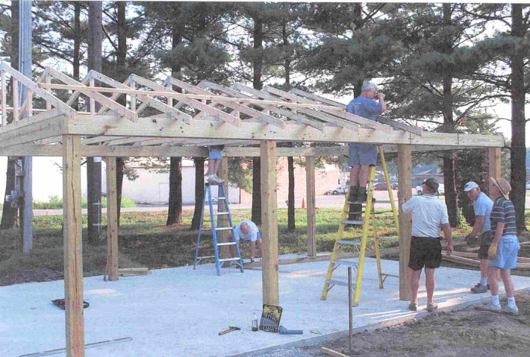
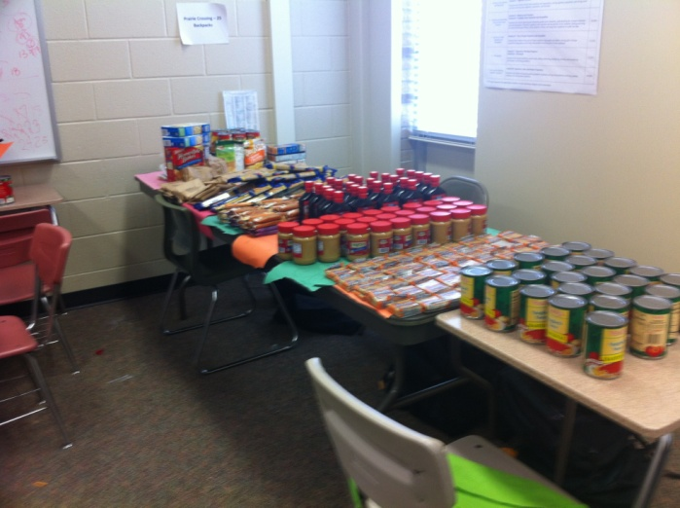
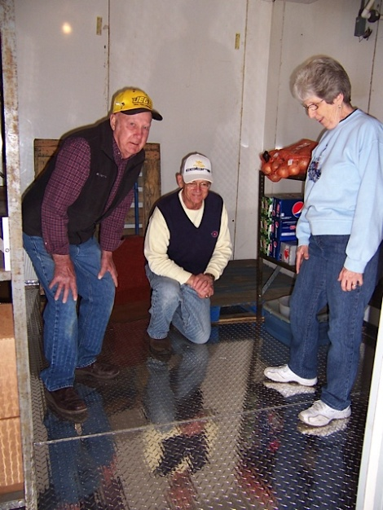
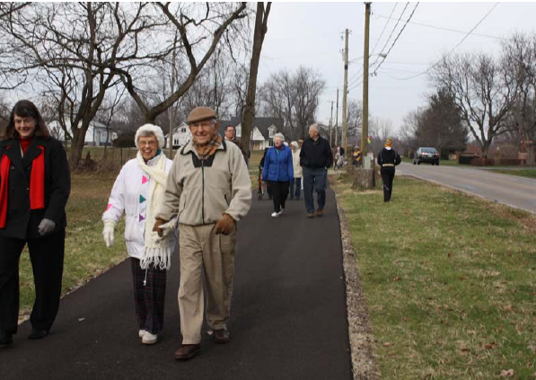
Email 2-3Pictures with Report

Slide 17
Getting Your Grant Funds
District Grants operate as a reimbursement
Be timely in preparing your final report
Funds will be direct-deposited to Club’s checking account in 2024-25. Please provide a voided check if you did NOT receive a grant in 2023-24, or if your club opened a new checking account in 2023.
Rotary allows only one District Grant year to be open at a time – meaning we can’t get funds for the 2024-25 grant year if 2023-24 projects are still open. Your problems become all our problems.

Slide 18
Common Mistakes
Income and Expenses don’t match
Buying Equipment, but no Rotary participation
Incomplete set of receipts
District Grant funds can only supply 75% of
Project Cost
Starting the project too early – Wait until after July 1
Providing way too much detail about project, both in the application and final report
Make Grant Request for Round Amounts, i.e. $950 not $947.65. Final Reports should be exact.
No handwritten applications or reports please

