Slide 1
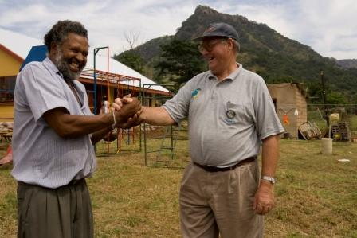
District 6540
Grant Management Seminar
Doing International Grants

Slide 2
Objectives
Understand how to manage a Rotary Foundation grant
Learn Stewardship expectations
Prepare Clubs to Plan good Projects
Qualify Clubs to receive grant funds

Slide 3






Areas of Focus
Peace and conflict prevention/resolution
Disease prevention and treatment
Water and sanitation
Maternal and child health
Basic education and literacy
Economic and community development

Slide 4
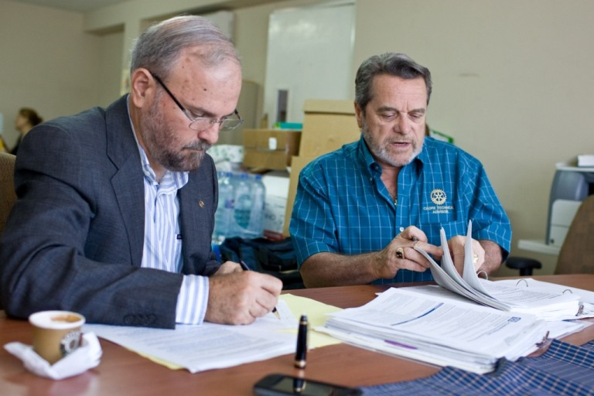
Grant Management
Ensures that projects
Have proper financial control
Adhere to technical standards
Meet the needs of the
beneficiaries
Fulfill their objectives
Safeguard funds

Slide 5
Successful Grant Projects
Meet community needs
Involve partners with same vision
Include frequent partner communication
Have implementation plan
Are sustainable beyond the grant
Maintain proper stewardship of funds

Slide 6
Stewardship

Slide 7
Stewardship
Stewardship is the responsible management and oversight of grant funds, including:
  Rotarian supervision
  Financial records review
  Oversight of funds
  Reporting irregularities
  Timely submission of reports

Slide 8
Designing a Project

Slide 9
Needs Assessment
Base project on the community’s need
Assess resources of your club and potential local or international partners
Talk to the community beneficiaries

Slide 10
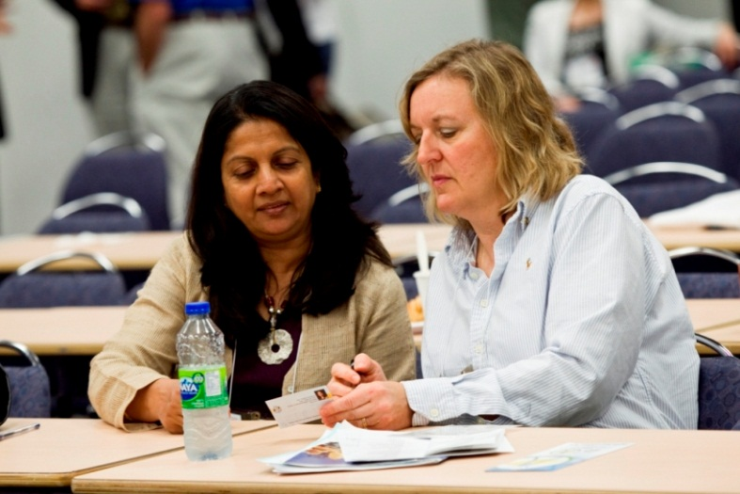
Finding Partners
RI Convention
Project Fairs
Heart 2 Heart Program
Matchinggrants.org
Church Affiliated Groups
Rotary Showcase / Facebook
Local Organizations
D6540 Rotary Clubs

Slide 11
Project Planning
Form a 2-3 person grant committee
Assign roles
Implementation plan
Budget
Contingency plan
Document retention plan

Slide 12

Setting Goals
Measurable
Sustainable
Qualitative (descriptive)
Quantitative (numeric)

Slide 13

Creating a Budget
Realistic
Competitive bidding
Reasonable prices
Disclose conflicts of interest

Slide 14
Conflict of Interest

Slide 15
Conflict of Interest
Exists when a Rotarian benefits financially or personally from a grant
Benefit can be direct (the Rotarian benefits) or indirect (an associate of the Rotarian benefits)
Conflicts can be a matter of Perception

Slide 16
Applying for and
Implementing a Grant
Notes:
The order of this session is really confusing and out of order. I think this is going to need work. I am happy to help with reordering if you like.

Slide 17
Rotary Foundation Grants
District grants
Global grants

Slide 18
Applying for District Grants
Rotary Year 2016-17
Maximum Grant to be $3,000
Application download from www.Rotary6540.org
Reflect one of 6 areas of focus
Address Sustainability
Rotarians MUST participate in the grant
Grant Award cannot be more than 75% of Budget
Application Window 1/1/16 thru 3/31/16

Slide 19
Applying for District Grants
Rotary Year 2016-17
Approved by Rotary Foundation Spring 2016
Grant Activities may commence 7/1/2016
Grant should conclude before 6/30/17
Grant request may be reduced by demand
Grant request may be reduced by Foundation Giving

Slide 20
District Grants
Important Points
Don’t Start before July 1
We want to get away from just “Buying Things”
We want Rotary visibility with project
We want Rotary “Hands-On”
Finish Your Projects by June 30

Slide 21
Global Grants 2014-15
Ongoing application process - no deadline
Application process completely online
Meet goals of area of focus
Be sustainable
Involve Rotary clubs in two districts
Minimum budget of US$30,000
Both clubs must be qualified

Slide 22
Qualification Requirements
Attend a grant management seminar
Agree to club memorandum of understanding and submit signed MOU to district

Slide 23
Terms of Qualification
Valid for one year
Club has responsibility for grant funds
Disclose conflicts of interest
Cooperate with all audits
Use grant funds properly
Implement the club MOU

Slide 24
Applying for Global Grants
Submit grant proposal through MY ROTARY
Talk to District BEFORE starting application to determine what amount of District Funds are available to budget
District must confirm club is qualified

Slide 25
Global Grant Financing
DDF matched 100% with World Fund $$$
Cash contributions matched
50% with World Fund $$$
Cash Contributions have 5% Surcharge
What Currency will be used

Slide 26
Financing Guidelines
Contributions raised by Rotarians
Funds cannot be raised from beneficiaries in exchange for a grant
Funds cannot come from other grants
Host Club minimum $100
International Partners minimum 30% of Total Budget

Slide 27
Sustainable Projects
Giving a community the skills and knowledge to maintain project outcomes for the long term, after grant funds have been expended

Slide 28
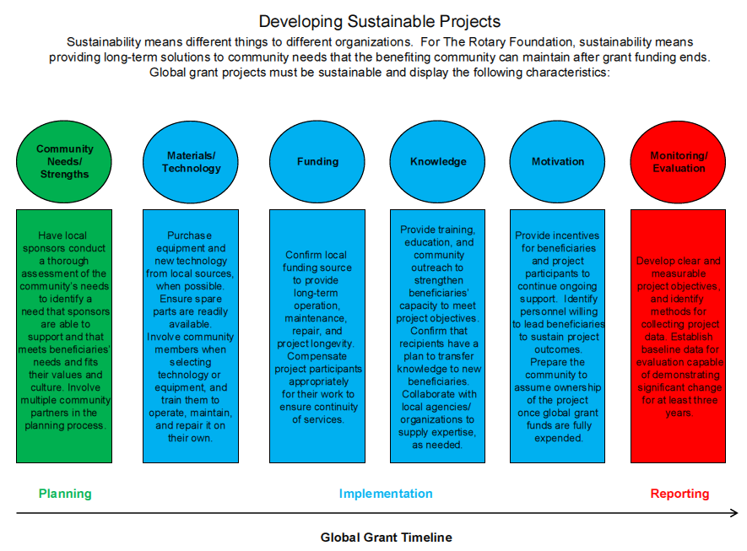

Slide 29
Global Grant First Steps
Complete a Memorandum of Understanding

Slide 30
Memorandum of Understanding
You Agree To
Provide Proper Stewardship of Funds
Avoid Conflict of Interest
Segregate Grant Funds from Club Funds
Proper Dispersal of Funds
Inventory Equipment Purchases
Proper Bank Account – 2 Signatories
Adhere to Reporting Requirements
Maintain Documents – 5 years

Slide 31
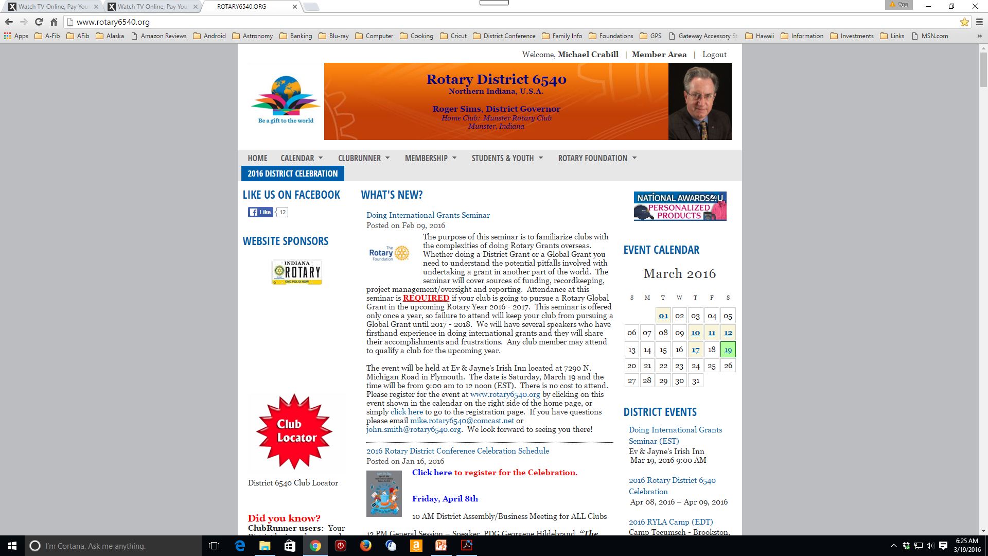
Memorandum of Understanding
Scroll down
www.rotary6540.org

Slide 32
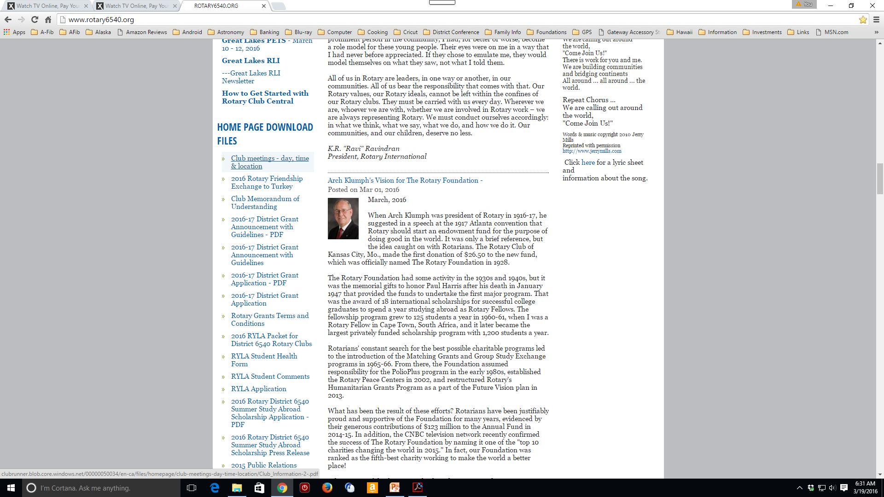
Memorandum of Understanding

Slide 33
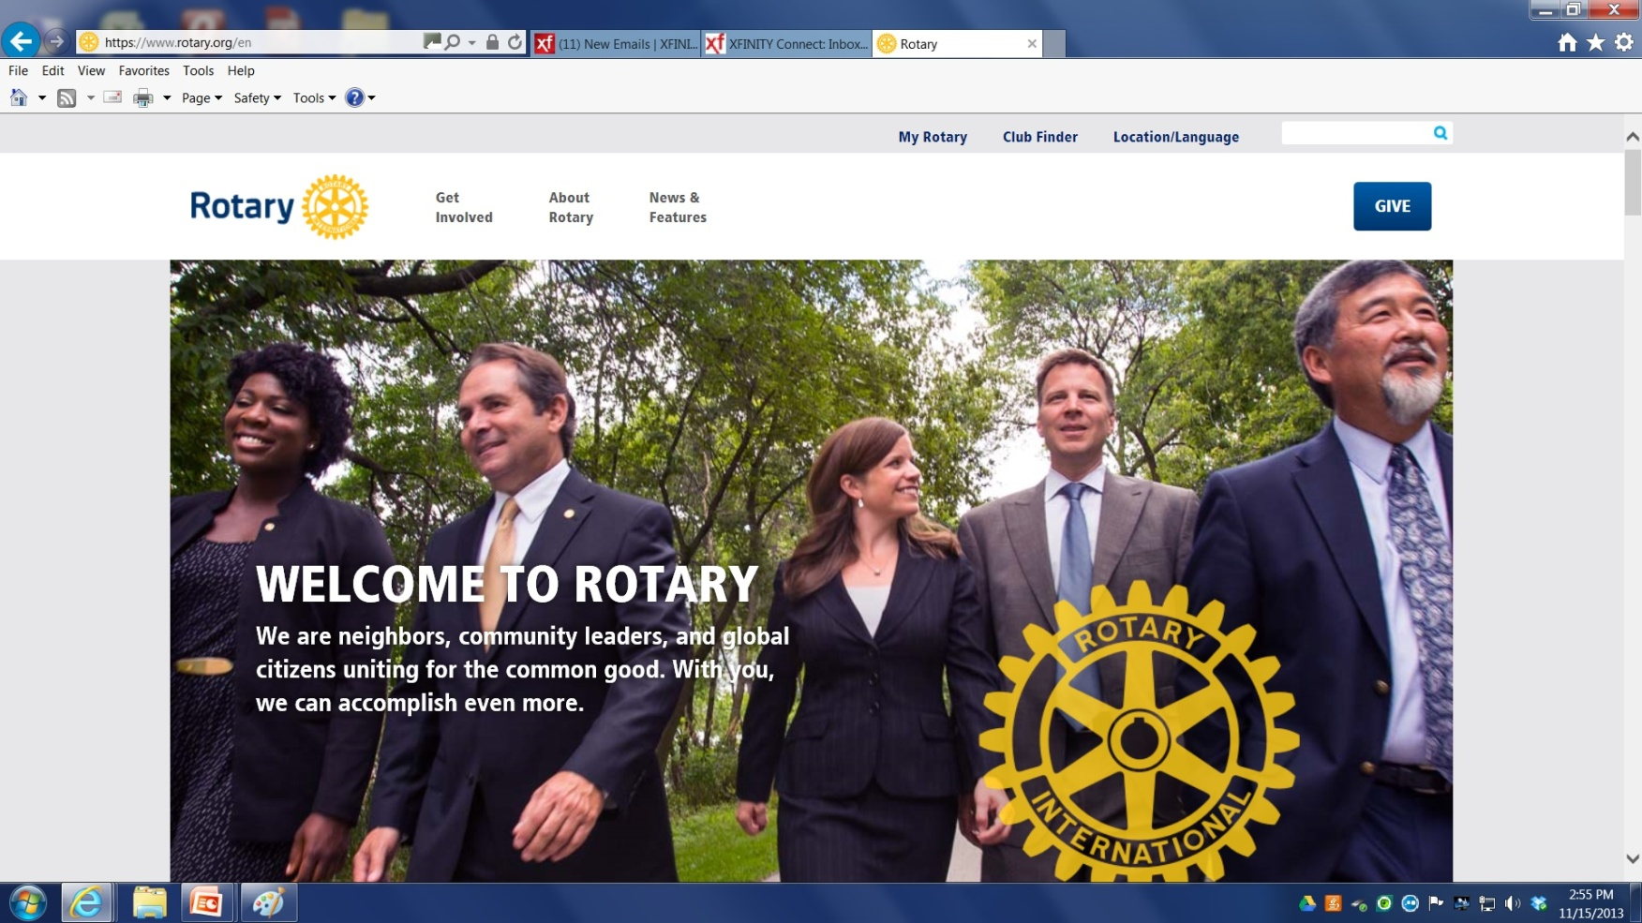
Global Grant First Steps

Slide 34
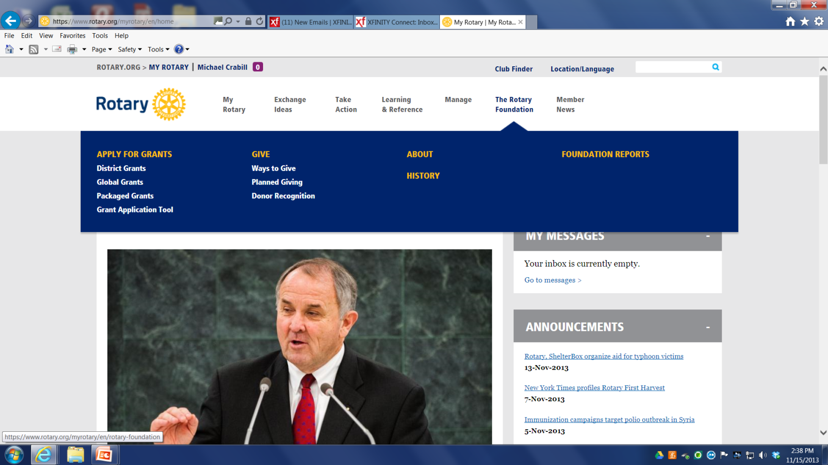
Global Grant First Steps

Slide 35
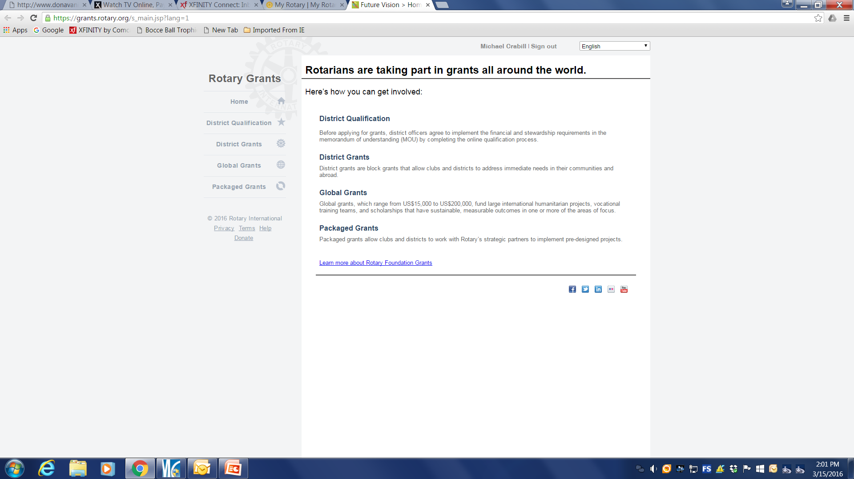
Global Grant First Steps

Slide 36
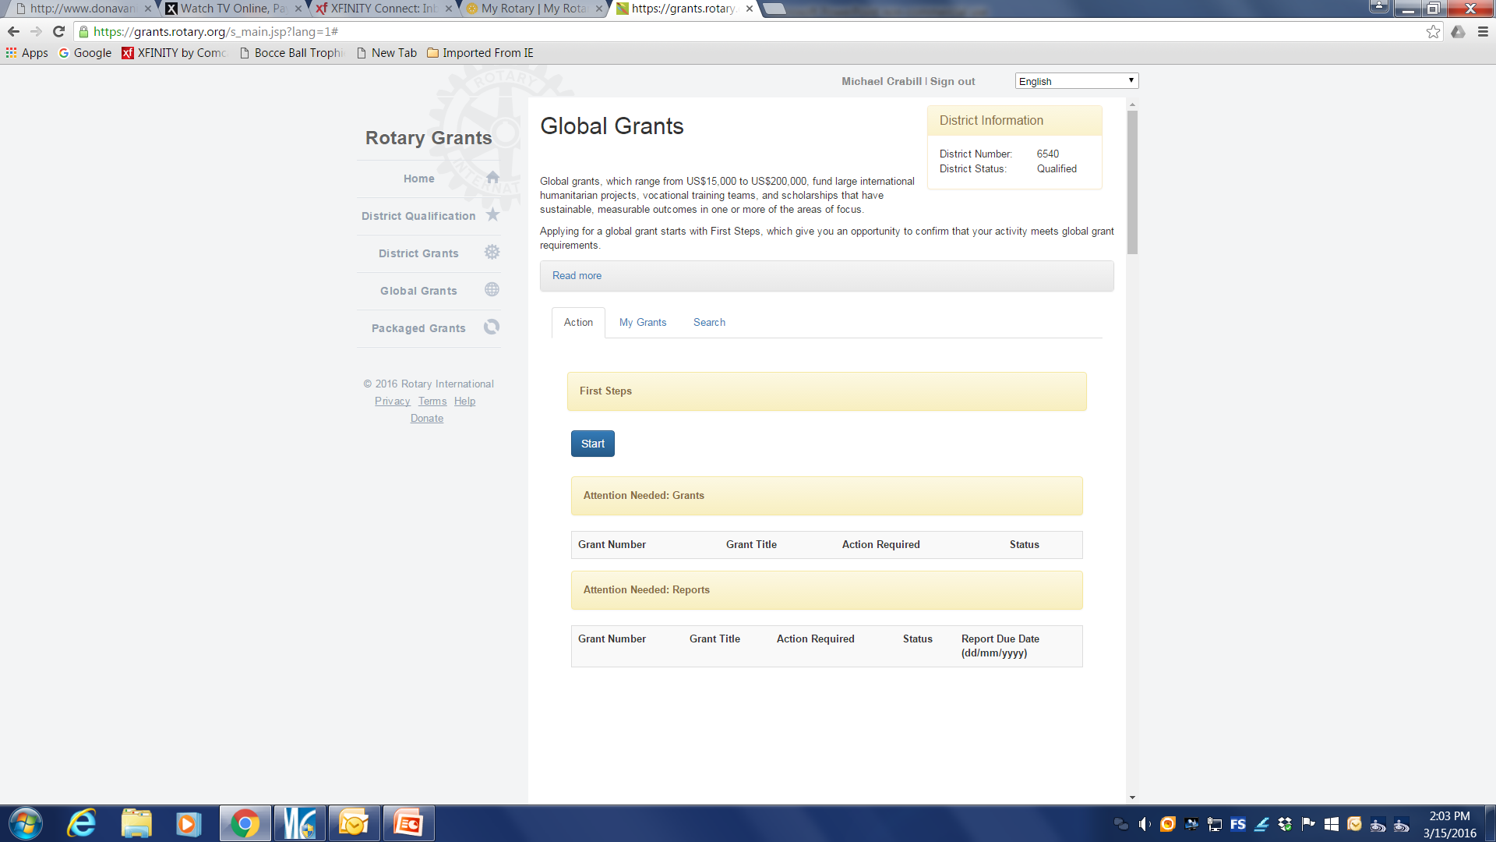
Global Grant First Steps

Slide 37
Global Grant Application
OBJECTIVES
AREAS OF FOCUS
PARTICIPANTS
BUDGET
FINANCING
AUTHORIZATIONS

Slide 38
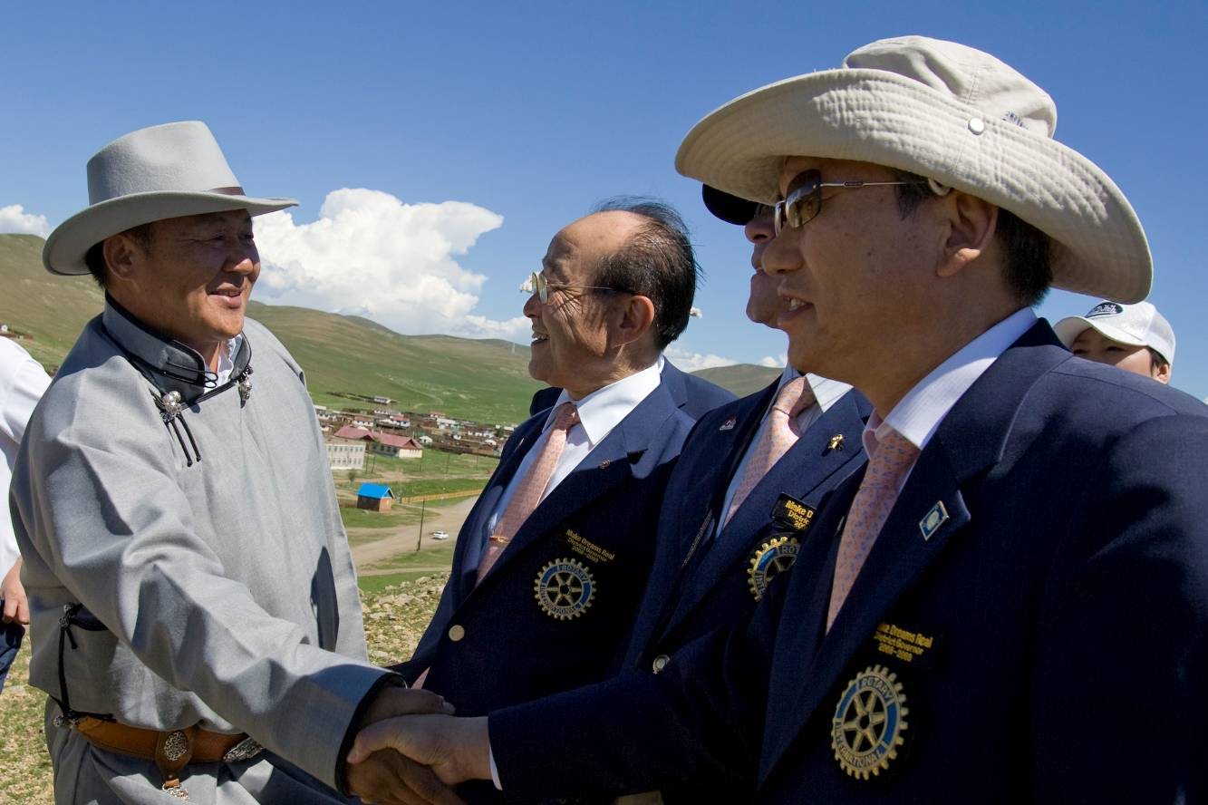
Implementation
Communication
Financial management plan
Recordkeeping
Following original plan

Slide 39
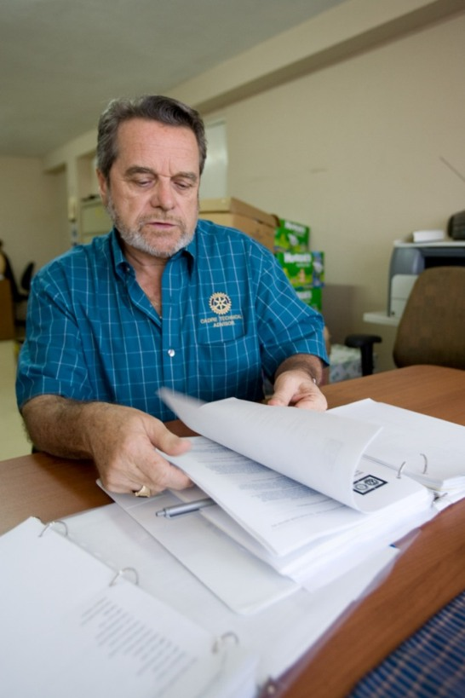
Evaluation
Assists with reporting
Improves future projects
Based on goals
Ongoing process
Identifies successes

Slide 40
Oversight and Reporting

Slide 41
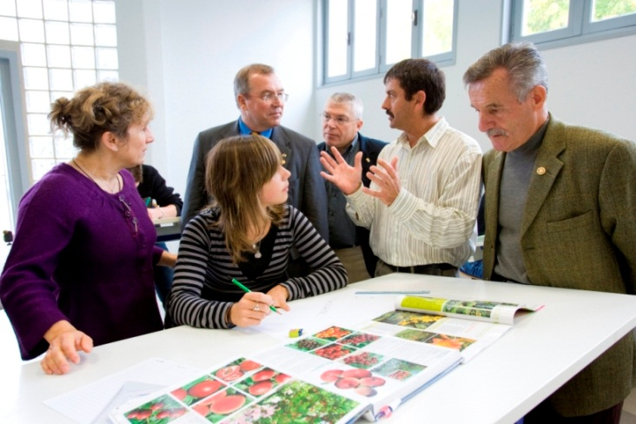
Financial Management Plan
Bank account for funds
Distributing funds
Use checks/bank cards to track funds
Detailed ledger
Observe local laws

Slide 42
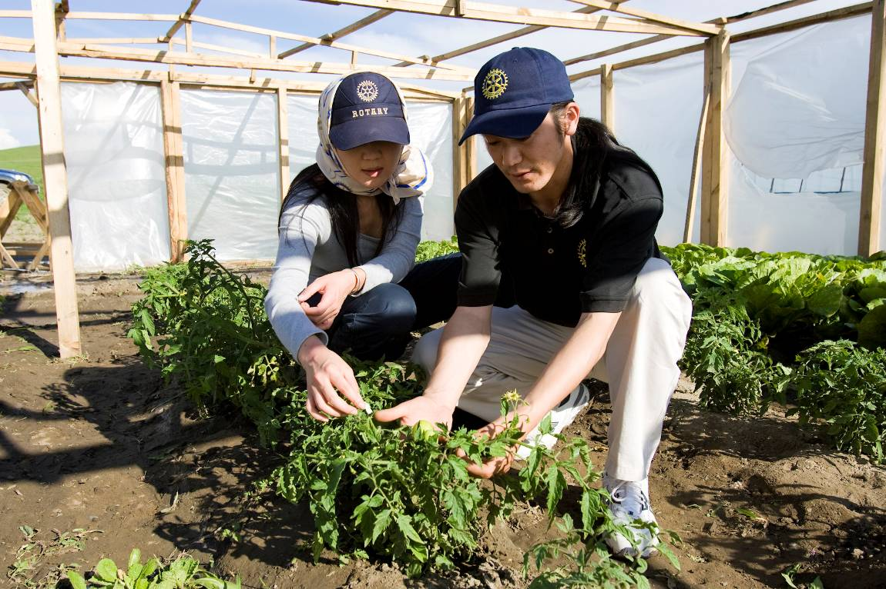
Resources
Document retention worksheet
Financial management plan worksheet
Transferring custody of a bank account
More on Rotary.org
Terms & Conditions

Slide 43

Document Retention
Provide access
Retain for a minimum of five years
Make copies
Use the “Cloud”

Slide 44
What if Things Change?

Slide 45
District Grant Reports
Simple report documenting:
  Objectives
  Rotary Involvement
  How dollars were spent
  How goals were met
  Receipts for expenditures
  Interim reporting after 6 months
  Final report within 2 months of completion

Slide 46
Global Grant Reports: Frequency
Progress reports
  Within 12 months of first payment
  Every 12 months through the life of the grant
Final report within 2 months of completion

Slide 47
Global Grant Reports: Content
How partners were involved
Type of activity
Evaluation of project goals
How area of focus goals were met
How funds were spent
Number of beneficiaries and how they benefited

Slide 48
Grant Flow of Funds
District Grants
Project cannot start until approved
Cannot apply to an already completed project
List of eligible and ineligible projects
Grant is reimbursement, not up front
Global Grants
Submit Application
Review by RI
Questions/Concerns Addressed
Application Approvals
Funds usually dispersed at beginning of grant to Rotary Club where work is to occur
Funds must be maintained in separate restricted account

Slide 49

Resources

Slide 50
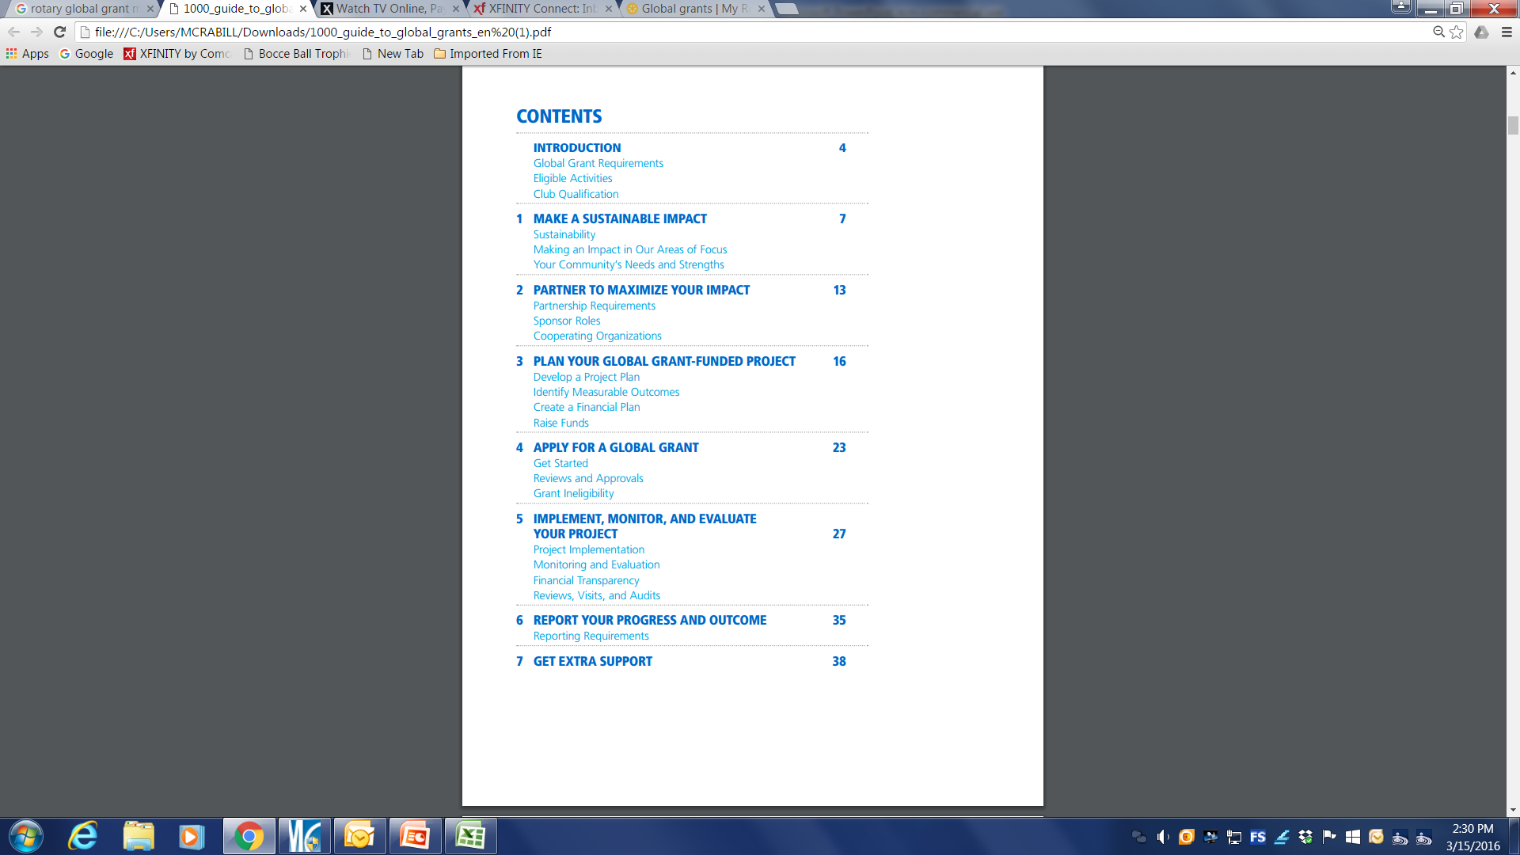
Resources

Slide 51
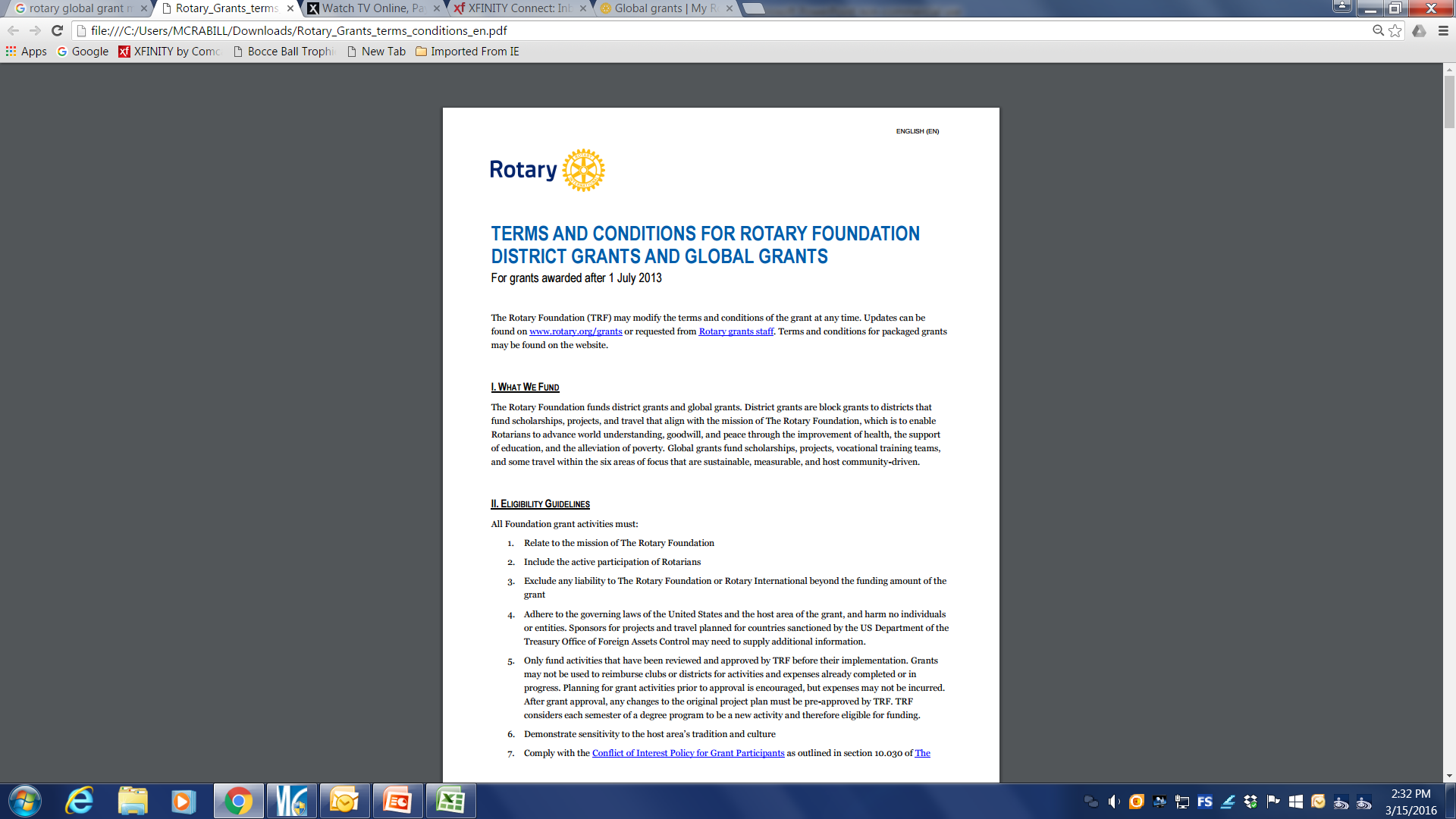
Resources

Slide 52
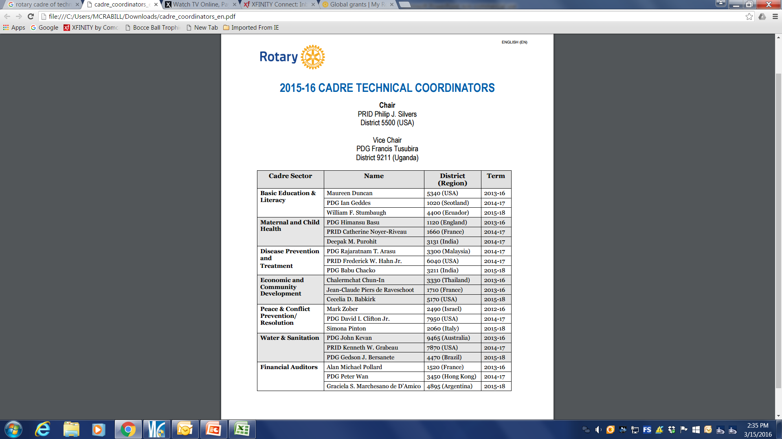
Technical Oversight

Slide 53
Some Individual Perspectives

Slide 54
Getting Home
US 31 North

