Slide 1
Notes:
I would like to welcome everyone to our first ever certification webinar. Given the size of our district we are hoping this is a good way to reach as many of you as possible.
Some housekeeping. On the right side of your screen you will see a side bar. Please mute your microphone. On the webinar with me today is District grants chair Kim Giffen and Global grants chair Colin Thacker. This is the same presentation we provided at the district leadership weekend.
We are going to be requesting attendance at the beginning as well as another time during the webinar. To receive foundation funding you must complete this webinar and also submit an MOU from your club. This was provided to you in the email that went out on Sat June 24th. Please have your President and President elect sign this form. Also please insert the name of your club and save it as a PDF and send it to me. Once that is completed I will enter your names into the system and you can commence your request for funding.
I would also want to point out that we have five handouts with this webinar. These may help you understand your responsibilities when using foundation monies.
Can I ask everyone to please look down the side bar on the right side of your screen and you will see a box in which you can write questions. We will try to get to as many of these as possible but please provide your name so we can answer these after the webinar if needed.
I would like to start the webinar by asking that you sign in with your name and your club. This will be my record of attendance and I will be matching these names up later in the webinar.
So let’s get started.

Slide 2
Agenda
The Rotary Foundation
Role of the Rotary Foundation Club Chair
District Grants
Global Grants
Notes:
This is the agenda for tonights meeting.

Slide 3
Notes:
What I find interesting in this mission are the words enable and advance.
The foundation is there to support the work of Rotarians. Just like you as district leaders are here to support the clubs. The foundation is also a support which facilitates the work accomplished. All work must “advance” must “move the world forward” in developing understanding and peace. Instead of needing to provide six areas of focus to memory – only remember three – health, education, and poverty. After all these are the “main issues” that create barriers to peace.

Slide 4
Notes:
Our Foundation is dedicated to six causes — or areas of focus — that build international relationships, improve lives, and promote a more peaceful world.
Often clubs will focus on one of these areas. You can use that excitement build support for the foundation.
The Rotary Foundation can help turn the passion you have for a specific cause into a reality by spearheading efforts in these areas, and The Rotary Foundation is here to make it possible.

Slide 5
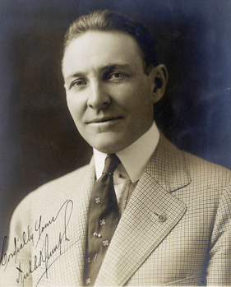
Arch Klumph’s Vision — 1917
It seems eminently proper that we should accept endowments for the purpose of doing good in the world, in charitable, educational or other avenues of community progress …
— Arch Klumph, 1917
Notes:
Arch Klumph is called the father of the Foundation because he had the vision of a Rotary endowment fund and the dedication to bring this dream to life.
As president of the Rotary Club of Cleveland, Ohio, USA, in 1913, he advocated for the club to build a reserve that would ensure its means to do future good work. As president of Rotary in 1916-17, he proposed this idea to a larger audience.
In his speech to the 1917 convention in Atlanta, he said the quote you see on the screen
Arch’s vision of an endowment would eventually become The Rotary Foundation, and his call for “doing good in the world” was to become the Foundation’s motto. But it would take some time for all of that to happen.

Slide 8
Notes:
The generosity of our members and the good work that we do have not gone unrecognized. Our Foundation is carefully overseen by your fellow Rotarians on the Board of Trustees. They ensure that your donations are invested well and spent wisely to do good in the world.
In 2016, we received top ratings from Charity Navigator, the leading evaluator for nonprofits in the U.S., in recognition of our exceptional impact, accountability, and transparency.
The Association of Fundraising Professionals named us the World’s Outstanding Foundation, and CNBC named us one of the top 10 charities changing the world for the second consecutive year.
Plus, in 2016-17, the Foundation celebrated its centennial year — a milestone that few other organizations reach.

Slide 9
Notes:
No matter how you choose to give, I hope you will join me in supporting our Foundation with a gift to the Annual Fund this year. Remember, gifts of any size have a big impact when they’re leveraged through our Foundation and our network of Rotarians here and around the world.

Slide 10
Notes:
Not all clubs have a foundation chair and I realize those clubs on this webinar support the foundation but here is how the foundation chair can help and the information they have access to.

Slide 12
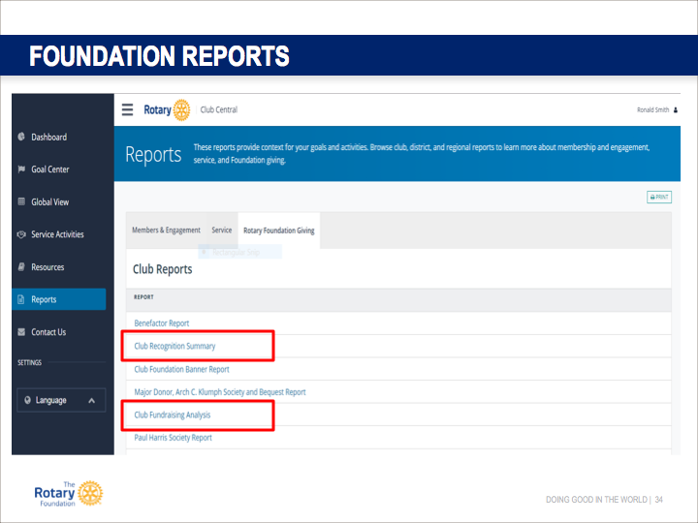
Notes:
Here are some of the reports that are available to clubs on the Rotary international site.

Slide 13
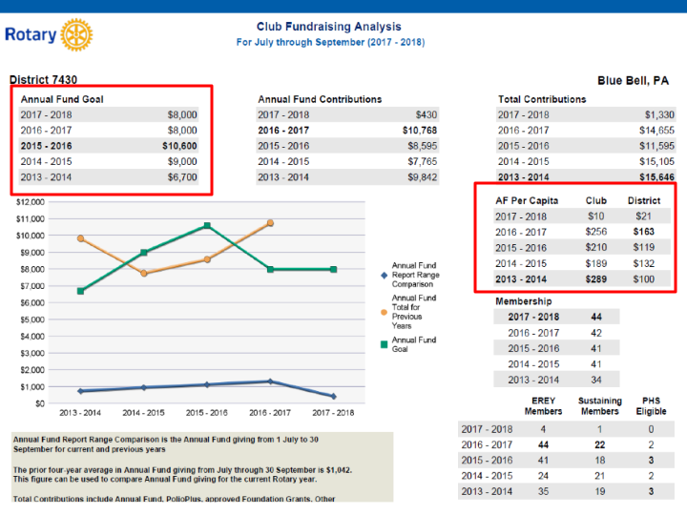
Notes:
This is a very handy report that provides you with information on trends in your club. It is all there: membership, annual fund goals and past years achievements, and per capita amounts. In the bottom corner you can see how many of your members are annual donors.

Slide 14
Notes:
One of the most commonly used reports is the Club Recognition Summary.
Many club leaders utilize the Club Recognition Summary to identify current club members who may be approaching a new recognition level as a way to encourage them to new heights in Rotary support.
However, a very common confusion with this report is that amounts shown represent dollars given. While there is often some correlation, that is not always true. This is because the “recognition amount” column would also reflect any points that have been transferred to people without them giving to the Foundation. Similarly, the “points available” column could show blank for someone who has given thousands of dollars if that donor has already given away all their resulting points to recognize community leaders with Paul Harris

Slide 15
Notes:
Because Rotary International has identified that Rotary Club Central is an Integral part of gaining information it is vital that you insert your goals. It is so important that many districts in our zone have now made it a criteria to apply for a district or global grant. We are also moving in this direction. So you can write your district or global grant but we will be looking to see if you have also entered your information into Rotary Club Central.

Slide 16
Notes:
Many of you probably focused on the mention of presentations. That’s understandable – good presentations help us inspire people to use the Foundation. Videos do that wonderfully.
Rotary has a talented communications staff that works to produce high-quality videos to help you tell the story of the Foundation. You can write down this address, or simply google search for “Rotary vimeo.”

Slide 18
Notes:
Where does funding come from ?
It comes from you.
Some funding goes straight through to the program such as polio, scholarships. It is the annual fund that drives the engine that powers the grants.
This is called the district designated fund or DDF and how much we get to spend on grants and scholarships and polio depends on how much you and your clubs give.

Slide 19
Notes:
Gifts to the Endowment Fund are held in perpetuity as part of an endowment. They are professionally invested, with a portion of the earnings used each year for purposes specified by the Trustees and the donors.
The Endowment Fund offers donors a way to create their own lasting legacy through Rotary.

Slide 20
Notes:
Contributions to the Annual Fund support local and international grants and activities through the SHARE system.
Contributions are credited to the individual donor and the donor’s club and counted toward the club’s and district’s Annual Fund goals.

Slide 21
Notes:
Funds collected – held for 3 years – impact of this process relating to expenses and amount available for project funding.
Once our district receives this money it is divided into 2 pots. One for district grants and the other for global grants and scholarships as well as any polio contribution we wish to make.
The other half of the money (the half that Rotary keeps) is used to fund our fight against polio, global grants, and scholarship programs.
When you apply for a grant that money is doubled or tripled and clubs are happy that Rotarians have access to this funding to help those in need but this can only occur if Rotarians and clubs give to the foundation.

Slide 23
Notes:
This is likely one of the most familiar programs to many Rotarians - What happens when we combine the energy, enthusiasm, and passion of our members? The world community pays attention.
The World Health Organization (WHO) realized the power of Rotary when we raised $247 million in the mid-1980’s for polio eradication. And with the Polio Eradication Fundraising Campaign launched in 2002-03, we raised over $130 million more. We have mobilized volunteers, communities, governments, and even warring factions in more than 90 countries to combat polio. W-H-O was so impressed that it joined in partnership with Rotary to launch the largest public health initiative in history.

Slide 24
Notes:
Chulalongkorn University, Thailand (certificate program)
Duke University and University of North Carolina at Chapel Hill, USA
International Christian University, Japan
University of Bradford, England
University of Queensland, Australia
Uppsala University, Sweden
Each year Rotary selects 100 professionals from around the world to receive fellowships to study at one of our graduate program. 50 are master’s programs lasting from 12-24 months and have an internship for three months in their field of study
. And 50 are certificate programs. These last 3 month and have a fieldwork placement of 2-3 weeks.

Slide 25
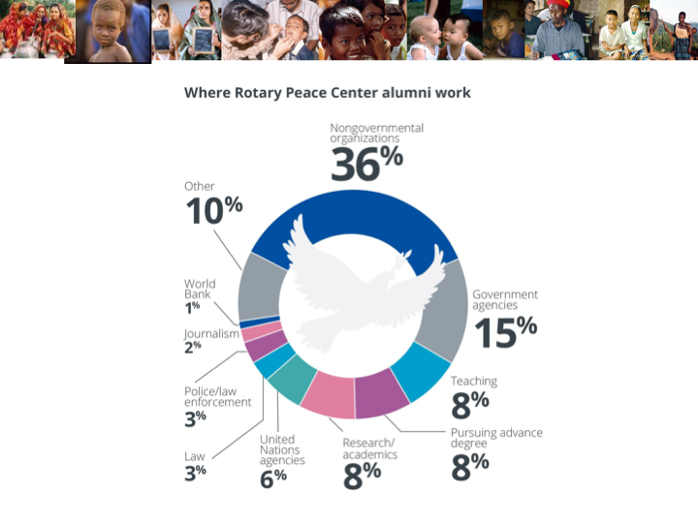
Notes:
These are the areas that employ the graduates.

Slide 26
Notes:
Important for you to know we are moving the timeline up for the grants this year.
In order to receive a district grant you must have your information entered into Rotary Club Central.
So if we want our clubs to be successful with respect to the foundation – the club foundation chair is the key.
I would add one more important thing….make sure you have club members that are certified.

Slide 27
Notes:
District grants are single, annual block grants made to districts in amounts up to 50 percent of their District Designated Fund (DDF).
The district grant can fund multiple club and district projects, which may be local or international.
Turn it over to Kim Giffen our district grants chair.
District grants allow local decision making, with minimal restrictions, for smaller-scale activities and projects.

Slide 31
Important Points
Deadline for district grant submission is June 30th, 2018.
Final report must be received as soon as the project is done. You will get your funding as soon as we get the report.
If a club applies for two grants they must indicate which is the priority
Project expenditures cannot start until notification that grant has been approved.

Slide 36
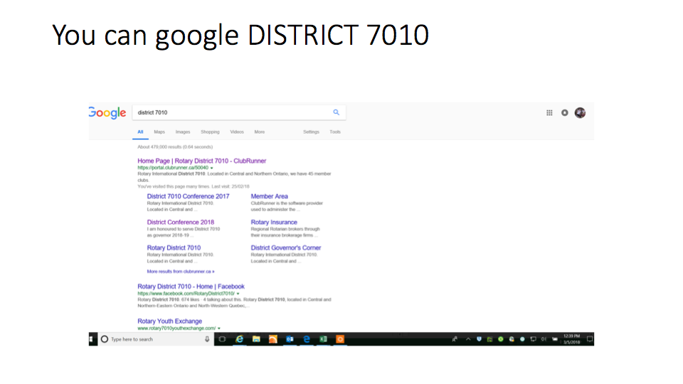

Slide 37
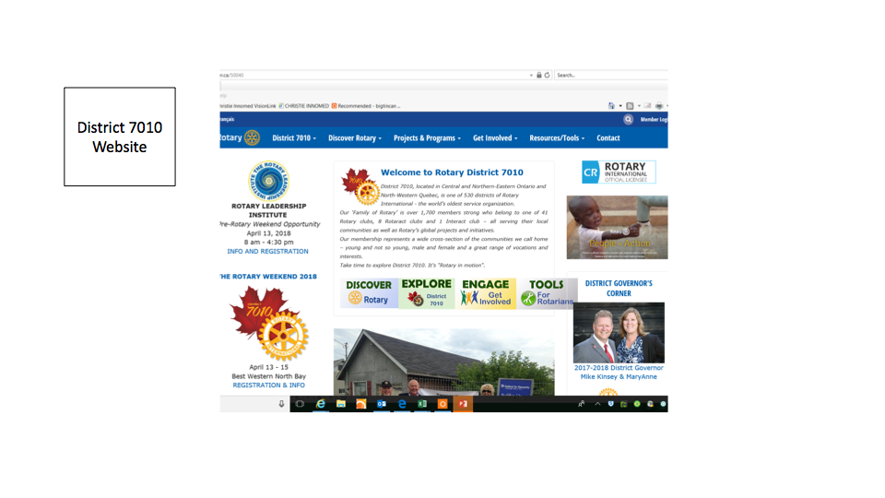

Slide 38
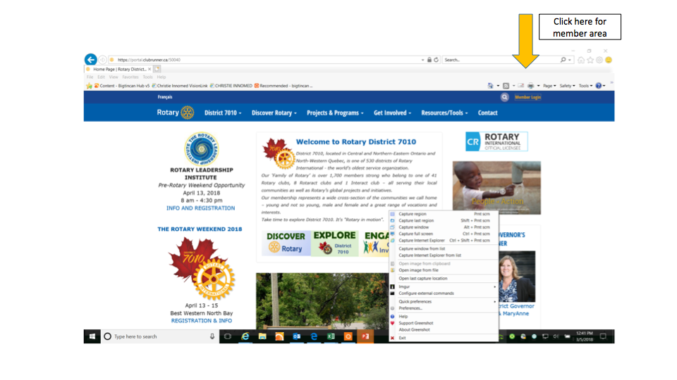

Slide 39
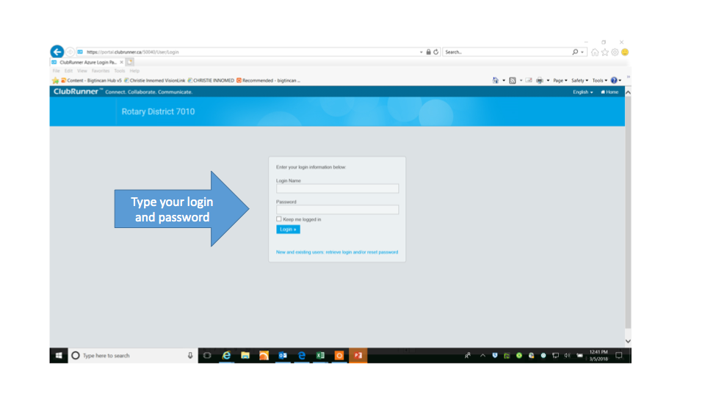

Slide 40
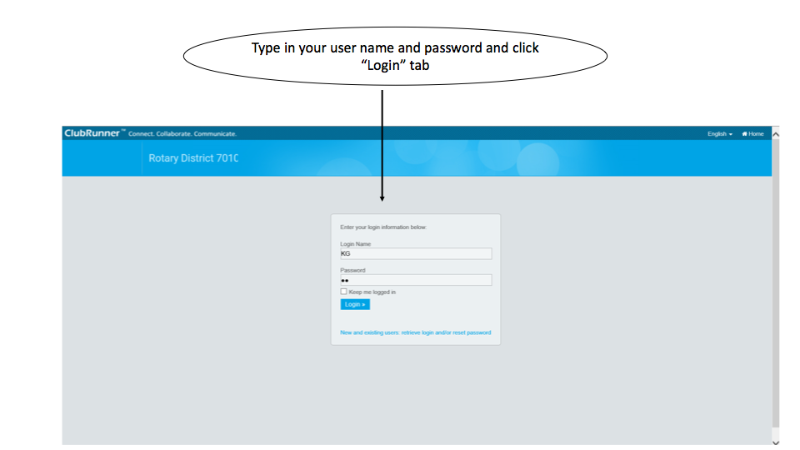

Slide 41
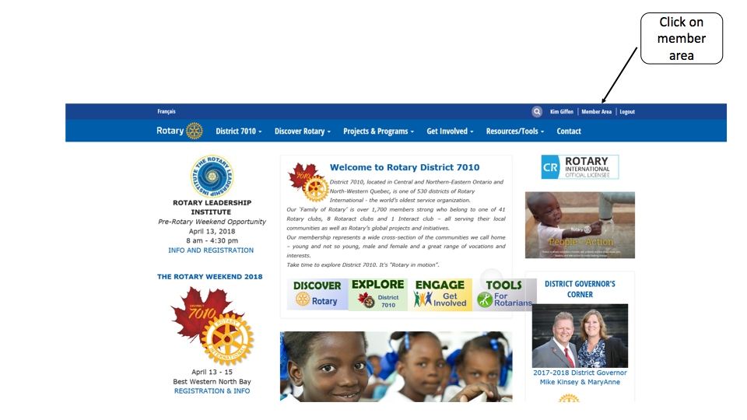

Slide 42
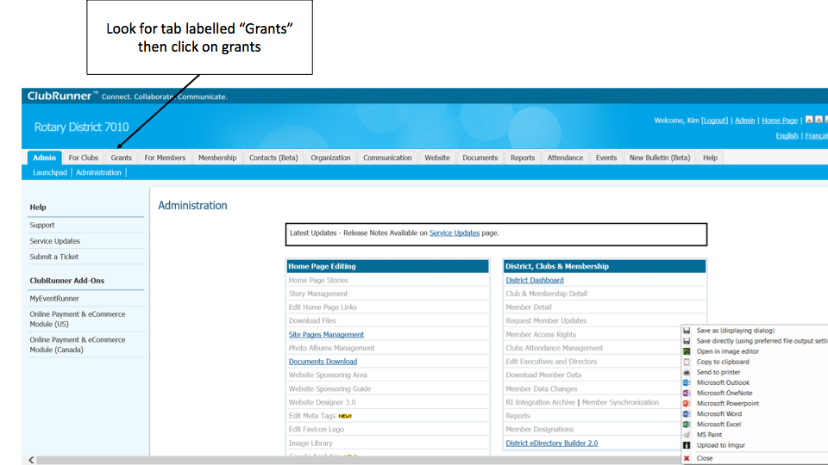

Slide 43
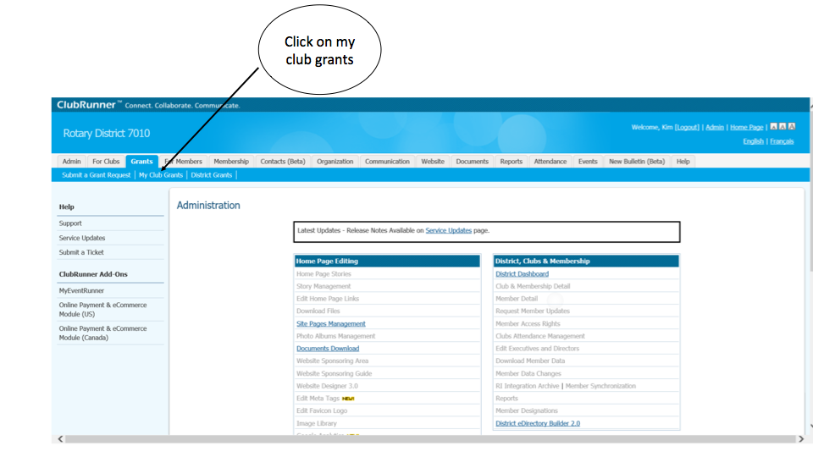

Slide 44
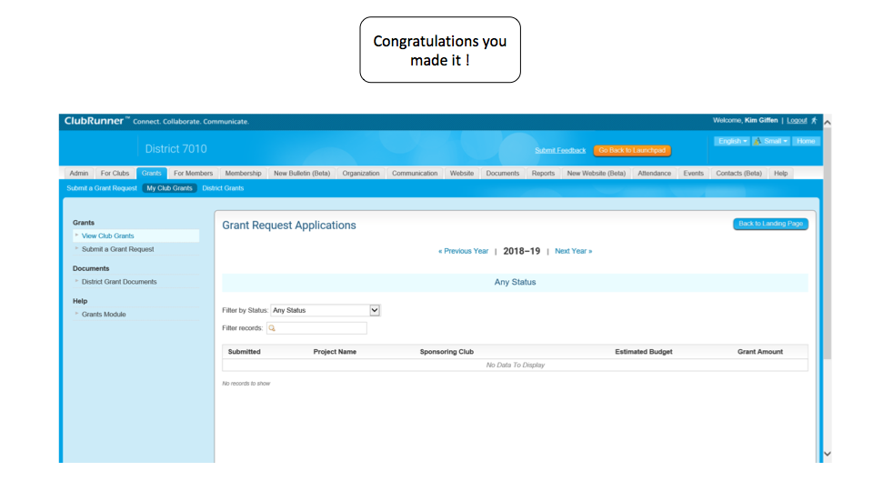

Slide 45
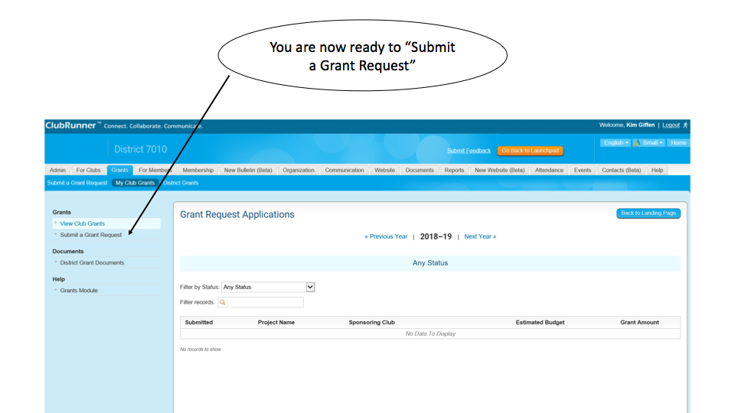

Slide 46
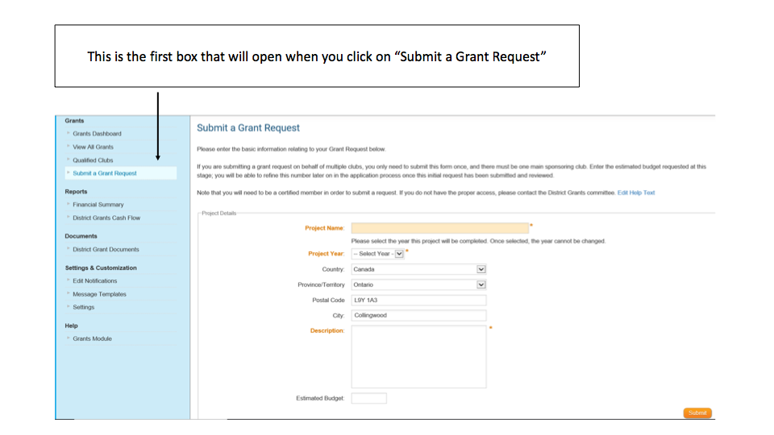

Slide 47
Notes:
District grants are single, annual block grants made to districts in amounts up to 50 percent of their District Designated Fund (DDF).
The district grant can fund multiple club and district projects, which may be local or international.
District grants allow local decision making, with minimal restrictions, for smaller-scale activities and projects.

Slide 48
Certification
District grant certification complete
Those requiring global grant certification please remain on the webinar.

Slide 49
Notes:
Under the new grant model, Rotary continues promoting peace through education.
Clubs and districts have more flexibility in sponsoring international and local scholars through global grants and district grants.
We have determined the best method for a VTT is a global grant.

Slide 50
Notes:
Global grants fund large-scale projects and activities that:
Align with one of Rotary’s 6 areas of focus
Respond to a need the benefiting community has identified
Include the active participation of the benefiting community
Include the active participation of Rotarians
Strengthen local knowledge, skills, and resources
Are designed to enable the benefiting community to address its own needs after the Rotary club or district has concluded its work
Have measurable results
A key feature of global grants is partnership, between the district or club where the activity is carried out and a district or club in another country. Both sponsors must be qualified before they can submit an application.
The minimum grant award is $15,000 (for a total budget of at least $30,000). The DDF allocation is matched 100 percent, and cash is matched at 50 percent from the World Fund. A global grant project is sponsored by a host club in the project country and a club outside the project country.
The Foundation’s World Fund provides a minimum of $15,000 and maximum of $200,000. Clubs and districts contribute District Designated Funds (DDF) and/or cash contributions that the World Fund matches. DDF is matched at 100% and cash is matched at 50%.

Slide 51
Notes:
We have identified specific causes to target to maximize our local and global impact. Through global grants we help clubs focus their service efforts in the following areas:
Peace and conflict prevention/resolution
Disease prevention and treatment
Water and sanitation
Maternal and child health
Basic education and literacy
Economic and community development

Slide 52
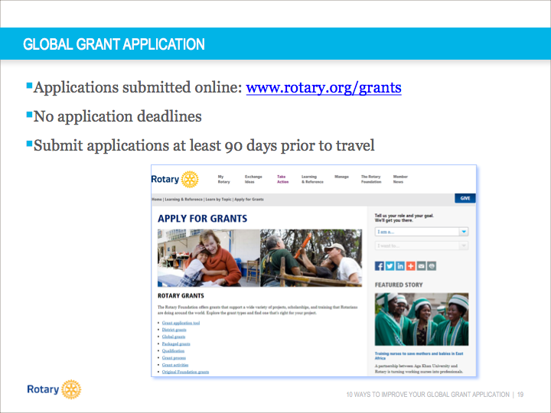
Notes:
Global grant applications are submitted online. The grant application tool is accessible by going to www.rotary.org/grants. Applications are accepted on a rolling basis throughout the year; there are no application deadlines. However, if your application includes travel, please ensure that it is submitted at least 90 days before the travel is scheduled to begin.
The following slides will discuss ten ways that you can improve your global grant application.

Slide 53
Notes:
Conduct a thorough assessment of community needs and strengths. Ask people what they have, how what they have can be better, or what they need in order to have better lives. If there’s a thorough understanding of community needs, the rest of the application comes much more naturally. Try to start the project with the beneficiaries rather than plan the project and then take it to the local community. Focus on a need that is local to you and your club if you can.
Rotary has resources available to help you conduct your needs assessment including the manual pictured here: Community Assessment Tools. This manual is available on Rotary’s website.

Slide 54
Notes:
Funding for A community needs assessment must either the club or a district grant. So you can use a district grant to offset funding a community needs assessment. If you want a grant this must be done.

Slide 55
Notes:
There is a form online that you can download and fill out.

Slide 56
Notes:
Review the Areas of Focus policy statements. Based on needs assessment, identify just one (or only the most appropriate) area of focus. Avoid taking a “fully-baked” project and fitting it into one of the areas of focus. Change the approach to project design. Work and think through the policy statements before designing projects. All project activities should relate directly to the area of focus goals.

Slide 57
Notes:
Provide a detailed project implementation plan that encompasses all aspects of the proposed project activity. Ensure that beneficiaries were involved in project design.

Slide 58
Notes:
Provide a detailed listing of the specific tasks that both the host and international Rotarians will carry out in conjunction with the project.

Slide 59
Notes:
Provide a detailed budget with vendor information and information about how these vendors were selected. The image on the screen shows where you will enter the budget information in the online application.

Slide 60
Notes:
Clearly explain specific sustainability components. We have a handout entitled “Six Steps to Sustainability” that provides helpful guidance about how to make your project more sustainable.

Slide 61
Notes:
Include detailed information for each training opportunity presented in application and include: frequency, curricula, exact beneficiaries, if training will be tailored for adults/children, who will be doing what for the training. Do not answer “not applicable” to this question. Training is applicable to all global grants.

Slide 62
Notes:
You will complete a Memorandum of Understanding for each cooperating organization with which you’re working on the project. The MOU(s) will be included with the grant application.

Slide 63
Notes:
Include specific information related to measurement and evaluation. The image on the screen shows where you will enter this information into the online system. We have resource materials to help you design your measurement and evaluation plan for your project.

Slide 64
Notes:
Complete the entire application. If you leave parts of your application blank, it will likely result in delays in application processing.
Also, we have a global grants committee that consist of Rotarians that are experienced in writing grants. Please send your grant to the committee first so we can review it and catch anything that may end up delaying your application.

Slide 65
Notes:
The following resources are available to assist you as you complete your global grant application:
www.rotary.org/myrotary/grants
Guide to Global Grants
A handout that walks you through the steps of using the online system to apply for a global grant
Rotary’s Learning Center
Rotary Support Center
Grants staff
However I would stress your first line of assistance should be our district global grant committee.

Slide 66
Notes:
It now has been almost one year since the Rotary Foundation (Canada) has entered into an agreement with the Department of Foreign Affairs, Trades and Development of the Canadian Government. Since that agreement was signed, the Department has changed its name to Global Affairs Canada.
It is now time to invite you to apply for these funds as we start our second year of the partnership with the Canadian Government.
a copy of the letter, both in English and French, that was send out to all Canadian club presidents and District Governors with Canadian clubs.

Slide 67
Notes:
The program will focus on efforts designed to reduce poverty, promote economic development, improve health (especially maternal and child health), promote literacy and empower women. (please keep this in mind when developing your grant).
Every three years’ the OECD’s Development Assistance Committee (DAC) prepares a list of countries for member states to direct their international assistance towards. Only countries included on that list are eligible for GAC financial support, including that which occurs via our program agreement. For the current list go to www.oecd.org/dac/stats/daclist.htm. Please note India is not eligible for this program due to their restrictions on the inflow of funds coming into their country.
The specific criteria will mean undertaking an assessment of the status of gender equality, the local environment, and governance capability prior to applying for funding from this program. It will also require building elements into the project proposal to address these issues and considering at the outset, the information that will need to be gathered to demonstrate progress upon completion of the project

Slide 70
Notes:
As with all Global Grant requests, the Rotary club(s)’ contributions will be the starting point. Then if the district(s) chooses, it may agree to allocate some of its District Designated Funds (“DDF”) to the project according to TRF and its policies. Then, presuming the project is eligible under this Partnership Program, the Canadian Rotary Club project proponent may request that TRFC allocate GOC funds to the project. This will be done on a 1 to 1 match for club and any allocated DDF, so long as sufficient GOC funds are available. The project proponents may then request a World Fund allocation, which would be on a 1 to 2 ratio for the club and GOC funds, and on a 1 to 1 ratio for any DDF contribution.

Slide 71
Notes:
There will be one additional requirement, which is that in addition to the final project report filed with TRF, a separate report with respect to the project's impact on gender equality, environmental sustainability and governance must be filed with TRFC. A reporting template will be provided by TRFC

Slide 72
Notes:
Through the Foundation, Rotary members find satisfaction in serving others. We make a real, life-changing difference for people in need.
And because of the Foundation, people around the world recognize Rotary as an agent of positive change in the world.

