Slide 1

COMMUNICATIONS/PUBLIC IMAGE
April 2025
Title Page Option
Notes:
Everything I am going over today can be found on our District website and/or My Rotary.
We will visit these 2 sites to view some of the info in further detail.

Slide 2


Rotary’s public image…
Rotary’s public image isn’t just what we think of ourselves. It’s also what people outside of Rotary think about us.
Getting people to recognize Rotary’s name > our brand, our tagline, is a start, but our work needs to go further.
Notes:
The tagline is really our “theme” for marketing Rotary vs the RI President yearly themes, which are meant to motivate the members.

Slide 3
PROMOTING ROTARY
Talking about Rotary in ways that explain what we do and the impact we make is essential to enhancing people’s understanding, appreciation and support - inspiring them to get involved – as members, volunteers, partners, and donors.
Promoting Rotary to the public can be as simple as wearing your Rotary pin or as elaborate as organizing an integrated marketing campaign.
“Telling our story”…
  Elevator Speech
  Website, Social Media (Club, District, My Rotary – Rotary Showcase) - stories, videos…
  Media releases, invites
  ‘Inclusive’ club meetings, functions…
  Speaking engagements - non-Rotarians
Communications/Public Image Team – public image strategies, website and social media champion(s)
WE ALL HAVE A PART TO PLAY IN PROMOTING ROTARY!
Notes:
Personalize the story you are telling for greater impact.
Comment: CTV coverage of Polio Eradication – discussion with PRIP John Germ and his reply to me – what action did I take to get the word out?

Slide 4
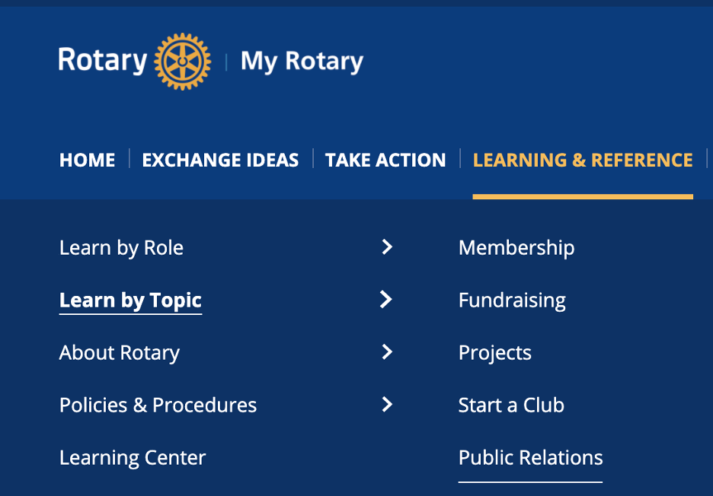

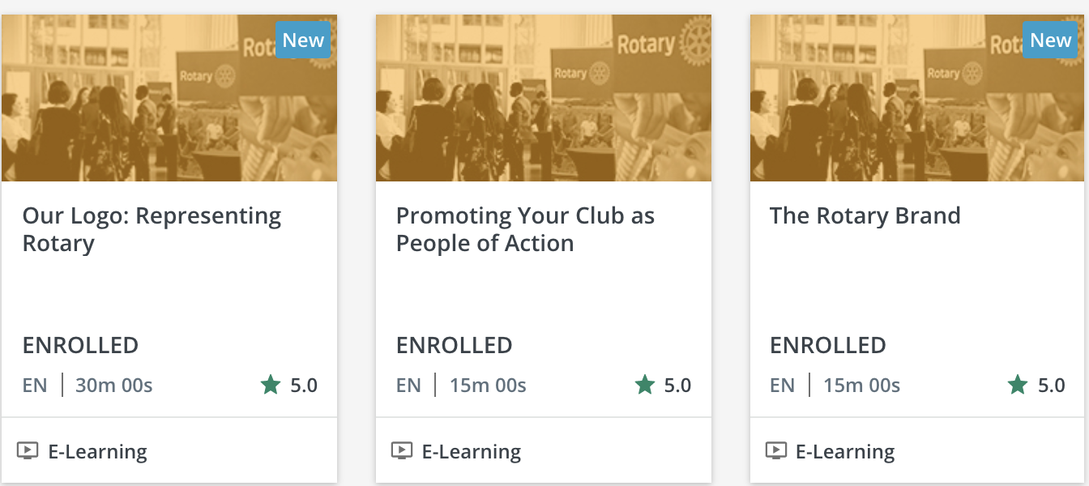
Start the learning process…
www.my.rotary.org
https://my.rotary.org/en/learning-reference/learn-topic/public-relations
Notes:
Learn by Topic > Public Relations page
Learning Center > Public Image courses

Slide 5
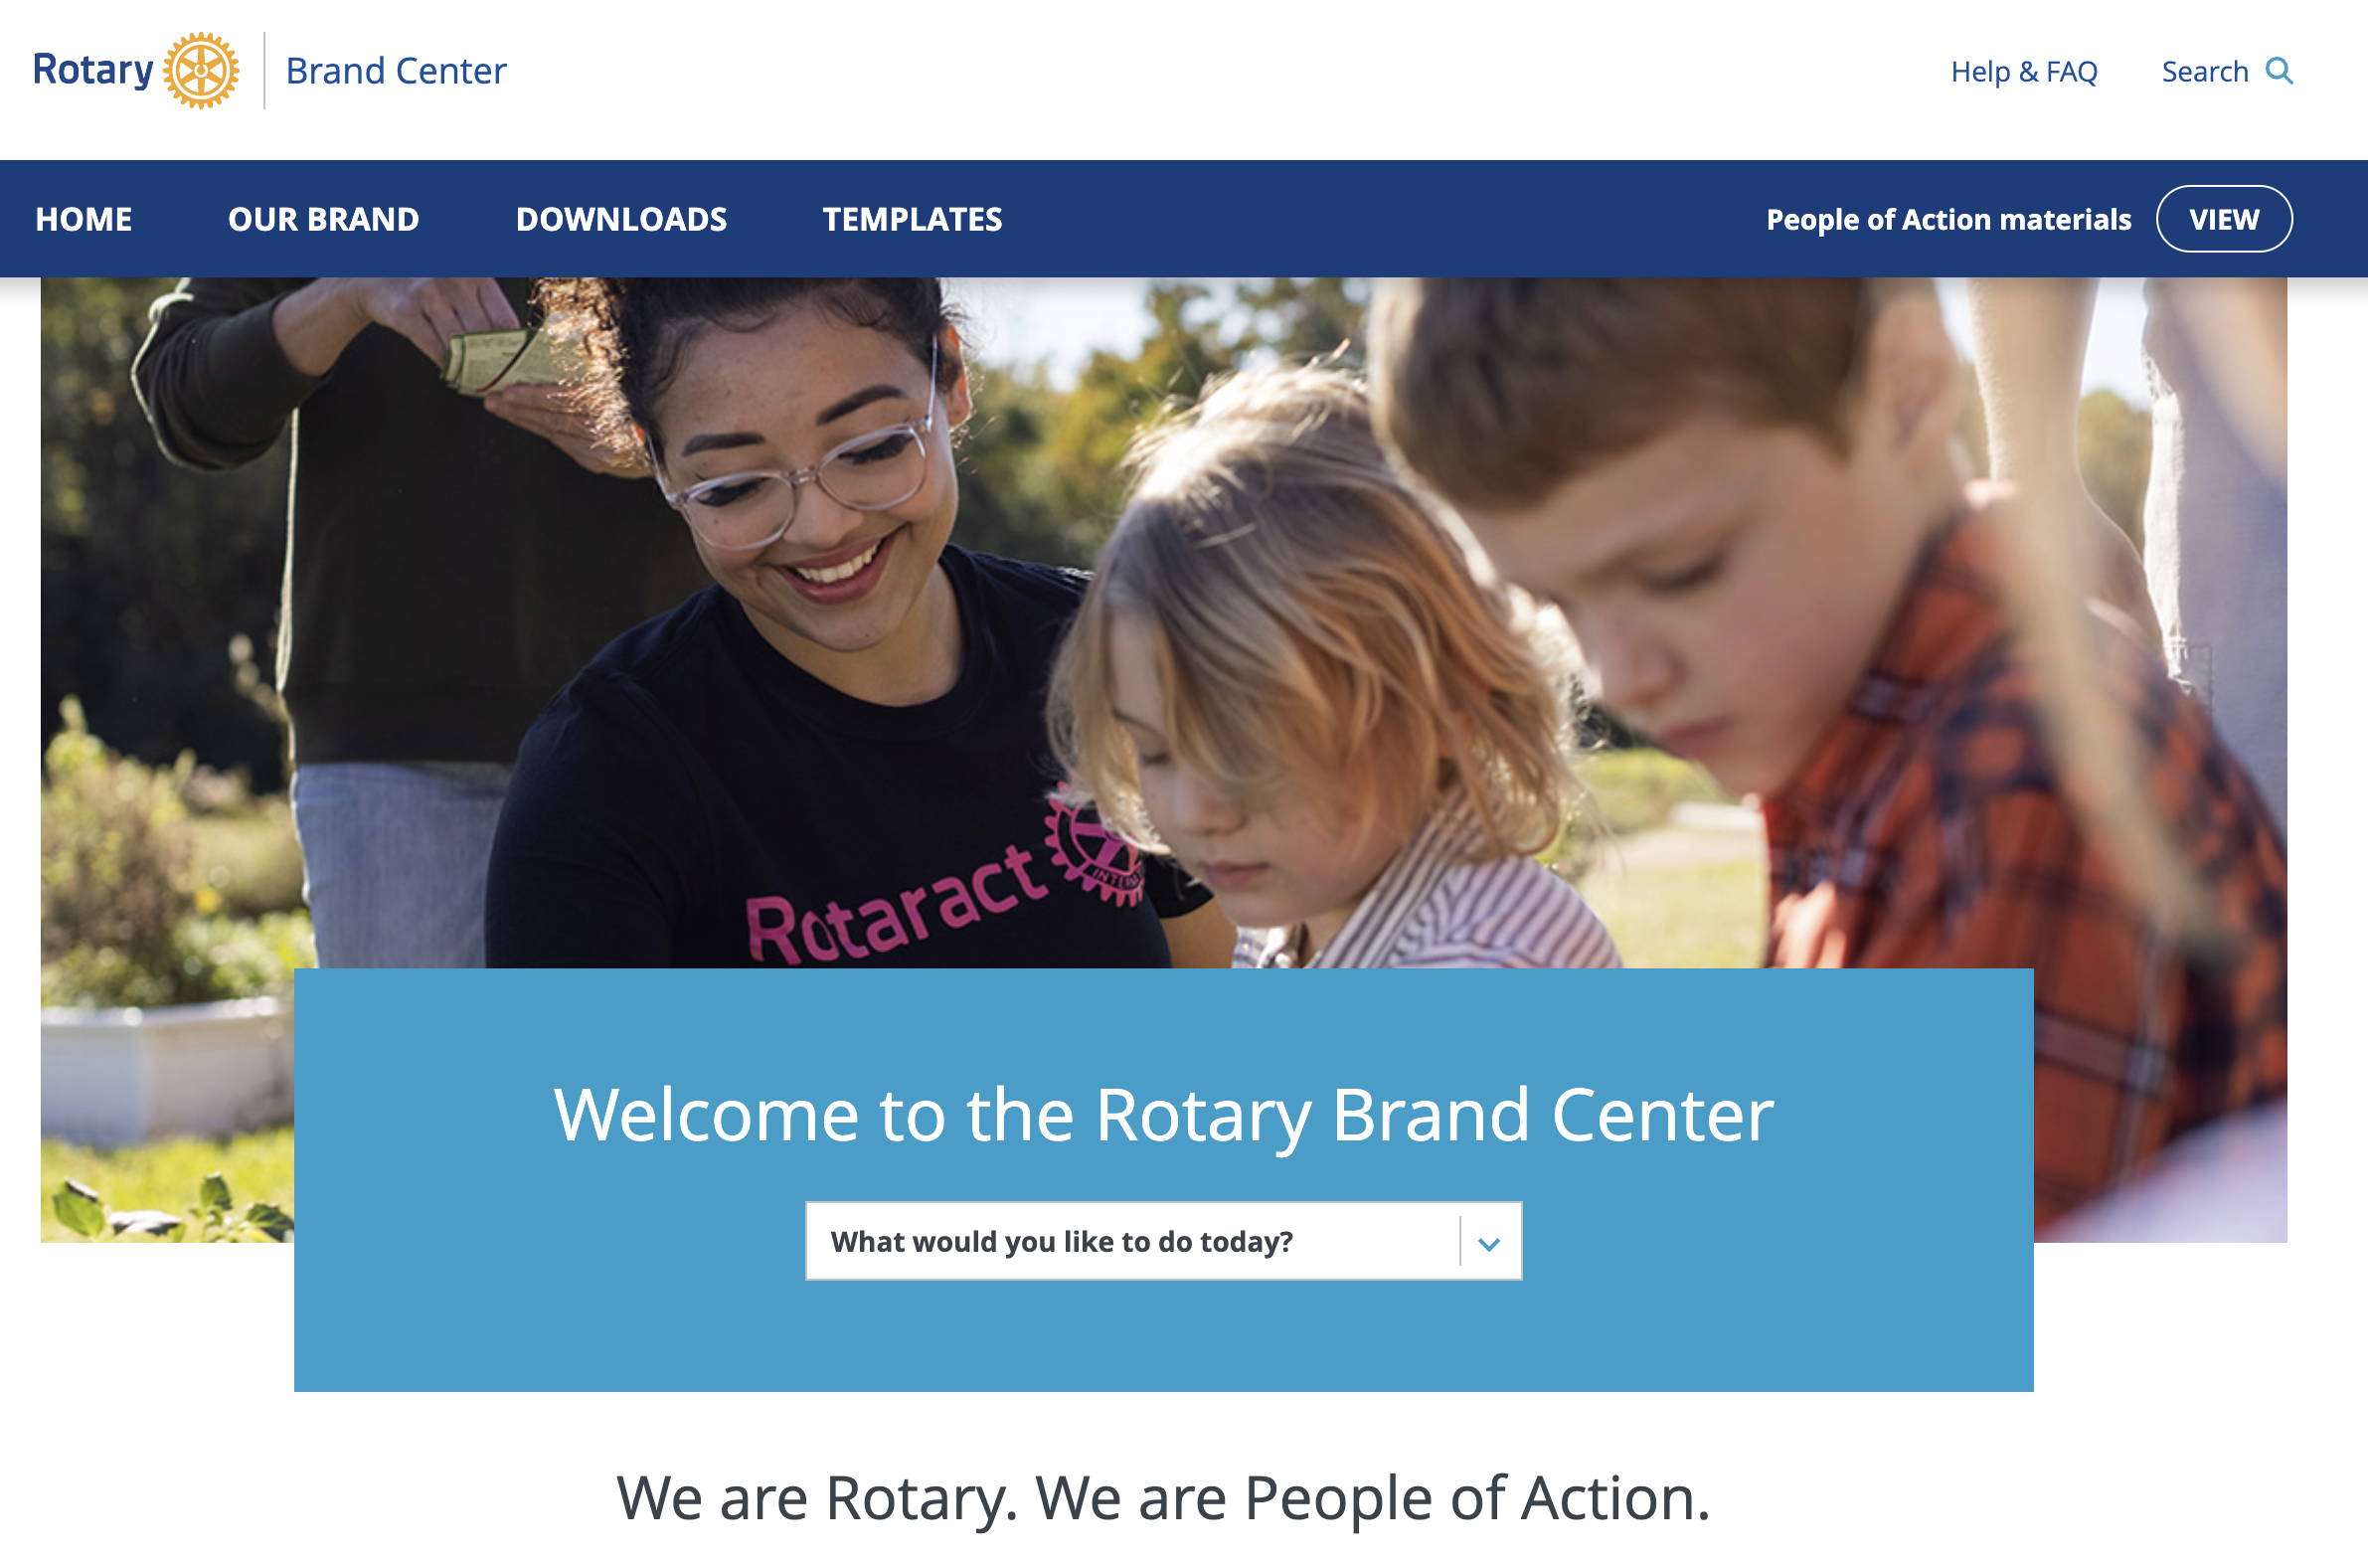
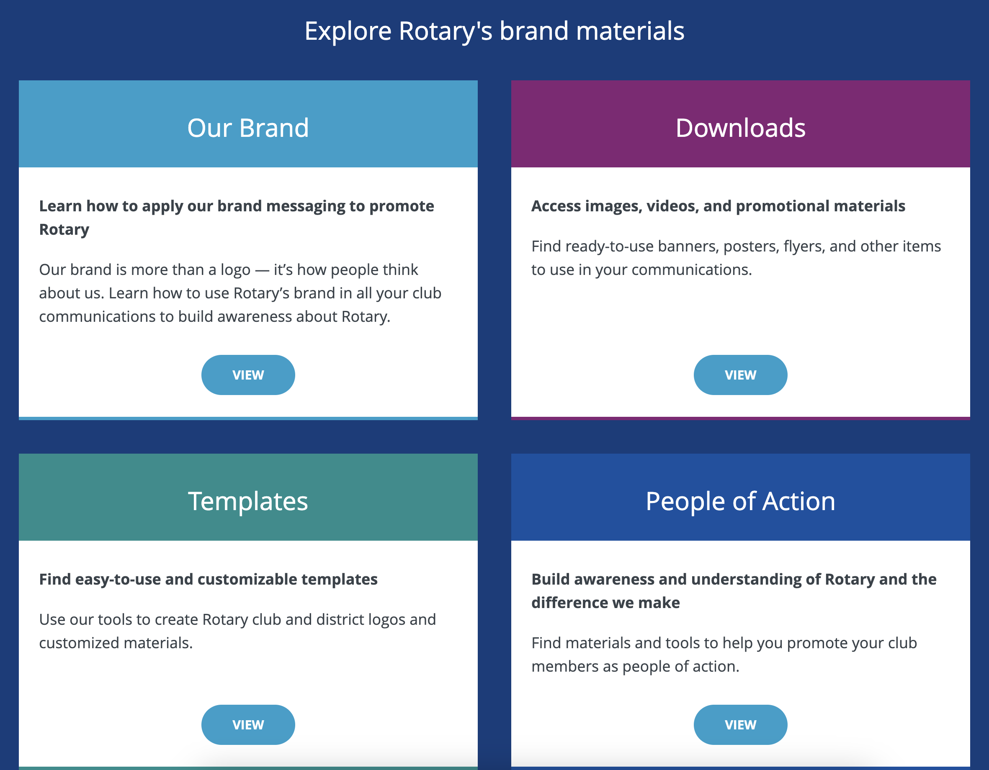
MY ROTARY: Resources
www.my.rotary.org
Notes:
Lots of resources to help your club “spread the word”.
We need to use the correct LOGOs, branding, wording.
THE BRAND CENTER has it all > key work already done.
Stationary, membership cards, certificates, videos, newsletter templates, posters, brochures, flags and banner templates, event resources…
Pre-made ads for print, online, outdoor, broadcast…

Slide 6
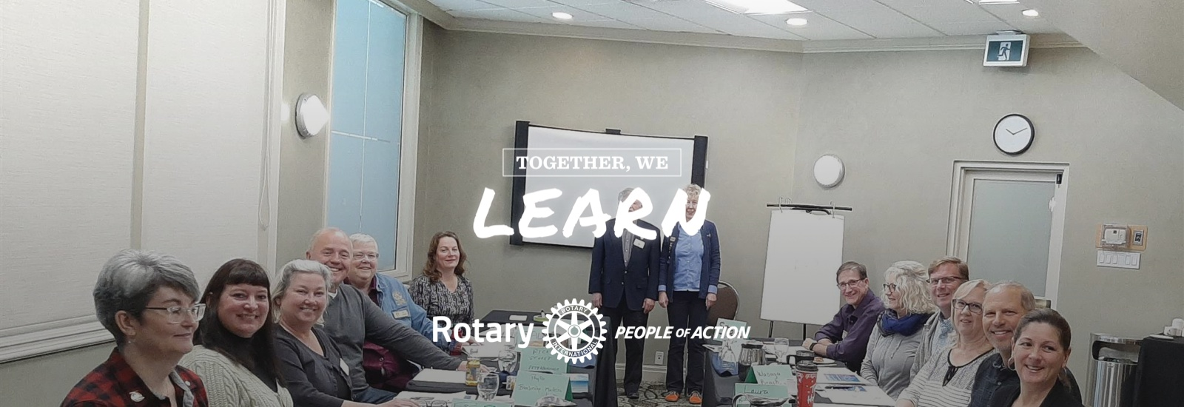
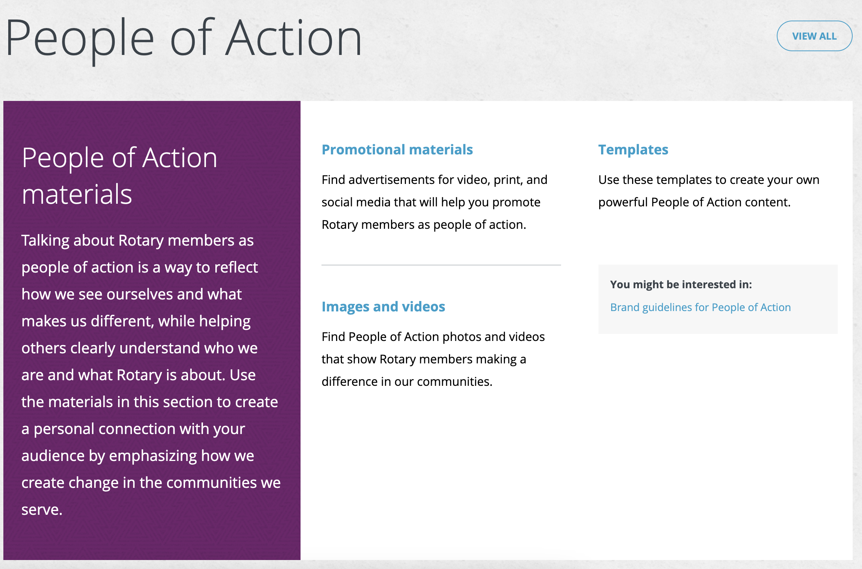
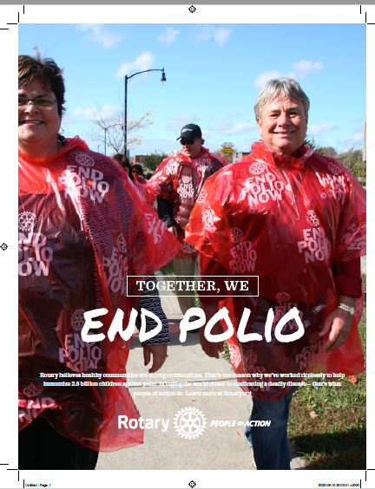
Create Personalized Graphics
MY ROTARY: Brand Center
www.my.rotary.org

Slide 7
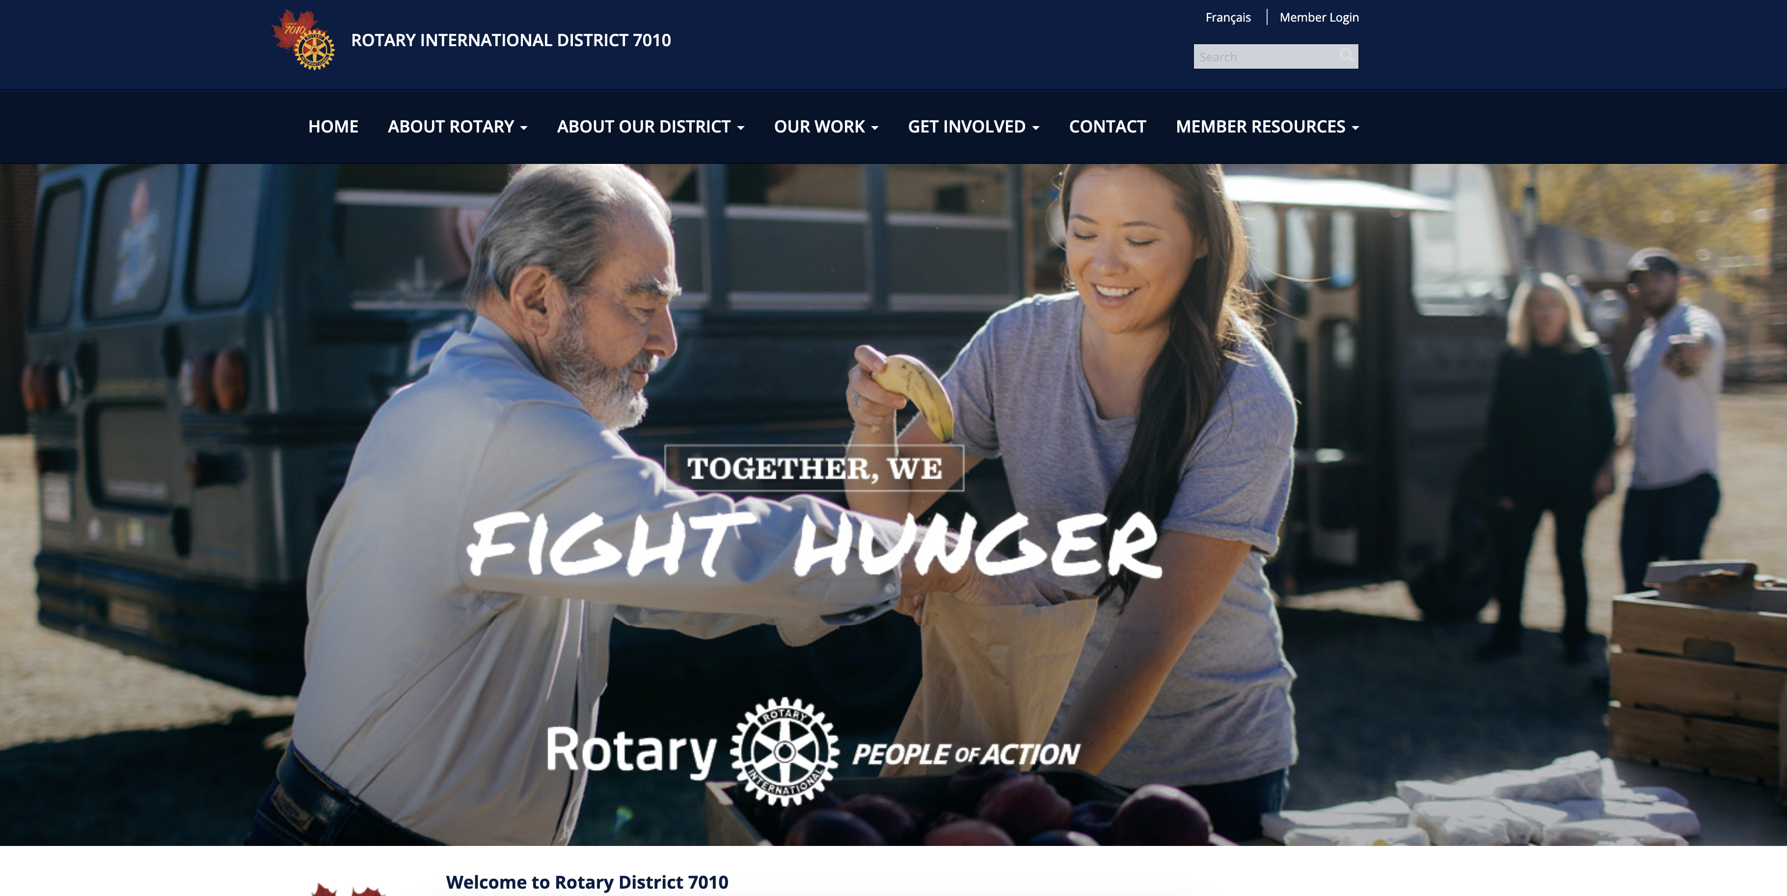
Website
www.rotary7010.org
Serves 2 roles…
www.rotary7010.org

Slide 8
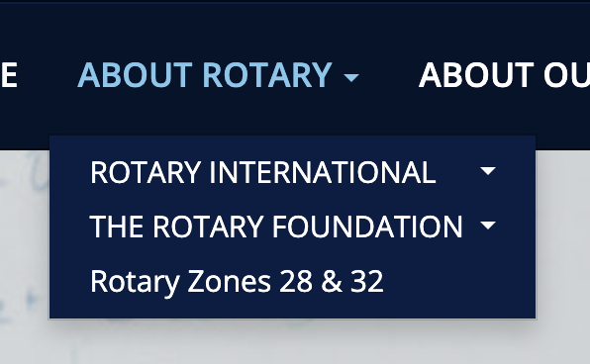
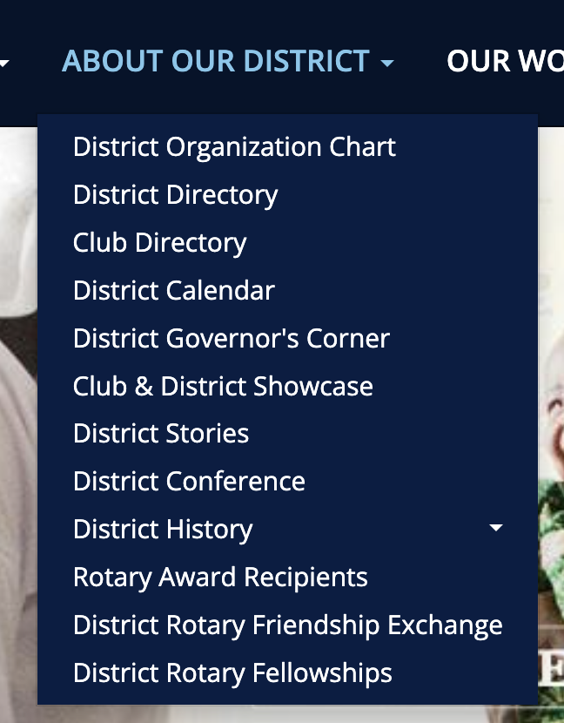
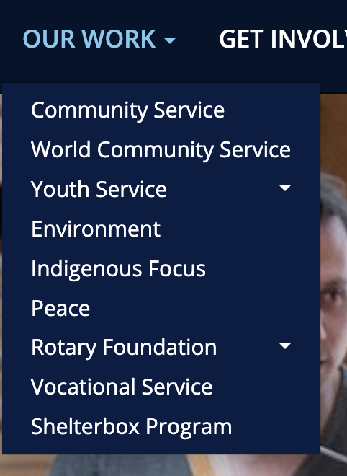
Rotary International District 7010 Website
www.rotary7010.org
Promote and educate awareness about Rotary – to BOTH non-Rotarians AND Rotarians.

Slide 9
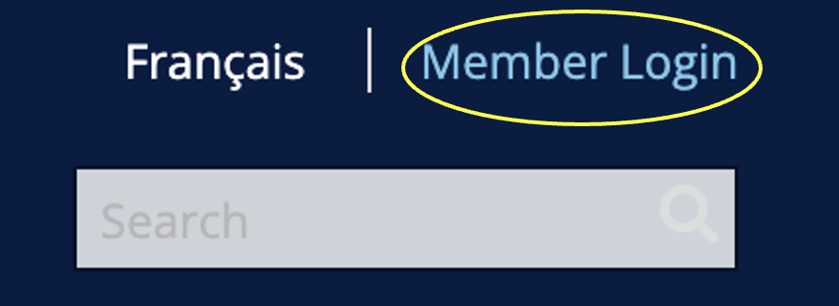

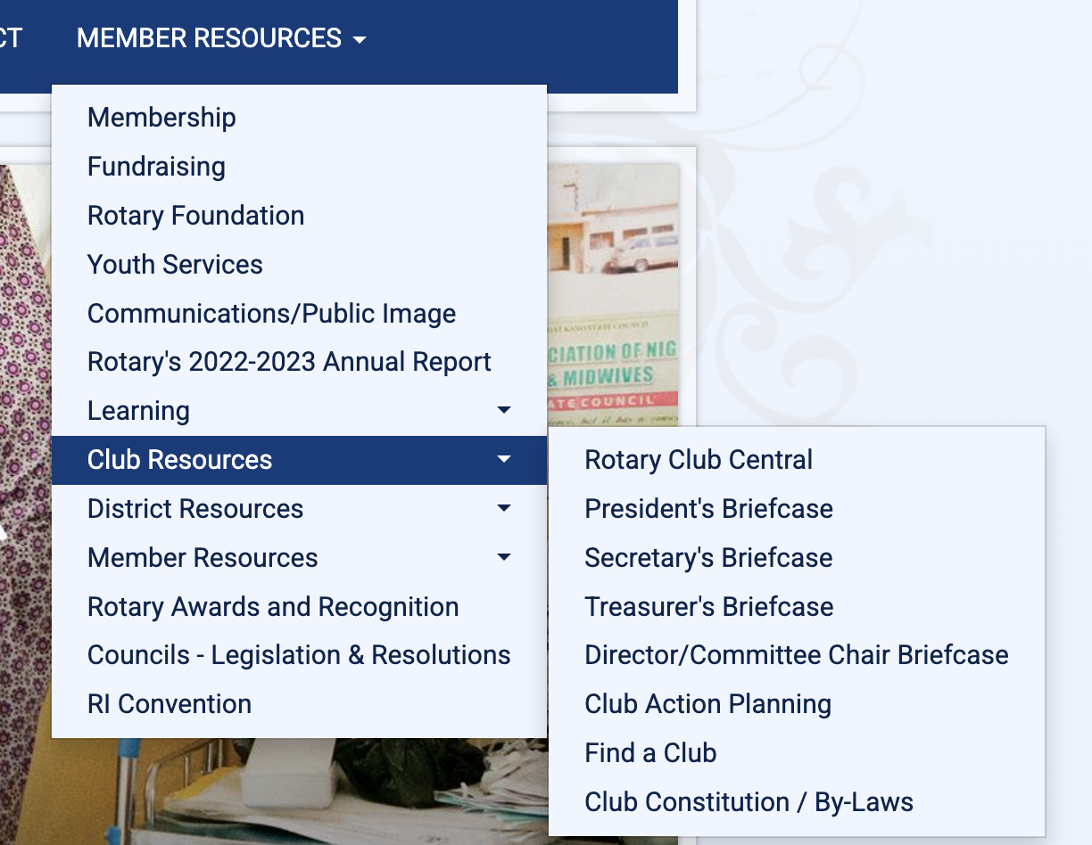
www.rotary7010.org
Members’ > Resources/Tools
Most of the resources and documents do not require Member Login to access.
Those consider to be for “Members only:” require Login > Member Area (ClubRunner) = Intranet Site.

Slide 10
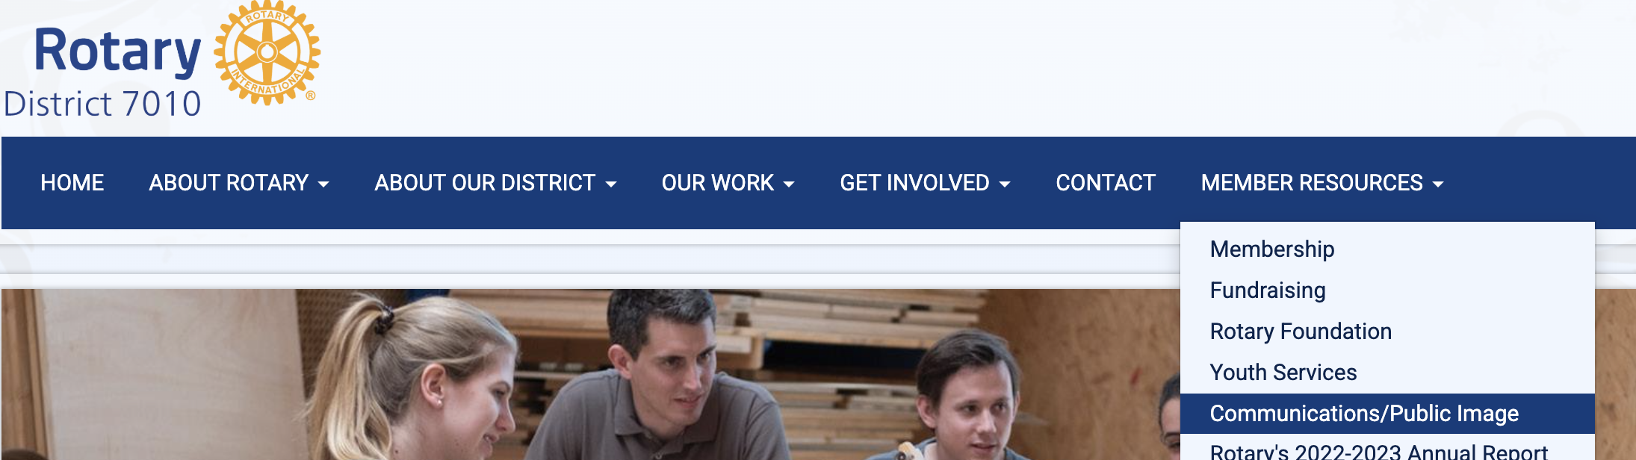
www.rotary7010.org

Slide 11
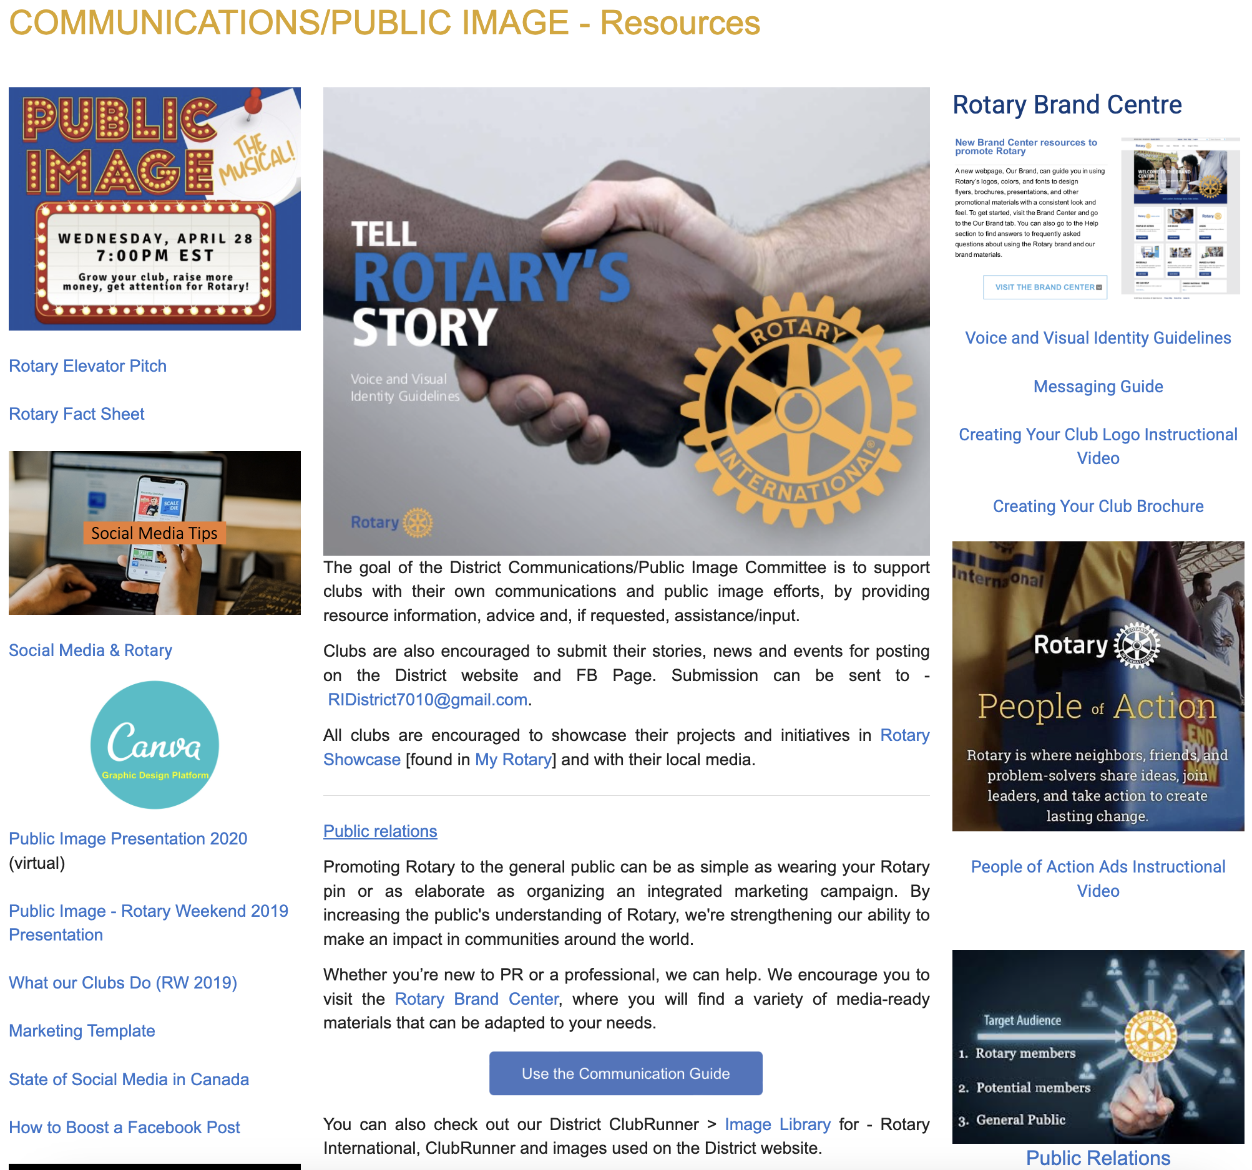
www.rotary7010.org

Slide 12
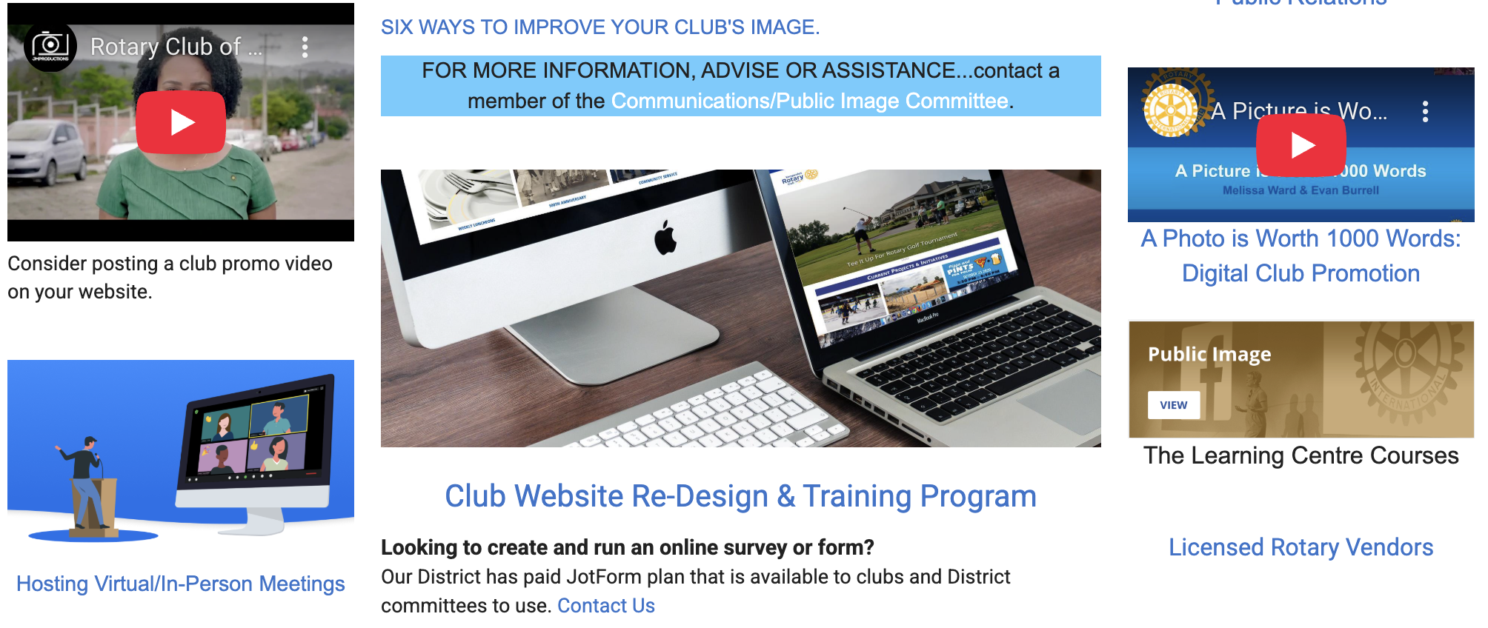
www.rotary7010.org

Slide 13

An appealing, well-organized website is key to attracting new members,
supporting your fundraising efforts,
“telling your story” and more.
Back for 2025-2026 by popular demand!
Club Presidents, Secretaries and Public Image Chair, for clubs who have yet to participate, will receive an email in early July.
The first 8 clubs to sign up will be accepted.
District 7010
Club Website Re-Design
&
Training Program
Notes:
Rotary is a vibrant organization with exceptional people working to build strong communities.

Slide 14
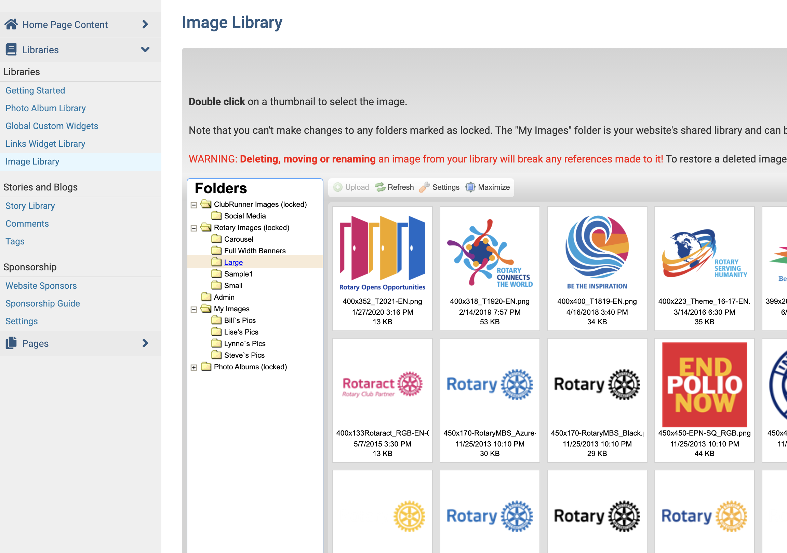


DISTRICT CLUBRUNNER (Member Area)
Visit our District ClubRunner > Image Library to access RI images and images created in-house by the District.

Slide 15
communications/public image
We are here to support you and your Club…
        Communications (internal/external)
        Public Image
        Website & Social Media
        ClubRunner [support@clubrunner.ca]
PDG Bill Hagborg, Director
bhagborg77@gmail.com
Notes:
Move to…
District Website > Communications/Public Image - Resources/Tools page.
My Rotary > Public Image; Brand Centre.

