Slide 1
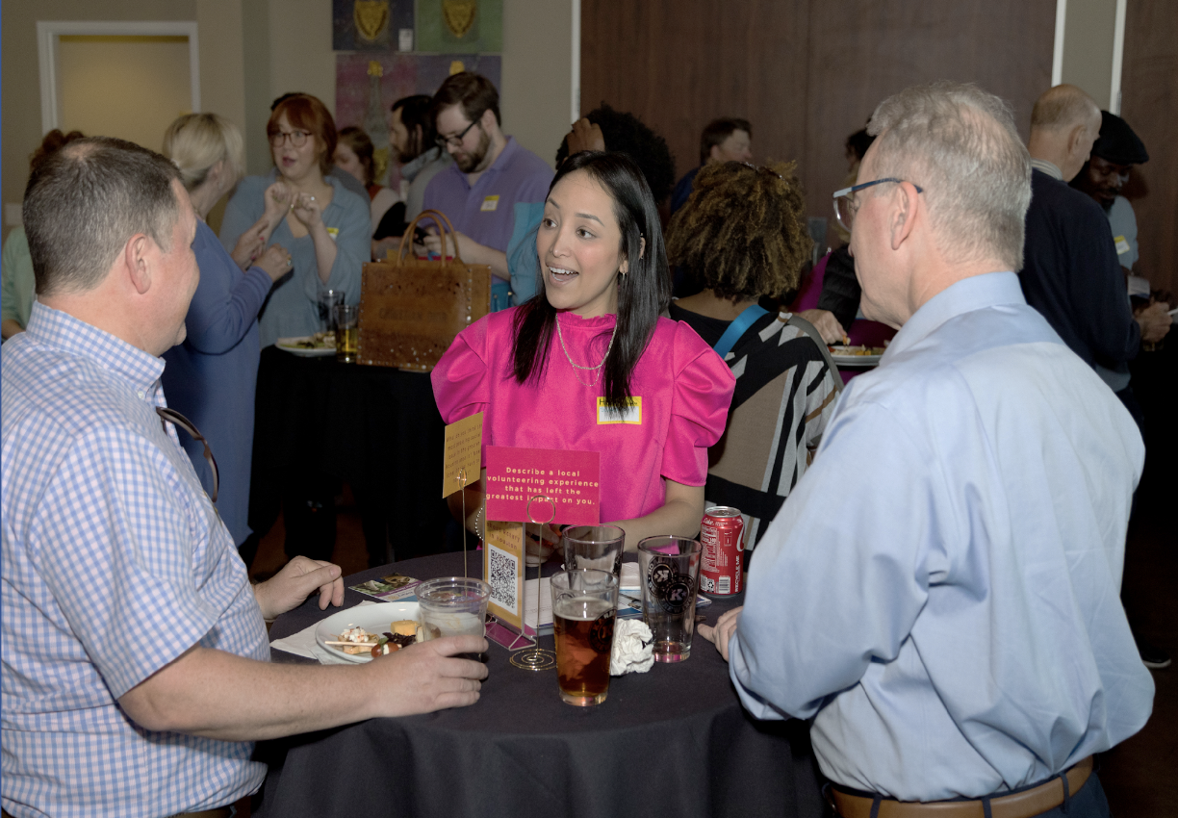
LEADING FOR GROWTH
Ensuring Your Club Thrives
Rotary Weekend / Presidents Elect Training Seminar (PETS)
D7010, April 2023
Notes:
We are pleased to share the results of our survey of successful clubs in Canada and the United States.
As you will see, these clubs have some powerful lessons about how Rotary leaders can focus, and help Rotary grow. In each club, teams of leaders stepped forward and collaboratively worked with each other – and their club’s membership – to grow Rotary.

Slide 2
AGENDA
Your Zone
And
Your District
Membership Stats
Understanding Success Track
GROWTH CLUB STUDY
2022 North American club growth study
The attributes of growing clubs
YOUR CLUB TOMORROW
Applying what you’ve heard
Setting relevant goals

Slide 3
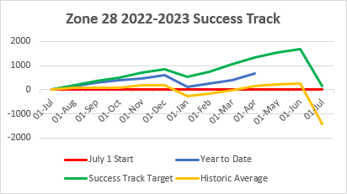
Notes:
Zone 28 Success Track to the end of March
Net change in membership
Yellow line: is the 4 year average history –what has been going on
See 5 months of growth, one month of decline then 5 more months of growth then a sharp decline. This happens because the dues are due on July 1st and Jan 1st.
Green line is our success track: this is the track we would like to be on so that we end up the year with a 0.5% increase
Blue line is where we are today.
As the graph shows, we are above where we were historically.
Zone 28 is still on track to lose members by end of the year, however, less than last year where we lost 1500 members!

Slide 4
Club Development
New Clubs
Vancouver Waterfront 5040
Nature Celebrators 5050
Ubly 6310
Windsor WIDE 6400
Huntsville Twilight 7010
New Rotaract
Parry Sound 7010
Albion College 6360
New Satellites
Tawas Area 6310
Notes:
The significant majority of clubs don’t just plan and set goals, they keep those plans alive and up to date, reviewing and adjusting regularly.
.

Slide 5
Zone 28 - District Summary
75% Outperforming Historic Trends
On track to grow!
5050
5060
5360
5370
6310
7010
Growth well within reach!
5040
5550
6330
6360
6380
6400
7070
7090
7790
Notes:
The significant majority of clubs don’t just plan and set goals, they keep those plans alive and up to date, reviewing and adjusting regularly.
.

Slide 6
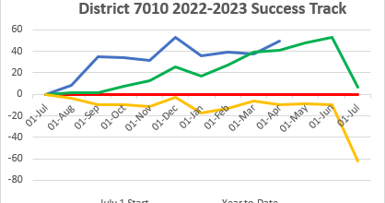
Notes:
D7010 Success Track
Based on this, our district will end the year with a net gain of 18 members.
Over the last 4 years, we averaged a loss of 62 members.
Well done District Membership Chair Phyllis and your membership committee, DG Richard and everyone else in our clubs working hard to grow membership!

Slide 7
SURVEY 1 (2021)
ROTARY CLUBS IN NORTH EAST USA, CANADA, MICHIGAN & ALASKA
CRITERIA:
5 + Net Member Growth
During the 2020-2021 (Pandemic) Rotary Year
11 Q survey to 2020-2021 Presidents of these clubs
60% response rate
55 clubs that grew significantly during the pandemic
Notes:
This is a refresher of the Survey that Zones 28 & 32 did last year when they reached out to Presidents in the year 2020-2021. The criteria for this survey were clubs who had grown significantly during the pandemic - in other words, clubs who had a net member growth of 5+.
The survey had 11 questions and the response rate was 60%.

Slide 8
The 5 Attributes (from Survey 1)
Strong Leadership
Many Events & Projects
Visible in the Community
Active, Intentional Member Engagement
Clear Goals & a Growth Plan
Notes:
As a result of the survey, it was clear that there were 5 attributes that contributed to the growth of a club. Although not all presidents quoted all 5 attributes, most had at least 3 of the above attributes.

Slide 9
SURVEY 2 (2022)
ROTARY CLUBS IN USA & CANADA
SURVEY 2 CRITERIA:
10+ Net Members in 5 years and growth in at Least 3 of the Past 5 Years
20 Q survey sent to 2021-2022 Presidents of these clubs
85 Responses (30%)
13 interviews
85 clubs that showed consistent growth between 2017-2022
Notes:
Fast Forward to 2022:
Led by the Zones 28 and 32 Analytics Team, this survey was designed to follow up on the 2021 survey completed on clubs in Zones 28 and 32 that grew during the pandemic. In this study we focussed on clubs that had demonstrated successful, long term growth. With the support and collaboration of USA & Canada Rotary Co-Ordinators, we were able to extend the survey to encompass clubs in the USA and Canada.
This survey confirmed and enriched the first and leave us confident in the validity of the key drivers of club growth.

Slide 10
A DIVERSITY OF CLUB SIZES
In 2017
In 2022
37% - 7 TO 25 MEMBERS
5% - 7 TO 25 MEMBERS
40% - 26 TO 50 MEMBERS
48 % - 26 To 50 MEMBERS
17% - 51 + MEMBERS
29% - 51 to 75 MEMBERS
2% - 76 to 100 Members
8% - 76 TO 100 MEMBERS
4% - 100 + MEMBERS
10% - 100 +MEMBERS
Notes:
We believe that the validity of these results is strengthened by the wide diversity of club sizes and types. As long as leaders act, plan and focus, the number of members in your club does not have to stop you from growing.

Slide 11
ATTRITION AND ATTRACTION
ATTRITION RATE
A RATE OF LOSS
% of members who leave our club in an average year
ATTRACTION RATE
A RATE OF GAIN
% of members admitted to our club in an average year
Notes:
Attrition is the average annual rate at which a club loses members. Attraction is the average annual rate at which a club gains members.
One way to measure club health is to compare the club’s rates of attrition and attraction. Thanks to the excellent work of Zone 33 Rotary Coordinator Terry Weaver, we were able to compare the attrition and attraction of each club that responded to the survey.
In general, healthy clubs will have an attrition rate of less than 15% and an attraction rate greater than that. As can be seen, the significant majority of clubs in this survey achieved this standard. And as you’ll see later on, they kept focussed on attracting new members and created an environment that people wanted to be part of. They have a product that they’re proud to sell and one which people want to buy.
As you will see, leaders make a critical difference, motivating and guiding their clubs to success. Let’s hear how successful club leaders describe leadership.
Look at your club’s goal worksheet. How does your club compare?

Slide 12
ATTRITION AND ATTRACTION
Average Attrition
North American Clubs 15%
Average Attraction
North American Clubs 12%
Surveyed Clubs 12%
Surveyed Clubs 23%

Slide 13
LEADERSHIP FOCUS
ACTIVE, INTENTIONAL MEMBER ENGAGEMENT
DYNAMIC, MEANINGFUL SERVICE
EFFECTIVE GOVERNANCE (Intentional Leadership)
STRONG PUBLIC IMAGE
(WELL KNOWN IN COMMUNITY)
DIVERSITY, EQUITY & INCLUSION
Notes:
With the data from the first survey as a key basis for inquiry, we were able to seek more detail, with the result that our understanding of the qualities that make clubs successful was enhanced, clarified and expanded:
First, and most importantly, strong leaders create strong clubs. More than this, leaders of surveyed clubs focused on 5 key attributes, which we will explore in more detail:
Outstanding governance – clubs are well organized, plan, set goals and have continuity in leadership.
Active, intentional member engagement – A healthy, engaged and inspired membership is key to club success.
Dynamic, meaningful service – engaged members keep busy ‘doing’ throughout the year. Rotary is about service.
Strong public image – Clubs aren’t just doing – they’re seen to be doing.
Diversity, Equity and Inclusion – ensuring club membership reflects their community
While not all leaders focussed equally on all 5 areas, most clubs take all these areas seriously.

Slide 14
EFFECTIVE GOVERNANCE
PLANNING PROCESS FOR GROWTH
LEADERSHIP CONTINUITY
INTENTIONAL MEMBERSHIP FOCUS
Notes:
Effective governance is highlighted in these clubs by three key elements.

Slide 15
THEY PLAN FOR GROWTH &
SET GOALS
81%
Have a Planning Process for Growth
83%
Established Annual Membership Goals
79%
Updated Plans at Least
Quarterly (20%) or
Annually (59%)
Notes:
The significant majority of clubs don’t just plan and set goals, they keep those plans alive and up to date, reviewing and adjusting regularly.
.

Slide 16
VIDEO: Planning for Growth https://www.youtube.com/watch?v=bofPr2qictE&list=PLGunX5-Uh7ZN-kEywsRRuQBb-mxq12bno&index=5&t=11s&pp=iAQB Michael Turner Rotary Club Las Vegas Summerlin, Nevada USA 3 min 14 sec

Slide 17
LEADERSHIP CONTINUITY
89%
Designate a President-Elect at least one year in advance
49%
Designate a President-Nominee at least 2 years in advance
92%
Have a club membership chair
Notes:
Leadership continuity is a key reflection of club health and governance strength. A club that knows who their future leaders are going to be has a significantly greater capacity to plan effectively – and to implement those plans. Almost half the responding clubs know who their president is going to be two years ahead.
Equally importantly, the successful clubs demonstrate the importance of membership in the appointment of a club membership chair.

Slide 18
Video: Rotary Leadership
https://www.youtube.com/watch?v=DOiFyV9ssFg&list=PLGunX5-Uh7ZN-kEywsRRuQBb-mxq12bno&index=3&t=8s&pp=iAQB
Todd Shepard
RC Tri-Cities Sunrise (Burbank) Washington USA
2 min 01 sec

Slide 19
INTENTIONAL MEMBERSHIP FOCUS
Membership growth top of mind
Membership is everyone’s responsibility
Weekly agenda item
Notes:
These clubs also have an intentional focus on membership. Leaders keep membership at the top of everyone’s mind. Indeed, most often it was an item for discussion at each club meeting.
Lets take a minute and listen to some of these club leaders talk about planning in their clubs.

Slide 20
Video: Membership is Everyone’s Job
https://www.youtube.com/watch?v=l3lE2uKxPcM&list=PLGunX5-Uh7ZN-kEywsRRuQBb-mxq12bno&index=15&pp=iAQB
Donna Boyles, Rotary Club King North Carolina, USA
1 min 50 sec
Went from 21 to 35 members
Notes:
T

Slide 21
ACTIVE, INTENTIONAL ENGAGEMENT
GREAT MEETINGS & STRONG FRIENDSHIPS #1
CONSISTENT & FLEXIBLE MEETINGS
ENGAGING NEW MEMBERS
SAYING “THANK YOU”
Notes:
One of the presidents from our 2021 study said, “Nobody wants to come to a dull meeting.” This study confirms the important role meetings play in ensuring engaged membership. But these clubs have meetings with a purpose, to strengthen their relationships, to learn together and to engage with each other in service.
Meetings are consistent, yet flexible.
Clubs have a process for engaging, supporting and ‘onboarding’ new members.
And they understand the importance of saying thanks.

Slide 22
CONSISTENT & FLEXIBLE MEETINGS
76%
Meet weekly in person
65%
Use hybrid or virtual technology
29%
Created a satellite club as an alternative Rotary experience
Notes:
These clubs meet regularly and are flexible in their approach. Nearly 30% of these growth clubs have created a satellite club as an alternate experience for prospective Rotarians

Slide 23
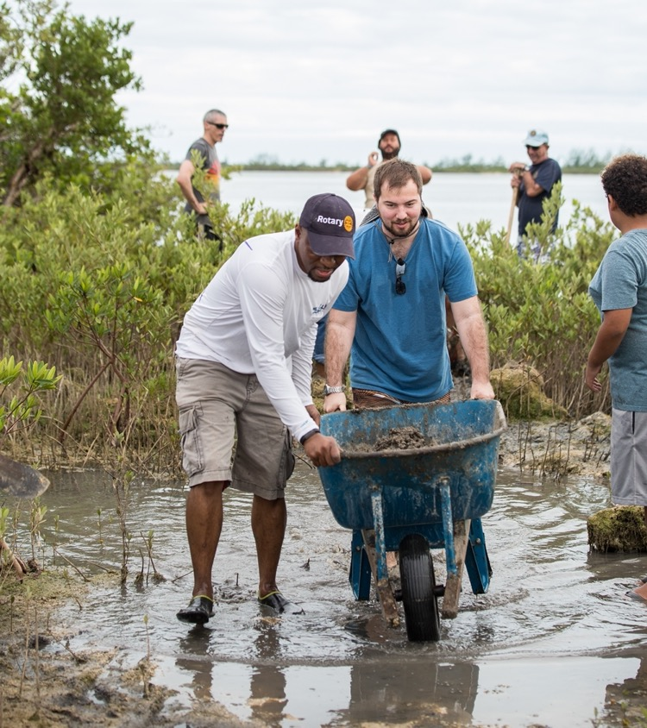
ENGAGING NEW MEMBERS &
THANKING ALL MEMBERS
70% Have a Defined New Member Orientation Process
77% Annually Take Time to Let Members Know the Club’s Accomplishments
70% Formally Recognize Members Time and Talent Contributions
Notes:
A few leaders talk about engagement in their clubs.

Slide 24
VIDEO: Engaging Members with Fun & Flexibility!
https://www.youtube.com/watch?v=RZP4a7wHUxM&list=PLGunX5-Uh7ZN-kEywsRRuQBb-mxq12bno&index=7&pp=iAQB
Patricia Johnson
Buffalo Sunrise, New York USA
3 min 17 secs

Slide 25
DYNAMIC, MEANINGFUL SERVICE
“SIGNATURE” PROJECTS & FUNDRAISERS
INCLUDING COMMUNITY MEMBERS
ONGOING, ACTIVE SERVICE
Notes:
Successful clubs make ‘service’ a dynamic center of their activities. They are actively engaged in projects and fundraisers and make it a priority to include community members in those activities. More importantly, and as will be seen, they make service an ongoing, year round priority.

Slide 26
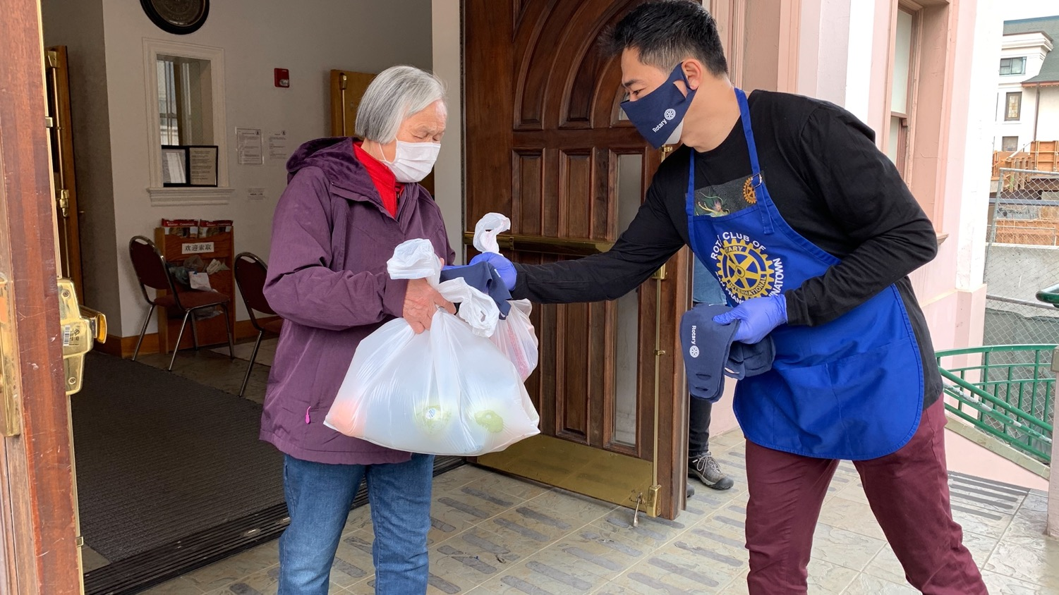
“SIGNATURE” SERVICE PROJECTS & FUNDRAISERS (>50% Member Involvement)
86%
Have a repeating ‘signature’ project every year
83%
Have a repeating ‘signature’ fundraiser every year

Slide 27
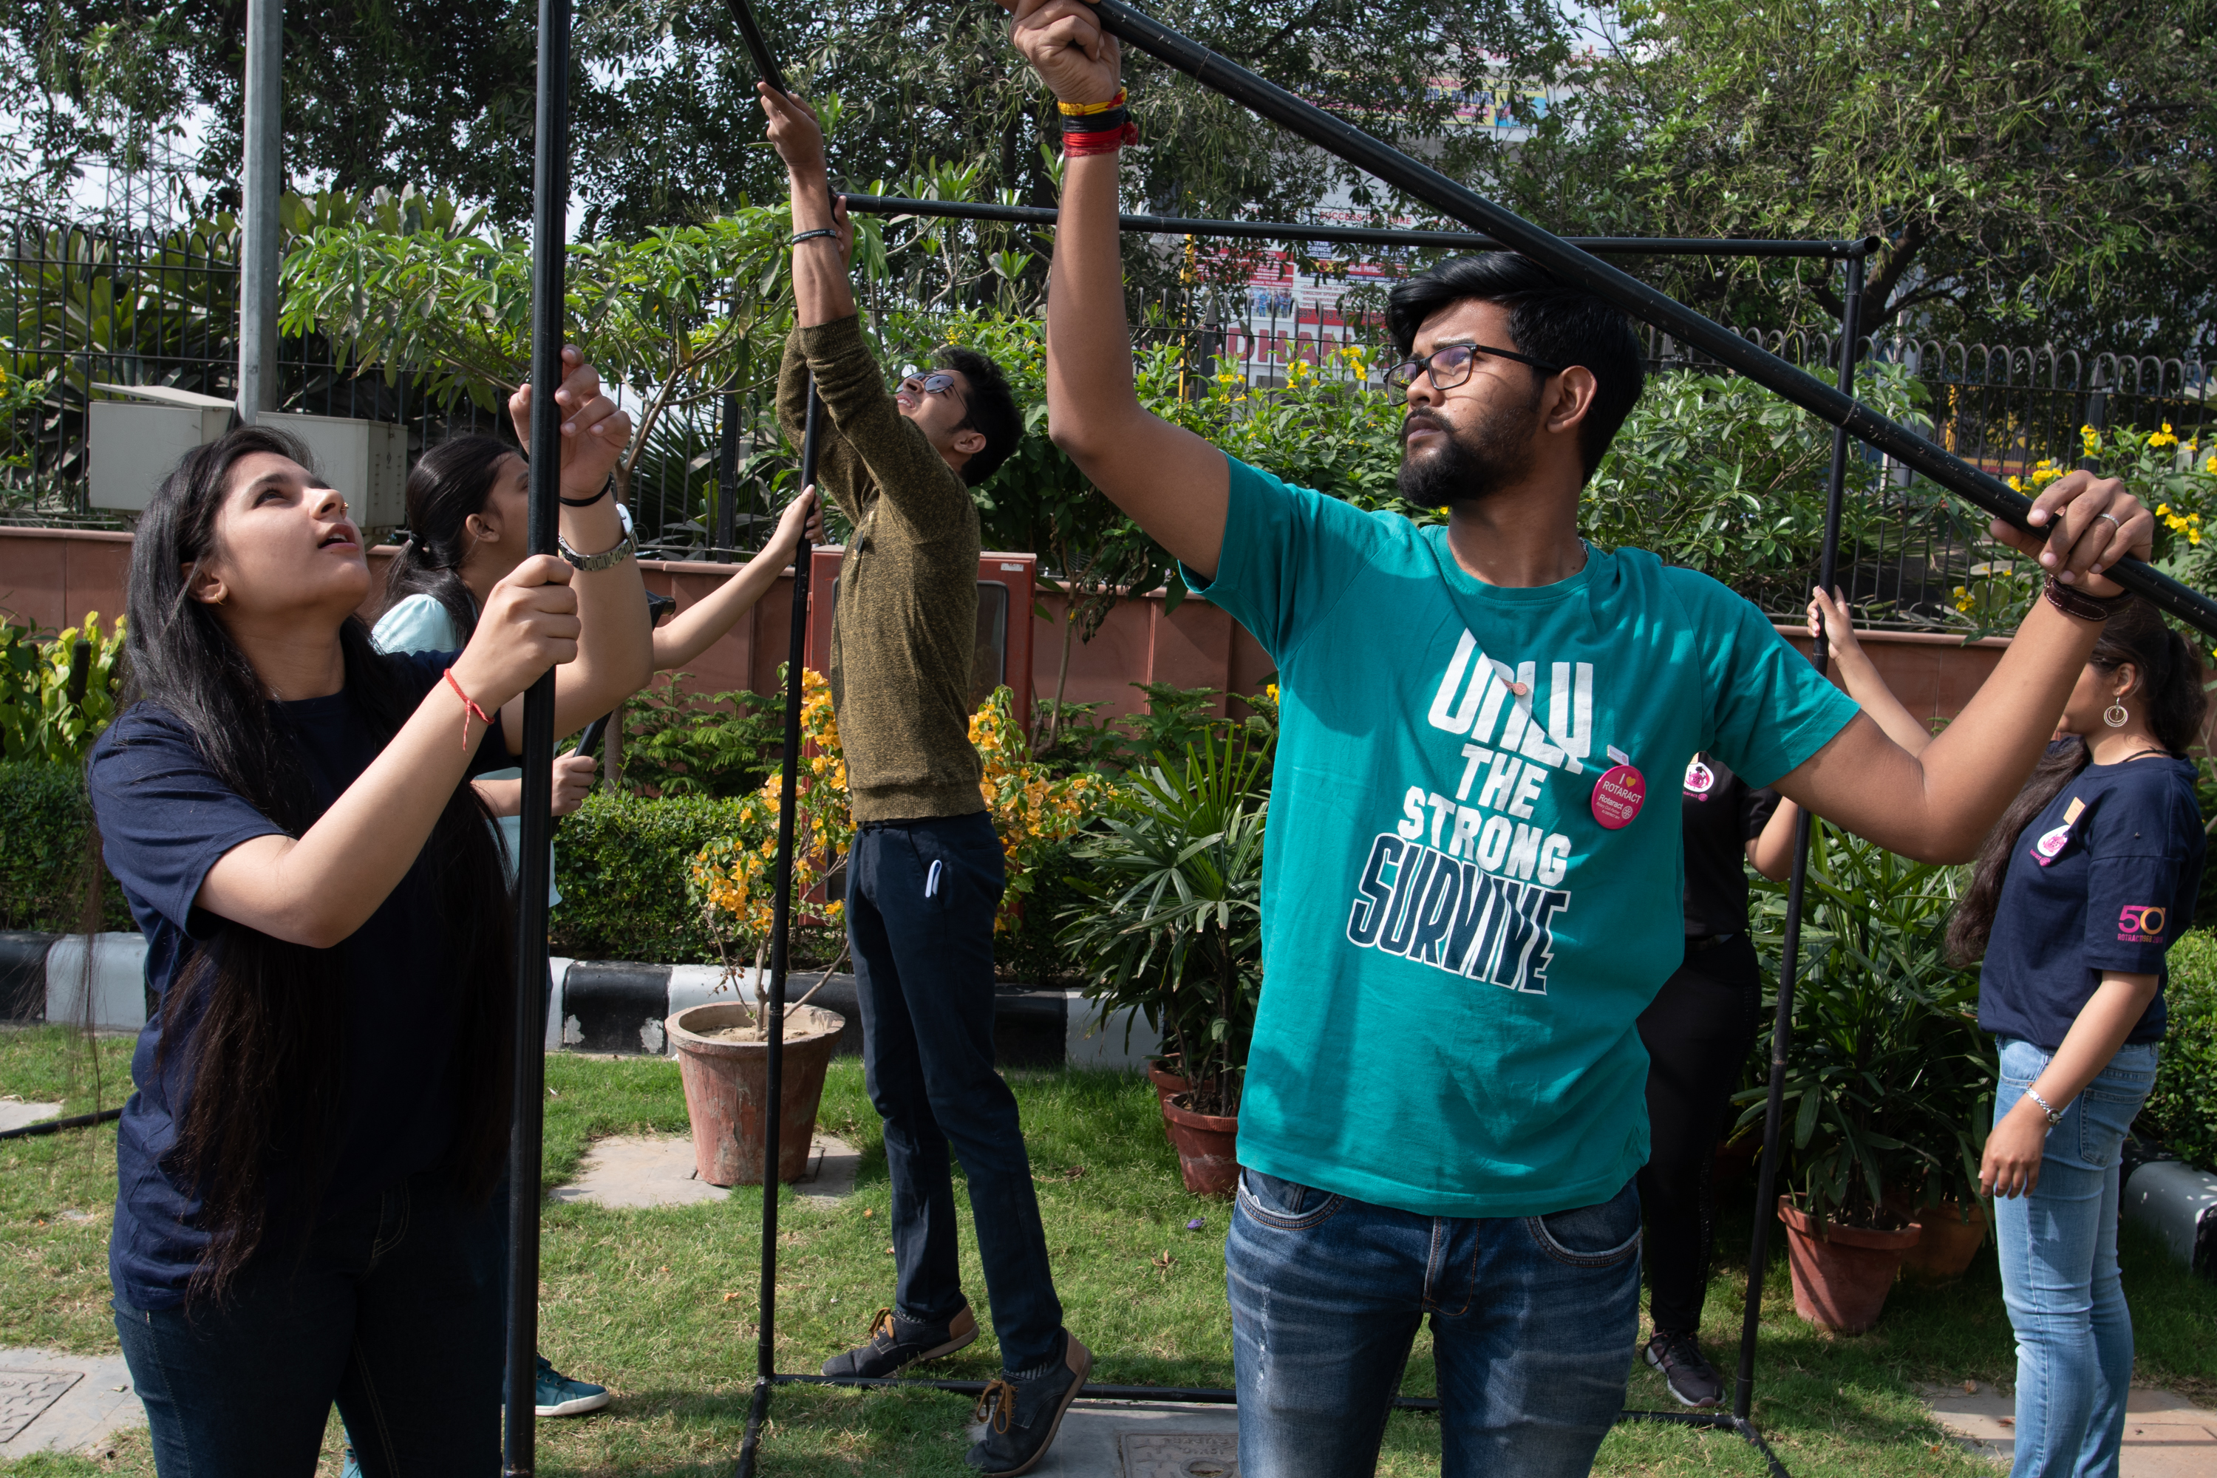
INCLUDE COMMUNITY MEMBERS
“The Secret Sauce”
87%
Invite community members to projects and fundraisers
67%
Hold one or more events to attract new members
Notes:
We can’t emphasize strongly enough how important the act of reaching out to the broader community is to creating the perception of a dynamic, attractive and welcoming group of people. As we quote from the survey. It really is the secret sauce, creating opportunities to engage and inspire ‘not yet Rotarians’.

Slide 28
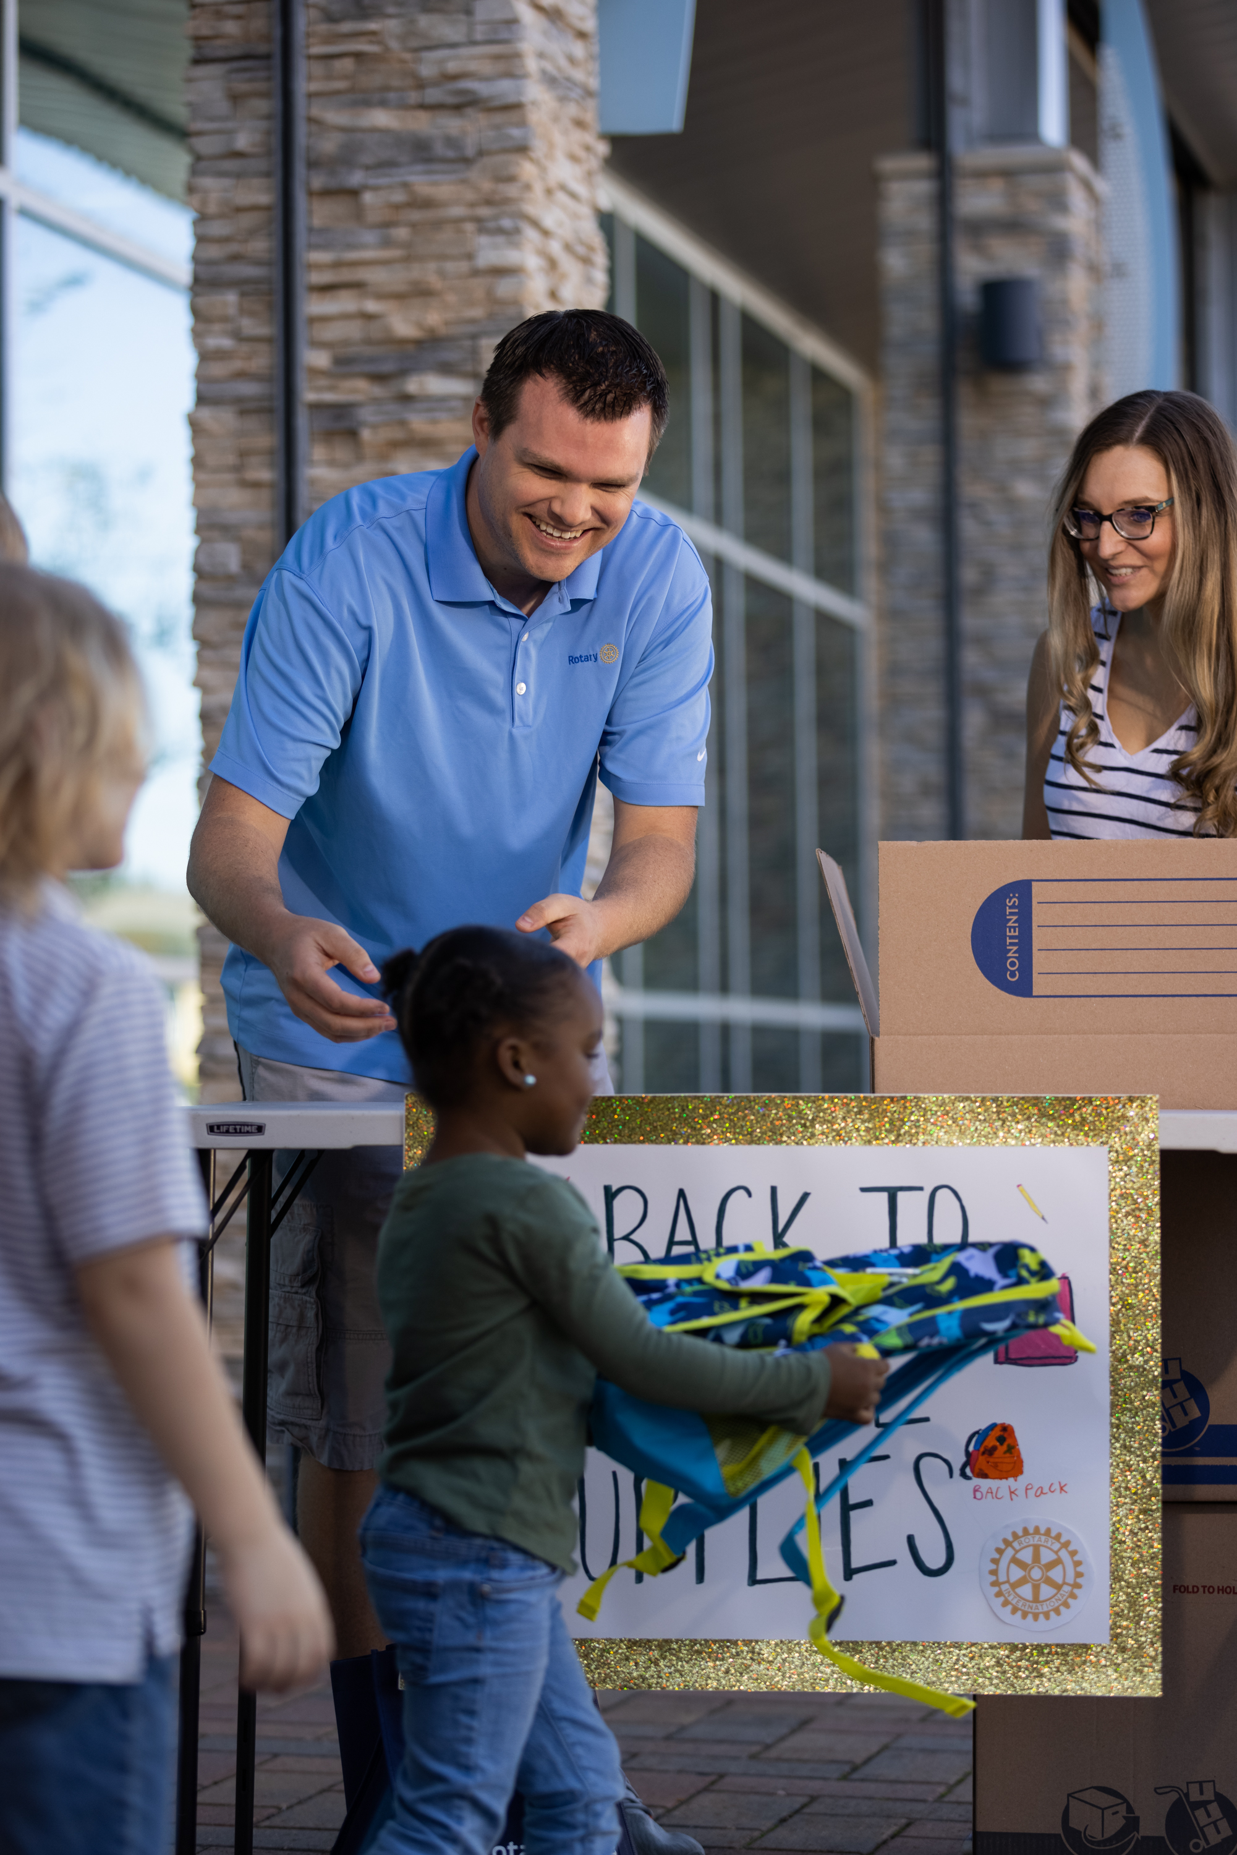
ONGOING, ACTIVE SERVICE
78% Had 4 or more Service Projects during the year
40% had 10 or more!
Notes:
These clubs have frequent service projects. Only about 20% of the clubs indicated that they only have a few service projects. Nearly 40% of the clubs have more than 10 service projects per year. Let’s hear club leaders talk about service.

Slide 29
Video: Service Matters
https://www.youtube.com/watch?v=nEplgkEeprk&list=PLGunX5-Uh7ZN-kEywsRRuQBb-mxq12bno&index=9&pp=iAQB
Dave Schwickerath
Rotary Club North Cobb County, Georgia USA
2 min 35 secs

Slide 30
STRONG PUBLIC IMAGE
ACTIVE USE OF MEDIA TOOLS
FOCUS ON MEMBER ATTRACTION
It’s not just doing, it’s being seen doing!
Notes:
Public Image also has played a key role in club growth. It’s not just doing, it’s being seen doing.

Slide 31
ACTIVE USE OF MEDIA TOOLS
95%
Use Facebook
21%
Use Instagram
77%
Use Their Club Website
55%
Use Local Print News Outlets

Slide 32
USING PUBLIC AWARENESS TO FOCUS ON MEMBER ATTRACTION
67%
Hold events to attract new members
77%
Many members sponsor new members
87%
Invite community members to projects
Notes:
Now, club leaders will talk about their approaches to public image in their community.

Slide 33
Video: Getting the Word Out
https://www.youtube.com/watch?v=ayIWo95fILg&list=PLGunX5-Uh7ZN-kEywsRRuQBb-mxq12bno&index=11&pp=iAQB
Todd Shepard
Tri-Cities Sunrise (Burbank) Washington USA
2 min 25 secs

Slide 34
DIVERSITY, EQUITY, INCLUSION
AN INTENTIONAL FOCUS
CLUB REFLECTS THE COMMUNITY
A WELCOMING ENVIRONMENT
Notes:
During interviews with club leaders, it became clear how important a contributor increasing club diversity was to club growth.
Club leaders were intentional in increasing their club’s diversity, recognizing, for example, that younger members are necessary to ensure the club’s long term viability; that they needed to broaden the professions represented in their club; or acting to reduce costs to make membership more appealing.
They also worked to make sure their membership reflected their community and finally, perhaps most importantly, acted to create an environment where everyone felt genuinely welcomed.
I want to let another leader conclude this presentation. Mary Anne Velayo is from the Vancouver Mountainview club, a club that grew from 18 to 52 during the period of this study. Let’s listen to her view of Rotary leadership.

Slide 35
Leadership Focus
ACTIVE, INTENTIONAL MEMBER ENGAGEMENT
DYNAMIC, MEANINGFUL SERVICE
EFFECTIVE GOVERNANCE (Intentional Leadership)
STRONG PUBLIC IMAGE
(WELL KNOWN IN COMMUNITY)
DIVERSITY, EQUITY & INCLUSION
Notes:
First, and most importantly, we see that leadership is more than an attribute for success – it is an essential, over arching requirement. Strong leaders create strong clubs. More than this, leaders of clubs focused on 5 key areas, which we will explore in more detail:
Outstanding governance – clubs are well organized, plan, set goals and have continuity in leadership.
Active, intentional member engagement – A healthy, engaged and inspired membership is key to club success.
Dynamic, meaningful service – engaged members keep busy ‘doing’ throughout the year. Rotary is about service.
Strong public image – Clubs aren’t just doing – they’re seen to be doing.
Diversity, Equity and Inclusion – ensuring club membership reflects their community
While not all leaders focussed equally on all 5 areas, most clubs take all these areas seriously.

