Slide 1
Celebrate World Polio Day

Slide 2
Notes:
Today, October 24 is World Polio Day. Currently there are only 2 countries with wild Polio virus - Afghanistan and Pakistan.

Slide 3
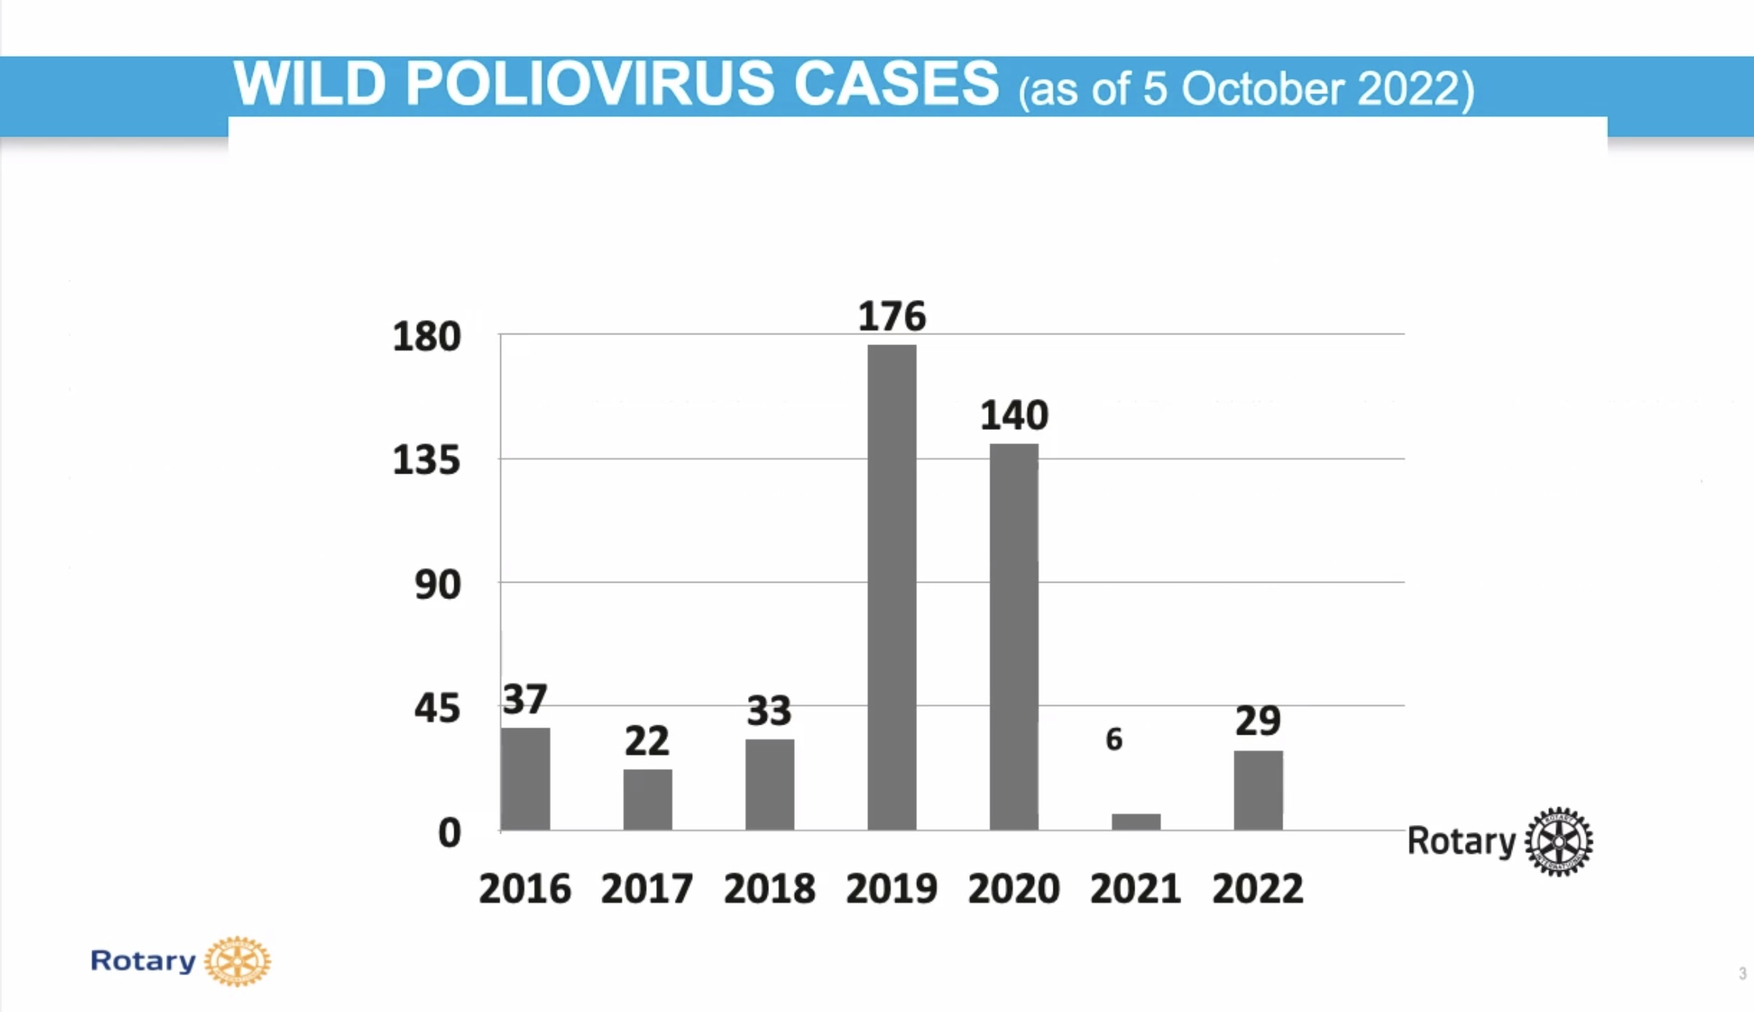
Notes:
The Wild Poliovirus as mentioned before is contained in 2 countries - Afghanistan and Pakistan. The cases in Pakistan are contained to a small area. Rotary believes that the world will be wild polio free by 2025.

Slide 4
Notes:
We need to celebrate our successes. Polio cases have declined by 99.9% and over 95% of the Global population lives in a Polio free world. Last year alone over a billion doses of vaccine were administered.
A concern is vaccine derived Polio which happens when the live virus contained in the vaccine is allowed to circulate in the environment because vaccine rates are either low or were stopped. It is not as severe as the wild Polio but it is still Polio.
To counter this, a new Novel Oral Polio Vaccine Type 2 has been developed. So far millions of doses have been administered and to date there has not been any sickness due to the new vaccine.

Slide 5
Notes:
Because polio is primarily transmitted by fecal - oral contact, testing of waste water is critical to see if the virus is circulating.

Slide 6
Five Fast Facts About Polio
Polio is a highly contagious virus …
Polio can strike at any age, but it mainly affects children under five …
Most people infected with Polio have no signs of illness …
Unlike most diseases, Polio can be completely eradicated …
COVID-19 is disrupting life-saving immunization services.
Notes:
Unfortunately for many countries they do not have the resources to fight COVID, measles, polio and the many other diseases that are out there. This has caused Polio to surge as vaccine rates have declined because the limited resources have been deployed to fight COVID.

Slide 7
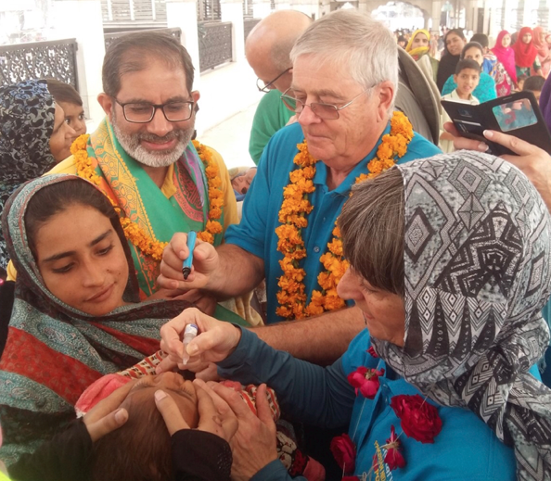
Notes:
As many countries do not have the infrastructure to do the injectable vaccination, an oral vaccine was developed that used a weakened live virus.
Hundreds of million children have been vaccinated because people like you and me can give a child the drops.
It proved to be enormously successful and has been instrumental in eradicating polio from 99.9% of the world. BUT, it has caused outbreaks of vaccine derived Polio.

Slide 8
Notes:
This map shows where there are currently outbreaks of vaccine derived polio shown in green. The wild Polio virus is shown in yellow. The closest country to us is the US, in particular New York State. Recently, waste water serveillance has shown the Polio virus has been spreading to other areas of New York State.

Slide 9
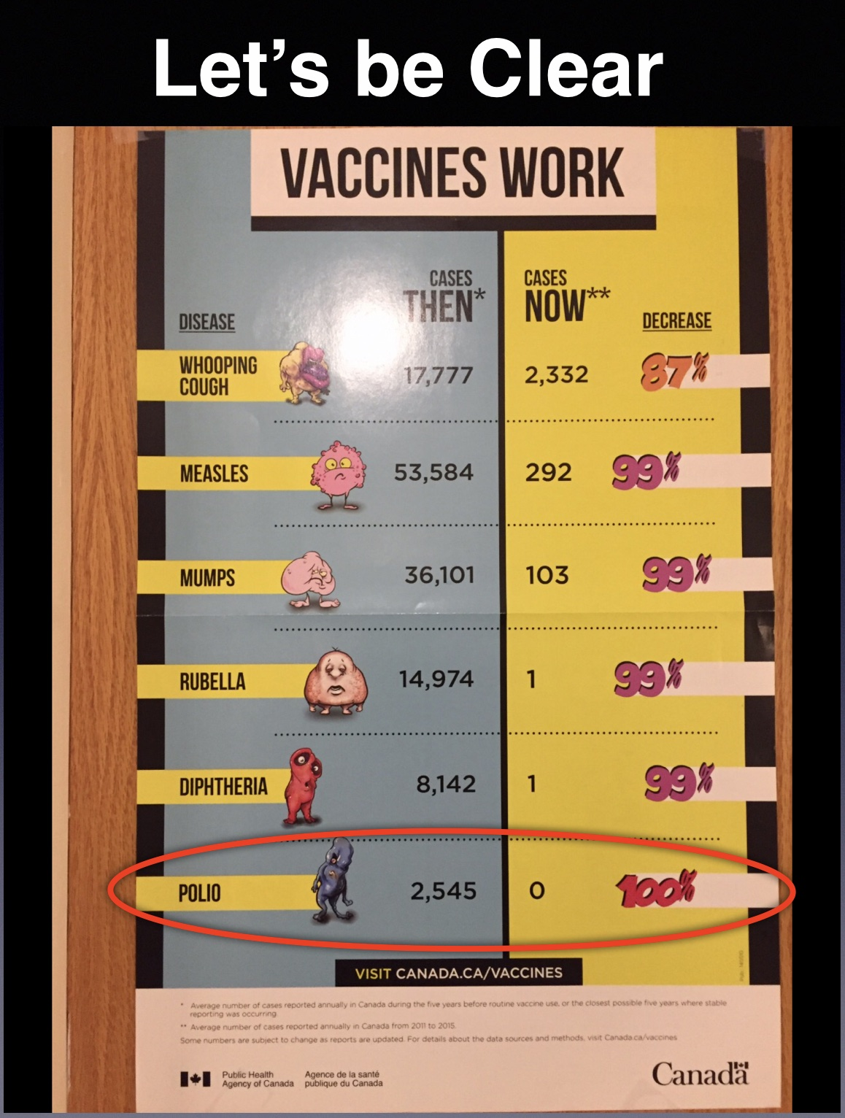
Notes:
A person will not get Polio if they have been vaccinated. Unfortunately, people have forgotten how dangerous this disease is and how easily it is transmitted. Many young children are not vaccinated and therefore are at risk.

Slide 10
Notes:
The new oral vaccine was developed starting in 2017. It was rolled out in March 2021 and there have now been over 370 million doses delivered in over 20 countries. The results have been very encouraging and it is hoped this will be a turning point in the complete eradication of Polio.
World Polio Day is a celebration. In 1985, when Rotary got involved in the eradication of Polio, there were over 350,000 cases of Polio worldwide. People who have contributed to eradicating Polio should be able to proudly say in the very near future, that they were part of this disease being eradicated from the world.

Slide 11
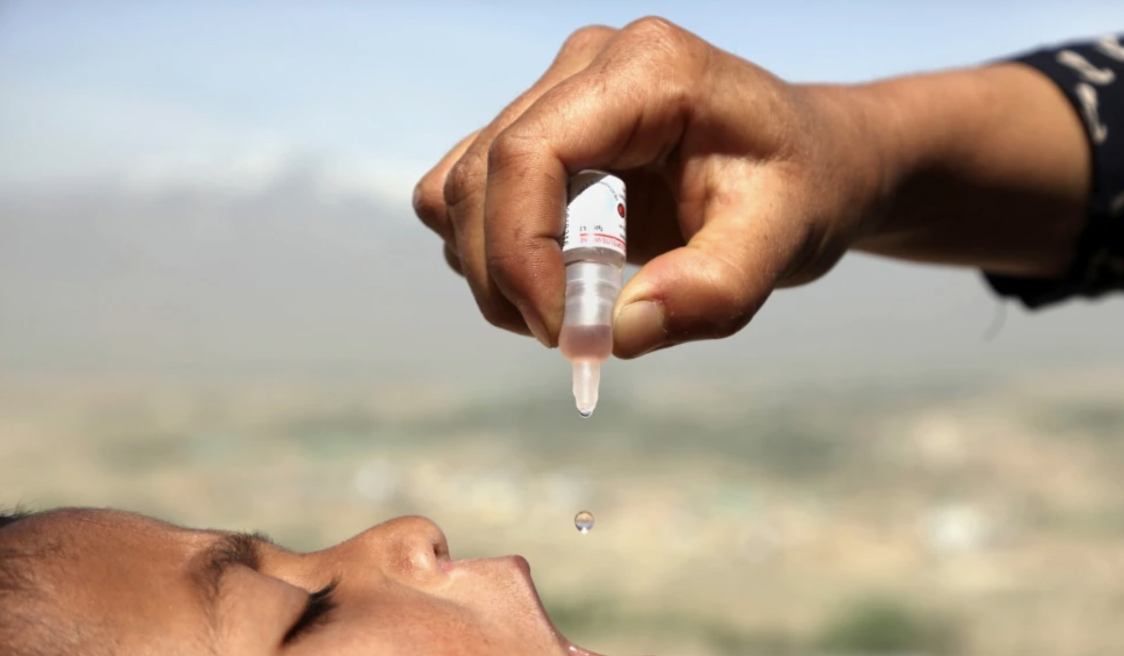
As long as poliovirus circulates,
everyone must be vaccinated.
No exceptions.
Notes:
Thank you.

