Slide 1

PUBLIC IMAGE 101
April 2023
Notes:
Everything I am going over today can be found on our District website and/or My Rotary.

Slide 2


Rotary’s public image…
Rotary’s public image isn’t just what we think of ourselves.
It’s also what people outside of Rotary think about us.
Getting people to recognize Rotary’s name > our brand, our tagline, is a start, but our work needs to go further.
Notes:
The tagline is really our “theme” for marketing Rotary vs the RI President yearly themes, which are meant to motivate the members.

Slide 3
PROMOTING ROTARY
Talking about Rotary in ways that explain what we do and the impact we make is essential to enhancing people’s understanding, appreciation and support - inspiring them to get involved – as members, volunteers, partners, and donors.
Promoting Rotary to the general public can be as simple as wearing your Rotary pin or as elaborate as organizing an integrated marketing campaign.
“Telling our story”…
Elevator Speech
Website, Social Media (Club, District, My Rotary – Rotary Showcase) - stories, videos…
Media releases, invites
‘Inclusive’ club meetings, functions…
Speaking engagements - non-Rotarians
Public Image Committee – public image strategies, website and social media champion(s)
WE ALL HAVE A PART TO PLAY IN PROMOTING ROTARY!
Notes:
SLIDE – 4 CLICKS
Comment: CTV coverage of Polio Eradication – discussion with PRIP John Germ and his reply to me – what action did I take to get the word out?
Personalize the story you are telling for greater impact.

Slide 4

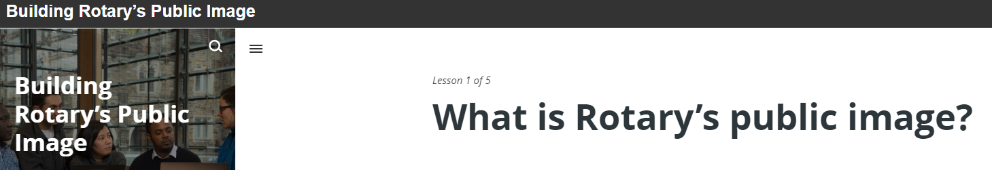
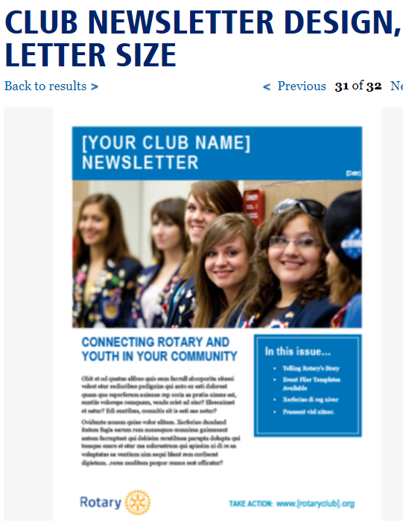


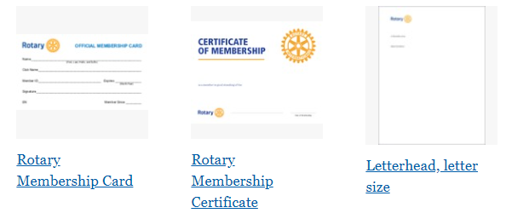

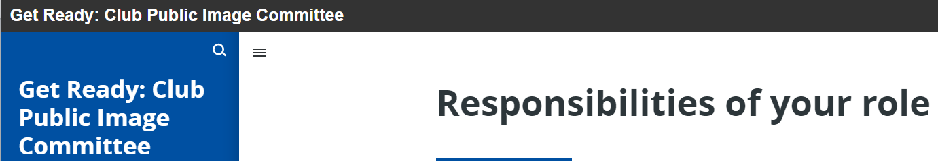
Welcome to the Rotary Brand Center
MY ROTARY: Resources
www.my.rotary.org
Notes:
We need to gather our resources to help our club “spread the word”.
We need to use the correct LOGOs, branding and wording.
THE BRAND CENTER has it all and the basic work is already done.
Stationary, videos, newsletter templates, posters, brochures, flags and banner templates, event resources and many other items.
Pre-made ad for print, online, outdoor, broadcast and radio.

Slide 5
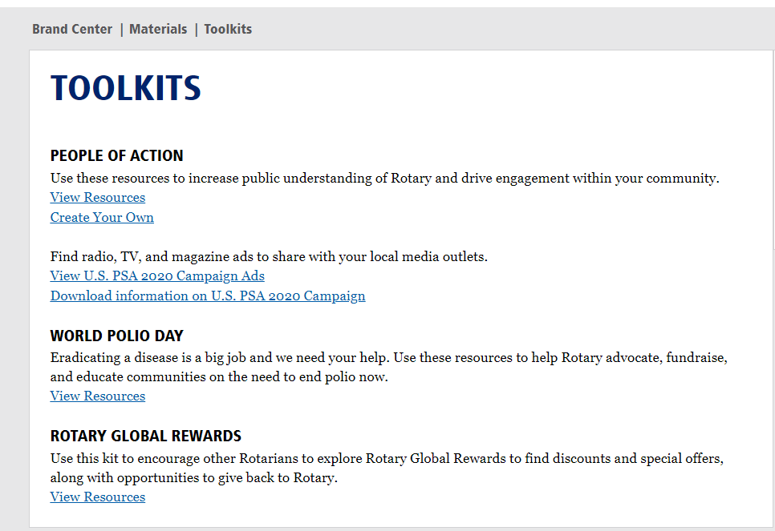
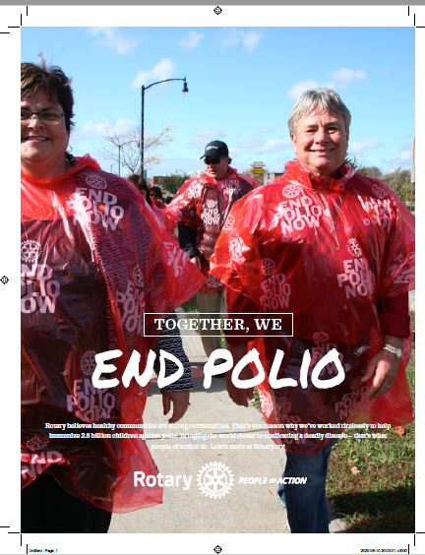
Making Your Own - “people of action” ads
MY ROTARY: Resources
www.my.rotary.org

Slide 6
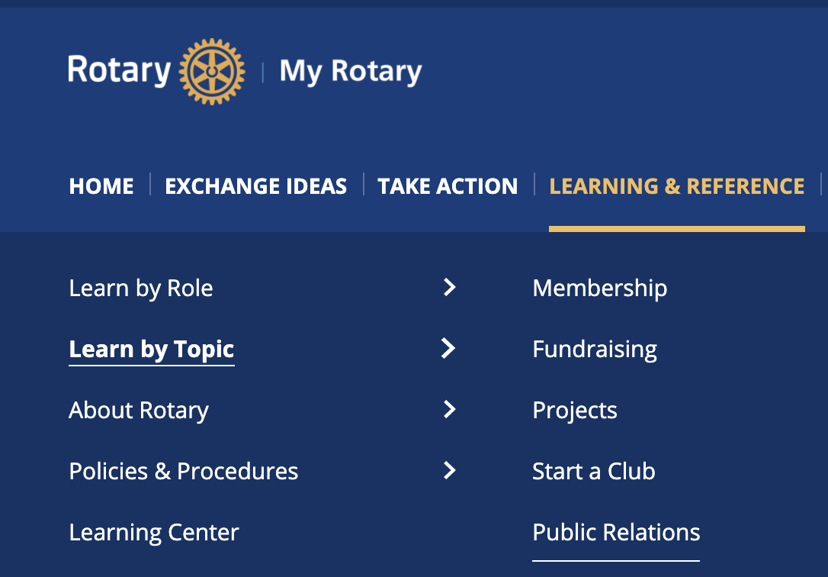
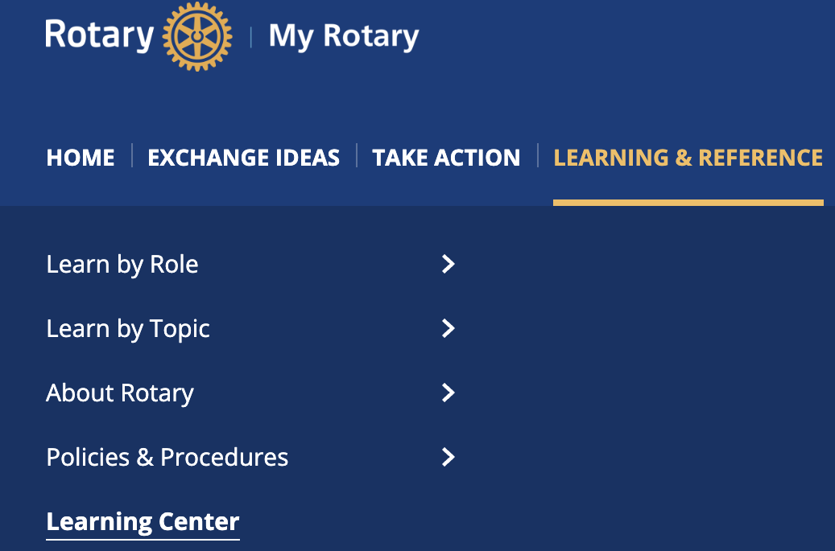

Learning & reference
MY ROTARY: Resources
www.my.rotary.org
https://my.rotary.org/en/learning-reference/learn-topic/public-relations
Notes:
Recommend 2 online courses:
“Building Rotary’s Public Image” “Promoting Your Club as People of Action”

Slide 7
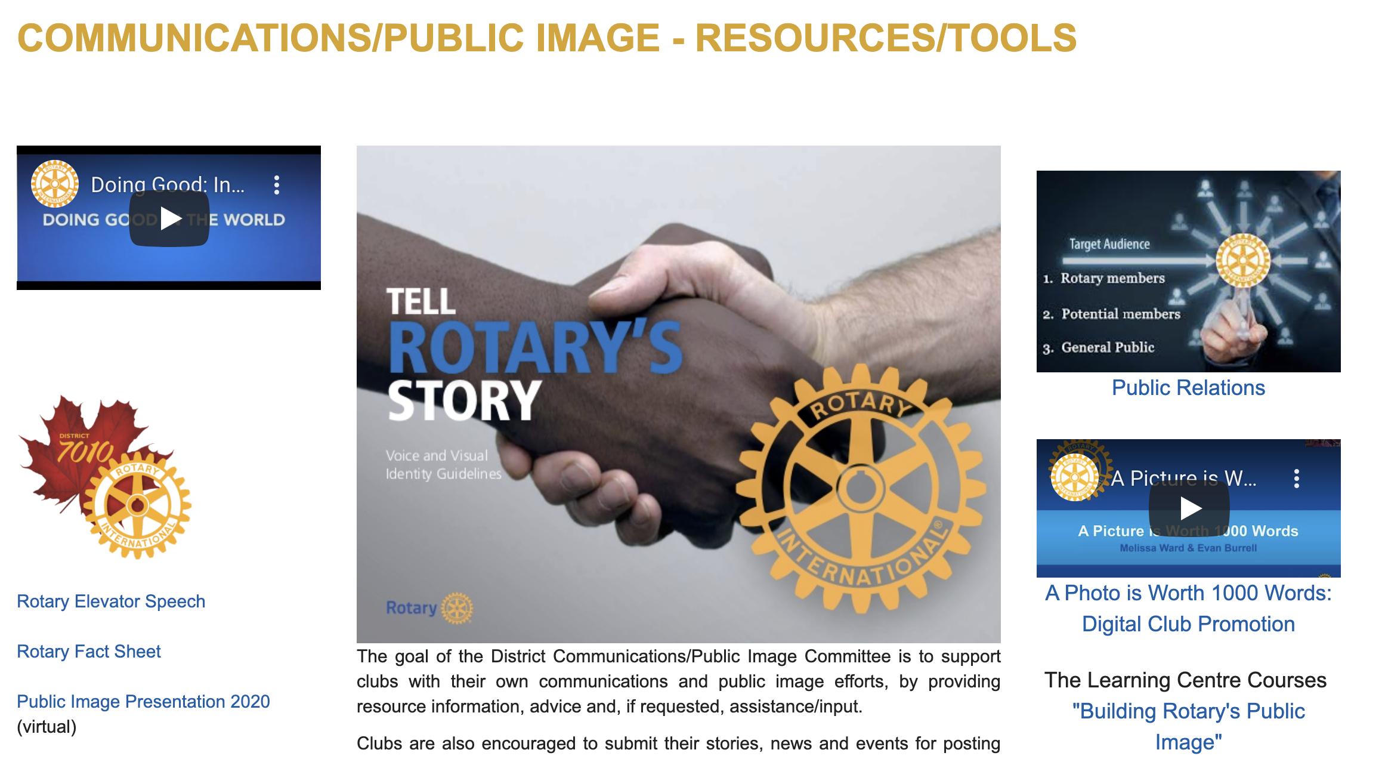
DISTRICT WEBSITE
www.rotary7010.org
Serves 2 roles…
Promote and educate awareness about Rotary – to BOTH non-Rotarians AND Rotarians
Members’ – Resources/Tools
Notes:
Additional resource info via District Website.

Slide 8
District 7010 communications/public image
We are here to provide advice and assistance to you and your Clubs with their communications needs (internal/external)
and public image efforts.
PDG Bill Hagborg, Director bhagborg77@gmail.com
705.471.2956

