Slide 1
This is Rotary (RI)
Rotary 101
by Joyce Campbell
Notes:
Rotary 101 is a very quick overview of what Rotary is all about.
There are so many programs of Rotary International and The Rotary Foundation – hopefully this will answer some of your questions and/or make you want to learn more.

Slide 2
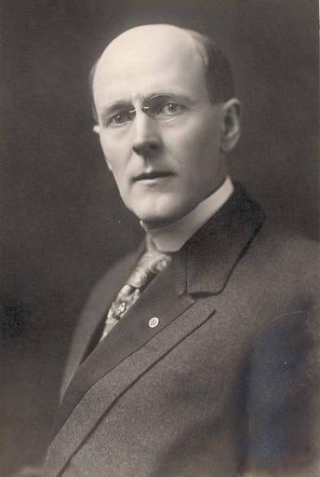
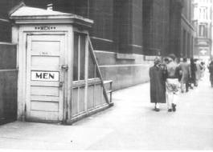
The Beginning
Paul Harris
Notes:
Rotary is the very first service club in the world.
The Rotary Club of Chicago was formed in 1905 by Paul Harris.
Rotary’s name was derived from the early practice of rotating meetings among members offices.
Rotary’s popularity spread and within a decade, clubs were chartered from San Francisco to New York to Winnipeg, Canada, the first club outside the United States to be officially chartered.
By 1921, Rotary clubs had been formed on six continents. The organization adopted the International name a year later.
The very first service project was a public washroom for men in Chicago.

Slide 3
Motto
Notes:
The motto - Service Above Self. This motto exemplifies the humanitarian spirit of the organization.
Strong fellowship among Rotarians meaningful community and international service projects characterize Rotary world wide.

Slide 4
Rotary International (RI)
World’s First Service Club
1.2 million Rotary members
35,000 clubs
22,000 clubs
250,000 Rotaract members
500,000 Interact members
Notes:
By 1925, Rotary had grown to 200 clubs with more than 20,000 members.
The organization’s distinguished reputation attracted presidents, prime ministers and a host of others including Albert Schweitzer.
Today, after 100 years these are approximately numbers

Slide 5
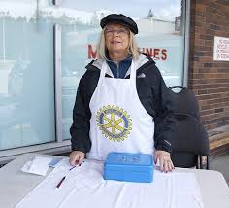
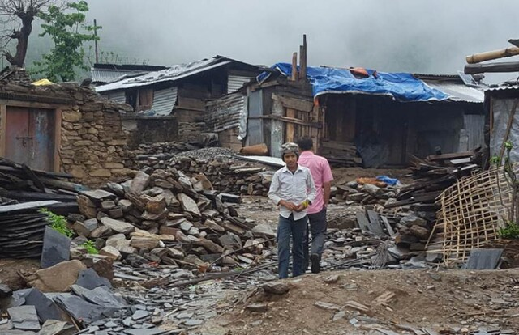
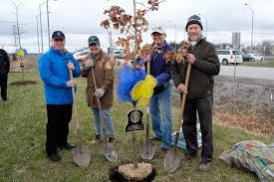
The Organization of Rotary
Grassroots
Service
District and International
Notes:
Rotary is essentially a grassroots organization, with most of its service efforts being carried out at the club level.
The district and international structure is designed to support clubs and help them provide more service in their local and international communities.

Slide 6
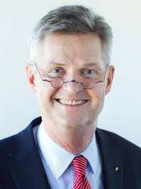
Rotary International President 2020 - 2021
Holger Knaack from Herzogtum Lauenburg-Molln, Germany
Notes:
Every year we have a new president.
This Rotary year for 2020 – 2021 Holger Knaack from Rotary Club of Herzogtum Lauenburg-Molln, Germany

Slide 7
2020– 2021 Theme
Notes:
Again, every year the RI President selects a new theme.
This year – Rotary Opens Opportunities

Slide 8
RI Board of Directors
19 members
President and President-elect
Notes:
The 19 members of the RI Board of Directors come from all over the world.
They meet quarterly to establish policies.

Slide 9
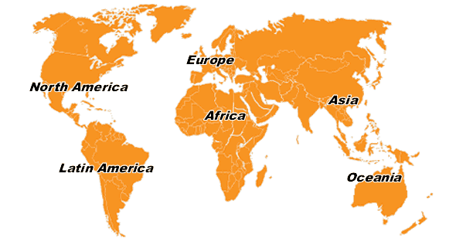
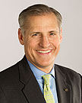
The Secretariat RI Headquarters Evanston, Illinois
Chief Operating Officer
RI General Secretary
800 Staff
John Hewko
Notes:
Now what about staff
John Hewko is the Chief Operating Officer and the RI General Secretary who heads up about 800 staff
Rotary International is headquartered in Evanston, Illinois with international offices:
Europe and Africa Office in Zurich, Switzerland
South Asia Office in New Delhi, India
Brazil Office in San Paulo
Japan Office in Toyoko
Korea Office in Seoul
South Pacific and Philippines Office in Sydney
New South Wales Office in Australia
Southern South America Office in Buenos Aires, Argentina
Rotary International in Great Britain and Ireland (RIBI) an independent office but still affiliated with Rotary, in Alcester, England

Slide 10
Rotary’s Vision Statement
“Together, we see a world where people unite and take action to create lasting change — across the globe, in our communities, and in ourselves.”
Notes:
READ

Slide 11
Mission of Rotary International
Rotary is a global network of 1.2 million neighbors, friends, leaders, and problem-solvers who see a world where people unite and take action to create lasting change – across the globe, in our communities, and in ourselves. Solving real problems takes real commitment and vision.
Notes:
READ

Slide 12
Notes:
Rotary’s Guiding Principles - Integrity - Service – Friendship – Diversity - Leadership

Slide 13
Notes:
FIRST – The development of acquaintance as an opportunity for service;
SECOND – High ethical standards in business and professions, the recognition of the worthiness of all useful occupations and the dignifying of each Rotarians’ occupation as an opportunity to serve society;
THIRD – The application of the ideal of service in each Rotarian’s personal, business and community life;
FOURTH – The advancement of International understanding, goodwill, and peace through a world fellowship of business and professional persons united in the ideal of service.

Slide 14
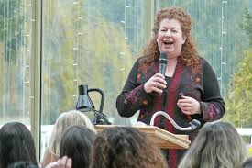
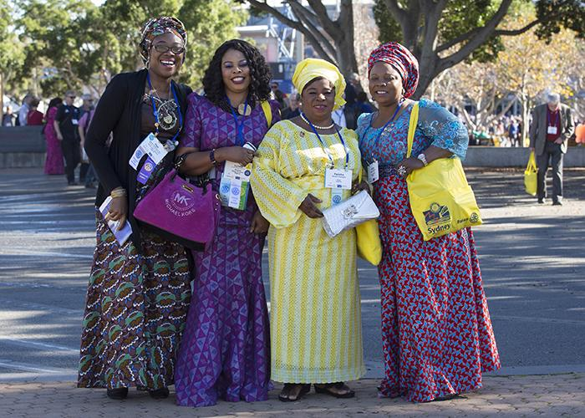
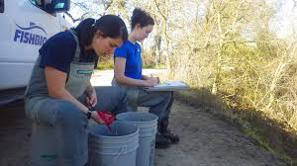
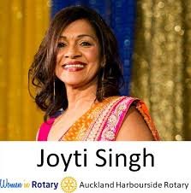
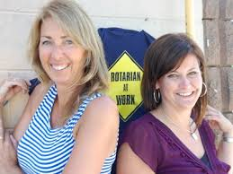
Women in Rotary
Notes:
Did you know that on January 23, 1989, the Council on Legislation voted to admit women into Rotary clubs worldwide? This remains a watershed moment in the history of Rotary.

Slide 15
RI Action Plan
To increase our impact
Expand our reach
Enhance participant engagement
4. Increase our ability to adapt
Notes:
The new Strategic Plan is different from past plans. It will be our Action Plan – our organization’s call to action work together to build a stronger future.
As People of Action, we share a strong sense of purpose.
As People of Action, we understand that fulfilling that vision takes a plan.
This is Rotary’s plan for the next few years

Slide 16
Priority #1 Increase Our Impact
Notes:
People of Action are effective problem solvers.
Let’s seek new ways to translate our expertise into making a difference in our communities and across the globe. Let’s prove that our impact on the world has just begun

Slide 17
Priority #2 Expand Our Reach
Notes:
People of Action activate and inspire one another.
Let’s build connections and opportunities that will allow people who share our drive to do the same

Slide 18
Priority #3 Enhance Participant Engagement
Notes:
People of Action strive to understand the needs of others.
Let’s recommit to putting the needs, expectations and growth of our participants at the center of all we do.

Slide 19
Priority #4 Increase Our Ability to Adapt
Notes:
People Of Action are inventive, entrepreneurial and resilient.
Let’s stay true to ourselves and stay ahead of change in our next 100 years.

Slide 20
Rotary’s World and Our Rotary Family
34 Zones
535 Districts
35,000 Clubs
1.2 Million Members
220 Countries
Notes:
This is our Rotary world and our Rotary family.
1.2 million members – 34 Zones - 535 districts - 35,000 clubs in 220 countries we are a huge organization.

Slide 21
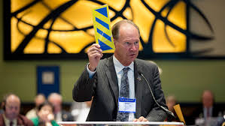
Councils – Legislation and Resolutions
Notes:
The Councils give us a voice on how our organization is governed.
Council on Legislation – A meeting where representatives from Rotary’s 535 Districts vote on policy that affect clubs worldwide. It takes place every three years.
The Council on Resolutions meets online every year to vote on proposed resolutions, which express opinions and make recommendations to the RI Board.

Slide 22
Rotary.org – My Rotary
Rotary Club Central
Brand Center
Rotary Showcase
Learning Center
Discussion Groups
Notes:
I encourage you to go to rotary.org – My Rotary and set up and account. Tons and tons of information
Rotary Club Central – is an online tool for setting goals. Explore data and trends related to your club’s goals.
Brand Center – tells the story of Rotary and how we are People of Action in your community and around the world
Rotary Showcase – Rotary members and program participants are improving lives in communities and around the world every day through thousands of service projects.
Learning Center – Features courses on how to give a speech, Rotary courses, Zone and District courses.
Discussion Groups – are group discussions.

Slide 23
Notes:
These are some of the images available for you and your club to use in the Brand Center

Slide 24
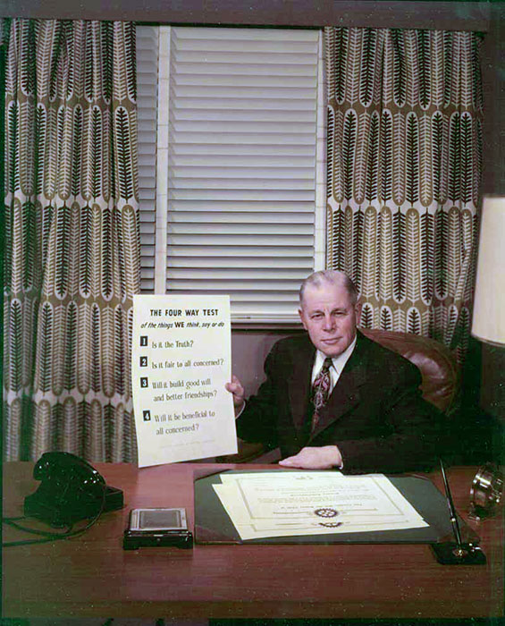
The Four-Way Test
Of the things we think, say or do
Is it the TRUTH?
Is it FAIR to all concerned?
Will it build GOODWILL and BETTER FRIENDSHIPS?
Will it be BENEFICIAL to all concerned?
Herbert Taylor
Notes:
In 1932, Rotarian Herbert Taylor, owner of a cookware company used this as an ethical yardstick for his employees.
In 1954, when he became Rotary International President, he formally presented Rotary with the copyright.
The Four-Way Test has been translated into more than 100 languages
So, of the things we think, say or do:
Is it the Truth?
Is it Fair to all concerned?
Will it build Goodwill and Better 0friendships?
Will it be Beneficial to all concerned?

Slide 25
4 Countries – 2 Languages
Notes:
Rotary International's Board of Directors is elected by Rotary's 34 zones.
Zone 28, which we belong, includes Canada, France, Bermuda and part of the United States.
Four countries and two languages.

Slide 26
District 7010
District administration includes:
Assistant Governors
Committees
Rotary Weekend
Rotary 101
Rotary Leadership Institute
Notes:
Rotary Districts exist to help Rotary clubs excel. We belong to District 7010.
Districts connect clubs with each other through Assistant Governors and committees.
The District also trains club leaders so that Rotarians get the most from their membership and shine as leaders in their communities.
Rotary Weekend trains President-elects, Secretaries, Treasurers, Board members and interested Rotarians.
Rotary 101 is a quick overview of RI and TRF
Rotary Leadership Institute is the next level training for leaders

Slide 27
2020 -2021 District Governor
Lynne Chant
Rotary Club of Peterborough-Kawartha
Notes:
The District Governor performs a very significant function in the world of Rotary.
He is the single officer of RI in the geographic area called a District. The District Governor who has been extensively trained at the International
Assembly and regionally at the Governors-elect training seminar. District Governors are responsible for the high performance of the clubs in his District.
He is a very experienced Rotarian who generously volunteers more that a year to lead the District.
Our District Governor for 2020– 2021 is Lynne Chant of the Rotary Club of Peterborough-Kawartha

Slide 28
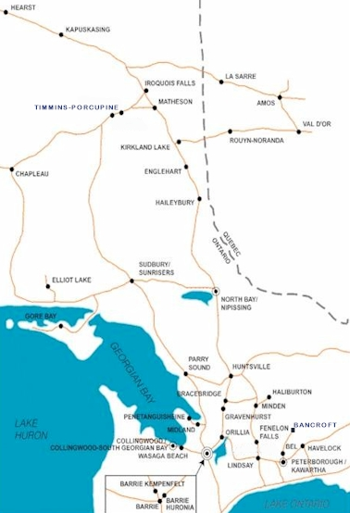
District 7010
40 Clubs
1450
Active
Rotarians
Notes:
Our district has 40 clubs with a huge geographical area. 7 Rotaract clubs and 9 Interact clubs
We extend from Hearst in the north
Val d’Or, Quebec in the north east
Peterborough in the south east
Collingwood to the west
Innisfil in the south.

Slide 29
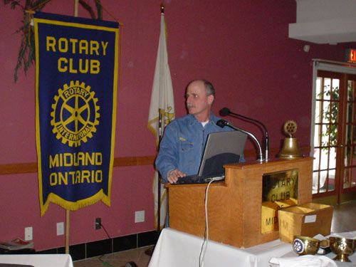
Clubs
We are members of a Rotary Club
Belong to Rotary International
RI constitution and bylaws
Notes:
We are all members of our Rotary clubs. And those clubs belong to District 7010 that are in Zone 28 of Rotary International.
We are not members of Rotary International.
We follow and abide by the recommended Rotary International constitution and bylaws.
We can set our own policies as long as they do not conflict with either the RI recommended constitution and bylaws.

Slide 30
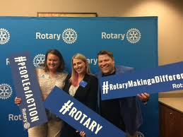
Benefits and Responsibilities of Membership
Active - Honourary
Fellowship
Service
Membership recruitment and engagement
Notes:
There are two types of members in Rotary – active and honourary.
Honourary members do not vote, do not pay dues
The 85 Factor are active members who the years in Rotary and their age equal 85. This is only applied if the Rotarian is 65 years old. The member then becomes attendance exempt.
All Rotary clubs share a key mission; to serve the community and those in need throughout the world.
To keep clubs strong, every Rotarian must share the responsibilities of bringing new people into Rotary. Remember someone shared Rotary with you.
Keeping members interested and engaged in Rotary is another responsibility.
Good club fellowship, early involvement in service projects and involvement in club operations are some of the best ways to sustain the club’s membership.

Slide 31
Club Flexibility
Change your meeting schedule
Vary your meeting format
Relax your attendance requirements
Offer multiple membership types
Invite Rotaractors to join your club
Notes:
Now we can change meeting days, times and frequency. But need to meet at least twice a month.
Meet in person, online, zoom or a combination including letting some members attend in-person meeting through the internet – not Covid 19.
Your club can ease attendance requirements and encourage members to participate in other ways – taking a leadership role, updating the website regularly, running a meeting a few times a year, planning an event.
Offer multiple membership options. Family memberships, junior memberships or corporate memberships. Each type of membership can have its own policy on dues, attendance and service expectations. Rotary will count these people in your club and will consider them active members if they pay RI dues.
Invite Rotaractors to join your club while remaining a member of their Rotaract club. If so special accommodations for these members, such as relaxed attendance requirements, reduced fees, as long as they are reflected in the club’s bylaws.

Slide 32
Classification Principle
Notes:
Rotary is the only service club that celebrates the members vocation by a classification principle.
When professionals join a Rotary club, they do so as a representative of their particular business or profession. This gives Rotarians the dual responsibility of representing their vocation within the club and of exemplifying the ideals of Rotary within the workplace.

Slide 33
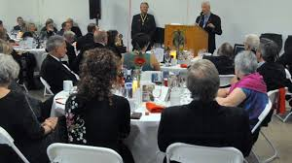
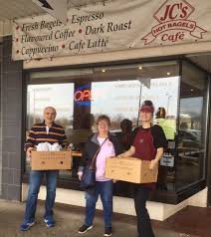
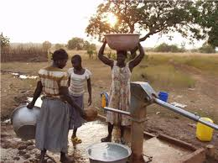
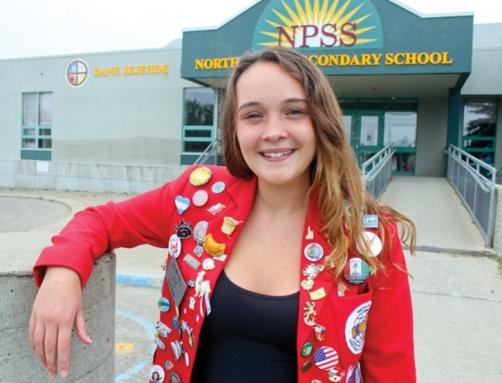
Avenues of Service
Club Service
Vocational Service
Community Service
International Service
Youth Service
Notes:
We channel our commitment to service through 5 Avenues of Service, which are the foundation of club activity.
CLUB SERVICE focuses on making clubs strong. A thriving club is anchored by strong relationships.
VOCATIONAL SERVICE calls on all Rotarians to work with integrity and contribute their work with integrity and contribute their expertise to the problems and needs of society.
COMMUNITY SERVICE encourages every Rotarian to find ways to improve the quality of life of people in their communities and to serve the public interest.
INTERNATIONAL SERVICE exemplifies our global reach in promoting peace and understanding. We support this avenue by sponsoring or volunteering in international projects, using local member expertise to build long term partnerships for sustainable projects, seeking service partners abroad and more.
YOUTH SERVICE recognizing the importance of empowering youth and young professionals through leadership development programs such as Rotaract, Interact, Rotary Youth Leadership Awards and Rotary Youth Exchange

Slide 34
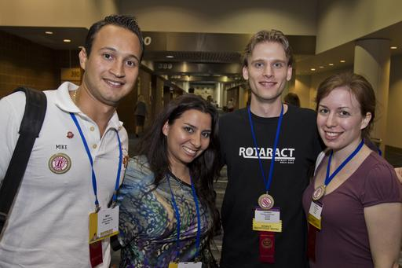
Rotary International Programs
Interact - 12 – 18 years
Rotaract - 18 – 30 years
Notes:
Rotary clubs organize and sponsor this service organization called Interact for youth ages 12 to 18. Each Interact club must plan annual projects of service to its school, its community and the world.
Rotaract was designed to promote responsible citizenship and leadership. Each club is required to complete at least two major service projects each year, one to serve the community and the other to promote international understanding.

Slide 35
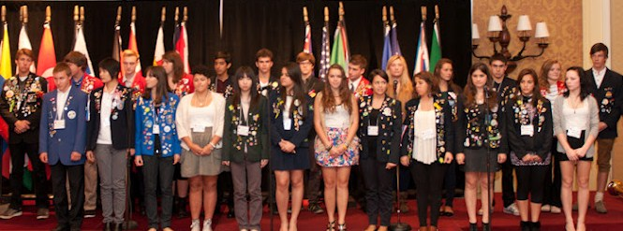
Rotary International Programs
Rotary Youth Leadership Awards (RYLA)
Rotary Youth Exchange – Long & Short
Notes:
Each year, thousands of young people are selected to attend Rotary sponsored leadership camps. RYLA. In an informal atmosphere, groups of outstanding young people ages 14 to 30 spend several days in a challenging program of leadership training and social activities.
Rotary Youth Exchange is one of the most popular programs to promote international understanding and develop life long friendships. The values of Youth Exchange are experienced not only by the high school student ages 15 to 19 but also by the host families, sponsor clubs, receiving high schools and the entire community.
Youth Exchange participants learn about customs, languages, traditions and family life in another country. There are more than 8,000 students in the program every year.
Long term students spend a year abroad and Short term exchanges vary from several days to weeks.

Slide 36
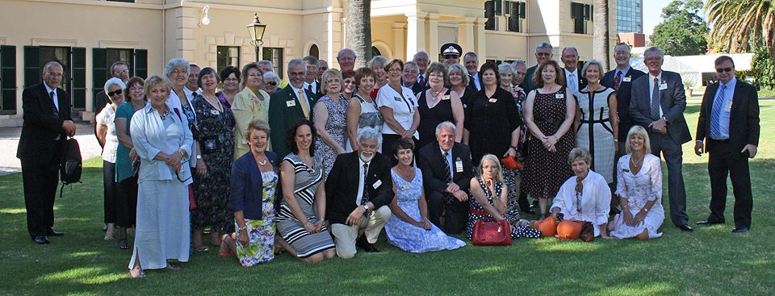
Rotary International Programs
Rotary Friendship Exchange
Rotarian Action Groups (RAG’s)
Rotary Volunteers
Notes:
Rotary Friendship Exchange are Rotary teams or individuals that make reciprocal visits to other countries. Staying in each others homes and learning cultures first hand. This exchange is funded by the participating individuals.
Rotary Action Group or RAGS are focused on specific humanitarian service activities such as dental volunteers.
Rotary Volunteers are Rotarians and other skilled professionals who offer services to local and international humanitarian service projects.

Slide 37
Rotary International Programs
Rotary Fellowships
Rotary Community Corps (RCC)
World Community Service (WCS)
Notes:
Rotary Fellowships are groups of Rotarians geared to vocational and recreational interests – tennis, sailing, music and even a law fellowship.
Rotary clubs organize and sponsor these groups of non –Rotarians who work to improve their communities; their are more than 6,000 Rotary Community Corps in 78 countries.
World Community Service is Rotary clubs and Districts from two different countries that form partnerships to implement community service projects.

Slide 38
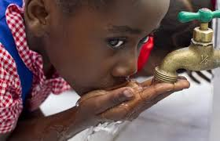
The Rotary Foundation (TRF)
Notes:
The Rotary Foundation of Rotary International is a not-for-profit corporation.

Slide 39
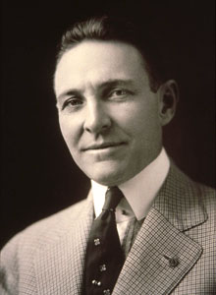
The Rotary Foundation
In 1917, an endowment was set up “for the purpose of doing good in the world”.
Arch Klump
Notes:
At the 1917 convention, outgoing Rotary president Arch Klumph proposed setting up an endowment “for the purpose of doing good in the world.” That one idea, and an initial contribution of $26.50, set in motion a powerful force that has transformed millions of lives around the globe.
In 1947, upon the death of Paul Harris a new era opened for the Foundation as memorial gifts poured in to honour the founder of Rotary

Slide 40
Mission of The Rotary Foundation
to enable Rotarians to advance
world understanding, goodwill and peace through the improvement of health, the support of education and the alleviation of poverty.
Notes:
READ

Slide 41
TRF Trustees
14 Members and General Secretary
Notes:
The Rotary Foundation Board of Trustees is responsible for managing the business of the Foundation.
Trustees are appointed to four-year terms.
There are 14 members and the General Secretary

Slide 42
The Rotary Foundation Programs
Annual Fund
Every Rotarian Every Year (EREY)
Endowment Fund
Polio Plus Fund
Notes:
All contributions go into one of three main funds.
Annual Fund
Endowment Fund
PolioPlus Fund and PolioPlus Partners
98% of funds contributed to the Foundation go to humanitarian, educational and cultural programs.

Slide 43
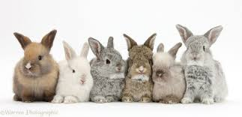
Annual Fund
Notes:
The Annual Fund, provides grants and awards through Foundation programs. Especially District Grants.
Think of this fund as bunnies having bunnies. They multiply. As District giving multiplies and the District gets 50% back after 3 years.
If and when you make a donation to TRF it is suggested you select this option as the money comes back to the District for grants to the clubs.
Example: If in this Rotary year we contribute $100,000 in 3 years we will have $50,000 available for District Grants.

Slide 44
Annual Fund
SUSTAINING MEMBER
Notes:
Every Rotarian Every Year (EREY). This is an individual who personally contributes some amount each year to the Annual Fund.
A sustaining member is an individual who personally contributes $100 US or more each year to the Annual Fund. Contributions are cumulative throughout the year.
Contributions count toward a Paul Harris Fellows.

Slide 45
Endowment Fund
Notes:
The Endowment Fund, is an endowment from which only a portion of the earnings are spent in support of The Rotary Foundation programs, ensuring the long term viability of the Foundation.
These contributions are professionally invested.

Slide 46
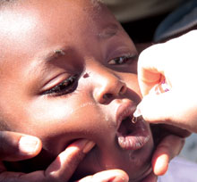
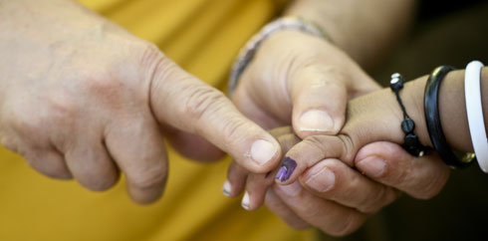
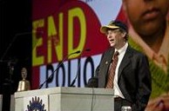
PolioPlus Fund
Notes:
The Polio Plus Fund supports Rotary’s goal of a polio free world.
Yes, the fight to end polio is 99% of the way to being eradicated.
Only 3 countries to go. Afghanistan, Pakistan and Nigeria
The majority of children that contract polio are under the age of 5.
2.5 billion children have been immunized at the cost of $.60 per child in 122 countries and we have spent $1.8 billion dollars.
The economic argument it is estimated that the eradication of polio will save the world between $40 and $50 billion in health care costs over the next 20 years.
Polio Plus Partners help with the marketing and distribution of the vaccine.

Slide 47
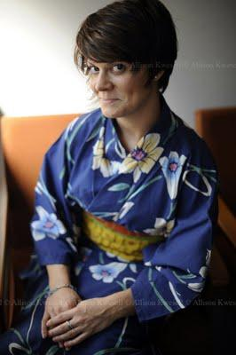
Educational Programs
Ambassadorial Scholarships
Rotary World Peace Fellowships
Notes:
TRF Ambassadorial Scholarship program is the world’s largest privately funded international scholarship program. For university level students.
Rotary World Peace Fellowships are awarded to individuals for study in master’s degree programs at one of the six Rotary Centers for International Studies in peace and conflict resolution.

Slide 48
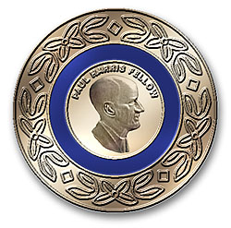
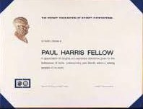
Paul Harris Fellows
Donors of $1,000 US or more
to
Annual Fund
PolioPlus
Paul Harris Society
Notes:
A special recognition of a pin and certificate is given to those who make a gift of $1,000 US to the TRF to either the annual fund or polio plus fund.
Each additional gift of $1,000 the gold pin includes a blue stone for donations from $2,000 to $6,000. Red stones signify gifts of $7,000 to $9,000.
The Paul Harris Society is for a Rotarian that pledges $1,000 US or more per year.
Paul Harris Fellows are given only to individuals.

Slide 49
Benefactor
Beneficiary of $1,000 or more
Notes:
Make the endowment fund a beneficiary in your estate plan by donating $1,000 US to $9,999 US will make you a Benefactor.
TRF will give you a certificate and wings that can be attached to a Rotary pin.

Slide 50
Bequest Society
Beneficiary of $10,000 US or more
Notes:
Couples or individuals that make the Endowment fund a gift of $10,000 US or more in their estate plans
Such as in a will, living trust or through whole or universal life insurance can become bequest society members.
All bequest society members receive recognition from the Trustees of the TRF.
Donors receive an engraved crystal recognition piece and a bequest society pin.
A simple codicil can be downloaded from the District or RI web site to add to your will.

Slide 51
Major Donors
Donate a gift of $10,000
Donate a gift of $250,000
Notes:
The Foundation recognizes couples or individuals whose combined personal outright or cumulative giving has reached $10,000 US to $249,999 US. They become Major Donors.
Donors who gift $250,000 US qualify for the Arch C. Klump Society.

Slide 52
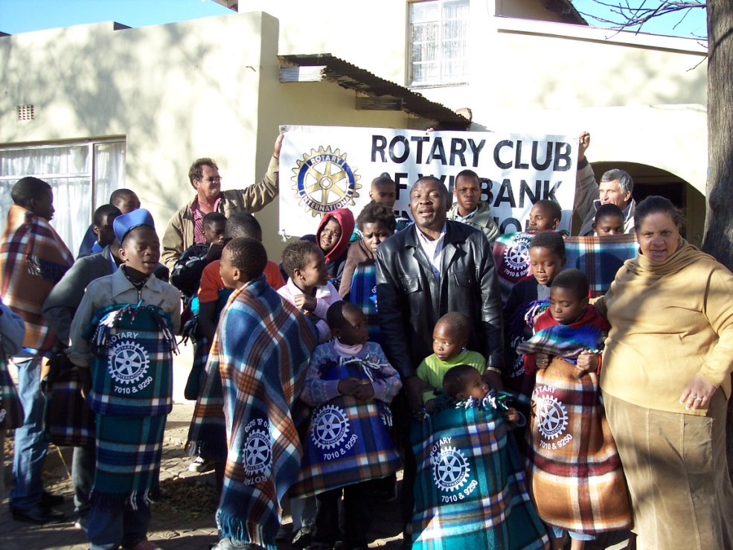
Grant Structure
District Grants
Global Grants
Notes:
The Foundation offers two types of grants.
District Grants, that are block grants that allow clubs and districts to address immediate needs in our communities here and abroad.
Global Grants offer opportunities to participate in high impact activities with support from TRF usually $30,000 and more.

Slide 53
Outstanding Performance
Notes:
Attaining a 4-star rating verifies that The Rotary Foundation exceeds industry standards and outperforms most charities in your area of work.
This exceptional designation sets the Foundation apart from its peers and demonstrates to the public its trustworthiness.
The TRF has received this for 12 consecutive years.

Slide 54
TRF 6 Areas of Focus
Peace and conflict prevention /resolution
Disease prevention and treatment
Water and sanitation
Maternal and child health
Basic education and literacy
Economic and community development
Notes:
The Rotary Foundation has 6 areas of focus
Peace and conflict prevention/resolution
Disease prevention and treatment
Water and sanitation
Maternal and child health
Basic education and literacy
Economic and community development

Slide 55
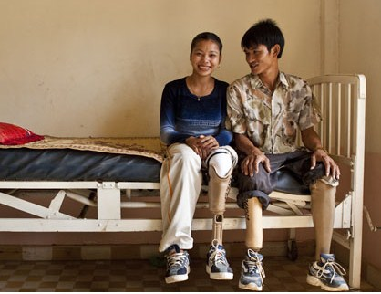
Peace and Conflict Prevention/Resolution
42 million people are currently displaced by armed conflict or persecution
90% of casualties in armed conflicts are civilians and at least 50% are children
Notes:
What can we do?
We could strengthen local peace efforts or recruit a candidate for a Rotary Peace Fellowship.

Slide 56
Disease Prevention and Treatment
1 billion people suffer from neglected tropical diseases each year
Notes:
We could help here by assisting combat the spread of HIV/AIDS, malaria and other major diseases.

Slide 57
Water and Sanitation
884 million people do not have clean drinking water
2.6 billion people lack access to adequate sanitation
Notes:
One thing we can do is strengthen the ability of communities to develop and maintain sustainable water and sanitation systems.

Slide 58
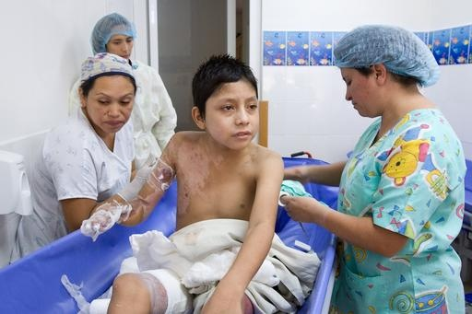
Maternal and Child Health
8.9 million children die before the age of 5
Notes:
We could provide immunizations and antibiotics for polio, measles, malaria, pneumonia, HIV/AIDS and diarrheal diseases as they are the leading causes of death in children under 5.

Slide 59
Basic Education and Literacy
1 in 5 adults cannot read
Women account for 2/3 of this group
72 million children are not in school
Notes:
We could develop an adult literacy program or ensure that children have access to quality basic education and reduce gender disparity in education.

Slide 60
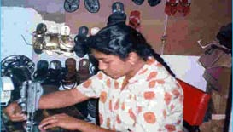
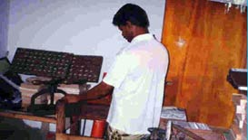
Economic and Community Development
1.4 billion or 1 in 4 people live on less than $1.25 a day
Notes:
We could strengthen the development of local entrepreneurs and community leaders, particularly women, in impoverished communities.

Slide 61
Key Meetings
June 20 to 26, 2020
November 6 to 8, 2020
Notes:
The Key Meetings are:
The Rotary International Convention. This year the Convention will be virtual. It a wonderful opportunity for every Rotarian to see what an international convention is all about and to watch and listen all the amazing speakers. This such an opportunity to attend an International Convention for free. Do sign up for some of the workshops.
District 7010 Conference 2020. Don’t Stop Believing. Everyone that attends a district conference finds that being a Rotarian becomes even more rewarding because of the experiences, insights and acquaintances developed. Register for the Conference on the District web site. At this time it is a go.

Slide 62
COVID-19
Notes:
Paul Harris told us that we must be evolutionary and if required, be revolutionary, but we must be in tune with our environment.
We must transform this threat into an opportunity to continue serving and to continue to make our Rotary wheel spin.
Virtual tools allow us to remain united and thus be able to continue coordinating in favor of our communities.

Slide 63
Learn More
www.rotary.org
Notes:
Well I sure hope you have learned a bit more about Rotary.
Do, go on to rotary.org or the district site to learn more or to answer questions you might have in the future.
Thank you Stay home and stay safe!

