Slide 1
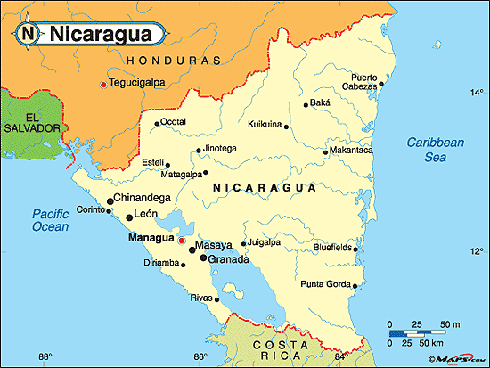
Nicaraguan
Stove Project
COMMIT is a team of dedicated volunteers from Southwestern Ontario working under the umbrella of the Rotary Club of Stratford Charitable Foundation and supported by the Stratford Rotary Club. We are committed to bettering the lives of people in less advantaged countries through medical, social and educational programs. We are involved in many projects in Nicaragua, including an Eco-Friendly Stove Project.
Stove Project villages we support:
Nandarola
La Vigia
El Piedra

Slide 2
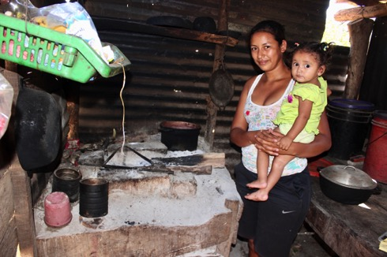
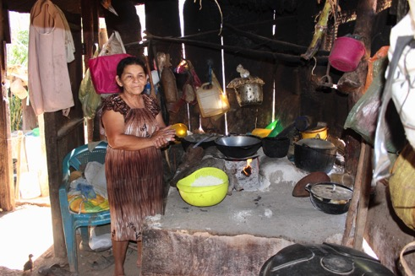
Nicaraguan
Stove Project
The Problem
Thick toxic smoke rising from stoves and fires inside homes is associated with approximately 4 million deaths per year in developing countries, like Nicaragua;
Approximately 4 million people, mainly women and children, suffer from severe burns associated with open fire burning;
More than 3 billion people cook with solid fuels such as dung, wood, agricultural residues and coal, without proper ventilation;
Smoke from burning these fuels gives off poisonous chemicals that cause respiratory illnesses such as bronchitis and pneumonia;
The effects of smoke from stoves in developing countries contribute significantly to the global greenhouse effect;
Almost all of the people in the villages whom we help are susceptible to the toxic effects of smoke in their homes.
Old open fire stoves in the village of Nandarola, Nicaragua.

Slide 3
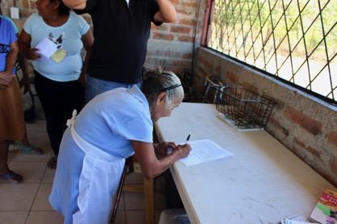
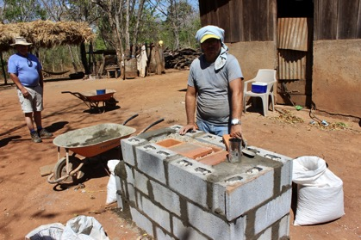
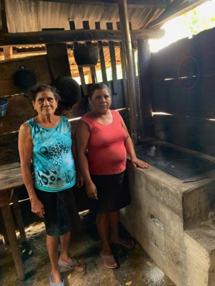
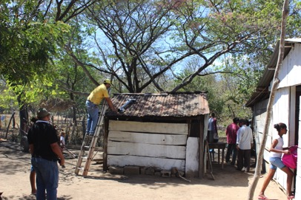
Nicaraguan
Stove Project
Pilot
DESIGN:
Six families in the village of Nandarola received an eco and health friendly steel or concrete stove:
RESULTS at 1 year:
Little or no toxic smoke in their home;
Decreased respiratory issues (difficulty breathing) and eye irritations;
Increased heat efficiency with 40% less wood required, which has a positive effect on reforestation efforts and decreased global warming;
Decreased fear of burns and improved safety;
Pride of ownership.
Villager signing pilot stove contract
Building the stoves
Proud of their new stove
Installing stove vent

Slide 4
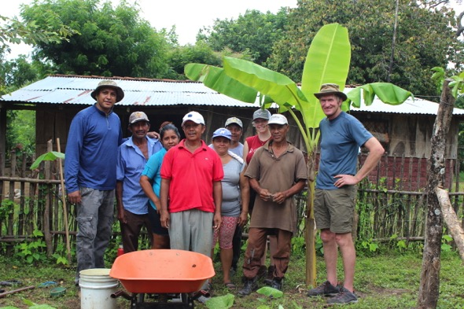
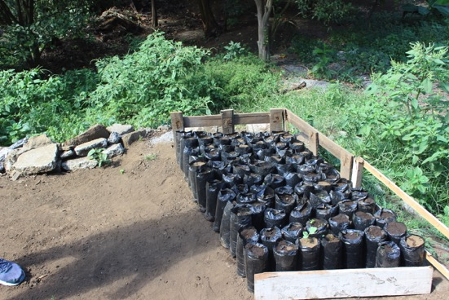
Nicaraguan
Stove Project
Reforestation
COMMIT’s Garden Project, started two years ago in the village of Nandarola, Nicaragua, has been working with local farmers to establish sustainable agricultural practices. Significant wood is used in open fire stoves, which is a major contributor to deforestation and global warming.
Our Garden Project has focused on the planting of new trees, trying to offset the devastating effects of deforestation. Replacing current open fire stoves with eco-friendly ones will reduce the use of wood by approximately 40% and contribute to global efforts of reforestation.
COMMIT Team with local farmers in Nandarola
Seedling trees ready for planting

Slide 5
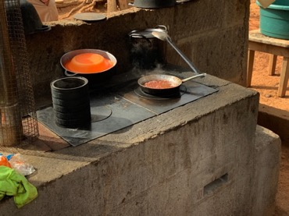
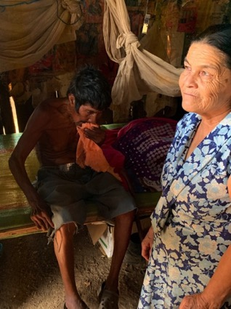
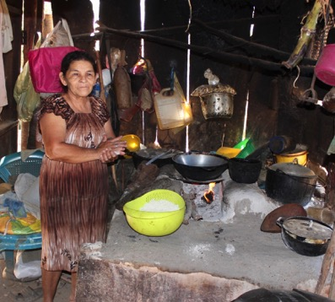
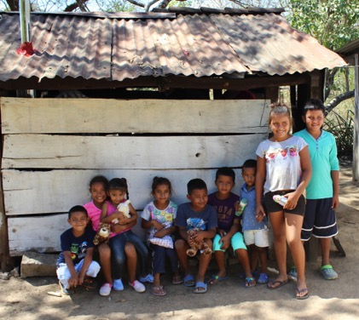
Nicaraguan
Stove Project
YOU CAN PURCHASE A STOVE
$142 Canadian will purchase a new family stove.
Your name, the name of a loved one, or your Rotary Club will be appropriately recognized.
For further information please contact: davidknoppert@sympatico.ca
Direct donations can be made easily via e-transfer.
(Please specify that your donation is for the Stove Project)
Click here: https://rotarystratford.com/SitePage/donate-now
New eco-friendly stove with pots & pans.
These are the families that need our help!

