Slide 1
https://www.youtube.com/watch?v=7ZXFYDaI-hg

Slide 2
Youth Exchange

Slide 3
Fun Facts
District 7010 has participated in YEX for over 40 years.
We use to have more than 25 students
Today -16 clubs supporting 12 students
37% participation in the district
Over 9,000 students participate every year
Over 250,000 alumni

Slide 4
What’s Holding Your Club back???
Cost to the club
Cost to the Family
Finding students
Finding Host Families

Slide 5
Cost to the club
$850 - $900 to participate in the program
$130 per month allowance for the student
Total cost $2,200.
DOWN FROM $4,800
You could share a student with another club or Rotaract club!
What are you waiting for?

Slide 6
Cost to the Parents
Its NOT $10,000
$3,500 fee of which $500 is a security deposit
Health Insurance $800-$1200 country specific
Passport, Visa (usually less that $250)
Year end trip $4,000 (optional)
There is significant cost savings by not having a teenager at home!!

Slide 7
Finding Students
Meet with high schools
Presentation at an assembly if possible
Marketing materials available from the District and RI Site
Lots of videos and testimonials on the internet
Our website http://www.rotary7010youthexchange.com

Slide 8
Host Families
3-4 host families are required
Does not have to be a Rotarian
Past exchange student families are a good source
Must have a police check for all family members over 18 years of age.

Slide 9
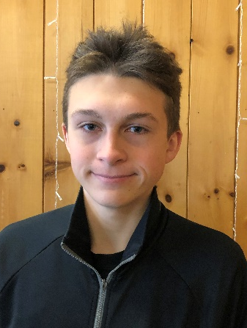
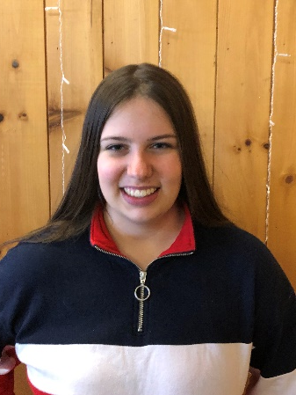
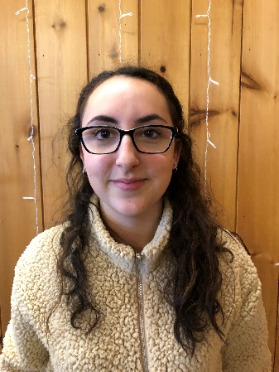
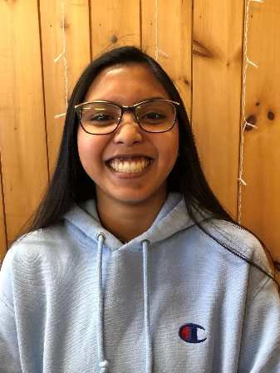
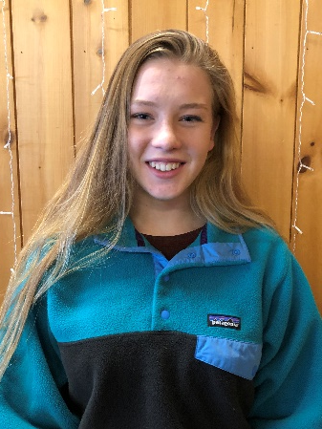
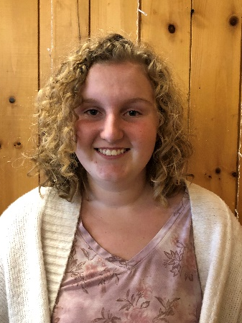
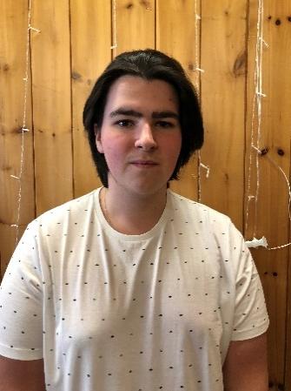
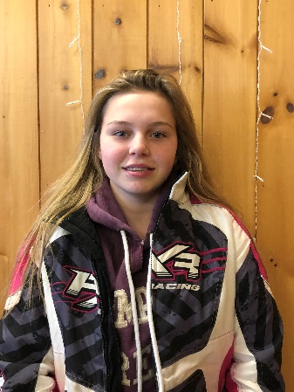
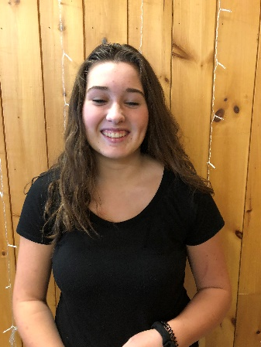
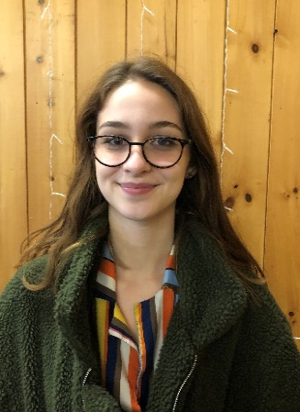
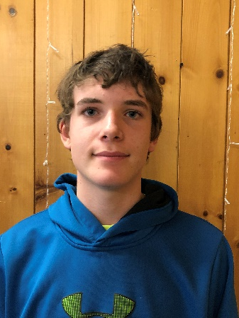
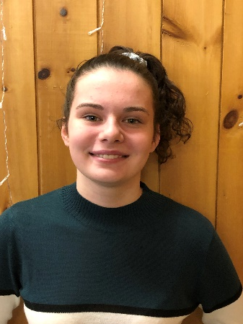
Aiden Jane Kaylee Danika Marti Zarah
Belgium Switzerland Switzerland Spain France Belgium
2019 Outbound Class
Logan Mila Megan Dezi Sam Gabrielle
Norway Czech Republic Italy Italy Finland Denmark

Slide 10
Rotary International president – Carl Wilhelm Stenhammer
“If every 17 year old student went on a Rotary Youth exchange program there would be no more war in the world.”

