Slide 1
Rotary 2018
Information Update

Slide 2
Rotary 2018 Merchandise is now Available for Purchase
SHOP NOW

Slide 3
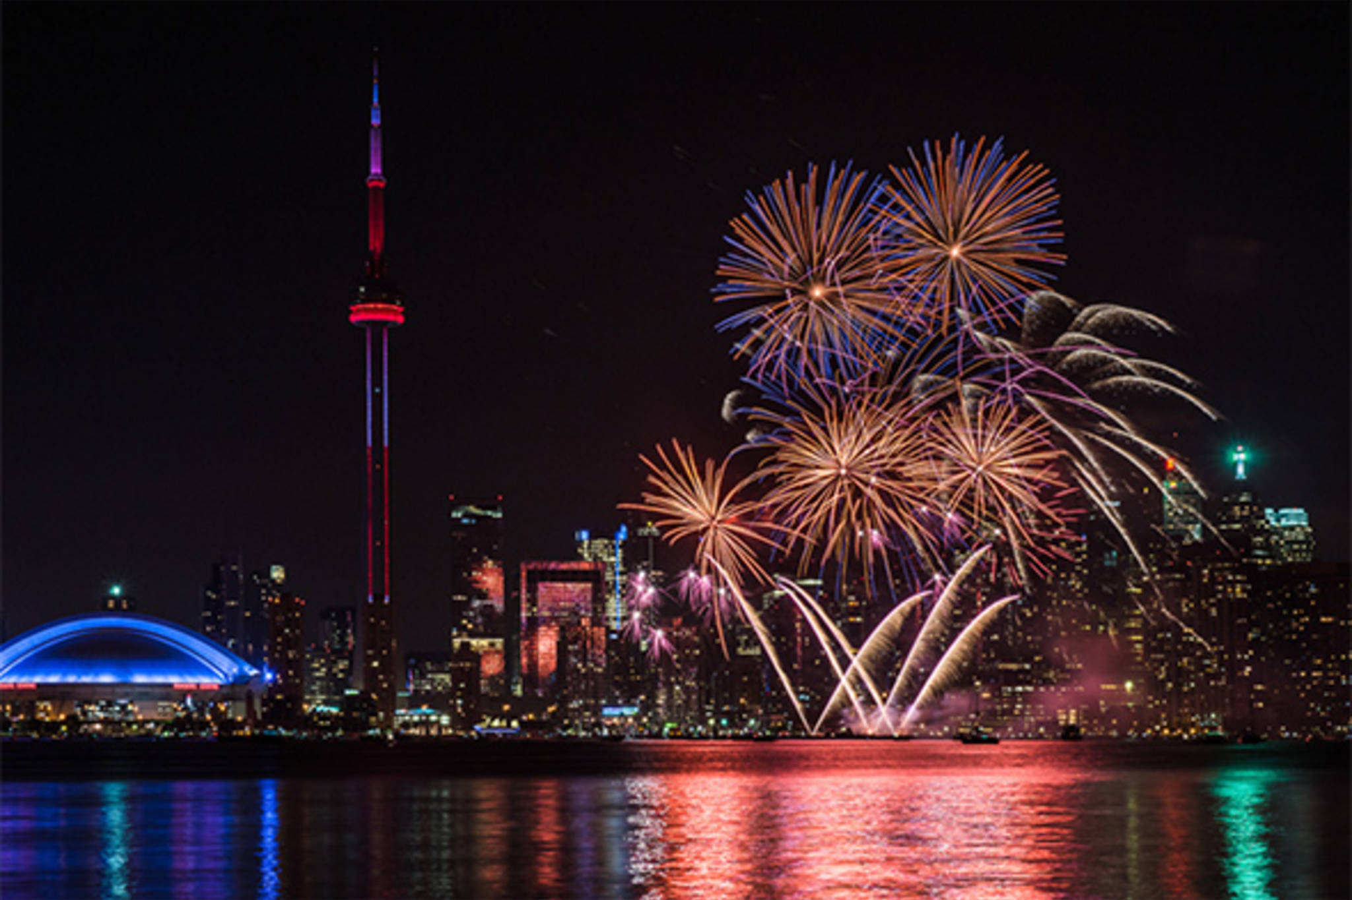
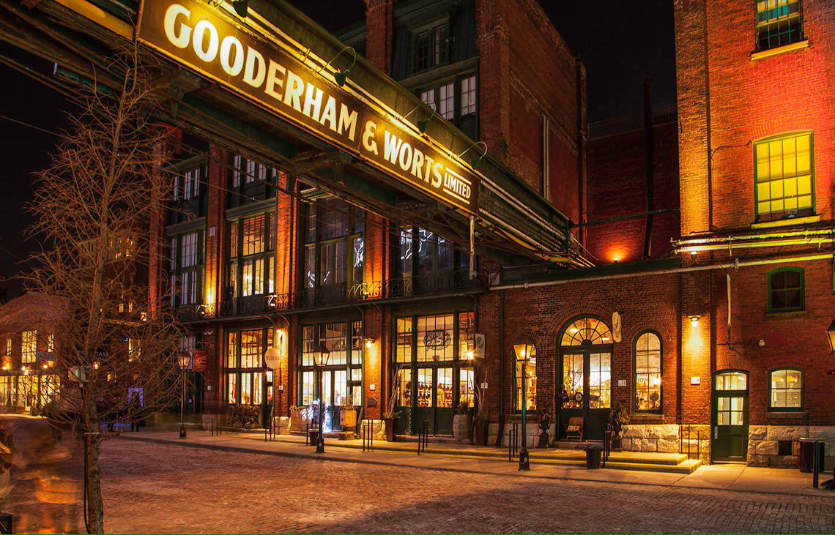
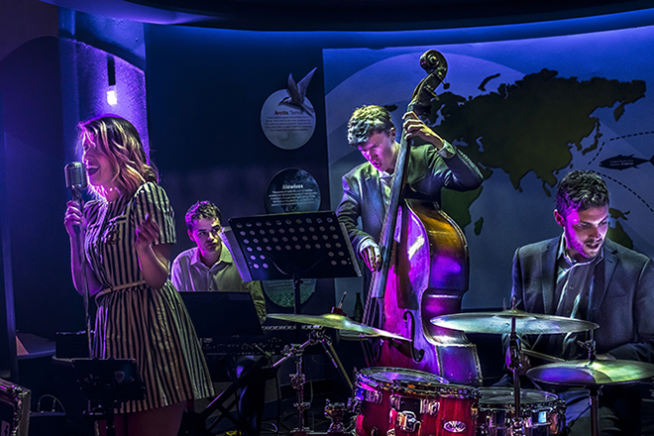
Host ticketed events can now be ordered on the HOC website
ROTARYFEST
Tuesday, June 26th, 2018, 4:00PM – 10:00PM
Ticket: $90 CDN (approx. $75 USD *)
Includes: Transportation, a meal, complimentary drink
Highlights: Fireworks, Canadian heritage featured events, music and entertainment, food and treats around the world.
Rock at the Historic Distillery District
Saturday, June 23rd, 2018, 6:00PM – 10:00PM
Ticket: $120 CDN (approx. $100 USD *)
Includes: All food, live music, buskers, attractions, and shopping at the array of shops in the District.
Highlights: Food, attractions, live country and rock music, and shopping at quaint shops, within the architectural beauty of this 185-year-old National Historic site!
Jazz at the Aquarium
Saturday, June 23rd, 2018, 7:00PM – 11:00PM
Ticket: $120 CDN (approx. $100 USD *)
Includes: food, full admission to the Aquarium, custom dive shows, photo port package and entertainment!
Highlights: Experience aquarium in a moonlight setting, accompanied by live classical jazz music!
Host Hospitality
Ticket: $43 CDN (approx. $36 USD *)
Tickets now can be purchased here.
*US currency based on the exchange rate in effect in November, 2017, and customary credit card exchange fees.

Slide 4
Register for the Convention
Important deadlines
15 December 2017: Last day for early-registration discount
31 March 2018: Last day for preregistration discount. Last day to register groups.
27 June 2018: Last day for online registration
To register or for more info – visit here

Slide 5
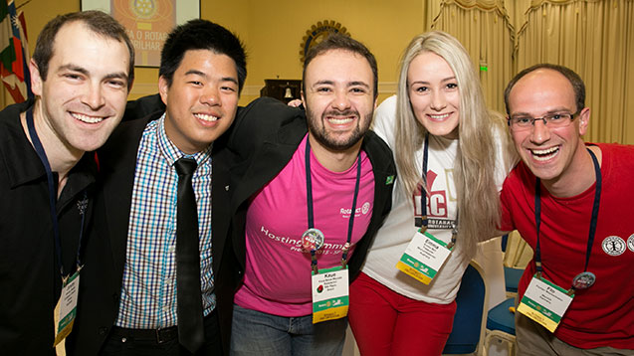
Help needed at the Convention
Sign up as a Host for Host Hospitality.
Volunteer as an Ambassador before and at the convention. Sign up here.

Slide 6
Opportunity for all Rotary Clubs to participate in unique Community Youth Art Project 2018 – exclusive to Rotary Clubs
Customized and turn-key project led by VIBE Arts will engage local youth in your community to create two 6 feet x 4 feet Rotary themed mural art reflecting Rotarian values to be displayed in Toronto’s subway system (in effect creating an underground art gallery for 1.2 million daily passengers to enjoy!). Art will also be displayed in other properties associated with the 2018 International Rotary Convention.
Your Rotary logo will be on display with the murals and the original art will return to your community after the exhibition.
To learn more - please contact Carole Boivin at carole@vibearts.ca or 416-268-6819
More info here

