Slide 1
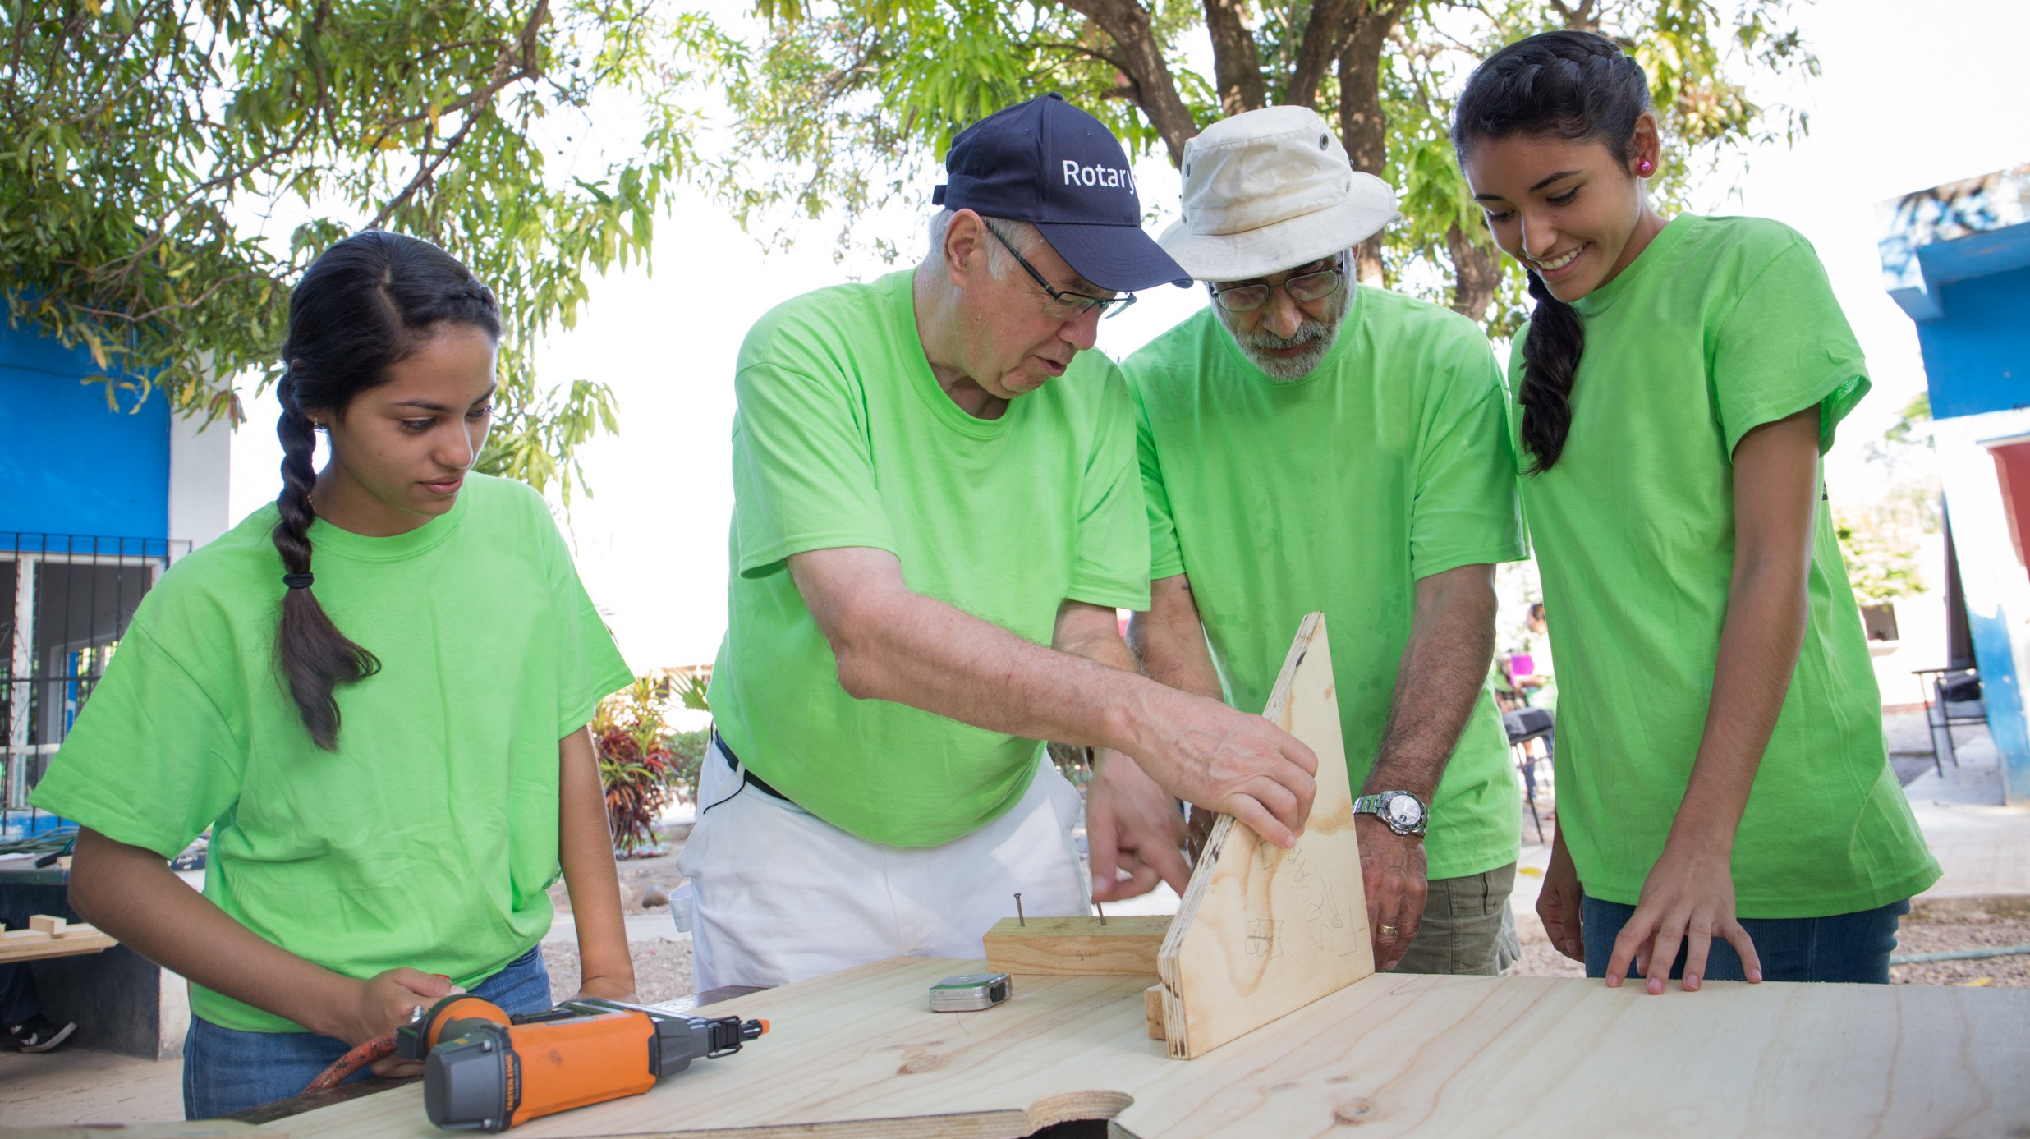

Engagement through
international service
Presented by RAJBIR S MANN
CHAIR
Notes:
Instructions: notes to the presenter are in italics.
Tailor this presentation to your region and audience. If you have a region that develops strong projects and grants, task the audience with motivating their clubs/members to build a network of expertise for mentoring fellow clubs with the project planning process.
Encourage collaboration amongst leadership and with expertise. If your region is not active in international projects, smaller ones or global grant-supported, use this presentation to motivate greater engagement. End the presentation with a call to action based on your audience -- and if you are a District International Service Chair, position yourself as a resource.

Slide 2
International Service Committee
AGENDA
ISC MEETING TUESDAY, JANUARY 12, 2021 6.00 – 7.30 PM
6.00 Welcome Chair
Introduction committee secretary Pari Gujar
6.15 Introductions and updates All
6.30 Water First Global Grant Dianne Dance-Rotary Club of Guelph
6.45 International Service Committee
role and resources Members and chair
7.05 The Lending Journey Vince Vetro - Rotary Club of Erin
7.20 Upcoming events information All
7.25 Closing remarks Chair
Next Meeting March 9, 2021

Slide 3

International Service Committee
To be a source for Rotary Clubs to learn about International Service initiatives with an emphasis on promoting joint projects, collaboration and utilizing Rotary Grants (District and Global )
Notes:
[District Resource Network model]
Here’s a basic model depicting the District Resource Network. There is no one-size-fits all model. Each club, district, and zone is unique and regions will experience success with varied strategies. By working collaboratively with club and district leaders, you will create the model that works best for your district.
Think of the DISC as the connector -- connecting clubs to resources (both human and otherwise, like guides, fact sheets, etc.) to help them design and implement better projects of all sizes.
DISCs manage their District Resource Network. They are the point of contact and connect clubs to mentors (and vice versa). They work collaboratively with district leaders to recruit and identify experts. Lastly, they collaborate regionally and globally with Other DISCs --and are excellent resources for finding international partners.
DISCs need to work collaboratively with their DGs, DRFCs and other key district leaders. DISCs support the work of fellow District Chairs-- including DRFCs, DGSCs, community & vocational service chairs, district alumni chairs, and other district leaders -- by helping connect clubs to regional experts. They support the work of fellow district chairs.

Slide 4
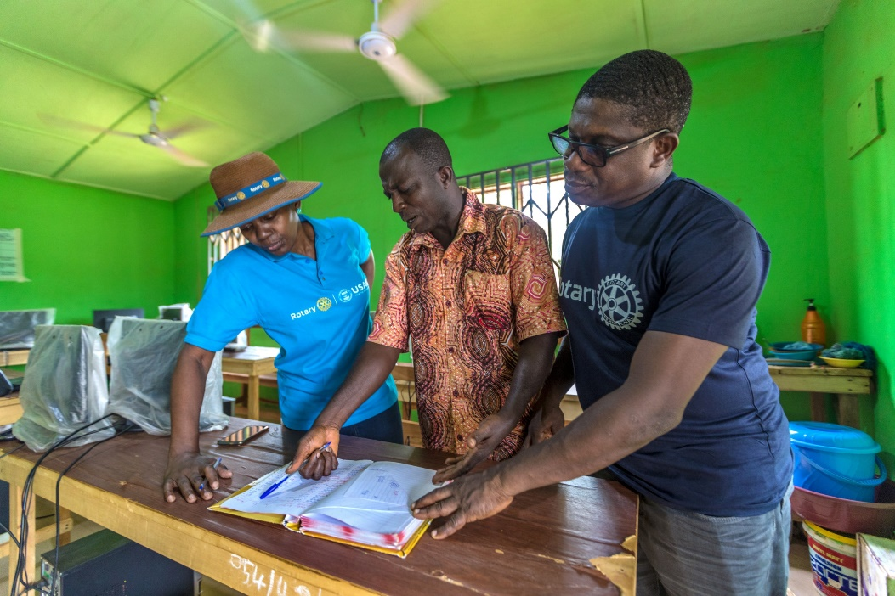
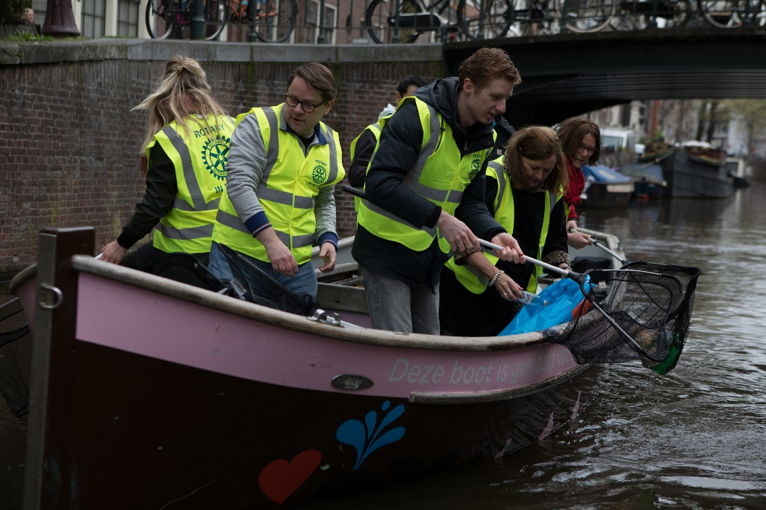
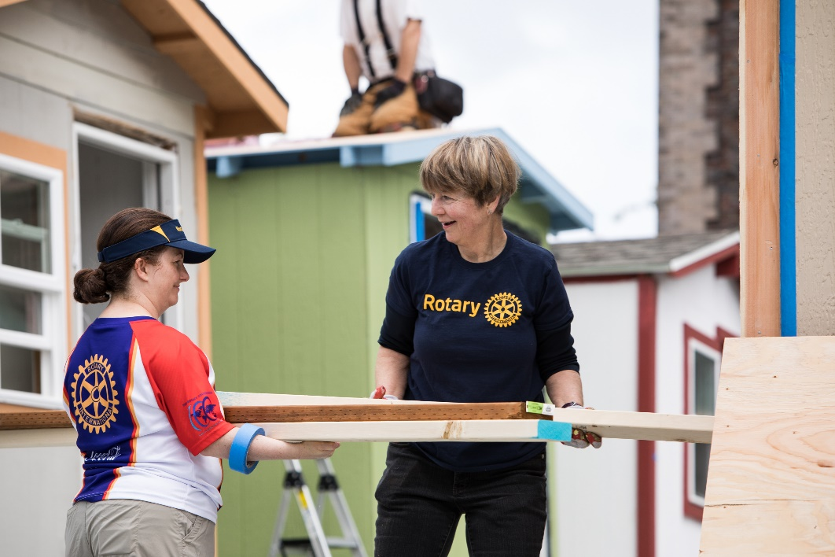
International Service Committee
MOTIVATE
INCREASED ENGAGEMENT
PROMOTE
USE OF MENTORS AND RESOURCES FOR PROJECT & GRANT PLANNING
COLLABORATE WITH DISRICT & CLUB LEADERS
CONNECT
THEM TO RESOURCES
IDENTIFY LOCAL MENTORS, RESOURCES
SHARE
BEST PRACTICES
Notes:
[International Service Committee Chairs]
For today’s [Insert type of event: workshop, training, presentation, etc.], we’re going to focus in on international service: club and district involvement in humanitarian service in conjunction with international partners. To motivate and support club involvement in international service, district governors are encouraged to appoint district international service committee chairs.
The district international service committee role has existed for many years – it’s not a new role.
Its duties include:
Motivating club and district involvement in international service;
Finding international partners;
Working with district leaders to identify and recruit local subject matter experts to serve as mentors;
Promoting greater awareness of resources and strategies for stronger international projects and grants by leveraging local Rotarian, Rotaractors, and alumni expertise; and
Establishing direct lines of communication and accountability for all types of international service – and connecting district and clubs to resources.

Slide 5
Rotary’s Strategic Plan Alignment
District Resource Network’s Support = 3 Strategic Priorities
ROTARY’S STRATEGIC PRIORITIES AND OBJECTIVES
INCREASE
OUR IMPACT
Eradicate polio and leverage the legacy
Focus our programs and offerings
Improve our ability to achieve and measure impact
EXPAND OUR REACH
Grow and diversify our membership and participation
Create new channels into Rotary
Increase Rotary’s openness and appeal
Build awareness of our impact and brand
ENHANCE PARTICIPANT ENGAGEMENT
Support clubs to better engage their members
Develop a participant-centered approach to deliver value
Offer new opportunities for personal and professional connection
Provide leadership development and skills training
INCREASE OUR
ABILITY TO ADAPT
Build a culture of research, innovation, and willingness to take risks
Streamline governance, structure, and processes
Review governance to foster more diverse perspectives in decision-making
Notes:
[Strategic Plan Alignment]
You now have a better idea of the role of the district international service chair. Their responsibility to create a District Resource Network of mentors to help clubs develop stronger projects is of significant importance to our organization.
District Resource Networks support three of Rotary’s Strategic Priorities:
Increasing Our Impact - By having mentors work with clubs, they’re helping design sustainable, more impactful projects. These projects have greater reach and empower communities in the long run.
Expanding Our Reach – By providing members with more or new opportunities for participation they will feel more connected to their club. Not only do we need to focus on new members, but equally important is retaining our current members. Through DRNs, we can do this. We can recruit members to join their district’s resource network and use their Rotary or professional skills to mentor clubs, and
Enhancing Participant Engagement - Members in District Resource Networks have more meaningful experiences through Rotary. They use their professional training and skill-set to mentor clubs and develop future leaders.
International service improves communities while providing worthwhile engagement opportunities – which directly leads to retaining our members and securing Rotary’s future. DISCs play a key role in engaging and mobilizing members.

Slide 6


International Service Committee
Connect you with projects and clubs in District 7080 and beyond!
Connect you with subject matter experts
Help you with project planning and preparation
Improve your global grant applications
Notes:
[District Resource Network model]
Here’s a basic model depicting the District Resource Network. There is no one-size-fits all model. Each club, district, and zone is unique and regions will experience success with varied strategies. By working collaboratively with club and district leaders, you will create the model that works best for your district.
Think of the DISC as the connector -- connecting clubs to resources (both human and otherwise, like guides, fact sheets, etc.) to help them design and implement better projects of all sizes.
DISCs manage their District Resource Network. They are the point of contact and connect clubs to mentors (and vice versa). They work collaboratively with district leaders to recruit and identify experts. Lastly, they collaborate regionally and globally with Other DISCs --and are excellent resources for finding international partners.
DISCs need to work collaboratively with their DGs, DRFCs and other key district leaders. DISCs support the work of fellow District Chairs-- including DRFCs, DGSCs, community & vocational service chairs, district alumni chairs, and other district leaders -- by helping connect clubs to regional experts. They support the work of fellow district chairs.

Slide 7
Clubs
Introduce yourself to your DISC
Share project or grant ideas with your DISC; ask to be connected with a mentor
Encourage club members with experience and technical skills to connect with your DISC
If you serve as the club international service committee chair, work with your DISC to receive regular updates, communications, resources, and best practices for success
Notes:
[Use this slide to engage clubs -- Calls to Action for Clubs]
Earlier in the presentation, I mentioned that districts have members with valuable technical skills and experience who could serve as mentors. We need club members, such as yourself, to join District [Number’s] Resource Network - or you can help identify a fellow club member with useful expertise.
You can help by:
Introducing yourself to your DISC (identify your experience or technical skill);
Share you project or grant ideas with your DISC; ask to be connected with a mentor in your District’s Resource Network;
Encourage fellow club members with experience and technical skills to connect with your DISC in order to join your District’s Resource Network:
If you serve as the club international service chair or support projects, work with your DISC to receive regular updates, communications, resources, and best practices for success

Slide 8



District International Service Committee/Chair Role
MOTIVATES
clubs to get involved in international service
MAINTAINS
the district resource network, a database of local mentors who can provide guidance and technical expertise
HELPS
clubs find international partners
SUPPORTS
district Foundation committees and clubs with resources for projects and global grants
COLLABORATES
with district leaders to recruit local experts to join the district resource network
PROMOTES
Rotary publications, online tools, and strategies for planning effective projects and grants
DISTRICT RESOURCE
NETWORK
Available on your district’s website or through your district international
service chair.
Mentors with expertise in project planning, Rotary’s areas of focus, and Rotary grants, including: ROTARIANS ∙ ROTARACTORS ∙ ROTARY PROGRAM ALUMNI ∙ COMMUNITY MEMBERS ∙ PROFESSIONALS FROM PARTNERING ORGANIZATIONS
PUBLICATIONS
Available on My Rotary
COMMUNITY ASSESSMENT TOOLS ∙ GUIDE TO GLOBAL GRANTS
ONLINE TOOLS
Available on My Rotary
ROTARY SHOWCASE ∙ DISCUSSION GROUPS ∙ CLUB SERVICE PROJECTS COMMITTEE BASICS
Notes:
[Updated DISC Role]
I’ll share a brief background on the updated DISC role. In 2016, the Board of Trustee’s approved a new strategy for involving our experienced members in mentoring clubs in projects and grants. The Boards updated the role of DISCs and encouraged three-year term appointments, with the option of reappointment, for continuity.
The DISC role was updated based on lessons learned after a pilot which demonstrated the need to help Rotarians tap into subject matter expertise within their districts or regions; and in order to develop bigger and better projects -- project hosts have to rely on the right technical resources from the very beginning of the planning process.
[DISC Appointments: edit DISC appointment totals and date below with data close to your meeting. For totals, contact Kiki Melonides.]
As of October, 440 districts have reported DISC appointments for 2019-20. In RY 2018-19, there were 384 districts with DISCs. Since the role was enhanced in 2016 and we have been raising awareness, there has been a steady increase in the number of DISC appointments.
[Customize to your audience by adding Zone/District-specific information below:]
In Zone ___, there are ___ districts (out of __ districts) with DISC appointments. Our goal is to have 100 percent of the DISC roles filled.

Slide 9
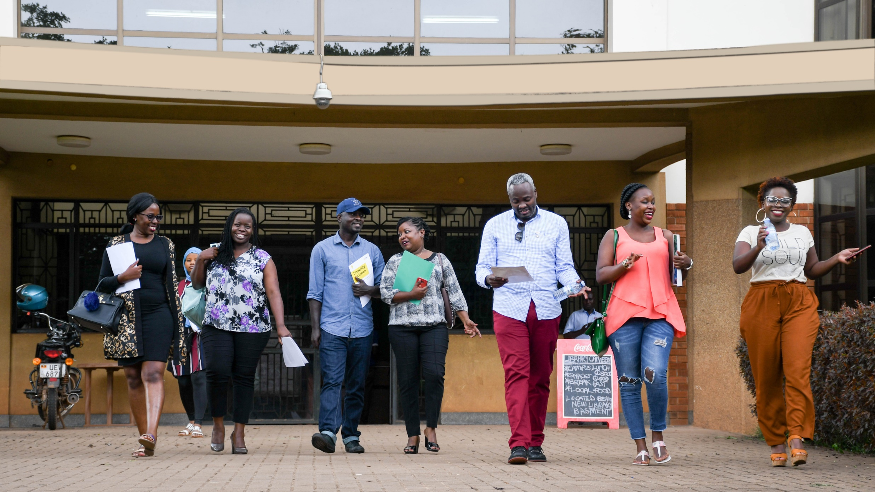
District resource networks

Slide 10
Identifying Mentors With Experience
Projects Need Mentors with Experience
Three General Areas
Project Planning & Implementation
Rotary’s Seven Areas of Focus
Rotary Grants
Notes:
[Mentors with experience in 3 general areas]
DISCs have always encouraged their clubs to participate in international service (either as a host or international partner). Now they are also tasked with identifying and recruiting mentors with expertise in the following three areas:
Experience in project planning and implementation – from community assessments to measurement & evaluation, etc.;
Technical expertise in Rotary’s 6 areas of focus; and
Experience with Rotary’s Grants: writing grants & the eligibility, application process
As mentioned, DISCs are responsible for developing a mechanism (the District Resource Network) for using those experts as mentors early in the planning process. Having mentors work with clubs during the development of projects is important, but equally essential is the collaboration among DISCs, DGs, and DRFCs (and other key district leaders) to move forward with identifying resources for global grants and projects of all sizes (large and small).
After a DISC is appointed by their DG, DGE, and DGN for a three-year term, their very first step is to meet with the DG, DRFC, and Foundation subcommittee chairs, as well as other key district leaders to develop a collaborative strategy which includes how to:
Structure their District Resource Network;
Identify and recruit experts; and
Promote the availability of District Resource Networks experts to clubs.
You are hearing the word “Collaboration” consistently when we refer to the DISC role. DISCs are appointed by District Governors and their efforts to develop District Resource Networks will always be in collaboration with their DG, DRFC, Foundation subcommittee chairs, and other key district leaders. DISCs works to support their DGs and DRFCs by connecting them to resources for projects and grants

Slide 11
Leveraging Members’ Skills
District Resource Network
Rotarians Rotaractors
Alumni, Intercountry Committees
Community Members, Partners
Rotary Community Corps, Rotary Reps
TRF Cadre of Technical Advisers
Rotary Action Groups, Vocational Fellowships
Notes:
[District Resource Networks]
Rotary is an organization rich with so many resources. Our greatest asset is our membership. Within the Rotary family, we have a wealth of valuable technical skills and experiences that can enhance projects. Capturing the Rotary family’s expertise is a great opportunity to activate our members through District Resource Networks. We can provide meaningful engagement opportunities – which directly leads to retaining our members and securing Rotary’s future. DISCs can play a key role in engaging and mobilizing members early in the project planning process.
Working closely with district and club leaders, DISCs identify local mentors and build a resource base, known as a District Resource Network, that helps clubs develop higher quality, sustainable projects and grants. I’m sure you already know mentors in your districts who should be included in your District Resource Network. They are involved in club projects or grants or have worked in an area of focus professionally.
These mentors may include:
Rotarians and Rotaractors with project and grant experience;
Members of Rotarian Action Groups and Vocationally oriented Fellowships;
Members of TRF Cadre of Technical Advisers;
Rotary Alumni, such as Global Grants scholars and Peace Fellows;
Rotary Inter-Country Committees (RCCs), groups of Rotarians of many countries working together; and
Non Rotarians: Rotary Community Corps, community members and professionals from NGO and partner organizations.

Slide 12
District Resource Network
Notes:
[District Resource Network model]
Here’s a basic model depicting the District Resource Network. There is no one-size-fits all model. Each club, district, and zone is unique and regions will experience success with varied strategies. By working collaboratively with club and district leaders, you will create the model that works best for your district.
Think of the DISC as the connector -- connecting clubs to resources (both human and otherwise, like guides, fact sheets, etc.) to help them design and implement better projects of all sizes.
DISCs manage their District Resource Network. They are the point of contact and connect clubs to mentors (and vice versa). They work collaboratively with district leaders to recruit and identify experts. Lastly, they collaborate regionally and globally with Other DISCs --and are excellent resources for finding international partners.
DISCs need to work collaboratively with their DGs, DRFCs and other key district leaders. DISCs support the work of fellow District Chairs-- including DRFCs, DGSCs, community & vocational service chairs, district alumni chairs, and other district leaders -- by helping connect clubs to regional experts. They support the work of fellow district chairs.

Slide 13
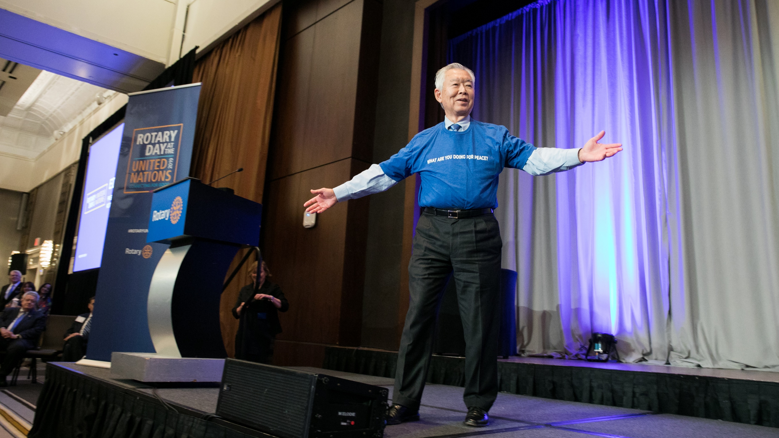
Questions?

