Slide 1
Diversity, Equity & inclusion (DEI)
Title Page Option
Notes:
Welcome –
Agenda (10 mins me and 40 minutes for panel members)
In a matter of time, I am going to ask to hold all questions to the end. Please write them down as they come to you. I’ll also be available during lunch to speak ☺

Slide 2
subhead
DIVERSITY IS ONE OF OUR GREATEST STRENGTHS
Notes:
As one of Rotary's core values, diversity is one of our great strengths. We should be proud that Rotary reflects so many cultures, generations, and lived experiences and offers leaders the opportunities to use those experiences to make a difference.
Rotary’s statement and commitment to DEI was adopted in 2021 – embracing DEI principles as part of everything we do at Rotary.

Slide 3
“At Rotary, we understand that cultivating a diverse, equitable, and inclusive culture is essential to realizing our vision of a world where people unite and take action to create lasting change.
Notes:
Rotary’s statement and commitment to DEI was adopted in 2021 – embracing DEI principles as part of everything we do at Rotary.

Slide 4
We value diversity and celebrate the contributions of people of all backgrounds, across age, ethnicity, race, color, disability, learning style, religion, faith, socioeconomic status, culture, marital status, languages spoken, sex, sexual orientation, and gender identity as well as differences in ideas, thoughts, values, and beliefs.
Notes:
Rotary’s statement and commitment to DEI was adopted in 2021 – embracing DEI principles as part of everything we do at Rotary.

Slide 5
Recognizing that individuals from certain groups have historically experienced barriers to membership, participation, and leadership, we commit to advancing equity in all aspects of Rotary, including in our community partnerships, so that each person has the necessary access to resources, opportunities, networks, and support to thrive.
Notes:
Rotary’s statement and commitment to DEI was adopted in 2021 – embracing DEI principles as part of everything we do at Rotary.

Slide 6
We believe that all people hold visible and invisible qualities that inherently make them unique, and we strive to create an inclusive culture where each person knows they are valued and belong.
Notes:
Rotary’s statement and commitment to DEI was adopted in 2021 – embracing DEI principles as part of everything we do at Rotary.

Slide 7
In line with our value of integrity, we are committed to being honest and transparent about where we are in our DEI journey as an organization, and to continuing to learn and do better.”
Notes:
Rotary’s statement and commitment to DEI was adopted in 2021 – embracing DEI principles as part of everything we do at Rotary.

Slide 8
Rotary’s action Plan
Increase our impact.
Expand our reach.
Enhance participant engagement.
Increase our ability to adapt.
Notes:
Increase our impact. Find new ways to use our expertise to make a difference in our communities and around the globe.
Expand our reach. Build connections and opportunities that allow people who share our drive to make change.
Enhance participant engagement. Recommit to putting the needs, expectations, and growth of our participants at the center of all that we do.
Increase our ability to adapt. Find new opportunities, create more paths to leadership, open our conversations to more diverse voices, and simplify how we operate.

Slide 9
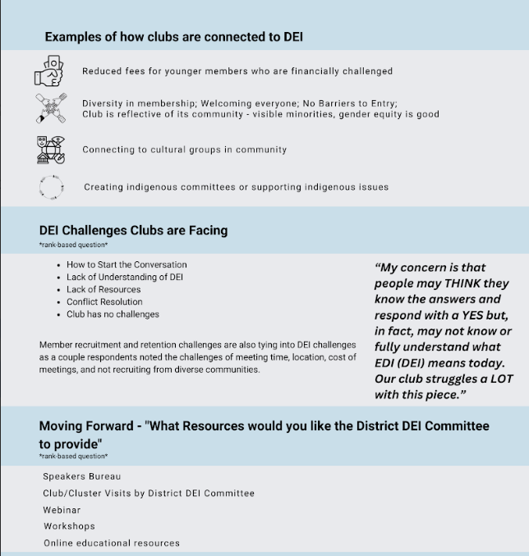

Slide 10
How can we each increase our efforts in support of DEI?
At Club Events
  Assess how welcoming your meetings and events are to people of various backgrounds and abilities, and identify any opportunities to improve
  Plan events at venues that are accessible
When we recruit new members
  Identify demographics in your community that aren't represented in your club
In programs for young leaders
  Empower young leaders to engage in meaningful opportunities, projects, and roles that advance and support their goals
Notes:
Club events - Manage event costs to keep them affordable

Slide 11
TOOLS & Resources
Rotary’s Commitment to Diversity, Equity and Inclusion
Diversity Assessment
DEI Code of Conduct
Diversity, Equity and Inclusion Basics (4 courses in the Learning Centre)
  Committing to Diversity, Equity and Inclusion
  Preventing and Addressing Harassment
  Microaggressions
  Uncovering Unconscious Bias
  Accessibility for Ontarians with Disabilities Act (AODA)
  The DEI Page on our District website has links to all these resources & more!
  DEI | Rotary District 7080 (rotary7080.org)

Slide 12
Microaggression
Words or actions that offend people or make them feel unwelcome by reinforcing negative stereotypes or power dynamics.
Example:
commenting on someone’s accent
Notes:
They may be intentional or unintentional, and they reflect biases that might be conscious or unconscious. The reasons behind them matter less than their impact and how we respond to them.
Understanding microaggressions can help us become kinder in relating to people.
Members of marginalized groups often experience microaggressions in their daily interactions, and these microaggressions can not only be hurtful but can also perpetuate marginalization.

Slide 13
Identifying microaggressions
Asking a person of colour where they are “really” from
Notes:
Racial microaggression – implying they cant truly be Canadian

Slide 14
Identifying microaggressions
Calling a group of mixed-gender individuals "guys," which can exclude non-male individuals.
Notes:
Gender microaggression – another common one is in forms that we see and when we restrict people from choosing between Male and Female

Slide 15
Identifying microaggressions
Assuming everyone is heterosexual and asking intrusive questions about a person's romantic life.
Notes:
This is a good one to reflect about even in our membership intake forms … do we still need to be asking questions about who a potential member’s spouse or children are?

Slide 16
Identifying microaggressions
Assuming a person with a disability needs constant help or cannot perform certain tasks.
Notes:
Ability microaggression - It’s important to have conversations with our Rotary members and colleagues to understand their needs. Let them tell us, instead of us assuming.

Slide 17
subhead
PANEL
Sue Ricketts – Rotary Club of Cambridge Sunset
Abiola Akinbi – Rotary Club of Milton
Aidan Harris – Rotary Club of Guelph

Slide 18
QUESTIONS

