Slide 1
Consent Agreement
What is it
&
How to Use it!

Slide 2
Meeting Agenda What is it?
An agenda lists the items of business to be taken up during a meeting or session.
Normal Process:
centered around the meeting goal using order of business to prioritize:
first minutes,
then reports, followed by
time-sensitive situations,
unfinished business,
general items,
new business.

Slide 3
Problems with Normal Agenda
People come unprepared
Routine items consume time
Important Items missed
TIME RUNS OUT

Slide 4
Consent Agenda: What is the Difference?
A Consent Agenda or a “consent calendar”:
groups routine meeting discussion points into a single agenda item.
the grouped items can be approved in one action, rather than through the filing of multiple motions.

Slide 5
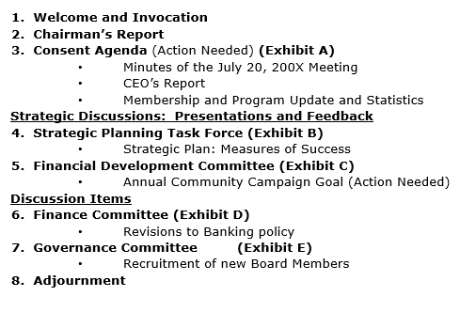
Look at Example:
Routine Items as Consent Agenda
These items are Prepared in advance
All attendees are asked if any Discussion
Can have simple questions with short dialogue
All items are voted on in one vote.

Slide 6
Look at Example:
What’s included in Consent Agenda
Topics of a routine/recurring nature
Procedural decisions
Non-controversial issues that do not require debate
Items previously discussed yet need an official vote

Slide 7
Look at Example:
Examples of items in Consent Agenda
Previous Meetings’ Minutes
Financial Reports
Committee Reports
Report on Goal Achievement

Slide 8
The Consent Agenda process
Committees and Directors
Community Services
Finance
Secretary to Distribute with Agenda
All Attending Receive and Review
Meeting Approval
Fund Raiser
International Service
ETC>>>

Slide 9
Consent Agreement Process in the Meeting
Like any motion – Consent Agenda Approval needs a mover and seconder to open for Vote of acceptance
Then Discussion on definitions or minor detail
Chair asks if anyone wants any portion removed from the consent portion of agenda
If anyone requests a removal it must be done without a seconder and then moved to a later part of meeting
Reasons to remove from Consent agenda:
Does not have support
Needs additional information
Desire further Discussion
Consent Agenda motion vote

Slide 10
It is Critical to……
Set a schedule to Receive Reports
Ensure all Agenda material distributed well prior to meeting
Board Members review material and prepare for meeting
Timing is Critical

Slide 11
Problems caused by:
Committees not submitting Reports
Directors not being prepared
Distribution giving insufficient time to Prepare

Slide 12
Consent Agendas Will allow Board to:
Cover more important matters during meeting
Be more aware of all accomplishments in club
Distribute more information to Club members
End the Meeting on time allotted

