Slide 1
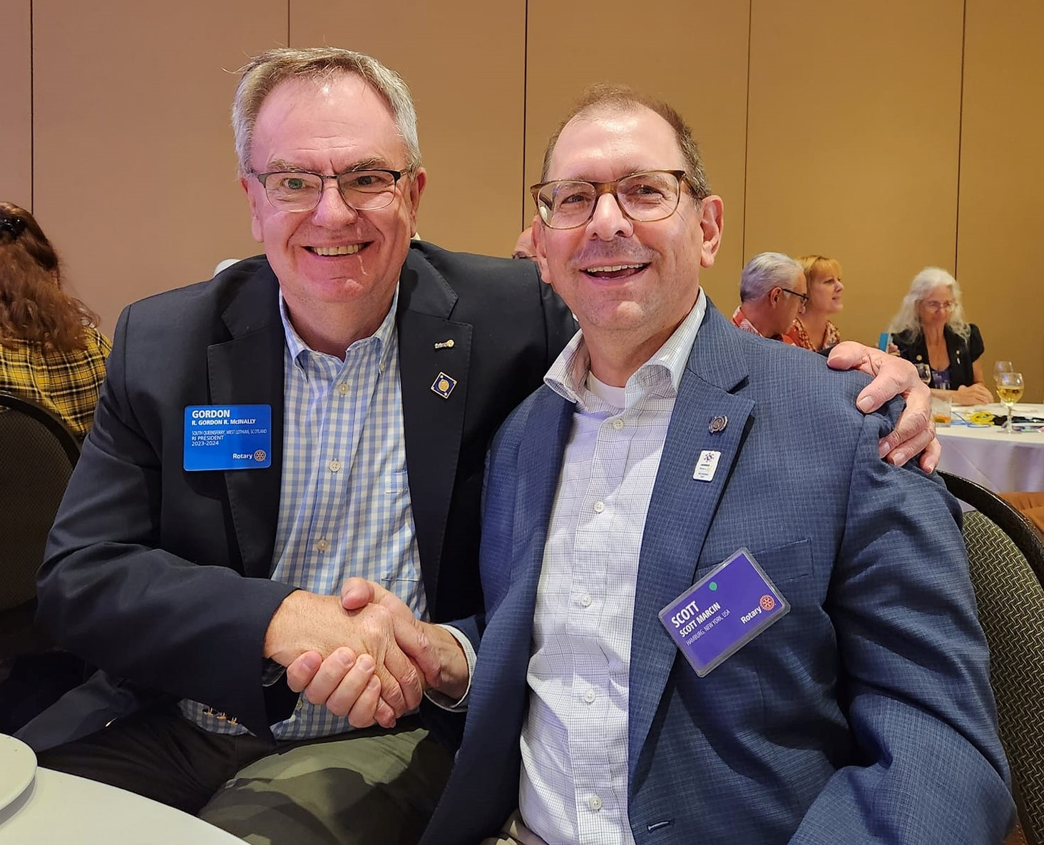
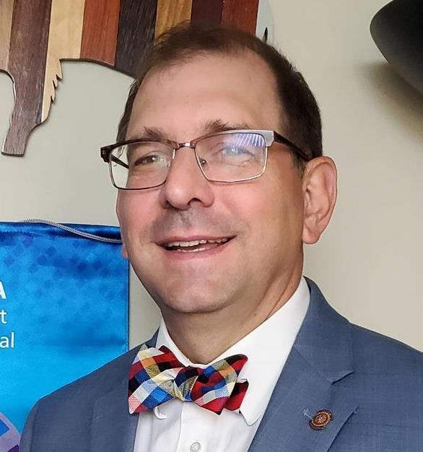
This was the powerpoint presentation
For seminar with discussion as well

Slide 2
Sandi Chard-Why Foundation is important to me!
I Believe in investing in Rotarians knowledge around the world
• Needs identified and implemented by Rotarians
• Local and International Activities
• Global network of compassionate volunteers
• Rotarian driven
I hope you will join me in my passion and Imagine all the great things Rotarians can do

Slide 3
Found on Line on our webe

Slide 4
Todays format
1. Showcase where the money for District grants come from
Present how your club can get involved in District Scholarships
Different types of district grants
Brainstorm –where to find a grant idea
Give you direction to find on district website information
Break out with a grant reviewer questions you might have
Questions and answers
We will be finished in one hour

Slide 7
Generates District designated funds (DDF)
Designated contributions through the Every Rotarian, Every Year (EREY) campaign remain crucial to Success of District Designated Fund and more

Slide 11
Gift ID: E20602

Slide 12
Suggestion for your club foundation to
Give to the Rotary Foundation a donation of
10% of your Foundation each year

Slide 16
2022-23 amounts

Slide 18
District 7090 Scholarship
The Rotary Foundation Scholarship Committee of District 7090 is pleased to be able to award 3 scholarships to deserving high school graduating students!
TWO - $1,000.00 USD Awards
ONE - $1,500.00 USD Award for a student with a median family income of less than $37,000 USD/year.
Scholarship Description
A general scholarship awarded to a student who at the time of application is in his/her final year of high school education, with a commitment to enroll in post-secondary education. The scholarship is open to any area of study and must be used towards full time Canada post-secondary/U.S. post high school study at a university, college, or community college, anywhere in the world. The applicant’s permanent address must be within the boundaries of District 7090, (which includes Rotary Clubs in Ontario, Canada and New York, USA).
Scholarship Criteria:
The scholarship will be based on the following criteria:
Academic merit: high school transcripts
A resume of community service and/or volunteer activities completed, plus a 100-word paragraph about the impact these experiences have had on you
And, an essay of 750 words describing: why you chose your career/education path, and what community service/volunteer activities you plan to participate in. Optional: letter of reference from any community member.
Timelines
Application deadline is April 30. The scholarship will be awarded no later than June 30.
Application Process
All eligible students must submit the scholarship application to their local Rotary Club (All applications must be endorsed by two members of that Rotary Club, one of which is the Club President.
All applications must be submitted, by the local Rotary Club, to the District Scholarship Chair by April 30.
Only complete applications will be considered.
The scholarship committee will evaluate all qualifying applications based on the above noted criteria.
Proof of college/university acceptance must be received by June 20.
Eligibility Requirements
The student’s permanent address must be within the boundaries of District 7090.
The student must be accepted to a full time post-secondary/high school study at a university, or a community college, anywhere in the world.
Proof of college acceptance must be provided prior to cheque(s)/check(s) being issued no later than June 20. Cheques/checks are issued to sponsoring Rotary Club.
Secondary/High School transcripts musts be submitted with application.
Rotary’s conflict of interest policy does apply to this scholarship and as a result cannot be awarded to the following:
A Rotarian, including Honorary Rotarians
An employee of a club, district, or other Rotary Entity, or of Rotary International;
A spouse, lineal descendant (child or grandchild by blood, legal adoption, or marriage without adoption), spouse of lineal descendants, or ancestor (parent or grandparent by blood) of person(s) in the above categories;
An employee of an agency, organization, or institution that partners with The Rotary Foundation or Rotary International;
A former Rotarian or honorary Rotarian who has terminated membership within the preceding 36 months.
CONTACT US

Slide 20
Clubs can give different amounts

Slide 22
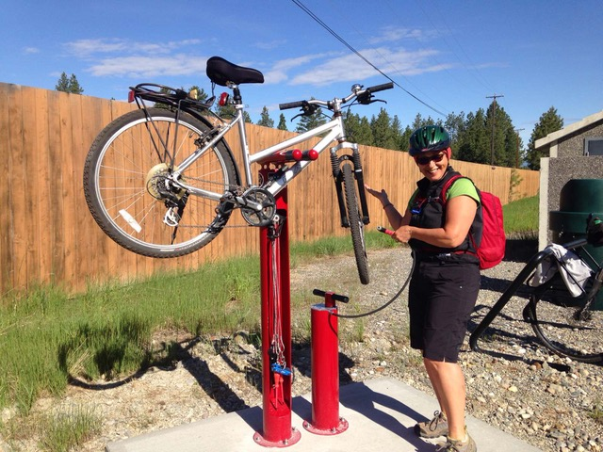
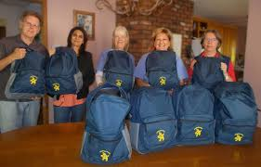
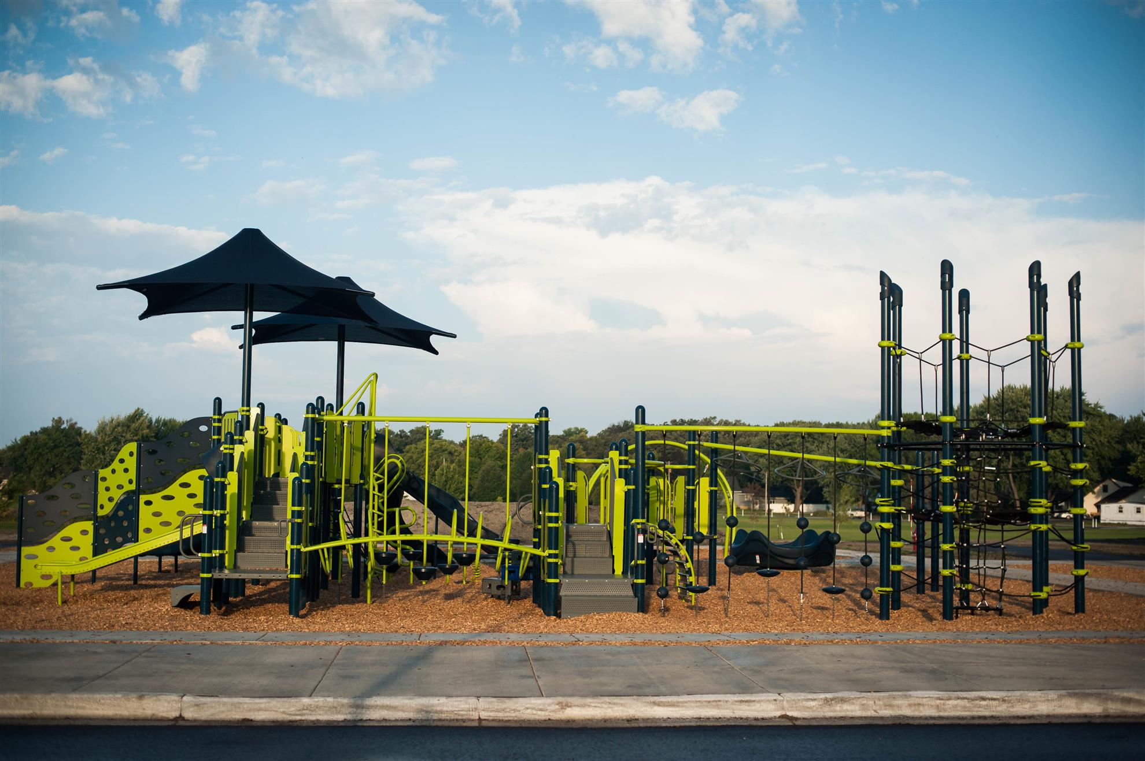
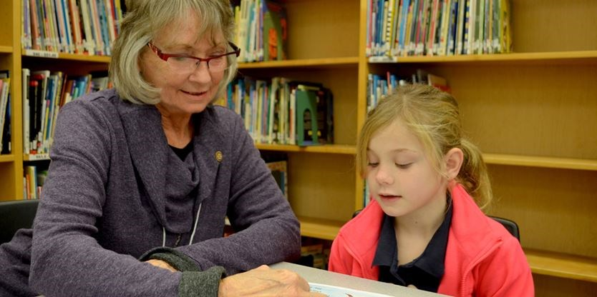
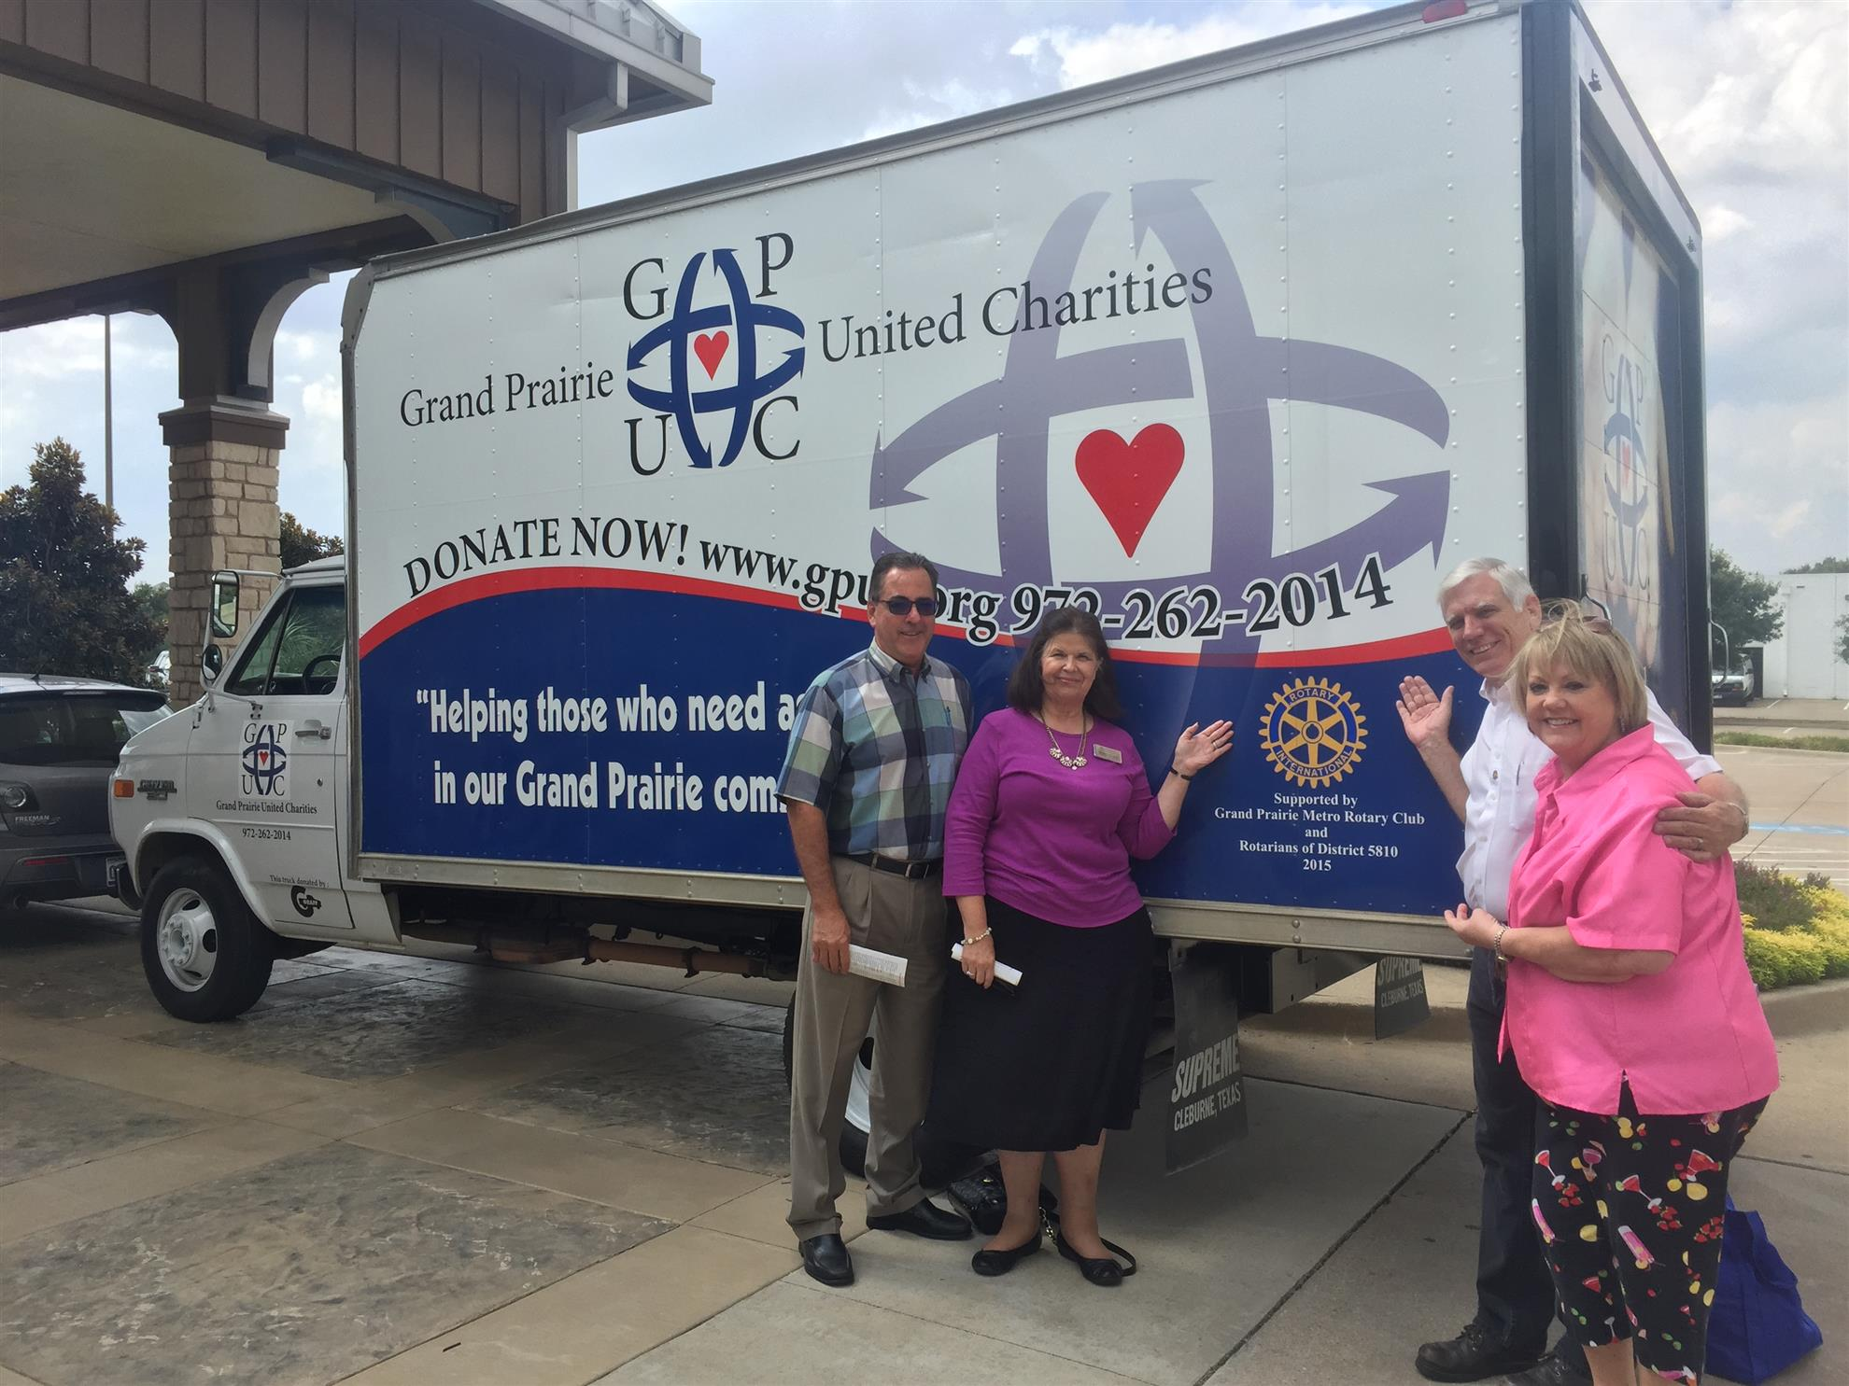
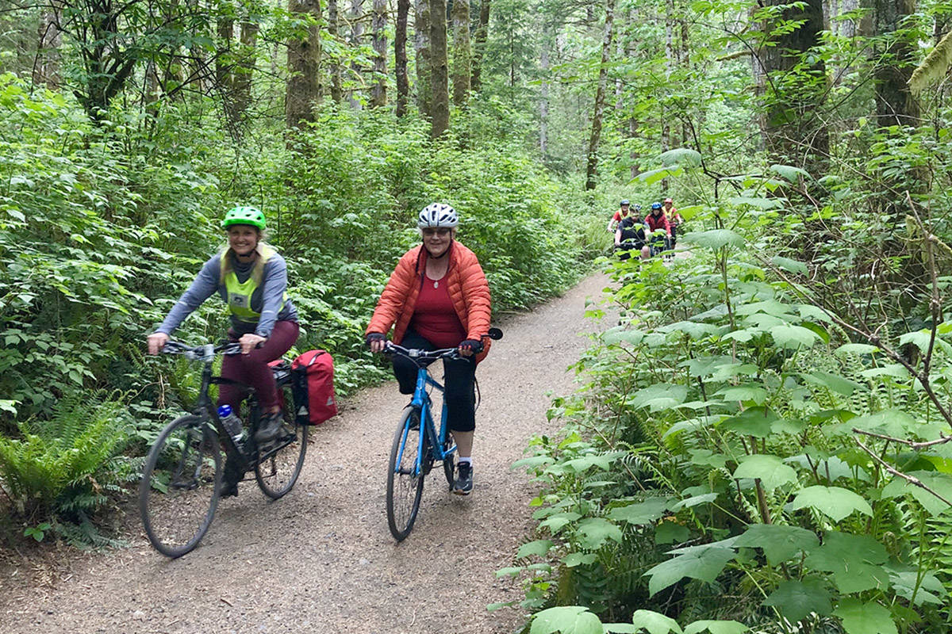

Slide 25
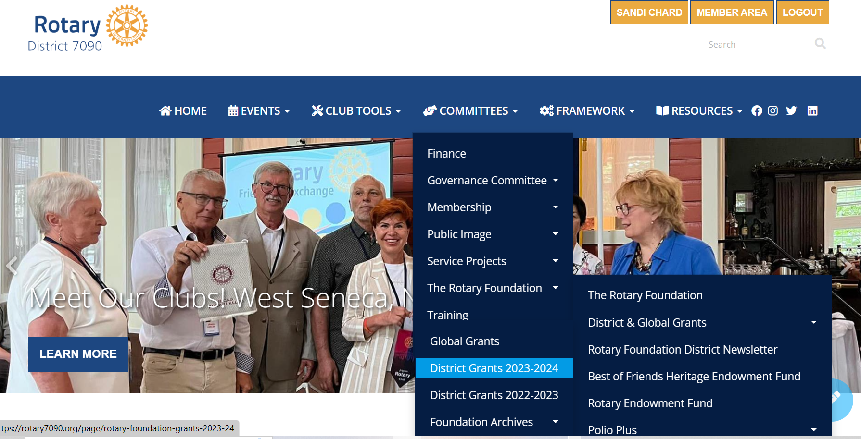

Slide 26
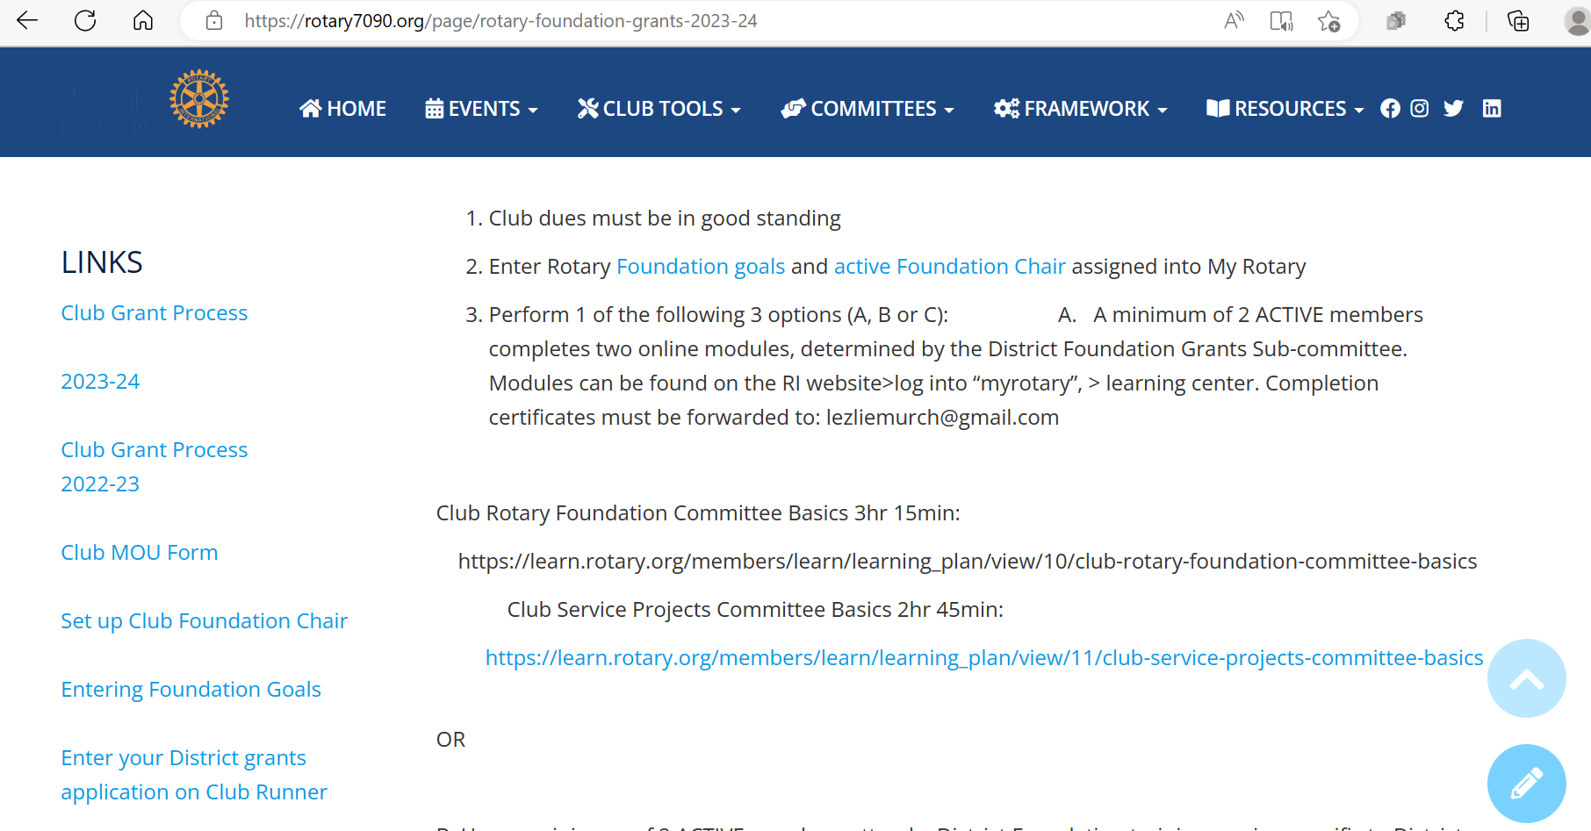

Slide 27
Global Grant Update for District 7090
District 7090 New York Cluster Group
District 7090 Ontario Cluster Group
For More information
https://rotary7090.org/documents/en-ca/32f28a98-fde3-4d70-b356-e9ff8a8a5ae1/1/

Slide 28
New York State District 7090 Cluster Fund-coordinator
District Grants (club) Chair
District Grant Reviewers
Peace Fellow Endorser
District Scholarship Reviewer
Polio Plus
Endowment Fund
Stewardship reviewer

Slide 30
Homework
2 members qualified for District Grant
Foundation Chair named---in Rotary International
Foundation goals entered-In Rotary International
MOU signed by President and President Elect-sent to Lezlie
Pick a project
Enter project in District Club Runner by April 30 2023

Slide 31
Break out room-10 minutes
Discuss project ideas-possible collaborative grant
Questions on how to do a grant application and final reports

