Slide 1

Your Club’s 3 Year Rolling Goals
Building Continuity and Driving Impact Across Leadership Transitions

Slide 2


Why 3-Year Rolling Goals?
Enhancing Continuity and Collaboration
Continuity Across Leadership Changes
Provides consistency in vision and projects despite annual changes in leadership.
Better Long-Term Planning
Allows clubs to adapt and grow over a multi-year timeline.

Slide 3
Why 3-Year Rolling Goals?
Enhancing Continuity and Collaboration
Increased Member Engagement
Drives meaningful engagement and collaboration, giving members a shared sense of purpose.
Increased Impact
Serving and strengthening our communities, local and global.

Slide 4
The Mechanics of Rolling Goals – How Does it Work?
Annual Review and Update: Leadership teams review and adjust goals annually to reflect evolving needs.
  Priority and Flexibility: Focus on 6 priority goals but allows clubs to choose other goals.
  Collaboration Across Teams: Promotes teamwork and input from members to shape objectives.
Photo by Sebastien Bonneval on Unsplash

Slide 5



Customizing Goals for Your Club
Tailoring the Process
Understand Club Needs
Identify unique challenges and opportunities in your community.
Engage Members
Gather input from members to shape personalized goals.
Adjust Targets
Modify Rotary-provided templates to align with club priorities.

Slide 6
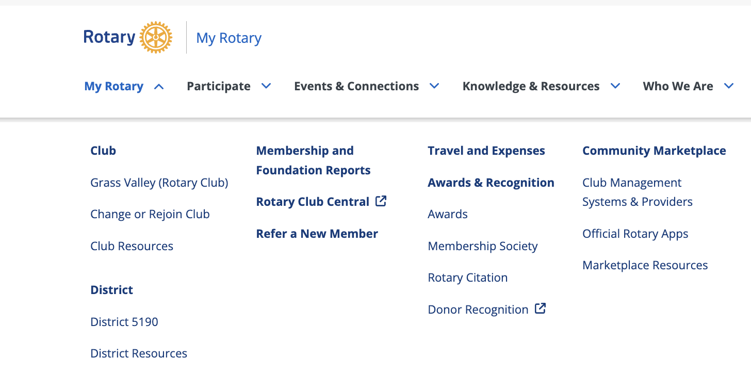
Accessing Rotary Club Central
Getting Started with Goal Entry
Visit My Rotary: Log in to My Rotary using your credentials.
Navigate to Rotary Club Central: Under ‘My Rotary’, select Rotary Club Central.
Confirm Your Role: Ensure you have access rights to input and edit goals.

Slide 7
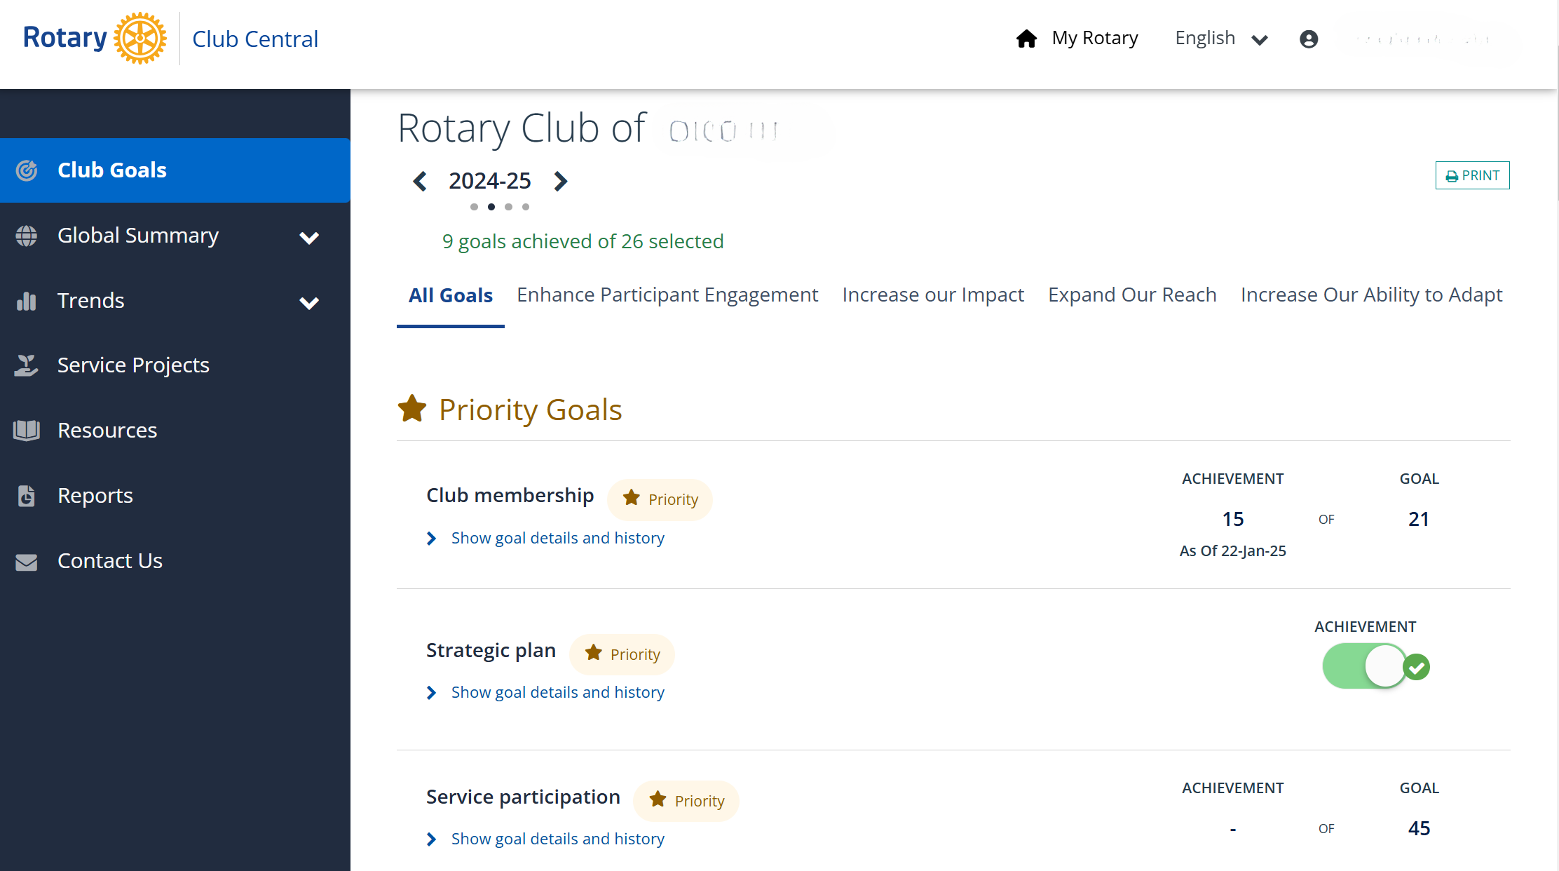
Inputting Priority Goals

Slide 8
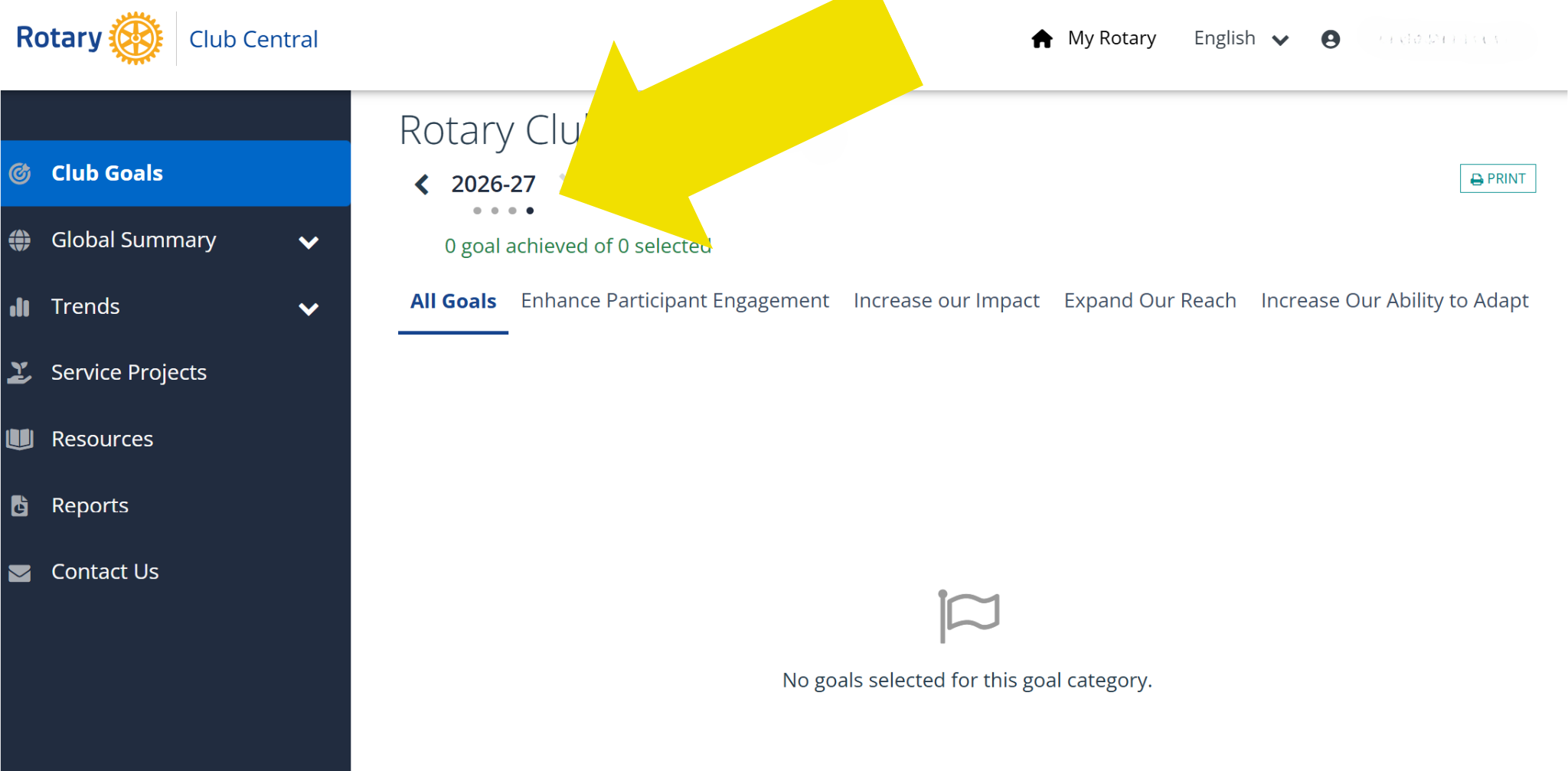
Inputting Priority Goals
Step-by-Step Guide

Slide 9
How our Club can work together with our future goals
Next Steps for Success
Communicate with Members: Share goals with members to ensure alignment and commitment.
  Implement Action Plans: Break goals into actionable steps and assign responsibilities.
  Review Regularly: Schedule periodic check-ins to evaluate progress.

Slide 10
Monitoring and Updating Goals
Stay on Track
Use the 'All Goals' Tab: View all active goals and their progress in one place.
  Update Data Regularly: Ensure accurate tracking by updating as new achievements occur.
  Adapt to Changing Needs: Modify goals each year to align with evolving priorities.
Photo by Markus Winkler on Unsplash

Slide 11

Recognition for Excellence
Meet Specific Goal Criteria: Ensure the six priority goals, chosen by your club, are fulfilled.
  Rotary International’s Certificate of Excellence: Achieve over 50% of the 26 goals in Rotary Club Central
  Big West Recognition: This recognition will focus on clubs achieving the six priority goals
  Celebrate Along the Way: Small steps forward are worth celebrating!
Photo by Daniel Patterson on Unsplash

Slide 12



Sustaining Success
Key Takeaways
Continuity and Collaboration
3-year rolling goals provide stability across leadership changes.
Member Engagement
Engaging members strengthens commitment and ensures progress.
Achieving Impact
Long-term planning drives meaningful and measurable success.

Slide 13
Let’s help every club Thrive!
Building Continuity and Driving Impact Across Leadership Transitions

