Slide 1
Three Year Goals + Regional Plans

Slide 2

April 2024 Board decision
The board strongly encourages:
Clubs to set three-year rolling goals
Zones to develop three-year rolling regional plans to help clubs reach their goals
Districts and zones to support the three-year rolling regional plans

Slide 3

Three year Goal Setting

Slide 4
Club Excellence Award
Formerly known as Rotary Citation
Achieved when 50% of goals within Rotary Club Central are set and achieved

Slide 5
Six priority goals
The Board and Trustees identified six goals within Rotary Club Central that are of strategic importance to the organization.
Aligned with Regional Leader goals
How many total members does your club want by the end of the Rotary year?
Does your club have an up-to-date strategic plan?
How many members will participate in club service activities during the Rotary year?
How much money (USD) will be contributed to The Rotary Foundation Annual Fund by your club and its members during the Rotary year?
How much money (USD) will be contributed to The Rotary Foundation PolioPlus Fund by your club and its members during the Rotary year?
During the Rotary year, how many individuals or couples will inform The Rotary Foundation of their estate plans to include the Endowment Fund as a beneficiary or will make an outright gift of US$1,000 or more to the Endowment Fund?

Slide 6
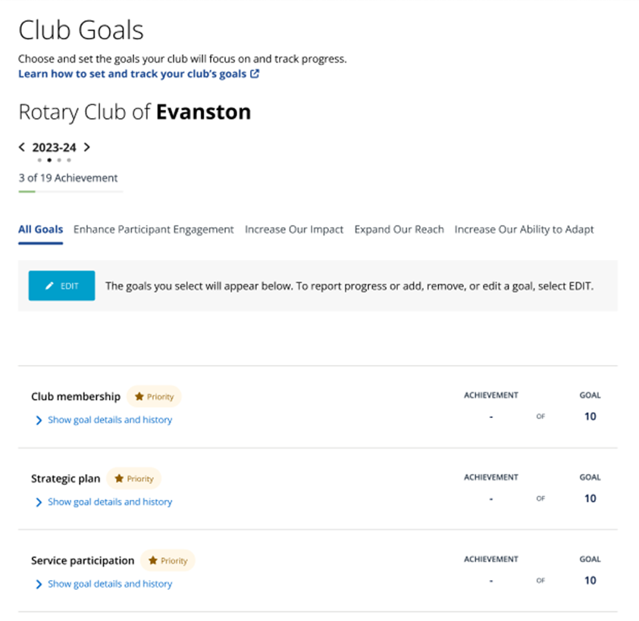
Goal setting for club presidents
Rotary Club Central now:
offers club leaders the ability to set goals for up to three years in advance
includes six priority goals, along with all other goals that can be set to achieve the Club Excellence Award

Slide 7
Regional Plans

Slide 8
Regional Plans
Regional plans should:
Help clubs reach their goals
Address regional challenges and opportunities
May include goals for zone and district leadership
Align with Rotary's Action Plan
Notes:
Regional adaptability in Action!

Slide 9
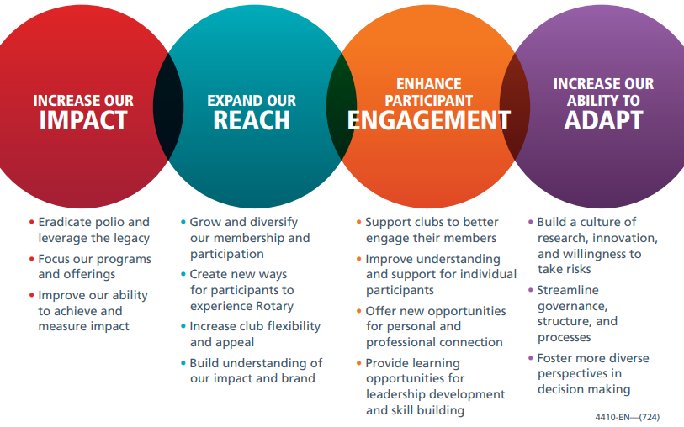
Rotary's Action Plan
Regional plans and goals should be:
informed by our strategic priorities and objectives
aligned to the Action Plan but also reflect regional adaptability

