Slide 1
Treasurer
Roles
Responsibilities
Oct 15, 2024

Slide 2
AGENDA
You are the Treasurer
Your Official Duties
When you do What?
You are the Keeper
You are the Support

Slide 3
Your Job
Maintain Accurate Club Financial Records
Track Income and Expenses through a bank or school account
Assist in Creating a Budget
Create a monthly update report of finances and budget comparison
Keep Historical Records safe for future use
Ensure an independent person reviews financial records at Year End
Contribute to Board of Directors decision making

Slide 4
What and When you are expected to do it!
Weekly | Monthly | Yearly
Approve all bills approved by Board | Reconcile records with Bank or school account information | Prepare and Present a Year End Financial Report
Attend all club and BoD meetings | Keep financial records updated and present reports to Club and Board Meetings | Assist in Preparing a Budget for next year and have approved by BofD
Record all club expenditures and income weekly | Present a comparative report of all Income and expenses with Budget | Hand all records over to the incoming Treasurer for next year
Follow Financial advice from Faculty Adviser and/or Rotary Advisor | Attend BoD Meetings | Have the Club’s Faculty Advisor review all Y/E records

Slide 5
You are the Number Keeper!
Prepare the Budget
Planning and Tracking
Manage the Accounts

Slide 6
You are the Number Keeper!
Prepare the Budget
Planning and Tracking
Manage the Accounts
Prepare the Budget
Purpose of the Budget
Example of a Budget
Comparative Report

Slide 7
Purpose of a Budget
A Budget is a guide to Planning. It is a plan you write down to decide how you will spend your money
A budget is an estimation of Income and Expenses over a fixed period
Allows one to set goals, monitor progress and measure outcomes
Fundraiser Budget
Car Wash | Budget | Actual | Difference | Reason
Revenue | $800 | $750 | ($50) | Rain forecast
Expenses | $150 | $47 | $103 | Supplies Donated
Net Income | $650 | $703 | $53

Slide 8
Purpose of a Budget
Go to the District 7090 for an Excel template for a Budget.
The budget is for a period of time or for a specific project.
Must Include
Period of time
Income sources and amounts
Expense specifics and amounts
Total Net Income (if any)
Annual Budget will be the result of multiple budgets

Slide 9
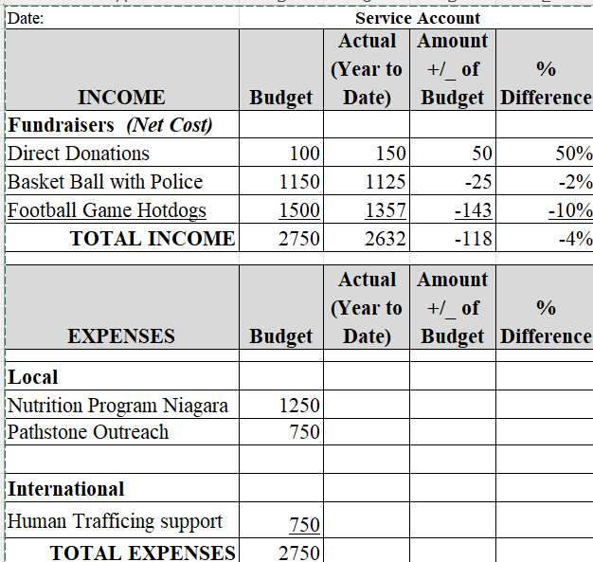

Slide 10
Tracking Progress!

Slide 11
You are the Number Keeper!
Prepare the Budget
Planning and Tracking
Manage the Accounts
Manage the Accounts
Accounting Basics
Balancing the numbers

Slide 12
The Cash Account: Tracking your Cash
Must keep a record of:
The Cash that comes in and out of your account
Ensure that the Bank account and your Records balance

Slide 13
Your Cheque Book

Slide 14
Simple Cheque Book

Slide 17
Report to Board of Directors
Must Include
Bank Balance
Financial Activities
Income
Expenses
Outstanding Cheques

Slide 18
Report for Months of Sept to October
Open Bank Balance |  |  |  | 100.00
Income
 | Basketball event | 125.75
 | Water Sale at Football Game | 72.00
 |  |  | 197.75
Expenses
 | Flyers for Basketball game | 23.56
 | Water for Football game | 32.59
 |  |  | 56.15
Net Income |  |  |  | 141.60
 |  |  | Subtotal | 241.60
Outstanding Cheques | #301 Home depot |  |  | 35.59
Closing Bank Balance |  |  |  | 206.01

Slide 19
As the Number Keeper……
Budget
Track Expenses / Income
Compare to Budget
Prepare Statements Monthly
Budget
Income / Expense
Bank reconciliation
Year End Statements

Slide 20
EXPERIENCE
Notes:
The previous are simply Treasurer duties…. But the BoD work as a Team. Teamwork is critical
1) All members have different skills …. Take advantage of this. Work together and Listen then 4) collaborate
2) Each of you have a vision that will help set a direction to success. Some ideas, that when shared can be seeds to better ideas. Don’t be afraid to share
3) Each of you will have a sense of Creativity….. Thinking Outside the Box can be the nucleus to great results
5) Each will have a strength based on their experience and knowledge; Benefit from other’s Experience; Share your Experience
7) The key is to communicate with each other. LISSEN Share ideas…. Accepting each others' strengths …. Feel confident about your own ….
8) Setting GOALS is a tool to Plan, Guide, Control and Succeed.
9) The result is Leadership as an individual and a Team.

Slide 21
You are a Team Member
The Role and Responsibilities of the Board of Directors
Set the organization's strategic direction, defining its mission, vision, and values.
Approve and monitor the implementation of strategic plans and initiatives.
Evaluate the organization's performance against strategic goals and make adjustments as needed.

