Slide 1
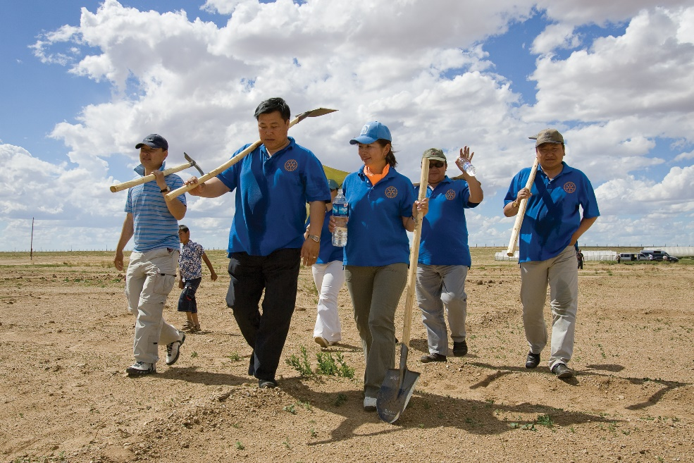
Great Membership Resources & Where to Find Them
Kevin Crosby, District 7090 Membership Director

Slide 2
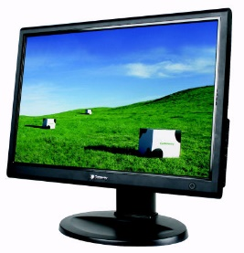
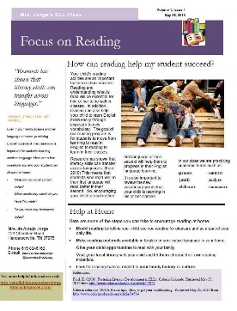
What kind of resources?
Manuals
Guides
Best practices
Tools (e.g., surveys)
Videos
PowerPoint presentations
Newsletters
Reports
Human

Slide 3
For what purpose?
Getting your club ready for membership growth
Recruiting / attracting new members
Recruiting / retaining Young Professionals
On-boarding new members
Retaining your current members
Building diversity
Creating satellite clubs

Slide 4
Where are these resources?
Our District
RI –
Shop Rotary
RI –
My Rotary
Zone 24
RI –
Brand Central
Vendors

Slide 5
Our District
Website
ClubRunner Dashboard
Human: me or Committee Chairs

Slide 6
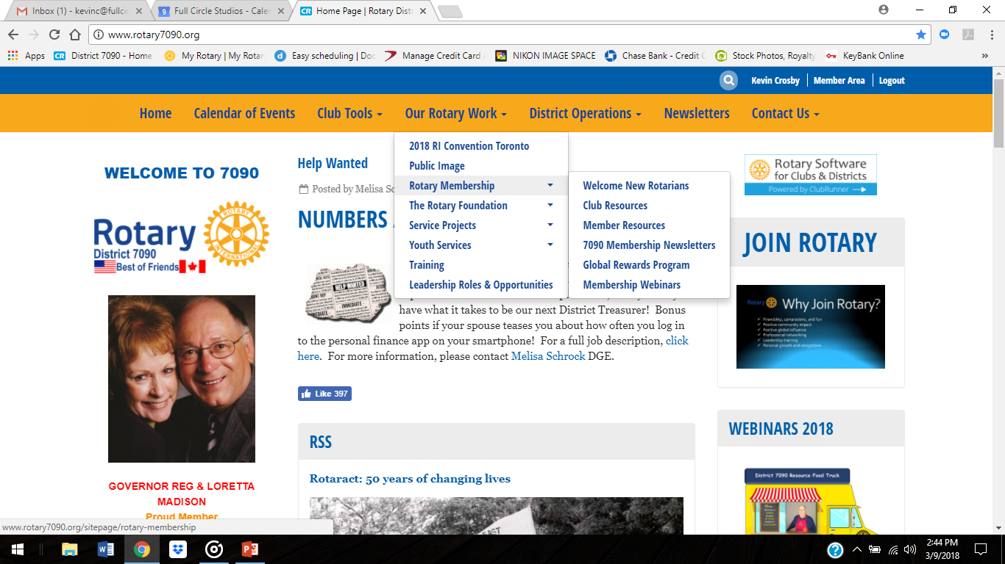

Slide 7
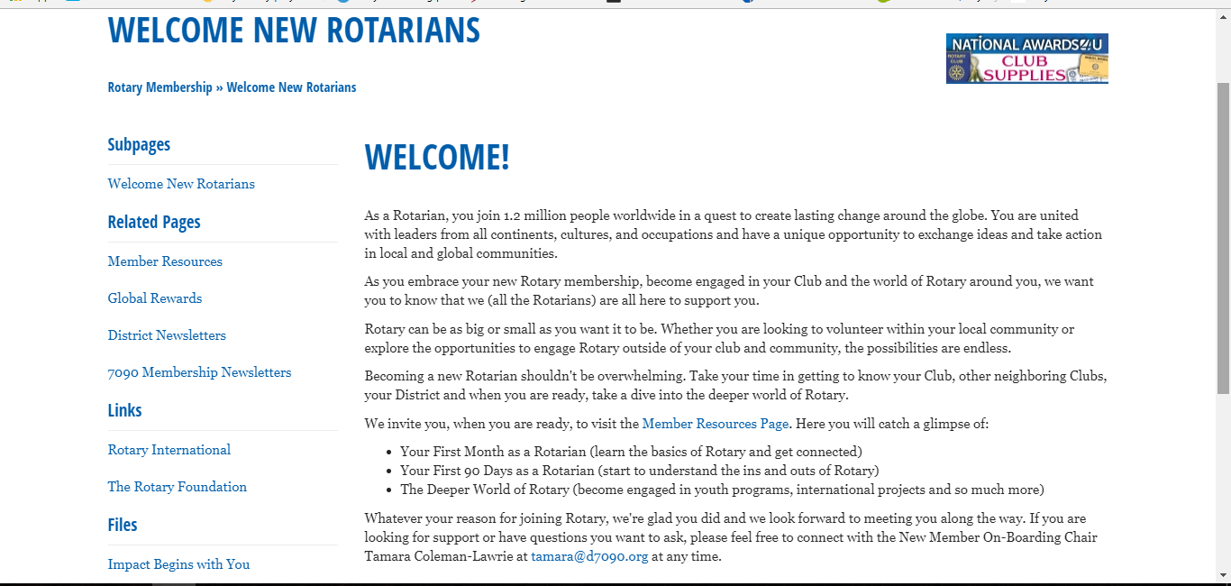

Slide 9
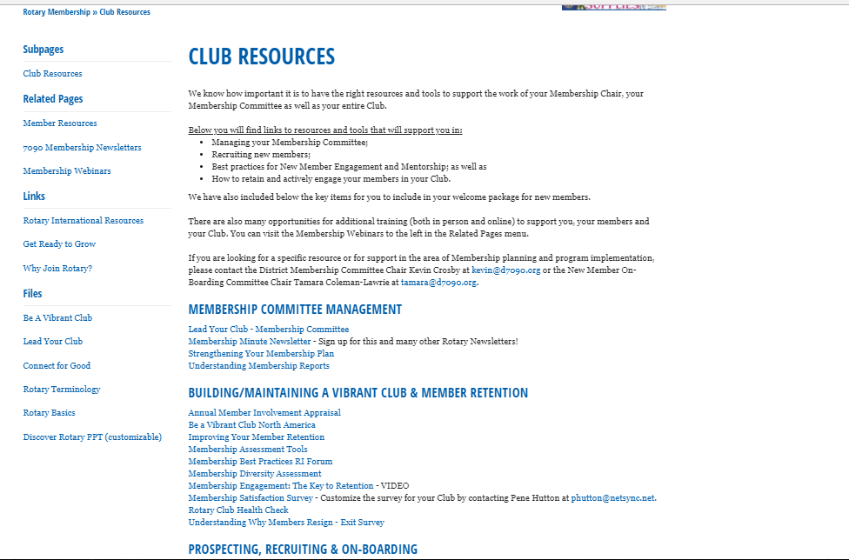

Slide 12
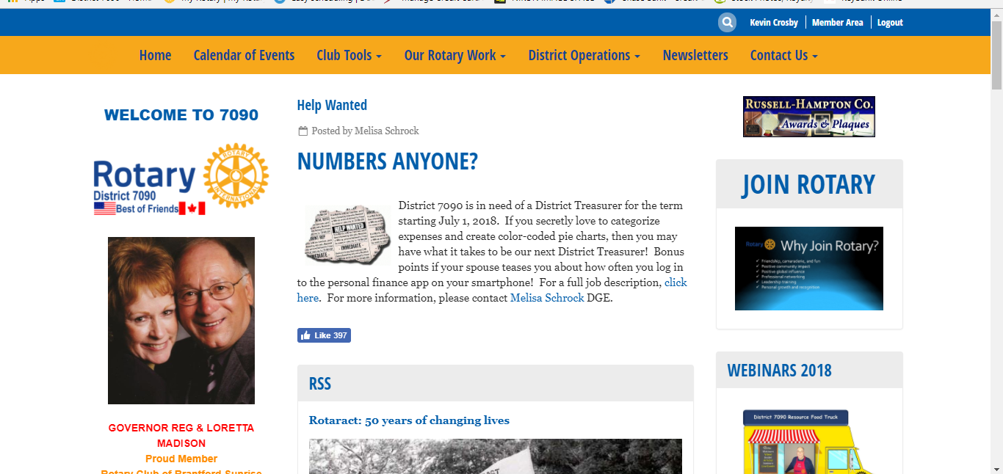
0

Slide 13
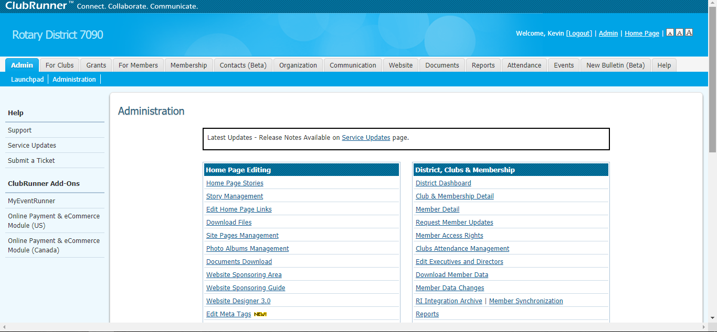

Slide 14
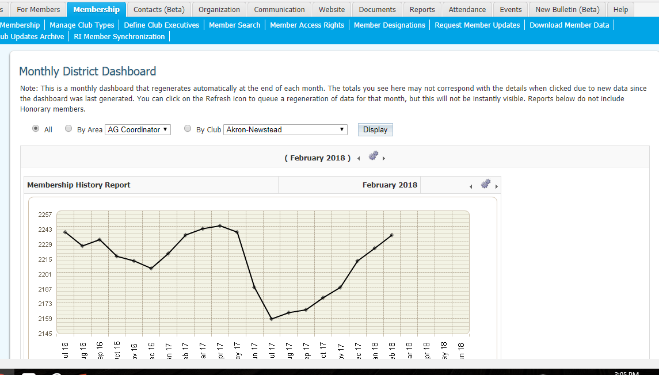

Slide 15
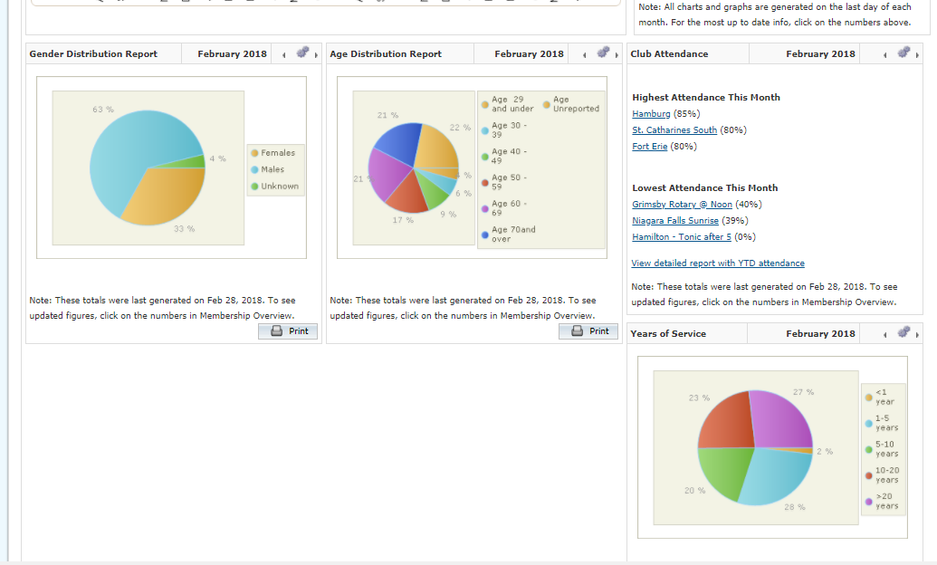

Slide 16
Human Resources
Membership Director – Kevin Crosby
Chair, Recruitment Committee – Gordon Crann
Chair, Retention Committee – Marlee Diehl
Chair, On-boarding/New Member Orientation – Tamara Coleman-Lawrie
Co-chairs, Young Professionals – Amy Gringhuis & Jamie Perry
Co-chairs, Accessibility Committee – Rob Benzel & Terrence Ho
Co-chairs, Club Extension Committee - TBA

Slide 17
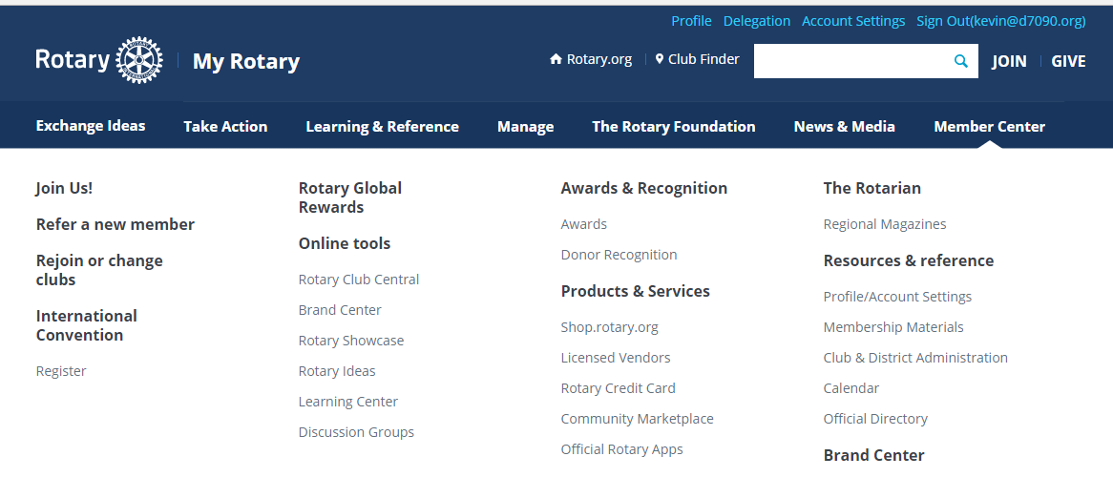
RI - My Rotary

Slide 18
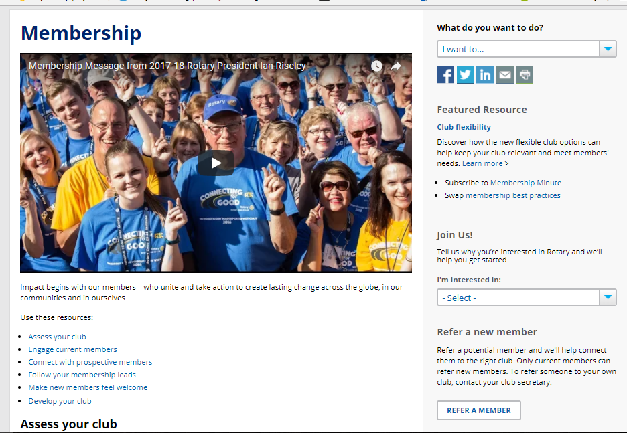

Slide 19
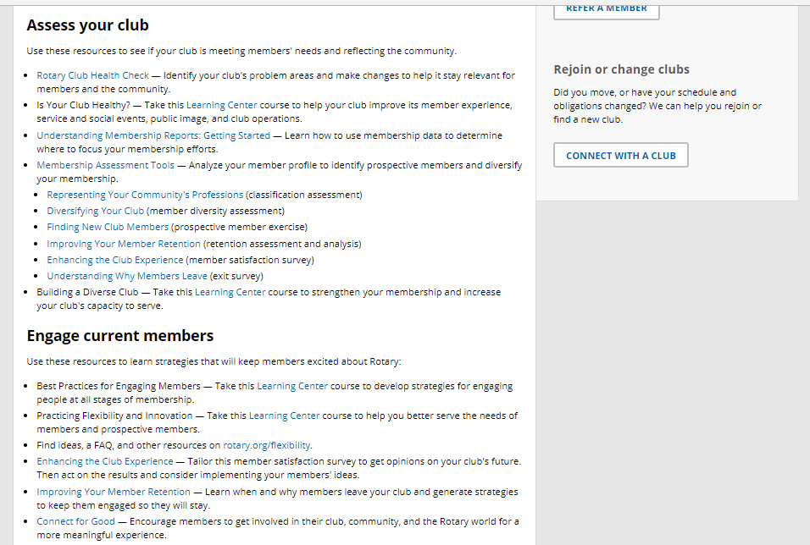

Slide 22
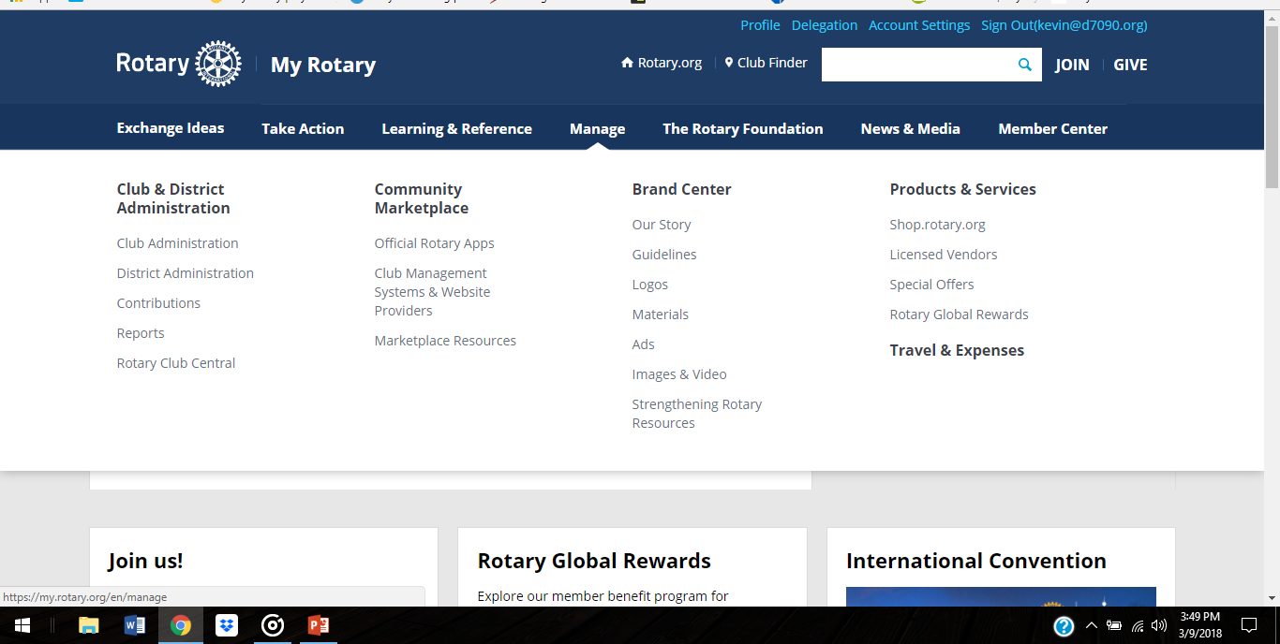
RI - Rotary Club Central

Slide 23
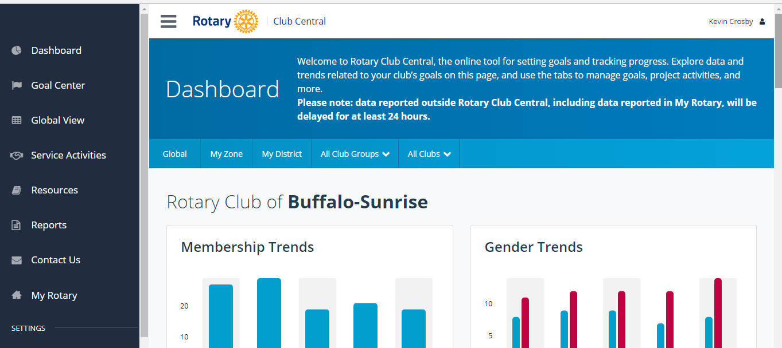

Slide 24
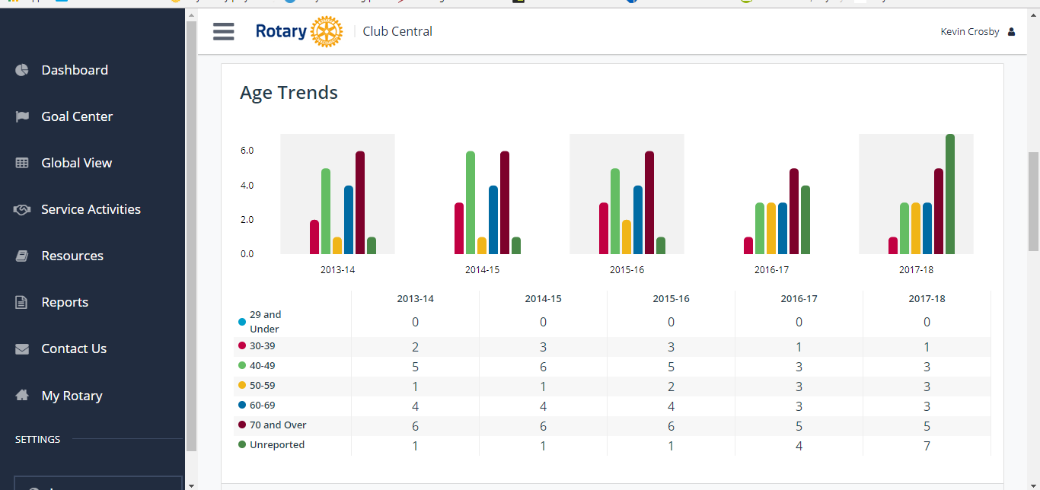

Slide 25
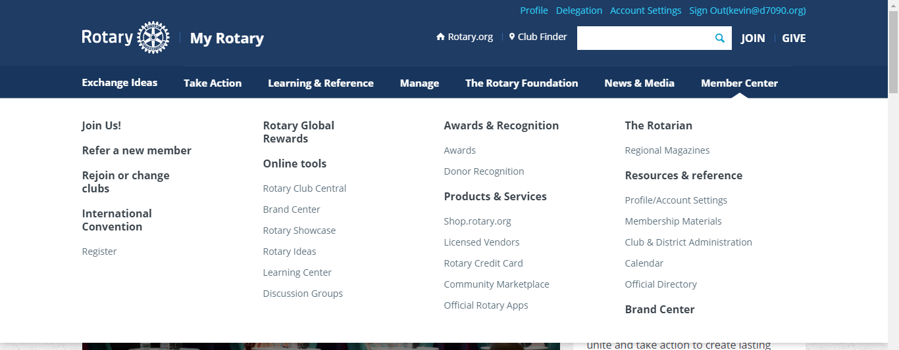
RI - Brand Central

Slide 26
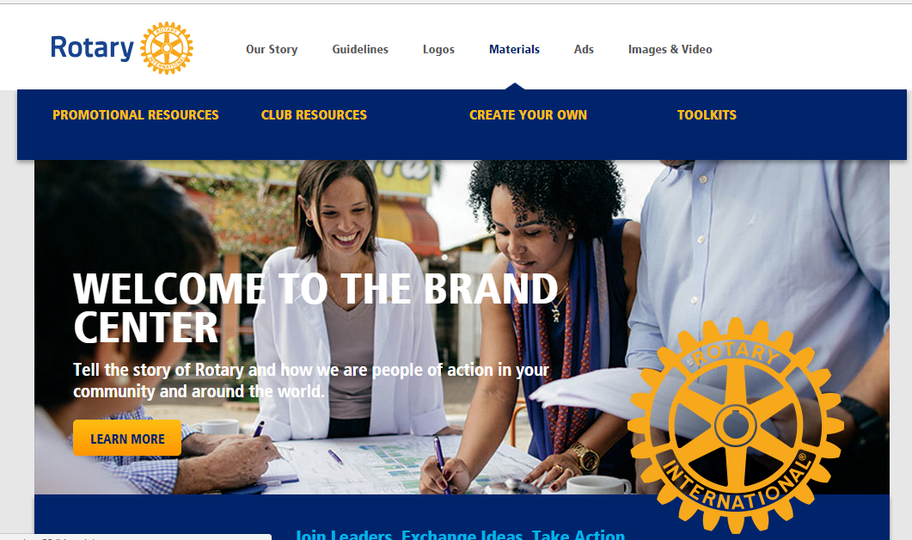

Slide 27
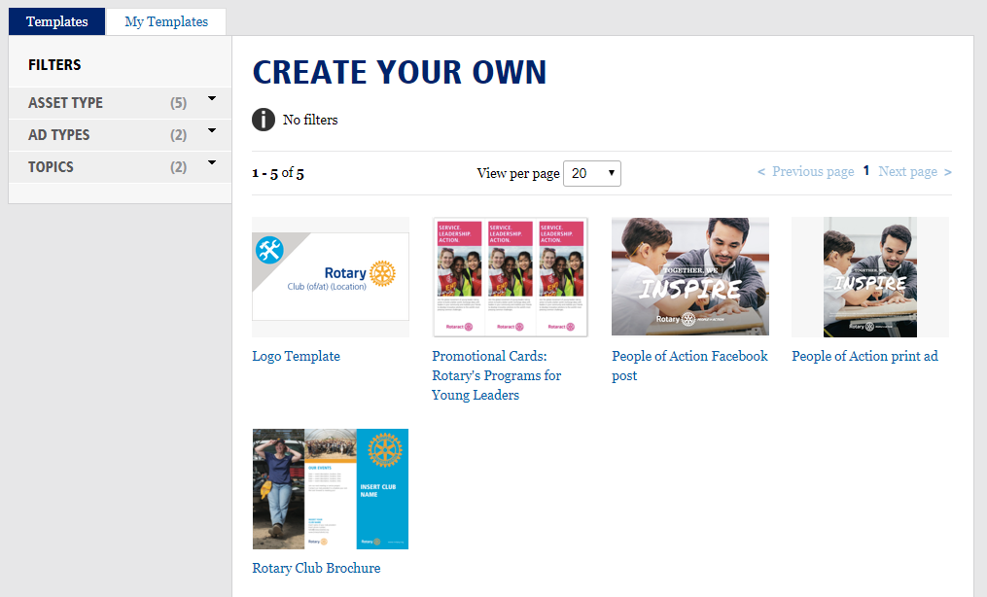

Slide 28
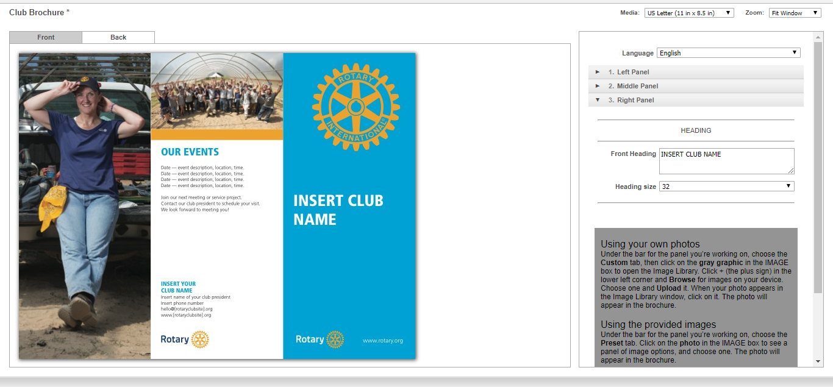

Slide 29
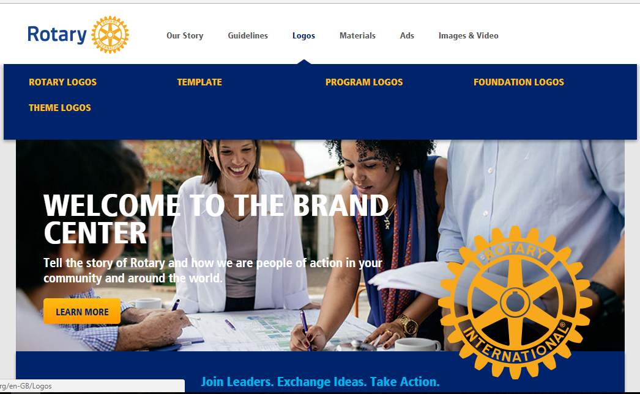

Slide 30
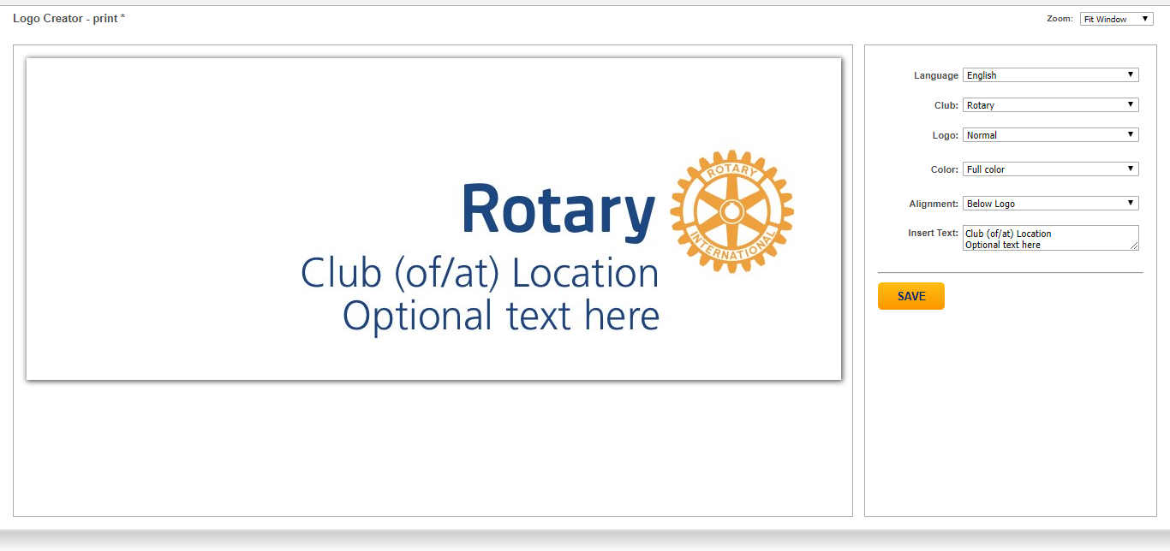

Slide 31
RI - Shop Rotary

Slide 32
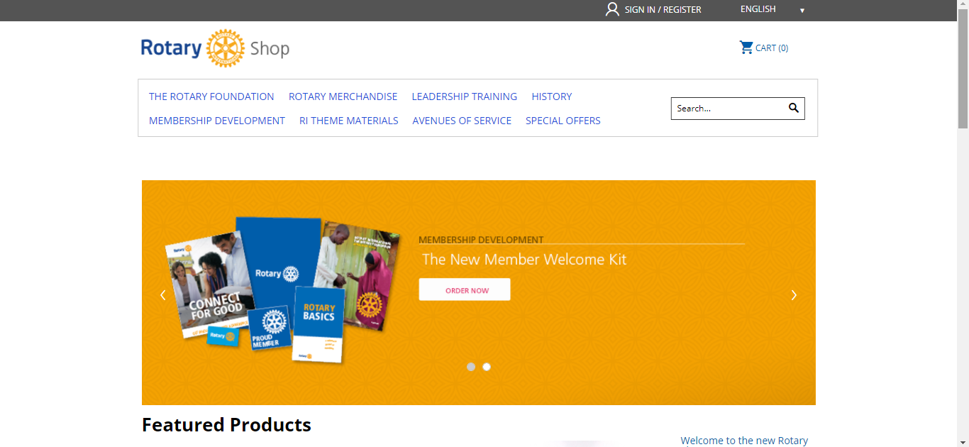

Slide 33
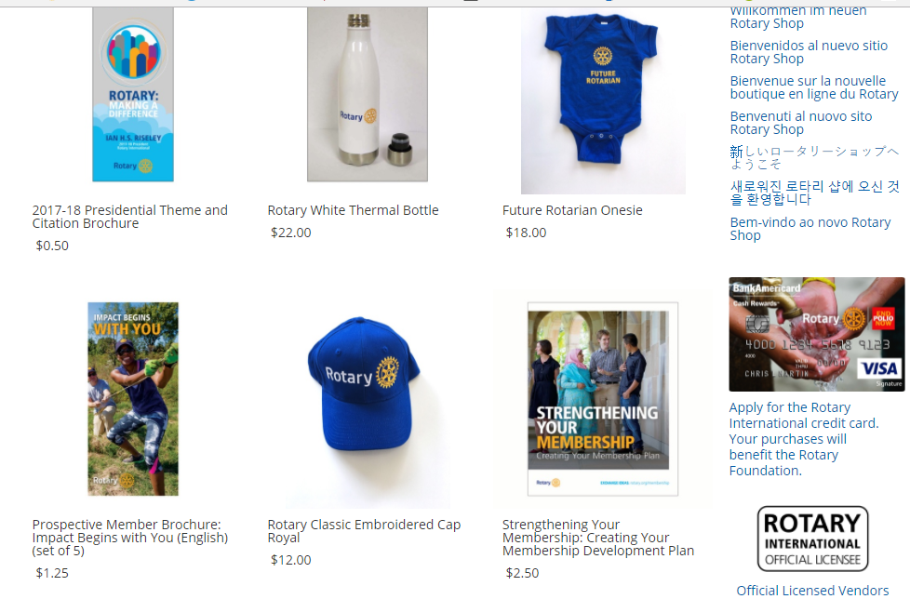

Slide 34
Zone 24

Slide 35
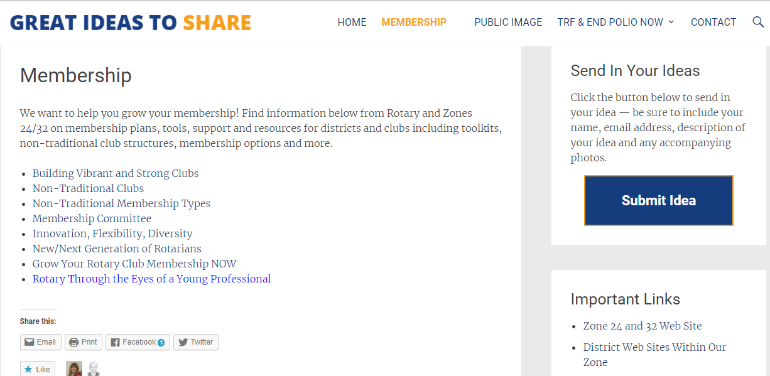

Slide 36
Zone 24 – Human Resources

Slide 37
Vendors

Slide 38
Where are these resources?
Our District
RI –
Shop Rotary
RI –
My Rotary
Zone 24
RI –
Brand Central
Vendors

Slide 40
Kevin Crosby
Kevin@D7090.org

