Slide 1
Club
Visioning
Presented By:
District 7090 Club Vision Facilitation Team
Notes:
Club visioning is a service provided by the District. Colleague Rotarians have been trained and are experienced as facilitators of the process.

Slide 2
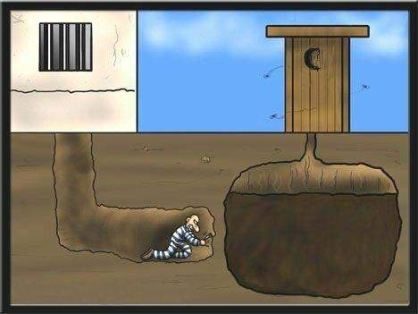
Notes:
Good planning makes good sense – or, how to avoid deep doo-doo – planning ensures that the Club moves forward.

Slide 3
Notes:
Planning provides for collaboration, continuity, consistency, that is, everyone pulling together– note the diversity represented.

Slide 4
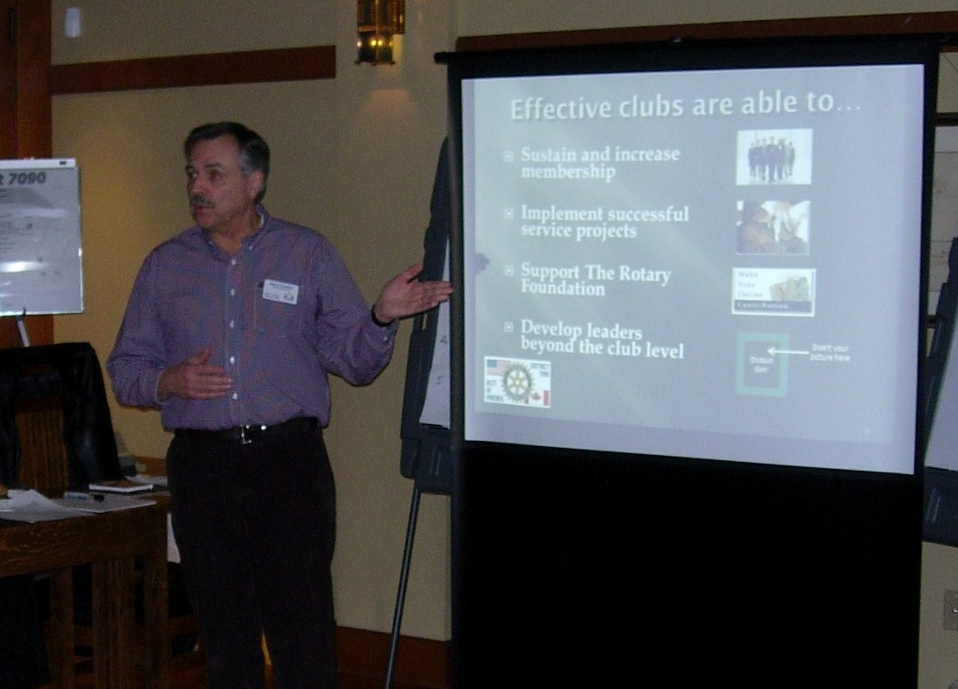
Notes:
The visioning process is a tool. It helps effective clubs manage membership development, produce successful service projects and take action regarding leadership development.

Slide 5
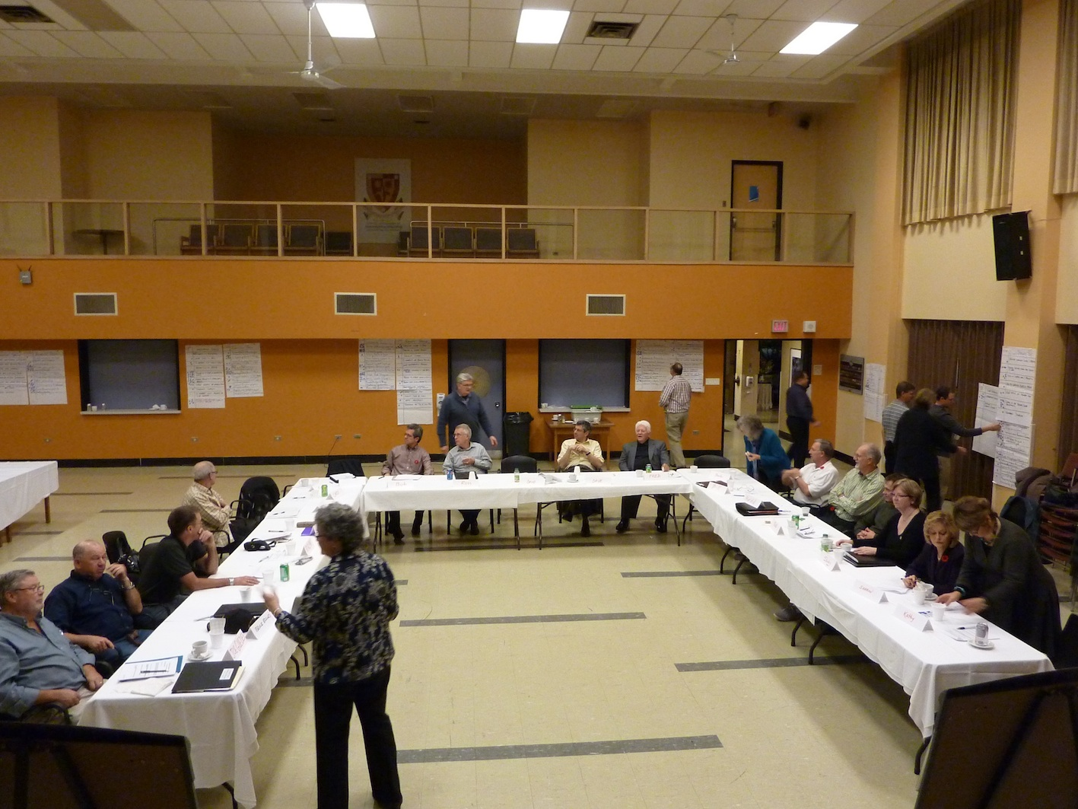
Notes:
Typical and preferred set up for successful visioning interaction.

Slide 6
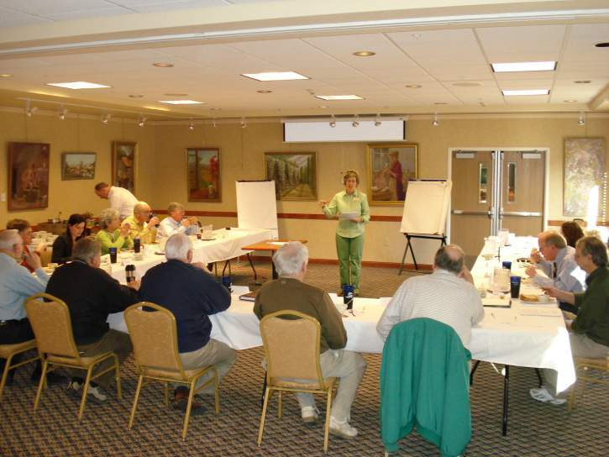
Notes:
The first step in the process is the Writing / Ideation exercise. (being explained in this slide)

Slide 7
Priority Areas
Visioned
Club size
PR & Public image
Club Service
Vocational Service
Youth Service
Community Service
International Service
Fund raising
The Rotary Foundation
Notes:
The specific areas looked at in the visioning process are these:

Slide 8
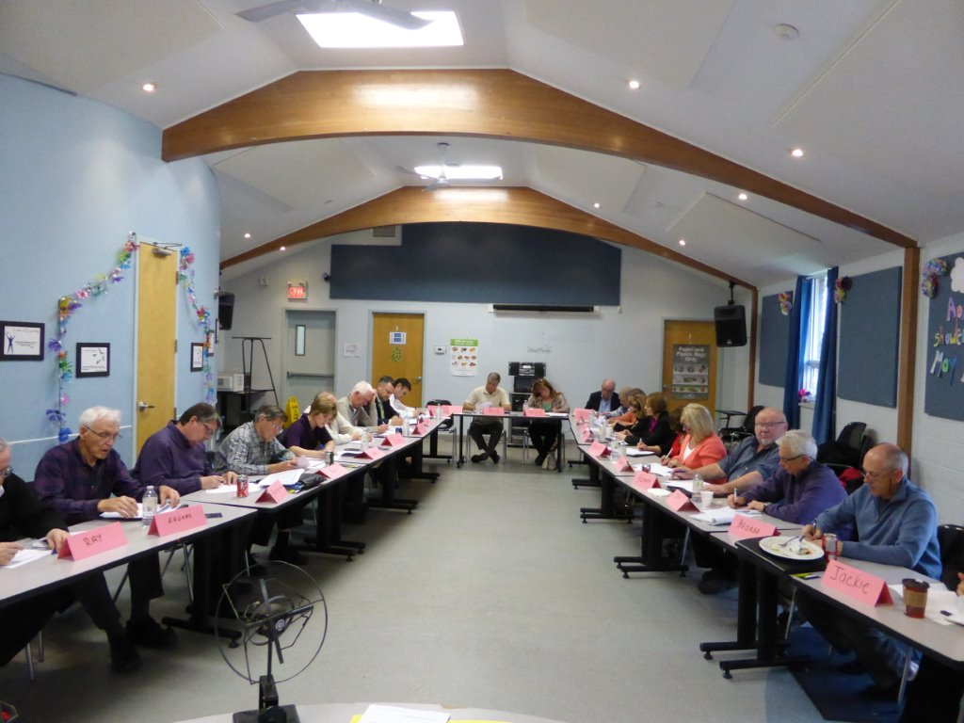
Notes:
Members record their ideas for the future – they are using key words, short descriptive phrases or outline format.

Slide 9
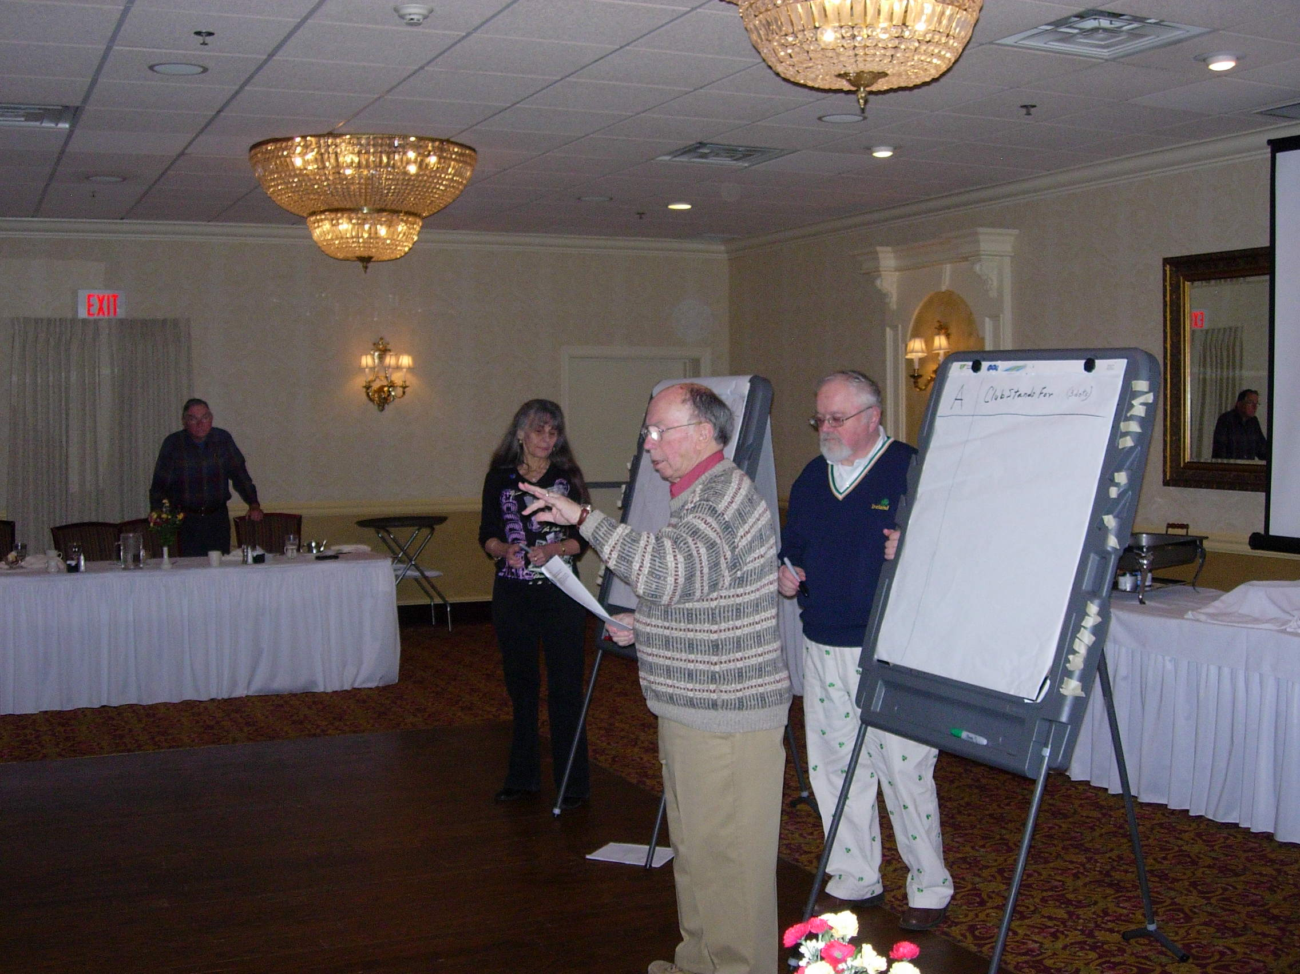
Notes:
After the writing portion, the ideas are shared and recorded. (Extraction process explained)

Slide 10
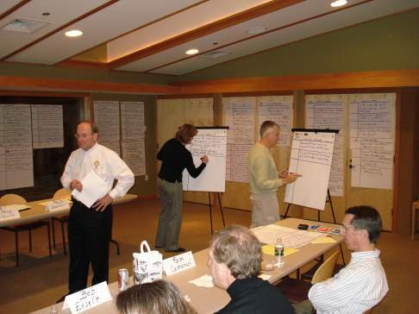
Notes:
Rotarians looking to the future usually produce many interesting ideas. (this shows ideas extracted and recorded)

Slide 11
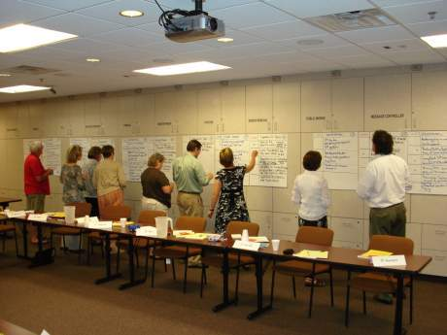
Notes:
Members vote on the ideas to establish priorities

Slide 12
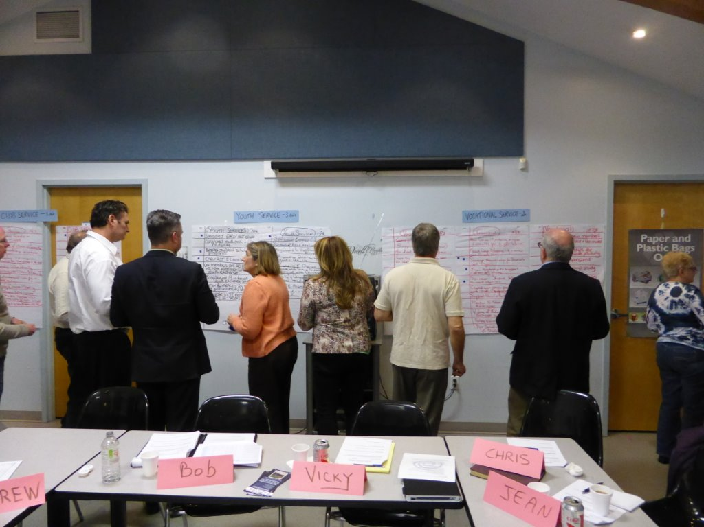
Notes:
Another Rotary Club voting -- Members vote on the ideas to establish priorities

Slide 13
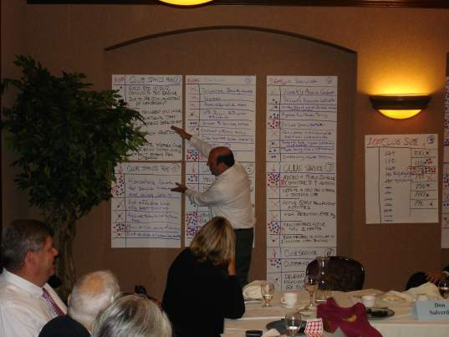
Notes:
One of the Facilitators doing a verbal summary and reinforcing the priorities observed.

Slide 14
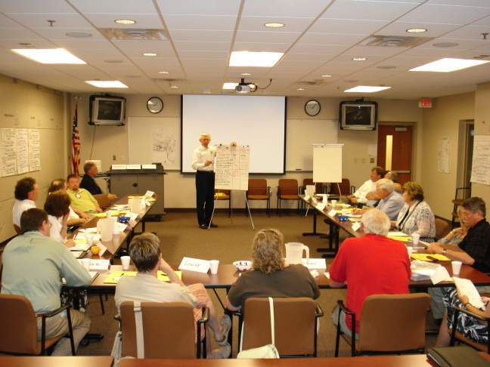
Notes:
Club Action Plan completed: compile wall charts; create Vision statement; schedule club assembly; assemble Planning Team; identify a Champion

Slide 15
The Club Action Plan
action | who | when
Compile wall charts | Club secretary | 2 weeks
Create vision statement | Name three people | 3 weeks
Schedule club assembly | Club president | Next scheduled meeting
Assemble the Long Range Planning Team | (led by past president) | (meet ASAP)
Identify the “champion” | Energetic, experienced, listener, social intelligence | At next Board meeting
Notes:
The what will be done, by whom and by what point in time are determined at the close of the visioning session.

Slide 16
Notes:
With the visioning process completed – NOW WHAT???

Slide 17
Priority Areas
Club size
PR & Public image
Club Service
Vocational Service
Youth Service
Community Service
International Service
Fund raising
The Rotary Foundation
Notes:
Recall that the club did visioning and setting of priorities in these areas

Slide 18
long range planning
Keep it:
simple, manageable, straightforward, transparent…
Avoid complexity and confusion
Notes:
The process should not be cumbersome. Rotary is not an enterprise. Few people are going to do most of the work.

Slide 19
Keep in mind
People will stay with a project
if they are…
Seeing signs that demonstrate
Worth / Value / Success
of a project
Notes:
Perception is important – members need to believe that the effort is valued

Slide 20
Implement and modify
Action Plans
Long Range Planning Team
Visioning session
R V Q
Just a few steps required
Notes:
The process of planning requires very few steps – or fewer

Slide 21
Model Action Plan Worksheet
Priority #1 _______________________________
Objective | Timeline … by when | Resources & Leader | Metrics
1
2
3
4
Notes:
A simple worksheet for communicating action plans.

Slide 22
How do you plant an orchard?
One Tree At A Time….
ANY QUESTIONS?
Notes:
Make some very intelligent closing statement.

Slide 23
For more information
and a
personal meeting,
contact:
Nan Bruce – nabruce@bell.net
Anne Bermingham – anne@2waconsulting.com
Barbara Ochterski – barbarao2@aol.com
John Boronkay – jrboronkay@verizon.net
Notes:
Characters to contact

