Slide 1
Grow Rotary!
Rotary District 7210 Learning Assembly 2023
District Membership Chair
Tony Marmo

Slide 2
DISTRICT GROW ROTARY INITIAVE PLAN
MEMBERSHIP – CHAIR TONY MARMO, KINGSTON
PUBLIC IMAGE – CHAIR JACOB LERNER, MONTICELLO
THINK DIFFERENTLY (DIVERSITY, EQUITY, INCLUSION)
CHAIR EARL MILLER, GREATER NEWBURGH
FOUNDATION- CHAIR LOUIS TURPIN, RHINEBECK

Slide 3
2022-2034 DISTRICT MEMBERSHIP COMMITTEE
Club Members on the Committee- 24 members- 17 different clubs!
Todd Bowen, Wappingers Falls Jo Lore, Nyack
Jim Damiani, PDG, Nanuet/West Nyack Larry Luxenberg, AGA New City
Mark Dollman, Suffern Ed Lynch, Warwick Valley
David Green, PDG, Greater Newburgh Alexandra Duenas, Clarkstown
Leo Kaytes, DGN, Warwick Valley Nicole Magro, East Fishkill
Geraldine Kelly, New Paltz Tony Marmo, PDG, DMC, Kingston
Cindie Kish, PDG, ARC – Millbrook BJ Mikkelsen, Highland
Matt Konecni, Nanuet/West Nyack Larry Palant, DG, Suffern
Gregg Kroner, Wallkill East Judy Siegel, Liberty
Knut Johnsen, PDG, Greater Newburgh Kathleen Pless, Kingston Beau Loendorf, DGND, Cairo Neil Sinclair, Warwick Valle
Jack Strassman, AG, Liberty Peter Sullivan, DGE, Walden

Slide 4
MEMBERSHIP SUB COMMITTEES
New Clubs – Explore new club opportunities, full(20) and satellites(8). Currently, there are initiatives in Beacon, New Paltz, Woodstock, and we recently formed an Eco Club (New City Rotary).
Membership Engagement – Members are available to meet with clubs to discuss growth strategies, onboarding, visitor days, club surveys, having fun at meetings, etc.
Rotary Young Professionals Action Committee- Any club member under 50 years old is eligible to join this new sub committee- See Beau Loendorf if interested.
Rotaract- We currently have 3 active Rotaract clubs at Dominican College (Pearl River Rotary), and Vassar-Haiti (Poughkeepsie Arlington), and Sullivan Community College (Liberty)

Slide 5
DISTRICT MEMBERSHIP INCENTIVE
NEW CLUB FORMATION: Dues for the first two full years of the new Club (upon prior written request and documentation from the Club) for all members who are new to Rotary within the current year and join a newly formed Club or Satellite Club. Existing Club members that transfer into a new Club or Satellite Club are not eligible for this dues waiver.
For any existing Club that sponsors a new Club or Satellite Club, the District will waive the District PETS training assessment fee (upon prior written request and documentation from the Club) for that Club for the year after the new or Satellite Club is formed.
DUES DISCOUNT for new and existing members under 35 or over 75: Our District will reduce the District dues (upon prior written request and documentation from the Club) by 50% for any Club’s members under the age of 35 or over the age of 75. The discount will be applicable for the member under 35 until they reach 35 years old, after which time the discount will no longer apply.
To be eligible for the above incentives, all club members birthdates must be entered into Clubrunner

Slide 6
DISTRICT NEW PROSPECT MEET UPS
D7210 has been selected by RI to be a pilot district to hold a series new prospect Meet Ups throughout the District.
RI is funding this initiative to see if the format would work in other selected districts
Attendance is FREE for new prospects and their potential sponsor
The AGs/AGAs are leading this initiative along with District leadership and the Public Image Committee
Monday, May 15 – Region 89 – Rockland County – Growler and Gill, Nanuet – 6-9pm-
Tuesday, May 16 – Regions 1E, 1W, 2 – Columbia, Greene, Ulster- Diamond Mills, Saugerties – 6pm -9pm
Wednesday, May 17 – Regions 3,4,7 – Dutchess, Putnam – Sloop Brewery, Fishkill- 6-9pm-
Thursday, May 18 – Regions 5, 6 – Sullivan, Orange – Clemson Brothers Brewery, Middletown – 6-9pm

Slide 7
ALL REGIONS FLYER

Slide 8
REGION 89 FLYER EXAMPLE

Slide 9
NEW MEMBER ONBOARDING
What is your process for introducing Rotary to new members?
A proper orientation/onboarding is the key to beginning the Engagement process
Rotary 101 – found on the District website, Club overview, Committee structure, etc.
Ask New members their opinion! Their voice sometimes gets lost amongst the senior members of the clubs

Slide 10
MEMBERSHIP ENGAGEMENT THOUGHTS
Ask and listen to opinions – Survey, Listen, Act
Committees, Calendar, Care, Communicate, Call
Meeting should be Fun and Interactive!
Get interesting speakers
Offer a Zoom or Hybrid option if you can
Are you meeting at the best time for members?
If not, create a Satellite!
Meet with newer Rotarians separately (1-2 yrs). Their thoughts are often overlooked
MORE MEMBERS = MORE MISSION= MORE FUN= MORE FOUNDATION $

Slide 11
resources
My Rotary Learning Center – Membership
https://rotary.org/learning-reference/learn-topic/membership
My Rotary Learning Center – Membership
https://rotary.org/learning-reference/learn-topic/membership
Use these resources to help your club grow:
Assess your club
Engage current members
Connect with prospective members
Follow your membership leads
Make new members feel welcome
Develop your club

Slide 15
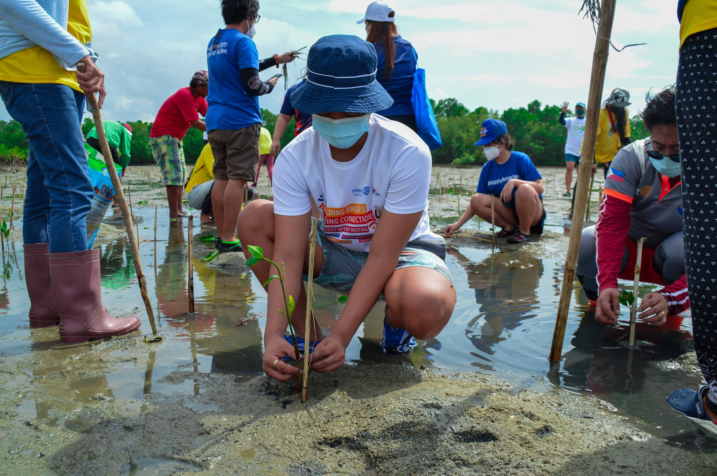

Slide 17
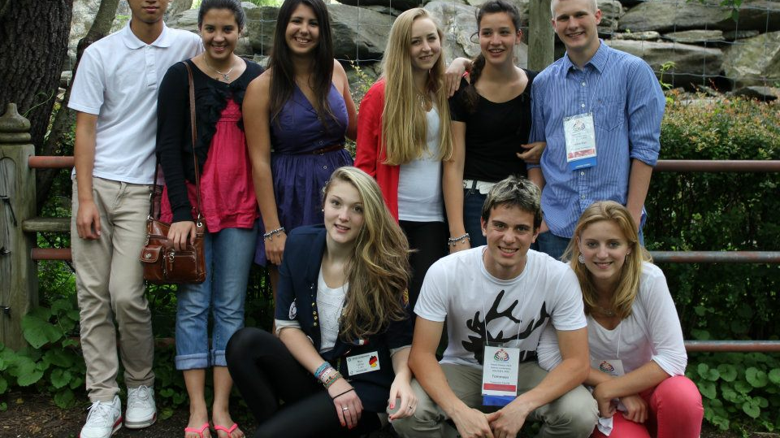

Slide 18
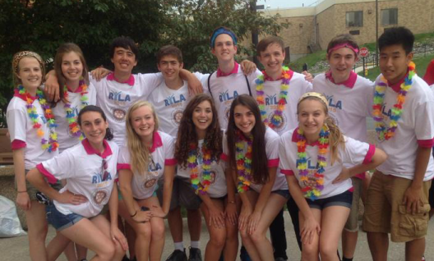

Slide 20
Our Rotary Foundation
Rotary District 7210 Learning Assembly 2023
District Rotary Foundation Chair
J. Louis Turpin

Slide 21
Rotary’s Vision Statement
TOGETHER WE SEE A WORLD
WHERE PEOPLE UNITE AND TAKE ACTION
TO CREATE LASTING
CHANGE ACROSS THE GLOBE
IN OUR COMMUNITIES AND IN OURSELVES

Slide 22
Rotary’s Vision Statement
TOGETHER WE SEE A WORLD
WHERE PEOPLE UNITE AND TAKE ACTION
TO CREATE LASTING
CHANGE ACROSS THE GLOBE
IN OUR COMMUNITIES AND IN OURSELVES

Slide 23
Rotary’s Vision Statement
TOGETHER WE SEE A WORLD
WHERE PEOPLE UNITE AND TAKE ACTION
TO CREATE LASTING
CHANGE ACROSS THE GLOBE
IN OUR COMMUNITIES AND IN OURSELVES

Slide 24
Together We….
Do Good: Service
Raise Awareness: Public Image
TOGETHER
WE
Raise Support:
The Rotary Foundation
Engage People: Membership

Slide 25
The Rotary Foundation’s role in helping our Clubs Do GOOD!
Rotary Foundation Grants
The Source & Types of Foundation Funding
Recognition Opportunities for Clubs & Individuals
Other Rotary Foundation Programs
Spoiler alert, it’s all about the FREE MONEY for your projects!
…and all you need to do is apply for Grants, and support TRF…

Slide 26
The Rotary Foundation Grants
There are two types of Rotary Foundation Grants:
District Grants
Global Grants
Each of these Grant types can fund local or international projects, and must be aligned with Rotary’s mission, but they are very different in other ways…

Slide 27
District Grants
District Grants:
Simple & Fast for small scale local or international projects
Administered primarily by our local District
Fund smaller-scale, short term projects ($1,000 project min.)
Simple single page (online) application with limited requirements
Project must take place during Rotary Year; July 1- June 30
Club covers costs, then receives Grant funds after final report
Average D7210 District Grant typically approximately $1,000
2022-23 District Grants: Grants to 18 Clubs totaling nearly $38,000!
2023-24 District Grant Application deadline is May 15, 2023, $49,000+!

Slide 28
District Grants
Large Scale Multi-Club Project: New in 2022-23!
Encourages collaboration with clubs on larger and more impactful projects
Must be a collaboration between 5 or more clubs (including Interact or Rotaract)
Led by a “Primary Club Sponsor”
Project scope between $10,000 - $30,000
Resulting in $5,000-$15,000 in District Grant Funds

Slide 29
District Grants
District Grant Project Examples:
Community Art Center in Haiti (Large-Scale, Multi-Club Project)
School Supplies for Local Children in Need (Backpack Programs)
Hands-on School Construction Project in Central America
Warm Coats for Children
Food Assistance Programs
Classroom Supplies for Schools in Vietnam
Rotary Youth Programs such as RYLA & Youth Exchange
Other Programs such as ShelterBox & the Dictionary Project

Slide 30
Global Grants
Global Grants:
Complex process for large projects, results in significant funding
Administered primarily by The Rotary Foundation
Fund large-scale projects ($30,000 project min.)
Requires verified need and sustainable/measurable results
International Partner required
Complex online application, process 1 year+ to complete
Foundation World Fund matches of $15,000 - $400,000
D7210 Designated Funds award typically $5,000 - $25,000
2023-24 Global Grant Proposal deadline: TBA Fall 2023

Slide 31
Rotary’s Areas of Focus for our Service Projects

Slide 32
Global Grants
Global Grant Project Examples:
Urban Environmental Restoration Project in the Hudson Valley!
Fishing Boats for Philippines Fishermen
Malaria Microscopy Project in Nigeria
Tele-med Orthopedic Services in Haiti (or maybe Ukraine)
Hearing Loss Screening & Mitigation in a variety of Countries
Medical Services in India
Clean Water in Kenya
Various Humanitarian Projects in Brazil
Human Milk Bank at Hospital in Vietnam

Slide 33
The Rotary Foundation Grants
Did I mention that it’s all about the
FREE MONEY!!
For YOUR Club’s Projects!

Slide 34
Source & Types of The Rotary Foundation Funding
So….where does our Foundation get funding for our Projects?
Donations to the Annual Fund -SHARE
What are primary fund choices to which we can donate?
Annual Fund – SHARE: Support for our Projects today
Endowment Fund: For a secure tomorrow
Specific Funds, such as Disaster Response, Polio, etc.

Slide 35
D7210 2023-24 Foundation Goals for Clubs
2023-24 Foundation Goals
$144+/Member average to Annual Fund
Every Rotarian Every Year Giving Challenge: 3 steps
$25+/member to Annual Fund & 100% EREY by December 31
$25+/member for PETS Challenge in March
$144+/Member average to Annual Fund by June 1
In addition to FREE MONEY for YOUR Club’s projects, what else does your Club receive from The Rotary Foundation in return for your support?

Slide 36
The Rotary Foundation Recognition Opportunities
Club Recognition Banners
100% Foundation Giving: $100/member, 100% participation
100% EREY: $100/member, 100% participation to Annual Fund
Top Three Per Capita Clubs in Annual Fund Giving
100% Paul Harris Fellow Club: All members are PHF

Slide 37
The Rotary Foundation Recognition Opportunities
Individual Recognition Awards
Foundation Sustaining Member: $100 to Annual Fund each year
Paul Harris Fellow: $1,000+ to Annual or Polio Funds (9 levels)
Paul Harris Society: $1,000+ to Annual or Polio Funds each year
Benefactor: $1,000+ bequest or donation to Endowment Fund
Major Donor: $10,000+ donation to Foundation Funds (4 levels)
Bequest Society: $10,000+ bequest to Endowment Fund (10 levels)
Arch Klumph Society: $250,000+ to Foundation Funds (6 levels)

Slide 38
The Rotary Foundation’s Other Programs
Other Programs
Rotary Peace Fellowships: Graduate study at Peace Centers
Rotary Scholarships: Tuition support, via Global or District Grants, for programs in Rotary’s Areas of Focus
Vocational Training Teams: International professional exchange

Slide 39
Our Rotary Foundation
So, that’s the overview of The Rotary Foundations Programs!
What is it really all about?
FREE MONEY for YOUR Club’s Projects!
What two things do YOU need to do?
Apply for District and/or Global Grants every year
Support Our Rotary Foundation generously every year
Thank You!

Slide 40
Our Rotary Foundation
Rotary District 7210 Learning Assembly 2023
District Rotary Foundation Chair
J. Louis Turpin

Slide 41
Together Foundation Video

Slide 42
Together We….
Do Good: Service
Raise Awareness: Public Image
TOGETHER WE
Raise Support:
The Rotary Foundation
Engage People: Membership

Slide 43
Annual Fund - SHARE
District Designated Funds (DDF)
50%
Funds raised
Funds spent
Unspent funds roll forward to Global Grants
2019-20
2020-21
2021-22
2022-23
2023-24
2016-17
50%
World Fund
Global Grants
District Grants
Up to 80% Match
Donations

Slide 44
Our Rotary Foundation’s Mission
The mission of The Rotary Foundation of Rotary International is to enable Rotarians to advance world understanding, goodwill, and peace through the improvement of health, the support of education, and the alleviation of poverty.

Slide 45
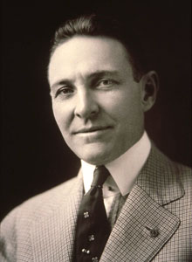
1917 Convention
$26.50
“For the purpose of DOING GOOD in the world”

Slide 46
Charity Navigator

Slide 48
ROTARY
Public Image
Club Communication
Print/ Digital
Social Media
Website Design
Public Releases

Slide 49
Introducing the NEW Website
Resources to use
How to receive support from the committee
JOIN the committee
Questions?
ROTARY

Slide 50
How to receive support from the committee
Social Media
Marketing
Website
Club Visits
Events
Contact/ Support
What do you need help with?
By what date?
Information- event, time, place, message, ect..
Color or theme?
Goal- market an event, educate about an event, support, ect…
Beau Loendorf: beauloendorf@gmail.com
Jacob Lerner: Jacob.lerner@siegelagency.com
ROTARY

Slide 51
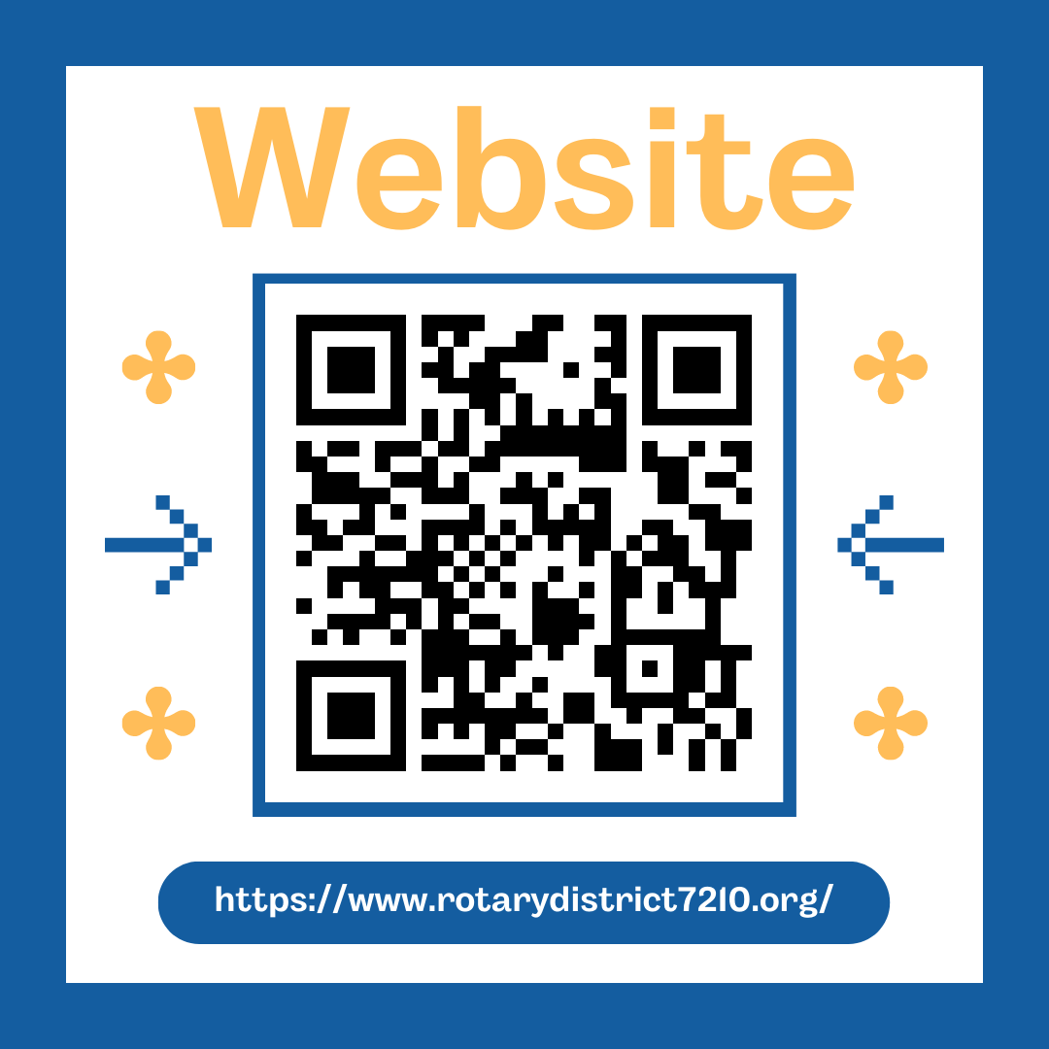
Questions?
Always looking to grow our committee, care to join us help our clubs?

