Slide 1
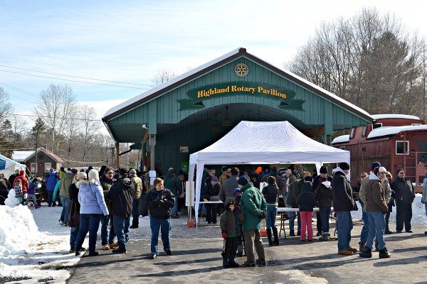
Welcome!
Insert Club Logo Above
(INSERT A CLUB PHOTOGRAPH HERE )

Slide 3
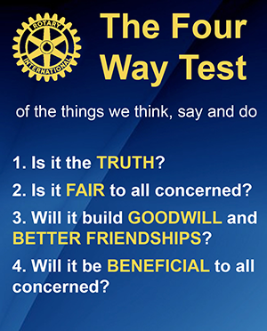

Slide 4
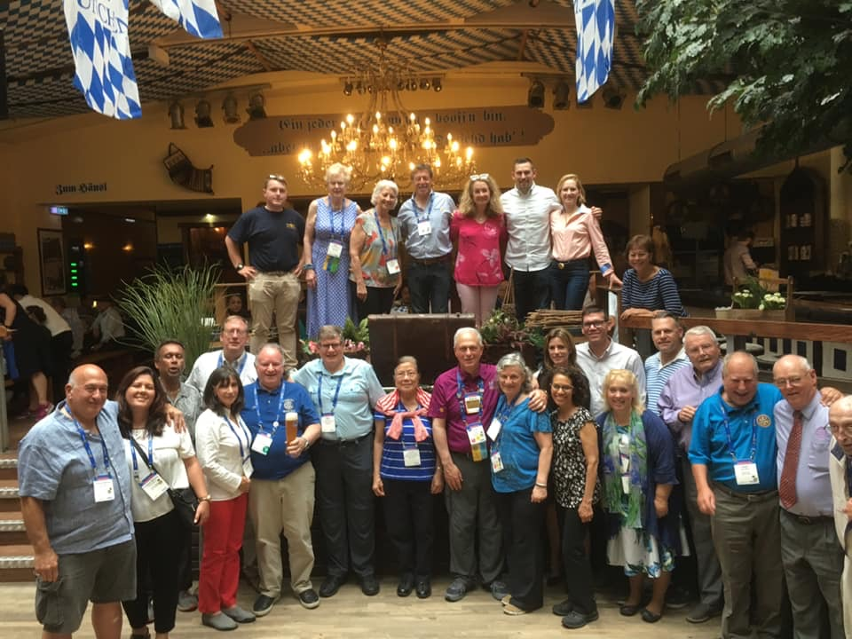
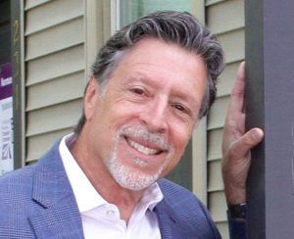
Rotary International
District Governor
Tony Marmo

Slide 5
CLUB HISTORY
(Utilize a club historian or a Board member)

Slide 6
CLUB SERVICE
(Club Service Chair)
(use a picture of a club service project)

Slide 7
Community service Projects
Sample Project

Slide 8
COMMUNITY SERVICE PROJECTS
Sample Project
Club Member to speak

Slide 9
COMMUNITY SERVICE PROJECTS
Sample Project
Club Speaker

Slide 10
Community service Projects
Sample Project
Club member speaker

Slide 11
INTERNATIONAL SERVICE PROJECTS
Sample International Project
International Coordinator

Slide 12
Any Stand Out Club Members
Outstanding Club Member

Slide 13
FUND RAISING:
Sample Project
Member
37 years

Slide 14
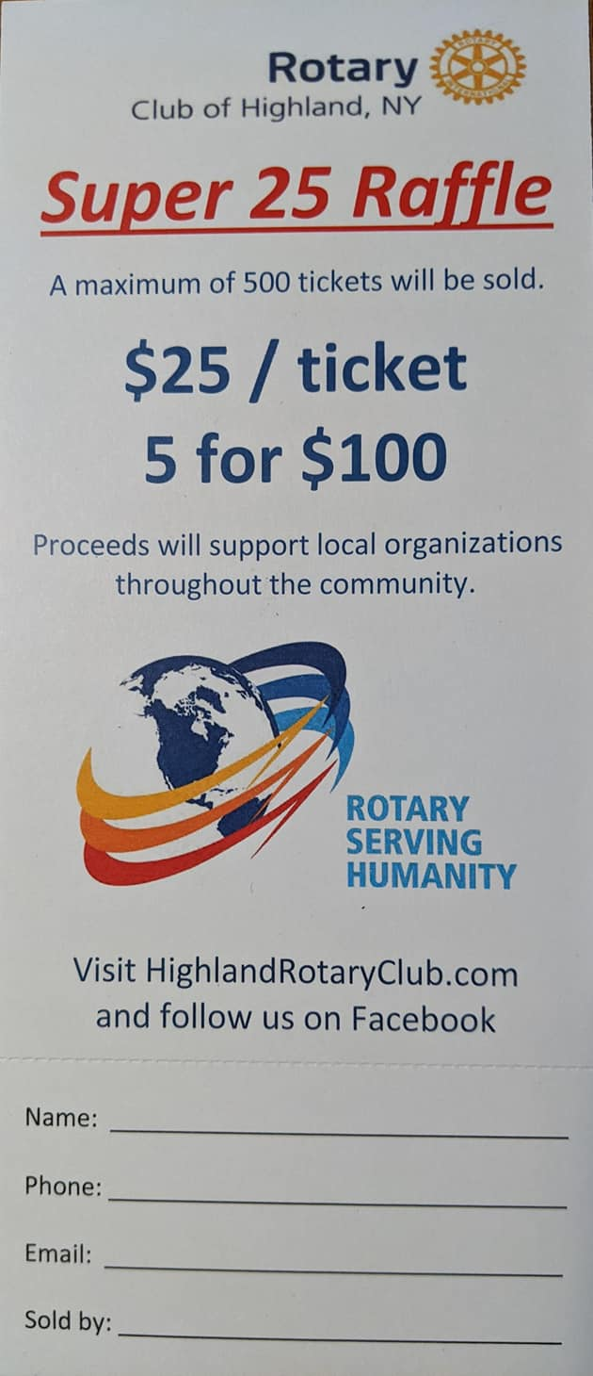
Fund Raising :
Sample Fundraiser
Speaker

Slide 15
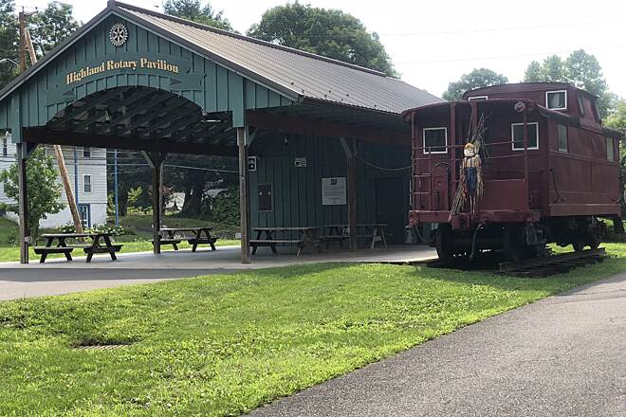
TESTIMONIALS

Slide 16
What’s on Your mind?

Slide 17
Agenda | Topic | Rotarian | notes
ICEBREAKER | GREEN GAME | PATRICIA | Group participation game where one person wins a bottle Jameson!
WELCOME | WELCOME | DON | Opening remarks
ROTARY OVERVIEW | Rotary’s OCAL AND INT’L SERVICE | TONY | Same speech as Kingston
ROTARY HISTORY | 34 YEARS OF HELPING THE COMMUNITY | CHRISTINE | Highlights over 34 years
SERVICE & FINANCIAL EXPECTATION | DUES, COMMITTEES AND COMMITMENTS | STEVE | What members are expected to to do as members
SERVICES 1 | POLICE CAMERAS | TONY | How we helped Town of Lloyd Police get new car video system
SERVICES 2 | ADOPT A FAMILY | PATRICIA | Explain our relationship with community Action and the Holiday Adopt a Family
SERVICES 3 | CENTENNIAL GARDEN | SAL | Where the garden is and what we do each year to maintain it
SERVICES 4 | JR ACHIEVEMENT | PETER | How Rotary teaches children in Elementary School Business concepts
SERVICES 5 | AUSTRALIA | BJ | Our upcoming commitment to Armidale Rotary
SERVICES 6 | Service above self | DENISE | Our annual salute to Citizens and Corporations that help Highland .
FUNDRAISERS RAFFLE | SUPER RAFFLE | DON | Our weekly Raffle program
FUNRAISERS RRRR | RRRR | STEVE | Our program that supports restaurants in Ulster County
TESTIMONIAL 1 |  | CHRISTINE | Why you like Rotary
TESTIMONIAL 2 |  | PETER | Why you like Rotary
TESTIMONIAL 3 |  | STEPHANIE | Why you like Rotary
TESTIMONIAL 4 |  | SHARON | Why you like Rotary
Q & A | Allow time for question from our guests | DON AND THE CLUB | ANSWERS FROM CLUB MEMBERS

