Slide 1
THINK DIFFERENTLY
District 7210 “Grow Rotary” Initiative
Notes:
Welcome!
Introduce yourself
Ask: before I begin ”has anyone heard of the Think Different committee, and could possibly share what we are about? (let two people share)
Those who know us- great, those who do not; I am excited to share. This is a safe space, looking to have a great conversation with you all.
Today I am hoping to provide some education and become a resource for each of you to use.
If you are ready, lets start to think differently in Rotary, together.

Slide 2
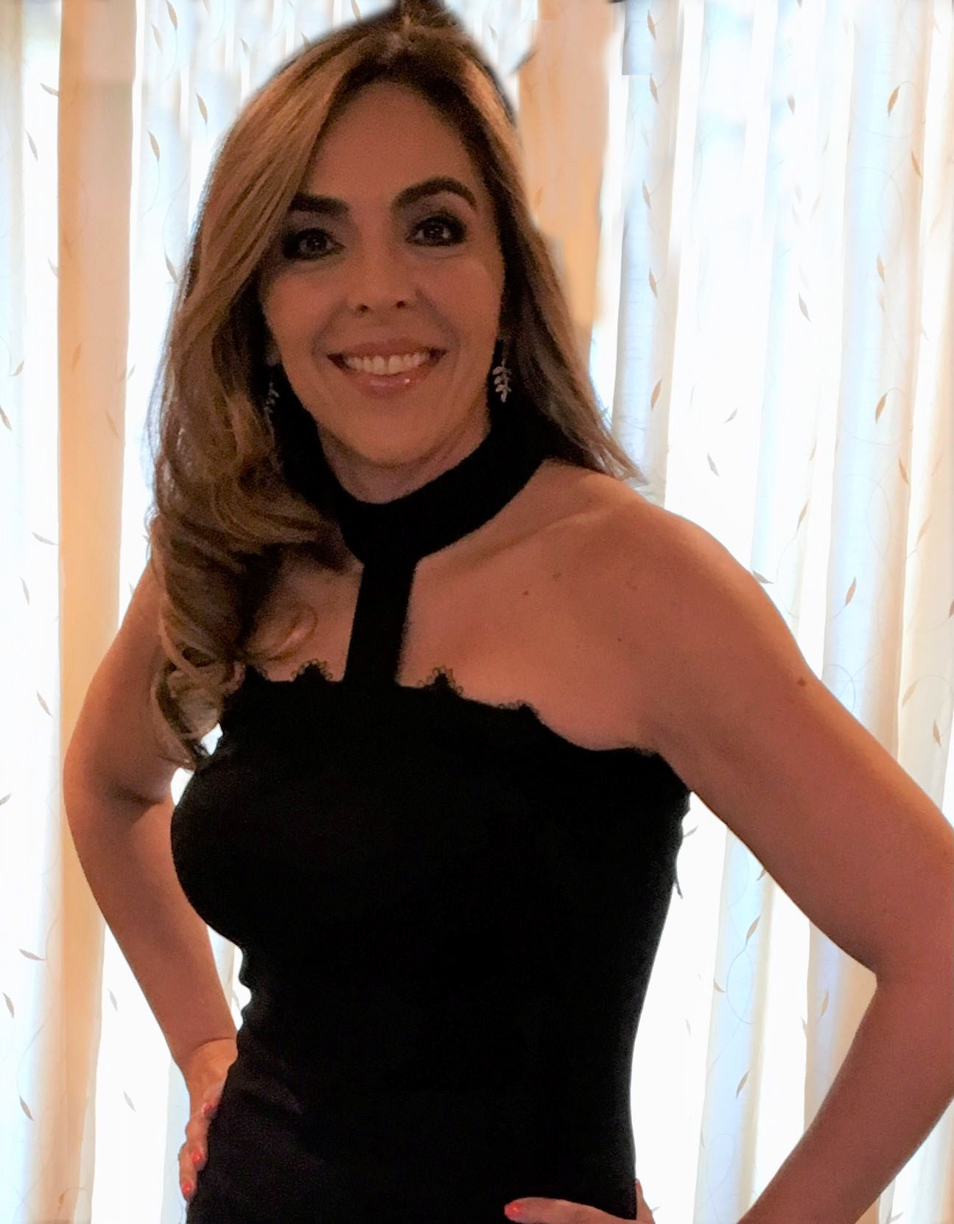
MEET THE TEAM
Earl Miller
Renae Leeming
Alexandra Duenas
Beau Loendorf
Think Differently, District 7210
“Grow Rotary” Initiative
Darrigan Demattos
Michael Seidenfrau
Wayne Paterson
Elena Mosley
Notes:
Welcome!
Introduce yourself
Ask: before I begin ”has anyone heard of the Think Different committee, and could possibly share what we are about? (let two people share)
Today I am hoping to provide some education and become a resource for each of you to use.
If you are ready, lets start to think differently in Rotary, together.

Slide 3
As a global network that strives to build a world where people unite and take action to create lasting change, Rotary values diversity and celebrates the contributions of people of all backgrounds, regardless of their age, ethnicity, race, color, abilities, religion, socioeconomic status, culture, sex, sexual orientation, and gender identity.
DEI ROTARY INTERNATIONAL
“Diversity is simply the acknowledgment of different variations within valued humanity”
Notes:
From the website: We believe that exemplifying and embracing diversity, equity, and inclusion (DEI) should be a part of everything we do at Rotary.
To ensure we live up to that ideal, the Board of Directors and our DEI Taskforce acted to strengthen the DEI statement originally adopted in 2019. The result is in a new commitment to diversity, equity, and inclusion:
At Rotary, we understand that cultivating a diverse, equitable, and inclusive culture is essential to realizing our vision of a world where people unite and take action to create lasting change.
We value diversity and celebrate the contributions of people of all backgrounds, across age, ethnicity, race, color, disability, learning style, religion, faith, socioeconomic status, culture, marital status, languages spoken, sex, sexual orientation, and gender identity as well as differences in ideas, thoughts, values, and beliefs.
Recognizing that individuals from certain groups have historically experienced barriers to membership, participation, and leadership, we commit to advancing equity in all aspects of Rotary, including in our community partnerships, so that each person has the necessary access to resources, opportunities, networks, and support to thrive.
We believe that all people hold visible and invisible qualities that inherently make them unique, and we strive to create an inclusive culture where each person knows they are valued and belong.
In line with our value of integrity, we are committed to being honest and transparent about where we are in our DEI journey as an organization, and to continuing to learn and do better.

Slide 4
The Rotary District 7210 “Grow Rotary” initiative exists to recruit unreached members from our communities and to strengthen retention within Rotary District clubs.
As part of the Rotary International DEI initiative, our District created the “Think Differently” Diversity, Equity, and Inclusion Team (DEI).
Notes:
From the website: We believe that exemplifying and embracing diversity, equity, and inclusion (DEI) should be a part of everything we do at Rotary.
To ensure we live up to that ideal, the Board of Directors and our DEI Taskforce acted to strengthen the DEI statement originally adopted in 2019. The result is in a new commitment to diversity, equity, and inclusion:
At Rotary, we understand that cultivating a diverse, equitable, and inclusive culture is essential to realizing our vision of a world where people unite and take action to create lasting change.
We value diversity and celebrate the contributions of people of all backgrounds, across age, ethnicity, race, color, disability, learning style, religion, faith, socioeconomic status, culture, marital status, languages spoken, sex, sexual orientation, and gender identity as well as differences in ideas, thoughts, values, and beliefs.
Recognizing that individuals from certain groups have historically experienced barriers to membership, participation, and leadership, we commit to advancing equity in all aspects of Rotary, including in our community partnerships, so that each person has the necessary access to resources, opportunities, networks, and support to thrive.
We believe that all people hold visible and invisible qualities that inherently make them unique, and we strive to create an inclusive culture where each person knows they are valued and belong.
In line with our value of integrity, we are committed to being honest and transparent about where we are in our DEI journey as an organization, and to continuing to learn and do better.

Slide 5
The “Grow Rotary” initiative exists to recruit unreached members from our community and to strengthen retention within our Rotary District.
Rotary International
#GROWTOGETHER
District 7210
Zone 32/ 28
Think Differently
Public Image
Membership
Foundation
DEI Club Representatives
Notes:
I. Rotary has become, for many of us, an extension of our lives. A fellowship or extended family that have worked to benefit many in our communities and the world, But also could be a resource that could help many more. Our clubs' future is not only in the service and work we do, but it is also hugely impacted by the people who join us as Rotarians.
II. The “Grow Rotary” initiative exists to create a more extensive outreach of our clubs, develop a plan to recruit unreached members from our community, and strengthen retention within our Rotary District.
III. Under our district leadership four District committees have been created: Membership Public Image Foundation and Think Differently
All are designed as a support system to help clubs realize growth through improvement. At the end of the day, we must work to deliver the best club experience for all current and future members.
IV. Along with Rotary International we, as the THINK DIFFERENTLY COMMITTEE are encouraging our club to focus on their own diversity outreach programs. We are here to celebrate the amazing club you are and remember that growth is not always about changing, it can simply be about improving on becoming better people, a better club.

Slide 6
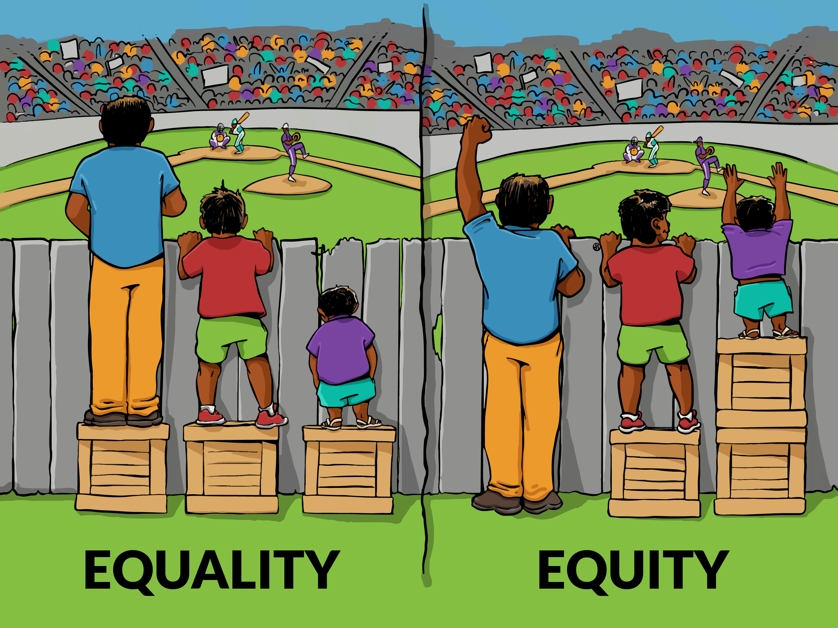
DEI Compass
Diversity, Equity and Inclusion
Equity
Diversity
Inclusion
Diversity is simply the acknowledgment of different variations within valued humanity
Just because the door is opened doesn’t mean you’re welcomed”

Slide 7
AGE
ETHNICITY
COLOR
SEX
ABILITIES
RELIGION
SOCIOECONOMIC STATUS
CULTURE
SEXUAL ORIENTATION
GENDER INDENTITY
GENERATIONAL DIFFERENCES
DIVERSITY
Notes:
Diversity, and it’s amazing how much power on word can have. Other words like “Welcome”, “Thank You”, “Equality”, or maybe phrases like “I hear you”, “I see you”, “I believe you”. Words have a huge impact on how we communicate, how we feel, and how we act. As we go into the topic around Diversity, I know I am not a professional by any means to teach a course but as a passion and experience (share experience) and on behalf of the DEI committee I am excited to be a catalyst for change.
To start- when looking at this page what do you see (hopefully someone points out the obvious- an iceberg). If you were on a cruise and this was outside your window, on a scale on 1-10. how big would you say this iceberg is? 1 being- not that big, and 10- it most likely is the biggest ever?
Based off this picture we are making an assumption on the size. Similar to diversity, a lot of conversations are around what we see. We love to put people into boxes and assume we know them, simply off what we see. Now when I say what we see, what are somethings that we see on or about someone that could give us hints to who they are. Remember this is a safe space and we are doing this to learn together.
People might say- color, what people wear could represent their profession, hair, ect…
(CLICK) when we see someone we feel like we can guess someone's AGE, maybe EHNICITY, RACE, and COLOR. And in todays age, 2021 there are lots of conversations about diversity and what are the first ones we talk about- typically its all those we see.
Our appearance is powerful but this only shares a little into the diversity makeup of who we are.
CLICK (see the whole iceberg now)
If our cruise ship was to only look at what is above the water and we go close to this iceberg; we might be in some trouble. And I first would like to say, we are not blaming anything on the staff aboard the Titanic; for this compassion we simple want to show if we go off what we simply see we only get to know a small part of what the person is. Its also what is below the water, or under our skin in this case that help show who someone is.
As I go through these identities, does anyone have any questions on any of these.

Slide 8
District 7210’s Generational Diversity
YOUNGER GENERATIONS REQUIRE DEI AWARENESS
Cultures that are diverse, inclusive and socially relative
GENERATIONAL DIVISIONS
Gen Z (1996 - after) 25 and below
Millennials (1982 - 1996) 26 - 45
Gen X (1965 -81) 44 - 56
Boomers (1946 - 64) 57-75
Greaters 75+
D 7210 GENERATIONAL
DEMOGRAPHIC SAMPLE
Under 29 - 0.6
33 to 39 - 3.1
40 to 49 - 5.8
50 to 59 - 11.8
60 to 69 - 16.8.
70+ - 19.6
(42.3 unreported)

Slide 9
“Each One, Bring One” (increase membership to 1.3 million)
DISTRICT 7210
GROWTH
Who needs Rotary and who does Rotary need?
”Together we can”
NEEDED: DEI Club Rep

Slide 10
THANK YOU
MEET THE TEAM
Earl Miller
Renae Leeming
Alexandra Duenas
Beau Loendorf
Think Differently, District 7210
“Grow Rotary” Initiative
Darrigan Demattos
Michael Seidenfrau
Wayne Paterson
Elena Mosley
Notes:
Welcome!
Introduce yourself
Ask: before I begin ”has anyone heard of the Think Different committee, and could possibly share what we are about? (let two people share)
Today I am hoping to provide some education and become a resource for each of you to use.
If you are ready, lets start to think differently in Rotary, together.

