Slide 1

Rotary District 7470
Short Term Youth Exchange
Host Family Orientation Webinar
May 22, 2018

Slide 2
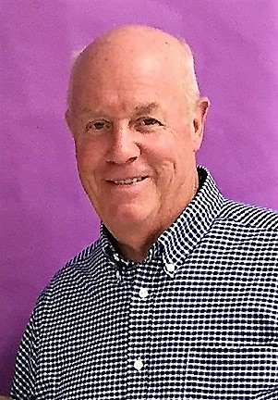
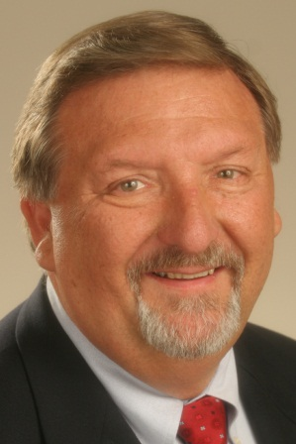

Tonight’s Presenters
Jim Allison, PDG
Program Chair
jra188@aol.com
Cell 201-213-6382
Barry Kroll, PDG
Program Assistant Chair
barrykroll@aol.com
Cell 973-476-2772

Slide 3
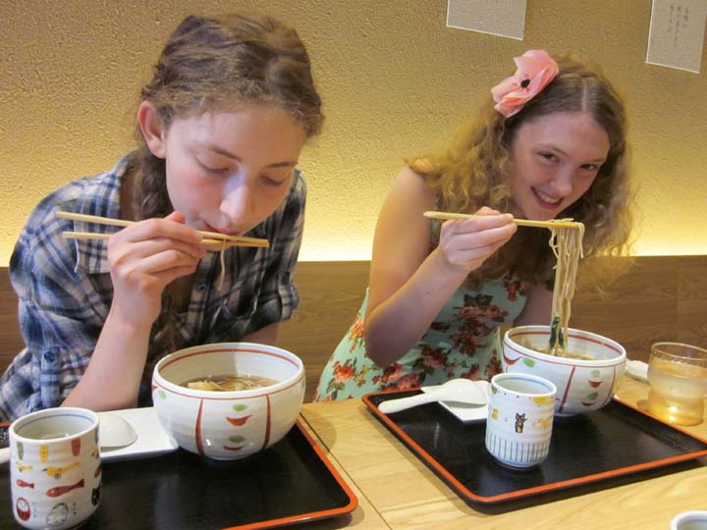
STYE
(Short Term Youth Exchange with Japan)
The purpose of the orientation webinar is to provide you with information and details that will aid in ensuring a positive experience for you, your family and our Japanese exchange students.
Remember you can contact Jim Allison or Barry Kroll anytime with questions if you need assistance.

Slide 4
STYE
Thank you for agreeing to be a host family and opening your home. We are confident it will be a rewarding experience for all.

Slide 5
STYE
The program is 40 years old.
Each year in July our local Rotary District 7470 sends 27 students and 3 leaders to Japan (Osaka/Shikoku Area).
Each year in August our sister Rotary District 2670 in Japan sends 27 students and 3 leaders to New Jersey.
Over the years thousands of students have participated in the program.
The essential ingredient in the program is the host family.

Slide 6
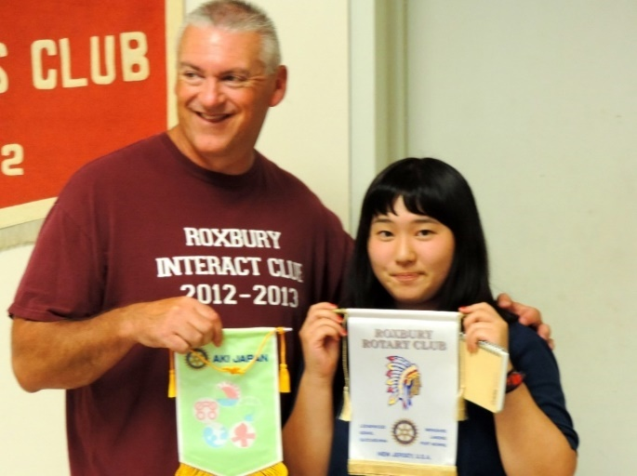
This Youth Exchange:
Provides young people with the opportunity to experience cultures other than their own
Gives participants/parents a broader view of the world and a deeper understanding of themselves
Develops leadership and communication skills in youth
Builds friendships
Fosters international understanding and world peace

Slide 7

What is expected of a host family?
Before students arrive
  Participate in training and orientation sessions
  Understand the program rules for students and hosts
  Know how to contact key Rotarians involved in the Exchange Program

Slide 8

What is expected of a host family?
After the students arrive
  Provide a safe and welcoming environment.
  Support and make the students feel like they are a part of your family.
  Encourage students to adopt the ways of your household.
  Provide food and accommodations.

Slide 9
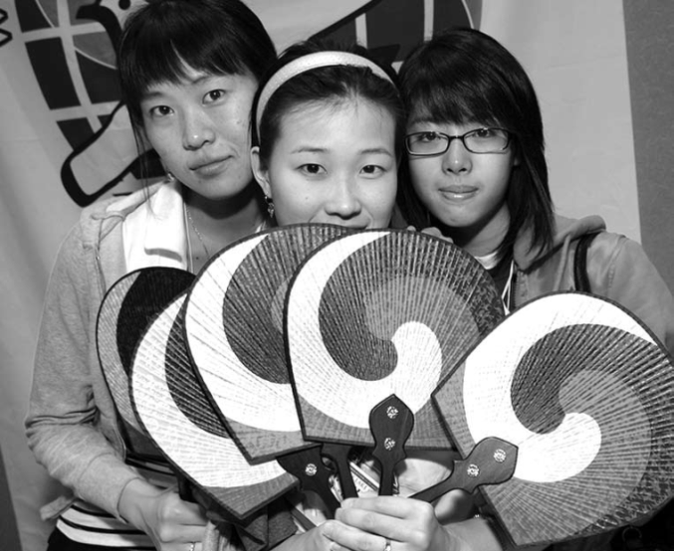
What is expected of a host family?
  In case of an emergency know what to do and whom to contact.
  Voice any concerns or questions regarding the students with Jim or Barry, i.e., homesickness, not eating, illness, etc.
  Exercise supervisory and parental responsibility to ensure the students’ well being.

Slide 10
The Basics – Step by Step
Upon meeting, be friendly and cordial; first impressions are important; a smile is understood in every language
Expect students to be very shy in the beginning.
Be sure to learn their names. Extra effort will be needed to get the correct pronunciation.
Be sure to teach them your names. Their language skills will be limited. They will understand better than they are able to speak.
When you get home, give them a tour of your home.
Show them where they will stay; help with their luggage.
Speak Slowly

Slide 11
The Basics – Step by Step
Immediately write down and give the students your contact information.
    Do a bathroom orientation. Towels, extra toilet paper, soaps, how your bathroom works. Show them how all of the faucets and drains work.
    Students will most likely give you some sort of gift as a thank you for hosting. You may wish to give a small gift in return.
    Don’t try to do too much.
    Avoid speaking loudly. Speaking a different language doesn’t mean they can’t hear.

Slide 12
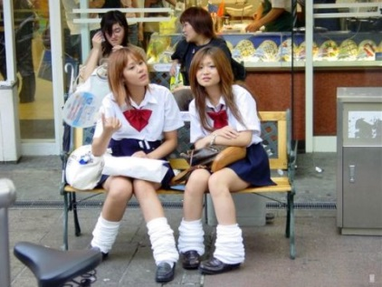
The Basics – Step by Step
Make note of their energy level. Be flexible depending how they feel.
Give them time to clean up and unpack and get settled.
Please offer to do their laundry. They may want to do this themselves; if so, teach them how the washer works. Dryers are not common in Japan.
Check to see how they are feeling; sometimes new food, water, etc., can cause problems.
Don’t be surprised if they take off their shoes before entering your house. It is part of their culture.

Slide 13
The Basics – Step by Step
Above All
  Be yourself, Be relaxed
  Always be warm and friendly

Slide 14
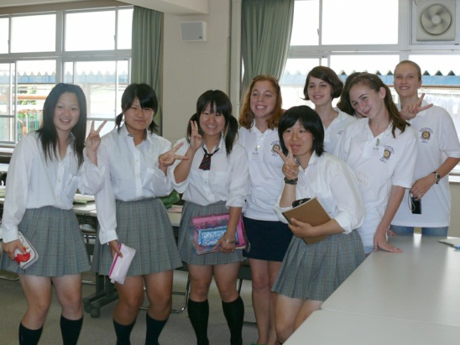
Weekday Activities
All weekday activities have been planned by the STYE Committee. You will be given a schedule so you are aware of what they will be doing everyday.
Remind students what they need to bring for the day’s activities, i.e., swim suits, towels, sun screen, etc.
Be flexible with weeknight activities.

Slide 15
Pick Up and Drop Off
You will be given a schedule of the drop off and pick up times for your students. These times do vary somewhat based upon the day’s activities.
It is critical to be on-time for drop off and pick up
  Most morning activities have a scheduled start time and the bus cannot wait for late arrivals. If you miss the drop off time, you will be responsible for the students for the entire day.
  Students cannot be left alone. If you are late for a pick up, the bus and leaders must wait for your arrival.

Slide 16
We need your contact information
Be sure we have the cell phone contact information for everyone who will be picking up and/or dropping off students.
In the event of any change to pick up or drop off times, we will contact you via text message or cell phone call.
We do our best to stay on schedule, but occasionally there are delays due to traffic or unforeseen circumstances.

Slide 17
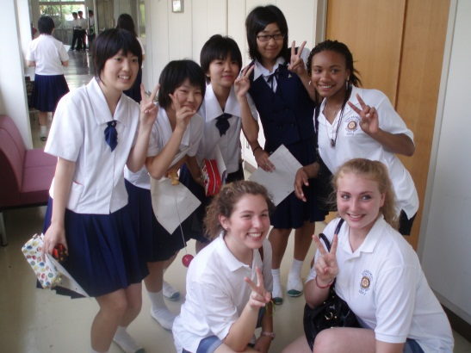
Weekend Activities
Plan to do some interesting activities with your students over the weekend.
Check with your students regarding any interest they may have (reasonable).
See if they want to help cook or perhaps make a meal.
Use your good judgment in choosing activities.
It is OK to have some down time.
Advise them of times for departure, clothing or anything special they need to bring.

Slide 18
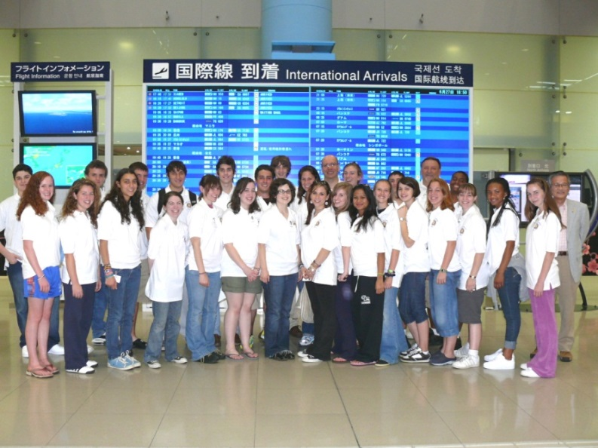
Activity Sheet
You will be given a student activity sheet to record information regarding your students. This sheet gets passed onto the next host family and also becomes a souvenir for the student.
Fill it out answering the questions about what the students like and dislike.
Include what activities you did.
Anything else that would be helpful for the next family.
Any problems??
Any quirks??

Slide 19

Safety and Rules
Do not let your students go anywhere by themselves. They should be supervised at all times.
No Alcohol
No driving of any vehicles: autos, boats, jet skis, ATV’s
OK for them to use the Internet, Skype and email, if available
Avoid high risk activities.

Slide 20
Possible Problems
Student becomes ill or has an accident
Student has an unreasonable request
Student is lost
You miss the bus drop off in the morning.
You are late for the bus pick up in the evening.
Student refuses to listen to you
Student wants to go someplace by himself/herself
Other concerns
Contact Jim or Barry

Slide 21
Rotary and State Dept. Regulations
Require all Host Families to complete background checks for all family members in the household aged 18 and older.
Each of you should have received a form from Jim Allison
It requires dates of birth and Social Security numbers
All information is kept confidential.
Forms are shredded after completing background check
Send completed forms to Jim Allison for processing

Slide 22
Contact Information
Jim Allison, PDG
jra188@aol.com
Cell 201-213-6382
Barry Kroll, PDG
barrykroll@aol.com
Cell 973-476-2772

Slide 23
Rotary District 7470
Thank you
for being a host family
and
for helping Rotary build goodwill and to foster international understanding.

