Slide 1


Membership Seminar
District Governor: Bruce Pacht
District Governor-Elect: Louisa Tripp
Membership Chair: Sonny Holt
Jan – Feb 2015

Slide 2
Membership Quiz
Best way to increase membership is to:
  Advertise in newspapers & public media
  Wear Rotary pin every day
  Simply ask people to join.
  Ask members to bring in another member
  Provide value to members

Slide 3
  A membership strategy based primarily on acquiring new members does not produce sustained membership growth.

Slide 4
Why Membership is Important
Rotary membership worldwide
  1.2 million members
  No change in past 10 years
  North American clubs – losing members
  Rest of world – gaining members

Slide 5
The North American Problem
1996 = 445,000 members,
2012 = 380,000 members.

Slide 6
Losing Members in North America
Past 4 years.
  Brought in 40,000 new members per year
  But lost 50,000 members per year
  Net loss of 10,000 members per year.
Conclusions – are the following valid??
  North American Clubs are older - members are just dying off ?
  Rest of world is building new clubs - much younger members ?

Slide 7
District 7850 Membership Results
We had been holding steady around 1,600
  Better than most North American districts
  But most recent results show a downtrend
Typical Results for One Year
41 Clubs Gained 182 Members (for 2013-2014)
But Lost 154 Members
  24 of the 154 passed away
Why did we lose the other 130?

Slide 8
District 7850 Membership Results
Top ten clubs had net gain of 76
  Recruited 89
  Lost only 13
Bottom ten clubs - net loss of 49
  Recruited 7
  But lost 56
Question: Do members stay or leave Rotary based on what’s happening in their clubs?

Slide 9
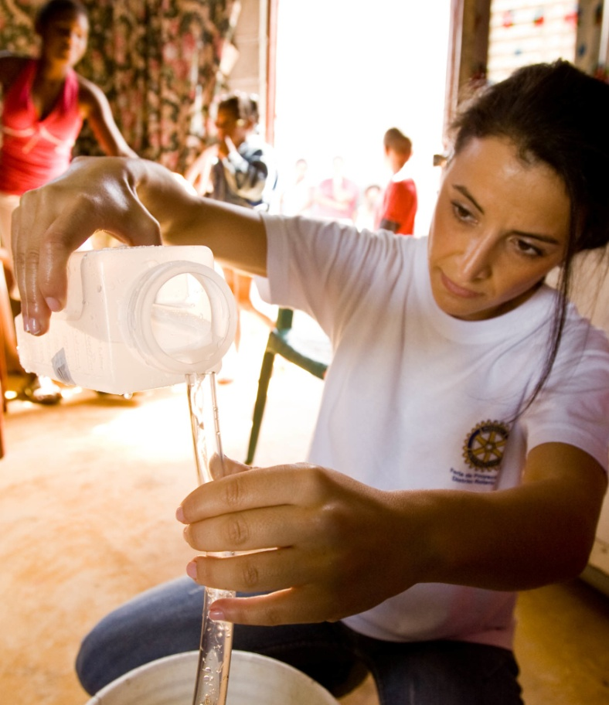
Agenda
Why members leave Rotary
Evaluating your club
Membership solutions
Engaging members
Break
Attracting members
Telling your story
Building an Action Plan for for Dynamic Growth

Slide 10
Why Members Leave Rotary

Slide 11
Why Members Leave Rotary
25% = Uncontrollable losses
  death, illness and relocations
75% = Controllable losses
    Club Environment
    Club Activities
    Cost
    Personal

Slide 12

Controllable Losses
  Club Environment:
    Boring, No fun
    Poor programs
    Same old agenda, week after week
    Seems like a ‘Good Old Boys’ club
    Very clique-y
    Too many argumentative people

Slide 13
Controllable Losses
  Club activities
    No meaningful service projects
    No networking opportunities
    Questionable practices
    Passing the hat
    Excessive fines

Slide 14

Controllable Losses
Cost
Expensive dues & meals
Fund raising takes time & money
Constantly asked for money
‘Mandatory’ donations
Buying of tickets

Slide 15

Controllable Losses
  Personal
    Attendance is difficult
    Inconvenient meeting time
    Job/family commitments

Slide 16
Why Members Leave Rotary
Bottom Line:
“The time, money and effort I put into Rotary does not return enough value for me to stay.”
This is club dependent

Slide 17
Value quotient
Every product or service in the marketplace contains a certain degree of value relative to the needs of an individual.
The goal is to fulfill desired needs and avoid undesired outcomes to the greatest extent possible.

Slide 18

The Value Proposition
Whether buying a business, shopping for bargains, or staying with Rotary:
    People weigh the time, money, and effort expended against the value received.
time, money, effort
If value received weighs more - then it’s a good “Value Proposition.”

Slide 19
Evaluating Your Club

Slide 20
Measuring your Club’s Value Quotient
Meeting Attendance:
  70% or more. “ You’re doing great!”
  50% “What’s keeping the other half away?”
  40% or less. “Can we fix the problem?“
IMPORTANT: Attendance helps measure the value quotient of your club. Track it, but don’t compel members to attend something they see little value in – they may just quit.

Slide 21
Top Ten Clubs for Attendance
  Essex 85%
  Lebanon 79%
  Ossipee Valley 75%
  White Mountain 75%
  Sherbrooke 73%
  South Burlington 72%
  Wolfboro 71%
  Cambridge Area 71%
  Waterbury 70%
  Williston-Richmond 69%

Slide 22
Other Value Indicators
Member Retention
Vibrant/Engaging Clubs
  Track their member losses, if any
  Determine the real cause(s) for leaving
  And fix the problem
Track member losses over time as another value indicator

Slide 23
More Value Indicators
Web Site/FaceBook
Your window to the world
If kept current with action photos of Service Projects – you’re doing great!
  But, if most recent update was 1 to 2 years ago, and has mostly text and outdated links:
    Current members will be embarrassed for their own club
    Prospective members will say “Yuk! Why should I join that club!”

Slide 24

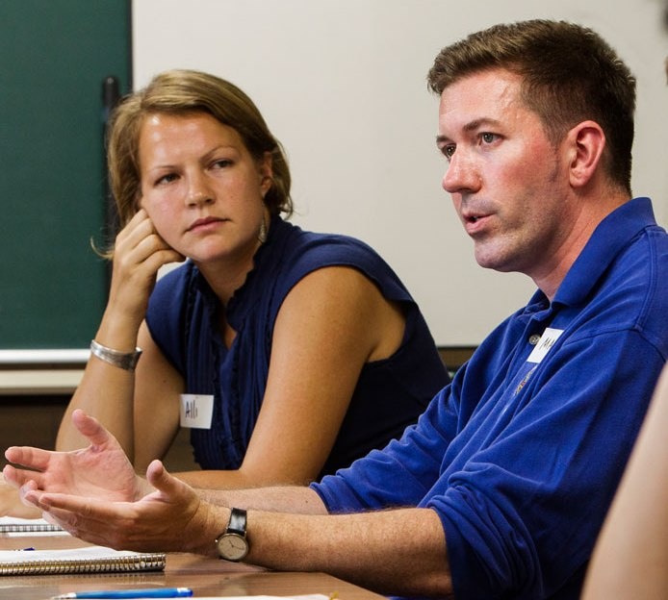
Value for Young Professionals
Generation X and Millennials
Deep desire to make world a better place
They rely more on personal networks of friends and associates – through social media

Slide 25
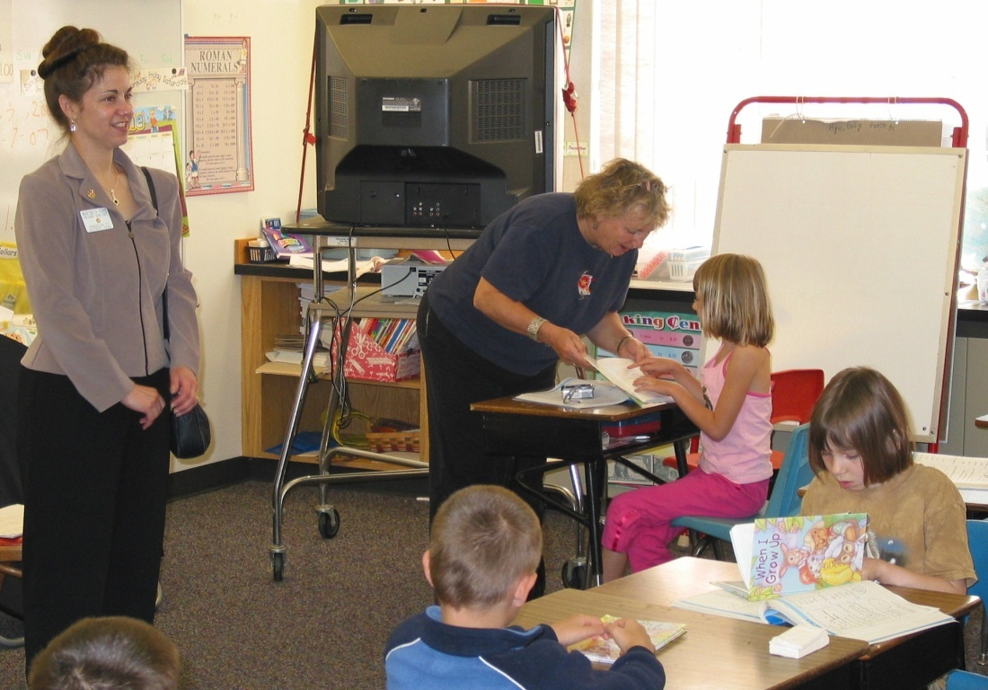
Value for Young Professionals
Generation X and Millennials
Cost considerations due to heavy college debt
Do they get value out of:
  Club singing? – old songs from past generations?
  Member fines?
  Mandatory meeting attendance?
  OR from meaningful service projects?

Slide 26
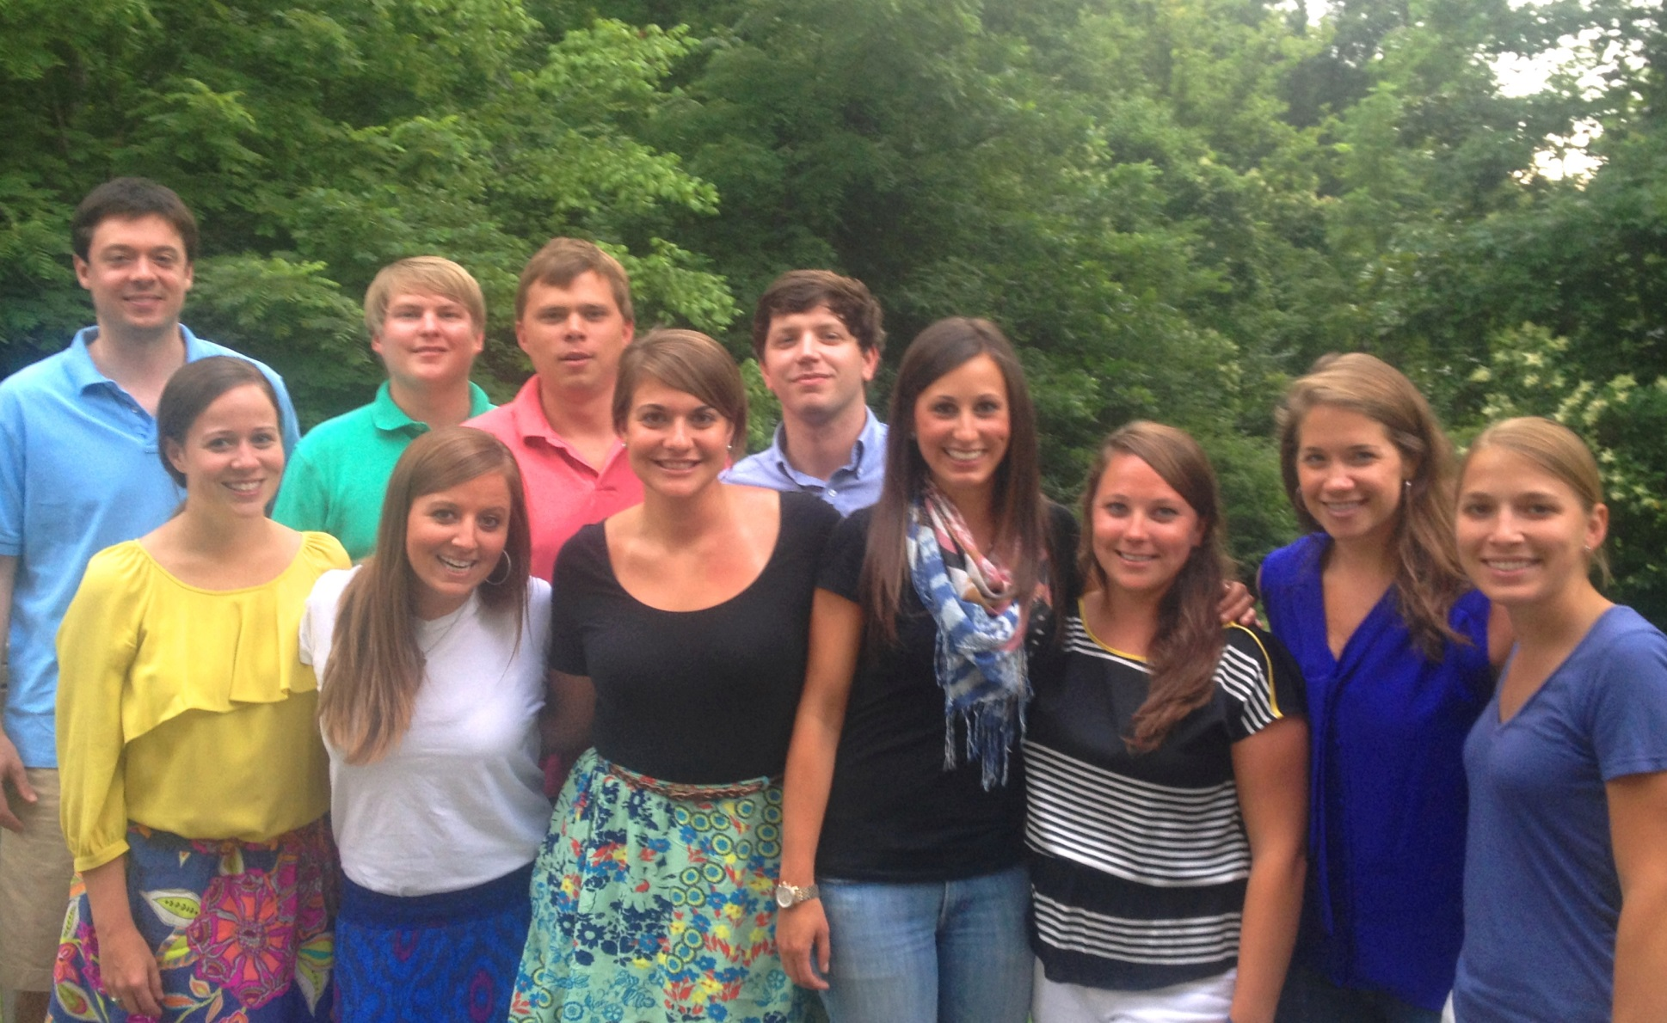
Potential Rotarians???
What is the minimum age to join Rotary?

Slide 27
Membership Solutions
Question: Do members stay or leave Rotary based on what’s happening in their clubs?

Slide 28
Strong, vibrant clubs with excellent programs, opportunities to serve, and an engaged membership provide the necessary kindling to fire dynamic growth.

Slide 29
What do people really want???
A sense of belonging?
Be nourished by the organization?
Make friends and network?
Have fun?
Find satisfaction from serving others?
Recognition for their service?
Feeling engaged?

Slide 30
How’s our club doing?
Do we provide good value?
Do we have a good product?

Slide 31
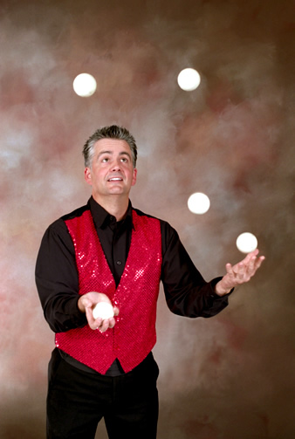
Our “Product”
Is our club nourishing for our members?
Do we have interesting or
boring weekly programs?
Do we go through the
same routine week after
week? Year after year?
Try something other than speakers (talkers)

Slide 32
Our “Product”
Is the day and time of our meeting still the best?
Are people receiving enough value for their time, money and effort?
  Are we offering service activities that meet the needs and preferences of our members?

Slide 33
10 Minute Break

Slide 34
Finding Solutions

Slide 35
Business Success – Rotary Success
Businesses succeed or fail by how well they create value for their customers.
Treat Rotarians as customers you can’t afford to lose.
Assess club practices, then implement changes to maintain a strong, vibrant club.
Overriding concept: “We will do everything possible to satisfy the needs and provide value for our members.”

Slide 36
Club Member Survey
Find out how to deliver better value.
Conduct a 100% Member Survey
1. Use survey at Appendix 9 of the District Membership Plan
2. SurveyMonkey – good tool for the survey
3. Why 100%? To find out why the non-attendees are skipping meetings.

Slide 37

Exit Interviews
Find out what could be done better.
Conduct exit Interviews
  One on one – over lunch
  Find out the real reasons for leaving

Slide 38
Engaging Your Members

Slide 39

Engage – Some Definitions
Involve, Engross, Immerse, Enthrall
To begin and to carry on an activity
To do or take part in something
To come together and interlock - like gears being engaged
keyway?

Slide 40
Engaging Members
  The largest loss of new members happens within the first six months of joining a Rotary Club.
  The 2nd largest loss occurs within the first 3 years.
Need to Change Our Way of Thinking
  Retaining Members → Engaging Members
  Some Words for Engagement
    Interested
    Active
    Excited
    Involved

Slide 41
Ideas for Making Meetings More Engaging

Slide 42
Engaging Meetings - Agenda
1. Start every meeting with a funny story (use Sonny’s 83 funny stories)
2. Rotary Minute (Life of Paul Harris or Rotary Magazine)
3. Rotary Moment (2-3 minutes, short video, or passionate/ inspirational talk) http://www.youtube.com/watch?feature=player_embedded&v=Ubqc7_MnBeE
4. Foundation minute every other meeting (good things the Rotary Foundation is doing)
5. Classification talk every other meeting (10 minutes, format available) Julie, Erika

Slide 43
Engaging Meetings - Agenda
6. Present programs to Inform, Inspire,
Educate, or Entertain your members.
7. Shy away from speakers wanting or
selling something
8. Happy dollars OK but don’t pass the hat
9. Fines??? (Can be overdone and hurtful.)
10. Close meeting with Inspirational
message e.g. a poem or quotation.
Suggestion: Prepare the day before!

Slide 44
Engaging Meetings – Adaptive ?
Once or twice a month – completely change the agenda.
  Members meet to plan or perform work service projects
  2-4 clubs have a joint Rotary meeting to share excellent speakers, fun, & fellowship
  Social event
  Networking opportunities
Assistant Governor has joint Lunch/Dinner meeting with area Presidents (good ideas shared)

Slide 45
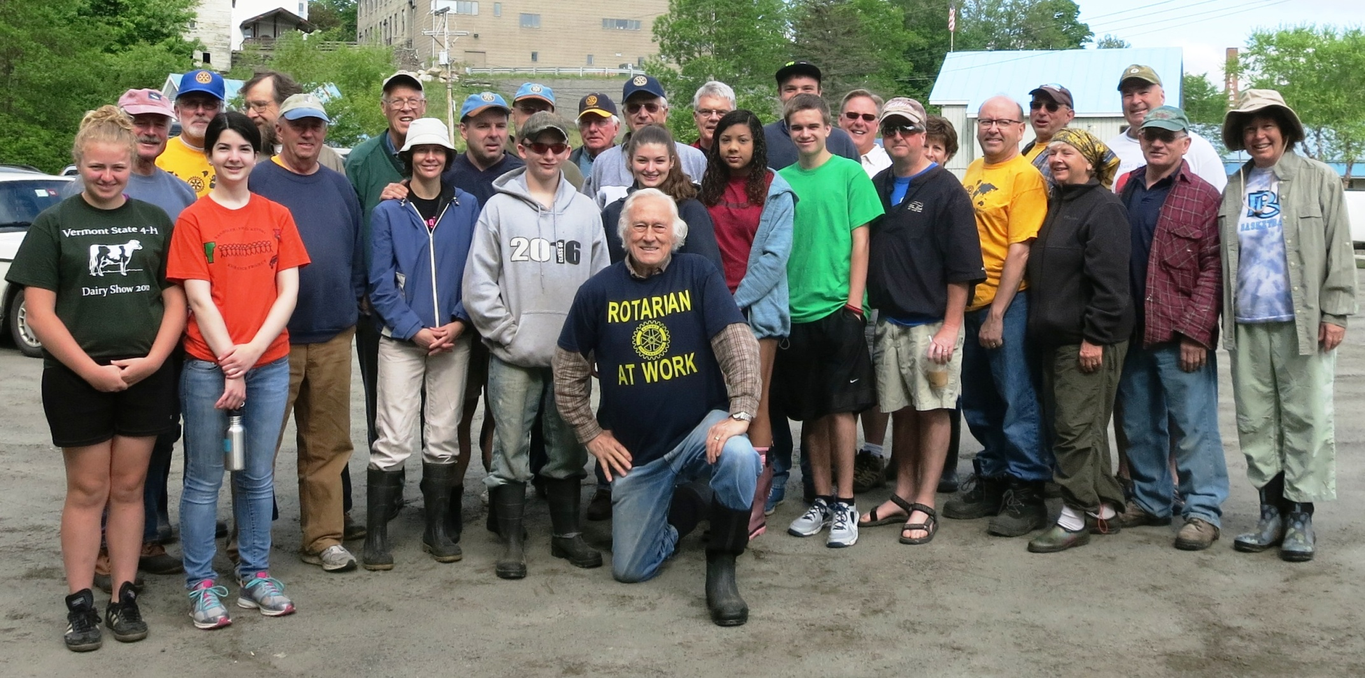
Joint Meetings & Projects
Clubs combine to work the same service project
Sunrise, Noon & Interact – River Cleanup

Slide 46
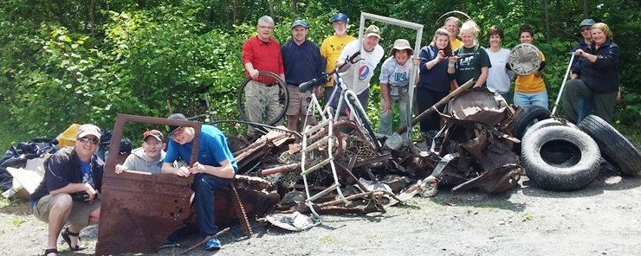
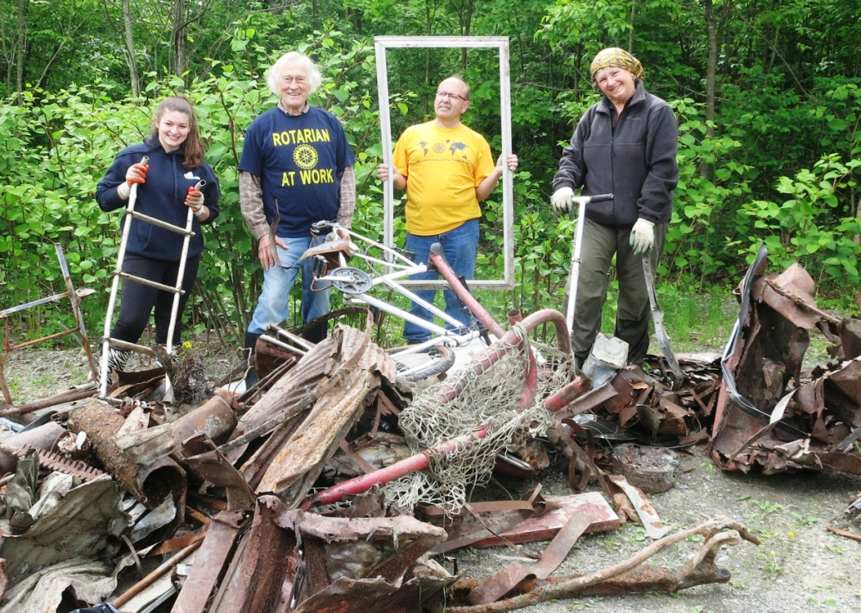
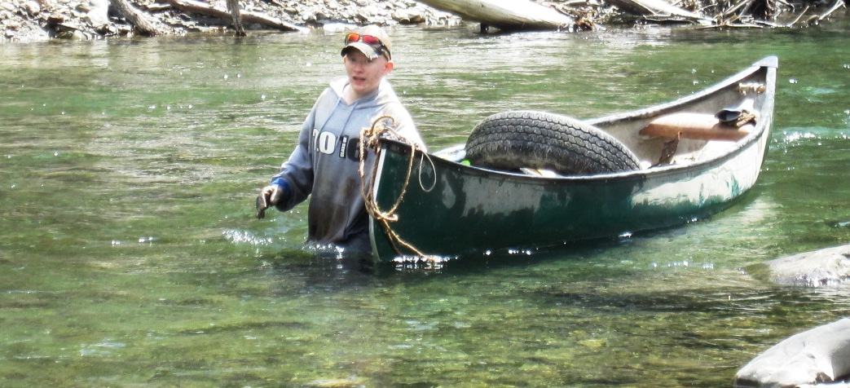
White River Clean Up

Slide 47

Engaging
Web Connected
Website/Facebook
  Make your members proud to see a dynamic web site, kept current with action photos
  Lets new members and potential members know who you are and what you do
Add links to members’ business websites
Make dues easy to pay on-line

Slide 48
Engaging Newer Members
    Mentoring
    - Pair new members with experienced
    members.
    - Have new members do “Spokes”
    (Appendix 6. in membership plan)
    - Sit together at meetings
    - Discuss Rotary history, club history, past
    projects
    - Encourage them to join current and
    future projects

Slide 49
Engaging New Members
Quick Hands-On Projects
- Conduct a single or multi-club ‘hands-on’
community project – no longer than two
hours
- Introduces the excitement and
satisfaction of doing service and seeing
Rotarians in action
- Document with pictures and/or videos

Slide 50
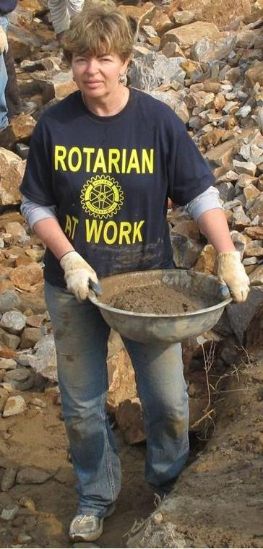
Engaging New Members
First year Committees
The club puts up $100 to 500, then
Challenges new members to find the next community service project for the club.
This helps them to learn about how Rotary works while keeping them “Engaged”

Slide 51

Engaging New Members
Leadership Training
New members should be informed, encouraged and financed by their clubs to attend the Rotary Leadership Institute.
(District will help with cost.)
Encourage groups of club members (old and new) to attend together and then to report back to the club one proposal for innovation and/or a new project.

Slide 52

Interacting
How Do You Interact?
Start an Interact Club with middle/high school students (ages 12 and up)
Encourage new members to participate in starting a club
If club is already established, have them attend your meeting; then do things together

Slide 53
Interacting
Career Share
Organizing and conducting a single or multi-club "Career Fair“, or "Career Day”, or “Job Shadowing“ event for local middle and/or high school
Encourage new members to participate or lead this event

Slide 54
Revamp Your Organization
Allow newer members to chair club committees
Infuse new blood into your board of directors
Example:
  Pigeon Cove Rotary - new Board of Directors

Slide 55
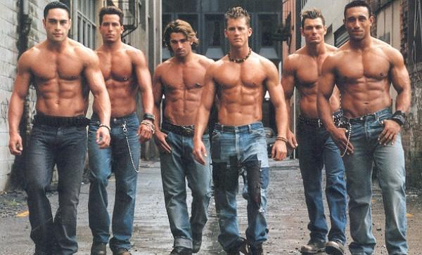
Pigeon Cove’s New Directors

Slide 56
Membership Quiz
Best way to increase membership is to:
  Advertise in newspapers & public media
  Wear Rotary pin every day
  Simply ask people to join.
  Ask members to bring in another member
  Provide value to members

Slide 57

In short:
Provide value to your members.
Change what has to be changed to engage and keep current members.
Make sure all members are involved and that we meet their expectations.
Do all of the above first, then
  Tell your Story to attract new members

Slide 58
10 Minute Break

Slide 59
Attracting New Members

Slide 60
Are we attractive?
How is our club doing?
Do we provide good value?

Slide 61
Thinking Outside the Box
“We need to ask questions and we need to open ourselves to the answers.
We cannot say ‘No, we will not do this,’ just because it has never been done before. ”
Past Rotary International President Sakuji Tanaka

Slide 62
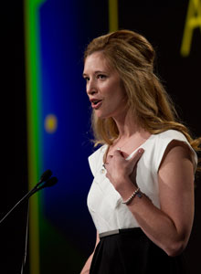
Adaptive Clubs
Katie Ischkin's club - South Metro Minneapolis Evenings
    2 Evening meetings – no meals.
    3rd meeting -happy hour/ networking event at different locations
    4th meeting is a hands-on volunteering opportunity.
    First Year Results:
    One matching grant and international service project
    Plus ten (10) community service or hands-on volunteer efforts.

Slide 63
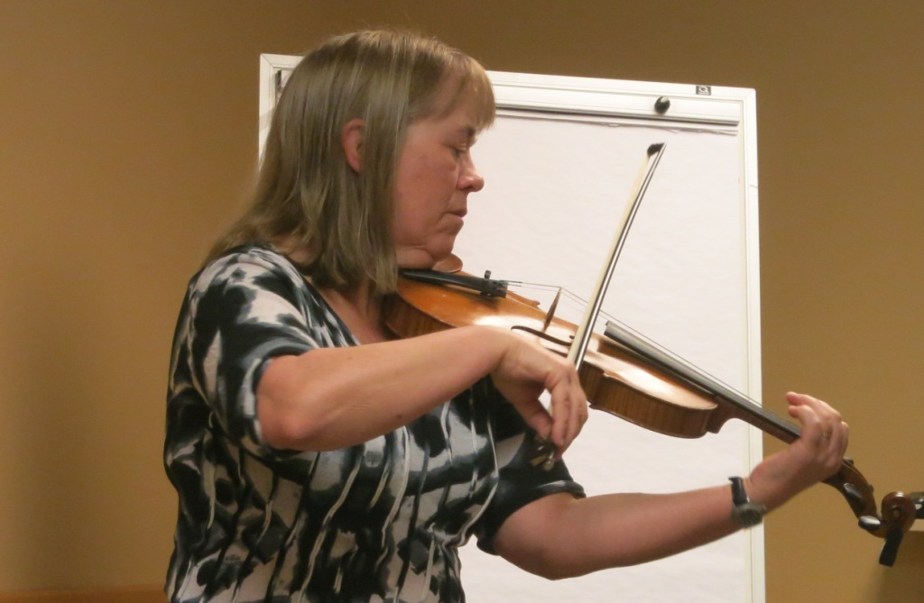
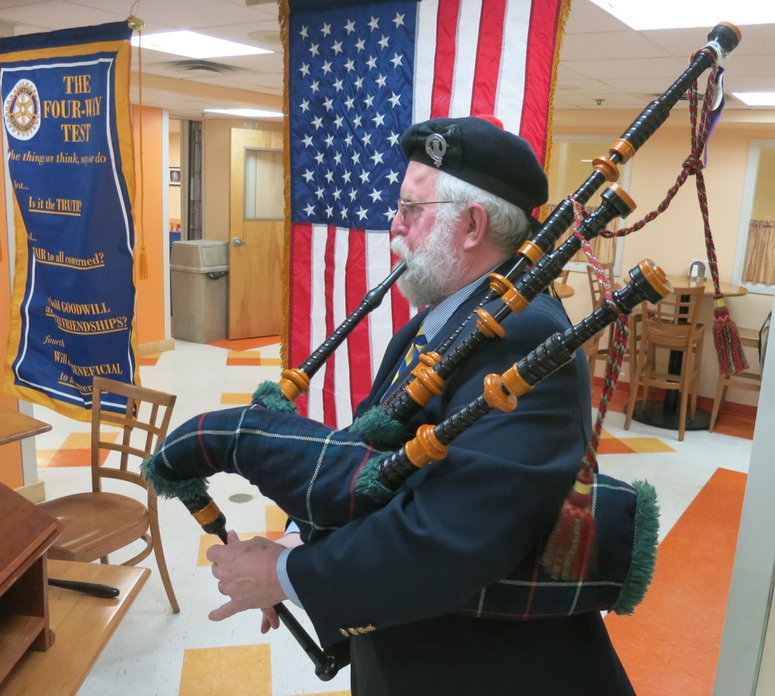
Adaptive Clubs
Randolph Rotary Sunrise – a Satellite club
  55 minutes – no meals
  1st & 3rd Meetings – programs / speakers
    First Year Results
    Matching Grant and International Service Project
    10 community service or hands-on volunteer efforts.

Slide 64
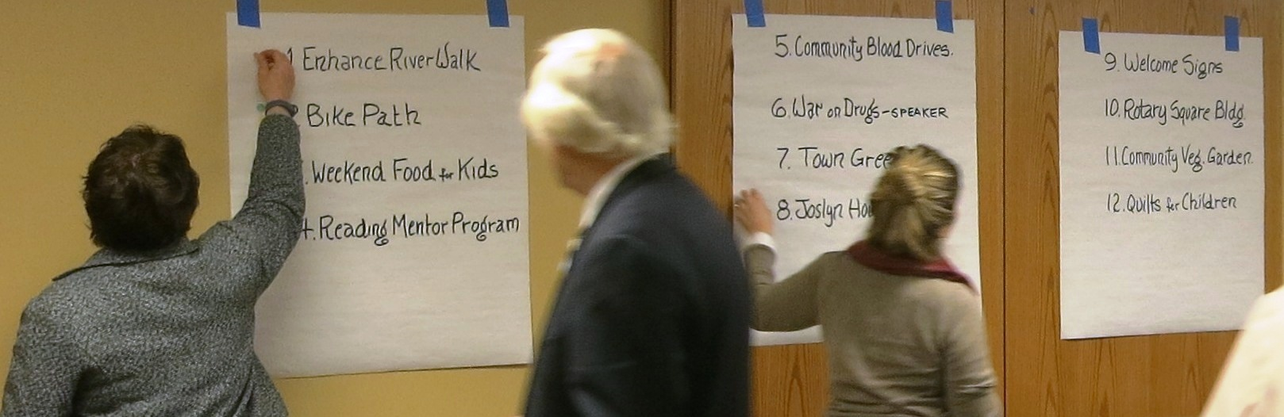
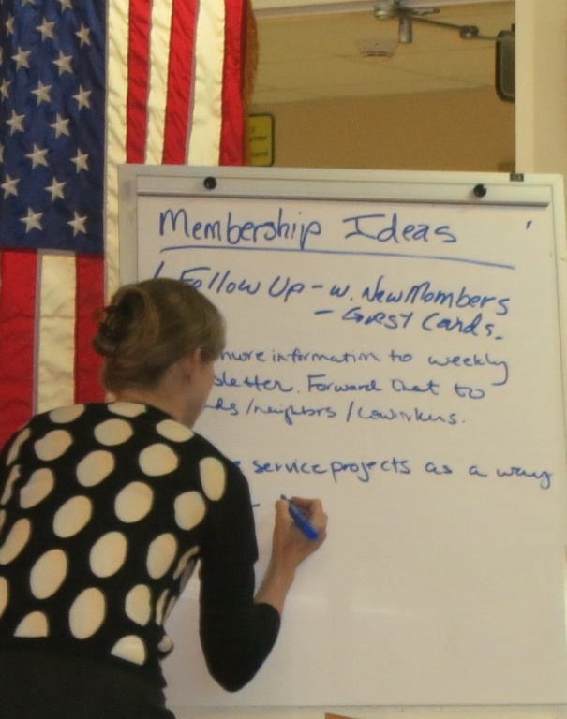
Adaptive Clubs – Randolph Sunrise
  2nd & 4th Meetings, Adaptive
No speaker –
- Assessing community needs:
  Prioritizing, planning, conducting community projects (above)
Membership development ideas (left)
Classification talks: knowing the members
5th Meeting - Social (Bar & Grill)
    First Year Results
    Matching Grant and International Service Project
    10 community service or hands-on volunteer efforts.

Slide 65
Adaptive Clubs – Randolph Sunrise
Results (after the club’s first 6 months)
19 Members
  2 Young Leaders, 1 Family Member
Over 80% weekly meeting attendance.
6 community projects either planned, under way or completed
Joint project with other clubs
Received a $4,000 district grant
    First Year Results
    Matching Grant and International Service Project
    10 community service or hands-on volunteer efforts.

Slide 66
Randolph Sunrise – Service Projects
“Walking for Wellness”: completed
Intergenerational dance: completed
Kids’ summer lunch: completed
Improve River Walk: in planning
8-mile bicycle path: in planning
Renovate Josyln House Seniors’ Home
  Being worked with district grant
    First Year Results
    Matching Grant and International Service Project
    10 community service or hands-on volunteer efforts.

Slide 67

Satellite Clubs – a New Initiative
Building
a Satellite Club
in
3 Easy Steps
by: Sonny Holt
by Sonny Holt
Membership Chair, District 7850
Advantages
Alternative meeting
time and place
“Theme” can be
different
  Service-oriented
  Young professionals
  Family members
  Adaptive meetings
Increases community
awareness of Rotary
Builds membership
for sponsor club

Slide 68
Satellite Clubs
Offers options for members to attend meetings that better accommodate their work schedule or focused on activities better suited to their needs.
ln same locality as the sponsor club
Submits annual report to sponsor

Slide 69
Satellite Clubs
Satellite members are also members of Sponsor Club
  The only dual membership allowed by RI
Title (example)
  Rotary Satellite Club of Pigeon Cove (A
  satellite of Rotary Club of Pigeon Cove)
Officers:
  Chair, immediate past Chair, Chair-elect, Secretary and Treasurer.

Slide 70
Attendance and Service
Members should:
  attend or make up at least 50 percent of club regular meetings or engage in club projects, other events and activities for at least 12 hours in each half of the year, or a proportionate combination of both.
  An average of 2 hours per month or 30 minutes per week !

Slide 71
Membership Categories
Active – only active members may have the title “Rotarian”
Honorary – term of such membership determined by the club’s board of directors
  exempt from the payment of admission fees and dues, and shall have no vote and shall not be eligible to hold any office in the club.
  conferred only in exceptional cases, but may not be conferred upon an active member by the members of his/her own club 5.010 Rotary code Of Policies

Slide 72
Types of Active Membership
Active 85
  if the member’s age and years of membership total 85 years or more and the member has notified the club secretary in writing of the member’s desire to be excused from attendance and the board has approved.

Slide 73
Membership Categories
Honorary vs Active Retired/85
  To “Honor” an outstanding member, a more appropriate alternative than “Honorary” might be a special ceremony with the presentation of an award/plaque for meritorious service.
  And if applicable, changing the member’s status to “Active Retired/85” That way the club does not lose an active member.
  Dues reduction may also be considered

Slide 74
Building Diversity in Your Club

Slide 75
Top Ten Clubs for Female Diversity
  Ossipee Valley 61%
  White Mountain 58%
  Cambridge Area 53%
  St. Hyacinth 50%
  Northfield 44%
  Littleton 43%
  South Burlington 43%
  Burlington Sunrise 43%
  Essex 42%
  Lyndonville 42%

Slide 76
Building Diversity
Family Plan Member (Appendix 10)
  Encourages spouses/partners (or any family member) to join Rotary by offering the incentive of reduced club dues and an incentive award of $20 from the District.
Care Giver/Domestic Professional
  An adult of good character and good business, professional and/or community reputation, having interrupted employment. or having never worked in order to care for children or assist their spouses in their work

Slide 77
Building Diversity
Young Leaders
  35 years or younger
  Offered the incentive of reduced club dues; also, the club receives an incentive award of $20 from the District.
  Required to recruit another member within 12 mos. to maintain status.
Clubs may waive club dues and admission fees for members under the age of 35. (RI Code of Policies 5.040.2)
In addition, clubs may provide payment of district dues for new members in this age group, (RI Code of Policies 5.040.2)

Slide 78
Benefits of Family & Young Leaders Plans
Helps address three problem areas
  Lack of diversity
  Difficulty in recruiting younger professionals
  Cost of membership

Slide 79
Advantages of the the Family & Young Leaders Plans
Important: A reduction of club dues for certain categories of members does not necessarily mean that other members will have to make up the difference.
  Club receives monetary awards from district.
  More members means more club revenue.
  Pro rata share of fixed club costs like PETS ($275), district training ($250), and other administrative/operational fees will be reduced on a per member basis.
Increasing membership tends to lower cost for all members over time.

Slide 80
The “Company Plan”
Member(s) of company join as a unit.
  Corporate executive plus up to 3 additional designees.
  All are members.
  Clubs have wide flexibility in administering this plan.
  District provides guidance in the Membership Plan. (See Appendix 11)

Slide 81
Building New Clubs

Slide 82
District Goal and Results
  Goal: One new club per year.
  Results:
    2012 – Drummondville Malouin, QC
    2013 – Ossipee Valley, NH
    2014 – Randolph Sunrise, VT (pending)

Slide 83
Satellite Clubs – a Great Option
Gives Community & Members More Options
    Sunrise
    (People who can’t make a lunch or dinner meeting)
    Weekend
    (Service-oriented, but busy or out of town weekdays)
    Young Professionals
    (Adaptive meetings – lower cost - networking)
    E-Club
    (No limit for E-Clubs – can be a hybrid i.e., satellite/e-club)

Slide 84
Club Extension

Slide 85
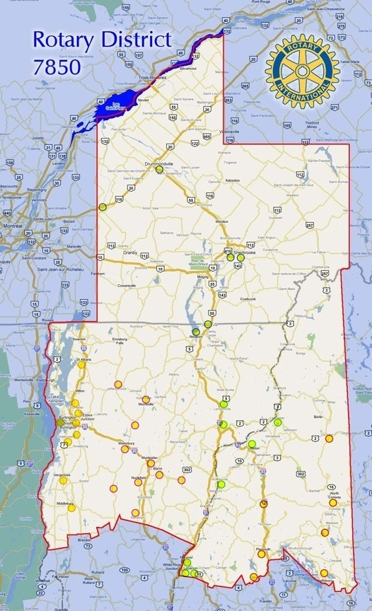
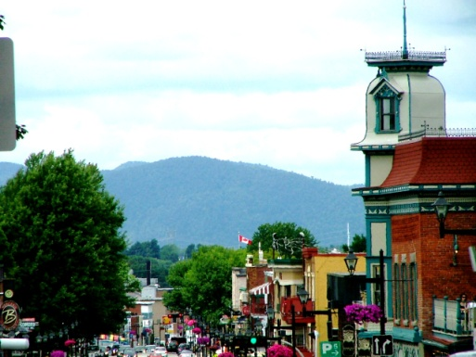
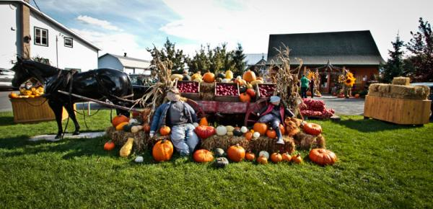
Club Extension
In large communities without a club, extension is possible!
called a “Provisional Club”
Example = Granby, QC
65,000 people - No Rotary club
Advantages of “Provisional Club”:
No RI Dues until chartered
Can be used for ‘make ups’
Extension Chair PDG Bill Thompson

Slide 86
Interact and Rotaract Clubs
Interact
Central Vermont
Lincoln-Woodstock
Mad River Valley
Milton
Northeast Kingdom
Northfield
Randolph
Sherbrooke
Interact
South Burlington
Hanover
Stowe
Wolfboro
Rotaract
Hanover
Northfield

Slide 87
Telling Your Story

Slide 88

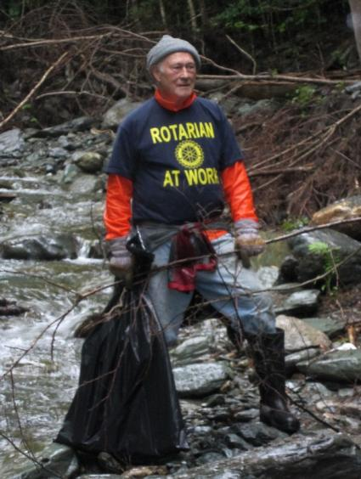
Telling Your Club’s Story
  “The Rotarian” magazine in public places
  Publicize service projects
  Promote work with young people
  www.RotarySmiles.org

Slide 89

Your Club’s Story
Paid newspaper ads about your club and what you do – cost effective.

Slide 90
Your Club’s Story
Print and post “RotarySmiles.org” posters in prominent places around town.
  Takes them to the “RotarySmiles” page on the District Web site and then to your club’s web site. www.RotarySmiles.org
Web site/Facebook page
  Keep it simple; use action-oriented photos.

Slide 91
Status of Your Web Site
Some great examples in our district
  Lancaster – top slide show http://lancasternhrotary.org/
  Sherbrooke – top slide show and Rotary Video http://www.rotarysherbrooke.org/
  Randolph Sunrise - http://ransat.wordpress.com/about/
  Hanover – link to Facebook http://www.hanovernhrotary.org/
  Stowe – Octoberfest http://www.stoweoktoberfest.com/

Slide 92
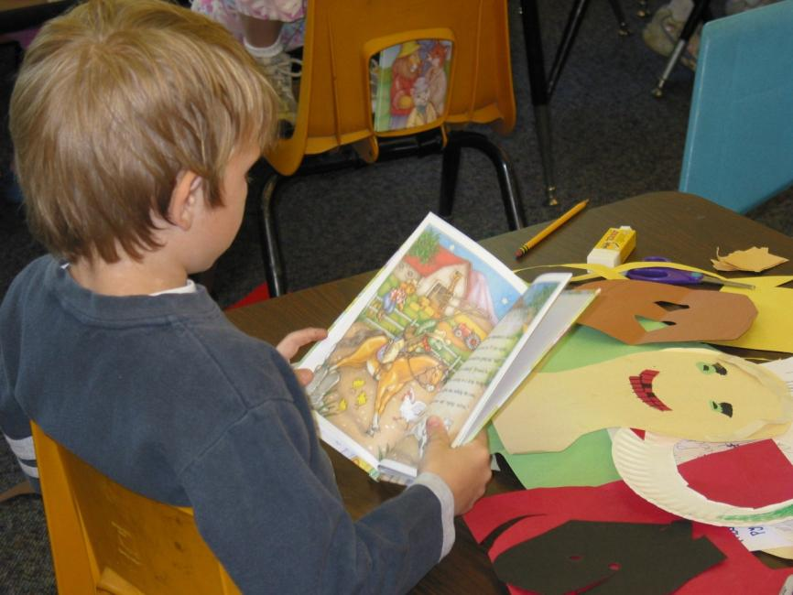
Telling Your Club’s Story
Seek opportunities for Rotarians to speak at community events and in schools
Promote Rotary’s work with and for young people
Personalized story books for 1st graders

Slide 93

Telling Your Personal Story
“What’s that pin?”
“That’s a Rotary pin”
“What’s Rotary?”
“Rotary’s the best decision I’ve ever made in my life.”
“What do you mean?”

Slide 94
Telling Your Personal Story
“I joined Rotary because I wanted to help make life better for people in my community, but I also enjoy the friendship and fun rotary offers – and it’s world wide. There are many opportunities, for example: “To bring clean water and better sanitation to communities.”

Slide 95
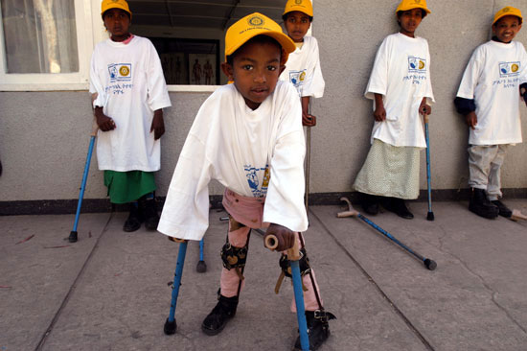
“To help rid the world of diseases like Polio”

Slide 96

Continue by telling about your club’s service projects

Slide 97
Building an “Action Plan” for Dynamic Growth
A checklist to get you started

Slide 98
Lunch Break
30 Minutes

Slide 99
Engagement-Retention
Evaluate Your Club’s Value/Engagement Quotient:
Average attendance per month
Retention rate (people lost/resigned running total)
Condition of Web site/Facebook page
Answer the eleven questions on page 5 of the Membership Plan
Conduct one-on-one exit interviews

Slide 100
Engagement-Retention
Conduct 100% Member survey using Appendix 9. (Can use SurveyMonkey)
Then gain Board of Directors’ and membership buy-in to;
1. Correct Problem Areas
2. Implement Improvements

Slide 101
Engagement-Retention
If Board of Directors and membership are reluctant to change, try an alternate approach: Build a Satellite Club
  1. Best of both worlds
  2. Corrects problem areas
  3. Implements improvements
  4. Can draw in Young Professionals
  5. Different Theme (service vs check \
  writing)
  6. May capture ex-Rotarians from home
  club

Slide 102
Engagement-Retention
Assign a sponsor to every new member
Have new members go through “Spokes” program (See Appendix 6. in membership plan)
Send members to Rotary Leadership Institute. - District helps with cost

Slide 103
Engagement-Retention
Improve Content of Meetings:
1. Start every meeting with a funny story
2. Rotary minute
3. Rotary moment (2-3 minutes)
4. Foundation minute (every other meeting)
5. Classification talk every other meeting (10 minutes)

Slide 104
Engagement-Retention
Improve Content of Meetings
1. Develop programs to Inform, Inspire, Educate, or Entertain your members
2. Shy away from speakers wanting or selling something
3. Happy dollars are OK, but don’t pass the hat
4. Fines????
5. Close meeting with an inspirational message such as a poem or quotation.

Slide 105
Engagement-Retention
Don’t be afraid to think “Outside the Box”:
Try adaptive meetings
1. Plan and do service projects
2. Hold joint meetings with 1 or 2
other clubs
3. Meet at different business locations
4 5th Tuesday social evening
5. Joint meetings with Interact Club
6. Open air meeting

Slide 106
Engagement-Retention
Implement 1st Year Committees
1. Club puts up $100 to $500
2. Challenges new members to
find a community service
project for the entire club
Schedule a district Visioning Session
Close the back door (use Rule of 85)
Produce a 1-page weekly newsletter

Slide 107
Attraction-Recruitment
  Mix, match and/or tailor the best recruitment approach (Appendixes 2, 3, 5,)
  Have members always wear Rotary pin in the community
  Tell our story: visit shops and businesses
  Add high visibility to service projects with “Rotary at Work” T-shirts
  Thursday evening town walks

Slide 108
Attraction-Recruitment
  News releases, radio/TV/Facebook ads, “RotarySmiles” posters
  Invite speakers back for two free meals
  Give speakers a certificate –“immunize 5 children against Polio”
  Ask family members to save money by joining Rotary under the district’s and club’s “Family Member Plan”

Slide 109
Attraction-Recruitment
  Bring in young professionals with the “Young Leaders” plan (this has a multiplier effect)
  Recruit spouses who interrupted their employment or never worked in order to care for their children, or who support a spouse in his/her work.

Slide 110

Attraction-Recruitment
  Keep your Web site updated and appealing
  Distribute newsletter to townspeople
  Place weekly ads in newspaper (cost effective)

Slide 111

Finally: Just Ask ! !
  Get some business cards like this

Slide 112
Be Proud and Inspire Others
What is our Product for others?
Service – Service above all else
“Service above Self”
“We do good in the World”

Slide 113
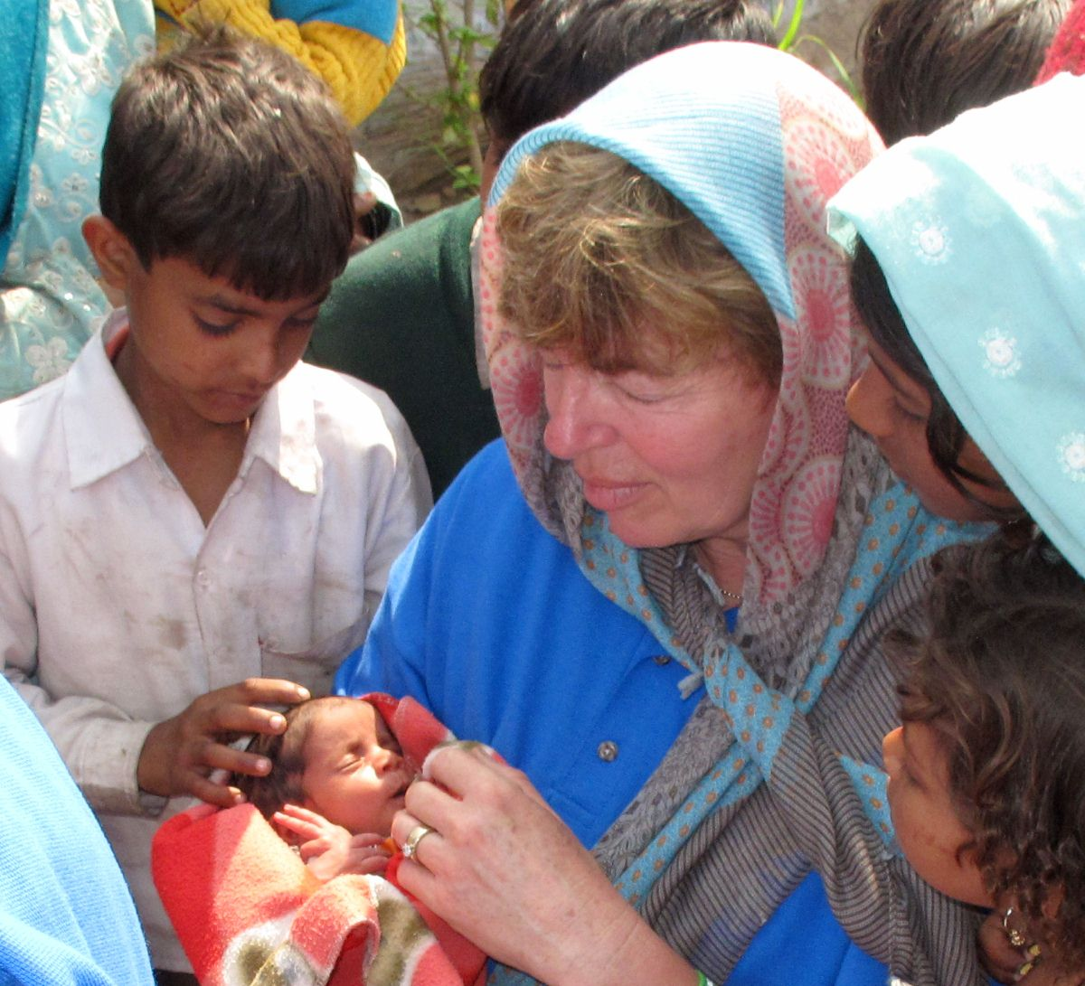

Slide 114
We have to show the
PRIDE
we have as Rotarians Because our goal is:
“To Make Life Better for People”

Slide 115

Rotarians Building a Dam in Chahalka, India

Slide 116

Thank You for Attending

Slide 117
Questions and Discussion

Slide 118
Back up

Slide 119
Format for Classification Talk
Classification Talk - from podium (10 Minutes max)
Introduce yourself and give your classification
Place of birth, where you grew up and meaningful memories about growing up
Education,
Current Employment/Profession
Work history, how did you get to where you are today?
Parts of your job you find most rewarding and most difficult.
Advice you would give persons entering your career field.
What have you learned about work relationships and life
in general during the course of your employment history?
What has been your real passion in life?
What life changing experience(s) brought you to where you are today?
What attracted you to Rotary service?
What would you like to accomplish in Rotary?
Hobbies / Travel to other countries
Ask for questions

