Slide 1
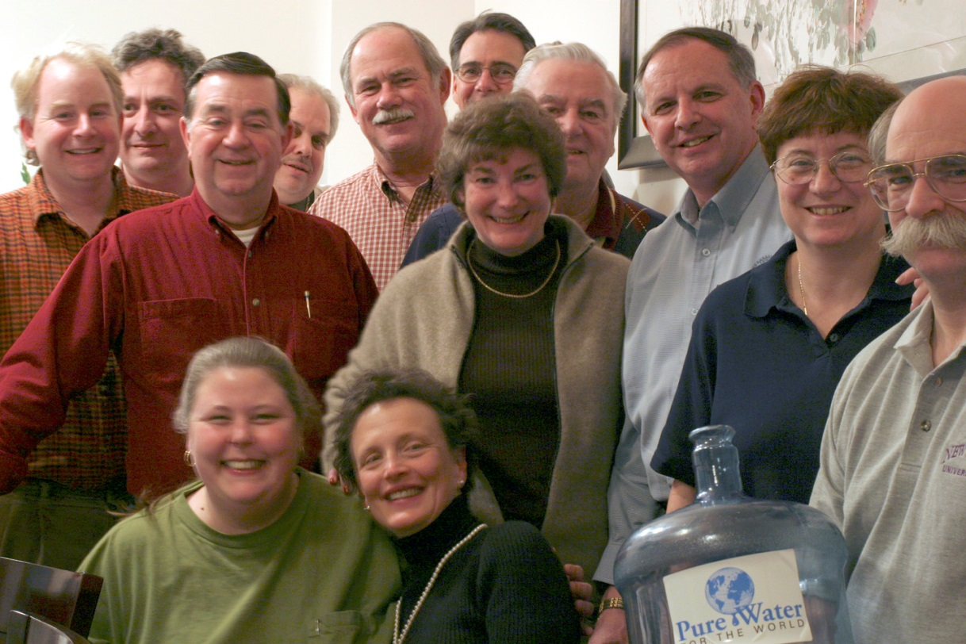
District 7870
Grant Management Seminar
Rick Manganello – 10/29/2016
Notes:
JULY 2012

Slide 2
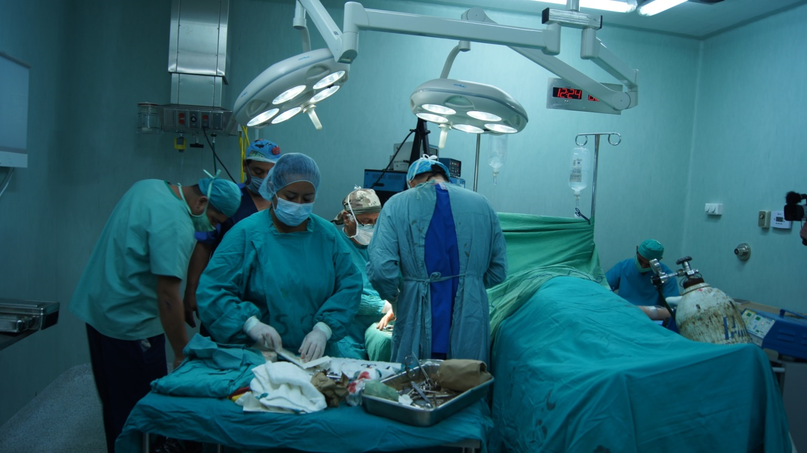
ROTARY GRANTS

Slide 3
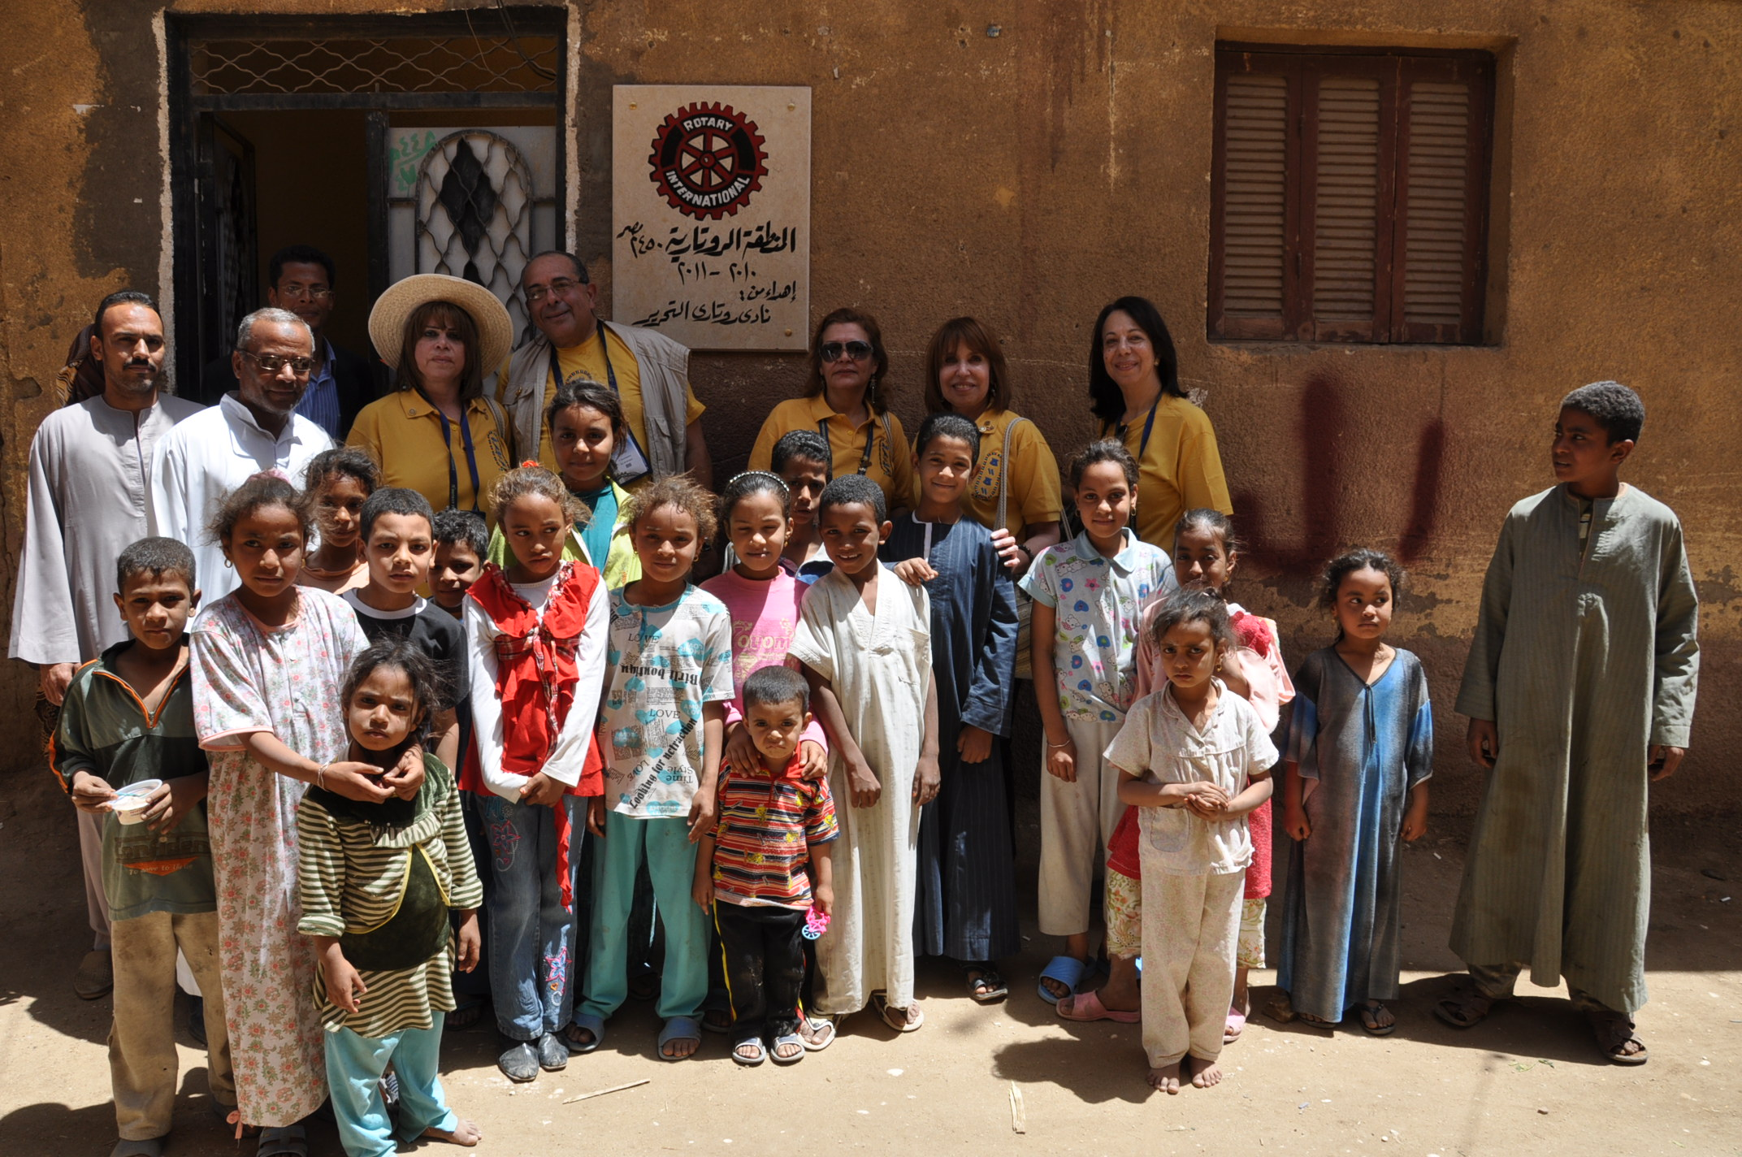
ROTARY GRANTS
  District grants
  Global grants
Notes:
The Rotary Foundation offers grants that support a wide variety of projects, scholarships, and training that Rotarians are doing around the world. There are two types of grants available: district grants and global grants.

Slide 4
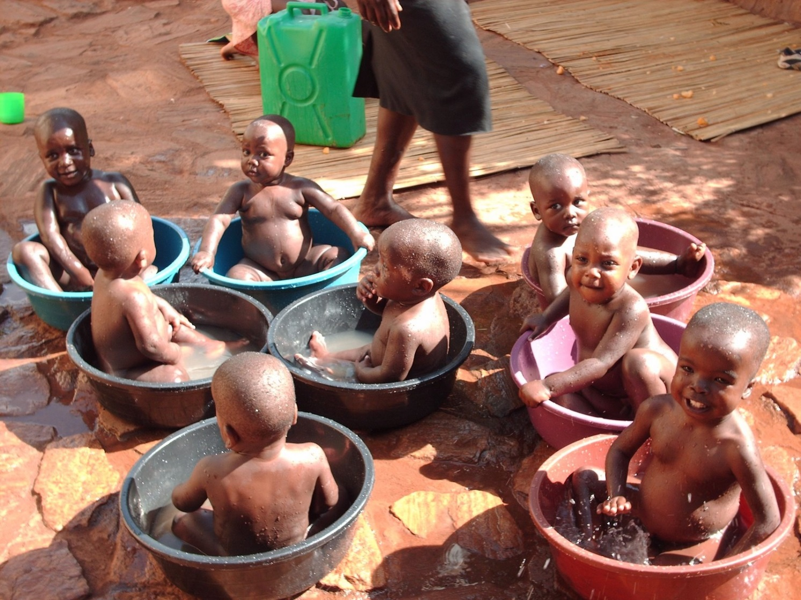
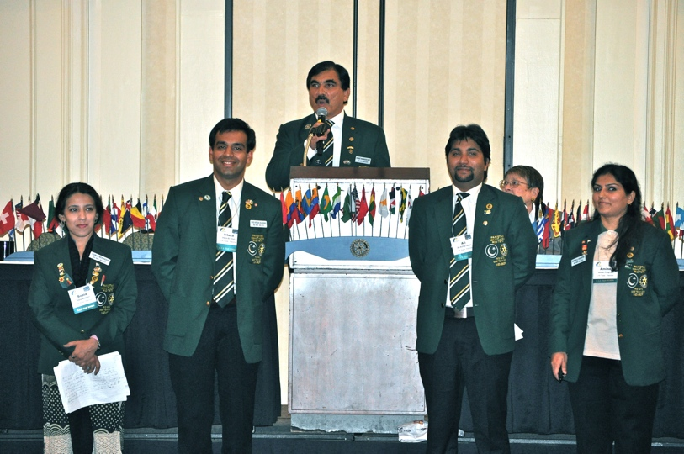
DISTRICT GRANTS
  Small-scale, short-term
  Local or international activities
  Aligned with the Foundation’s mission
  Single grant awarded annually
  GSE
Notes:
District grants fund small-scale, short-term activities that address needs in your community and communities abroad. Each district chooses which activities it will fund with these grants. You can use district grants to fund a variety of district and club projects and activities.
You have a lot of freedom to customize your service projects. There aren’t many restrictions, as long as your district grant supports the mission of The Rotary Foundation, which is to enable Rotarians to advance world understanding, goodwill, and peace through the improvement of health, the support of education, and the alleviation of poverty. Districts must be qualified before they can administer district grants.
Districts may use up to 50 percent of their District Designated Fund to receive one district grant annually. This percentage is calculated based on the amount of DDF generated from a district’s Annual Fund giving three years prior, including Endowment Fund earnings. You aren’t required to request the full amount available.
Districts receive this funding as a lump sum and then distribute it to their clubs.

Slide 5
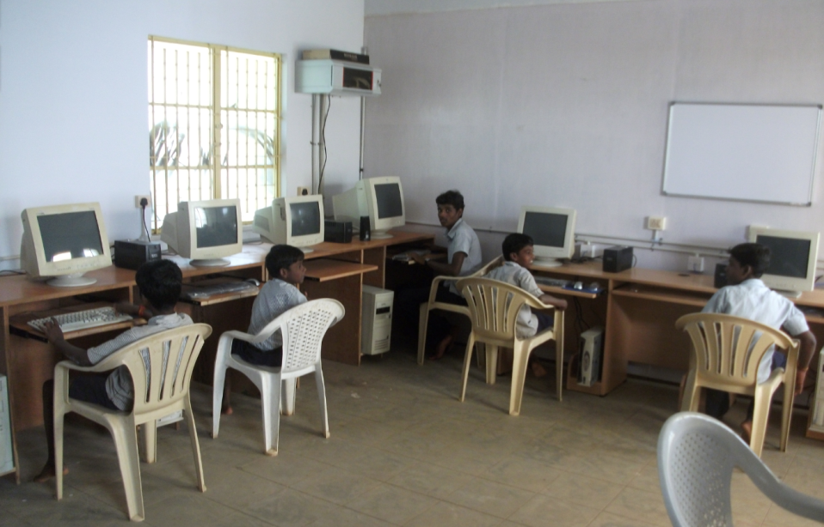
DISTRICT GRANT
Notes:
Rotarians in District 4420 (part of Sao Paulo, Brazil) used district grant funds to begin Project READ (Reading and Education Center) to provide reading rooms for children in poor communities. The project equips each center with books and toys that encourage reading among children ages 5-12. A local monitor supervises each reading room and tutors students.

Slide 6
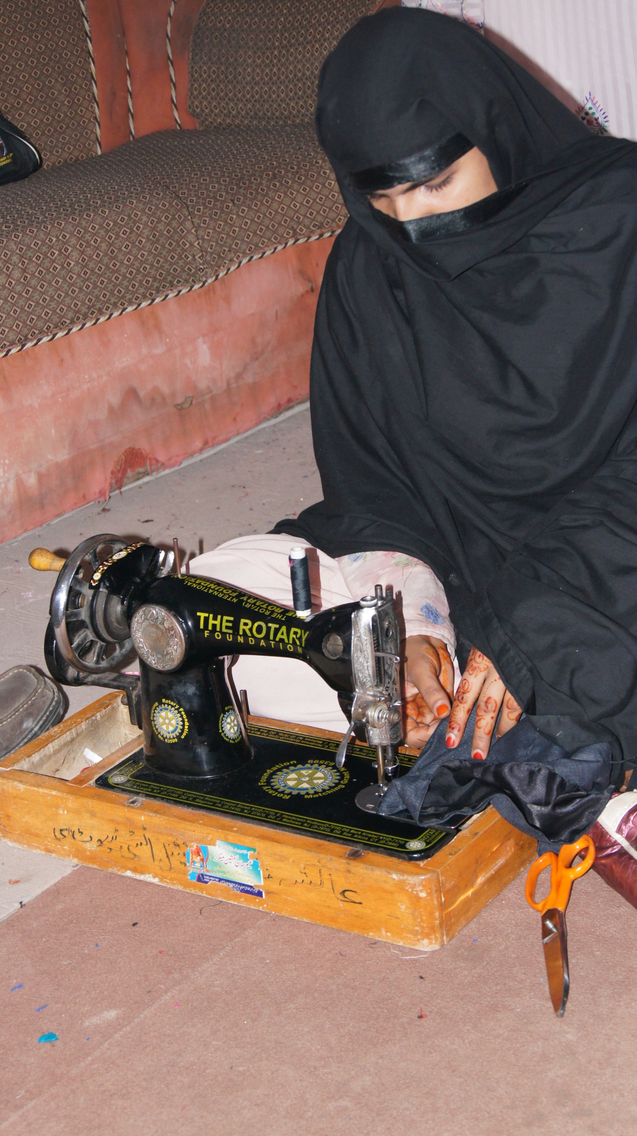
GLOBAL GRANTS
  Large, long-term projects
  Sustainable
  Measurable outcomes
  Alignment with areas of focus
  International partnership
  World Fund match
Notes:
Global grants support large international activities with sustainable, measurable outcomes in Rotary’s areas of focus. A key feature of global grants is partnership, between the district or club where the activity is carried out and a district or club in another country. Both sponsors must be qualified before they can submit an application.
The minimum budget for a global grant activity is $30,000. The Foundation’s World Fund provides a minimum of $15,000 and maximum of $200,000. Clubs and districts contribute District Designated Funds (DDF) and/or cash contributions that the World Fund matches. DDF is matched at 100% and cash is matched at 50%.

Slide 7
Minimum Grant Size – $15,000 World Fund Contribution
District Sponsored
DDF $15,000
WF Match $15,000
Total Grant $30,000
Club Sponsored
Club $10,000
DDF Match $10,000
WF Match of DDF $10,000
WF Match of Club $5,000
Total Grant $35,000

Slide 8






AREAS OF FOCUS
  Peace and conflict prevention/resolution
  Disease prevention and treatment
  Water and sanitation
  Maternal and child health
  Basic education and literacy
  Economic and community development
Notes:
We have identified specific causes to target to maximize our local and global impact. Through global grants we help clubs focus their service efforts in the following areas:
Peace and conflict prevention/resolution
Disease prevention and treatment
Water and sanitation
Maternal and child health
Basic education and literacy
Economic and community development

Slide 9
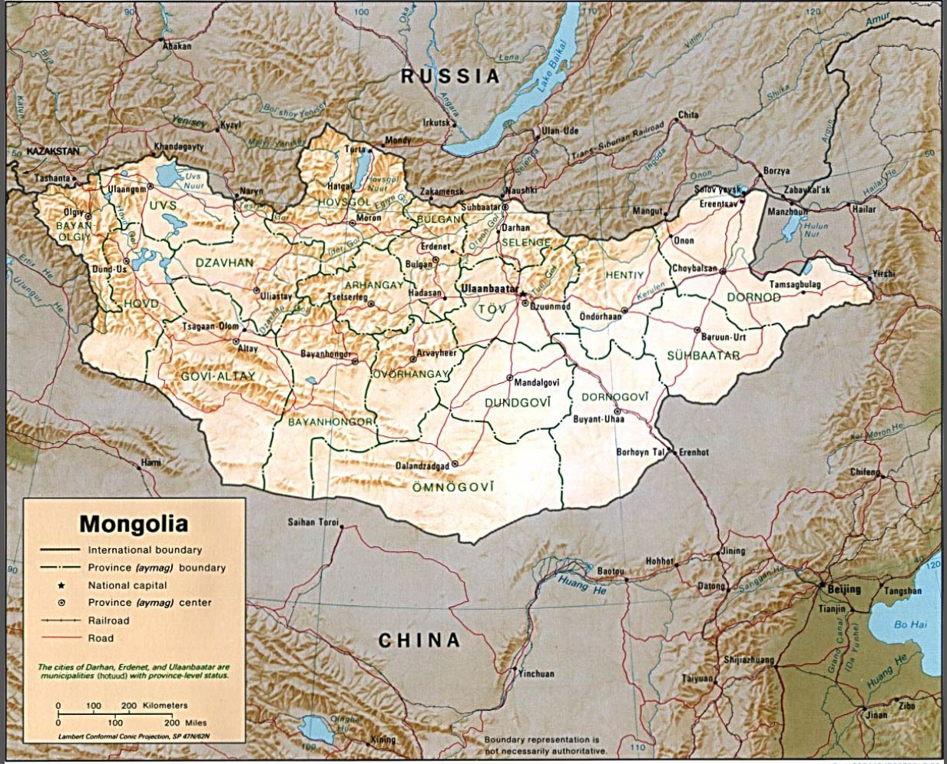
GLOBAL GRANT IN MONGOLIA
Notes:
Through a Rotary global grant, Rotarians in India and the USA were able to provide a bus equipped with mammography and ultrasonogram machines to help detect breast cancer and save lives in India. The bus travels around the countryside administering free breast cancer screenings. Early stage cancer has been detected and treated in six women, and thousands have been taught how to conduct regular self-exams, an important means of early detection. This grant falls within the disease prevention and treatment area of focus.

Slide 10
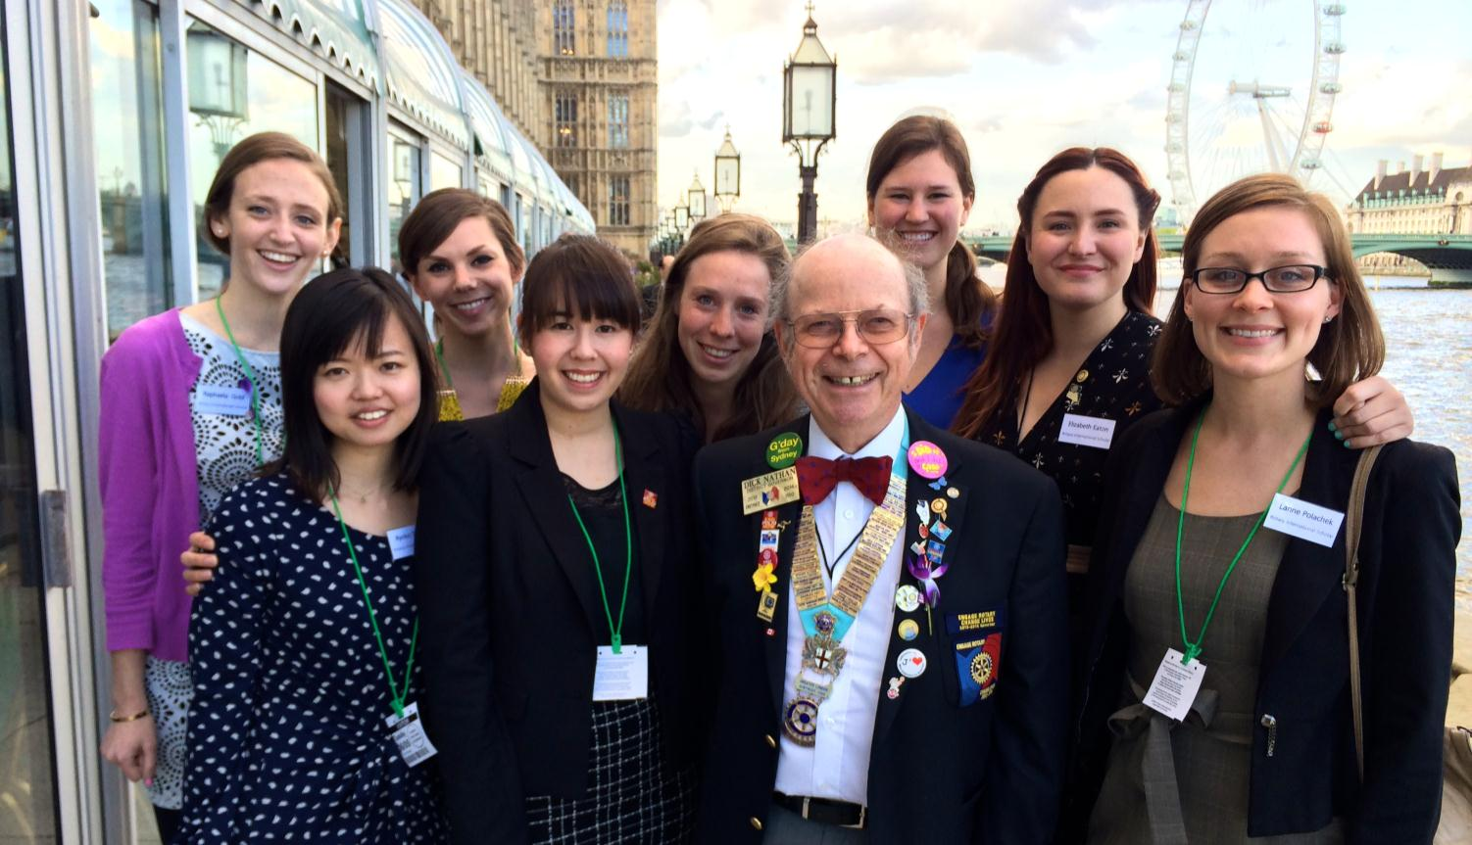
GLOBAL GRANT SCHOLARSHIP
Notes:
Rotarians in the US and the UK teamed up to provide a global grant scholarship to Reagan Thompson (center, back row) to receive a Master’s of Science (M.Sc.) degree in International Affairs with a Concentration in Conflict Prevention at the London School of Economics (LSE). Before beginning this program, she obtained a Master’s in Chinese Diplomacy at Peking University in China. She plans to pursue a career in government service focused on encouraging collaboration between the US and China. This grant falls within peace and conflict prevention/resolution area of focus.

Slide 11
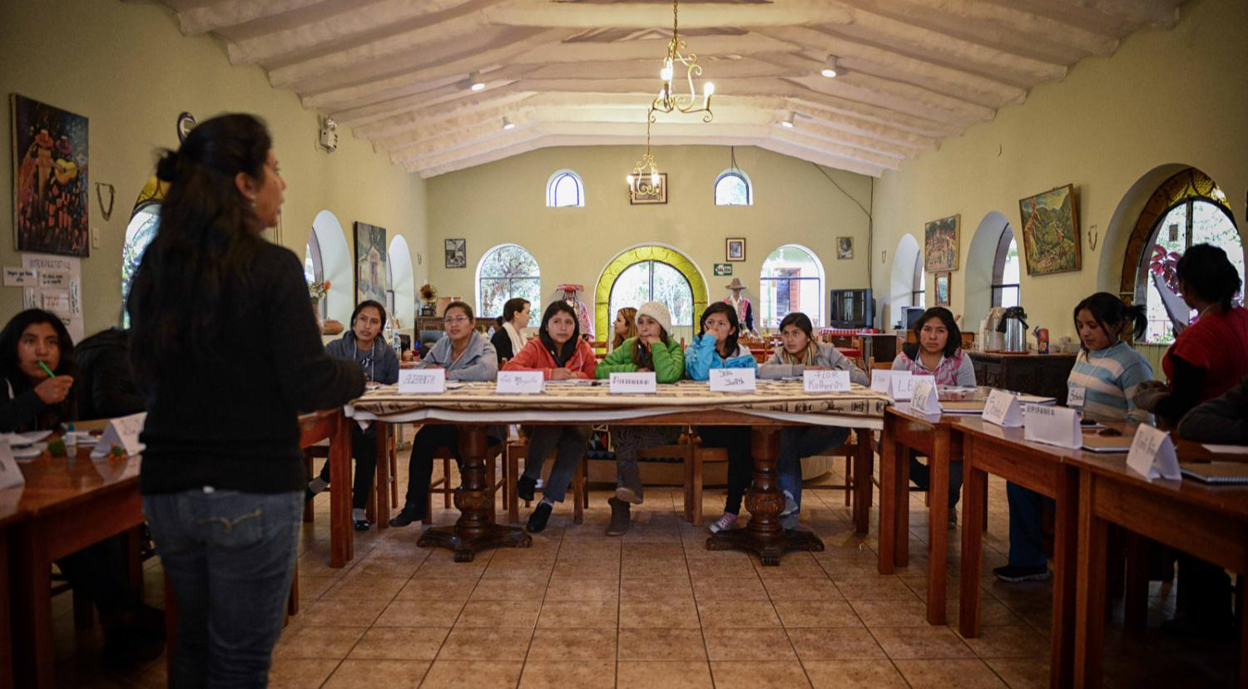
GLOBAL GRANT VOCATIONAL TRAINING TEAM
Notes:
Rotarians in Peru and the US worked together to get a global grant to support a leadership institute for young women in Peru. The goal of the program is to enhance the young Andean women’s self-awareness, leadership skills, and professional development to improve their opportunities to succeed academically and professionally. Secondly, the program engages the women to create their own visions for change and lead projects that deal with sustainable development initiatives appropriate for and desired by their families and communities. Rotarians from the US traveled to Peru to lend their professional expertise to the training sessions.

Slide 12
QUALIFICATION
District
Club

Slide 13
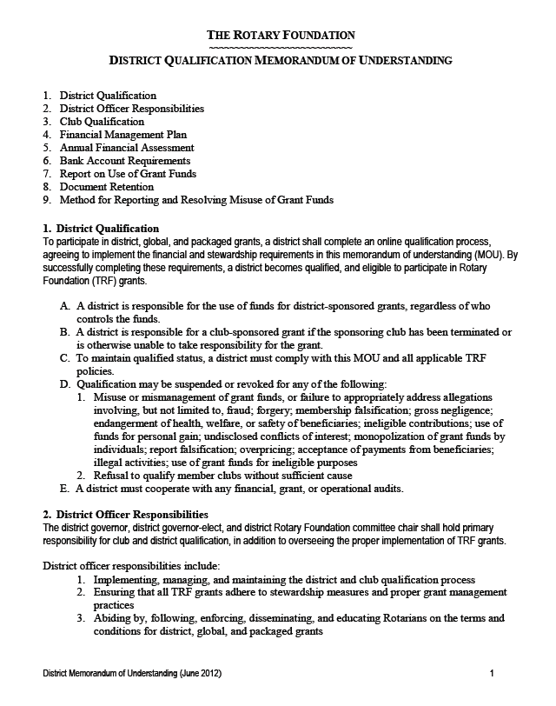
DISTRICT QUALIFICATION
  District leaders complete qualification process online annually
  Agree to implement MOU
  Conduct grant management seminars for clubs
Notes:
Districts must become qualified in order to receive grant funding from The Rotary Foundation. The online qualification process helps ensure that your district understands your financial responsibilities, including stewardship, and is prepared to take them on. Qualification must be completed each year.
Becoming qualified is simple. Your district governor, governor-elect, and Rotary Foundation chair should:
Read through the district qualification memorandum of understanding (MOU) on the grants application tool, answer a series of questions, and agree to the MOU
Conduct grant management seminars for clubs

Slide 14
CLUB QUALIFICATION
  Agree to implement the club MOU
  Send club member to grant management seminar sponsored by the district
  Complete any other district requirements
Notes:
Clubs that want to apply for global grants must also be qualified. Districts are responsible for qualifying their clubs each year. To become qualified, your president and president-elect must:
Agree to implement the club qualification MOU
Send at least one club member to a grant management seminar held by your district
Complete any additional steps that your district requires
Your club must qualify each year if you plan to apply for global grants.

Slide 15
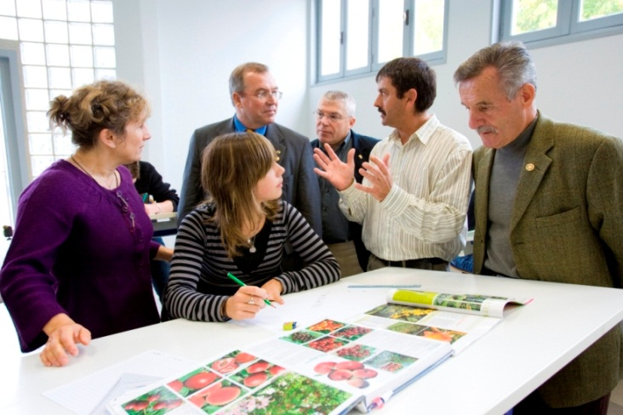
Financial Management Plan
Bank account for funds
Distributing funds
Use checks/bank cards to track funds
Detailed ledger
Include local laws

Slide 16

Document Retention
Provide access
  Maintain a copy of club qualification and grant documents on District Website
Retain for a minimum of five years
Make copies

Slide 17
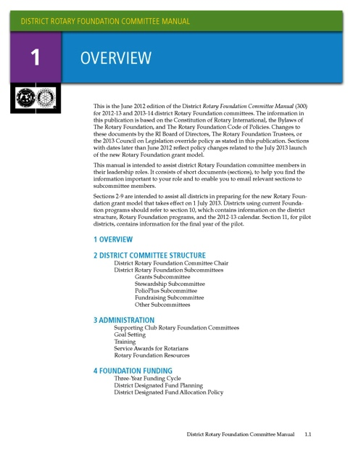

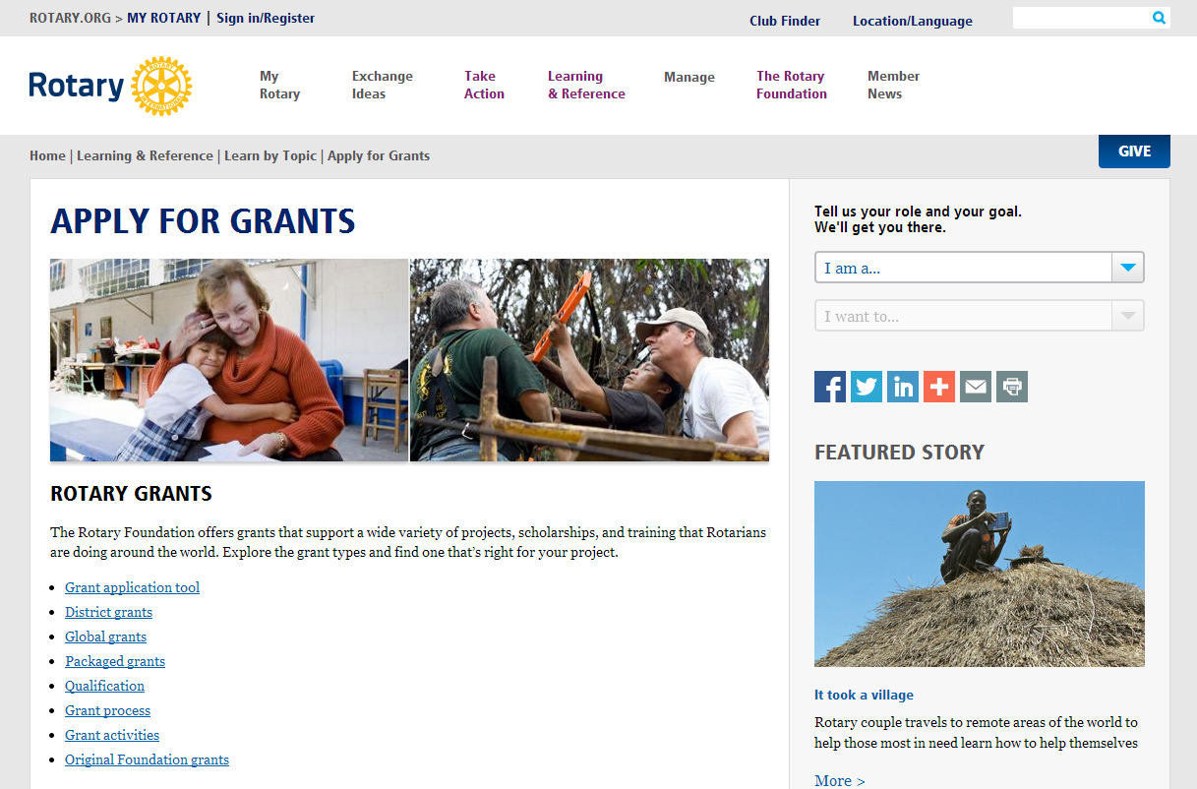
RESOURCES
  www.rotary.org/myrotary/grants
  Guide to Global Grants
  Learning center
  Training materials
  www.Rotary7870.com
Notes:
We have a number of resources available to help you take full advantage of grant opportunities.
Rotary’s website has a wealth of general and detailed information about grants.
The learning center offers training resources to help you apply for Foundation grants.
Our training manuals can help you successfully participate in grants, especially:
District Rotary Foundation Committee Manual
District Rotary Foundation Seminar Manual
Guide to Global Grants

Slide 18
Ways to Improve Your Global Grant Application
Notes:
This presentation will provide an overview of global grants and present ten ways that you can improve your global grant application.

Slide 19
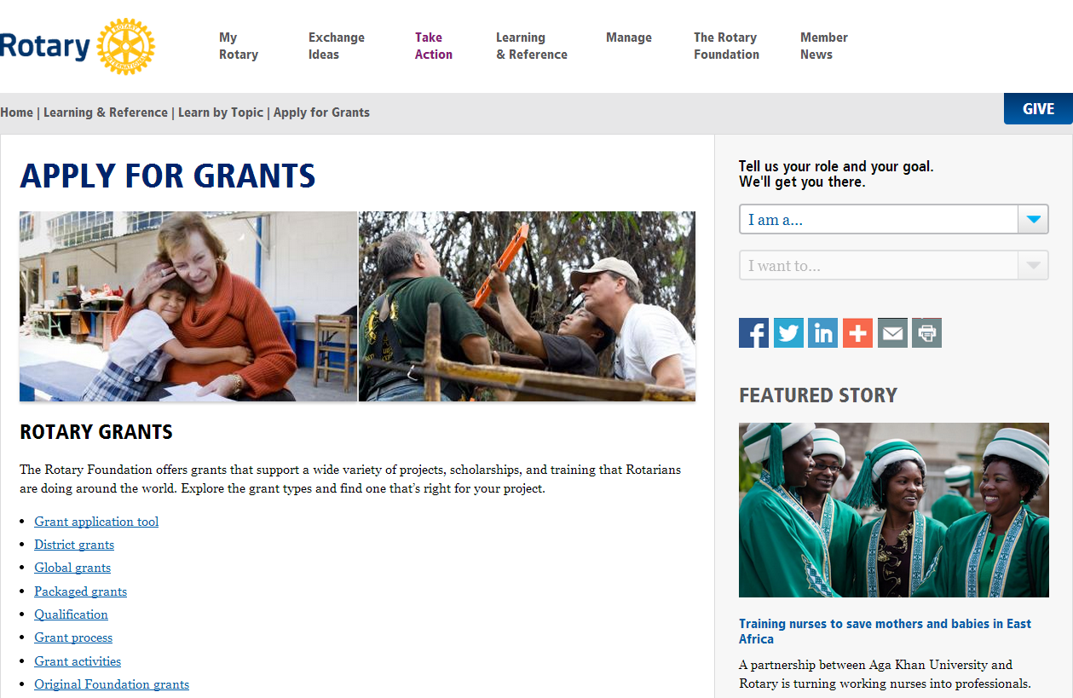
GLOBAL GRANT APPLICATION
Applications submitted online: www.rotary.org/grants
No application deadlines
Submit applications at least 90 days prior to travel
Notes:
Global grant applications are submitted online. The grant application tool is accessible by going to www.rotary.org/grants. Applications are accepted on a rolling basis throughout the year; there are no application deadlines. However, if your application includes travel, please ensure that it is submitted at least 90 days before the travel is scheduled to begin.
The following slides will discuss ten ways that you can improve your global grant application.

Slide 20
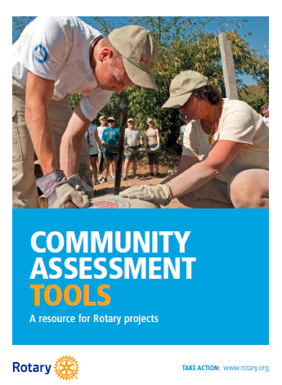
#1 NEEDS ASSESSMENT
Conduct thorough assessment of community needs and strengths
Talk to community members directly
Start with needs assessment rather than project plan
Notes:
Conduct a thorough assessment of community needs and strengths. Ask people what they have, how what they have can be better, or what they need in order to have better lives. If there’s a thorough understanding of community needs, the rest of the application comes much more naturally. Try to start the project with the beneficiaries rather than plan the project and then take it to the local community. Focus on a need that is local to you and your club if you can.
Rotary has resources available to help you conduct your needs assessment including the manual pictured here: Community Assessment Tools. This manual is available on Rotary’s website.

Slide 21
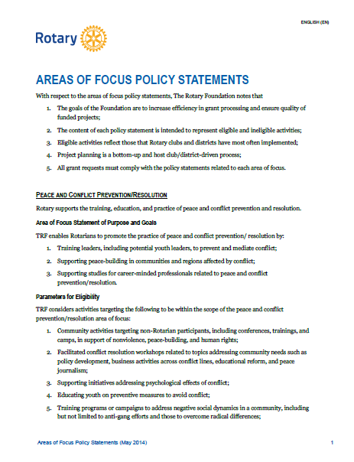
#2 AREA OF FOCUS
Review areas of focus policy statements
Identify most appropriate area of focus based on needs assessment
Design project based on identified area of focus
Ensure that all project activities relate to the area of focus goals
Notes:
Review the Areas of Focus policy statements. Based on needs assessment, identify just one (or only the most appropriate) area of focus. Avoid taking a “fully-baked” project and fitting it into one of the areas of focus. Change the approach to project design. Work and think through the policy statements before designing projects. All project activities should relate directly to the area of focus goals.

Slide 22
AREAS OF FOCUS
  Peace and conflict prevention/resolution
  Disease prevention and treatment
  Water and sanitation
  Maternal and child health
  Basic education and literacy
  Economic and community development
Notes:
We have identified specific causes to target to maximize our local and global impact. Through global grants we help clubs focus their service efforts in the following areas:
Peace and conflict prevention/resolution
Disease prevention and treatment
Water and sanitation
Maternal and child health
Basic education and literacy
Economic and community development

