Slide 1
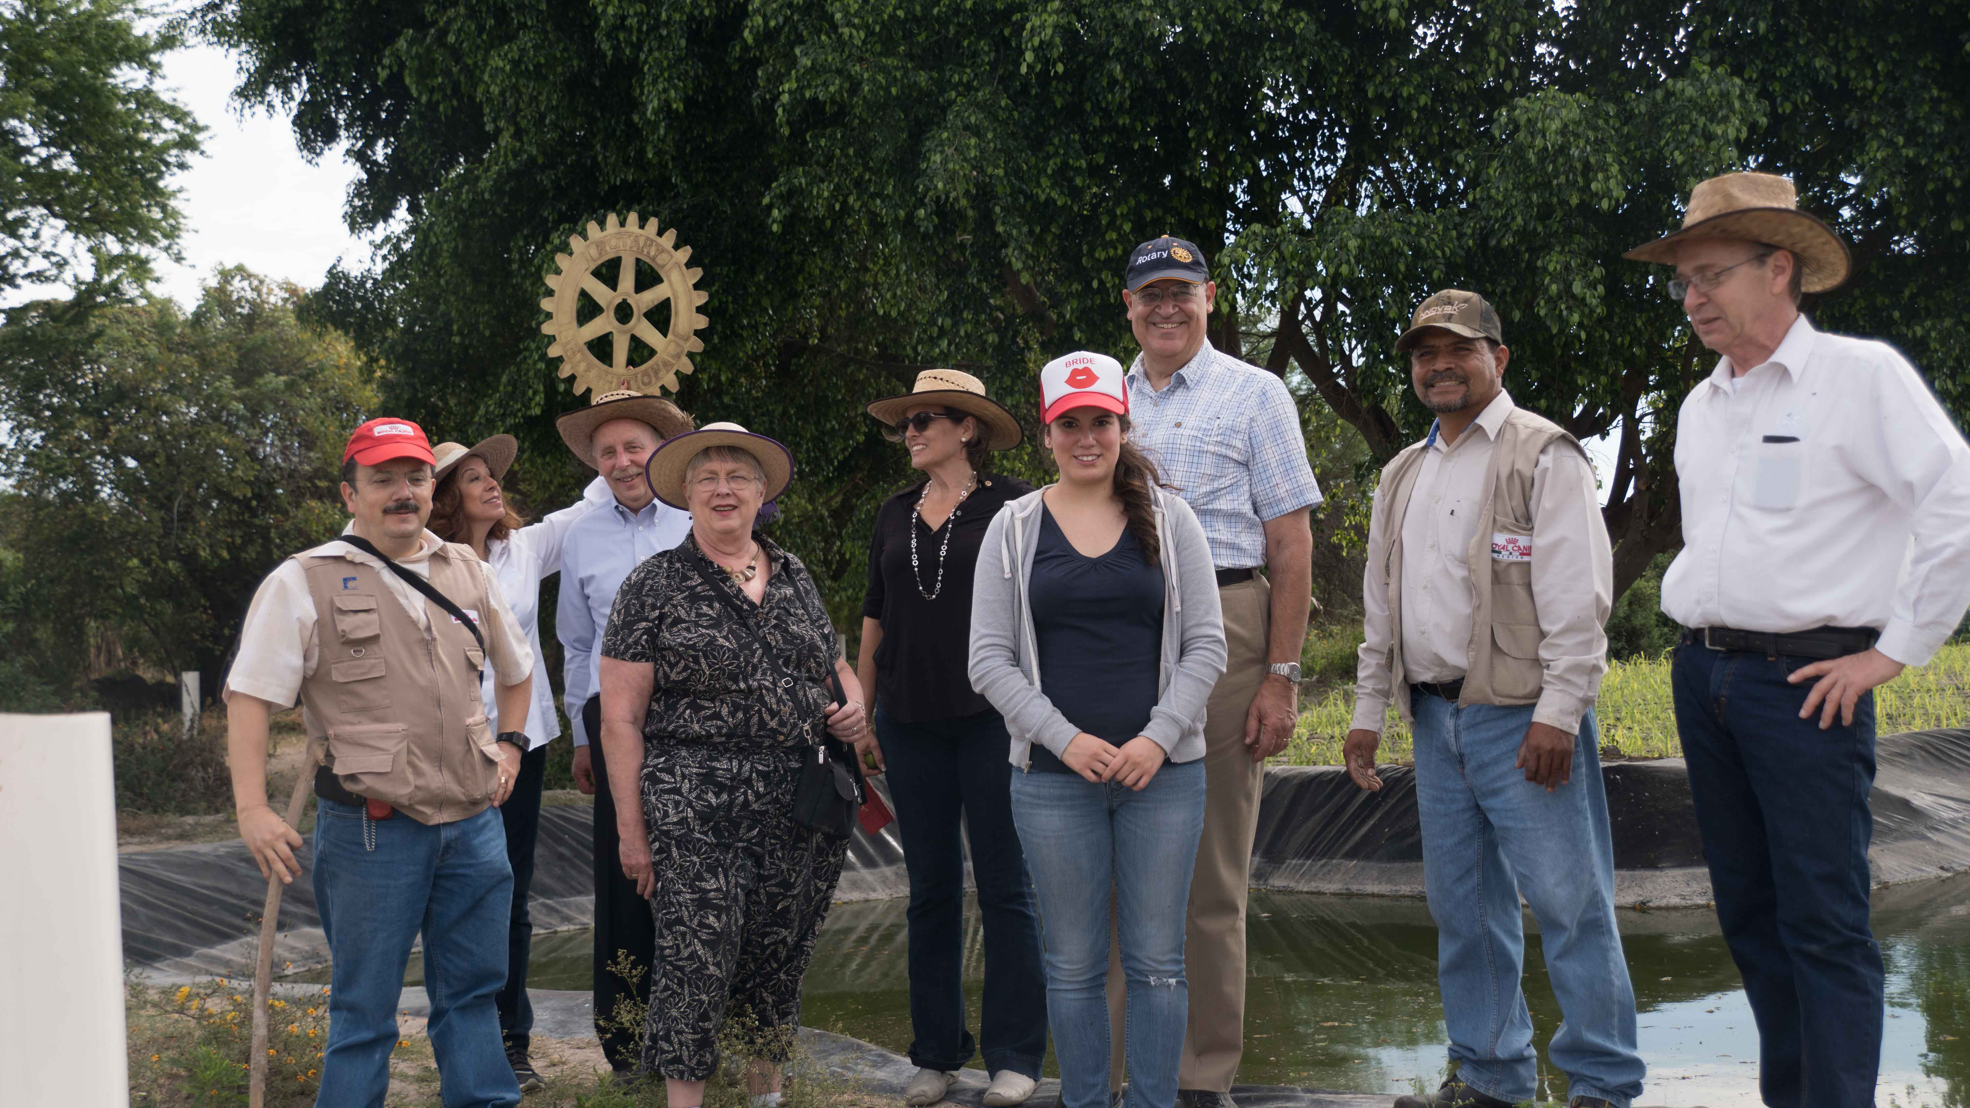
#3 DETAILED PROJECT PLAN
Provide detailed project implementation plan
Involve beneficiaries in project design
Notes:
Provide a detailed project implementation plan that encompasses all aspects of the proposed project activity. Ensure that beneficiaries were involved in project design.

Slide 2
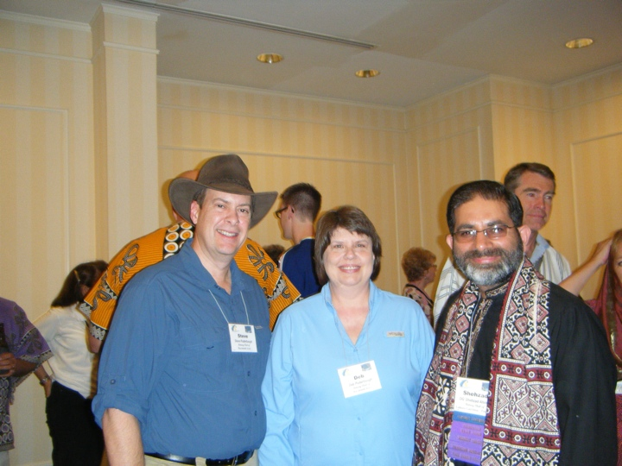
#4 ROTARIAN INVOLVEMENT
Provide detailed list of tasks for host and international Rotarians
Notes:
Provide a detailed listing of the specific tasks that both the host and international Rotarians will carry out in conjunction with the project.

Slide 3
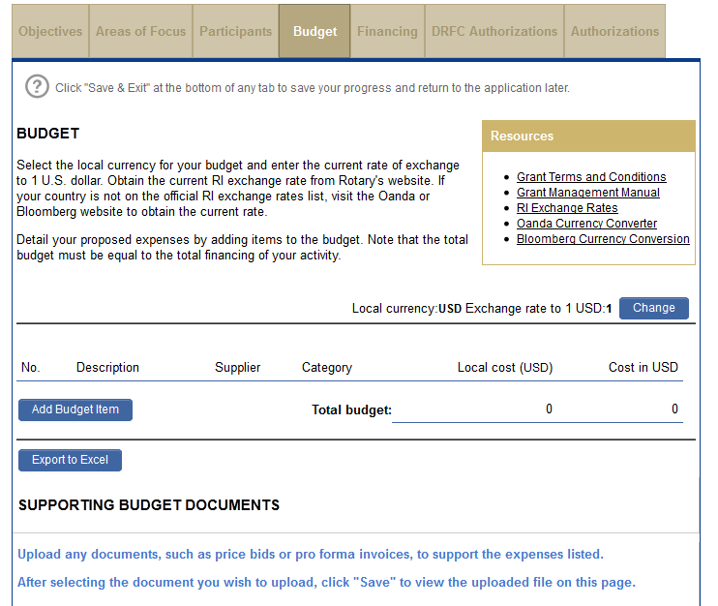
#5 BUDGET
Provide detailed budget
Include vendor information and explain how vendors were selected
Notes:
Provide a detailed budget with vendor information and information about how these vendors were selected. The image on the screen shows where you will enter the budget information in the online application.

Slide 4
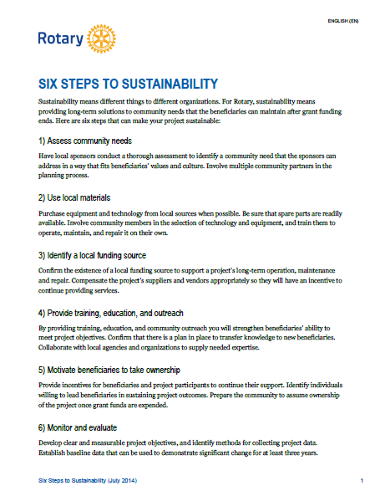
#6 SUSTAINABILITY
Clearly explain specific sustainability components
Notes:
Clearly explain specific sustainability components. We have a handout entitled “Six Steps to Sustainability” that provides helpful guidance about how to make your project more sustainable.

Slide 5
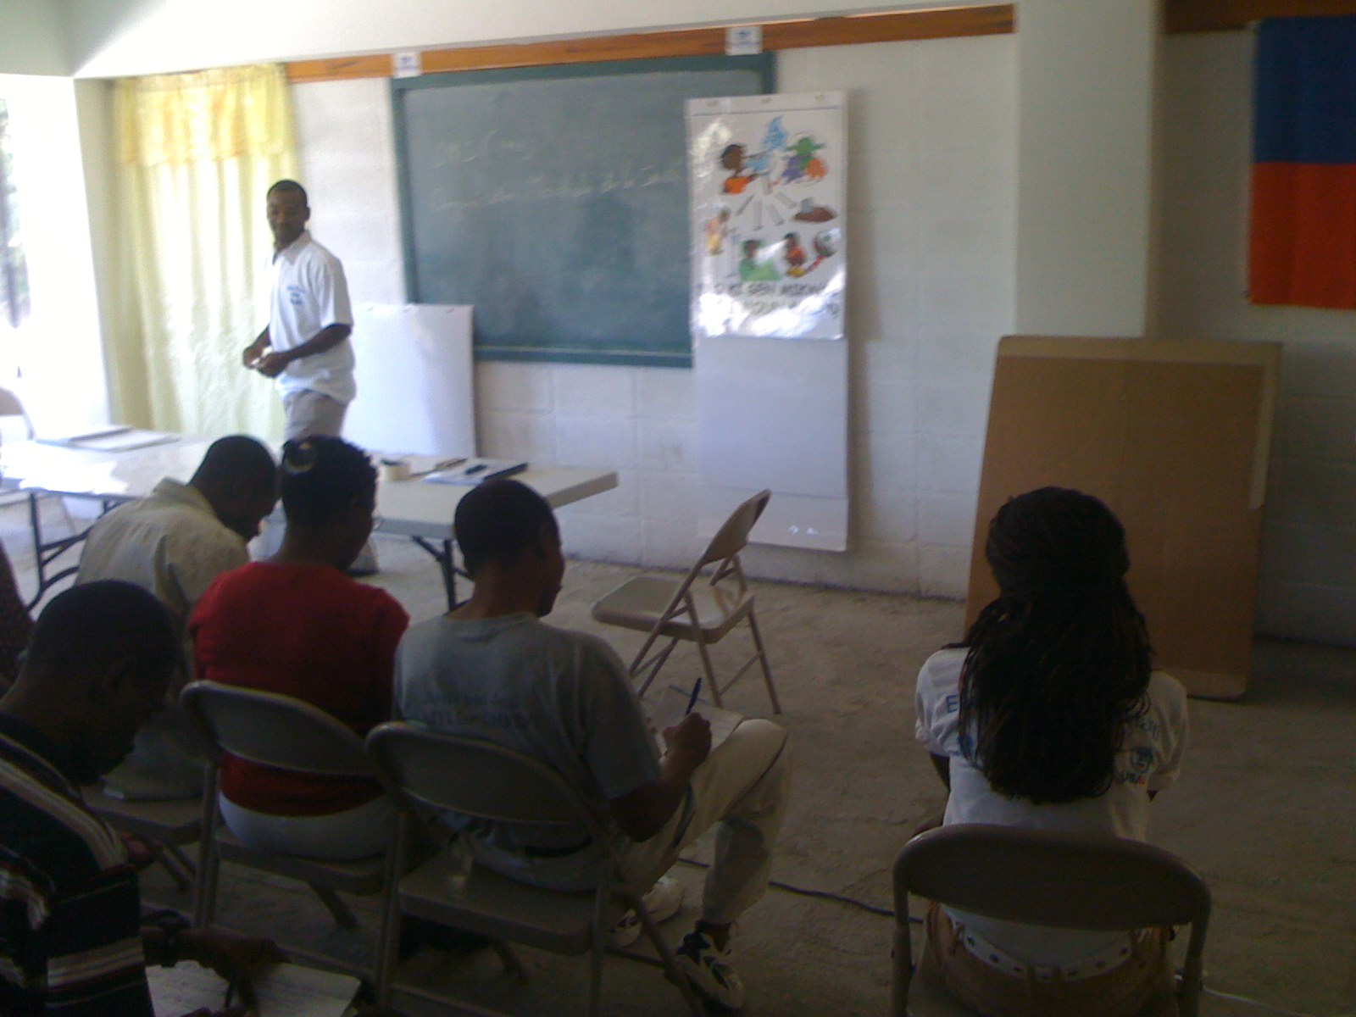
#7 TRAINING INFORMATION
Include detailed information for each training opportunity
  Frequency
  Curricula
  Target audience (specific beneficiaries, adults vs. children, etc.)
  Trainer
Notes:
Include detailed information for each training opportunity presented in application and include: frequency, curricula, exact beneficiaries, if training will be tailored for adults/children, who will be doing what for the training. Do not answer “not applicable” to this question. Training is applicable to all global grants.

Slide 6
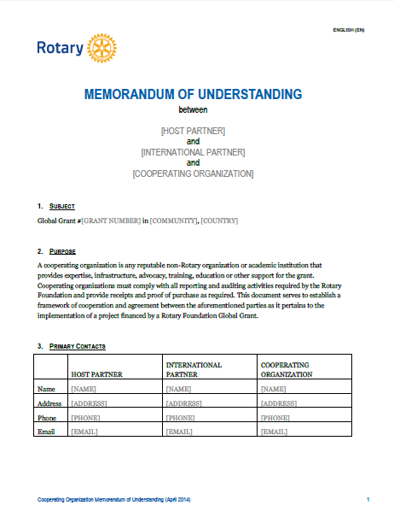
#8 COOPERATING ORGANIZATION MOU
Include MOUs for each cooperating organization
Notes:
You will complete a Memorandum of Understanding for each cooperating organization with which you’re working on the project. The MOU(s) will be included with the grant application.

Slide 7
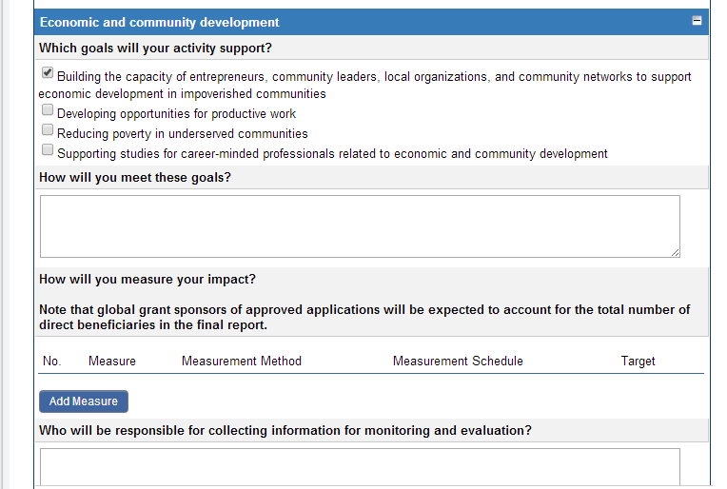
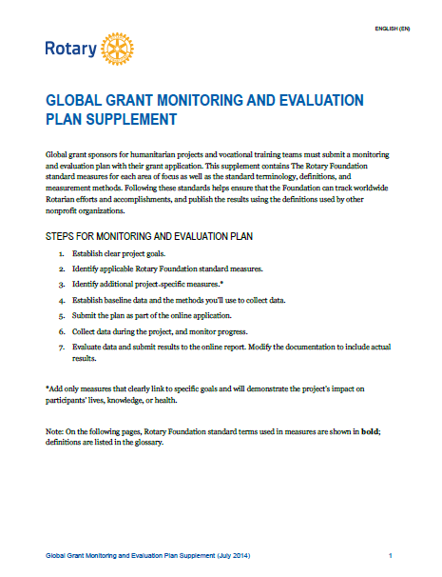
#9 MEASUREMENT AND EVALUATION
Include specific information related to measurement and evaluation
Notes:
Include specific information related to measurement and evaluation. The image on the screen shows where you will enter this information into the online system. We have resource materials to help you design your measurement and evaluation plan for your project.

Slide 8
#10 COMPLETE APPLICATION
Complete the entire application!
Notes:
Complete the entire application. If you leave parts of your application blank, it will likely result in delays in application processing.

Slide 9
Global Grant Reports: Frequency
Progress reports
  Within 12 months of first payment
  Every 12 months through the life of the grant
Final report within 2 months of completion

Slide 10
Global Grant Reports: Content
How partners were involved
Type of activity
Evaluation of project goals
How area of focus goals were met
How funds were spent
Number of beneficiaries and how they benefited

Slide 11
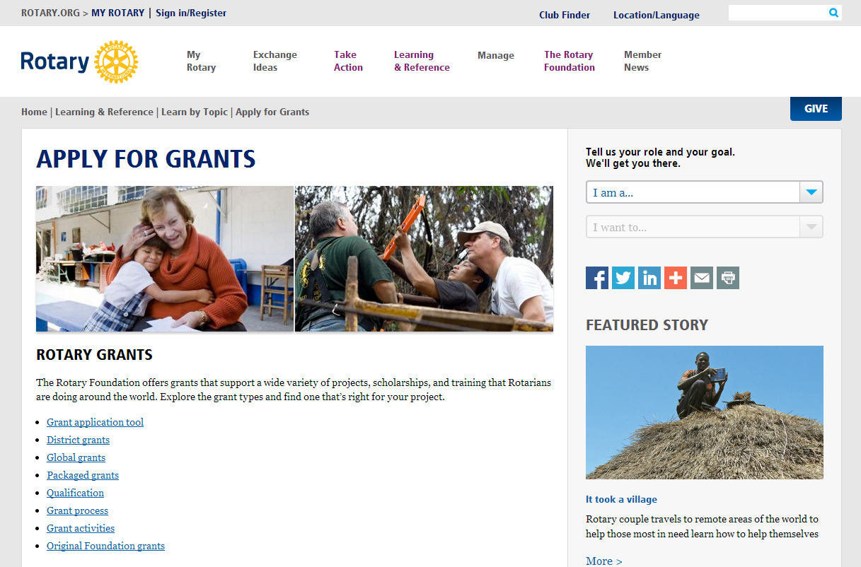

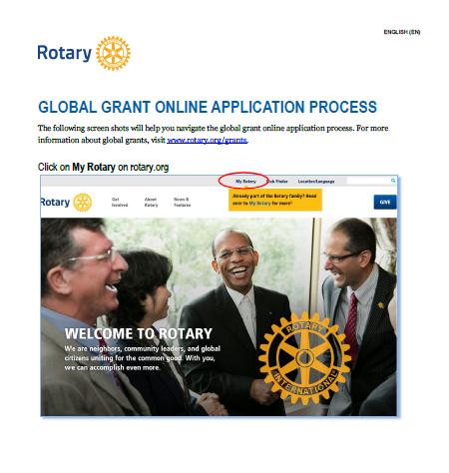
RESOURCES
www.rotary.org/myrotary/grants
Guide to Global Grants
Online application process aide
Learning Center
Rotary Support Center
Grants staff
Notes:
The following resources are available to assist you as you complete your global grant application:
www.rotary.org/myrotary/grants
Guide to Global Grants
A handout that walks you through the steps of using the online system to apply for a global grant
Rotary’s Learning Center
Rotary Support Center
Grants staff

Slide 12
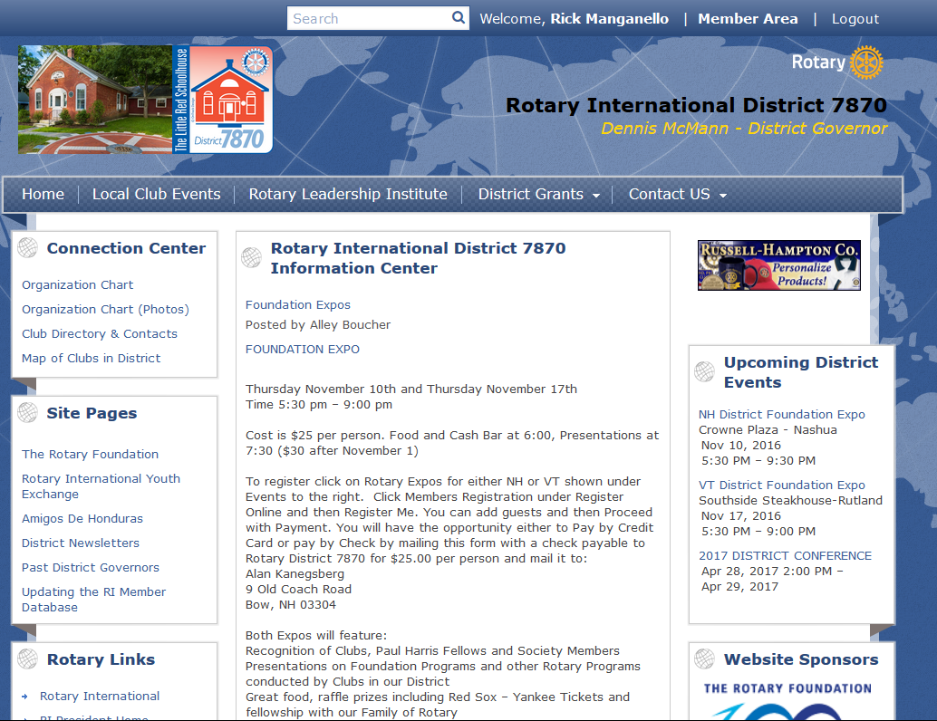
www.Rotary7870.org

Slide 13
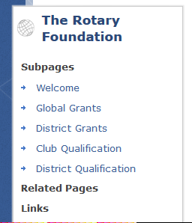
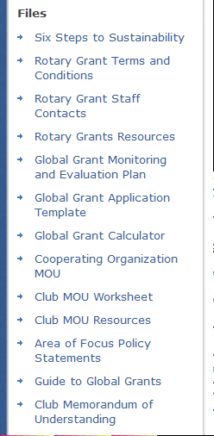
District 7870 Website

Slide 14

QUESTIONS?
  rotarysupportcenter@rotary.org
  DRFC Rick Manganello
    RotaryRick@Outlook.com

