Slide 1

2025-2026
GRANT MANAGEMENT TRAINING
District 7910
Saturday April 5, 2025
Ingrid Detweiler, DGSC Chair 2025-2026

Slide 2
Vision Of Rotary
International
Together, we see a world where people unite and take action to create lasting change — across the globe, in our communities, and in ourselves.
The Rotary Foundation
OUR MISSION
The Rotary Foundation helps Rotary members to advance world understanding, goodwill, and peace by improving health, providing quality education, improving the environment, and alleviating poverty.

Slide 3
Training Agenda
1. Foundation Grants Overview, Club Qualification
2. District Grants in 2025-2026
  Requirements, Process, Timeline, Grant amount, Prior Examples, ClubRunner, Grants Module, Implementation, Report, Close-out
3. Global Grants in 2025-2026
  Requirements, Process, Timeline, Grant amount, Prior Examples, Funding, Best practices, Implementation, Report and Close-out

Slide 4
FOUNDATION GRANTS

Slide 5
FOUNDATION FUNDS
Annual Fund – Share*, supports humanitarian grants, scholarships, vocational training in any of the 7 Areas of Focus, Local and International. A percentage of member contributions comes back to the District for matching grant requests.
Annual Fund – Area of Focus specific funds
Specific Global Grant, direct to specific projects
Polio Plus Fund, donations matched 2:1 by Gates Foundation
Disaster Response Fund, fast funding
Endowment Fund, major gifts or bequests of $10,000 or more.

Slide 6







Rotary 7 Areas Of Focus
Providing Clean Water
Fighting Disease
Enhancing Maternal and Child Health
Supporting Education and Literacy
Growing Local Economies
Promoting Peace
Protecting Our Environment

Slide 7

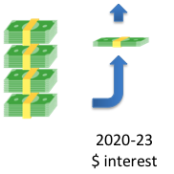

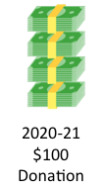

How Your AF-Share Donation Returns to D7910
$47.50
TRF
Holds Funds for
3 years.
Spends 5% + Interest to Manage Grants
World Fund
TRF
AF-Share
District Designated Fund
D7910
$47.50
District Grants
Global Grants
2022-23 $100
Donation
2025-26 $5 + $ interest

Slide 8

DISTRICT PROJECTS
Last 6 Years for District Grants
21
20
20
20
17
21
20
24
20
17
16
21
17
2016-17
2019-20
2020-21
2021-22
2022-23
2023-24
2024-25

Slide 9
THREE TYPES OF GRANTS
District Grants:
In 2024-2025 approximately $36,347 was available for clubs in our district
Funds smaller projects often local but can be international
Global Grants:
About $100,000 carried forward from past years
Another approximately $36,347 available to Clubs in our District
All international, for humanitarian projects, scholarships or vocational training
Disaster Response:
No District limit

Slide 10
TO BE QUALIFIED TO RECEIVE A GRANT
CLUB MUST
1. Sign Memorandum Of Understanding (MOU) by Club President President-Elect and Foundation Chair
  Have at least 1 club member who has completed Grant Training within the last 3 years.
  Appoint a Club Foundation Chair and List in Clubrunner
  Set Foundation Annual Fund Share Goal in Clubrunner
  Close previous year Club District Grant

Slide 11
MAINTAIN CLUB QUALIFICATION
Maintain good standing under the District rules
Comply with all qualification criteria
Ensure compliance with the Club MOU
  Appoint a club member or committee – Club Foundation Chair can lead the effort
Fully implement stewardship practices to prevent misuse of funds

Slide 12
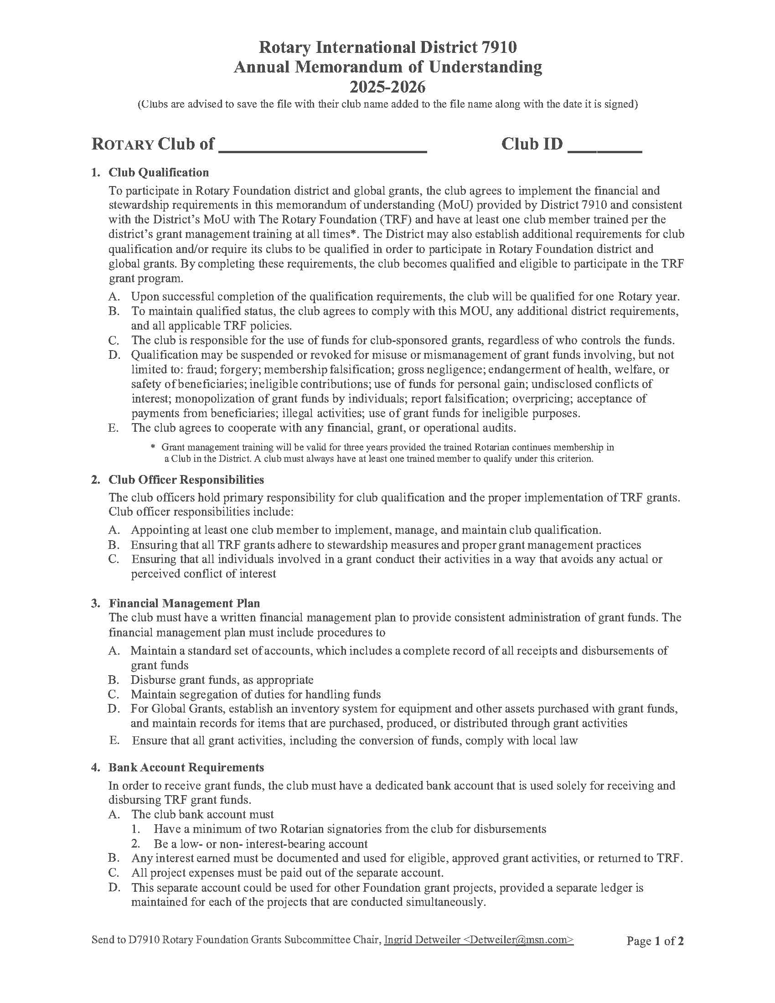

Slide 13
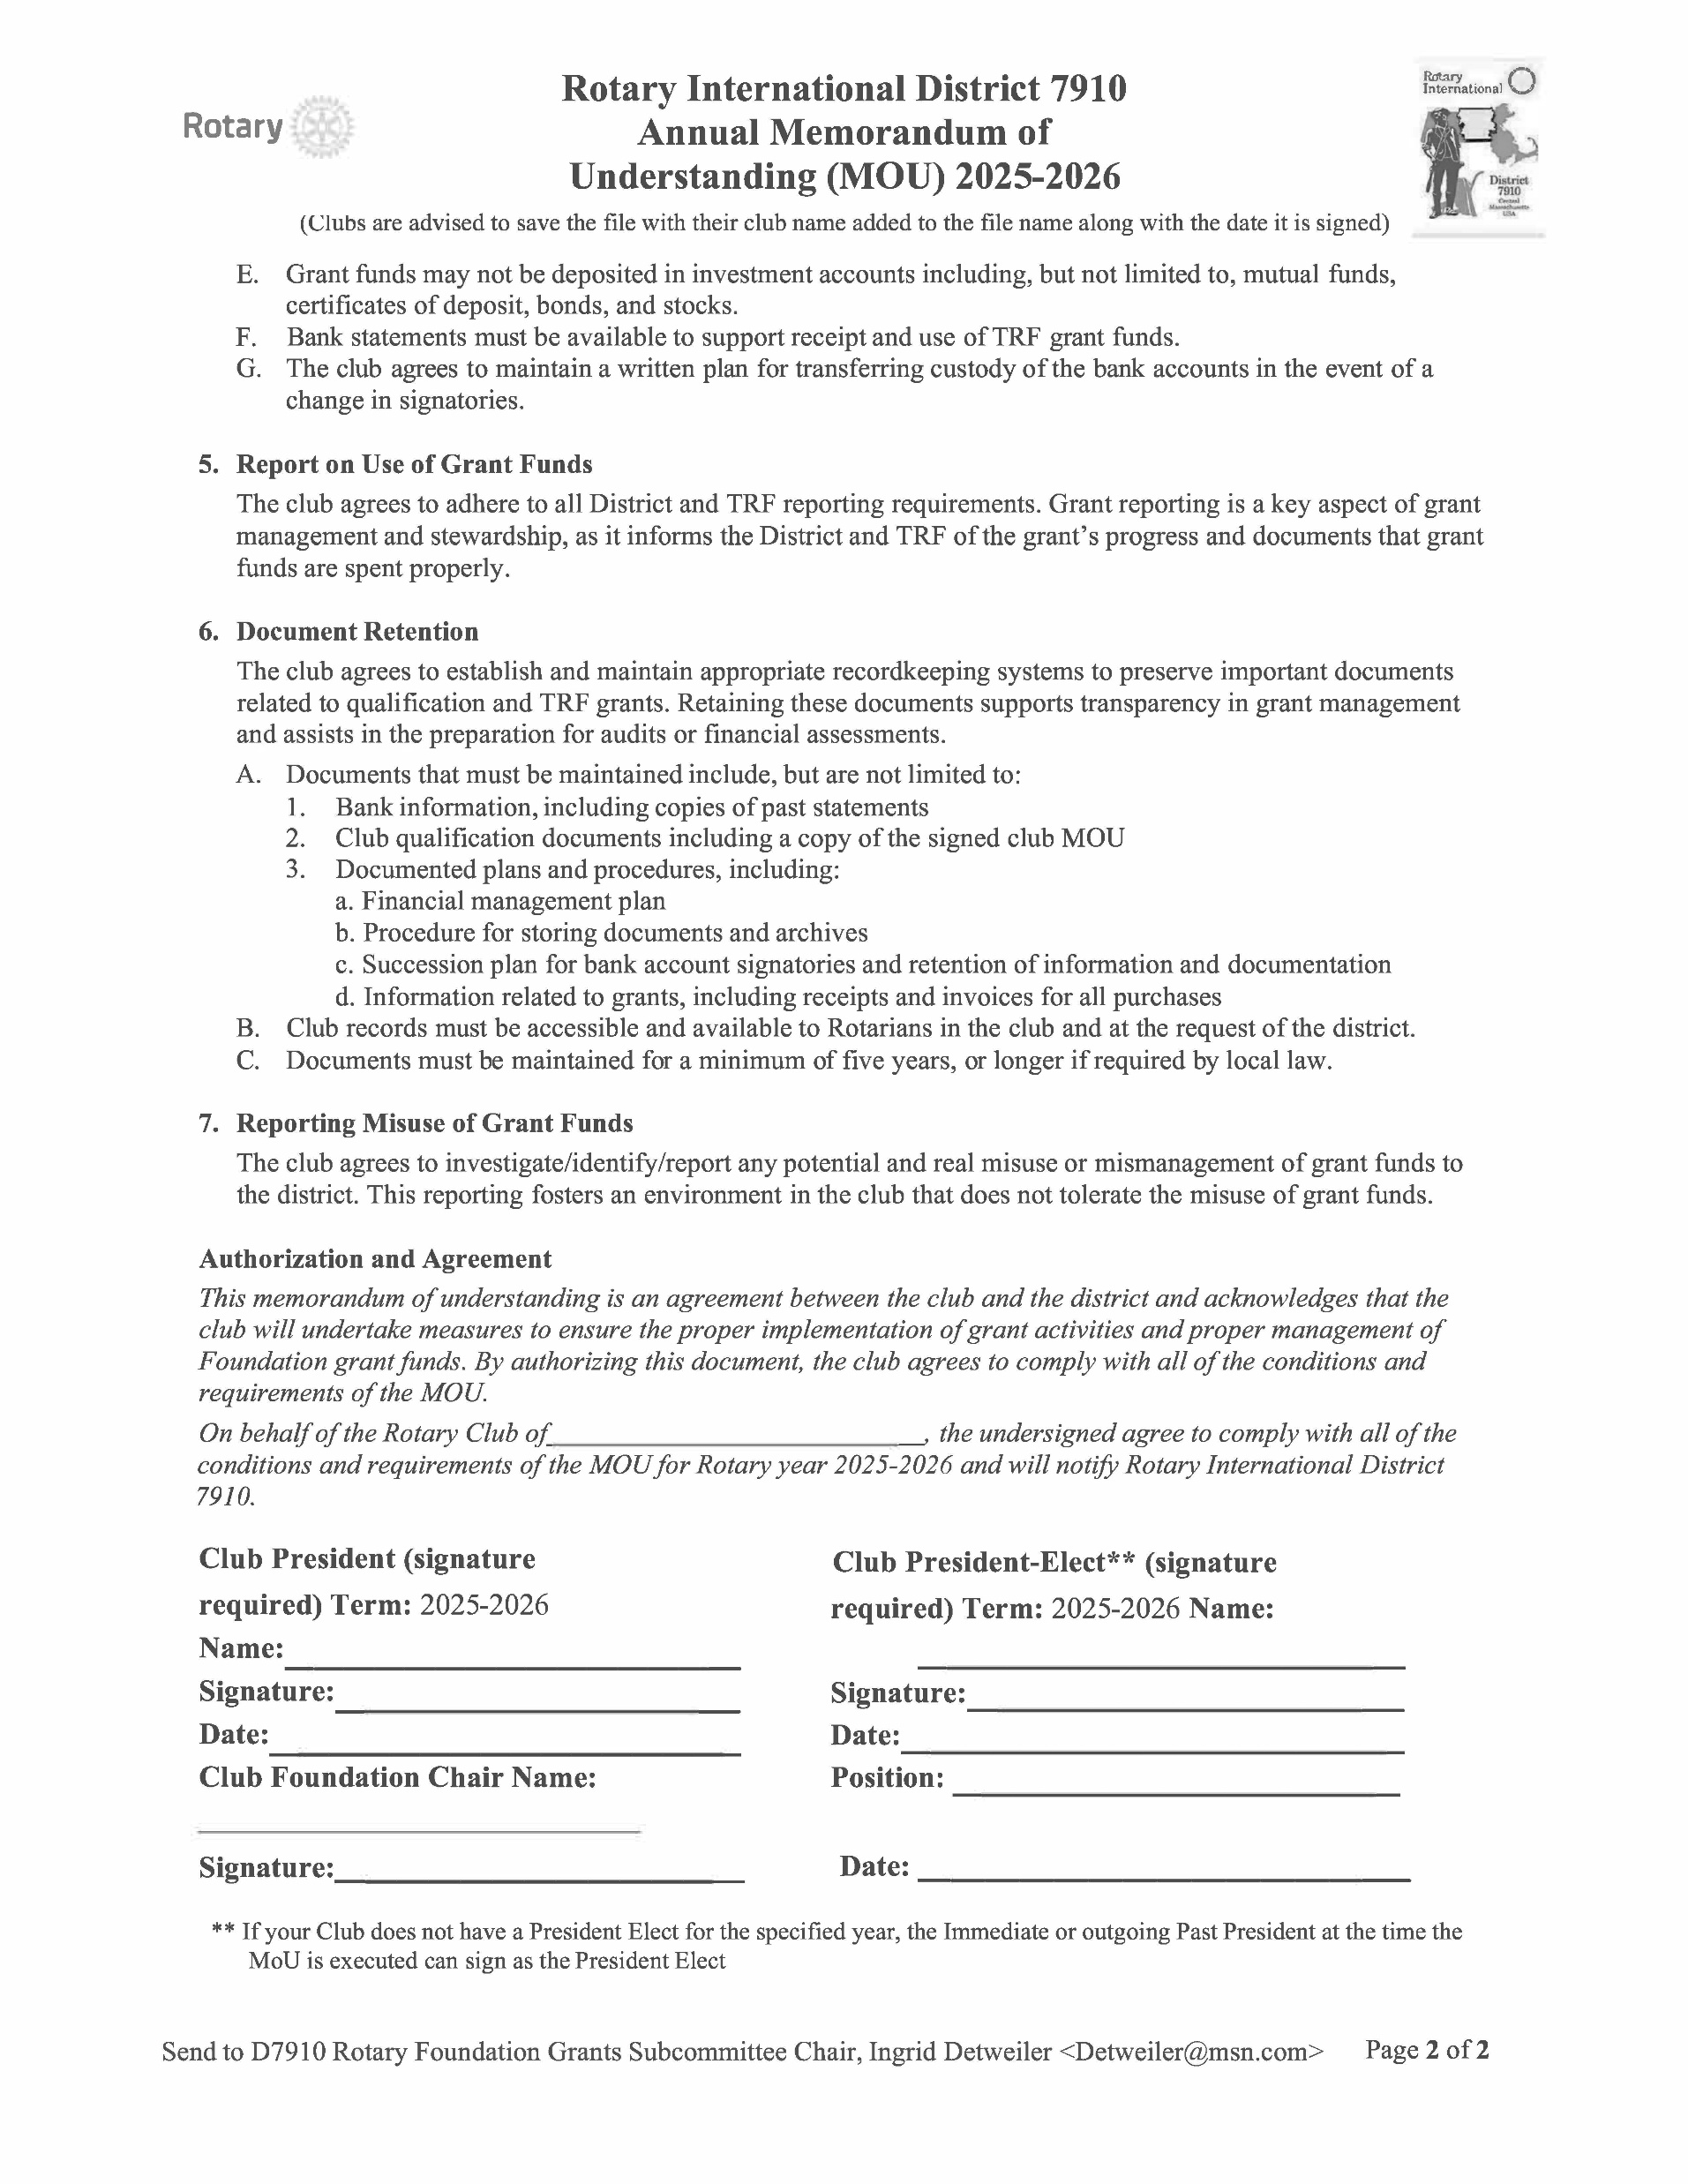

Slide 14
GRANT DISTRICT DECISIONS
Recommended by the District Grants Subcommittee
  Chair, DGSC Ingrid Detweiler.
  Some key decisions are:
    Approval of DDF for global and district grants, and other Foundation Funds
    Review procedures for applications including scoring rubric
    District sponsored grants to address common needs in communities
Recommendations are then endorsed by the District Rotary Foundation Committee
  Chair, DRFC Bob Worth
  For Global Grants the Foundation Advisory Board (FAB)
    comprising DG, DGN and DRFC reviews and approves.
TRF gives final approval then sends funds to the District

Slide 15
Foundation Advisory Board (FAB) 2025-2026
DG Johnny Ahern
Penny Hamel
FC Bob Worth
Foundation Chair Bob Worth
District Grants Subcommittee
Chair (DGSC) Ingrid Detweiler, RC of Concord
Joyce Fukami, Southboro. Would welcome a few more members who are Club Foundation Chairs.

Slide 16
        DISTRICT GRANT REQUIREMENTS
Fund small-scale, short-term projects that address immediate needs in your community or abroad
All projects must
  Relate to the mission of The Rotary Foundation
  Include the active participation of Rotarians
  Comply with conflict-of-interest policy
    No Rotarian benefits financially or personally from a grant
    Benefit cannot be direct to a Rotarian or indirect to an associate of the Rotarian
  Be a new project
  Cannot begin until aproved by the District
  Avoid continuous or excessive support of any one beneficiary, entity, or community

Slide 17
DISTRICT GRANT NOTES
Multi-club involvement and non-Rotarian participation in district grants is encouraged
Get ideas from past District Grant List
District sponsored projects focusing on common needs in multiple communities may be undertaken to get more clubs to participate
Only one District Grant per club – Rotary/Rotaract/Interact
Up to $3,000 may be requested. Range is $1,000 to $3,000

Slide 18
DISTRICT GRANTS 2024-2025
Rotary District 7910
District Grants 2024-2025
PROJECT | AREA OF FOCUS | PROJECT COST | GRANT REQUEST | 87% GRANT APPROVED
North Quabbin Trails Kiosk, & Performing Stage | ENVIRONMENT | 4,000.00 | $2,000.00 | $1,740.00
Reading Nooks in Schools Without Libraries | Basic education and literacy | 6,000.00 | $3,000.00 | $2,610.00
WCC Pollinator Habitat | ENVIRONMENT | 1,015.00 | $515.00 | $448.05
Food Insecurity - Helpiing Residents, Students and Veterans | Disease prevention and treatment | 5,000.00 | $2,500.00 | $2,175.00
Rain Barrel Envronmental Project | ENVIRONMENT | 4,000.00 | $2,000.00 | $1,740.00
Kairos Spring Farm | Disease prevention and treatment | 3,000.00 | $1,500.00 | $1,305.00
Lounge 250: Midtown West Concord | Economic and community development Economic and community development | 6,000.00 | $3,000.00 | $2,610.00
Support Veterans to improve their mental stability | Maternal And Child Healthcare | 4,000.00 | $2,000.00 | $1,740.00
Suitcases to Foster Dignity | Maternal and Child Health – too | 6,000.00 | $3,000.00 | $2,610.00
Handicap Toilets for West Brookfield Common Events | Water and Sanitation | 2,000.00 | $1,000.00 | $870.00
Westborough Farmer's Market Healthy Food Program | Economic and Community Development | 5,000.00 | $2,500.00 | $2,175.00
Turkey and ham for senior centers at hanksgiving and Christmas | Economic And Community Development | 4,000.00 | $2,000.00 | $1,740.00
Build-a-bed | Maternal and Child Health | 5,000.00 | $2,500.00 | $2,175.00
Sears Field Conservation | ENVIRONMENT | 3,000.00 | $1,500.00 | $1,305.00
Hope for the Hungry 2024 Multi Club | Maternal and Child Health | 15,000.00 | $6,000.00 | $5,220.00
Nutrition 68 2024-2025 | Maternal and child Health | 9,000.00 | $2,000.00 | $1,740.00
St. Paul's Soup Kitchen | Economic and Community Developme | 3,000.00 | $1,440.00 | $1,252.80
 |  | 85,015.00 | $38,455.00 | $33,455.85

Slide 19
SUCCESSFUL DISTRICT GRANTS
Have achievable goals
Meet community needs
Are sustainable
Involve a partner
  Other Rotary Club(s) or Non-Rotary entity(ies) (learn how another club has run a project)
  Help identify and recruit new members
Have an implementation plan
Maintain proper stewardship of funds

Slide 20
Accessing The District Grant Module
Step 1: Log into www.Rotary7910.org
Step 2: Click on Member Login and log in as a D7910 member
Step 3: Click on Member Area in the upper right-hand side
Step 4: Click on Grants and then on “Submit a Grant Request”
Step 5: Fill in Submit a Grant request and wait for approval
Step 6: Fill in Application Tab, Budget Tab, Documents Tab
Step 7: Complete and upload Rubric

Slide 23
Scoring Rubric – An Example
1 to 5 scale, 11 measures
Maximum score: 53, Minimum Required Score: 20
1 to 5 scale, 11 measures |  |  |  |  |  |  | "Project Score" is computed when the values you determine for each measure is entered in the "Value for Project" column.
Maximum score: 53, Minimum Required Score: 20
Evaluation Criteria |  | Score for different Values
Category | Measure | 1 | 2 | 3 | 4 | 5 | Value | Score
Impact | Beneficiaries | 1 to 5 | 6 to 8 | 9 to 15 | 16 to 25 | >25 | 100 | 5
 | DG Focus Area |  |  |  |  | Y or n | y | 5
Sponsor Club | Rotarians | 1 to 3 | 4 to 8 | 9 to12 | 13 to 20 | >20 | 20 | 4
 | Volunteer Hours | 1 to 5 | 6 to 10 | 11 to 20 | 21 to 30 | >30 | 300 | 5
 |  |  |  | y or n |  |  | n | 0
Non-Rotarian Entity | Funding support | $1 - 50 | $51-100 | $101-200 | $201-300 | >$300 | 200 | 3
 | Volunteers | 1 to 2 | 3 to 5 | 6 to 9 | 10 to 15 | >15 | 10 | 4
 | Volunteer Hours | 1 to 2 | 3 to 4 | 5 to 6 | 7 to 10 | >10 | 25 | 5
Other Rotary Clubs | Clubs |  |  | 1 |  | >1 | 1 | 3
 | Funding support | $1-50 | 51-100 | $101-200 | $201-300 | >$300 | 250 | 4
 | Volunteer Hours | 1 to 2 | 3 to 5 | 6 to 9 | 10 to 15 | >15 | 15 | 4
 |  |  |  |  |  | TOTAL SCORE |  | 42
Club Size
Less then 15
Smal

Slide 24
Application Content
Must-Provide Information
Tab/Section |  | Information that must be provided
DETAILS |  | Rotary Clubs in the District participating in the project
 |  | Non-Rotary entities participating in the project
APPLICATION | Impact | Number of beneficiaries
 |  | Focus Area
 | Co-Operating Organization | Cash Contribution of non-Rotary partners
 |  | Volunteers and volunteer hours from non-Rotarian partner
 | Implementation Plan | Number of Rotarians from sponsoring club participating
 |  | Rotarian volunteer hours from sponsoring club
 |  | Monetary contribution from other Rotary Clubs*
 |  | Number of Rotarians and volunteer hours from other RCs*.
* Participation by Interact and Rotaract Clubs will be deemed as “Other Rotary Clubs”

Slide 25

Pay Special Attention
Year at the top of the page says 2025-2026
Your club MUST be qualified in order to begin the application
  If club qualified last year, module will allow you to enter a grant in that year (2024-2025), but that will not count and may not be seen by the Grant committee.
Enter grant amount requested in the budget tab
Rubric score must exceed 20
Extra Points for DG Area Of Focus: To Be Determined

Slide 26
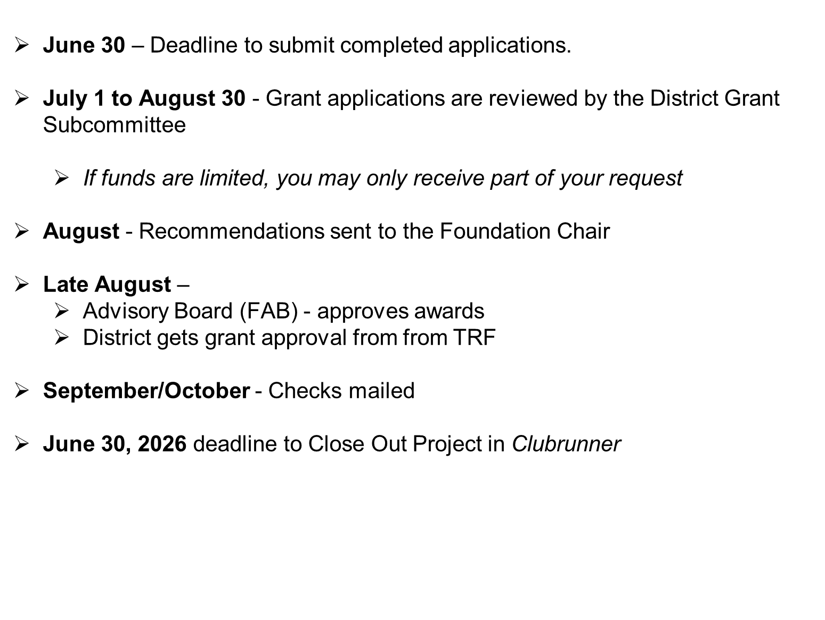
GRANT PROCESS

Slide 27
Before receiving your check…
1. Open a dedicated checking account
2. Deposit your club’s contribution into the account
3. Upload bank statement to Clubrunner showing your deposit
a. ALL project transactions must go through this account.
b. It is ok to lend money to the dedicated District Grant account, while you wait for your
check, and repay after receiving the check
4. Provide address where the check should be mailed.

Slide 28
CREATING A BUDGET
            Realistic
            Competitive bidding (costly items)
            Reasonable prices
            Avoid direct donations to beneficiaries
            Disclose conflicts of interest
                Partners, Beneficiaries or suppliers

Slide 29
DISTRICT GRANT IMPLEMENTATION
Conduct all activities described in the application
Inform the DGSC if any significant changes needed to be made
Document the activities of the project with pictures and reports
Keep records, receipts and retain them
Publicize the project on club and district web sites, social media and local media – newspapers, TV etc.

Slide 30
STEWARDSHIP
Stewardship is the responsible management and oversight of grant funds, including:
            Reporting any irregularities
            Financial records review
            Oversight of funds
            Avoid direct payment to beneficiaries
            Timely submission of reports
            All transactions through grant account

Slide 31
DISTRICT GRANT PROJECT REPORTS
Final Report submitted online in the tab “Individual Project Report”
    Answer 6 questions
    Fill out Final Accounting
Upload required supporting documents in the tab “documents”
    Bank statements (showing project costs. Funds received/spent)
    Copies of canceled checks
    Receipts/invoices for items purchased
    Photos of the project activities
    Acknowledgment letters from beneficiaries
    Ledger if necessary

Slide 32
DOCUMENT RETENTION
Provide access to documents for transparency
Even though district has uploaded docs, retain local copies for 5 years

Slide 33
GLOBAL GRANTS

Slide 34
TYPES OF GLOBAL GRANTS
Humanitarian Projects
Use our knowledge of local issues to identify areas of need, apply our expertise, and resources to produce sustainable, measurable outcomes
Scholarships
Fund international graduate-level study by someone seeking a career within an area of focus
Vocational Training
Groups of professionals travel abroad either to teach local professionals about their field or to learn more about it themselves

Slide 35
GLOBAL GRANTS
HUMANITARIAN PROJECTS
Support large international projects with long-term, sustainable outcomes in one or more of Rotary’s areas of focus
Minimum project budget is $30,000
Overseas projects must be in countries with Rotary Clubs (you’ll need a host Rotary Club to oversee the project).
All projects must
  Comply with conflict-of-interest policy
  Must avoid continuous or excessive support of any one beneficiary, entity, or community

Slide 36
Humanitarian Projects (continued)
Global Grants must start with a community assessment and address an existing need the local community has identified.
Must make a difference that is measurable.
Must be sustainable over the expected life of the project
Global Grants must actively involve Rotarians and community members
Selected partner club and the district are qualified to participate in global grants
  DRFC and DGSC can help
  Get advice from The Rotary Cadre of Technical Advisors offering experience in the area of focus Email: cadre@rotary.org

Slide 37
Partner Selection and Cooperation
Look for club(s) that have global grant experience
    Must be qualified for global grant participation for current year
    Strong in assessing community needs and conceiving a project
    Local initiative and inputs are critical to success
Agree on funding and implementing roles
    Insist on local club having “skin in the game”
    A “hand up” lasts much longer than a “hand out”
Develop clear understanding of stewardship and reporting responsibilities

Slide 38
Example Global Grant Projects
D7910 Rotary Club | Marlborough
Project Location | Uganda
Global Grant # | GG2350520
Project Title | Kira School Revitalization
Host RC &District | Kira, D9213
Primary Area of Focus | Basic Education, Literacy
Beneficiaries | Primary School Students
Over first five years | 4920
Total Budget | 31,247
D7910 Clubs’ cash | $11,430
DDF, World Fund Match | $20,605
#of Districts | 4

Slide 39
Example Global Grant Projects
D7910 Rotary Club | Westborough | Bedford
Project Location | Guatemala | Kenya
Global Grant # | GG2569435 | GG2458065
Project Title | Education Quality With Gender Perspective | Rainwater Catchment Tanks For Students
Host RC &District | Nueva Guatemala | Maseno, Kenya 9212
Primary Area of Focus | Basic Education & Literacy | Water Sanitation And Hygiene
Beneficiaries | Teachers & Students | Students & more
Over first five years | 2,400. to 6,500. | 6,000. to 11,000
Total Budget | $56,970 | $68600
D7910 Clubs’ cash | $5000 | $12,000.
DDF,World Fund Match | 51,970. | 56,600
#of Districts | 3 | 2

Slide 40
Global Grants Application Process
Two-step Process
District Application
  Purpose is to formulate your project plan and secure D7910 DDF
  Fill Out District’s Global Grant Proposal Form (2 pages plus attachments, if any)
    Complete the form, sign, scan and send with attachments
    Need written confirmation of approval by Club’s Board
    Need written evidence of cooperation by overseas partner
    Ask the overseas partner to confirm qualification status

Slide 41
Global Grants Application
2. TRF Application
Must NOT start before proposal is approved by Grants subcommittee and FAB
District will set aside DDF for the project
  Start with a “Needs Assessment” per the template from TRF; and upload it within the on-line application
  TRF grant application is in the Grant Center of My Rotary, all entered online
      Project committees of both host and international clubs are listed
      Budget and financing tables are entered (with written commitments)
      Be sure that all your plans are in place before you start to write the grant
      Consult with DGSC and DRFC frequently
      Be sure to answer the questions! Be specific!
      TRF will ask additional questions for clarification
      Allow 8 to 12 weeks for completing the 12 steps

Slide 42
CREATING A BUDGET
Realistic
Competitive bidding
Reasonable prices
Allow for contingencies up to 10%
  After implementation, unused amount will need to be returned to TRF
Disclose conflicts of interest
    Partners, Beneficiaries or suppliers

Slide 43
GLOBAL GRANT FINANCING
Minimum budget for a global grant is US $30,000
Clubs must contribute 100% match for DDF
DDF matched 80% with World Fund
Funds sent to TRF earmarked for the project are charged a 5% administrative fee
Funds sent straight to the Operating account of the Project are not charged an administrative fee
International sponsors provide at least 30% of total sponsor funding
Funds cannot be raised from beneficiaries or cooperating organizations in exchange for a grant, or from other Rotary grants

Slide 44
GLOBAL GRANT FINANCING CALCULATION
.
Club Cash = $11,000 +$550 Admin Fee(5%)
DDF = $11,000
WF = $ 8,800
Total = $30,800.
Other Clubs and Districts = ??

Slide 45
  Same Guidelines as for District Grants
  Set SMART Goals
    Specific, Measurable, Achievable, Realistic, Time-specific
  Stewardship
  Financial Management Plan
  Document Retention
    For a minimum 5 years
  Reporting Requirements
    Progress report entered once every 12 months
    Final report due 2 months after project completion
    District can be penalized for failure to comply
  Greater responsibility usually falls on the host club. But the D-7910 Club must bear a fair share

Slide 46
Expect TRF to ask questions:
Does project fall within one of the seven the Areas of Focus?
Is Project Sustainable?
Can results be measured?

Slide 47
  Participating in Global Grants as a
  non-International Partner
  Under Certain Circumstances it is possible to receive District 7910 DDF funds
    You (or your club) contributes to a Global Grant project (with some other Host and International Partner clubs)
    You (or your club) actively participate in the execution of the project (e.g., your expertise is valuable and used to teach the community, or you participate in a building activity on site)

Slide 48
GLOBAL SCHOLARSHIP GRANT
Minimum $30,0000
For 1 year of Graduate Study
Relate to one of the 7 Focus Areas
Have a host club who will assist the student
Typically all funding comes from the International Club
In District 7910 we have the Morley Scholarship given to an outbound scholar.

Slide 49
Rotary Disaster Response Grant
Relates to Rotary mission
Involves active participation of Rotarians
Maximum grant of 25K to qualified districts
Typically given to impacted districts, but not always
Expedited TRF review

Slide 50
Q&A
and
Wrap-up

