Slide 1
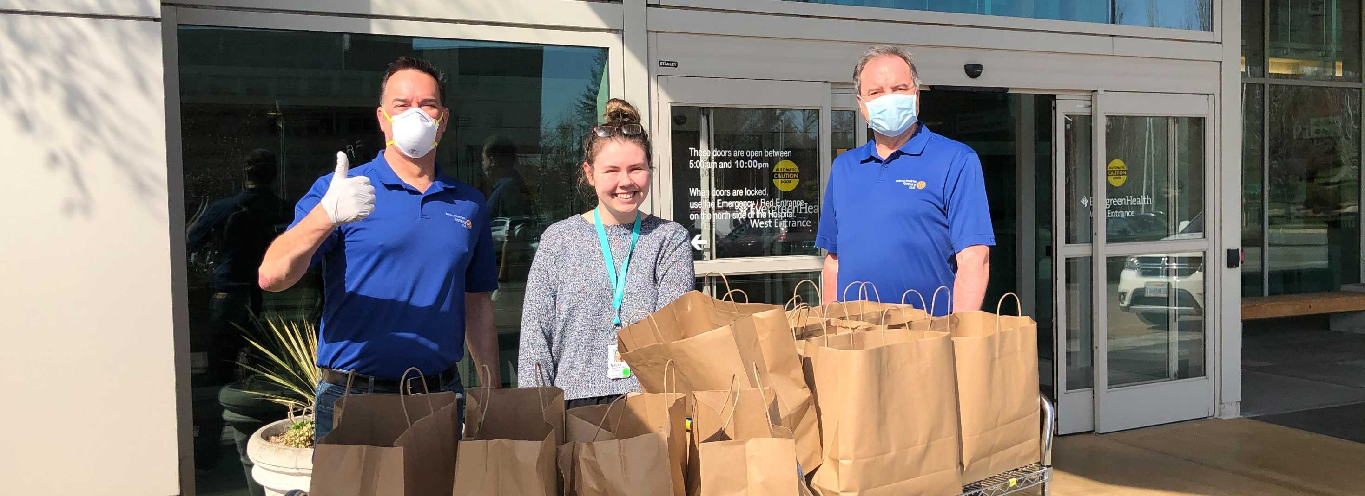
The state of rotary membership
As of 1 July 2020
Notes:
NOTES TO SPEAKER: Customize this presentation to meet your region’s needs. At minimum, you will need to customize slide 5: Where you see X’s, replace them with data from Rotary Club Central or delete them. Unhide the slide (use the Slide Show menu) so it’s visible during the presentation. Make comparisons between regional and global trends.
SPEAKER:
Our members are our greatest assets. And when Rotary’s membership is strong, our clubs are more vibrant, Rotary has greater visibility, and our members have more resources to help communities flourish.
Growing Rotary’s membership is Rotary International’s highest internal organizational priority, while polio eradication remains Rotary’s highest external program priority. When we grow Rotary, we grow our service and the impact of our projects; we grow the awareness and understanding of Rotary in our communities; and most importantly, we grow our membership so that we can achieve more.
I’m going to share information about the current state of our membership, and ideas for how to increase our impact, expand our reach, enhance participant engagement, and increase our ability to adapt.
Over the past five years, we’ve remained at around 1.2 million members. Without question, COVID-19 has posed new and previously unimaginable challenges for us. But within every challenge is perhaps an even greater opportunity. And although we experienced a 14,000-member decline, overall our membership is still strong because of the way our members continue to adapt.
To accomplish all the good in the world that we want to do, we need a commitment and a continued emphasis on growing Rotary and Rotaract from our club, district, and zone leaders.

Slide 2
As of
rOTARACT
rOTARY
1,174,890
-14,576 since 1 July 2019
202,738
+13,369 since 1 July 2019
MEMBERS
36,159
+269 since 1 July 2019
10,592
+419 since 1 July 2019
CLUBS
24%
50%
WOMEN
WOMEN
1 July 2020
Notes:
You’ll notice that this slide includes trends for both Rotary and Rotaract. Overwhelmingly, we have heard that Rotaract was more than just a Rotary club-sponsored program and Rotaractors wanted more flexibility, more products and services, and more recognition from Rotary for the amazing work they’re doing in their clubs, districts, and beyond. The 2019 Council on Legislation amended the constitutional documents of Rotary International to include Rotaract clubs as a unique membership type of Rotary International. This action elevates Rotaract and positions Rotary for a future that is innovative, inclusive, and adapting to the world around us.
As of 1 July:
The number of clubs has grown in both Rotary and Rotaract. Starting new clubs expands our reach and increases our capacity for service around the world. In addition to traditional Rotary clubs, new club models, including satellite clubs, corporate clubs, and passport clubs, bring together friends, neighbors, and problem-solvers who see a world where people unite and take action to create lasting change.
Rotaract has achieved gender parity, with women representing 50 percent of their membership. Women make up 24 percent of Rotary members, an increase of about 1 percent since 1 July 2019. The Board of Directors set a goal for women to make up 30 percent of our members and leaders by June 2023 and has made public their commitment to diversity, equity and inclusion by working to open opportunities and create experiences where all people feel welcomed, respected, and valued.

Slide 3


ROTARY CLUB MEMBERSHIP BY REGION: | 2020 | 2015
Asia | 33% | 30%
Canada, the Caribbean, and the United States | 28% | 30%
Africa, Europe and the Middle East | 25% | 25%
Latin America | 8% | 8%
Great Britain and Ireland | 4% | 4%
Australia, New Zealand, and the Pacific Islands | 3% | 3%
Percentages may not sum to 100% due to rounding
Notes:
In the past 5 years, we’ve seen a change in the regional makeup of our Rotary membership, especially if you compare Canada, the, Caribbean and the United States to Asia. In the past 5 years Canada, the Caribbean and the United states lost almost 30,000 while Asia has added over 18,000 members and continues to grow, especially in the regions of India, the Philippines and Southeast Asia.

Slide 4
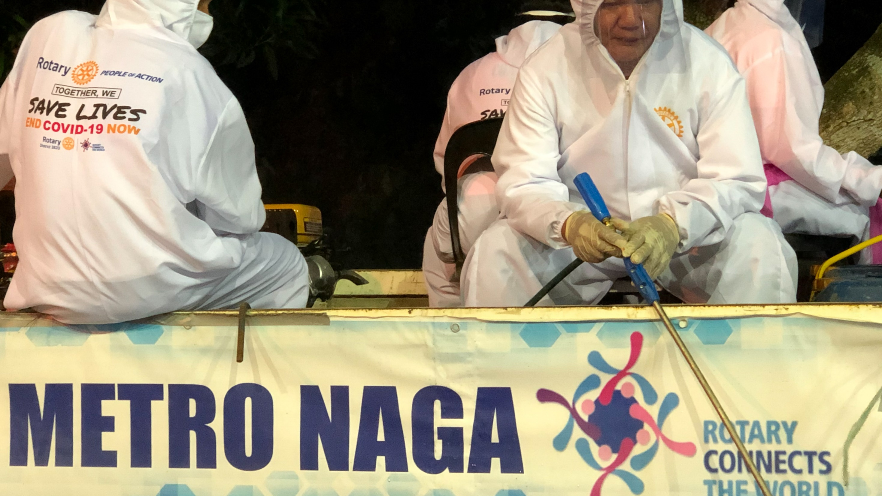


Membership gains
& losses 2019-2020
145,000 members
18,000 left
before their first
full year
142,000 MEMBERS
Notes:
The desire to increase membership often results in a focus on adding new members to clubs and overlooks the importance of delivering an engaging experience for current members. Last Rotary year, we welcomed nearly 145,000 new members into our clubs. Unfortunately, approximately 18,000 of these new members terminated their membership within their first year. In addition, more than 142,000 existing Rotarians also left Rotary last year. Retaining our existing members remains a both a challenge and an opportunity.
RI President Holger Knaack reminds us, “We need to stop thinking of new members as people we can mark down as statistics and then forget about. Every new member changes us a little bit. That person brings a new perspective, new experiences. We need to embrace this constant renewal. We will grow stronger as we learn from new members.”

Slide 5
District xxxx:
XXXX MEMBERS
+/- XXX from 2017
XX CLUBS
+/- XXX from 2017
TREND, AS OF (INSERT DATE) | DISTRICT | WORLDWIDE
Men / Women | XX% / XX% | 76% / 24%
New Member Retention | XX% | 79%
Existing Member Retention | XX% | 77%
Members Under Age 50 | XX% | 16%
Members 50+ | XX% | 46%
Age Not Reported | XX% | 37%
Notes:
NOTE TO SPEAKER: Age and gender trends are found on the dashboard of Rotary Club Central. To populate this slide with district-specific data, leaders at the district-level and above can access the District Membership Profile for your district, under the Reports section of Rotary Club Central.
Where you see X’s on the slide and in the notes below, replace them with data from Rotary Club Central or delete them. Unhide the slide (use the Slide Show menu) so it’s visible during the presentation. Draw comparisons between regional and global trends, and add your own observations.
SPEAKER:
Here’s the district profile for DXXXX, as of <XXdateXX>.
GENERAL MEMBERSHIP TREND
Currently we have xx clubs and xxxx members.
RETENTION
Our district’s retention profile for existing and new members is shown here:
xx percent of members who joined before 1 July of this year are still members.
xx percent of members who joined after 1 July of this year are still members.
[Add your observations:]
AGE AND GENDER PROFILE
Our district’s members are xx percent men and xx percent women, and this has changed [greatly/a little/somewhat] over three years. xx percent of members are under the age of 40, and xx percent have not reported their age to Rotary International.
[Add your observations:]

Slide 6
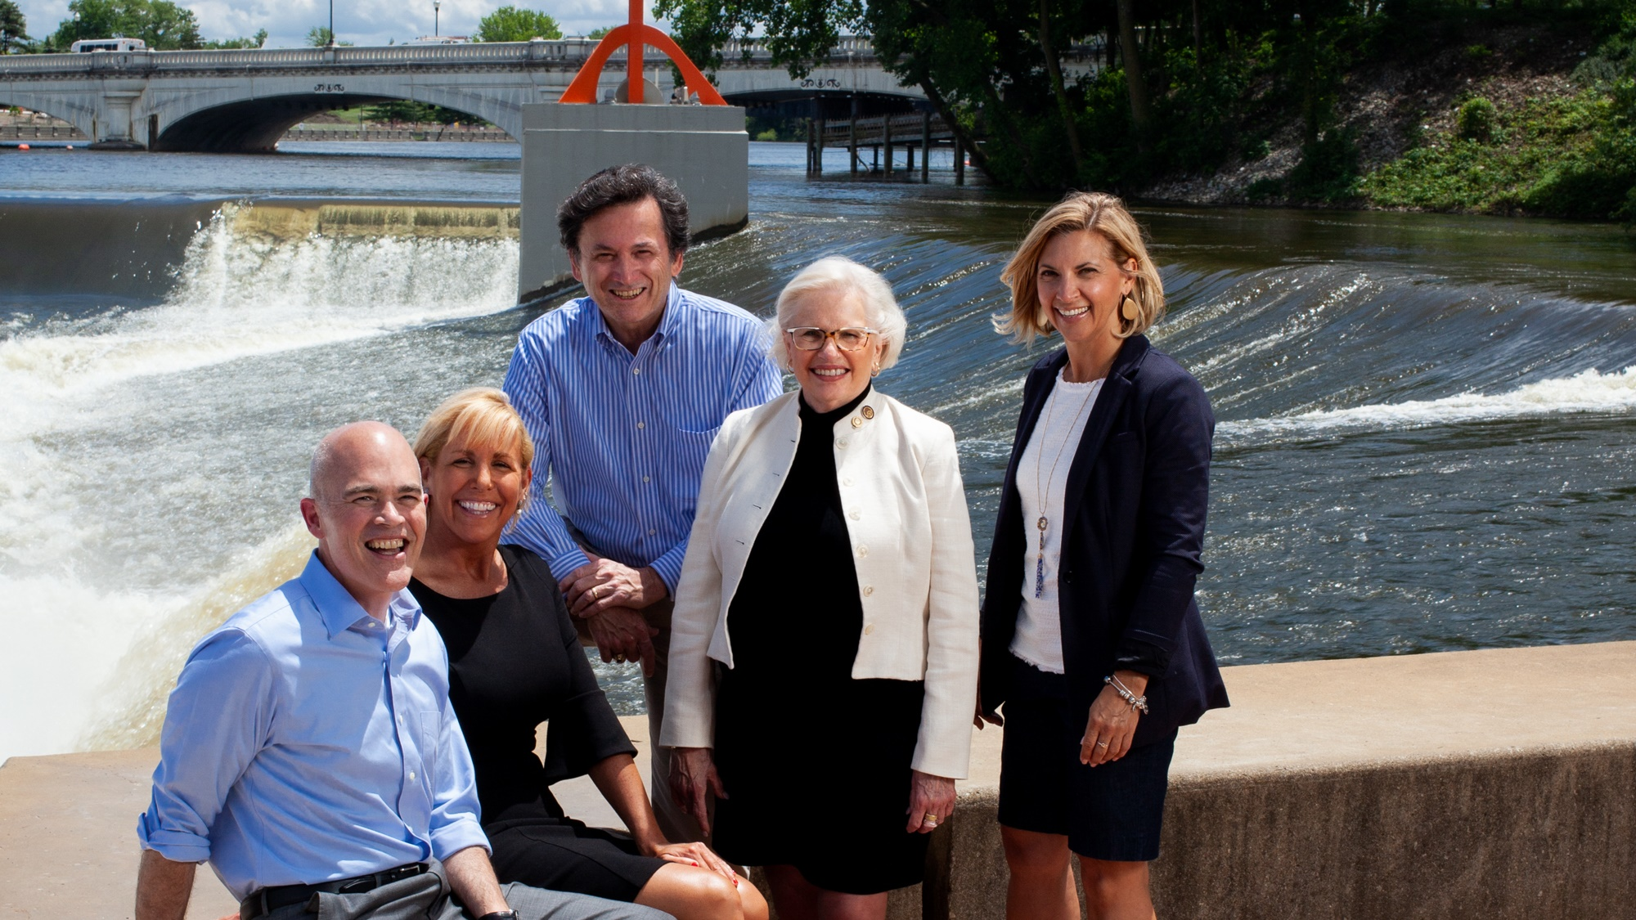
What members want
Local community service
Friendship & fellowship
Professional development opportunities
Notes:
When we look at what potential and current members of both Rotary and Rotaract value most, some interesting trends appear. Both list “participating in service projects to positively impact my community” as the opportunity they value most. But potential members, and younger professionals in particular, also want to make change globally and foster their careers through professional development and networking.
Current members, however, value community service, friendship and fellowship, and connecting with people outside work and their circle of friends. So even when both groups cite making a positive impact through service as their top reason for joining or staying, they each have different motivations.
Our research shows us that prospective members are also looking for opportunities to grow personally and professionally. Rotary and Rotaract offers them that. You don’t have to offer a formal professional development strategy for members to achieve their goals. Every service project or event you hold is a chance for someone to lead and grow. Members can also take online courses through Rotary’s Learning Center, or Leverage our alliance with Toastmasters to provide your members with additional growth opportunities.

Slide 7

The prospective, referred, relocating or returning members who go to Rotary.org/join to connect with clubs like yours
+20,000 inquires last year
35% women
59% under 40 years old
50% have a personal connection to Rotary
71% are
never
contacted
by clubs
Notes:
And people want to join us! How do we know? Last year, more than 20,000 membership candidates from all around the world come through rotary.org/join to express interest in joining a club. A notice of their interest is sent to a district, and district and club leaders can track those notices through the Manage Membership Leads page of My Rotary. Tracking leads and updating a status is easy and keeps the prospective member’s data secure.
Unfortunately, clubs contacted less than a third of the prospective members assigned to them last year. Some club leaders say they have no interest in contacting someone they know nothing about. Contacting them does not guarantee membership to your club, or to Rotary. But it DOES signal to that person– a member of your community-- that Rotary cares and is interested in learning how we can engage with them in meaningful ways.
Look at the opportunity here! 35 percent of these candidates are women, 59 percent are under 40 and 50 percent have a personal connection to Rotary. And while not every one of them will be a good fit for an existing Rotary club, some may be great for Rotaract. And some may be good charter members for a new club just waiting to be formed! We must a view these prospective members as an opportunity to grow Rotary, and strengthen our public image.
Now we know what our members are looking for and how to find candidates. What do we know about why they leave?

Slide 8
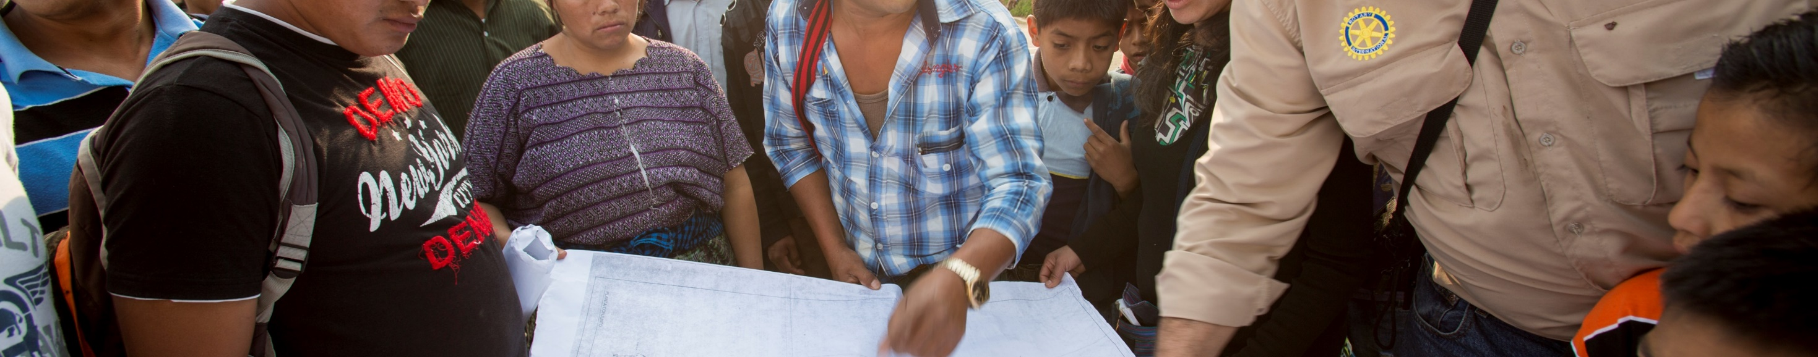



WHY MEMBERS LEAVE
30%
Cost and/or time
23%
Club environment
19%
Unmet expectations
Notes:
According to a recent Member Experience survey conducted by Rotary International,30 percent of former members cited cost or time as the No. 1 reason they leave.
The job of a Rotarian should never be seen as a time commitment too great for a busy professional to consider. Otherwise, we’re closing the door to the contributions of the people we need most in Rotary — the ones with the potential for decades of Rotary service and leadership. We need to meet people right where they are, at whatever stage of life they are in, and welcome them.
A growing number of departing members also cite the club environment and unmet expectations as reasons for leaving. Imagine being excited to be a member of Rotary, only to discover that the experience you were promised isn’t available.
As we build a stronger future for our organization, it’s good that we are reaching out to new people and introducing them to Rotary. It’s important that our clubs reflect the communities we serve, and deliver the things our members join for.
So let’s find every opportunity to show we value each and every member and participant. Let’s seize this moment to build on what we’ve learned, to embrace our new reality, to welcome new faces, and to find additional ways to shine. More diverse voices in our clubs and in our leadership will help Rotary stay in touch with a changing world. This is how we will have a continuing impact on the world. And if you need help along the way, Rotary offers many resources that can help you reach your goals.

Slide 9

subhead
Take your club in a
New direction
Is your club flexible and ready for the future?
New resources on satellite clubs, passport clubs, and Corporate Membership can help you create an experience that works for
every member.
ROTARY.ORG/FLEXIBILITY
Notes:
Now, more than ever, we have the chance to connect with each other differently—to offer MORE opportunities for people to join our meetings, to support their communities, and to grow personally and professionally.
Clubs around the world are adapting by taking advantage of this flexibility. Here are some ways clubs are meeting the diverse needs of their members and their communities:
Starting a satellite club to give qualified people who can’t attend club meetings a chance to join Rotary.
Changing how, when, and how often clubs meet. Some examples are meeting just twice a month, switching from a sit-down meal to a less formal — and likely less expensive — gathering, or replacing a regular meeting with a social event or service project.
Offering a new membership type. For example, offering a corporate membership to attract multiple members of the same company, or an associate membership for younger professionals who want an option that costs less or requires less time.
Developing a cause-based club to attract and engage members who are passionate about a specific issue, like water or peace.

Slide 10
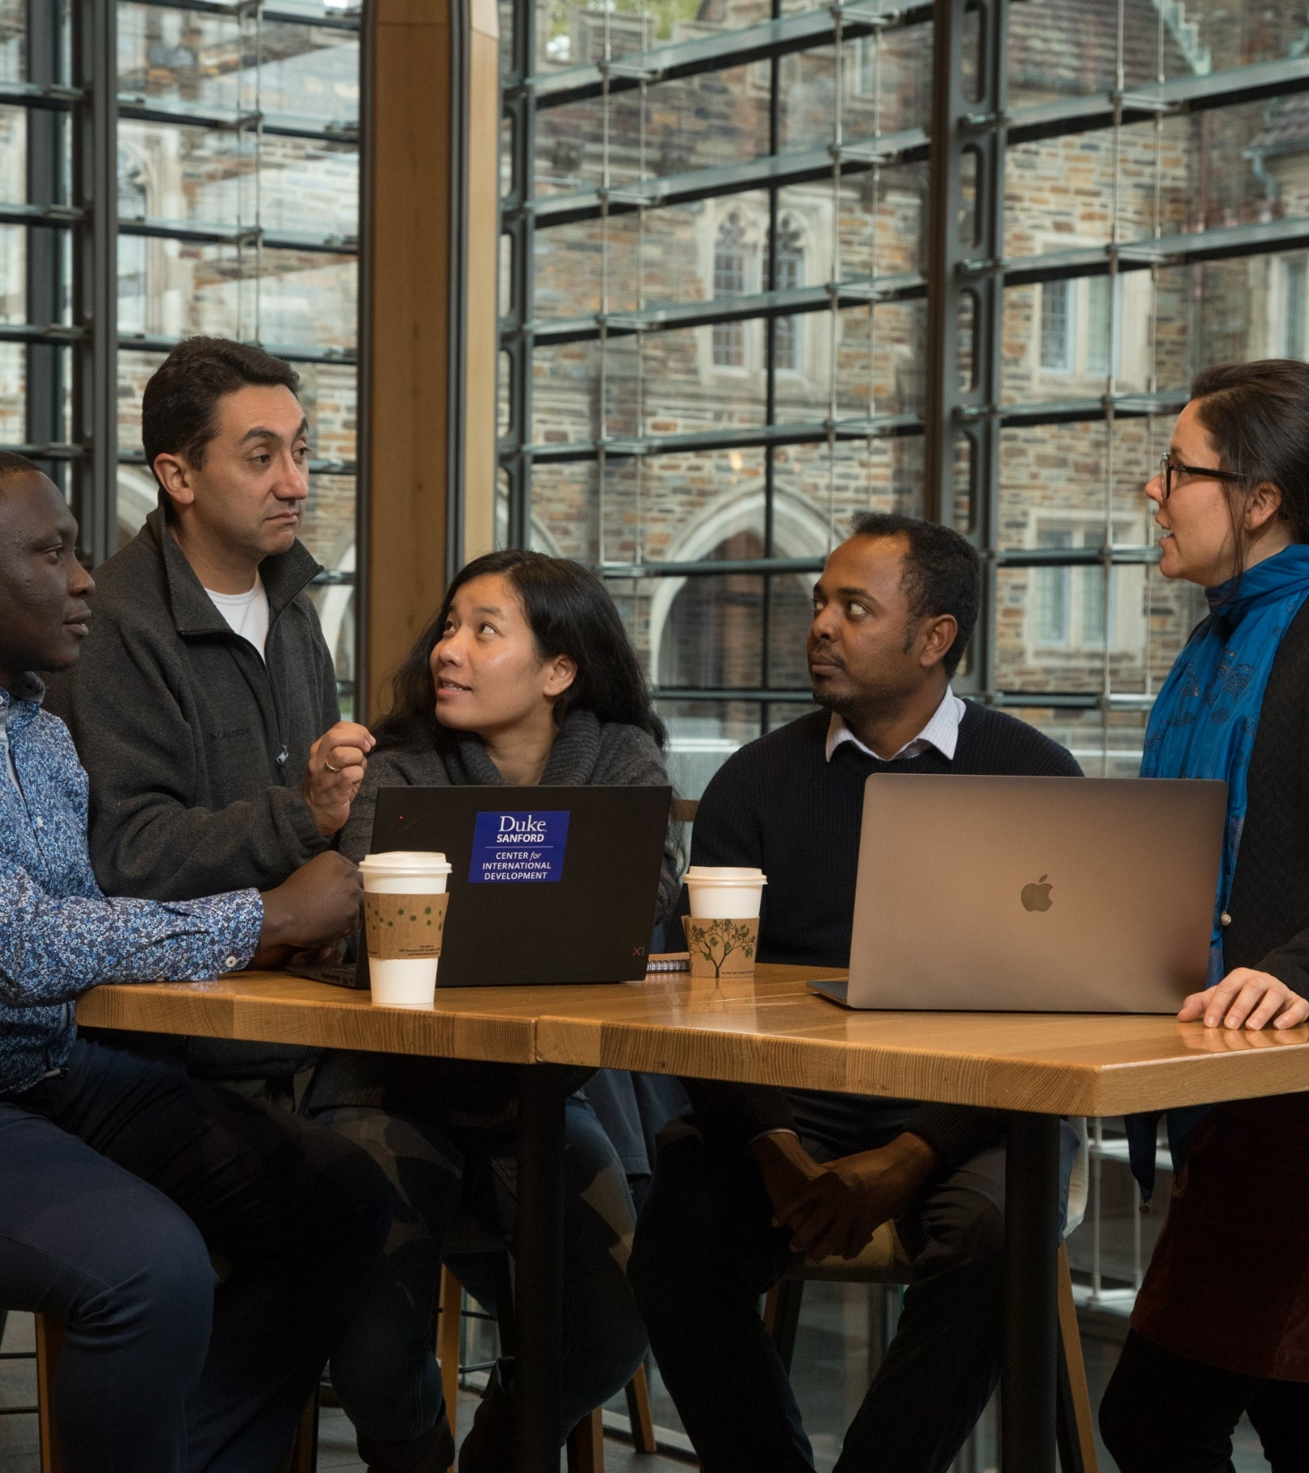
Online & Hybrid
meetings
Choose technology that meets your needs
Build a confident team
Offer training and support
Adjust your agenda
Set clear expectations
Include options for everyone to participate
ROTARY.ORG/ONLINEMEETINGS
Notes:
Many clubs are hosting their meetings online or adding an online component, like hosting a guest speaker from a Rotary or Rotaract club located in a different part of the world. Online and hybrid meetings take planning to make sure they are engaging and inclusive. Here are six things to keep in mind:
Choose the best technology for your needs. Some free services limit the number of participants or the length of your meeting.
Building a team allows people to contribute to the success of your meeting. Ask others to monitor chat boxes, answer questions during the call, and troubleshoot technical issues.
Some clubs and districts are appointing “Virtual Meeting Coordinators” who work to train people who may not be used to the new technology. Offering that support to your members shows a commitment to keeping them engaged.
If some parts of an in-person meeting don't work well online, adjust your meeting content to maximize your online format. Practice with any presenters so they know how to request control and share their screens. Log on early to test your audio and make sure all presenters are on.
Use an agenda, set meeting ground rules, and clearly outline next steps at the end of the meeting. If background information is required, be sure to share it with all participants beforehand.
Seeing and interacting with fellow participants via technology helps keep everyone connected and engaged. However, not everyone will be able to join your meeting via video. Provide an audio option and consider recording the meeting and sharing it later.

Slide 11

subhead
Is your club healthy?
Members who have a positive Rotary experience are more likely to stay.
In turn, they create a positive Rotary experience for others, because their enthusiasm is contagious.
ROTARY.ORG/MEMBERSHIP
Notes:
Clubs must actively work to take care of their members and other participants, connecting each individual with the elements of Rotary that are most important to them and provide the greatest engagement and value. One of the best ways to take care of one another is simply to ask what members need. No two clubs are exactly the same, and those unique club experiences are what differentiates Rotary from any other organization.
While these check-ins can be informal, Rotary offers many resources that can help you plan for the future. You can find them at rotary.org/membership. Remember this address — write it down, take a picture of it. And visit as often as you need to.

Slide 12




TAKE ACTION
LEARN
ASK
VISIT
ROTARY.ORG/MEMBERSHIP
Notes:
What can you do with all of this information, especially if some of it is new to you? I suggest three things:
Take time to understand membership data and trends in your region. We can offer you a global look at the state of membership, but Rotary Club Central makes it easy for you to see the trends closest to you.
Ask members what matters most to them. Find out what they value, what they might be missing, and what they need to stay a member for life. And make sure you deliver that.
Finally, visit rotary.org/membership for resources to support you. Whether you need access to club assessments, directions on how to manage your membership leads, or even guidelines for starting new clubs and membership types, there is likely a resource designed to help.

Slide 13

Notes:
When people connect with Rotary, their potential to make a difference in the world grows exponentially. That’s because they’re gaining access to a network of over 1.2 million people of action — from all over the world who share a goal of improving people’s lives.
RI President Holger encourages us by saying, “We will not let rapid change defeat us. We will capture this moment to grow Rotary, making it stronger, more adaptable, and even more aligned with our core values.”
Our members are our greatest assets: a diverse group of leaders who share the drive to serve their communities. And together, we see a world where people unite and take action to create lasting change — across the globe, in our communities, and in ourselves.
Thank you.
Are there any questions I can answer?
NOTE TO SPEAKER:
Write to membershipdevelopment@rotary.org with any questions.

