Slide 1
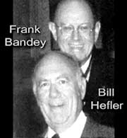

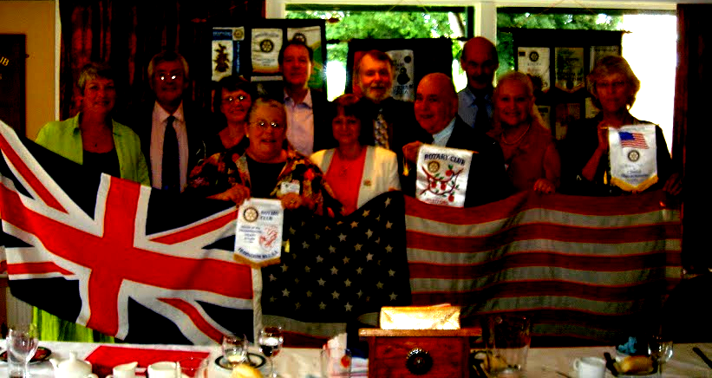
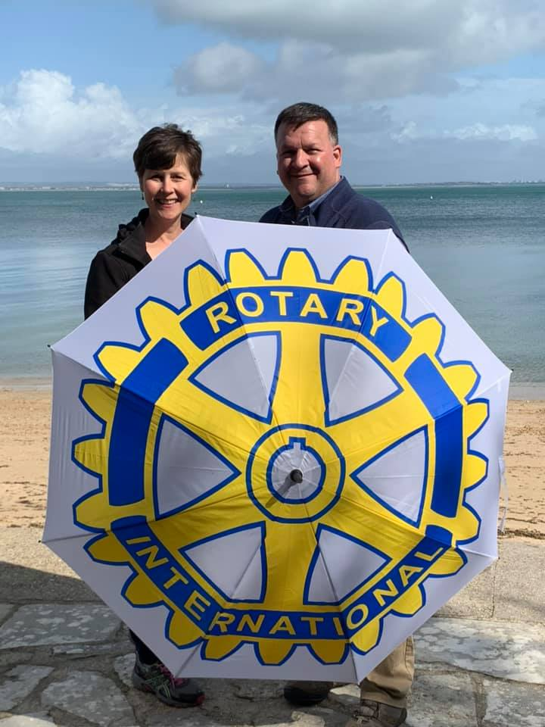
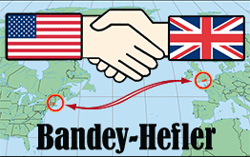
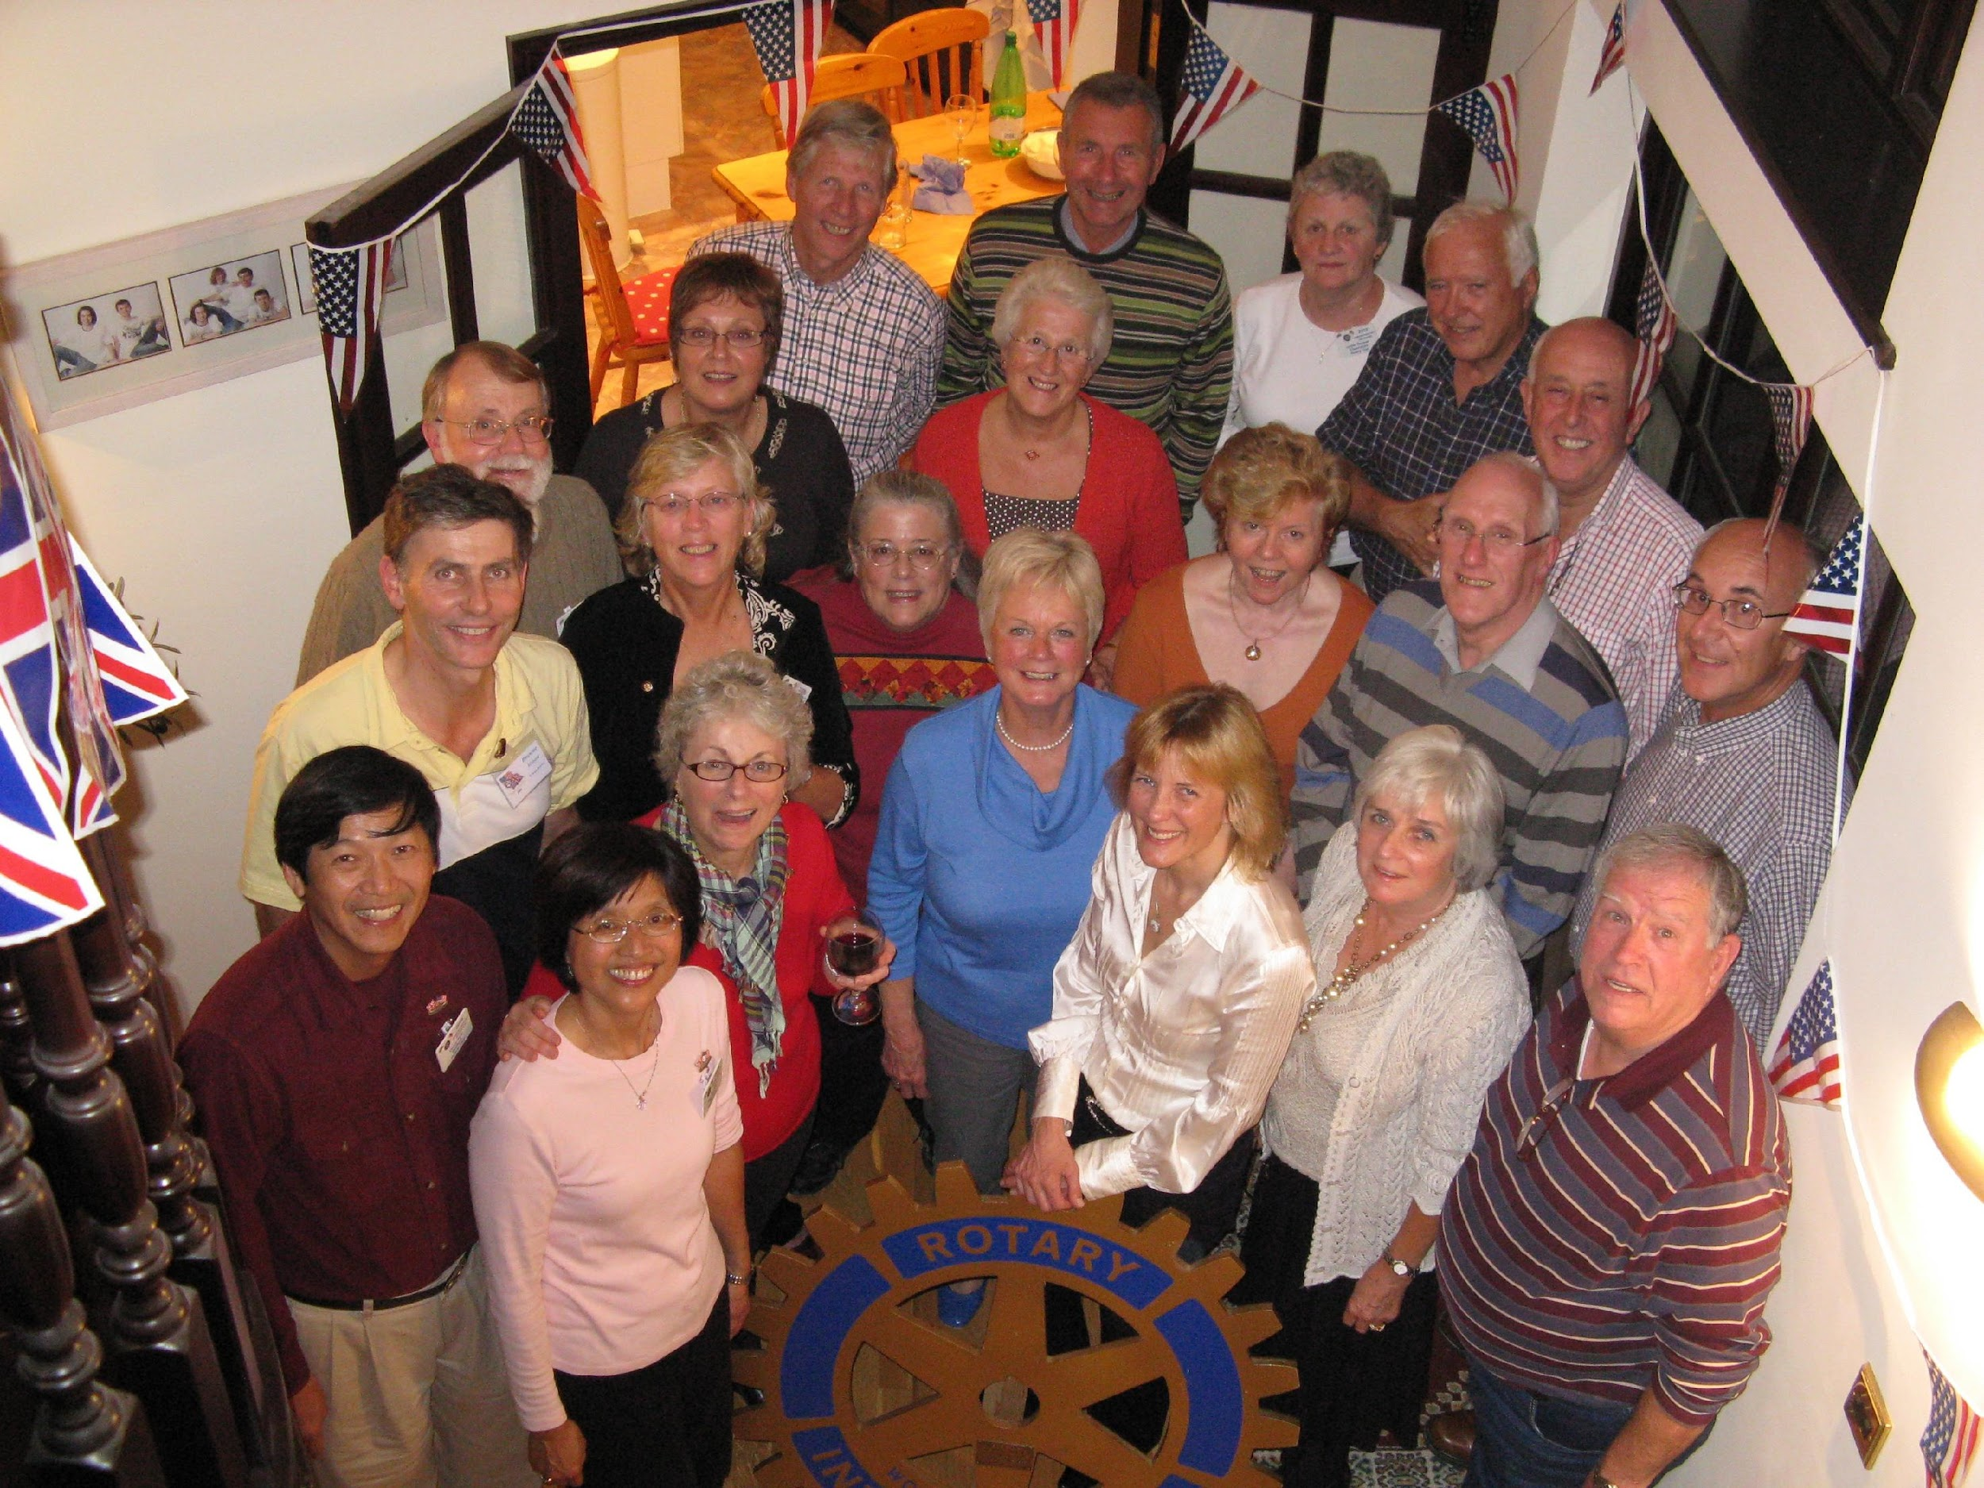
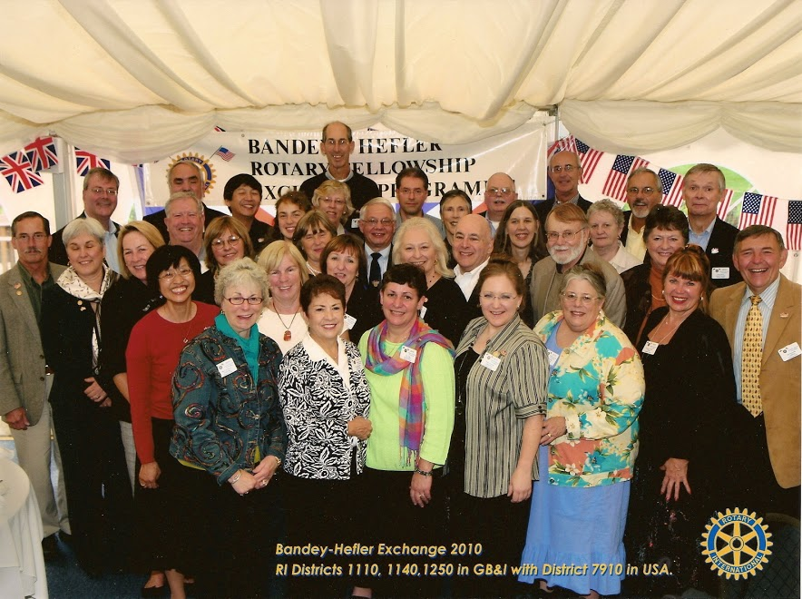
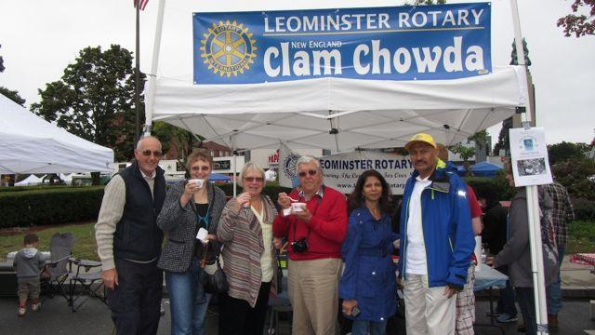
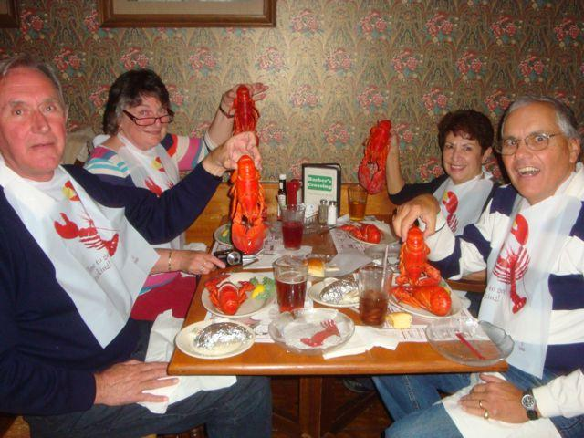
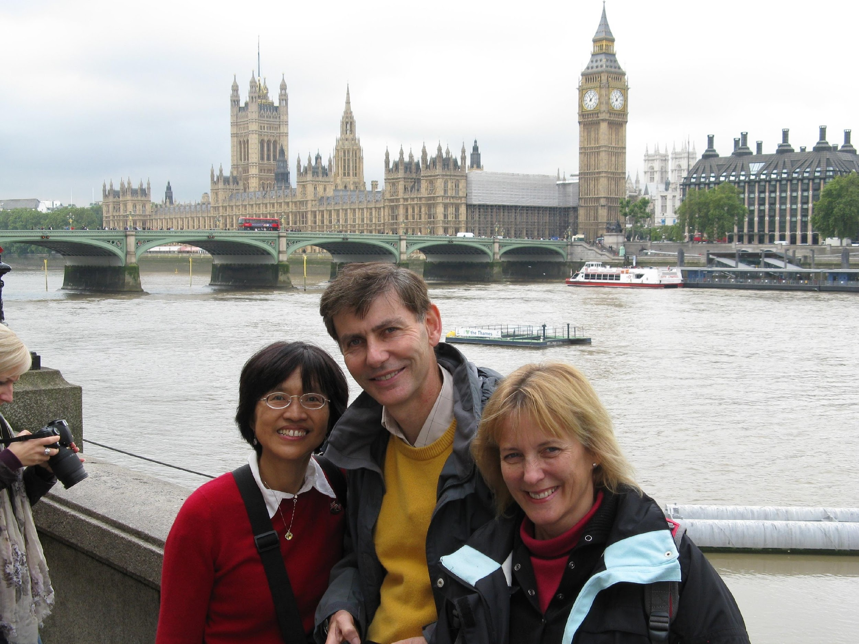
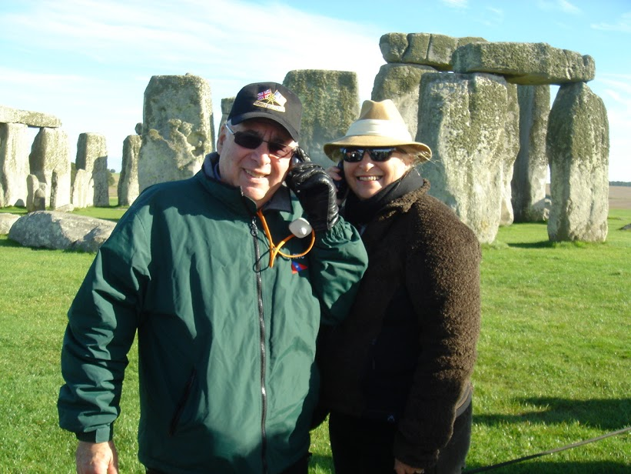
If you are a first-time host, you may find it useful to talk with someone who has hosted before. Every new host is apprehensive about bringing "strangers" into their homes, and every host ends up loving the experience. A list of all participating hosts is available for your reference in this regard.
They are your guests, and you will be responsible for their food and entertainment expenses during your period. However, it's up to you and your individual lifestyle as to whether you have your meals in or out, where you will sightsee or what you choose to do to entertain your guests. Many of the English Rotarians come prepared with a list of things they would like to see and do, and others leave all the decisions up to you, their gracious hosts.
Past Exchanges:
U.K. U.S.A.
1977 1978
1979 1980
1982 1983
1985 1986
1988 1989
1991 1992
1994 1995
1997 1998
2000 2001
2003 2004
2006 2007
2009 2010
2012 2013
2016
2019
2023 2024
Current Schedule
2026 2027
BANDEY-HEFLER
ROTARY
FELLOWSHIP EXCHANGE PROGRAM
An Exchange Between Rotarians in the Suburbs of Boston and London
For more information:
https://www.rotary7910.org/Page/bandey-hefler-fellowship-exchange
Chair:
Tom Pinney
bandeyhefler@gmail.com

Slide 2
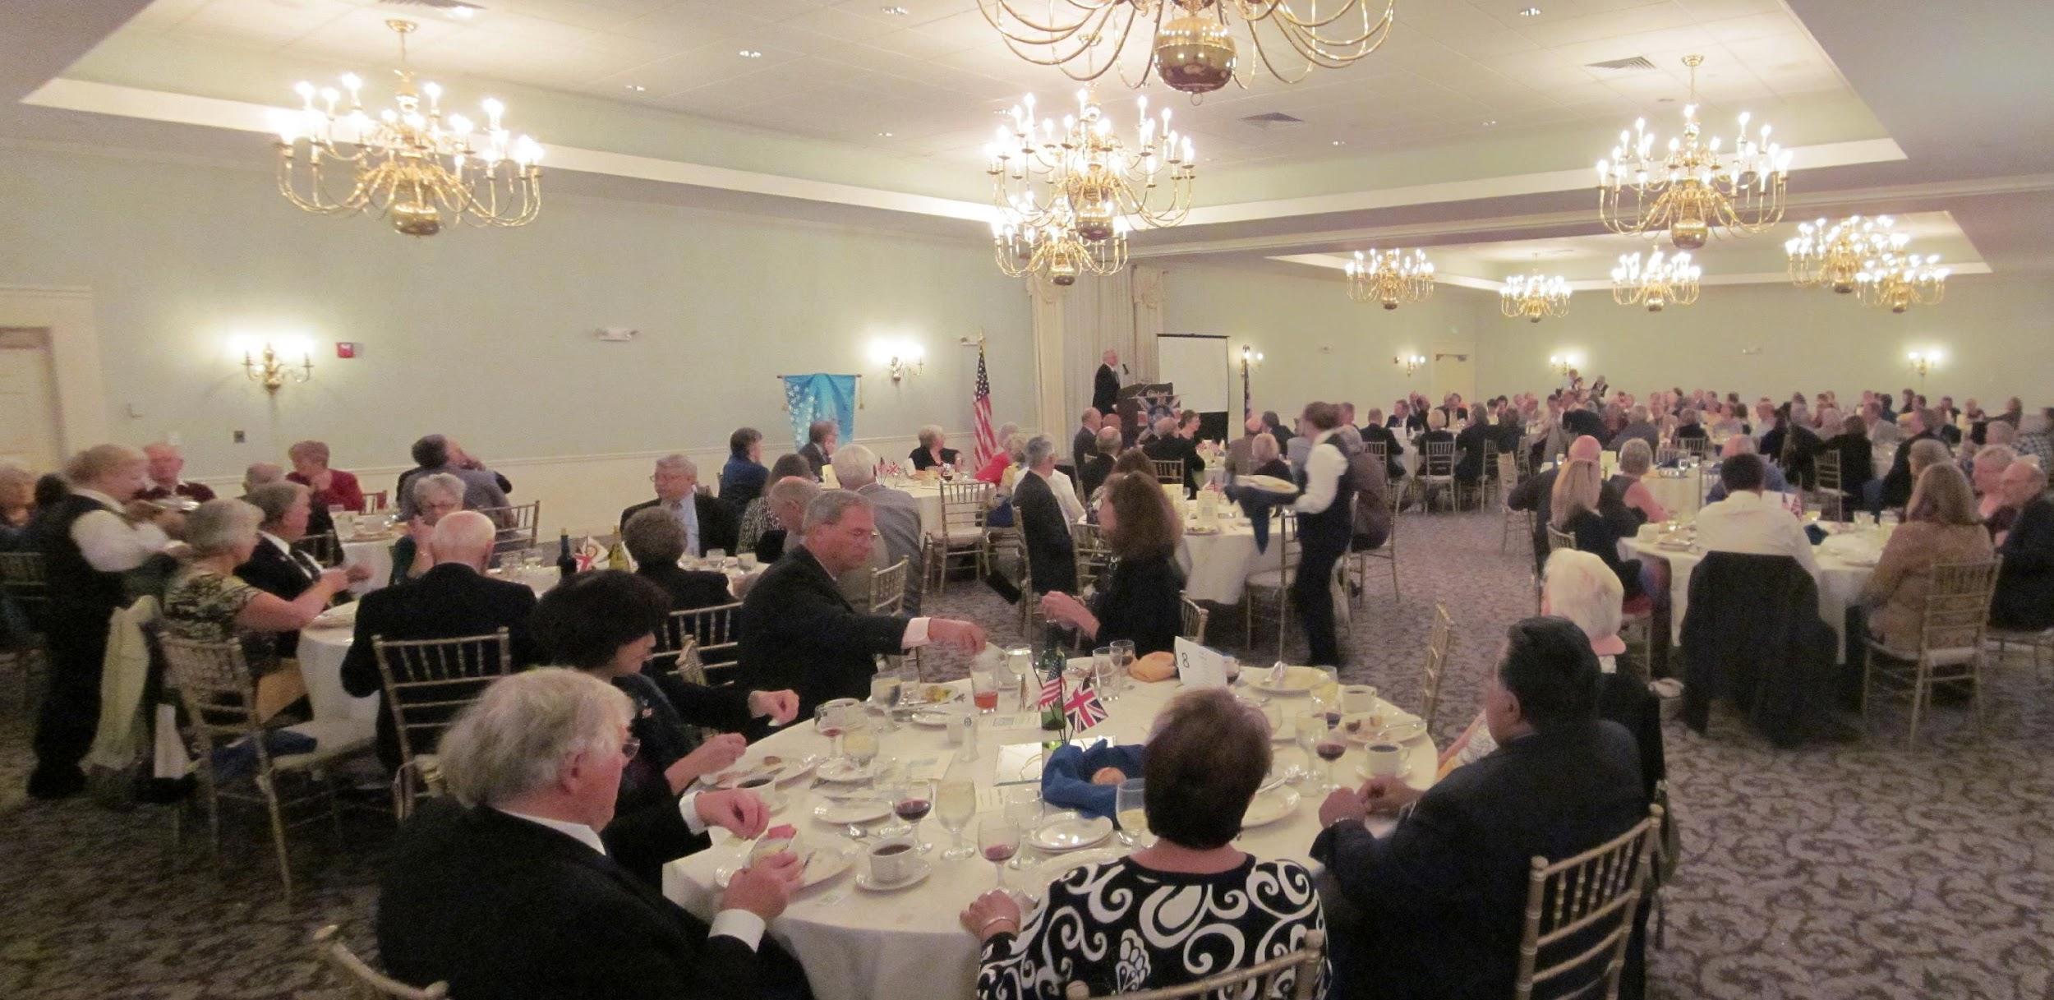
History
It all began in the spring of 1973. The late Frank Bandey, incoming District Governor of District 114 England, went to the U.S.A. for the Assembly at Lake Placid. While he was there he was invited to attend the 50th anniversary celebrations of the Rotary Club of Dedham in Massachusetts. He and his wife were hosted by the late Bill Hefler, a member and past president of that club and his wife.
In October 1973, the American couple came to England and Bill spoke at the District 114 Conference held in Jersey. Attending a discussion at the International Group Meeting, he learned for the first time of the 'contact club' arrangements in Europe. He became very interested in this concept and suggested that similar exchanges should he arranged with American clubs; but having a distinctly vocational aspect. Bill originally suggested
exchanges between the two Districts 791 (now 7910 - around the Boston area) and 114 (now 1140 and 1250).
It took four years to set up, but in October, 1977 eleven Rotarians (and their partners) left these sunlit climes for Boston, District 791 and "New England in the fall": the first ever Bandey-Hefler Exchange visit. From Logan Airport these hardy Brits were transported to Milton (the Heflers’ home town) where they
were met by 100 Rotarians and their wives. A great welcoming party ensued and set the standard of generosity and convivial fellowship that endures to this day.
Fellowship Exchange Format
The intention was that, accompanied by their spouses, each Rotarian would stay with a Rotarian of similar vocation and their family. During their two-week stay all the Brits stayed at four homes (currently three homes), the idea being to ensure circulation and to meet as many families as possible. The visitors also found it interesting to see the different way in which Rotary Club meetings are conducted in America.
This Massachusetts trip was followed by a visit of thirteen American couples to England in September/October 1978.
Those who have been fortunate enough to participate in these exchanges have no doubt that it is International Rotary in action and at its very best. The original basic format has been retained as much as possible; although vocational pairing is no longer practical to any significant degree. The emphasis is now very much based on international fellowship – the enjoyment that comes from meeting new friends in different surroundings.
Host Responsibilities
To become a host is a truly rewarding experience but also one that requires a commitment of time and money for the 4 days. You and your partner (or just yourself if you are single and choose to do it solo) are in for a fantastic time.
Both you and your spouse/friend are expected to spend meaningful time with the guests and be involved in the planning and entertaining of the visitors. Hosts are expected to devote full time to their guests during the visit. Try to forget about work for a few days and give yourselves a chance to really get to know one another.
Be yourself! No matter what you may have experienced in England or what you may have heard of their customs, please remember that our visitors are here to become acquainted with our “American Way of Life” and to make new and lasting friendships.
Allow your guests to rest and relax. While there will be many places to go and things you want them to see, it is important that everyone has a chance to take a nap, put up their feet, and otherwise catch up with jet lag and a very busy visitor pace.
Be prepared to help your English guests with money exchange, if needed. Your guest may want to pay for a meal (we usually graciously accept one meal), but expenses during the visit are generally born by the host couples.
Be sure to offer the use of your washer and dryer and give instructions on the use of these appliances. Allow time in your schedule for laundry and similar necessities to be done, a trip to a local beauty salon or pharmacy at mid-trip is often appreciated, so be sure to ask.

