Slide 1
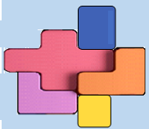
Rotary District 7950 Foundation, Inc.
The Solution to Your Club’s Fundraising Puzzle
Charlene J. Jarest, PDG, Clerk
Graphic Design and PowerPoint Presentation by Diane J. Cloutier, President 2020/2021, Rotary Club of Fall River

Slide 2
Why a 501c3 for District 7950?
Rotary District 7950 Foundation, Inc.
The District Leadership Team recognized that a District-wide 501c3 could help clubs raise more money, especially those that do not have a club charitable foundation.
A 501c3 would:
Give clubs the ability to raise funds by appealing to corporate donors and donors who respond more favorably to tax advantaged philanthropy

Slide 3
Rotary District 7950 Foundation, Inc….*
Rotary District 7950 Foundation, Inc.
Is made up of Member Clubs
Is a full 501c3 under IRS rules
Can be used by Massachusetts and Rhode Island Member Clubs
Operates under a Memorandum of Understanding
Offers Givebutter charitable giving software platform to all Members Clubs.
*See District 7950 website for Articles of Organization and By-Laws.

Slide 4
Goals for this Presentation…
Rotary District 7950 Foundation, Inc.
At the end of this session, you will have an understanding of:
How being a member benefits your club,
What the District and participating club responsibilities are,
The components of the Memorandum of Understanding,
What the Givebutter fundraising platform offers for non-profits, and
Where to find 501c3 resource materials.

Slide 5
What are the Benefits to Your Club?
Rotary District 7950 Foundation, Inc.
As a “Member Club”, your club will now be able to:
Approach corporate donors
Approach donors who prefer tax advantaged philanthropy
Obtain a sales tax-exempt certificate for fundraisers
Have access to many new fundraising opportunities
Utilize a free recordkeeping fundraising platform
Easily stay in touch with your donor base
There are no minimal requirements or limitations for participation. There are currently no fees to use the District 7950 501c3.

Slide 6
District 7950 501c3 Supports Clubs by . . .
Rotary District 7950 Foundation, Inc.
Providing use of this 501c3, giving your club “not-for-profit” status
Qualifying clubs for participation
Supporting Campaigns by offering a robust fundraising platform
Please note that the District 7950 501c3 is separate from the District Grants Program and does not issue grants.

Slide 7
Understanding the “Memorandum of Understanding”
Rotary District 7950 Foundation, Inc.
All clubs “in good standing” may participate, meaning that your club:
Is current with their International and District dues, and there are no other club impediments
Has a dedicated charitable works checking account
Provides designation of club Givebutter account administrator
Has the support of your club President and President-Elect
Avoids actual or perceived conflicts of interest
Uses good stewardship practices
Protects qualification status by adhering to above requirements

Slide 8
How does the 501c3 Givebutter Fundraising Platform Work?
Rotary District 7950 Foundation, Inc.
The Foundation Clerk will open a sub-account for your club.
Your club will run its own fundraising campaigns.
Campaign monies will be accumulated in your club’s sub-account.
At conclusion of your campaign, the 501c3 treasurer will transfer your funds to your club’s dedicated charitable giving checking account.

Slide 9
A 501c3 Givebutter Fundraising Platform- Trial Run
Rotary District 7950 Foundation, Inc.
How did the pilot program go?
The Rotary Club of Holbrook agreed to be a Pilot Club and LOVED it! They ran a Holiday Stroll fundraiser and General Funds Appeal…. simultaneously!
“GiveButter allows us to have simultaneous events - a raffle, a vendor registration section, and even the ability to directly donate! Very easy to set up and for our vendors or donors to utilize.”
Colleen Cahill-Viera President, 2023/2024 Rotary Club of Holbrook

Slide 10
Givebutter Fundraising Opportunities
Rotary District 7950 Foundation, Inc.
Your club will now have the ability to:
Accept donations
Run simultaneous campaigns
Hold auctions
Sell tickets
Create donation forms
Use custom branding
Host fundraising pages
And so much more. . .

Slide 11
Givebutter Tracking Management will assist your club with:
Rotary District 7950 Foundation, Inc.
Donor contact management
Donation management
Ticket management
Timeline and history maintenance
And more. . .

Slide 12
Givebutter offers many donor engagement opportunities through:
Rotary District 7950 Foundation, Inc.
Email
Texting
Video
Personalization
Automations
Conversion Tracking

Slide 13
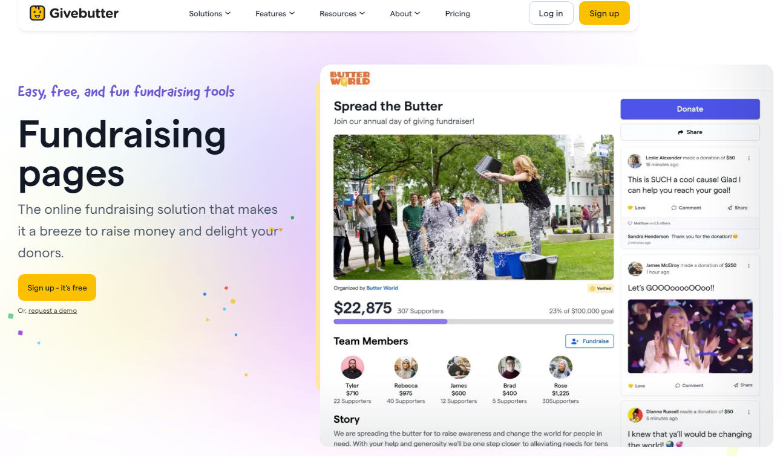
Rotary District 7950 Foundation, Inc.

Slide 14
How is Givebutter Funded?
Rotary District 7950 Foundation, Inc.
Givebutter is a free software platform for non-profits.
It is supported by optional tips received from donors.*
A standard processing fee is always applied, which is covered by most donors.
*If you prefer not to use the tips received from donors option, a small platform fee will be applied.

Slide 15
Additional Ways to Support your Campaign
Rotary District 7950 Foundation, Inc.
Social Media Promotion
Dedicated Website
Facebook, etc.
Traditional Marketing

Slide 16
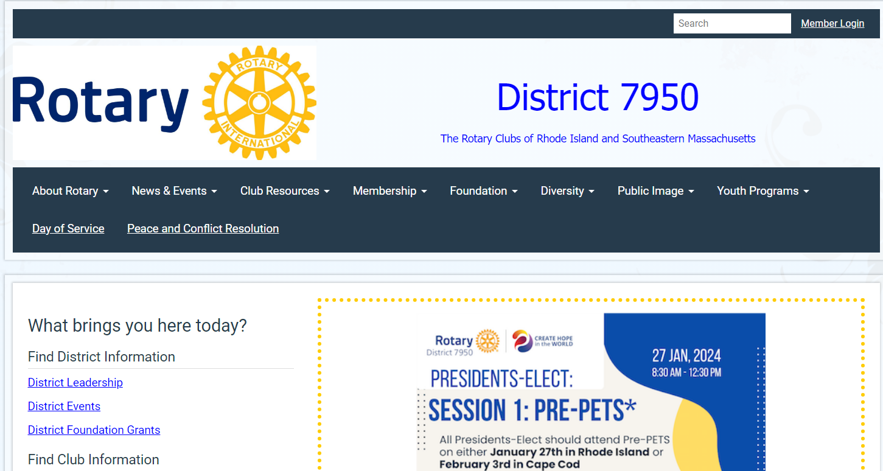
Rotary District 7950 Foundation, Inc.
Where do you find Rotary District 7950 Foundation, Inc. resource materials?
Resources are only three clicks away!
Home Page | Rotary District 7950 (rotary7950.com)

Slide 17
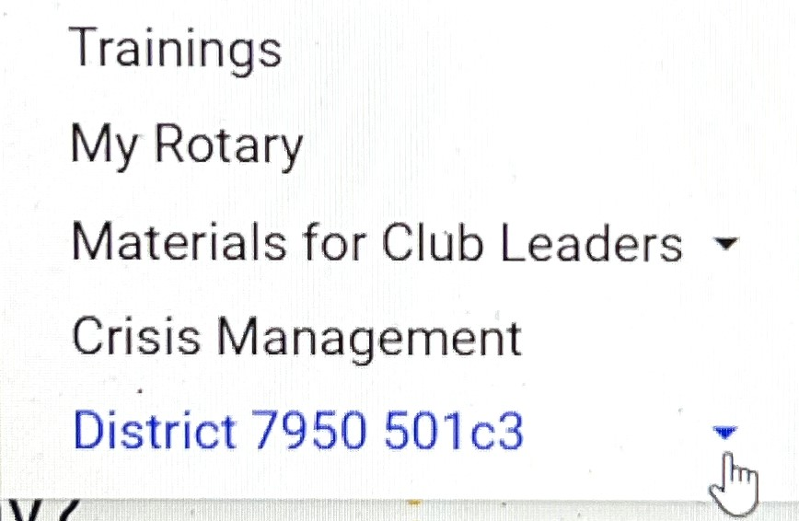
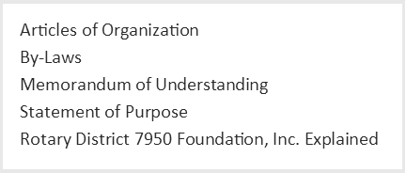
Rotary District 7950 Foundation, Inc.
Where do you find Rotary District 7950 Foundation, Inc. resource materials?
Home Page | Rotary District 7950 (rotary7950.com)

Slide 18
Questions?
Charlene J. Jarest, Clerk
Rotary District 7950 D.G. 2020/2021
cjarest@comcast.net
508-269-9008
Graphic Design and PowerPoint Presentation by Diane J. Cloutier, President 2020/2021, Rotary Club of Fall River

