Slide 1


District 7950 Diversity
Equity
Inclusion Committee

Slide 2

Our Commitment:
At Rotary, we understand that cultivating a diverse, equitable, and inclusive culture is essential to realizing our vision of a world where people unite and take action to create lasting change.
We value diversity and celebrate the contributions of people of all backgrounds, across age, ethnicity, race, color, disability, learning style, religion, faith, socioeconomic status, culture, marital status, languages spoken, sex, sexual orientation, and gender identity as well as differences in ideas, thoughts, values, and beliefs.
Recognizing that individuals from certain groups have historically experienced barriers to membership, participation, and leadership, we commit to advancing equity in all aspects of Rotary, including in our community partnerships, so that each person has the necessary access to resources, opportunities, networks, and support to thrive.
We believe that all people hold visible and invisible qualities that inherently make them unique, and we strive to create an inclusive culture where each person knows they are valued and belong.
In line with our value of integrity, we are committed to being honest and transparent about where we are in our DEI journey as an organization, and to continuing to learn and do better.
Notes:
Most members of Rotary are aware of the history of the organization. As a global entity it is very diverse but in individual countries that diversity becomes quite limited. This is the framework and the reasoning for the DEI initiative.

Slide 3
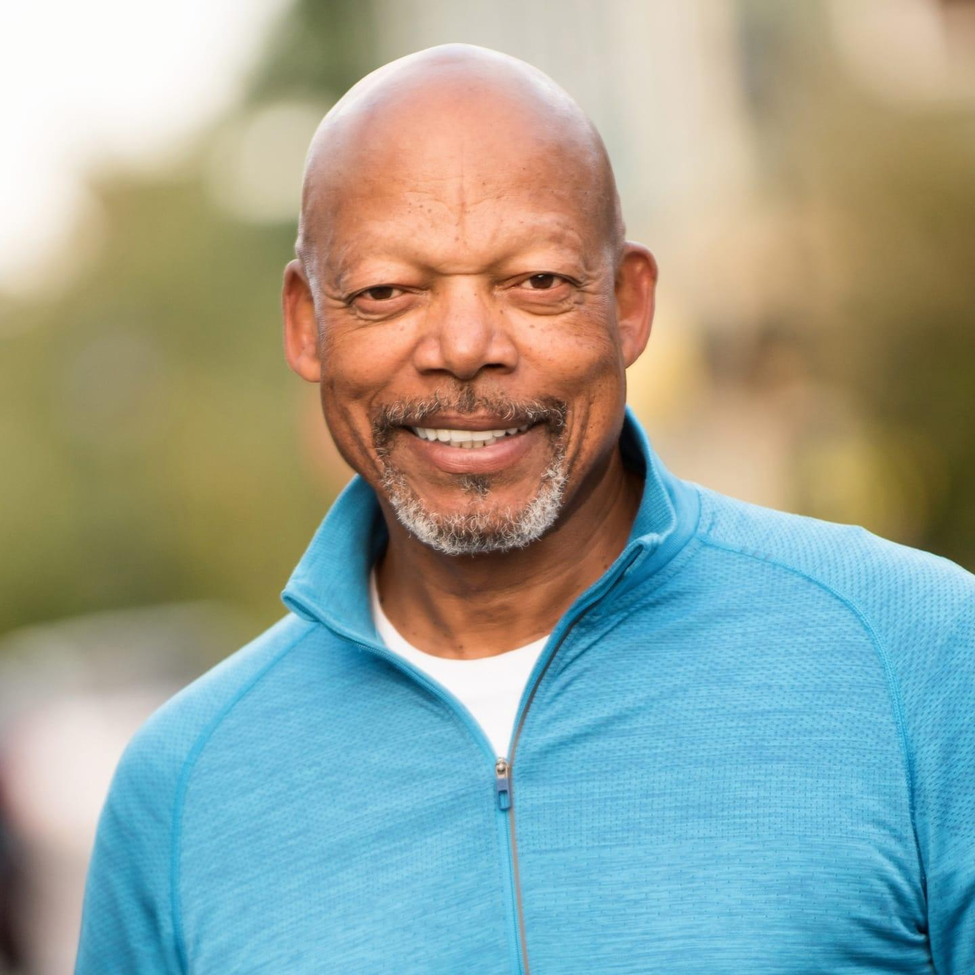
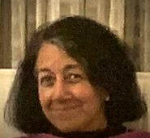
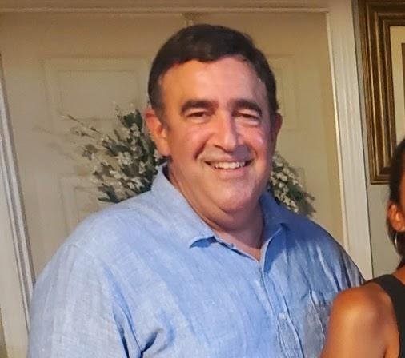
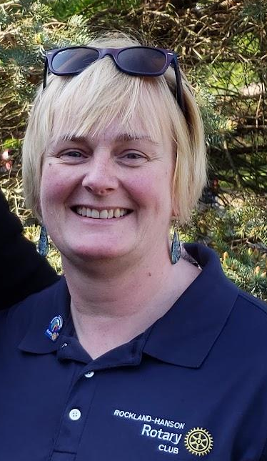
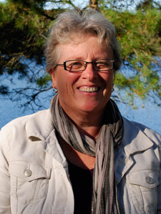
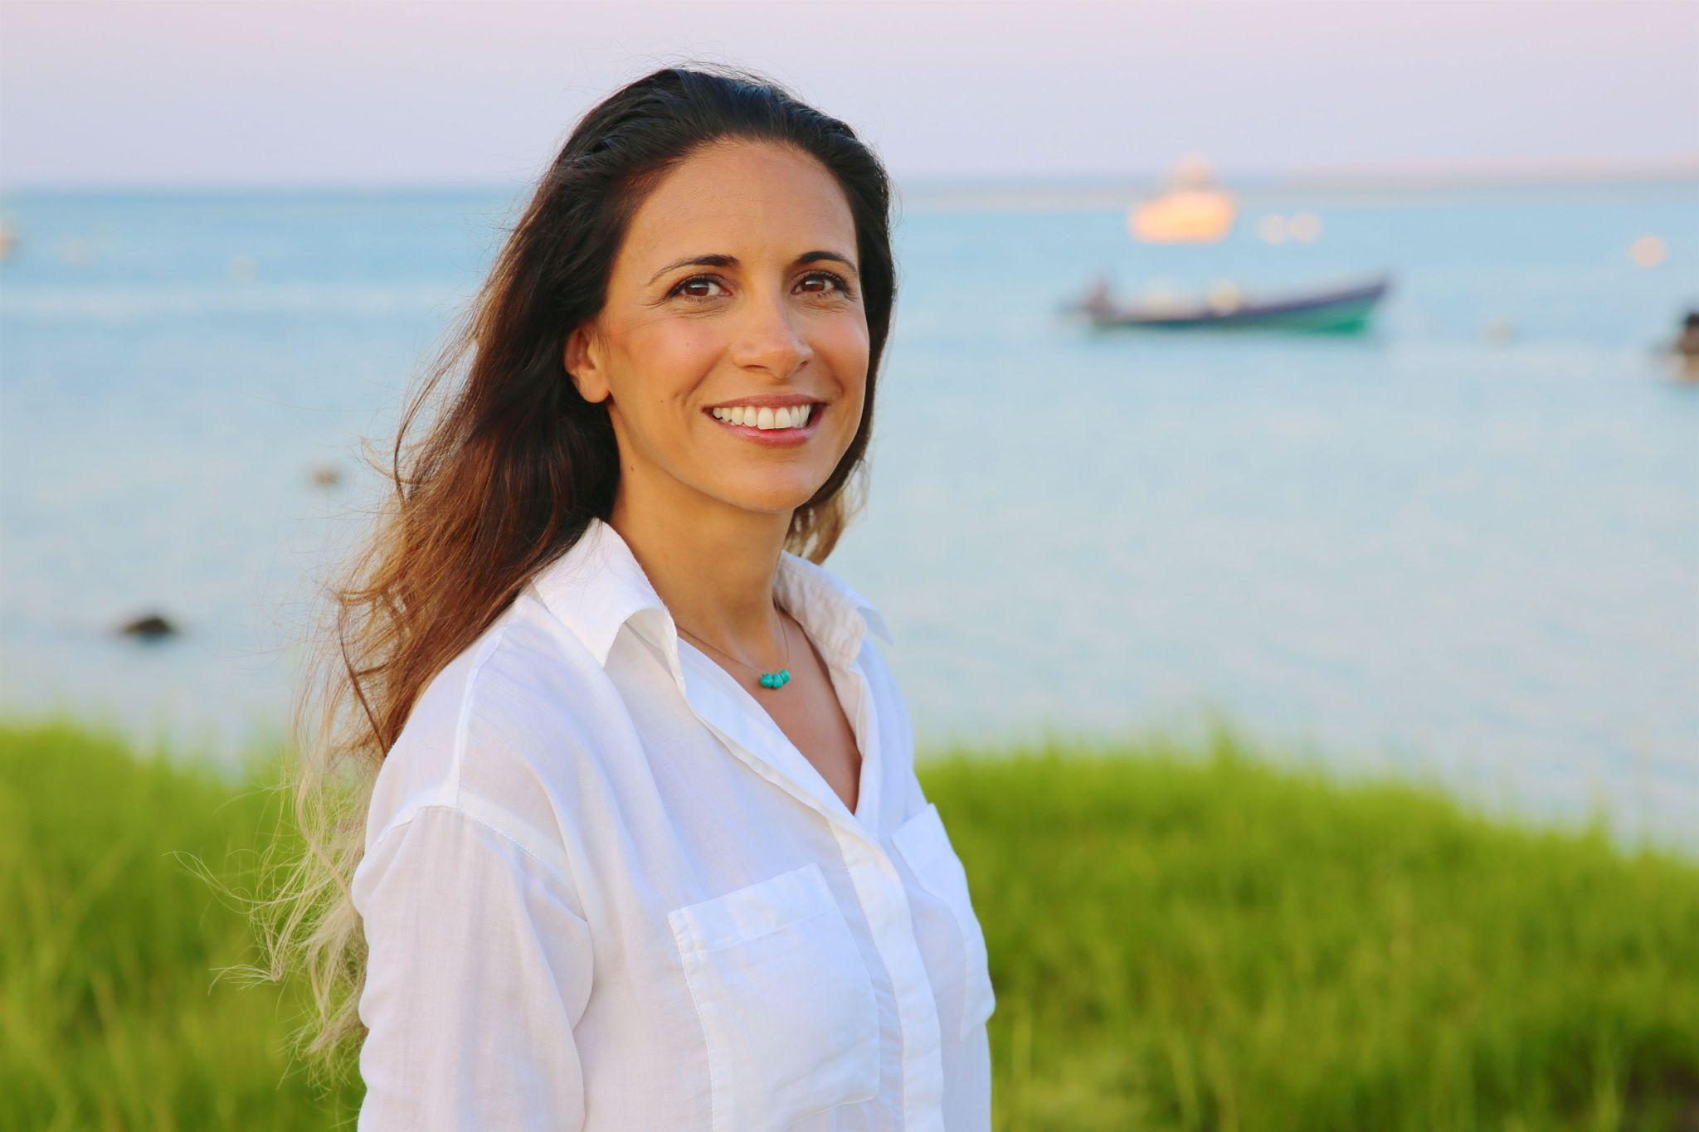
District 7950 DEI Committee Members...
Joe Small
Chair
Usha
Vakil
Carl
Alves
Patricia
Armstrong
Elika Dadsetan-Foley
Helen Mastico
...we’re here to help.

Slide 4
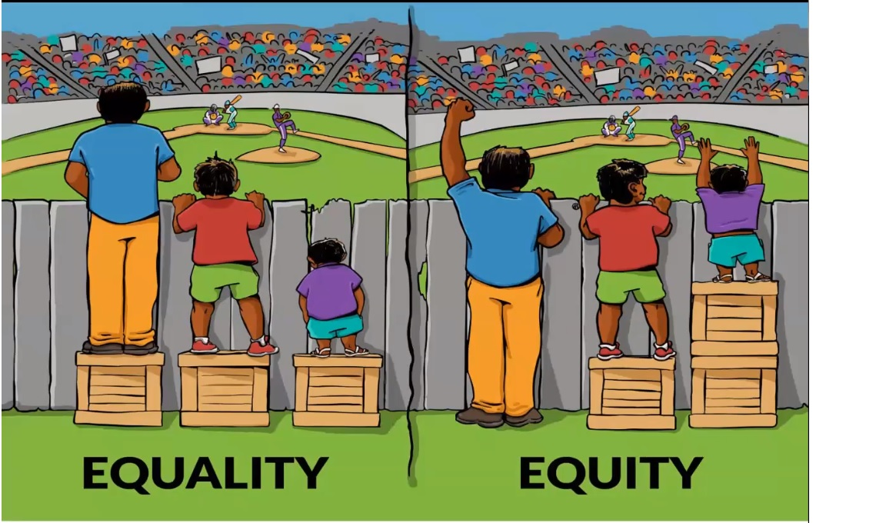
What barriers to success do individuals face? What is fair is not always what is equal.

Slide 5

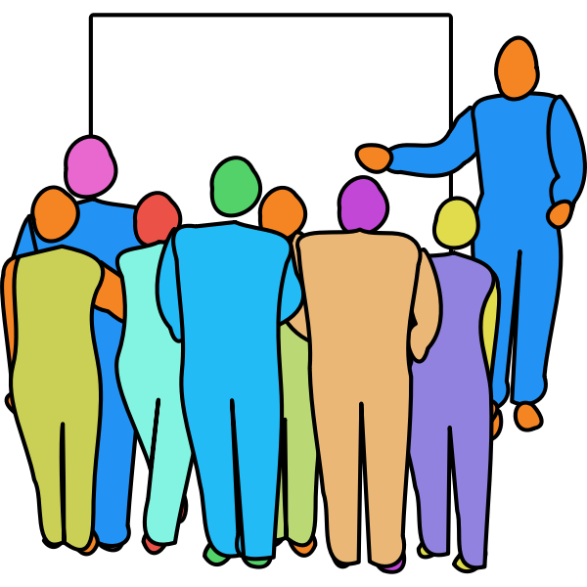

DEI or DIE - What your club can do…
Talk together about diversity
Invite a local DEI speaker
Connect with local organizations
Notes:
Talk about diversity with your club members and create a member diversity and inclusion action plan using the Diversifying Club Assessment.
Invite local diversity, equity, and inclusion experts to speak at your club’s next gathering.
Connect with local organizations that are supporting diversity, equity and inclusion efforts and work with them on projects or events.

Slide 6
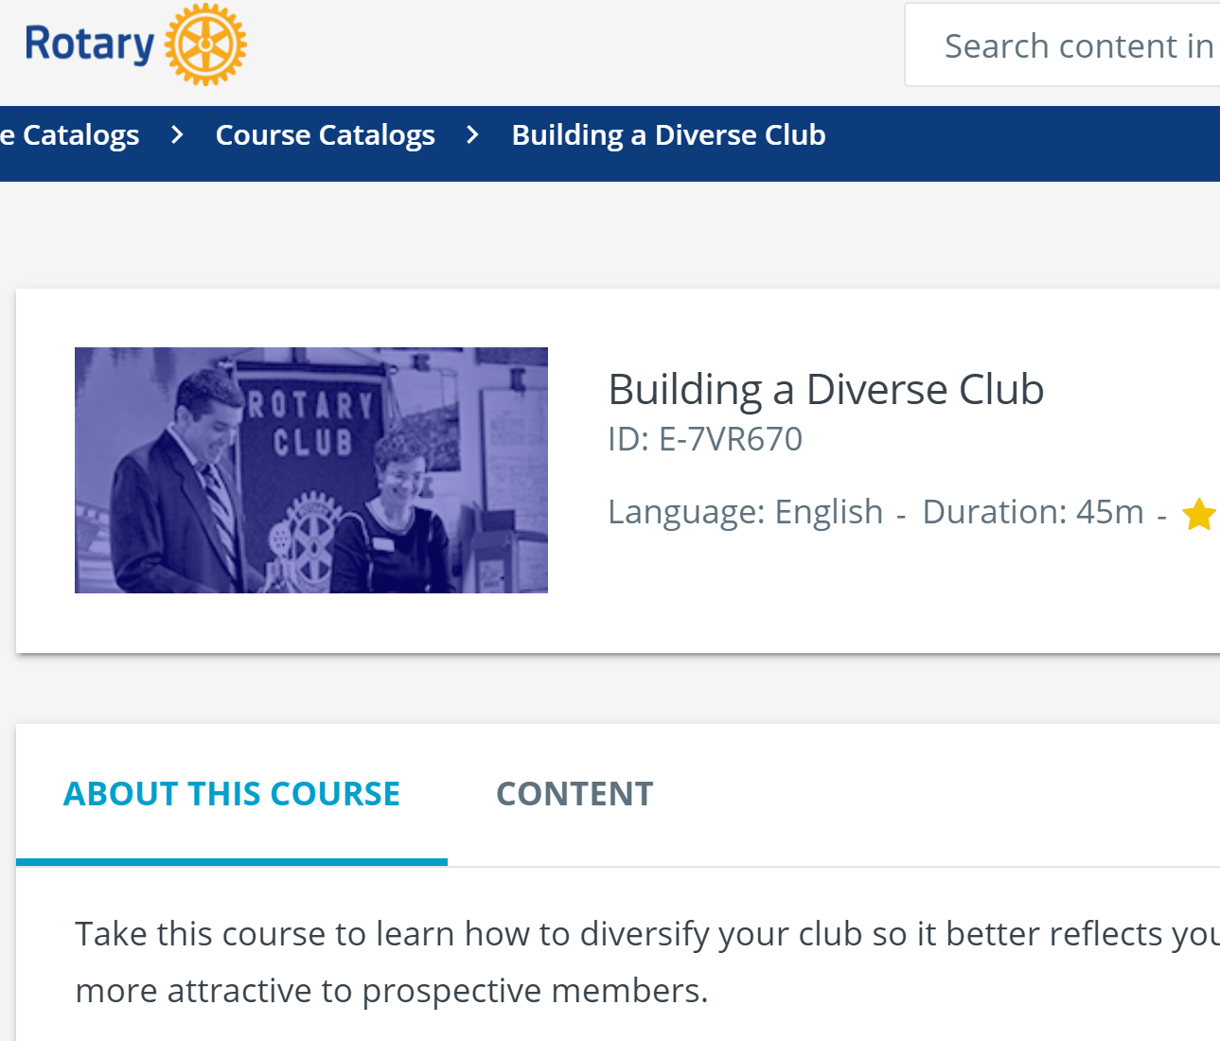
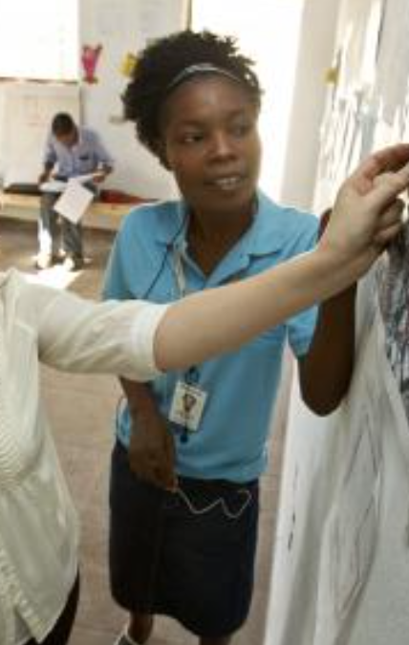
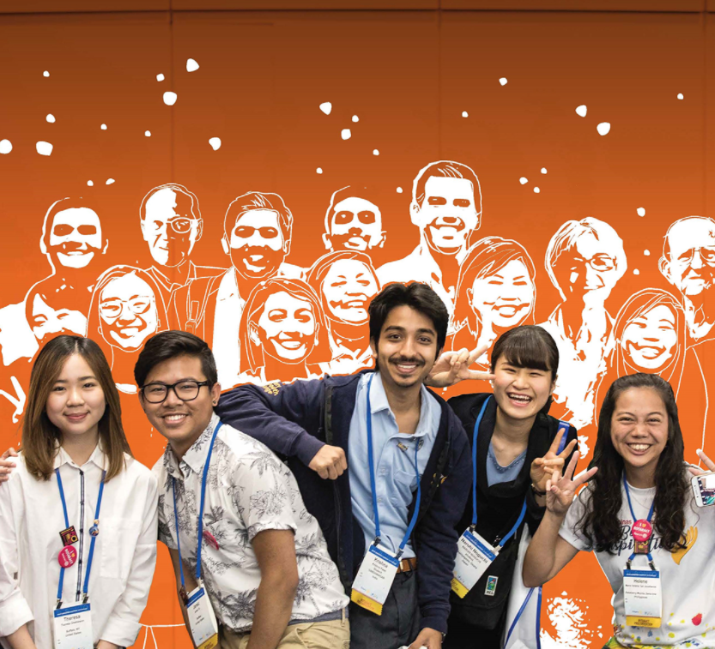
And…
Encourage and support
Take the course from Rotary International
Create a community advisory board
Notes:
Encourage and support people from under-represented groups to take on leadership positions in your club and district.
Encourage club members to take the Building a Diverse Club course in the Learning Center to learn more about diversity, equity and inclusion.
Create a community advisory board and invite diverse members from the community and from your club to take part. You will learn what’s important to the community and discover ways to work together and take action.

Slide 7

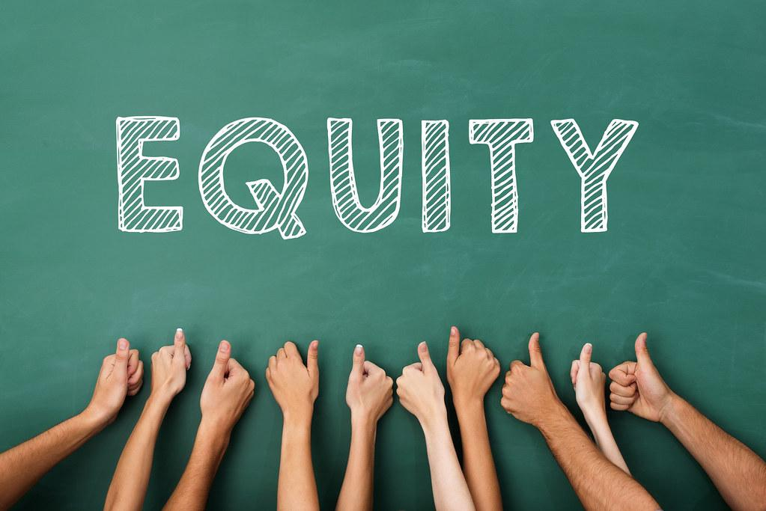
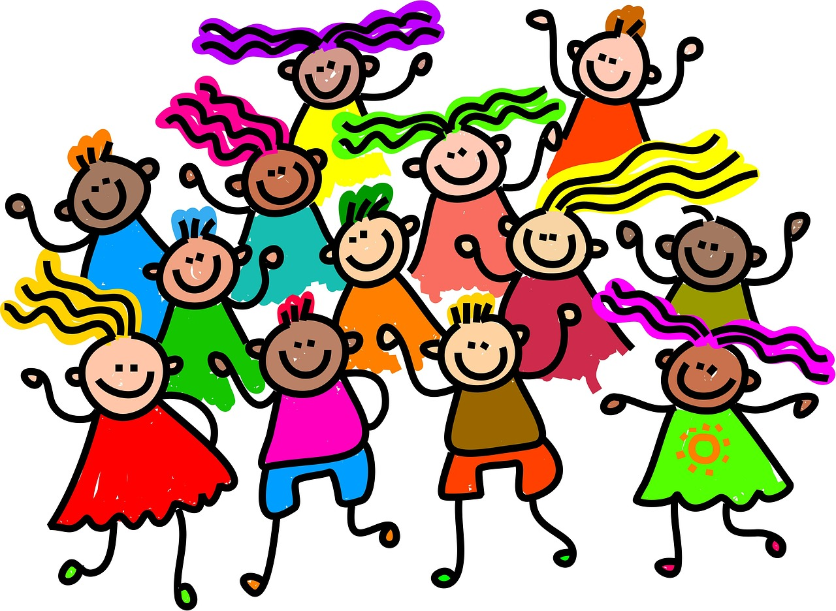
Everyone is invited to and welcome at the party.
Everyone has the chance to help plan the party and make decisions.
Inclusion
Everyone is fully engaged – dancing, talking, eating, laughing – together.

Slide 8

Communication?
Inherent bias exists. Life experiences change the way that we view and interact with the world. For meaningful conversation, we need to speak using a common language.
To illuminate our biases, we need to “name it, frame it and explain it.”
Notes:
Often, race-focused conversations derail because people are using the same terms in different ways. One of the challenges of communicating effectively about race is to move people from the narrow and individualized definition of racism to a more comprehensive and systemic awareness.
To illuminate racism, we need to “name it, frame it and explain it.”
Establishing a shared language to present data, describe conditions and outcomes and identify root causes of inequities serves an important function. A common language creates a narrative that makes it easier to communicate the commitment to racial equity, both internally and externally, and it creates a platform for coordinated work toward equitable outcomes.

Slide 9

Unconscious Bias
Everyday
Automatic
Hard-Wired
None of us are immune
We don’t see things as they are ...
...we see things as we are
Notes:
bias helps us make decisions but at the same time it affects all of our daily interactions. It is awfully difficult (nigh impossible) to remove bias but by being aware of our own biases we can make efforts to mitigate them

Slide 10
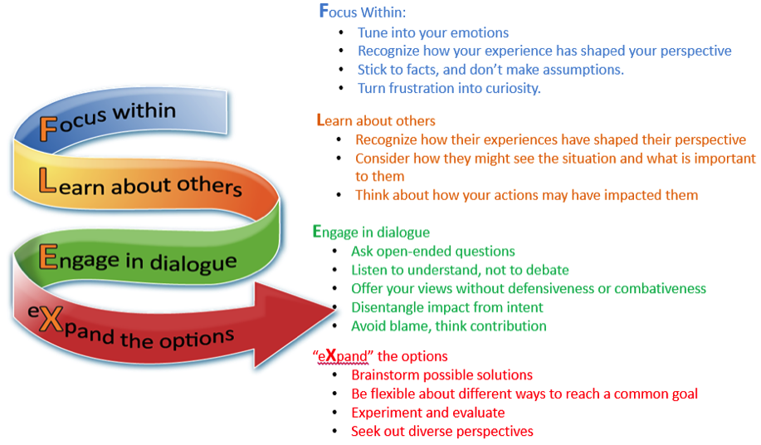
Unconscious Bias – How can I improve?
Notes:
These are the ways you can begin to mitigate your bias. There are multiple tools to raise awareness of your own bias, check out Project Implicit from Harvard. It can be upsetting to learn you have a bias but it is necessary.

Slide 11
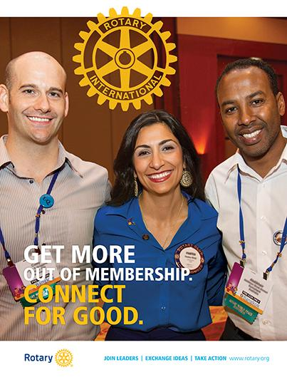
Who is in your club?
Is there diversity?

Slide 12
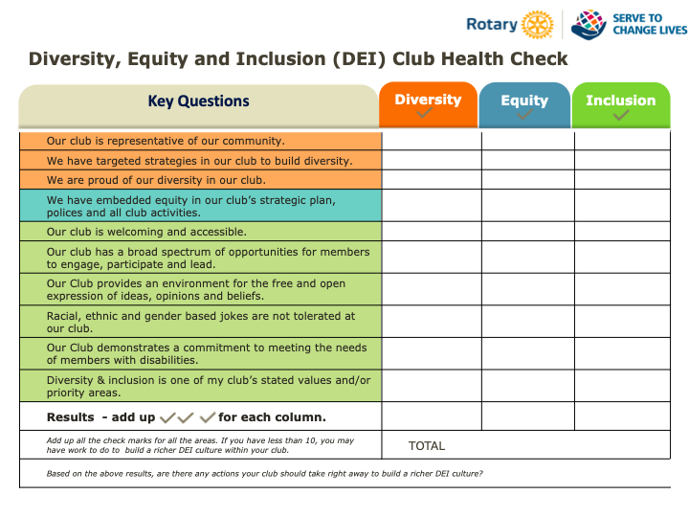
Notes:
When you have taken the DEI health check as a club you can brainstorm ideas for change

Slide 13

Diversity Questions for Your Rotary Club
Do the demographics of your club match the demographics of the community?
Age
Race
Gender
Religion
Sexual Orientation
Economic
Career
Handicapped
Is there a bias in seeking new members?
Is there an active plan to increase diversity?

Slide 14

Equity in Your Rotary Club
Are there barriers preventing people from attending meetings?
location handicap accessible
time accessible
cost accessible
ethnic bias to your meetings or menu
hybrid meetings
does everyone have the technology capabilities to join your zoom meeting
non-political
non-denominational moments of reflection/Rotary moments vs specific religious prayers.

Slide 15

Inclusion Questions for Your Rotary Club
Are all members involved on at least two committees or activities?
Are new members assigned a mentor?
Is every member considered for leadership positions?
Are members invited to participate, not just an announcement from the podium?
Are activities accessible so all can join?
Day/Time/Location
Physically Accessible
Not conflicting with work or family
Cost Accessible
Are Alternatives possible?

Slide 16
Rotary Links
RI Diversity, Equity, and Inclusion Statement
Rotary Learning Center: Committing to Diversity, Equity, and Inclusion
DEI in Rotary Youth Exchange (pdf)
Rotary 2020: Moving from Diversity to Inclusive Actions

Slide 17

External (non-Rotary) Resources online
LinkedIn Learning Path on Diversity, Inclusion, and Belonging for All
LinkedIn Course on Inclusive Leadership
The Look: A Story About Bias in America
10 Best Diversity Videos

Slide 18
District 7950 DEI Committee Members
Chair – Joe Small, Nantasket-Hull Rotary, 617-921-5076, jsmall428@gmail.com
Usha Vakil, Nantasket-Hull Rotary, 617-504-0077, ushavakil@aol.com
Carl Alves, Dartmouth Rotary, 508-400-2977, carljalves@gmail.com
Helen Mastico, Rockland-Hanson Rotary, 781-264-1089 , hmastico@gmail.com
Patricia Armstrong, Yarmouth Rotary, 774-994-2712, yarmrec@gmail.com
Elika Dadsetan-Foley, Duxbury Rotary, 818-858-3369, edadsetan-foley@visions-inc.org

