Slide 2
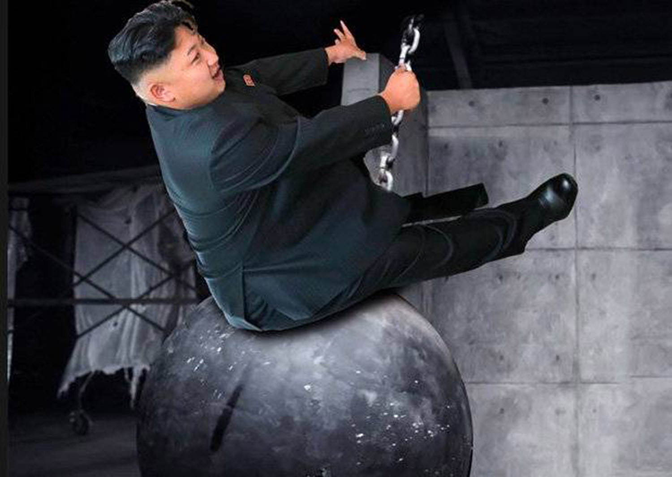
Nuclear Armageddon or
How I learned to love the Bomb
FRANCESCA GIOVANNINI
Program Director for Global Security
Rotary District
Plymouth, May 2018

Slide 3
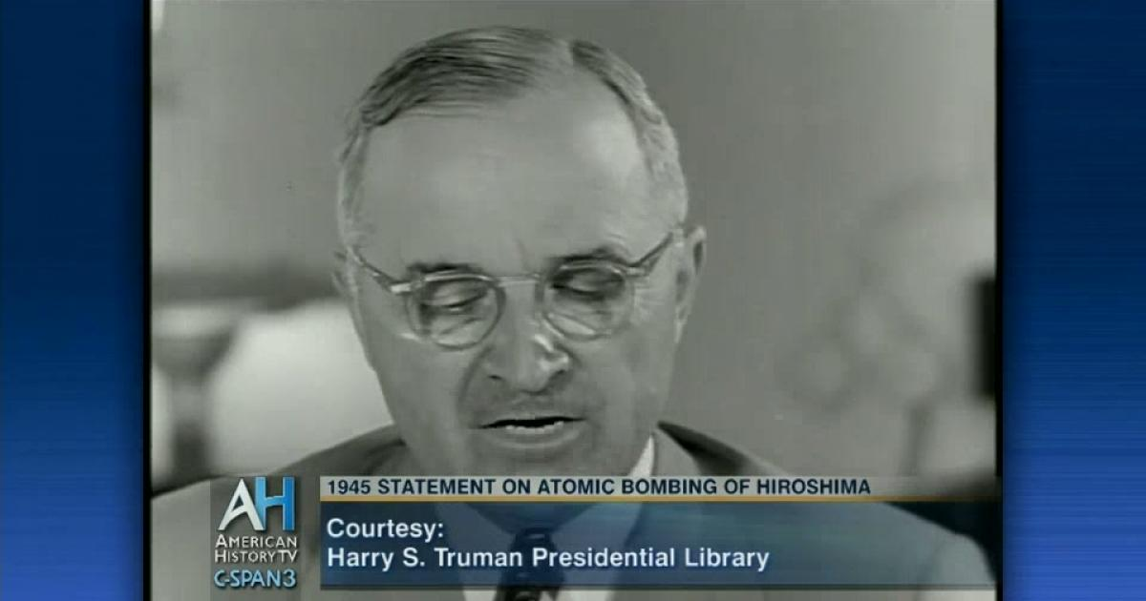
The NUCLEAR AGE begins
“Sixteen hours ago, an American airplane dropped one bomb on Hiroshima, an important Japanese Army base. That bomb had more power than 20,000 tons of T.N.T. ….
It is an atomic bomb. It is a harnessing of the basic power of the universe. The force from which the sun draws its power has been loosed against those who brought war to the Far East.”

Slide 4
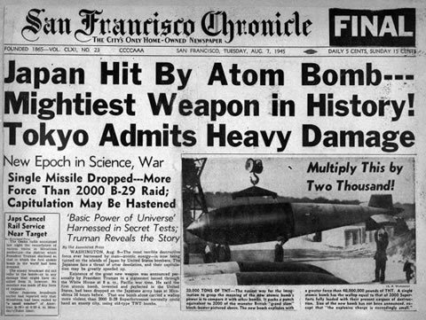
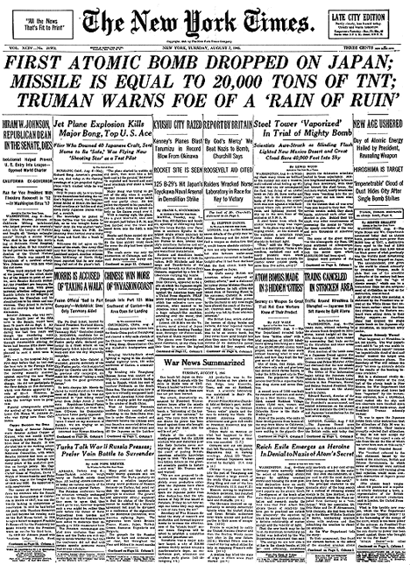
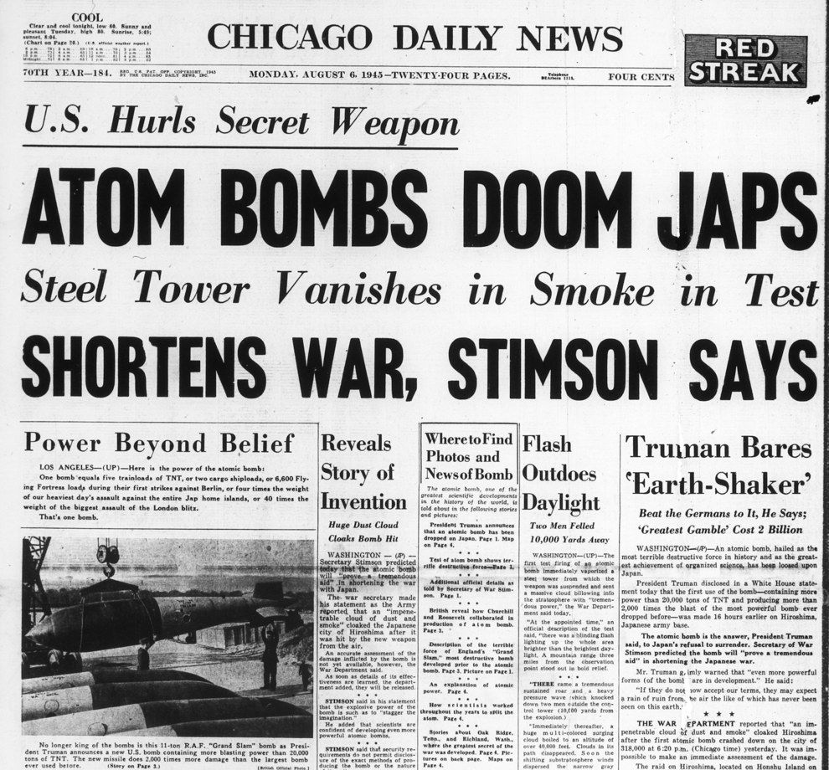

Slide 5
From a Nuclear Imagination
“We are now prepared to obliterate more rapidly and completely every productive enterprise the Japanese have above ground in any city. We shall destroy their docks, their factories, and their communications….If they do not now accept our terms they may expect a rain of ruin from the air, the like of which has never been seen on this earth.”

Slide 6
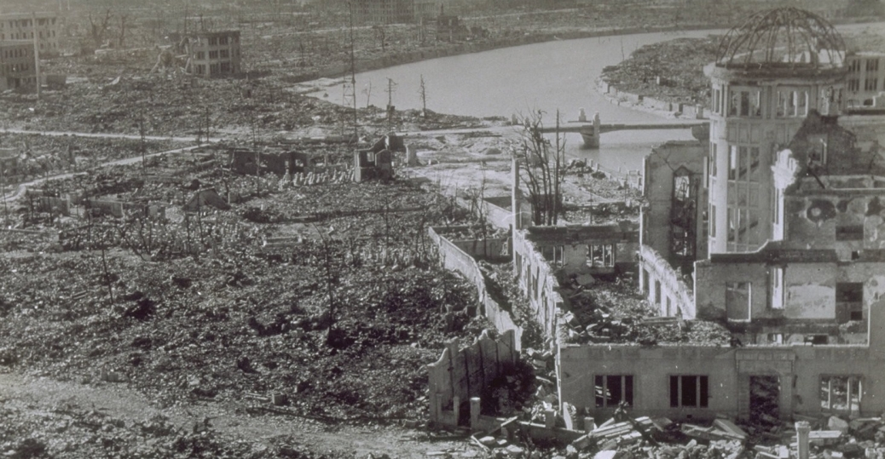
To a Nuclear Reality

Slide 7
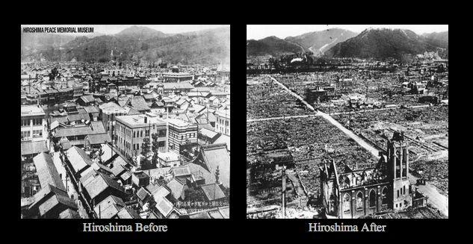
Notes:
The story of Hiroshima and the numbers

Slide 8

Notes:
It has been 62 years since the first use of atomic weapon in war – according to many studies however these 62 years without a nuclear detonation has been merely the result of luck rather than human rationality. I would like to say that in spite of our human irrationality no nuclear weapon has gone off since Hiroshima and Nagasaki
But please do not count on making it another 60 years.
According to the majority of the nuclear scenario studies, one of these scenarios will become true within 15-20 years..

Slide 9
Nuclear Weapons and the Art of War
Thus, the first and most vital step in any American security program for the age of the atomic bombs is to take measures to guarantee to ourselves in case of attack the possibility of retaliation in kind. . . . Thus far the chief purpose of our military establishment has been to win wars. From now on its chief purpose must be to avert them. (Brodie, 1946, p. 76)
Notes:
Kaufmann noted in 1958, deterrence consists of essentially two basic components: first, the expressed intention to defend a certain interest; secondly, the demonstrated capability actually to achieve the defense of the interest in question, or to inflict such a cost on the attacker that, even if he should be able to gain his end, it would not seem worth the effort to him. (Kaufmann, 1958, p. 2
Kaufmann’s definition points out that an intention includes two parts: “an expressed intention” and a “certain interest.” The first part is a declaratory policy that makes clear what is to be deterred.
At the same time, as Schelling noted, deterrence is often enhanced by not being entirely clear in declaratory threats, instead “leaving something to chance.”3 This again highlights the importance of the unknown in deterrence. If an opponent believes that taking an action that one wishes to deter will set in motion events that may escalate beyond the control of both parties, then uncertainty will make him less likely to take an action. This is particularly effective if the deterrent threat is matched by a counter threat of equal or greater magnitude from the opponent.
Yet it is worth mentioning that in the first phase of the nuclear age the United States who held at the time the nuclear monopoly seriously considered the use of nuclear weapons in over 20 episodes.
the key document “Possible courses of action” released by the National Security Council in 1950 the case of a preventive nuclear war against the Soviet Union is mentioned. In addition in 1950 with the Chinese-north Korean offensive forcing the United Nations forces rapidly southward, General MacArthur reported that the use of nuclear weapons against North Korea might be the only way to avoid the evacuation of his forces and Truman during a press conference confirmed that the actual use of nuclear weapons in that crisis was under active consideration.
In 1953 During the Eisenhower administration , the US considered the possibility of using nuclear weapons against China to force them to accept an armistice.
Again China became a possible target in 1955 and 1956 over the issue of offshore islands and most particularly Quemoy and Matsu.
And of course during the Cuba Missile Crisis in 1963.. Just to name a few of them..
This non comprehensive list should suggest that not all US nuclear thinkers accepted passively the concept of deterrence. Deterrence implies a certain degree of reciprocity and uncertaint

Slide 10
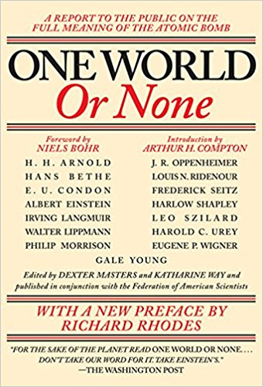
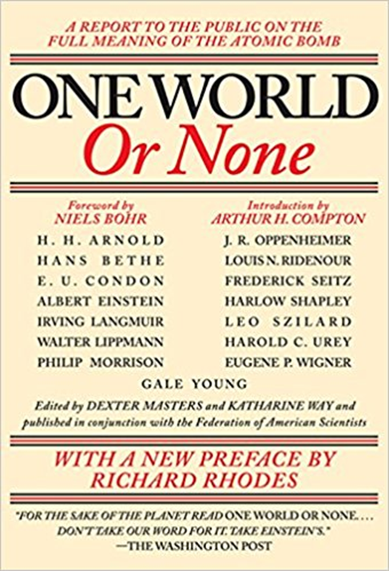
Revolutionize International Politics
It is urgent that the implications of the nuclear revolution and the magnitude of the nuclear danger be understood.
"We now have before us the clear choice between adjusting the pattern of our society on a world basis so that wars cannot come again, or of following the outworn tradition of national self-defense, which if carried through to its logical conclusion must result in catastrophic conflict" (Arthur Compton)

Slide 11
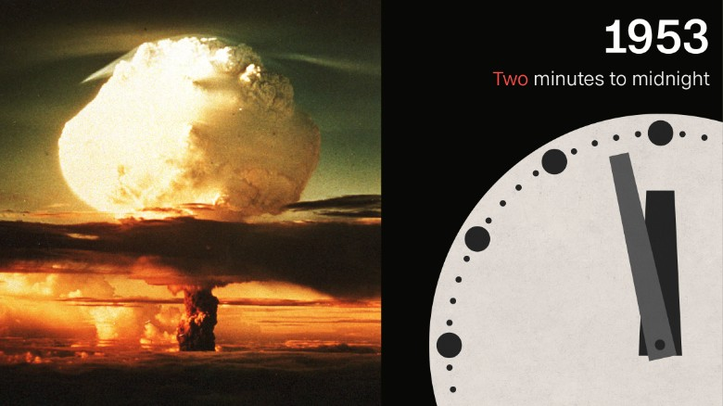
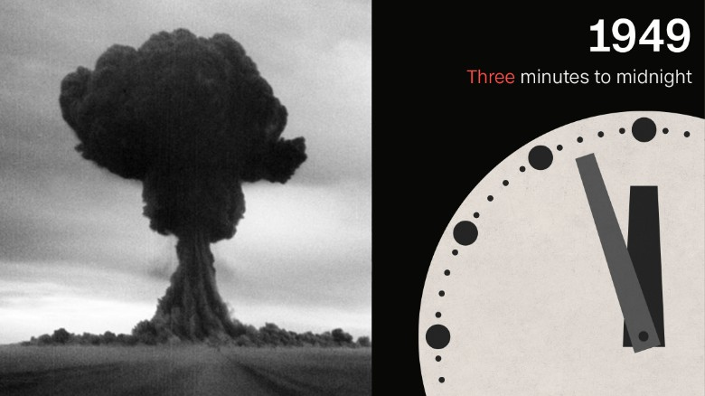
But something has gone wrong:
2 MINUTES TO DOOMSDAY
A rise in strident nationalism worldwide, President Donald Trump's comments on nuclear arms and climate issues, a darkening global security landscape that is colored by increasingly sophisticated technology, and a growing disregard for scientific expertise: we are now 2.5 minutes away from doomsday.

Slide 12
Three introductory concepts
Nuclear Weapons as WMD
Nuclear Stability requires Mutual Vulnerability
The Nuclear Taboo is eroding rapidly

Slide 13
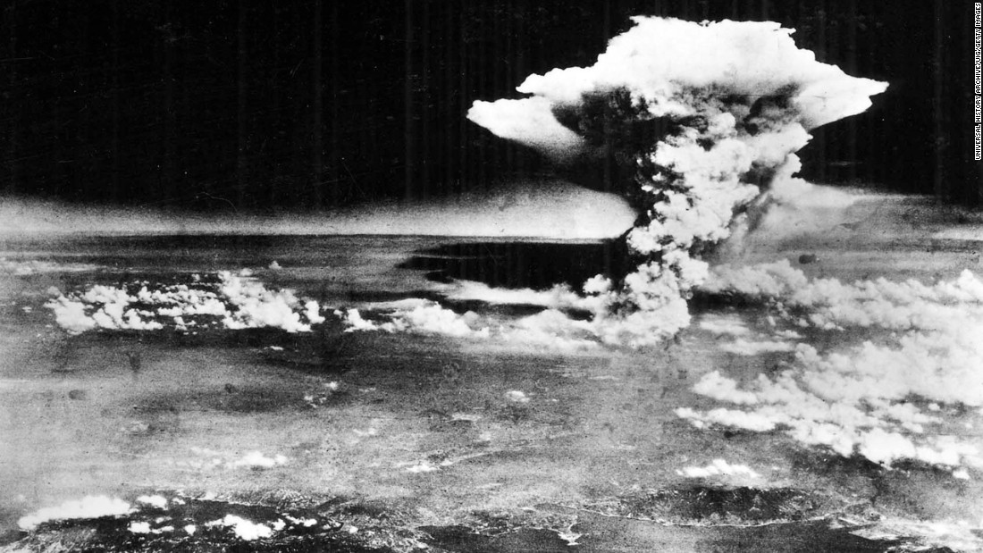
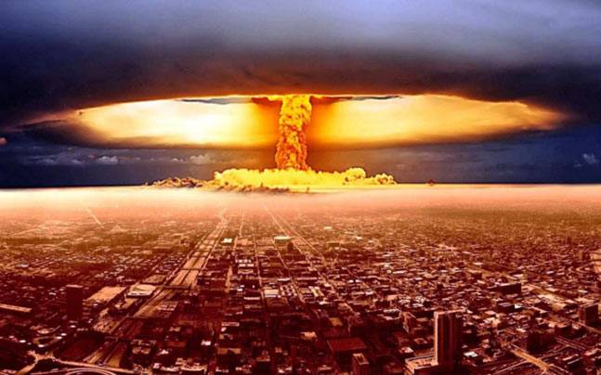
NUKES AS WMD
Hiroshima – ATOMIC WEAPON
135,000 direct casualties – another 60,000 indirect casualties (from 6-months onward)
Hiroshima and Nagasaki exploded with the yield of 15 kilotons and 20 kilotons of TNT
HYDROGEN BOMB SIMULATION
10,000 TNT (3 would wipe out Tokyo, 20 Millions)
Notes:
(no proportionality, no distinction – discussion about the principle of necessity)

Slide 14
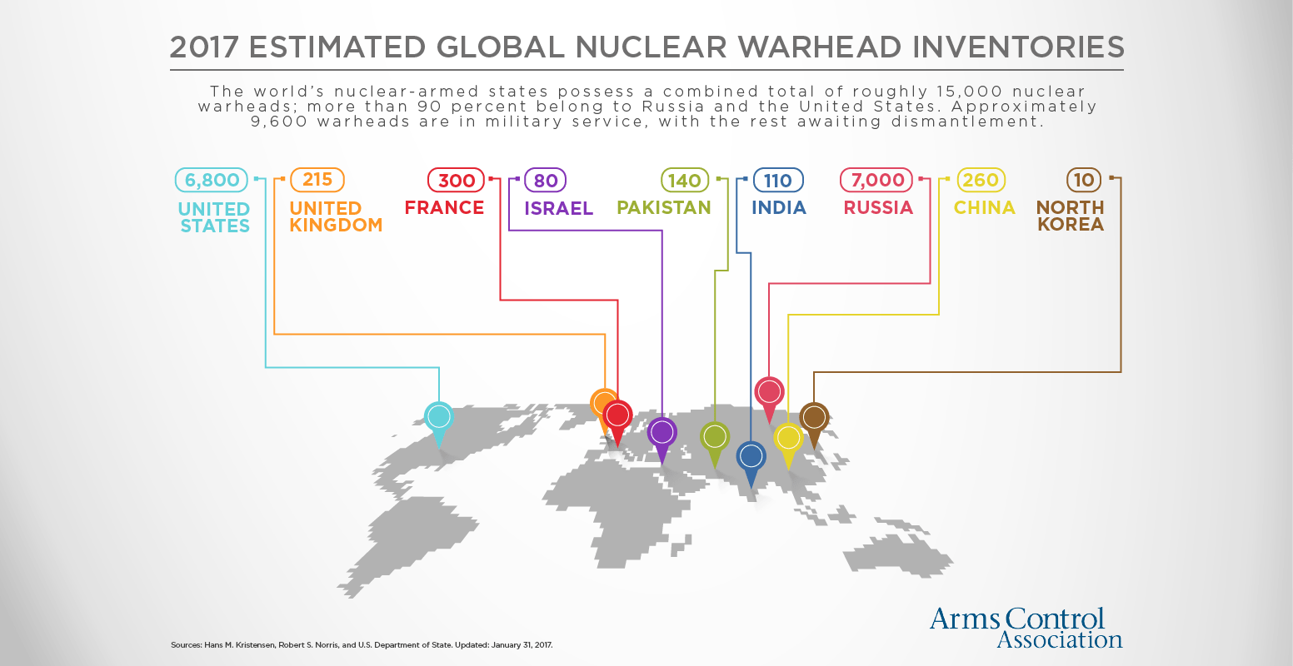

Slide 15
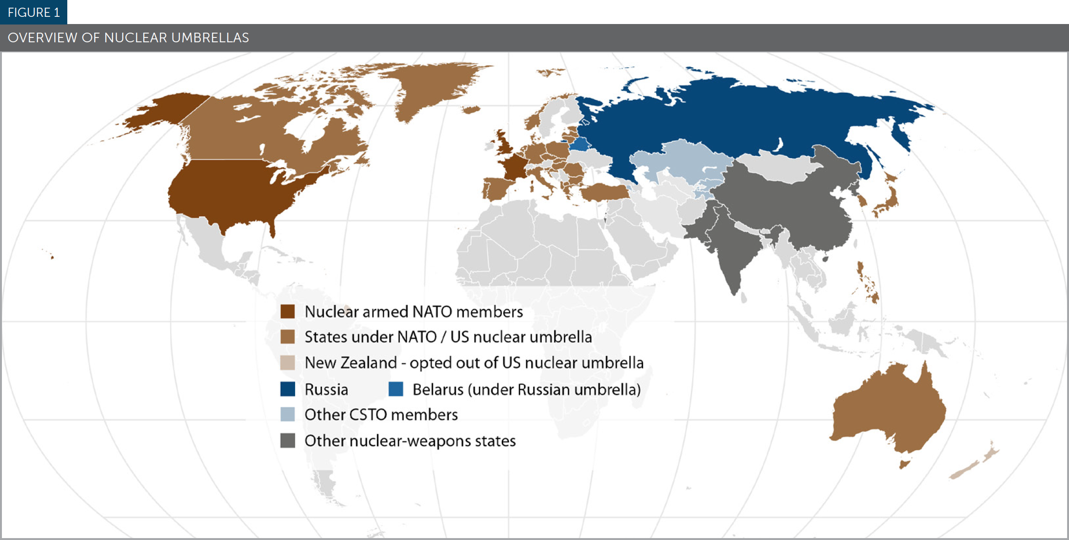
THE NORTH KOREA ISSUE
Notes:
FIRST STRIKE AND SECOND STRIKE

Slide 16
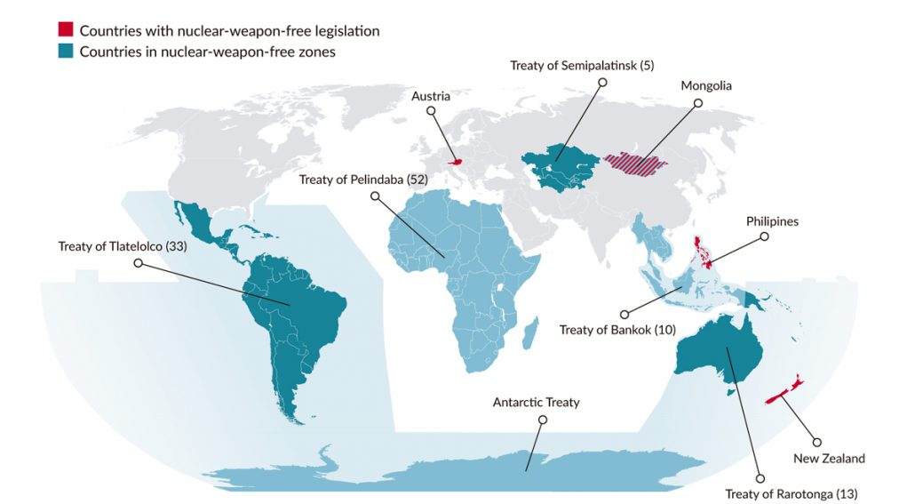
Nuclear weapons and the Global South
Notes:
FIRST STRIKE AND SECOND STRIKE

Slide 17
MEETING THE CHALLENGES OF THE NEW NUCLEAR AGE
US-RUSSIA NUCLEAR STABILITY IS COLLAPSING
TECHNOLOGY, ENTANGLEMENT AND ARMS RACE
THE NUCLEAR TABOO IS ERODING – MORE USABLE NUCLEAR WEAPONS
Notes:
The Conventional Argument is that…
Nuclear Weapons are the great stabilizer of the international system
Nuclear Deterrence is the ordering principle among Great Powers…
Nuclear weapons are for defense only
Is that true?
Russia and China expanding and diversifying their portfolio of nuclear weapons – the declaratory policy of these states is that nuclear weapons remain only for defence purpose however the expansion and the diversification of these nuclear arsenals are also conducted so to contain and constrain the United States. For instance the new Chinese naval nuclear program and the fleet of nuclear-capable submarines that china is developing is done specifically to respond to the increased naval presence of the united states in the south china sea and in the indian ocean.
Similarly when it comes to Russia, there is little doubt that all the nuclear bombers that Russia is currently modernizing would have a formidable impact on nuclear deterrence in Europe that is noticeable very weak when it comes to airpower and in addition – it goes without saying that fundamentally any possibility to get back to the negotiating table with the U.S.. for further nuclear reductions is long gone
India adoption of Cold Start doctrine (2011): The doctrine reorganises the Indian Army’s offensive power away from the three large strike corps into eight smaller division-sized battle groups that combine mechanized infantry, artillery, to prevent Pakistan from being capable of launching a nuclear attack
Pakistan has responded with the adoption of a new doctrine which involves the use of short range nuclear missiles against parts of the Pakistani territory to prevent the Indians to reach strategic positions - flexible deterrence options
Iran's Foreign Minister Mohammad Javad Zarif wrote in The Guardian last week that the concept of mutually assured destruction was "insane" and called for negotiations on a weapons elimination treaty.

Slide 18
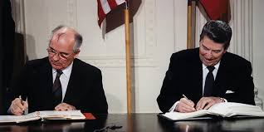
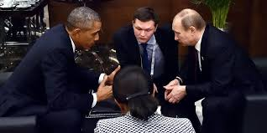
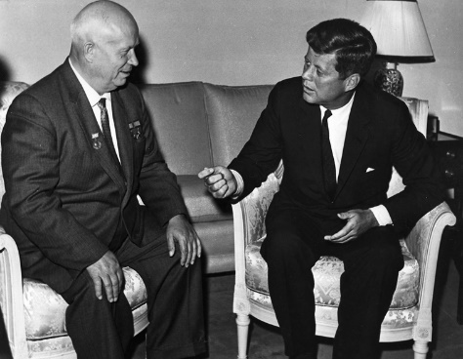
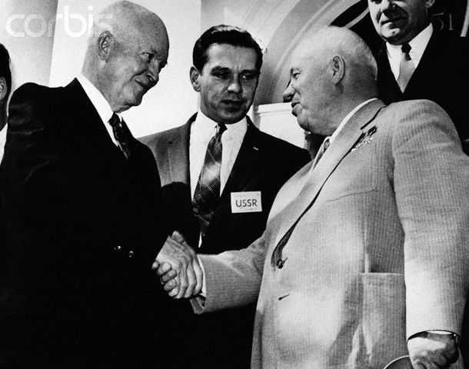
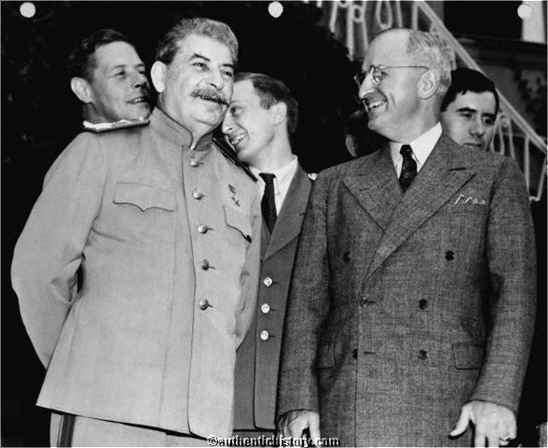
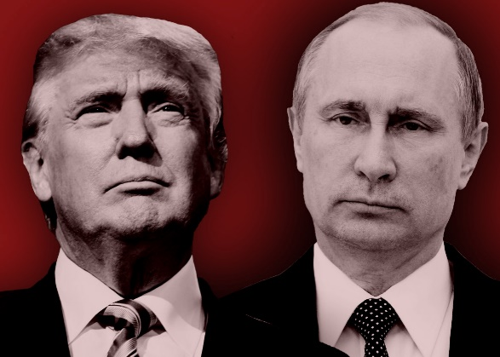
The US & Russia: The Cornerstone of the Global Nuclear Order
Lesson 2

Slide 19
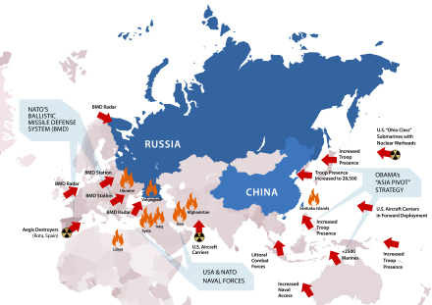
AMERICAN (NUCLEAR) SUPREMACY
Notes:
Missile Defense System
NATO ALLIANCES
RUSSIA IS ACCUSING US OF SEEKING PRIMACY (rejection of vulnerability)
ESCALATE TO DE-ESCALATE
Emergence of a nuclear triangulation with China

Slide 20
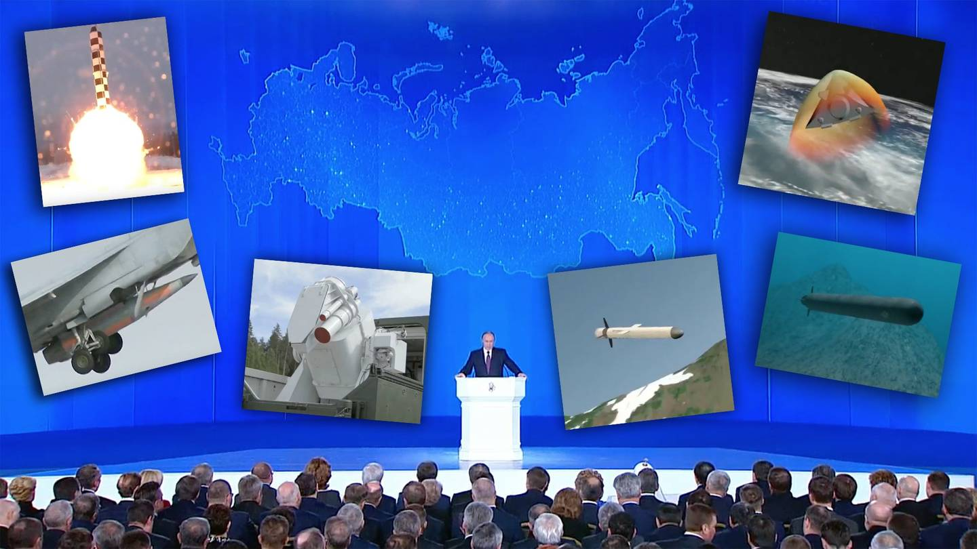
THE RUSSIAN RESPONSE
Notes:
Missile Defense System
NATO ALLIANCES
RUSSIA IS ACCUSING US OF SEEKING PRIMACY (rejection of vulnerability)
ESCALATE TO DE-ESCALATE
Emergence of a nuclear triangulation with China

Slide 21
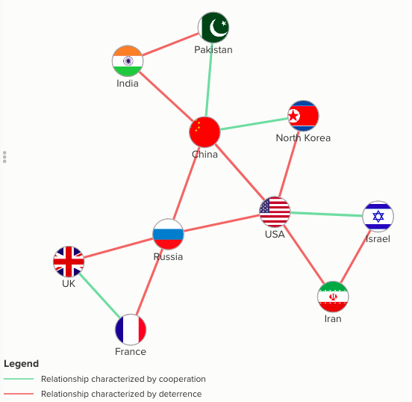
TECHNOLOGY, ENTANGLEMENT AND ARMS RACE
Drones
Cyber weapons
Space
Artificial Intelligence
Hypersonic Missiles
Figure 1: The Five Triangles Model
Notes:
The Conventional Argument is that…
Nuclear Weapons are the great stabilizer of the international system
Nuclear Deterrence is the ordering principle among Great Powers…
Nuclear weapons are for defense only
Is that true?
Russia and China expanding and diversifying their portfolio of nuclear weapons – the declaratory policy of these states is that nuclear weapons remain only for defence purpose however the expansion and the diversification of these nuclear arsenals are also conducted so to contain and constrain the United States. For instance the new Chinese naval nuclear program and the fleet of nuclear-capable submarines that china is developing is done specifically to respond to the increased naval presence of the united states in the south china sea and in the indian ocean.
Similarly when it comes to Russia, there is little doubt that all the nuclear bombers that Russia is currently modernizing would have a formidable impact on nuclear deterrence in Europe that is noticeable very weak when it comes to airpower and in addition – it goes without saying that fundamentally any possibility to get back to the negotiating table with the U.S.. for further nuclear reductions is long gone
India adoption of Cold Start doctrine (2011): The doctrine reorganises the Indian Army’s offensive power away from the three large strike corps into eight smaller division-sized battle groups that combine mechanized infantry, artillery, to prevent Pakistan from being capable of launching a nuclear attack
Pakistan has responded with the adoption of a new doctrine which involves the use of short range nuclear missiles against parts of the Pakistani territory to prevent the Indians to reach strategic positions - flexible deterrence options
Iran's Foreign Minister Mohammad Javad Zarif wrote in The Guardian last week that the concept of mutually assured destruction was "insane" and called for negotiations on a weapons elimination treaty.

Slide 22
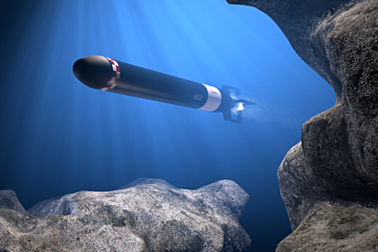
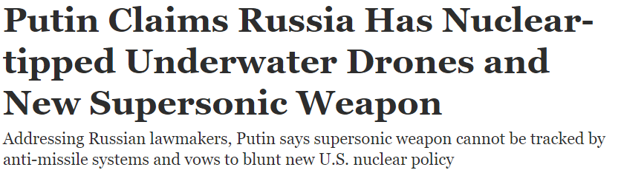
Russia and the domination of the deep sea

Slide 23
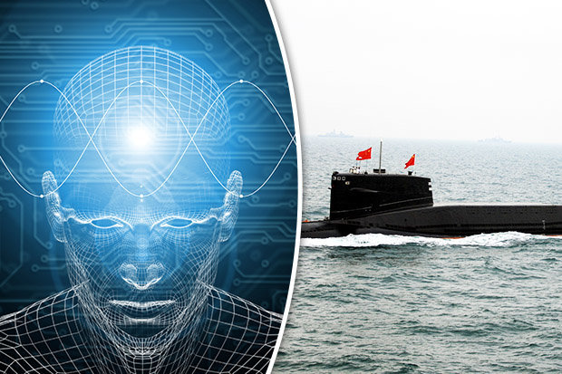
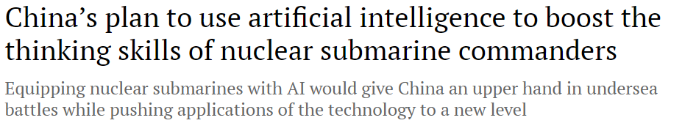
China and Artificial Intelligence

Slide 24
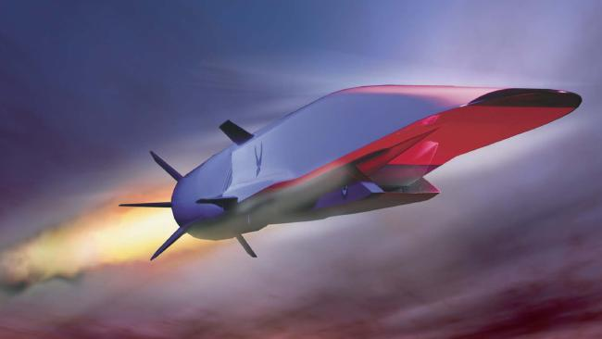
United States and Hypersonic Missiles

Slide 25
The nuclear taboo is eroding
(or long gone?)
Russia National Security Strategy (escalate to de-escalate)
United States Limited Nuclear War Strategy (Cyber)
Pakistan Nuclear Posture (Tactical Nuclear Weapons)
India New Nuclear Posture (Preventive Nuclear War and Links to Counter Terrorism)
Notes:
The Conventional Argument is that…
Nuclear Weapons are the great stabilizer of the international system
Nuclear Deterrence is the ordering principle among Great Powers…
Nuclear weapons are for defense only
Is that true?
Russia and China expanding and diversifying their portfolio of nuclear weapons – the declaratory policy of these states is that nuclear weapons remain only for defence purpose however the expansion and the diversification of these nuclear arsenals are also conducted so to contain and constrain the United States. For instance the new Chinese naval nuclear program and the fleet of nuclear-capable submarines that china is developing is done specifically to respond to the increased naval presence of the united states in the south china sea and in the indian ocean.
Similarly when it comes to Russia, there is little doubt that all the nuclear bombers that Russia is currently modernizing would have a formidable impact on nuclear deterrence in Europe that is noticeable very weak when it comes to airpower and in addition – it goes without saying that fundamentally any possibility to get back to the negotiating table with the U.S.. for further nuclear reductions is long gone
India adoption of Cold Start doctrine (2011): The doctrine reorganises the Indian Army’s offensive power away from the three large strike corps into eight smaller division-sized battle groups that combine mechanized infantry, artillery, to prevent Pakistan from being capable of launching a nuclear attack
Pakistan has responded with the adoption of a new doctrine which involves the use of short range nuclear missiles against parts of the Pakistani territory to prevent the Indians to reach strategic positions - flexible deterrence options
Iran's Foreign Minister Mohammad Javad Zarif wrote in The Guardian last week that the concept of mutually assured destruction was "insane" and called for negotiations on a weapons elimination treaty.

Slide 26
Russia Defense Strategy 2009/2014
The Russian Federation reserves the right to use nuclear weapons in response to the use of nuclear and other types of weapons of mass destruction against it and (or) its allies, as well as in response to large-scale aggression utilizing conventional weapons in situations critical to the national security of the Russian Federation and its allies
Cannot rule out the possibility of a pre-emptive strike with Nuclear Weapons

Slide 27
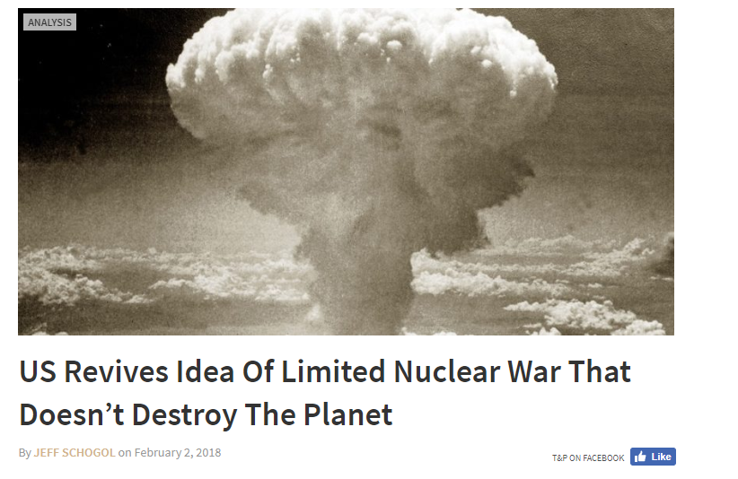
Limited Nuclear War Strategy

Slide 28
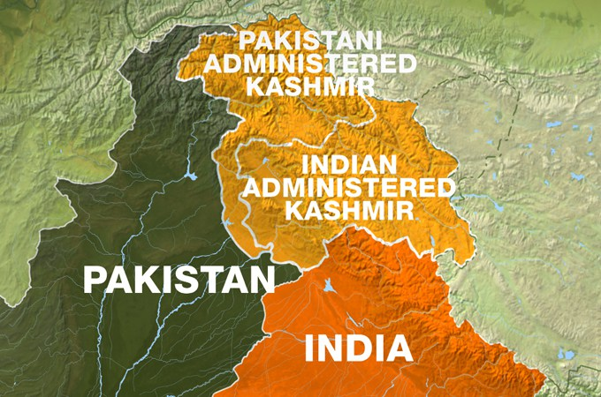
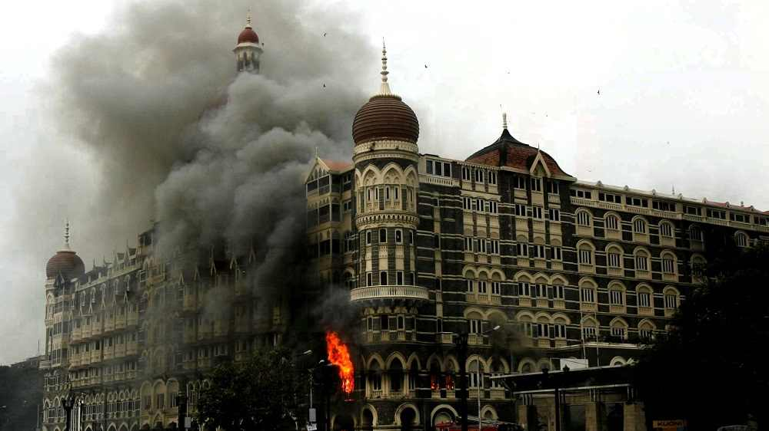
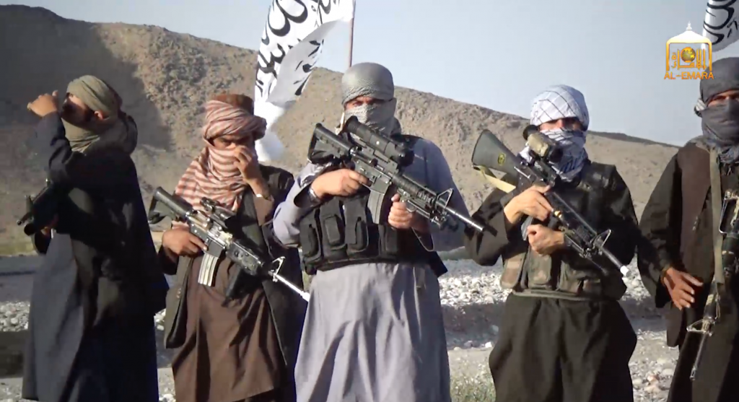
Terrorism and Nuclear Weapons: Pakistan and India
429 miles between capitals
Delhi – Islamabad = New York-Boston (469 miles)
4,861 DC and Moscow
6,927 Beijing and DC
3,600 Beijing Moscow
2,371 Beijing Delhi
2,412 Beijing Islamabad
Notes:
Complex deterrence is not necessarily nuclear – in fact complex deterrence is in part complex because it has to accommodate both conventional and nuclear elements – and both being active and preventing, and passive and containing
Complex deterrence is also not necessarily about states – but rather it is about actors and their capabilities – this is particularly important because for many years deterrence was understood simply as a mechanism of engagement among state-actors – unitary rational actors – with a specific chain of command – states also in the conventional IR literature operates based on some assumptions like survival and relative power
This leads me to the third point: Complex deterrence is not necessarily about rationality: it is about actors’ motives and intentions – for many years the assumption of deterrence was based on the idea that the state wanted to survive and maintain in tact its territory on which its sovereignty is based – today non state actors are not necessarily concerned about survival nor territory, nor they operate with a system of command and control that states have.
There are of course very complicated relations among all these elements – that require a new approach to deterrence that is far more fluid and in a way inter-disciplinary.
Finally and most importantly: what is the real purpose of deterrence today?
The concept of deterrence that was for the first time put forward by Bernard Brodie at the beginning of the nuclear age in 1945 was the following: “Thus far the chief purpose of our military establishment has been to win wars. From now on its chief purpose must be to avert them”.
Is the purpose of deterrence today to avert wars? The answer is: it depends. In some cases, the purpose of deterrence is to prevent actors from acquiring certain capabilities or to dissuade actors from behaving in a certain manner. The concept of deterrence under which we operates today is far broader and in a way vague because it has to encompass multiple strategic situations.

Slide 29
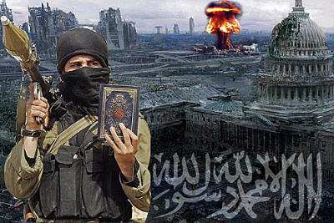
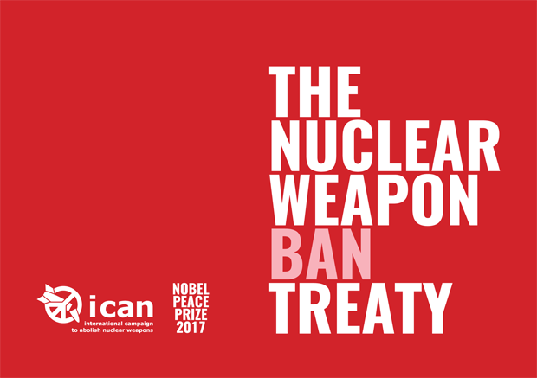
The Future of The Global Nuclear Order:
Threats and Opportunities

Slide 30
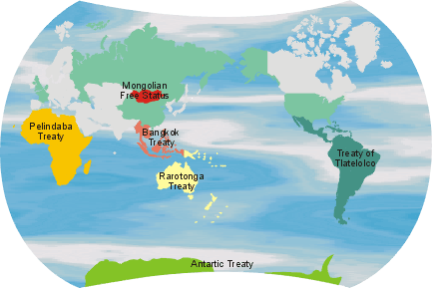
NUCLEAR WEAPONS FREE ZONE TREATIES
More than 110 states covered
Antarctic (1959)
Latin America and the Caribbean (Tlatelolco) (1967)
South Pacific (Rarotonga) (1986)
South East Asia (Bangkok) (1995)
Mongolia (2000) (NUCLEAR WEAPONS FREE STATUS)
Africa (Pelindaba) (2009)
Nuclear Waste and no destruction
of nuclear facilities
Central Asia (?)
Middle East (?) WMD not only nuclear
South Asia (?)
Notes:
A NWFZ prohibits the development, manufacture, stockpiling, acquisition, possession, control, assistance in research on the development, manufacture, stockpiling or acquisition, or possession, of any nuclear explosive device within the zone of application by any contracting party. Peaceful applications and uses of nuclear energy, under appropriate IAEA safeguards, are allowed
The first NWFZ to affect a major inhabited region applies to Latin America, and was open for signature in 1967, prior to the signing of the NPT. The impetus for it was the stationing of Soviet nuclear missiles in Cuba during the Cuban missile crisis of 1962

Slide 31
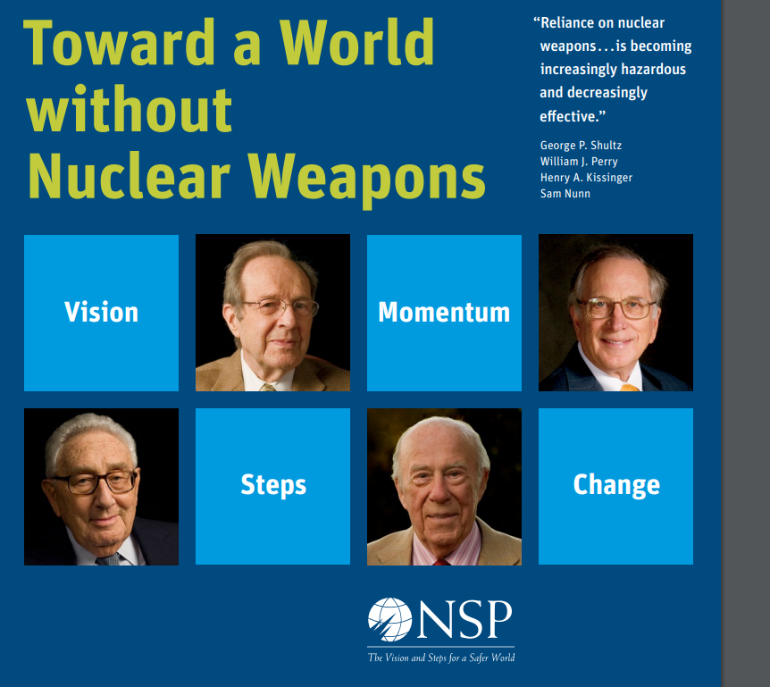
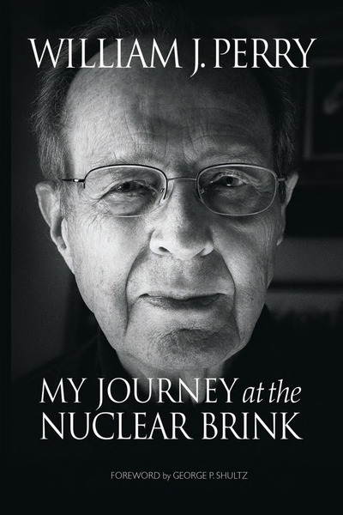
Global Zero
(from the Four Horsemen article)
“The gravest security threat of our time is the danger of a nuclear weapon being detonated in one of our cities.” — My Journey at the Nuclear Brink (Secretary William Perry)

Slide 32
Global Zero
(from the Four Horsemen article)
“It is not possible to replicate the high-risk stability that prevailed between the two nuclear superpowers during the Cold War. …The growing number of nations with nuclear arms and differing motives, aims and ambitions poses very high and unpredictable risks and increased instability…Does the world want to continue to bet its survival on continued good fortune with a growing number of nuclear nations and adversaries globally?
Continued reliance on nuclear weapons as the principal element for deterrence [by the U.S. and Russia] is encouraging, or at least excusing, the spread of nuclear weapons, and will inevitably erode the essential cooperation necessary to avoid proliferation, protect nuclear materials and deal effectively with new threats,” the statesmen wrote.

Slide 33
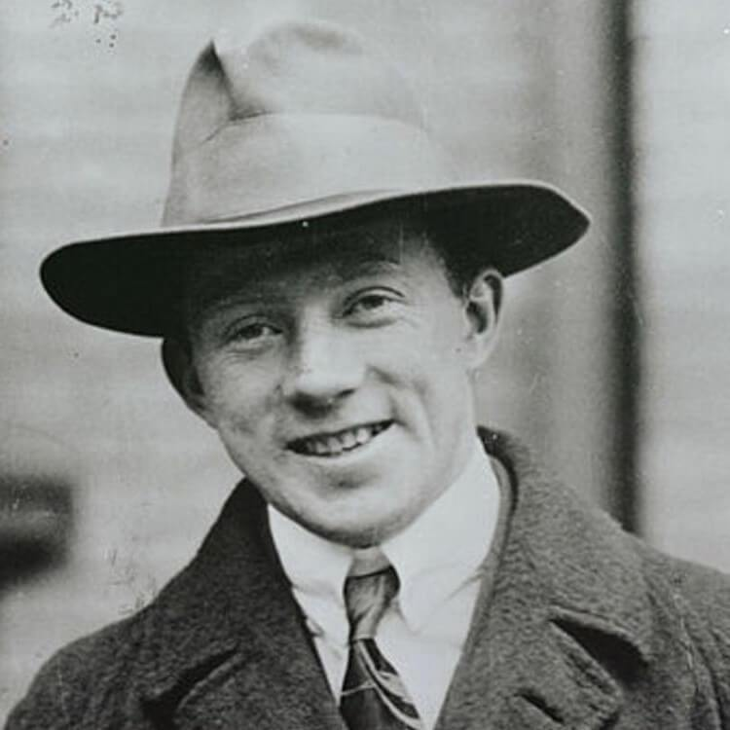
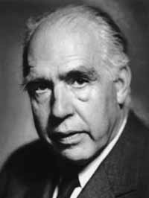
The Nuclear Journey is the Man Journey away from his own self-destruction
Werner Karl Heisenberg
Niels Bohr
COPENHAGEN, SEPTEMBER 15, 1941

