Slide 1

Our Vision for the Future
Notes:
STUART
Reference to letter
Continuing development of strategy implementation
Thank staff
Major impediment of theme
Refer to resource requirement
Reference Core Essence statement
Reference need for cultural change/behavior
Membership change
Background on session objectives

Slide 2
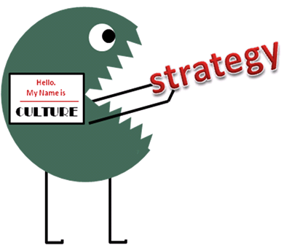
Culture/Behavior Shift
Notes:
STUART
We talked a lot about this at the last SPC in September as we considered the particular opportunities and challenges of each strategic priority. In my letter to you I shared some observations about where we are and spoke to a select few and significant challenges that tangibly inhibit realizing our mission.
I’m calling these out in particular because they affect progress in all of the priorities. In this report I hope it will become clear how and to what extent these issues are obstacles.
Annual themes/”my year” mentality – promotes short over long term goals and planning
Rigid rules and outdated language (attendance over engagement)
Lack of diversity and negative perception, particularly with regard to gender imbalance
Disconnect between decisions, strategic progress and financial impact
With the help of staff, the committee was able grasp the far reaching nature of these issues and also to guide and support the general secretary in its effort to serve RI.
There are many decisions brought forward for your consideration which we believe will give RI the starting advantage to implement its strategy
Culture is resistant to change
The selection, analysis and discussion of obstacles to progressing in our priorities is fact-based and thoroughly considered.
Going to highlight the most significant in each priority that require action or direction.
However inspiring the annual themes are, if you look beyond the convention, they present surprising obstacles:
Inhibits long term planning at all levels
Diverts attention, energy and resources from Rotary’s shared priorities
Fractures Rotary’s brand image.
Over time, Rotary has allowed the rules to define the culture
Rotary is not its rules. Rotary is its members and it’s members’ achievements.

Slide 3
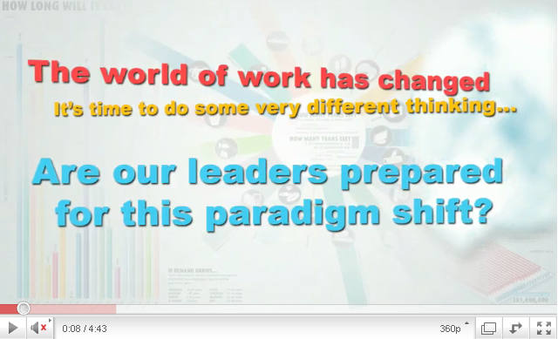
The world has changed…
Notes:
STUART
As background for the SPC’s report, I’d like to show you a video that illustrates the shifts in social and work culture that shape the environment and mindset of our New Generations . The world of work has changed, is Rotary ready? Are WE ready?

Slide 4

Our Research
Who?
Expensive?
Accomplishments?
Not diverse?
Inflexible?
Old?
Exclusive?
Notes:
STUART
We all know how we are perceived.
To some who know us, they perceive us as:
Able to get things done
Having great connections
And significant resources
While making an impact
Others, however, do not perceive us in a positive light.
<<click>>
They don’t know who we are and the good things we do
We deserve a better brand image and greater awareness of who we are and what we do!

Slide 5
Key Learning
1
COST
2
TIME CONSTRAINTS
3
EXCLUSIVITY
4
ACTIVE SERVICE
5
GENERATIONAL DIVIDE
Notes:
JOE
1. High financial burden for younger members, especially when they are starting out with their families and careers
2. Understanding and being aware of different time schedules – some meeting times can’t fit into professionals’ schedules Moving to new locations Weekly obligations Need to keep a sense of commitment and community
3. More welcoming environment for Rotaractors/new members/Use aspirational aspects of Rotary to leverage their strengths and buy-in
4. PASSIVE versus ACTIVE service
Service need to be more “hands-on” and ACTION-oriented, need to feel high SROI
Check-writing oriented vs. Service-oriented
Balance between local and global service
Function of money versus time
5. Rotarians are less aware of Rotaract members
Sometimes less welcoming to new members
Less connection with Rotaract and Interact, there needs to be more nurturing of the young future members

Slide 6
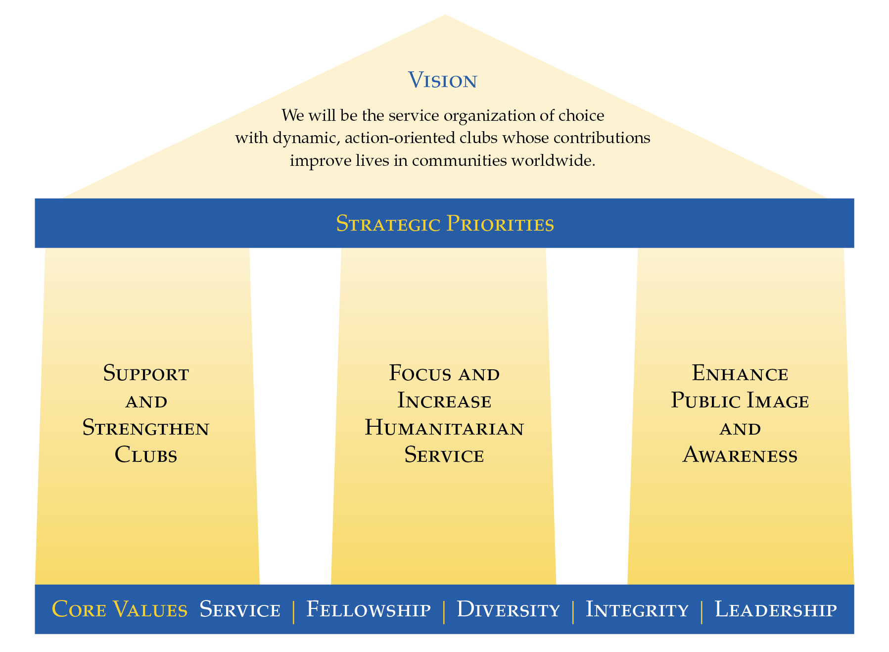
Revised RI Strategic Plan
Notes:
JOE
progress is made through collaboration and cooperation,
the SPC, members of the Board of Directors and the general secretary have been methodically working together on a systematic strategic approach to implementation.
Using an action-oriented and measurable method that is modeled on best practices in business.
Board assigned Priorities & Goals/
SPC w/ staff and board input develops Measures/Targets/Tactics
Actions and progress since November 2010
September 09 Board adopted revised RISP recognizing and addressing strengths and weaknesses
1 May 2010 Director/SPC/general secretary meeting generating plan measures
June 2010-ongoing SPC/Director/general secretary goal teams defining and refining measures, developing tactics and identifying significant obstacles
This process has resulted in some pretty clear obstacles that have to be addressed
The obstacles are consequential in large part because many are based in cultural practice. Effecting culture change is by far more difficult than changing business practice. Culture change is emotional.

Slide 7
Support and strengthen clubs
Shift to engagement
Online club planning and evaluation tool
Make Rotary language contemporary (e.g. HOF to Rotary Expo/Showcase make-up to visit)
Amend membership requirements to match career and social trends
Notes:
JOE
Highlights of the decision E-14-a include
Encourage clubs to try out new ideas and operations (pilot test ideas)
Encourage collaboration among clubs in the same community to fundraise, do service, etc.
Allow clubs greater leeway to measure member involvement/commitment beyond attendance
Request the COL to change select rules and
increase # of e-clubs
Update terminology to include fewer “Rotary-only” worlds
Improve club data collection and reporting tools (on-line assessment tool)
Decisions forwarded under E-14 will enable broader, more sustainable growth by empowering clubs to be innovative and focus on their local needs

Slide 8
Focus and Increase Humanitarian Service
RI programs resource and support model
  Focus support on service—international, community, and vocational
  Help clubs find partners
  Improve resources in developing projects
  Expand cooperative relationships
Connect and attract all Rotary alumni
  Return on our investment in alumni
Notes:
JOE
The board is already considering a proposal to add a New Generations Program (EarlyAct) which will add cost if approved
SPC endorses the recommended changes to the RI Programs Structure in E-14-b phasing out two programs and to centralize the Rotary Volunteer database and ProjectLink under a redesigned Rotary Friendship Exchange.
The SPC also supports the creation of a joint RI/TRF alumni relations function to take advantage of the benefit of combining the organization’s alumni efforts.
Point out that annual themes inhibit clubs from doing longer term, sustainable service

Slide 9

Enhance Public Image and Awareness
Increasing districts public relations grant funding to support and expand successful PR initiatives
Notes:
STUART
Value of PR grants
Underfunding
4-6:1 Ratio
Rotary is well known in the international arena (UN/gov’t)
Need to help clubs and districts reach out to prospective members and the general public to help them understand the Rotary brand promise of service integrity, networking and relationships
E-14-c decisions help:
Raise our profile locally
Encourages multi-district cooperation in publicizing Rotary achievements
More needs to happen –
Need to provide tools and training to Rotarians in PR – leveraging the contributions of PIRF

Slide 10












Brand Confusion?
Notes:
10
STUART
Several obstacles. The one on screen is only one, but a significant one.
Rotary brand recognition diluted by annual themes and internal program logos
Every time a new logo is introduced,
Further complicated by the lack of PR skills, knowledge and material hinders local recognition
Networking and vocational service under-promoted

Slide 11
Potential Corporate Change
Notes:
11
STUART

Slide 12


Strengthening our Brand
Notes:
12
STUART

Slide 13
Controlling our Brand
Rotary Youth Exchange
Rotary Youth Leadership Awards
Rotary Friendship Exchange
Rotary Fellowships
Notes:
13
STUART

Slide 14
Enhance Public Image and Awareness
Standardizing logo use
Phase out program logos
Simplified access to Rotary marks increases use and raises Rotary’s profile
Is it time to revitalize our logo?
Notes:
STUART
Value of PR grants
Underfunding
4-6:1 Ratio
Rotary is well known in the international arena (UN/gov’t)
Need to help clubs and districts reach out to prospective members and the general public to help them understand the Rotary brand promise of service integrity, networking and relationships
E-14-c decisions help:
Raise our profile locally
Encourages multi-district cooperation in publicizing Rotary achievements
More needs to happen –
Need to provide tools and training to Rotarians in PR – leveraging the contributions of PIRF

Slide 15
Administrative/Governance
Strategic impact of all decisions
Regular updates on scorecard
President-elect and –nominee contact
Notes:
STUART pt 1
JOE pt 2-3
E-14-d supports the continuing effort to support the board’s strategic decision making.
Board decisions inadequately supported without strategic impact information (E-14-d.4)
Inconsistent measuring and monitoring of organizational progress (E-14-d.2)
These decisions do not address how long term planning impeded by annual leadership themes and turnover
Provides a consistent measuring tool and report system that helps maintain continuity across presidential years

Slide 16
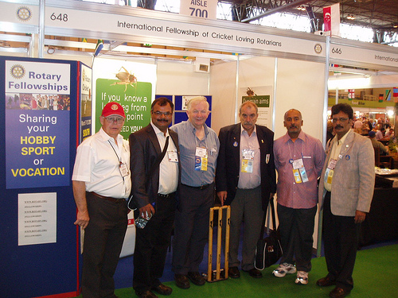
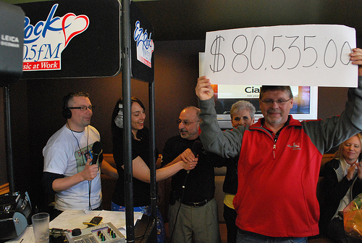
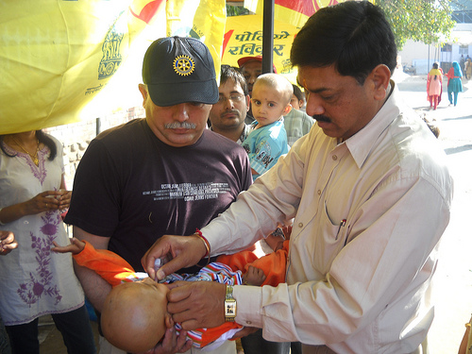
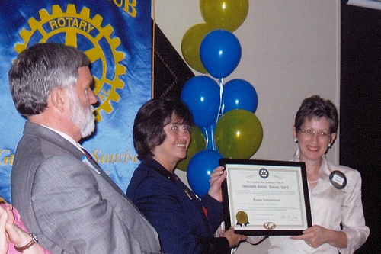
Our Core Essence
A worldwide network of inspired individuals who translate their passions into relevant social causes to change lives in communities.
16
Notes:
JOE (with Stuart interjecting)
Is this the promise land?
Here’s a take on our core essence from an outsider’s perspective recently shared with several board members….
Does this translate our purpose and meaning more powerfully? Would the younger generations view Rotary as a more relevant organization if this is their perspective?
Believe it or not, this is one perspective about Rotary from a bunch of university graduate students. How motivating is this?

Slide 17
Revisions to Goals
Support and Strengthen Clubs | Focus and Increase Humanitarian Service | Enhance Public Image and Awareness
Foster club innovation and flexibility Encourage clubs to participate in a variety of service activities Balance activities in all Avenues of Service Promote membership diversity Improve member recruitment and retention Develop leaders Start new, dynamic clubs Extend Rotary Encourage strategic planning at club and district levels | Eradicate polio Increase sustainable service focused on in New Generations programs TRF’s six areas of focus Increase collaboration and connection with other organizations Expand strategic partnerships and cooperative relationships Create significant projects both locally and internationally | Unify image and brand awareness Publicize action-oriented service Promote core values Emphasize vocational service Encourage clubs to promote their networking opportunities and signature activities
Notes:
JOE

Slide 18
COLLABORATE
Bringing together people of all ages and experiences to foster and build the Rotary community
REVITALIZE
Embracing a mindset of change to rejuvenate the Rotary organization
ENERGIZE
Moving and energizing members to take on greater responsibility and action in building up the Rotary organization
Notes:
JOE
Sort of language to use in future; the way of the future
To highlight Rotary existing resource tools: district governors and people to spread the word and message
SL: I think maybe verb form is more powerful, so collaborate, revitalize, etc. While I love the overall connotation of revitalize, I’m not sure I love the think it fits because I think it’s more of an overall solution, not so much a step to get there. Thoughts? Embrace isn’t as strong but seems a little more fitting…I don’t know, what do y’all think? Maybe:
Embrace – Welcome a new generations’ approach to service and social while respecting Rotary’s traditions to co-exist within a more dynamic, sustainable organization’
The other thought I had was that if we look at it more as a linear progression of steps rather than 3 general pillars all at the same time, maybe collaborate (work together, mentorships, old clubs help start new clubs, etc.) → revitalize (new clubs and more dynamic clubs like Capital Hill thrive and inspire people, reinvigorating Rotary) → co-exist (through their collaboration and revitalization they can now coexist for a better Rotary)
Might be a dumb idea, just throwing things out there
I also thought inspire, collaborate, activate go well together (they all indicate empowerment to me)
I also liked provoke and just a few other suggestions: energize, galvanize, inflame. More generally in terms of fitting them together, I think collaboration is vital and then one that suggests the inspiring their mind and one that suggests their action upon this….that’s how I think of empowerment anyway…btw you can call me if I was just really confusing
TH: I like the idea of verb form, but either way I think it will work. Here are my suggestions for the third word: Implementation or Execution (either or)
"Effect change and achieve objectives through Rotary-wide acceptance and implementation or execution of strategies."
With the above, I just think the point needs to get across that necessary steps should be taken to implement!
18

Slide 19

THE ROTARY BRAND STORY
Notes:
STUART

Slide 20
Summary of Key Suggestions
Shift culture (attendance to engagement)
More contemporary Rotary language
Amend membership requirements
Create online club planning and evaluation tool
Transform RI Programs to resource model
Connect and attract all Rotary alumni
Expand funding of PR grants to US$4M
Strengthen and control Rotary’s brand
  Standardize, phase-out, and revitalize

Slide 21
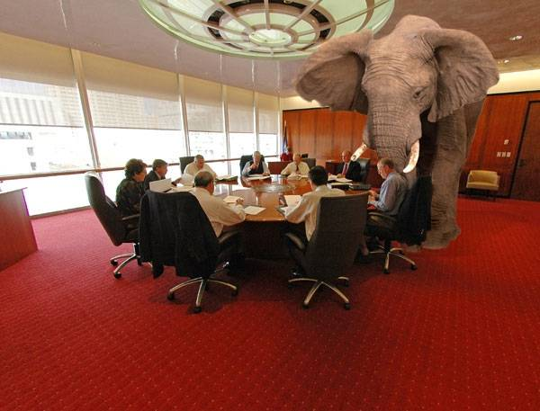
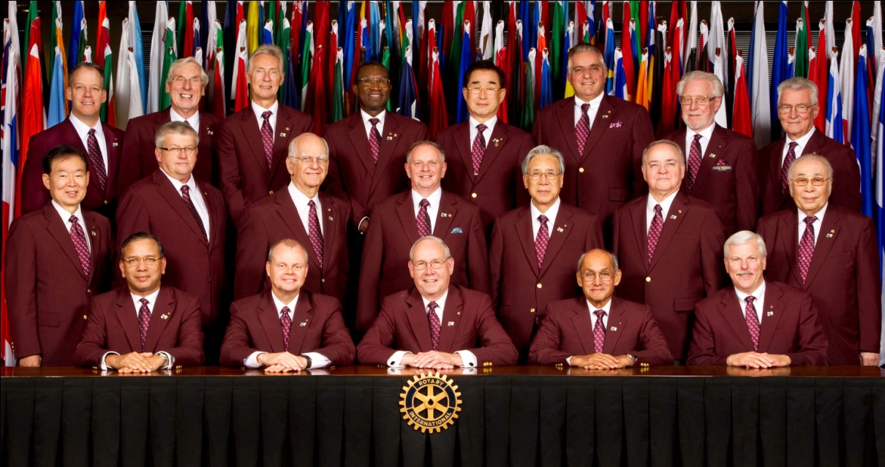
Cultural challenges
Notes:
STUART
Annual theme affects all priorities, diverting resources, diluting the brand and inhibiting long term orientation at all levels
Modernizing
The Rotary wheel
Club structure
Terms and terminology
Grass roots driven
Navigating the Council on Legislation
Paul harris urged us to mind the times. Change with the world
“– We must never permit ourselves to become a super-exclusive, hide bound little body…” 1918 RI Convention
Need to bring the organization along and plan a strategy to address those items that require the Council’s action.

