Slide 1
INK 03: Ten Steps to the Four Way Test

Slide 2
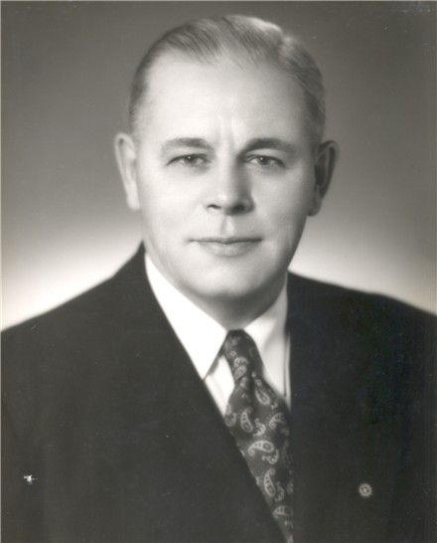
[1] Beginnings
Introduced by Herbert Taylor in early 1932 – to help save the Club Aluminium Company from bankruptcy

Slide 3
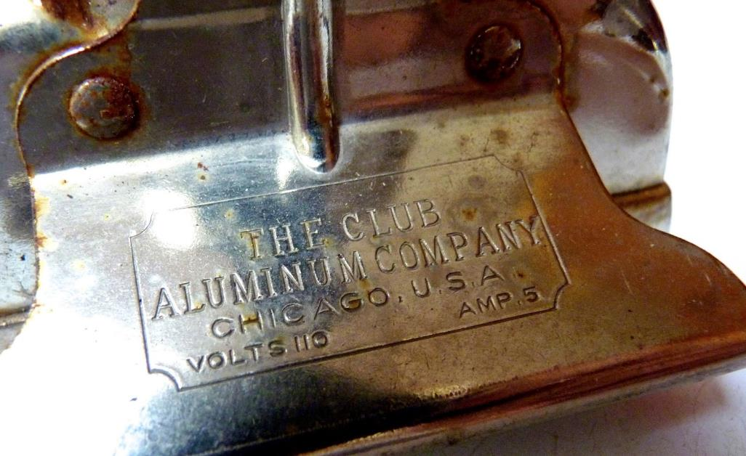
[2] Need For a Code
Taylor wanted a simple measuring stick of ethics which everyone in the company could quickly memorize

Slide 4
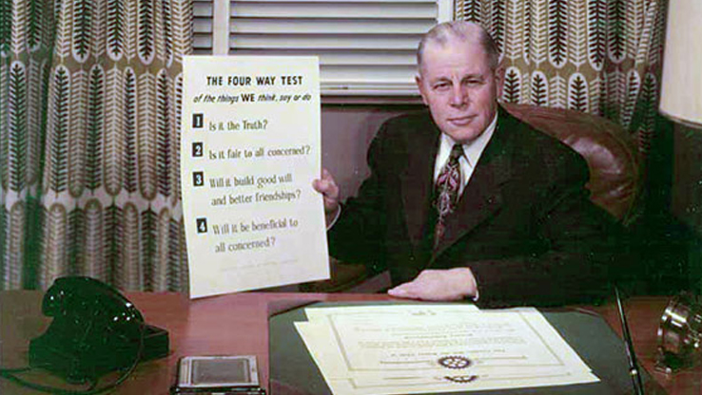
[3] Writing the Code
In July, 1932, Taylor reflected long and hard, then wrote out the complete test on white card

Slide 5
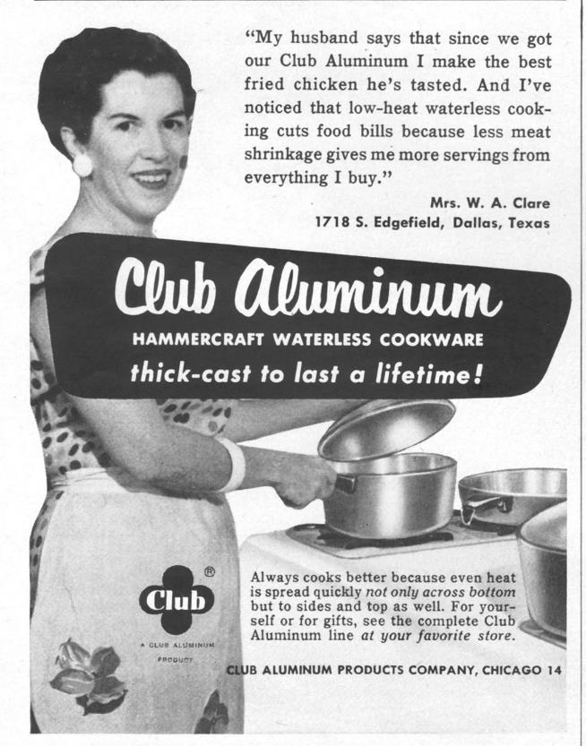
[4] Testing the Code
Taylor discovered the test was difficult to implement due to so many lies in the company’s advertising – but he persevered for 60 days.

Slide 6
[5] Implementing the code
Employees were asked to memorize and use the 4-Way Test in their relations with others.
Lies were removed from advertising and gradually, the public placed more confidence in what was stated in publicity

Slide 7
[6] Attitudes to Competitors
The company also changed policies towards competitors and gradually built friendships.

Slide 8
[7] Results
Over 20 years there was a steady increase in sales, profits and earnings, and in the moral character of personnel.
Went from bankrupt in 1932, to value of over $2m.

Slide 9
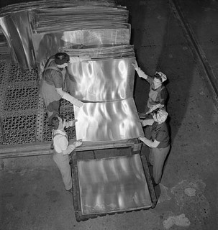
[8] Lesson learnt
The test affected all areas of life – personnel became better parents, better friends and better citizens.

Slide 10
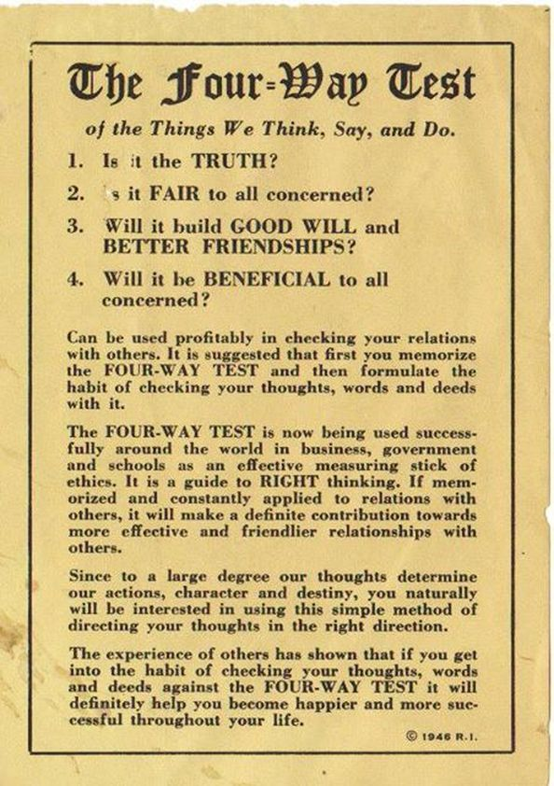
[9] Adoption by Rotary
In 1940s, Taylor gave Rotary permission to use the test in publications – it was officially adopted by Rotary in January, 1943

Slide 11
[10] The test hasn’t changed since 1932 –
Of the things we think, say or do, ask….
Is it the TRUTH?
Is it FAIR to all concerned?
Does it promote GOOD WILL and BETTER FRIENDSHIPS?
Will it be BENEFICIAL to all concerned?

Slide 12
Thank You

