Slide 1
INK 05: 11 Key Moments for Women in Rotary

Slide 2

1. 1911 - All Women Clubs
In 1911 an all-women club existed in Minneapolis and between 1911 and 1917 an all-women Rotary club existed in Duluth, Minnesota alongside the men's club.
In 1918, the RI Board refused recognition of all women clubs and changed the constitution to state that Rotary membership was for "males only".

Slide 3
2. 1978 – RC of Duarte
In 1978 the Rotary Club of Duarte, California, invited three women to become members. The RI board withdrew the charter of that club for violation of the RI Constitution.

Slide 4
3. Law Suit
The club brought suit against RI claiming a violation of a state civil rights law which prevents discrimination of any form in business establishments or public accommodations
The appeals court and the California Supreme Court supported the Duarte position that Rotary could not remove the club's charter merely for inducting women into the club

Slide 5

4. US Supreme Court Ruling
The United States Supreme Court upheld the California court indicating that Rotary clubs do have a "business purpose" and are in some ways public-type organizations. This action in 1987 allowed women to become Rotarians in any jurisdiction having similar "public accommodation" statutes.

Slide 6
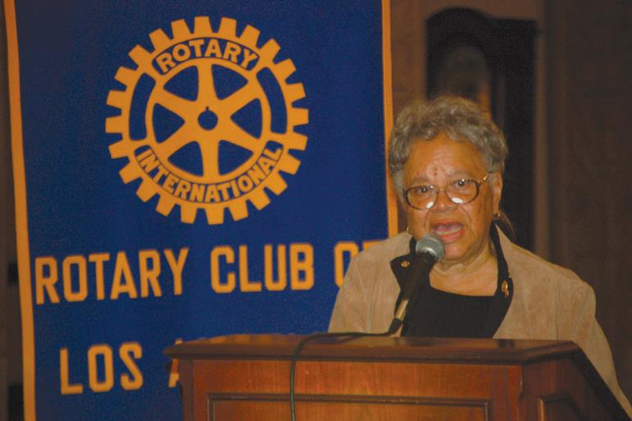
5. First female club president of Rotary
Sylvia Whitlock became the first female president of a Rotary club when she was elected president of the Duarte Rotary club in 1987

Slide 7
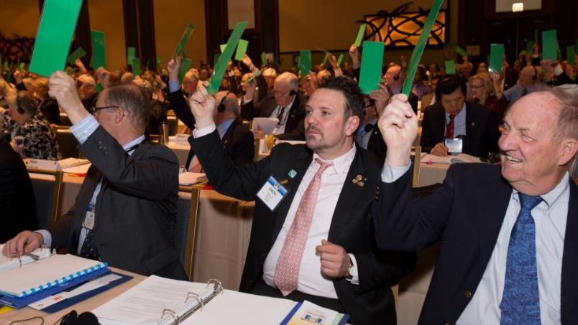
6. RI Constitutional Change
The RI constitutional change was made at the 1989 Council on Legislation, with a vote to eliminate the "male only" provision for all of Rotary.

Slide 8
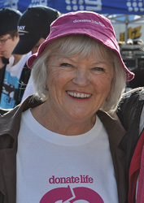
7. First female member in 9780
PP Mary Elliott ( RC Torquay ) was the first female Rotarian in District 9780 - Mary was inducted into RC Torquay on 21st August 1989

Slide 9
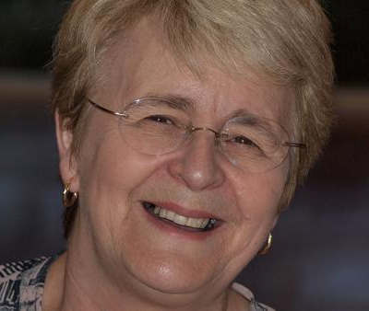
8. First female president in 9780
PDG Cathy Roth was the charter President of the Rotary Club of Geelong Central in 1990 and the first female President of a Rotary Club in Australia and the Asia/Pacific

Slide 10
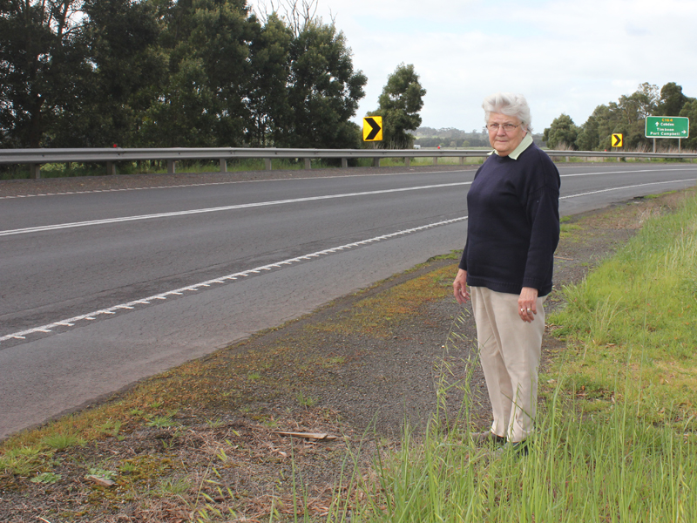
9. First female DG in 9780
Pat Robertson was the first female District Governor in 9780 in 2002-03

Slide 11
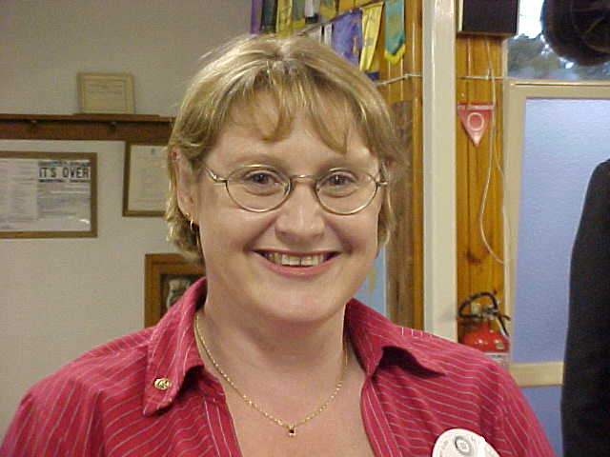
10. First female member in our club
Sharron Fanning was the first female member in the Maryborough Rotary club in December, 2002 (transferred from NT)
Pieta McNaught was the first female member nominated by our club in 2005

Slide 12
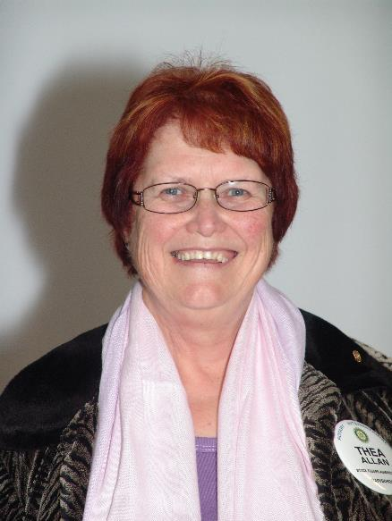
11. First female president in our club
Thea Allan was our club’s first female president in the Rotary year of 2015-16

Slide 13
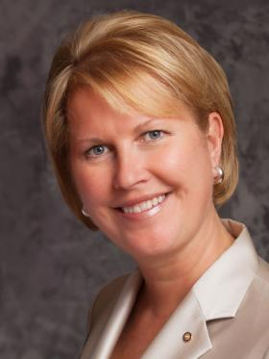
12. First female vice president in RI
This Rotary year (2016-17), Jennifer Jones became the first female Vice President of Rotary International

Slide 14
Just 20% of female Rotarians
Currently there are around 20% of female Rotarians in the world
We need to get this closer to 50%
It is not that women make “better” Rotarians but increased diversity yields better outcomes, and clubs that reflect the communities they serve may be able to better engage those communities and meet their needs.

Slide 15
Thank You
Why not ask a friend or work colleague to come along to a Rotary meeting to find out more?
Thank You

