Slide 1

INK 11: Ten things to Know about PolioPlus

Slide 2

{01} World Polio Day?
October 24th is celebrated as World Polio Day each year
A day to celebrate the great work attempting to rid Polio from the World
Work has been spearheaded by Rotary with their PolioPlus program
The timing in late October is in honour of the birthday of Dr. Jonas Salk, who led the team that developed the first polio vaccine

Slide 3
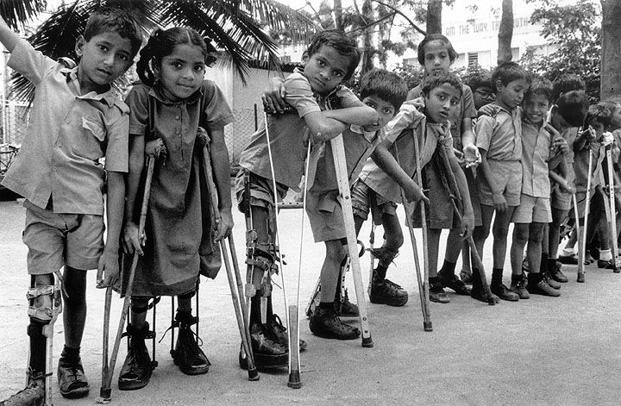
{02} What is Polio?
A paralyzing and potentially fatal disease that mainly threatens children under 5 in some parts of the world
The poliovirus invades the nervous system and can cause total paralysis in a matter of hours

Slide 4


{04} What Is PolioPlus?
In 1985, Rotary launched its PolioPlus program, the first initiative ever to tackle global polio eradication through the mass vaccination of children
Rotary has contributed more than $1.6 billion and countless volunteer hours to immunize more than 2.5 billion children in 122 countries

Slide 5


{03} Why the Plus?
Belief that a focussed attack on polio would also promote & assist immunizations against five other childhood diseases:
Measles
Tuberculosis
Diphtheria
Whooping cough
Tetanus.

Slide 6
{05} Global Polio Eradication Initiative
Rotary is now working as part of the Global Polio Eradication Initiative, formed in 1988 - a public-private partnership that includes the World Health Organization, the U.S. Centres for Disease Control and Prevention, UNICEF, the Bill & Melinda Gates Foundation, and governments of the world

Slide 7
{06} Polio Today
1980’s – 1000 new cases of polio per day (360,000 per year)
2016 – 37 new wild polio cases per year in Afghanistan, Pakistan and Nigeria
A reduction of more than 99.9 percent!
So far this year, only 5 cases have been detected in Afghanistan & Pakistan

Slide 8
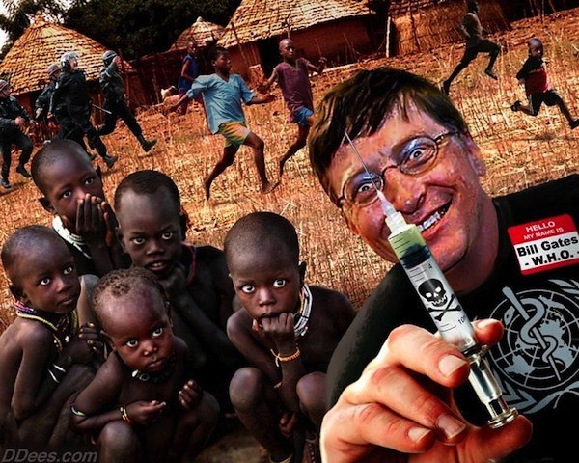
{07} The Challenge Remains
The polio cases remaining are the most difficult to prevent, due to:
geographical isolation
poor public infrastructure
armed conflict
cultural suspicion
Until polio is completely eradicated, all countries remain at risk of outbreaks

Slide 9
{08} Ensuring Success
Every dollar Rotary commits to polio eradication will be matched two-to-one by the Bill & Melinda Gates Foundation up to $35 million a year through to 2018. These funds help to provide:
much-needed operational support
medical personnel
laboratory equipment
educational materials for health workers and parents.

Slide 10
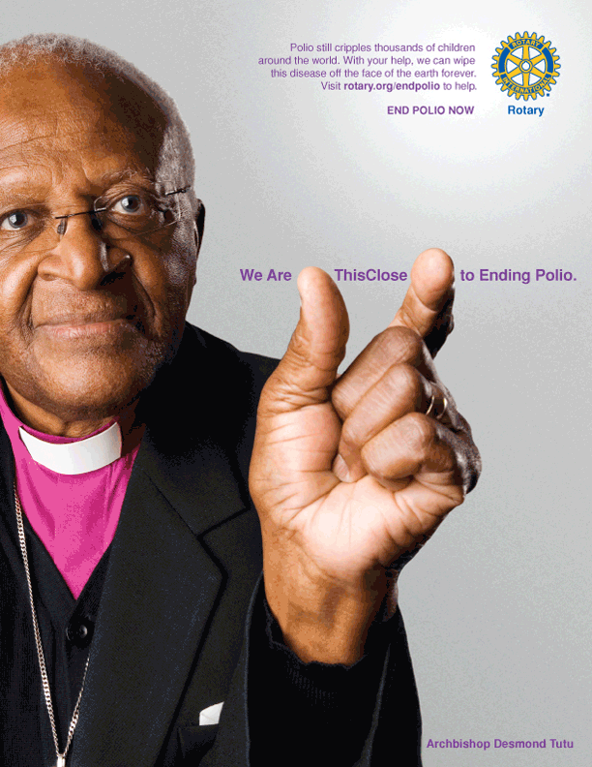
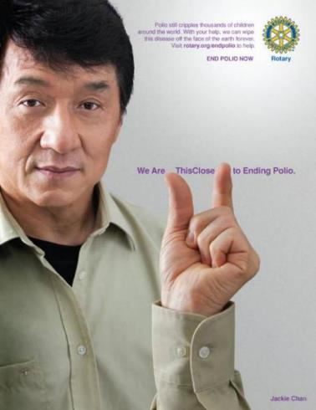
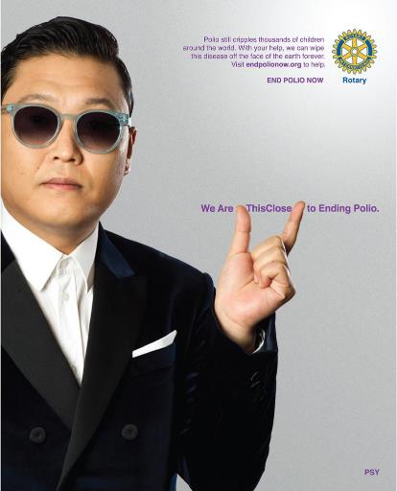

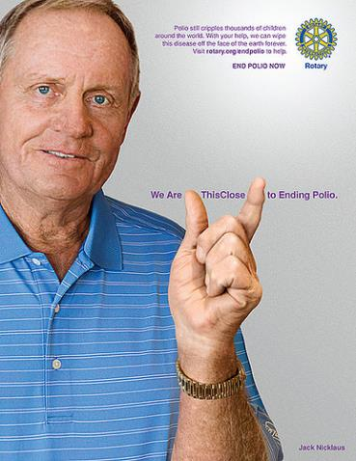
{09} This Close Campaign
Many celebrities have got on board with the PolioPlus “This close” campaign:
Desmond Jackie Psy Queen Noor of Jordan Jack

Slide 11
{10} What we can do
We can donate to PolioPlus as individuals
Our Club can donate money raised from a fund raiser
Individuals can travel to an infected country and help with vaccinations
We can make others aware of these facts

Slide 12
Thank You

