Slide 1
INK 18: Ten Questions Answered On Rotary Peace Centres

Slide 2
{01} What is Rotary Mainly About?
The ultimate part of the Object of Rotary is to encourage and foster the advancement of… International understanding, goodwill and peace

Slide 3
{02} What is the Rotary Foundation’s First Area of Focus?
• Peace and conflict prevention/resolution
• Disease prevention and treatment
• Water and sanitation
• Maternal and child health
• Basic education and literacy
• Economic and community development

Slide 4
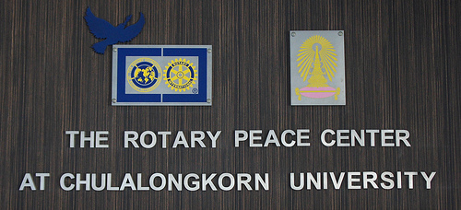
{03} How Does Rotary Promote Peace?
Apart from Global Humanitarian work, Rotary has set up “Peace Centres” to train people to be “Peace Makers”

Slide 5
{04} Where are The Peace Centres?
Peace Centres are set up at Universities in:
USA (Duke Uni. & Uni. of Nth Carolina)
Japan (International Christian Uni – Tokyo)
England (Uni. Of Bradford)
Sweden (Uppsala Uni.)
Thailand (Chulalongkorn Uni. Bangkok)
Australia (Uni. of Queensland)

Slide 6
{05} How Do They Work?
Each year, Rotary International selects up to 100 individuals from around the world to receive fully funded academic fellowships at one of their peace centres.
These fellowships cover tuition and fees, room and board, round-trip transportation, and all internship and field-study expenses.
Programs last 15 to 24 months

Slide 7
{06} What Happens to the Graduates?
Graduates become catalysts for peace and conflict prevention and resolution in their communities and around the globe. They…
are reintegrating refugees in Sudan
are creating jobs for disadvantaged women in India
are supporting reconstruction in devastated regions of the world

Slide 8
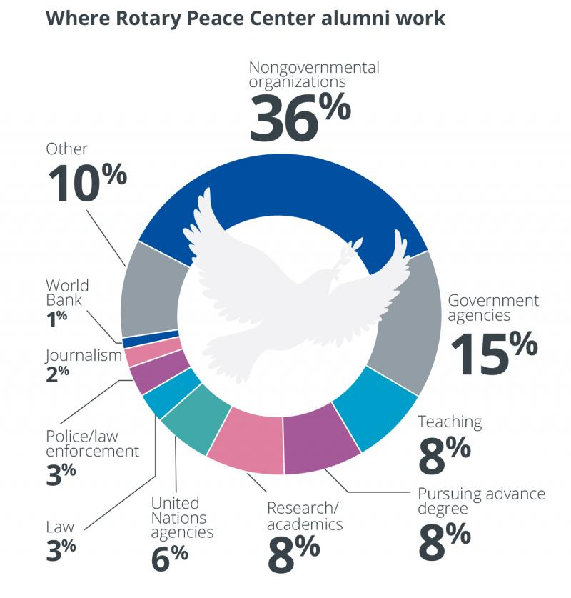
{07} Where do they work?
NGO’s
Government Agencies
Teaching & Research
United Nations
Law & Law Enforcement
Journalism
World Bank

Slide 9
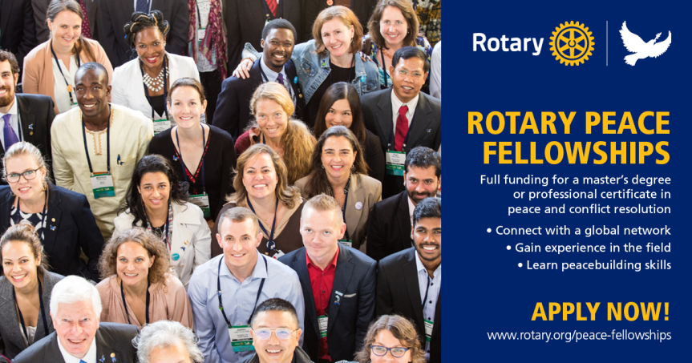
{08} What has been achieved?
In just over a decade, the Rotary Peace Centers have trained more than 900 fellows for careers in peace building

Slide 10
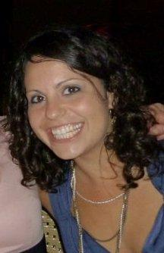
{09} D9780 Peace Scholar?
Lucinda Garrido became District 9780’s first Rotary Peace Fellow and commenced her studies in Buenos Aires, Argentina in February 2011.
She later transferred to the University of Queensland where she completed her Masters in International Studies (Peace & Conflict Resolution), graduating in June 2013.

Slide 11
{10} What we can do?
We can donate to Peace Centres as individuals
Our Club can donate money raised from a fund raiser
We can invite Australian Peace scholars to speak to us
We can make others aware of these facts

Slide 12
Thank You

