Slide 1
Ink 29: Rotary’s Famous 711
Rotary History

Slide 2
<1> Why is 711 significant to Rotary?
Number 711 is significant – why?
Not the Store Chain
Room 711, Unity Building
127 North Dearborn St. Chicago
Birthplace of RI in 1905

Slide 3
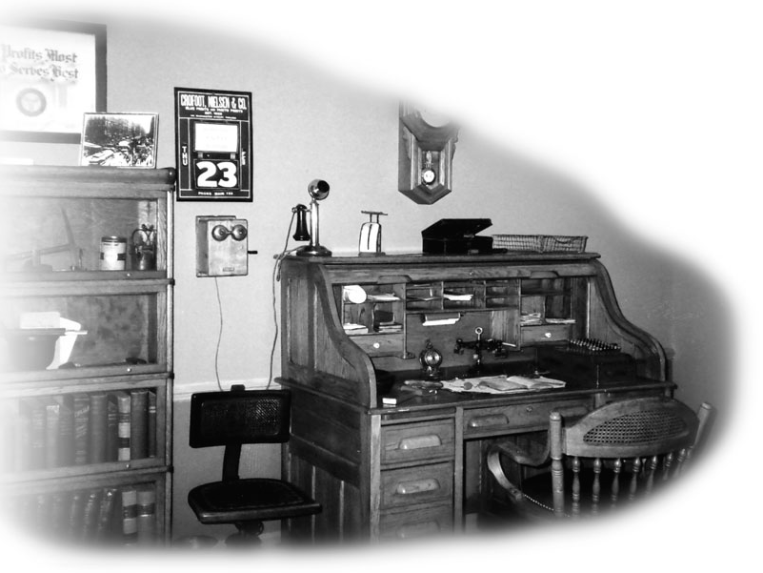
<2> The Room
Room belonged to Gus Loehr, Engineer
Location of “the” first Rotary meeting

Slide 4
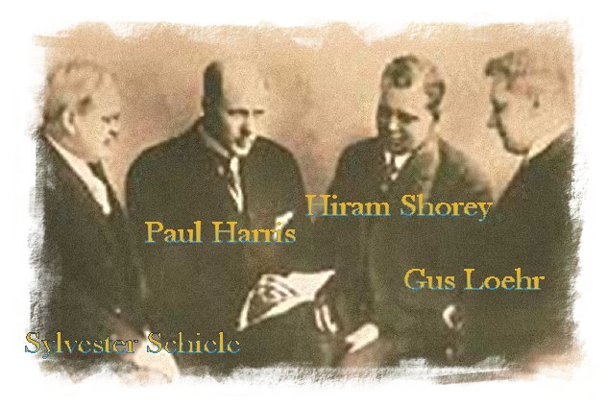
<3> A Meeting of 4 Friends
A meeting between Paul Harris
…and 3 friends

Slide 5
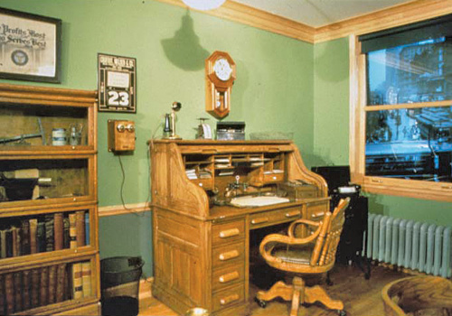
<4> Room 711 Preserved as a Museum
Originally, preserved as a mini museum
By Rotarians around the world…
…contributing to the “Paul Harris 711 Club”

Slide 6
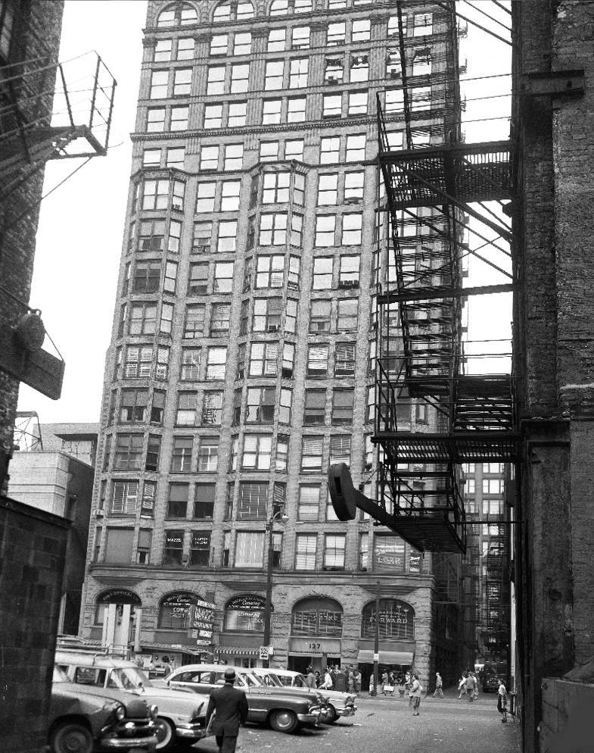
<5> Unity Building Destroyed
1989 - Unity Building was to be torn down
Members of 711 club dismantled the room piece by piece
Placed contents in storage

Slide 7
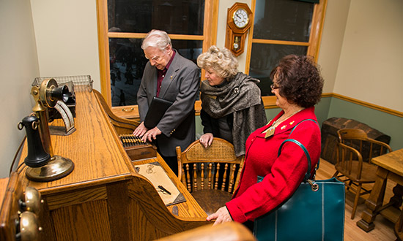
<6> Room Re-created
1994, Room 711 re-created after painstaking research…
…at RI Headquarters in Evanston

Slide 8
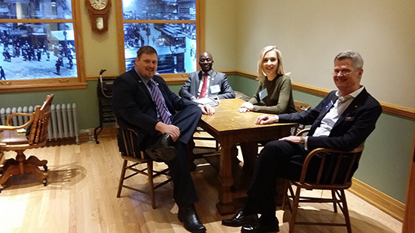
<7> Now a Mecca for Rotarians
Now visited by Rotarians around the world

Slide 9
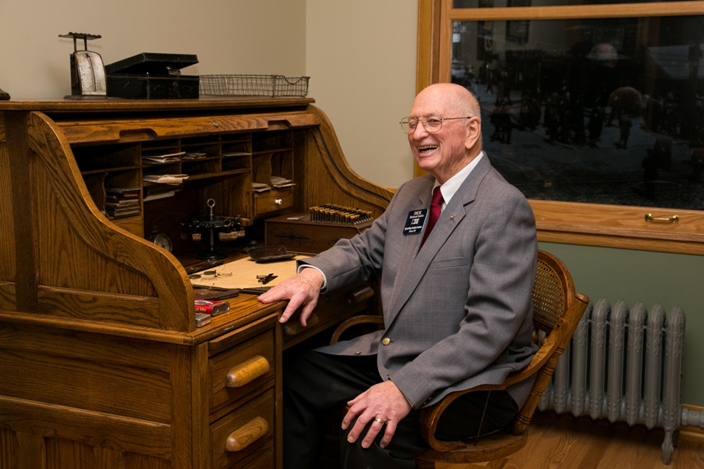
<8> A Fitting Reminder
A fitting reminder of the humble beginnings of our organization

Slide 10
<9> Main Point 9

Slide 11
Thank You

